Slide 1
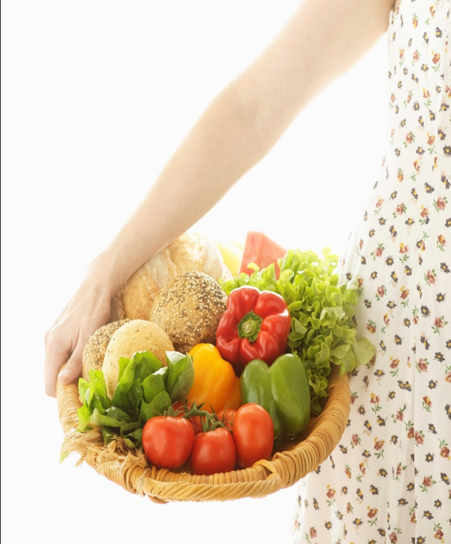
Demand Elasticities and Supply Flexibilities of Fresh Produce, and How They Affect “Buy-Local”
SEDSI, 02/29/2012, Columbia, SC
Forrest Stegelin
Agricultural and Applied Economics
University of Georgia

Slide 2
The “Buy-Local” Movement
Specialty crop market for fresh fruits and vegetables is bolstered by positive media press, the new “MyPlate” dietary guidelines replacing the old food pyramid, and the “buy-local” movement.
“Buy-Local” movement has gained momentum with consumers seeking local produce at a variety of retail venues – local direct markets (PYO, roadside stands, CSA, gov’t sponsored farmers’ markets) and local/organic grocery stores for multiple reasons: food safety, organic, sustainability, freshness, relationships.
Retailers who embrace buy-local build relationships with local growers of produce, and typically increase retail sales and profits.
But what is a “local” source of supply? Same community? Hour’s drive? Same state? 500 mile radius or 10-12 hour truck delivery?

Slide 3
Demand Elasticity
A measurement of the change in consumers’ purchasing behavior when a perceived price change occurs.
Law of demand – if price increases, quantity purchased decreases, and vice-versa – rational and normal response.
Depending on magnitude of price change, purchase quantity will also vary.
A price change for each fruit or vegetable elicits a quantifiable change in quantity purchase; varies as to consumer. Demand = f(P_{O}, P_{S}, P_{C}, T/P, I, Pop., Seas.)
Σ_{D} = %ΔQ ÷ %ΔP, as measured at the retail level.

Slide 4
Supply Flexibility
A measurement of the price change observed for the grower when supply or production quantities change.
Price rations supply – price decreases occur when abundant supply exist, and vice-versa.
Σ_{S} = %ΔP ÷ %ΔS, as measured at the grower level.
In theory, demand elasticities and supply flexibilities should be approximate reciprocals of each other, and both carry negative signs reflecting inverse relationship between price and quantity.

Slide 5
Buy-Local is a double-edged sword.
Marketer is the intermediary between the grower and the consumer, and likes to maintain constant contribution margins between selling prices and prices paid (cost).
As growers are enticed into producing more and more specialty produce, supply increases; as supply increases, prices paid by the marketer to the grower decline in order to clear the harvested supply (Σ_{S}).
As consumers react to price changes via the quantities they purchase, the produce department’s goals are to increase its revenues (P x Q).
Knowing the consumer’s purchase response to price changes (Σ_{D}) gives marketer guidance of a price change to implement and the expected sales response in quantity and revenue.

Slide 6
Price Trap
Price
D_{F} S_{F}
D_{R}
Quantity
Movement toward a stable price is altered with a supply shock (hurricane, food recall, freeze, immigration reform, hail storm, flood, harvesting problems).

Slide 7
Objective, methodology, and results.
Quantify the consumers’ purchase responses to observed price changes at retail to calculate a series of Σ_{D}.
Quantify the pricing response at the farm level to observed supply quantity changes to calculate Σ_{S}.
Neither has been done for produce since the mid-1960s.
Price and quantity activity tracked within the Georgia marketing season at both the farm level and retail level for 5 fruit and 11 vegetable specialty crops.
Retail venues monitored included 3 grocery stores, 2 state-sponsored farmers’ markets, 3 community- or county-sponsored farmers’ markets, and 4 family-owned farm-site markets.
Farm level data provided by 9 growing operations that each produced at least 3 of the 16 produce crops.

Slide 8
Item Measurement Σ_{D} Σ_{S}
Apples, fresh mkt. Price - 2.26
Apples, fresh mkt. Production - 0.73
Apples, in-season Price - 2.34
Apples, in-season Production - 0.85
Apples, in-season Consumption - 1.80
Apples, PYO Price - 5.71
Blueberries, PYO Price - 2.84
Grapes, in-season Price - 1.37
Peaches, in-season Production - 0.46
Peaches, in-season Price - 1.19
Strawberries, PYO Price - 3.01
Strawberries, PYO Production - 0.89

Slide 9
Item Measurement Σ_{D} Σ_{S}
Asparagus Consumption - 0.15
Green Beans Consumption - 0.18
Cabbage, head Price - 0.45
Carrots Consumption - 0.76
Sweet Corn, ears Price - 2.00
Cukes, slicers Consumption - 1.40
Vidalia Onions Consumption - 1.74
Shelled Peas Consumption - 0.68
Bell Peppers Production - 1.03
Tomatoes, whole Consumption - 1.80
Watermelons Production - 0.93

Slide 10
Interpreting the fresh market apple entries.
If the price of locally grown apples were to decrease 10% (from 50¢/lb to 45¢/lb, as an example), the quantity purchased would likely increase 22.6%.
If the supply of locally grown apples were to increase 10%, the price paid would generally decrease 7.3%.
Price and quantity move in opposite directions (inverse relationship), hence a negative (-) sign.

Slide 11
Arithmetic of pricing favors the intermediary.
Selling Price/Unit
- Variable Cost (or price paid)
= Contribution
Contribution Margin % = Contribution ÷ Selling Price
If a produce buyer for a retail market buys bell peppers at 10¢ each, for example, and sells them for 25¢ each, the contribution of 15¢ is a contribution margin of 60%.
If the price paid rose to 15¢ [due to reduction in supply], and marketer desired constant 60% contribution margin percentage, new selling price becomes 37½¢ each.

Slide 12
Application of C-V-P to Σ_{D} & Σ_{S} Values for Strawberries.
Marketers understand that if Σ_{D} is elastic (elasticity > -1), to increase revenue, marketer must lower price. [If inelastic, marketer raises price to increase revenues.]
If marketer has been selling fresh market strawberries at $3.49/quart and decides to lower the price 10% to increase revenues, with a strawberry demand elasticity of – 3.01, lowering the price from $3.49 to $3.14/quart (a 10% decrease) will generate 30% more quarts sold.
If marketer has been buying strawberries locally for $2.00/quart and selling them for $3.49 results in a $1.49 contribution (a 44% contribution margin).

Slide 13
Concerned that the marketer has enough strawberries to meet the anticipated increased demand from lowering the retail price, marketer encourages local strawberry growers to raise total production by 20%.
Supply elasticity or flexibility of – 0.89 suggests an increase in strawberry output by 20% results in produce buyers paying 18% less in price to the grower (larger supply) to meet the buyer’s expected rise in demand.
A lower price of $1.64/quart (instead of original $2/quart) to be paid is now anticipated.
With new retail price of $3.14/quart and new price paid to growers of $1.64/quart, marketer realizes new contribution of $1.50/quart (a 47% contribution margin).

Slide 14
In this example, the marketer has been able to lower the retail price to the consumer while paying less for the strawberries from the grower, and still increase the retail marketing margins and the marketing revenues.
For the grower, realizing that unless own products are highly differentiable from other growers raising same fruits or vegetables, as the aggregate supply increases due to the demand encouragement from the buy-local movement, the price received from the produce buyer will decline by the calculated supply flexibility.
What appeared to be a good thing initially for grower in terms of increased revenues by producing, harvesting and selling more of a specialty crop is dampened by reduced price received from a produce buyer as total or aggregate supply increases.

Slide 15
Prior extensive research on demand and supply elasticities for food and environmental horticulture:
Western Extension Marketing Committee’s Task Force on Price and Demand Analysis. A Handbook on the Elasticity of Demand for Agricultural Products in the United States, 1964. USDA/AMS (primarily focused on the Atlanta, GA wholesale farmers’ market).

Slide 16
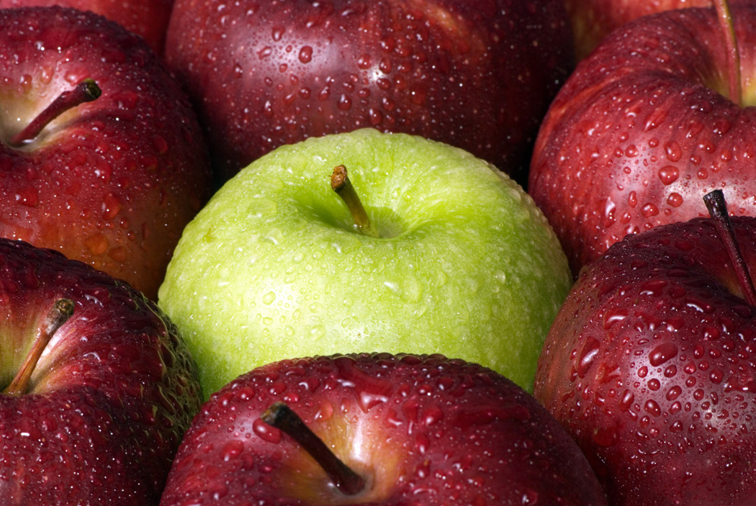
Thank you for your attention and interest. Questions or comments?

