Slide 1
Agricultural Economics in the Flipped Learning Environment
Neal MacDougall
Agribusiness Department, Cal Poly
and
Olivia Molodanof
Undergraduate, Agribusiness Department, Cal Poly

Slide 2
Concept Test
Before we start, did you do your Concept Test?
Link to Socrative: beta.socrative.com
Room: “BlissAGB” (all one word, caps unimportant)

Slide 3
The Standard Lecture Class Structure
Chapter
Reading
Lecture
Assessment

Slide 4
How Do Students Feel?
Student #13:
I have gone through school spitting back what the teacher taught us but feeling like I never truly grasped the material enough to remember it past when I “needed to”.

Slide 5
Design Response Objectives
More frequent and tighter feedback
Clearer determination of who knows how much/Better formative assessment
Increase formal level of peer teaching and learning

Slide 6
New Overall Class Structure
Pre-Class Preparation
Introduction
Reading
Self-Assessment
JiTT Exercise
In-Class
Concept Test
Group Work
Targeted Lecture

Slide 7
Pre-Class Preparation Structure
Module Introduction
Chapter Reading
Self-Assessment
JiTT Exercise

Slide 8
How Do Students Feel?
Student #14:
The videos provided insight into the mind of the teacher and how to work through problems without overthinking them. They also allowed students to go back and review the material prior to the exam. The JITTs, while frustrating at times, also provided insight into the chapters by forcing us to think on our own as to how what we were learning applied to our world, by working through written and hypothetical problems.

Slide 9
In-Class Structure
Pre-Class
JiTT Exercise
In-Class
Concept Test
(Individual/Group)
In-Class
Group Work
In-Class
Targeted Lecture

Slide 10
How Do Students Feel?
Student #18:
Most classes I've been in do not have very many, if any, group projects or peer-teaching activities as this class does. Learning from other people in your class can be very helpful, because they can help you understand the material that you don't know and you could help explain the things that you may understand that they don't. Other people can see things differently, so being able to see how other students in class look at the subject can help you learn. Having all the in class discussions are always useful, but having the videos online helped reinforce a lot of what we talked about in class.

Slide 11
Some General Results

Slide 12
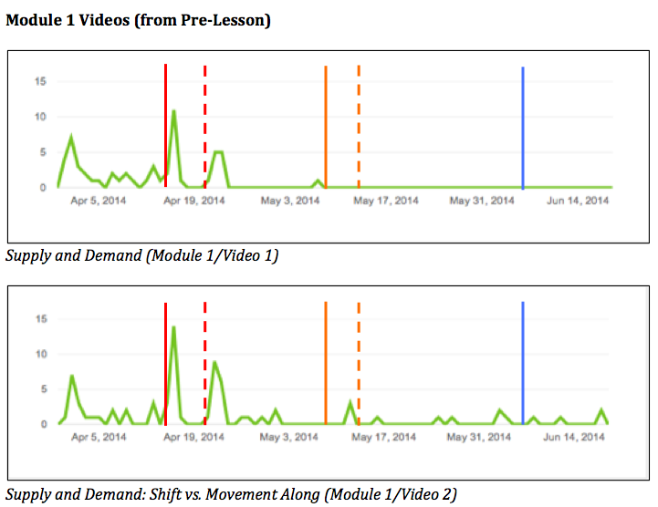
When are videos watched?

Slide 13
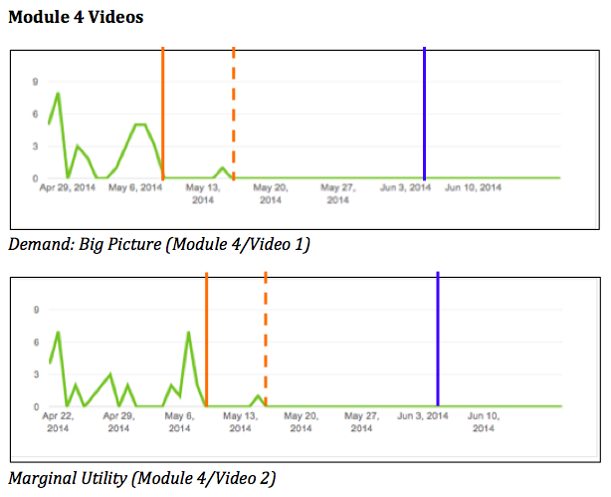
When are videos watched? (cont’d)

Slide 14
How Do Students Feel?
Student #19:
I have to say though that most of my classes have only tested on concepts, knowing formulas, where to put numbers, knowing definitions of terms, that sort of thing. This is the first that put such a heavy emphasis on the “why” factor. But because we had to learn the “why” I feel like this material will stick in my head a little longer. Maybe not all the terms and demand or supply shifters, but an underlying knowledge of how markets work.

Slide 15
How Do Students Feel? (cont’d)
Student #22:
This class itself has taught me a lot in preparing for the future. To be honest, I did not get the best grade in this class. I did not get the grade that I wanted and I am not upset about that at all. I got much more out of this class than a grade, I learned about how important it is to truly understand something than to just memorize a formula. This class was difficult, because it challenged me to think outside of just the classroom. This class was real life; it taught me that what I have to do to really understand something and the process I have to go through to understand things.

Slide 16
Next Steps/Questions?
Now this is not the end. It is not even the beginning of the end. But it is, perhaps, the end of the beginning.
Winston Churchill
November 20, 1942

