Slide 1
Crop Yield Response To Nitrogen: How Does Technology Fit?
Nichole L. Busdieker
WERA-72
July 1st, 2014

Slide 2
Research Objectives
The purpose of this research is to:
Evaluate crop yield response to nitrogen fertilizer for 30 years of experimental data.
Production function estimation
Determine the impact of technology on crop response to nitrogen.

Slide 3
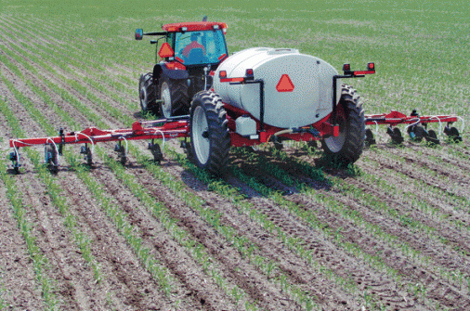
Motivation
Missouri Farmer
Understanding production functions estimation can lead to:
Optimal decision making
Optimal input use

Slide 4
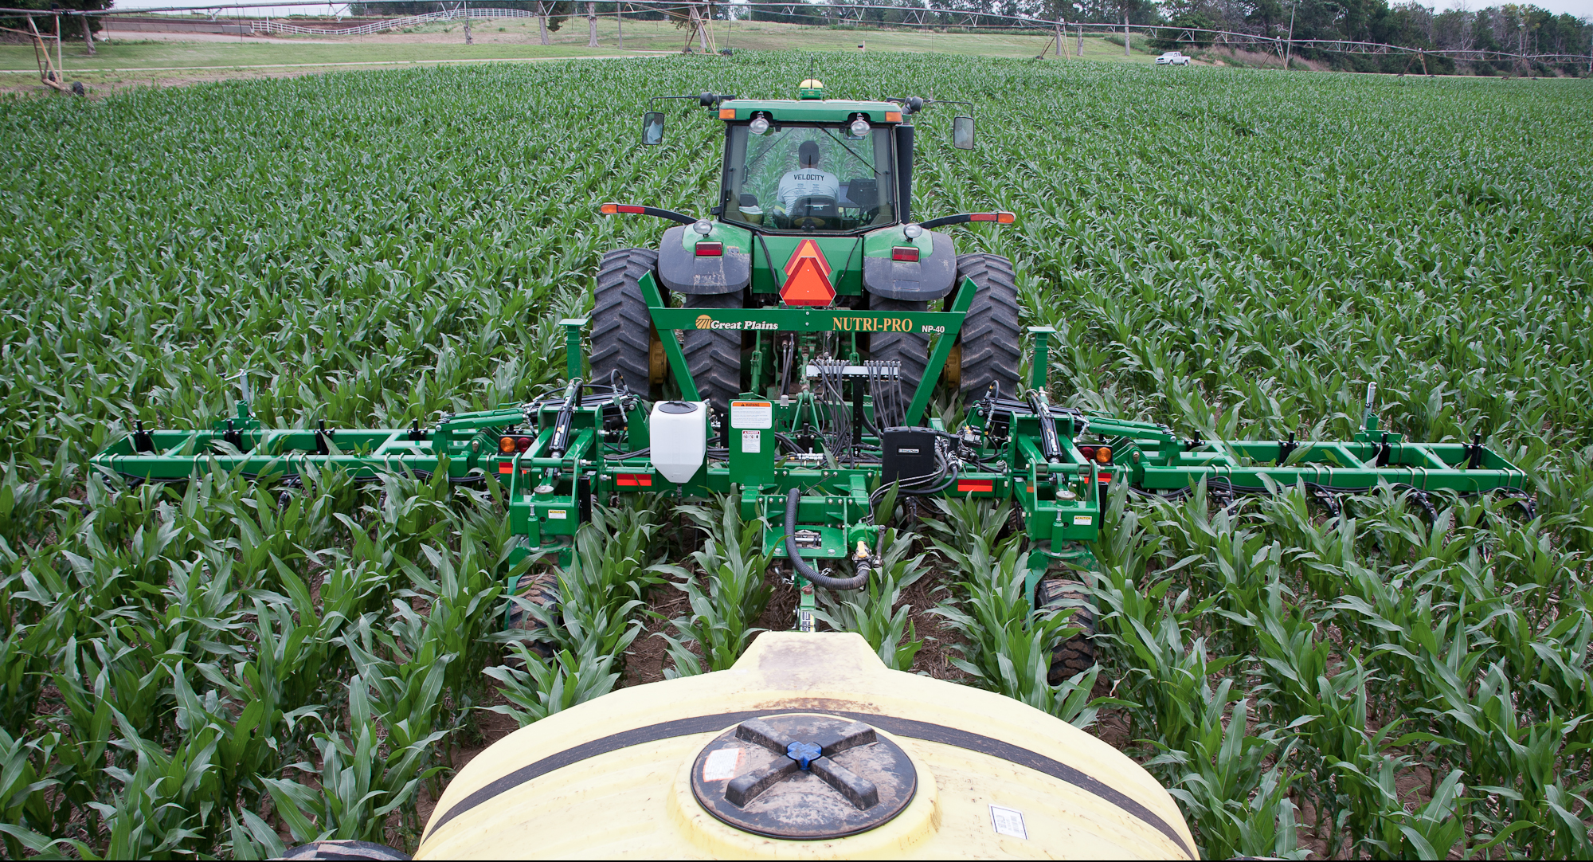
Motivation
Minimizes costs to producers
Notes:
Production
Input costs
Nitrogen fertilizer Importance- Nitrogen Limiting factor in corn production

Slide 5
Motivation
Understand output relationship
Notes:
Optimal Output
Corn production to meet demands

Slide 6
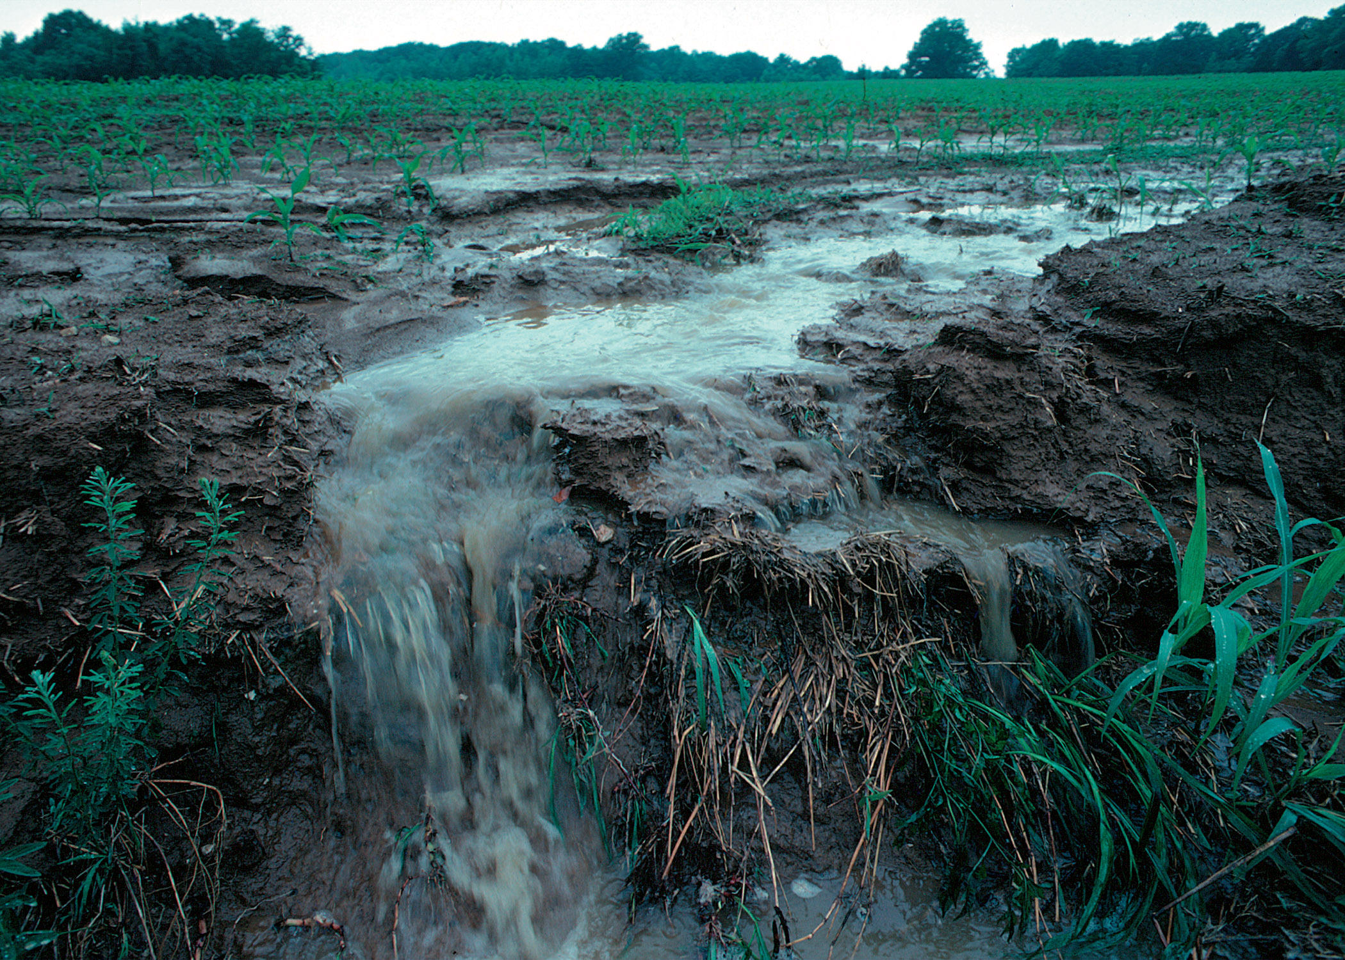
Motivation
Environmental stewardship
Notes:
Environmental concerns
Runoff

Slide 7
Previous Literature
Production Function Analysis:
Heady and Pesek (1954)
Frank, Beattie and Embleton (1990)
Paris (1992)
Polynomial production function
Later work includes plateau based
von Liebig: “law of the minimum”
Linear vs. nonlinear
Notes:
Law of min: idea that plants respond linearly to nutrients until one of the nutrients becomes a limiting factor of production. When one factor reaches its limitations in the growth of a plant, yields cannot improve even with an increase in other non-limiting nutrients
H&P-polynomial with experimental data
B&T-support plateau based functions
Paris-NLVL included…highlights misspecification of linear relationship using MLE

Slide 8
Previous Literature
Water/Weather Inputs:
Grimm, Paris and Williams (1987)
Llewelyn and Featherstone (1997)
Babcock and Blackmer (1994)
Irrigated acres
Is water a limiting nutrient?
von Liebig holds for some cases
Growing conditions-6 sites and 6 yrs.
Soil type and nutrients…weather?
Notes:
VL specification implies first order interaction but it could be that N response is conditioned on water or vice versa
GPW some not all
L&F holds for corn
B&B 6 different sites for 6 years, accounts soil types and nutrients…but weather?

Slide 9
Previous Literature
Technology:
Nelson and Dale (1978)
Linear regression model for corn
Squared terms but no interactions
6 weather variables
Trend represents technology
Linear model is sensitive to trend

Slide 10
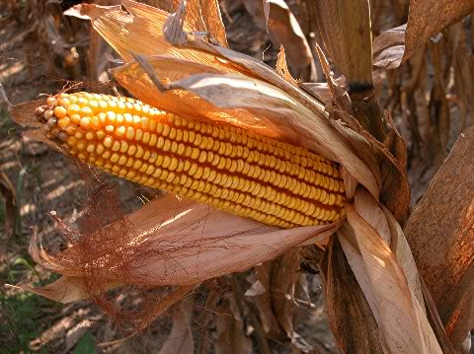
Method
Production Function Estimation
Nonlinear estimation methods
P-tests:
f_{i} and g_{i} are the fitted values in each pairwise test
F_{i} is the vector of first-order derivatives of the null
With respect to the β parameters.
Notes:
Nonlinear over ML to avoid distribution assumptions on the data
Hetero: from clilmate changes beyond the weather variables, technology beyond what is captured in the trend
(sometimes gm seed technology reduces the actual output
Fitted is predicted output values

Slide 11
Models
Notes:
M is the asymptotic plateau
*describe highlight for each

Slide 12
Technology
Linear Trend
Trend Squared
LVL model example: α'=k₀+k₁T +k₂T²
Trend Shift Model
Notes:
Planting cost, as rootstock is more expensive

Slide 13
Data
Weather- Ill. Climatologist dataset (ISWS)
Experimental data from NW Illinois Ag. R&D Center in Monmouth, Illinois
1983 to 2012
Muscatine Sil
Previous crops
Nitrogen fertilizer rates
Yields
Notes:
Illinois State Climatologist dataset compiled in the Illinois State Water Survey through the Prairie Research Institute

Slide 14
Data
Nitrogen:
0, 60,120,180, and 240 lbs/acre
Urea and ammonium nitrate water based solution applied pre-planting

Slide 15
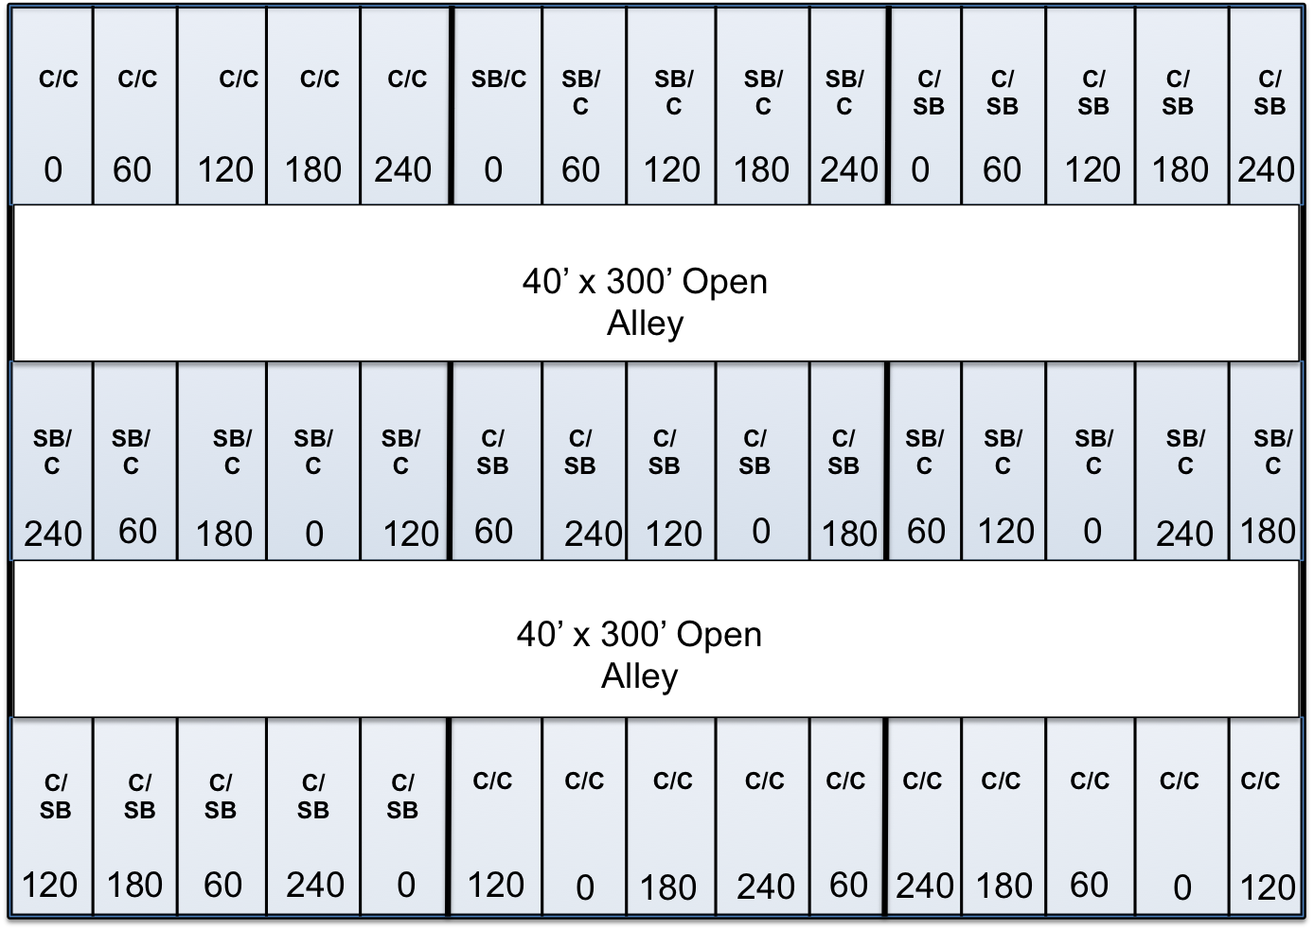
Data
60’
60’
60’
20’
20’

Slide 16
Data

Slide 17
Results
Technology Model Highlights:
Evidence of Separability?

Slide 18
Notes:
When evaluating the role that technology has in the nitrogen production equation, I closely evaluate the results to see if separability could be a concern in the models I examine. Inputs are separable if the ratio of marginal products or marginal rate of technical substitution of one input does not change with the use of the other. Through examination of the results for the quadratic and square root production functions for this analysis, technology appears to impact the marginal product of nitrogen with significant trend coefficients for both nitrogen and weather variables in both models. However, of the coefficients for both T_{i} and T_{i}² in the linear von Liebig, Mitscherlich-Baule and nonlinear von Liebig models are insignificant, shown in Table 4.
Therefore, the marginal product of nitrogen is not dependent on technology for the plateau models of the analysis. This provides evidence to support the idea of separability of technology and nitrogen, inputs in plateau production functions, based on the data of this study.

Slide 19
Notes:
M based on the data is around 254 bu. acre
This result leads to the conclusion that using T_{i} as a shift variable, as described, does not accomplish the intended purpose. Further study and examination should be able to draw stronger conclusions on this form of the model.
. Again, this does not fit the data for the analysis and provides evidence against this model specification of a trend shift.
Based on the technology model’s results, I find evidence to support the concept of nitrogen and technology separability when analyzing plateau-based production functions for the linear and nonlinear trend specifications. This is based on the fact that inputs are considered separable in this analysis when the ratio of marginal products or marginal rate of technical substitution of nitrogen does not change with the use of technology. The variable insignificance and concerns with model fitness provide support for separability in the plateau production functions when considering the role of technology.

Slide 20
Results
Production Function Estimation:
Corn-Corn Rotation

Slide 21
Signs follow that of previous research

Slide 22
Nitrogen Signs follow that of previous research

Slide 23
Concerns with the NL von Liebig function
Notes:
Grimm, Paris and Williams (1987) note that complexities from second-order interactions as well whether summer rain is a true limiting input, as too little rain in July and August can also impact yield, will change the roll of water in a production function. The notable differences in the signs and magnitudes of the summer rain coeficients, highlight the need to understand important balance summer precipitation has compared to other times of the year and other inputs. The summer variable captures July and August rains; and as such it includes plant pollination where too much or too little precipitation can decrease yields and the dry down period where prolonged exposure to excessive moisture can lead to disease.

Slide 25
Sensitivity
Sensitive to weather variable of choice
Estimated using summer rain and summer average temperature as well
Generally opposite signs of coefficients compared to annual rainfall
Notes:
The results of summer mean temperature analysis are highly similar to that of summer rainfall levels as well as the reasoning behind those results. Full results for the summer mean temperature analysis are available upon request and only excluded here due to page constraints.

Slide 26
Sensitivity
Sensitive to weather variable of choice
Estimated using summer rain and summer average temperature as well
Generally opposite signs of coefficients compared to annual rainfall
Tested corn-soybean rotation data
Generally smaller coefficients
Signs hold and P-test results are the same
Quadratic and M-B
Notes:
Sometimes the significance was lower or even insignificant in some cases…minimal

Slide 27
Conclusions
Evidence of separability when considering technology and nitrogen for the plateau based functions

Slide 28
Conclusions
Evidence of separability when considering technology and nitrogen for the plateau based functions
Based on NLvL and LvL results, there is evidence that rainfall is not a limiting factor
Due to non-irrigated acres? Soil type?
Notes:
However it is also important to recall that previous literature supported basic polynomial functions as appropriate for water production models (Grimm, Paris and Williams 1987).

Slide 29
Conclusions
Evidence of separability when considering technology and nitrogen for the plateau based functions
Based on NLvL and LvL results, there is evidence that rainfall is not a limiting factor
Due to non-irrigated acres? Soil type?
Mitscherlich-Baule is the best-fit function for the experimental data examined
Notes:
Closely followed by the quadratic function

Slide 30
Conclusions
Mitscherlich-Baule function:
on 1,000 corn acres uses 5,500 fewer pounds of nitrogen
Notes:
.20 nitrogen
Average heartland price 2000 3.25

Slide 31
Conclusions
Mitscherlich-Baule function:
on 1,000 corn acres uses 5,500 fewer pounds of nitrogen
saves a minimum of $1,100 in production costs alone annually

Slide 32
Conclusions
Mitscherlich-Baule function:
on 1,000 corn acres uses 5,500 fewer pounds of nitrogen
saves a minimum of $1,100 in production costs alone annually
profits nearly $300/acre
more compared to the
quadratic function
Notes:
Average nitrogen price used is $0.20 per pound , heartland price corn 3.25 (average 2000) and the weather considered in calculations are evaluated at the data minimum to give a ground figure.
This value is based on the worst-case scenario for an Illinois farmer and the use of the true production function. In cases where weather is more favorable to production the savings increases. When producers use efficient application levels for their crops there is less of a chance for excess nitrogen to run off into water sources or seep into the water tables. The idea of safer drinking water and efficient input use while increasing profits for producers should continue to be an area of focus for agricultural economists and further research.

Slide 33
Thank You!
Questions?

