Slide 1
Christiane Schroeter
Lindsey Higgins
Determining the "Ripple
Effect” in Team Work
on Individual
Information Literacy
Agribusiness Department
California Polytechnic State University
San Luis Obispo

Slide 2
Skills relevant for Graduates?
Most valued skills among new hires:
  Critical thinking skills
  Writing skills
  Interpersonal communication skills
  Team work skills
Information Literacy
Boland and Akridge (2004)

Slide 3
Information Literacy
Recognizes the need for information
Able to:
  Identify
  Locate
  Evaluate
  Effectively use the needed information
  National Forum on Information Literacy, 2014
  Association of College and Research Libraries, 2013

Slide 4

Information Search for Students….

Slide 5
Knowledge Based Economy
Increase in formal and informal plagiarism
Literacy concept extends beyond classroom
  Independent investigations in internships and professional positions
What type of guidance should be provided in teaching information literacy?
Do student teams enhance learning?

Slide 6
The ‘Ripple Effect’ in Teaching
Team of students with various levels of knowledge
Acquisition of knowledge via social learning and support
“A” Student
“B” Student
“C” Student

Slide 7
Teamwork in Teaching
“Group with a common purpose through which members develop mutual relationships for the achievement of goals/ tasks.”
  (Harris and Harris, 1996)
Key component of active learning strategy
Peer collaboration necessary

Slide 8
Teamwork in Teaching (cont.)
Academic preparedness of group members
  Leads to group satisfaction (Hillyard et al., 2010)
Kline’s (1999) Team Player Inventory
Social comparison
  Anxiety/intimidation
  Reduced ability to learn (Mugny et al., 2001)
  Need to assess impact of teamwork on individual student’s learning

Slide 9

Objective
Determine the impact of the “ripple effect” of team work on an individual student’s level of information literacy

Slide 10
Comparing Learning Approaches Guided vs. Self-Directed
Initial lab session to learn about databases
Quizzes/ homework check and expand on knowledge about databases
Develop skills by
  repeated exposure
Instructor acts as a facilitator
Student centered
Assignments treated as “experiences”
Develop skills by
  independent learning

Slide 11
Weekly Teaching Overview:
Guided vs. Self-Directed
Weeks in Quarter | Guided Learning | Self-Directed
1 | Electronic pre-survey of information literacy
2 | Lab session about databases, quizzes, assignments | Initial introduction to info literacy project
5 | Formal introduction of final project
8 | Exam #2: Check retention about databases | Lab session about databases
10 + 11 | Project due and electronic post-survey

Slide 12
Data and Methods
One course
  AGB 301- Food and Fiber Marketing
  Four quarters, eight sections
One project
  Marketing analysis for a branded food product submitted as a two-page infographic
Two instructors
  Guided learning approach
  Self-directed learning approach

Slide 13
Measurement Instruments
Pre and post electronic survey
Measured
  Individual information literacy abilities
  Familiarity with research databases
  Confidence at finding key pieces of information
  Knowledge to locate specific information using key databases

Slide 14
The Project
Company history
Company headquarters
Primary ingredients
Degree of processing
Industry trends
Horizontal / vertical linkages
Market shares
Main competitors
Target market
4Ps- Marketing mix
Assessment of product’s marketing
Recommendations for future marketing

Slide 15
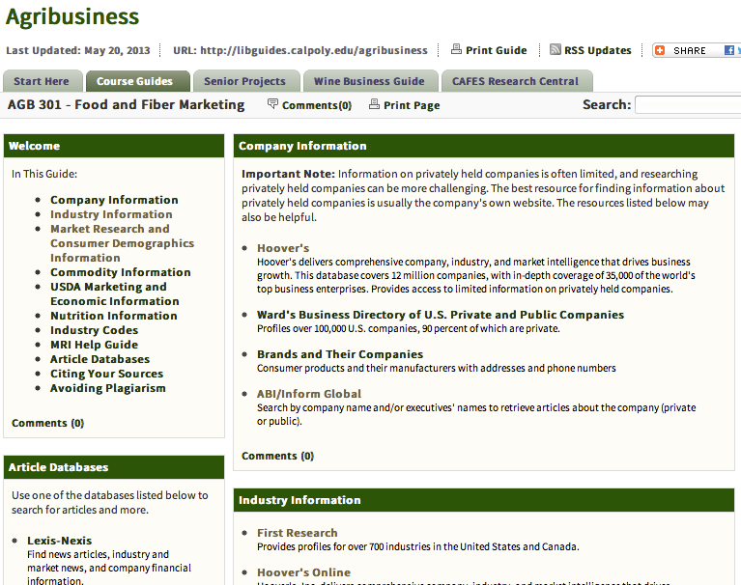

Slide 16
Samples of Student Work

Slide 17

Samples of Student Work

Slide 18
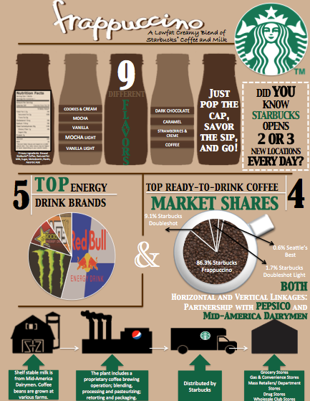
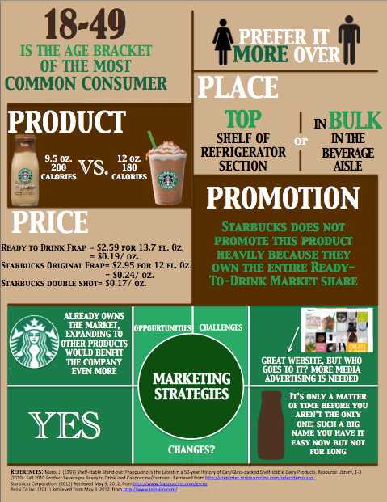
Samples of Student Work

Slide 19
Results
Demographics and Academic Information
  Sample of 252 students
    149 students in guided learning
    103 students in self-directed learning
  97% response rate
  41% Sophomores
  75% take class as required course

Slide 20
Pre-Survey Results: Familiarity with Marketing Databases
1= not at all familiar; 5= extremely familiar

Slide 21
Post-Survey Results: Familiarity with Marketing Databases

Slide 22
Pre-Survey Results:
Level of Confidence with Tasks

Slide 23
Post-Survey Results:
Level of Confidence with Tasks

Slide 24
Pre-Survey Results: Self-Reported Confidence Info Literacy

Slide 25
Post-Survey Results: Self-Reported Confidence Info Literacy

Slide 26
Teams
117 students, 31 teams, 3 quarters of instruction
Target groups based on objective scores
  Teams with low average scores
  Teams with high standard deviations
  Teams with high min – max ranges
  Teams with high change (pre to post)
Groups tested for outcome differences
  Project scores
  Post scores
  Class grades
A team doesn’t work unless everyone is doing their job

Slide 27
Relationships
Significant correlation
  Positive:
    Pre group standard deviation and post group average objective score (p=.001)
  Negative:
    Pre group standard deviation and post group objective standard deviation (p=.000)
Pre
High spread
Post
High scores
High spread

Slide 28
Relationships
Pre Standard Deviation | Post Score
“Low” | .66
“High” | .73
 | P=.008
Pre Average | Value of Course Assignments (1= not at all influential, 5=extremely influential)
“Low” | 3.89
“High” | 3.42
 | P=.093
Pre Range | Change in Pre to Post Score
“Low” | .2378
“High” | .3244
 | P=.043

Slide 29
Teaching Conclusions
Guided approach more effective to enhance students’ information literacy
Scaffolding concept of learning
Increased use of databases
  Guided learning
  Repeated use in assignments

Slide 30
Teaching Conclusions (cont.)
Disconnect between what students know and what they think they know
  Challenge in teaching
Increase in self-confidence in utilizing marketing databases
Building pathways to information literacy
  Increased usage of “big data”

Slide 31
Team Work Conclusions
No relationship between initial team objective classifiers and final project scores or course grade
Groups with more capability differences (high range / high standard deviation)
  Higher post scores
  Lower post standard deviations
Groups with low initial performance
  Attributed added importance to course assignments

Slide 32
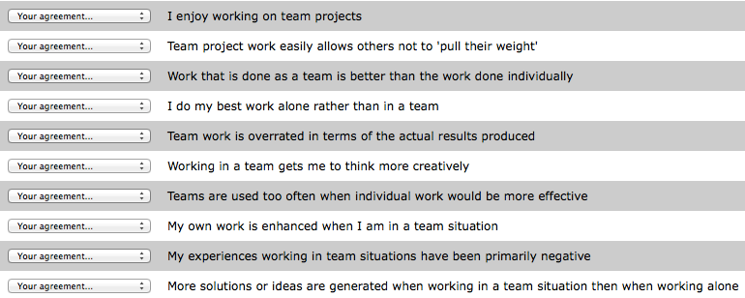
Next step:
Kline’s Team Player Inventory
T. J. B. Kline, "The Team Player Inventory: Reliability and Validity of a Measure of Predisposition Towards Organizational Team Working Environments," Journal for Specialists in Group Work, 24 (1999), pp. 102-12.

Slide 33
