Slide 1
Economic Impact of Cap-and-Trade Policy
On the Food Processing Industry of California: A Case of Dairy Industry
Srinivasa Konduru, Fumiko Yamazaki and Mechel S. Paggi
WERA 72 Annual Meeting
Santa Clara, CA
June 30-July 1, 2014

Slide 2
Overview of Presentation
Global Market for Dairy Products
Problems in capturing opportunities
- Global Warming Solutions Act
Cost of Carbon
Insights from the Milk Processing Industry
California Changes the World?

Slide 5
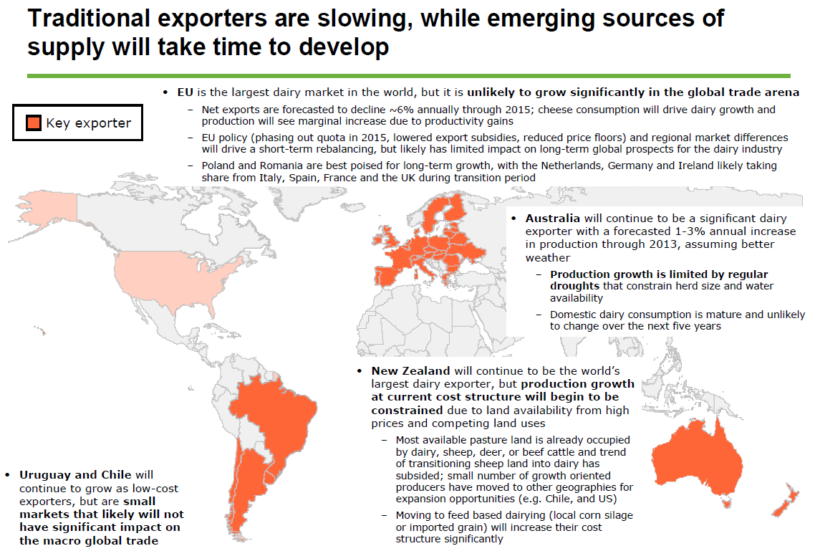

Slide 6
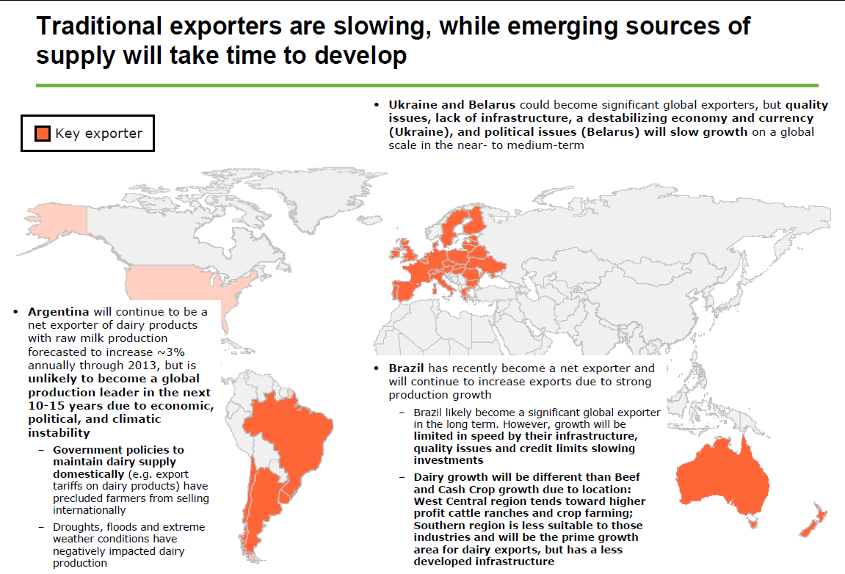

Slide 7
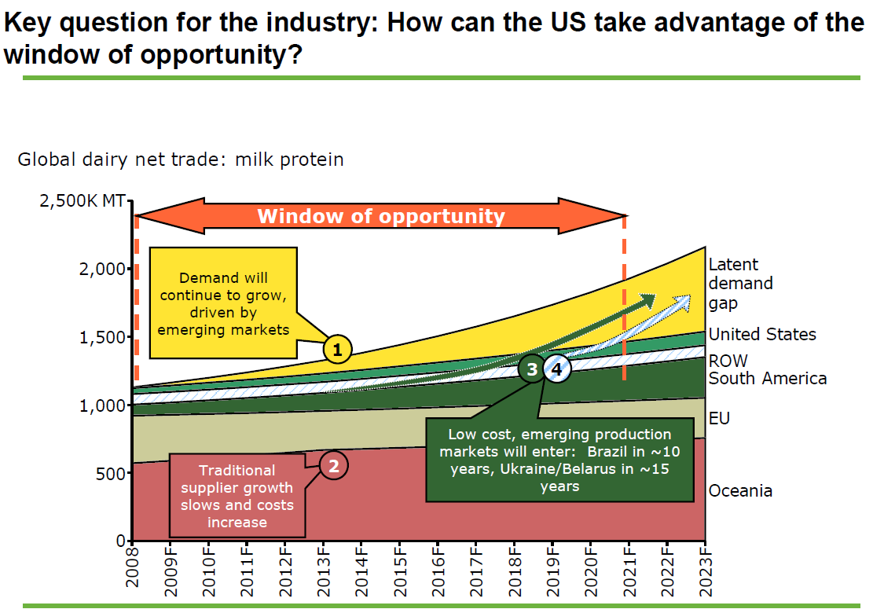

Slide 8
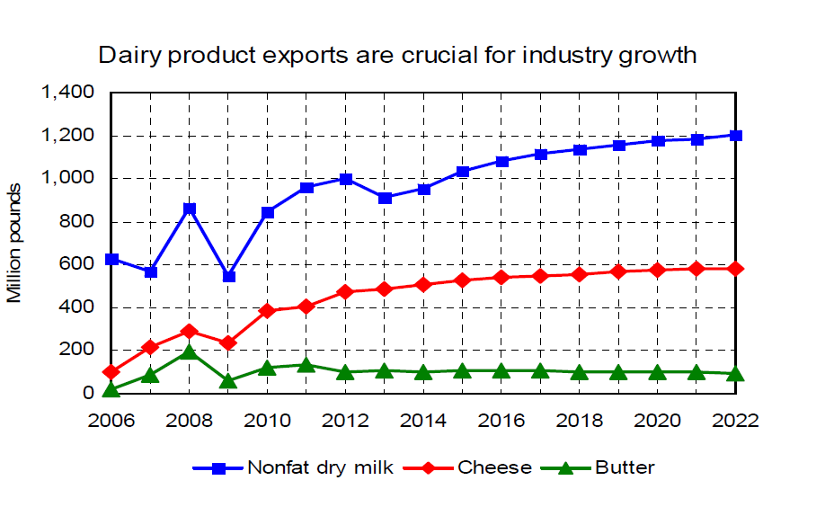
FAPRI-MU 2013 Baseline Dairy

Slide 9
U.S. ; 1000 MTs

Slide 10
Emerging Market Growth
Rates Decline from 7.3 to 4.8%

Slide 12
Share of CA in US Dairy Product Manufacturing
Butter #1 – 35%

Slide 13
Issue that may prevent in
capturing global opportunities ?

Slide 14
Assembly Bill 32:
Global Warming Solutions Act
In 2006, the California passed the AB 32, the Global Warming Solutions Act of 2006, which set the 2020 greenhouse gas emissions reduction goal into law.
This program will help put California on the path to meet its goal of reducing GHG emissions to 1990 levels by the year 2020, and ultimately achieving an 80% reduction from 1990 levels by 2050.

Slide 15
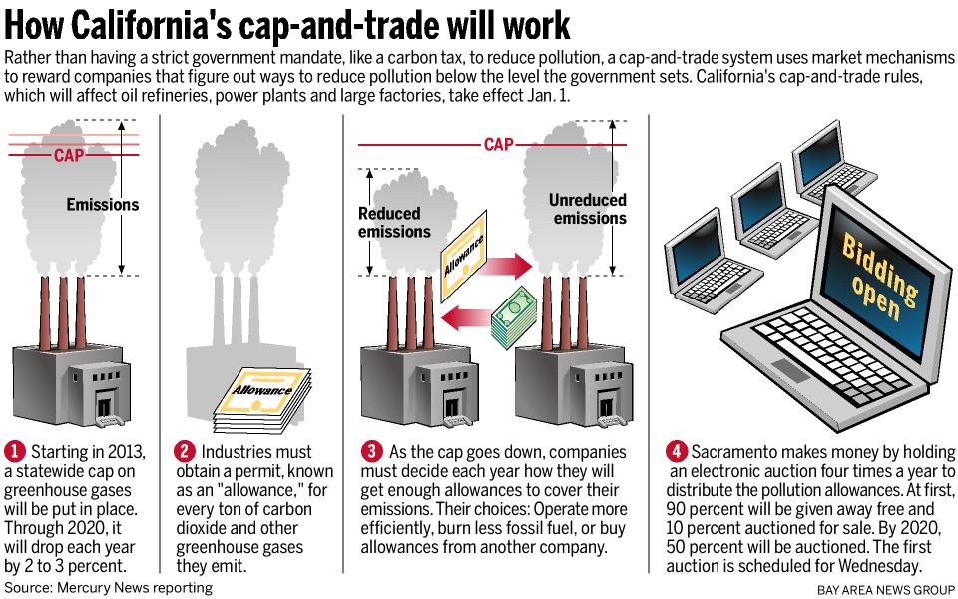
Global Warming Solutions Act
How California’s cap-and-trade system Works

Slide 16
Global Warming Solutions Act
The Plan specifies that the cap-and-trade provisions will be applied :
“Starting in the first compliance period (2013):
Large industrial facilities that emit over 25,000 metric tons CO2E per year,
including high global warming potential gases.”
At the present time production agriculture is not included among the industry sectors that will be subject to these new regulations. However, the processors of agricultural products have not been excluded from compliance with these provisions at this time.

Slide 17
Table 1. Allowances Compliance Periods
1st Period 2nd Period 3rd Period
(2013–2014) (2015–2017) (2018–2020)
During the Transition Period the ARB will make allowances for Industries that are determined to be in risk of having their production replaced by imported products from areas where equivalent GHG emission regulations are not in place (domestic or foreign) thus reducing the profitability of facilities in California.
“Emissions Leakage Risk”

Slide 18
Emissions Leakage Short - Run
CO₂ Emissions Allowance Price Increase Production Costs in Carbon Constrained Area
Consumers Switch to Cheaper Imports from Non-Carbon Constrained Origin
Change in Carbon Constrained Product Trade Flows
Julia Reinaud, “ Issues Behind Competitiveness and Carbon Leakage: Focus on Heavy Industry
International Energy Agency, October 2008.

Slide 19
Emissions Leakage Long - Run
Profit Margins Erode for Producers in Carbon Constrained Region
Investment to Maintain Existing Production Postponed
Investment in New Capacity moves to Greenfields Outside the Carbon Constrained Region
Sunding et al. found that a one percent increase in the cost of regulation will cause food processors to shift production out of region, ranging from 0.5% to 20% of production shifting out of region

Slide 20
Global Warming Solutions Act
Using an established benchmarking procedure the ARB has segmented industries subject to regulation into three categories with associated allowance assistance provisions (Table 2).
Based on this procedure food manufacturing firms in California that are determined to emit over 25,000 metric tons of CO2 per year are placed in the medium leakage risk ARB classifications.
Industries in the medium risk category are initially be awarded 100% of their allowances free of charge, in period two free allowances will decline to 75%(now 100%) and fall to 50% (now 75%) during the third compliance period.
California Air Resources Board for the State of California, “Appendix J: Allowance Allocation”.

Slide 21
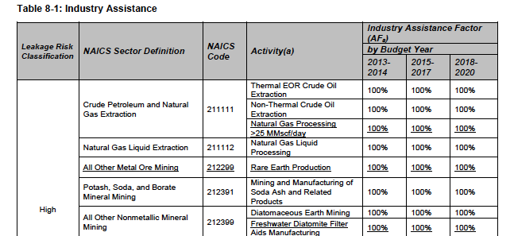

Slide 22
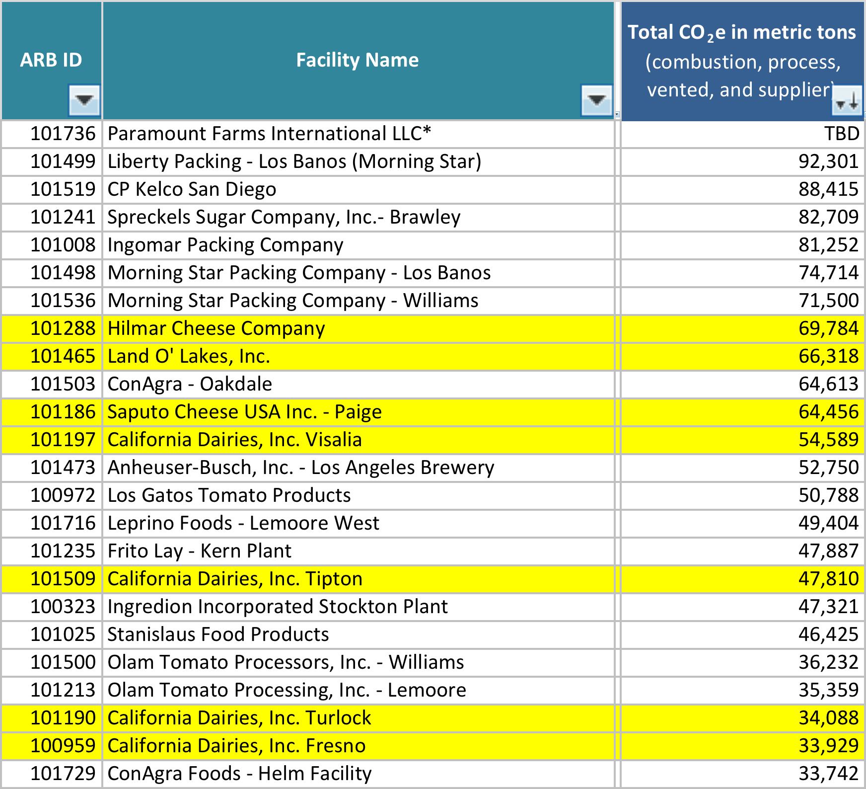
Annual Co2 emissions reported by food processing firms in California for year 2012

Slide 23
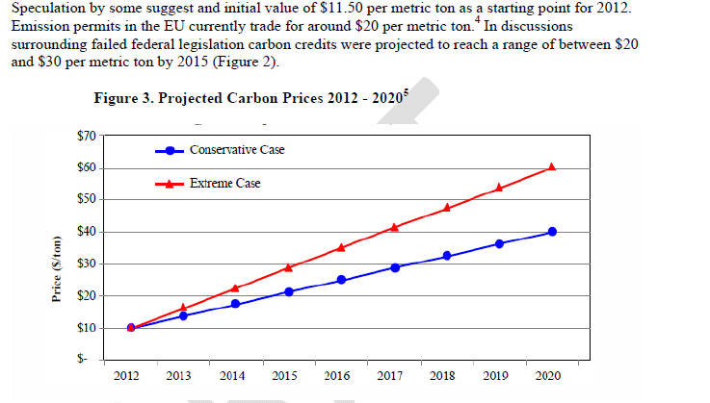
Cost of Carbon
Other ideas on Cost? Australia – 2012 $23/mt increasing by 2.5%
For 3 years then going to open trading system.
UK starts at £16 per mt increasing to £70 by 2030 at today’s exchange
Rate = 1.5755 : $25.21 to $110.28;

Slide 24
US Govt. Quietly Raises 'Carbon Price'
Buried in a little-noticed rule on microwave ovens is a change in the U.S. government’s accounting for carbon emissions that could have wide-ranging implications for everything from power plants to the Keystone XL pipeline.
The increase of the so-called social cost of carbon, to $38 a metric ton in 2015 from $23.80, adjusts the calculation the government uses to weigh costs and benefits of proposed regulations. The figure is meant to approximate losses from global warming such as flood damage and diminished crops.
“As we learn that climate damage is worse and worse, there is no direction they could go but up,” Laurie Johnson, chief economist for climate at the Natural Resources Defense Council, said in an interview. Johnson says the administration should go further; she estimates the carbon cost could be as much as $266 a ton.

Slide 25
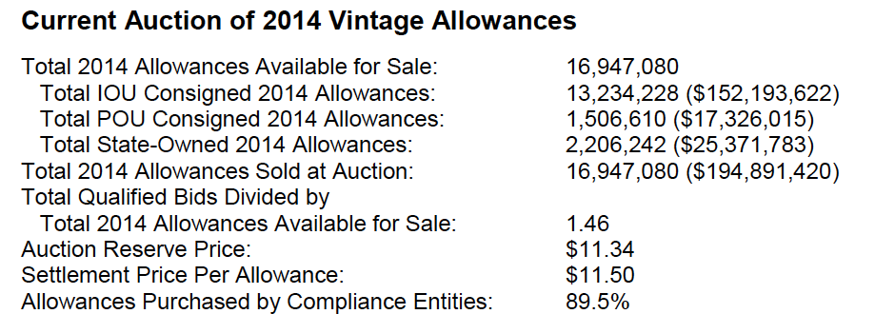
Actual Market Results

Slide 26
Cheese Trade Flow Pre-C&T Allowance Costs
$1.95/lb.
CA Central
Valley
Shanghai
Port of Long Beach
$2.06/lb.
New Zealand
F.O.B. NZ Port
$1.73/lb.
Shipping: $0.122/lb.
CA Central Valley to Shanghai
F.O.B. Long Beach = $1.70/lb.
OT $0.051 + Tariff $0.204
Tariff = 12% = $0.208
Notes:
http://free-editable-worldmap-for-powerpoint.en.softonic.com/download

Slide 27
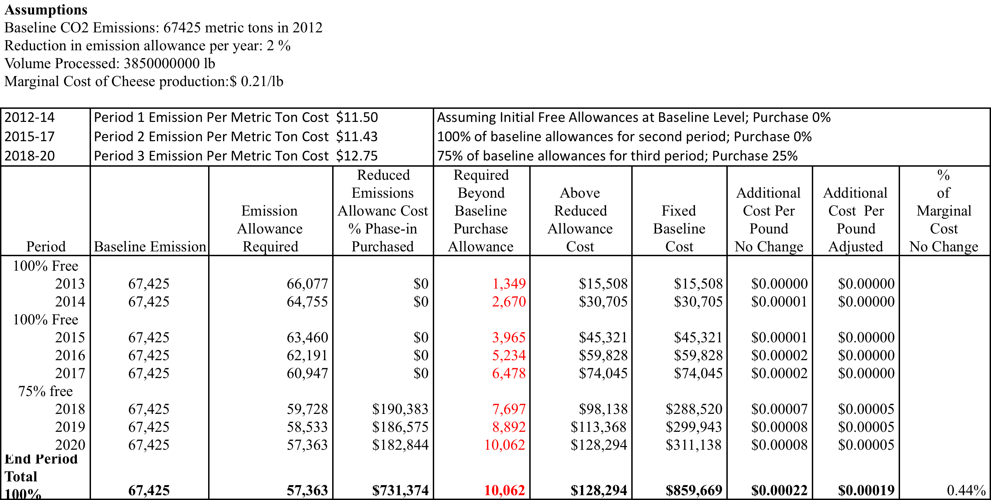
Cheese: Effect of AB-32 at Carbon Allowance Auction Prices

Slide 28
Cheese Trade Flow Post-C&T Allowance Costs
CA Auction Price of Carbon
$1.96/lb.
CA Central
Valley
Shanghai
Port of Long Beach
$2.06/lb.
New Zealand
F.O.B. NZ Port
$1.73/lb.
Shipping: $0.122/lb.
CA Central Valley to Shanghai
F.O.B. Long Beach = $1.71
OT $0.051 + Tariff $0.204
+0.11%
Tariff = 12% = $0.208
Notes:
http://free-editable-worldmap-for-powerpoint.en.softonic.com/download

Slide 29
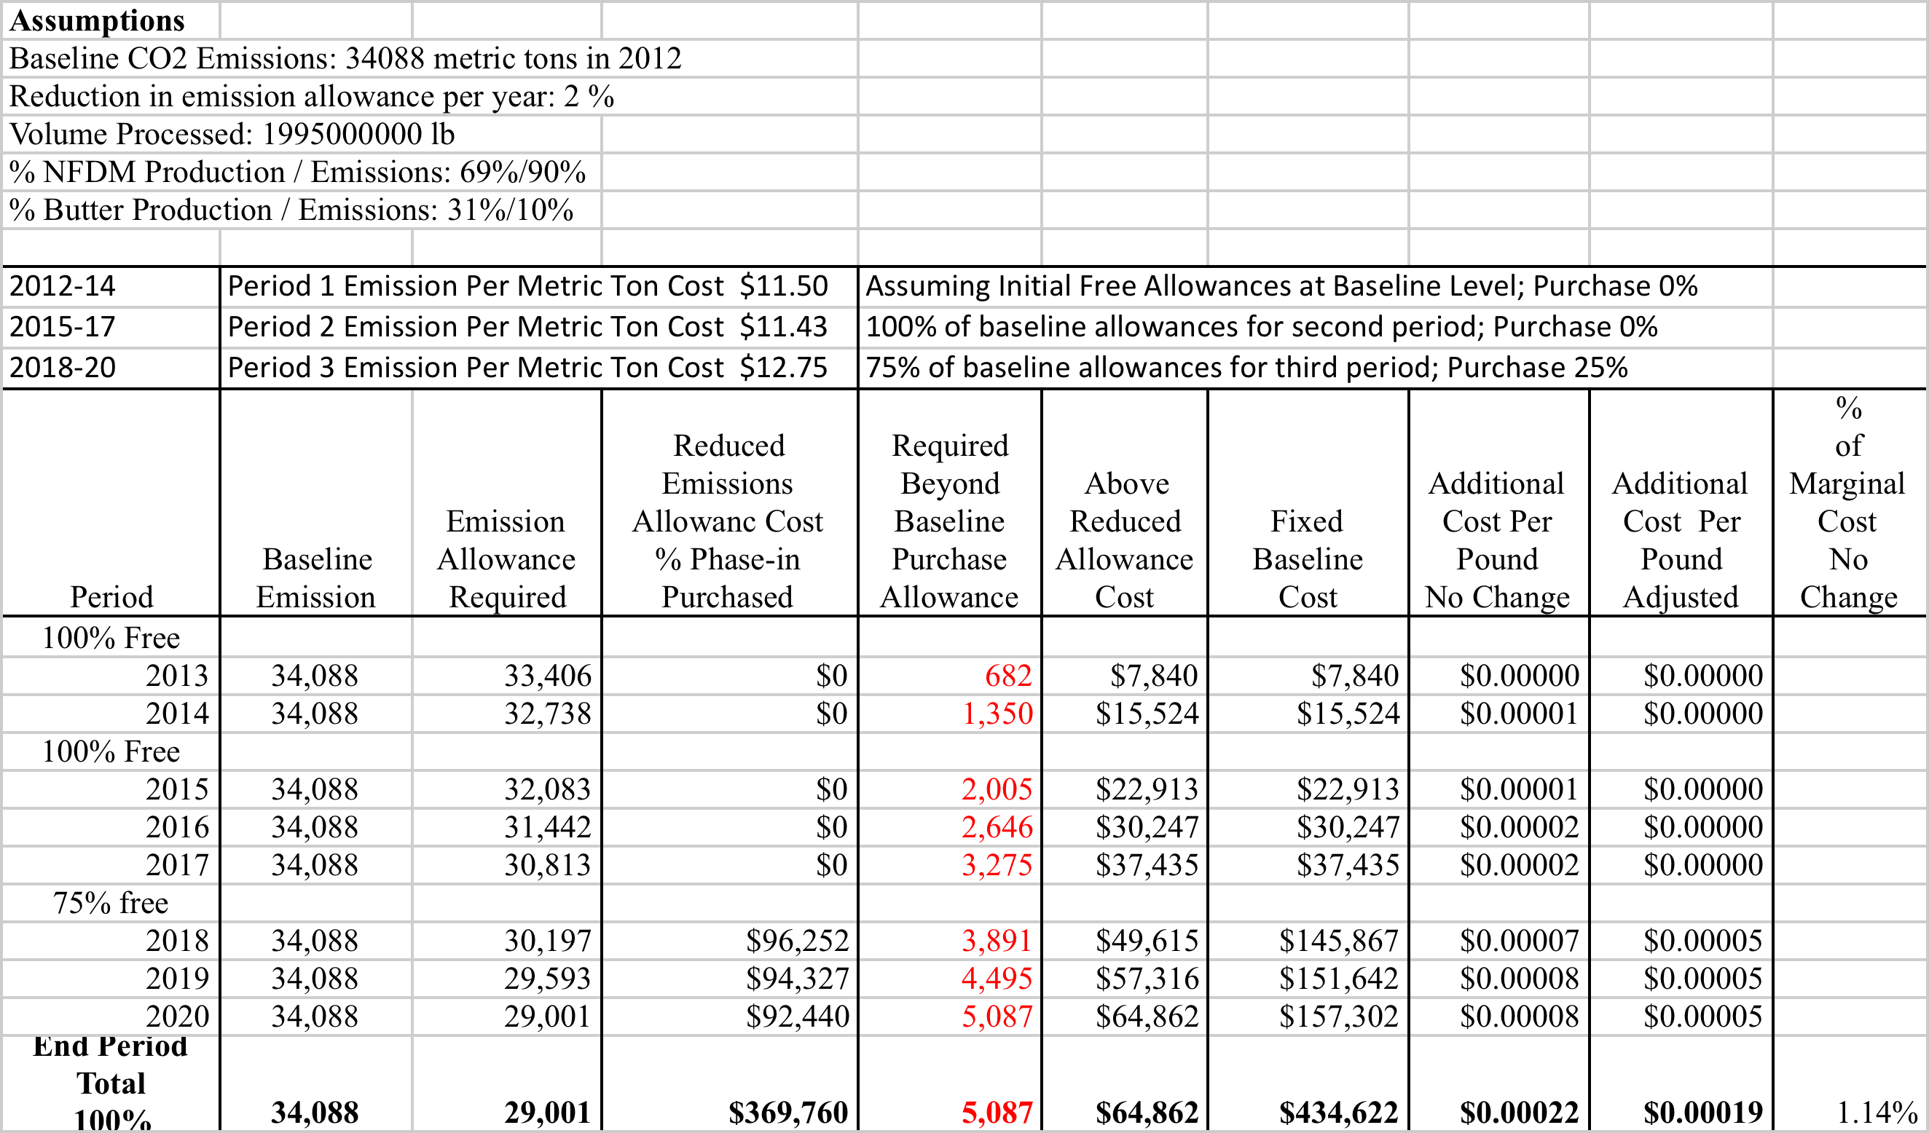
Effects of AB 32 on NFDM/Butter Plants at CA Auction prices

Slide 30
Summary & Concluding Comments
California Cap & Trade System Has Potential to Have Negative Impact for the
State’s Food Processor’s Relative Competitiveness
- Higher Production Costs Will be Pushed Back in form of Lower Price to Producers and/or Higher Prices to Consumers and/or Lower Processor Margins
- All the above may lead to Emission Leakage: consumers move to less expensive imports; producers switch to other crops ; industry does not engage in preventive maintenance and/or expansion plans.
Present level of regulations /allowance assistance/carbon prices may not lead to much impact till 2020
Global GHG Emissions is a Global Problem requiring Global Solutions; California alone WILL NOT SAVE THE PLANET, Leading by example??

Slide 31
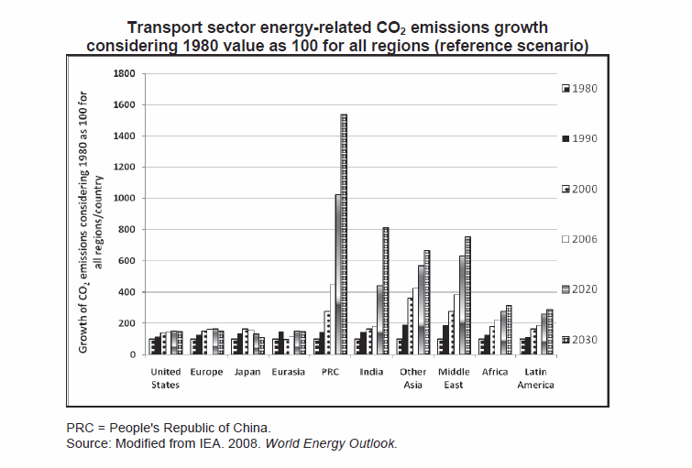
Assembly Bill 32: Global Warming Solutions Act?
Global Problems Need Global Solutions

Slide 32
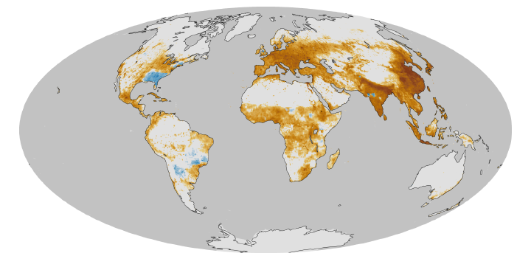
Assembly Bill 32: Global Warming Solutions Act?
Global Problems Need Global Solutions

Slide 33
Thanks

