Slide 1
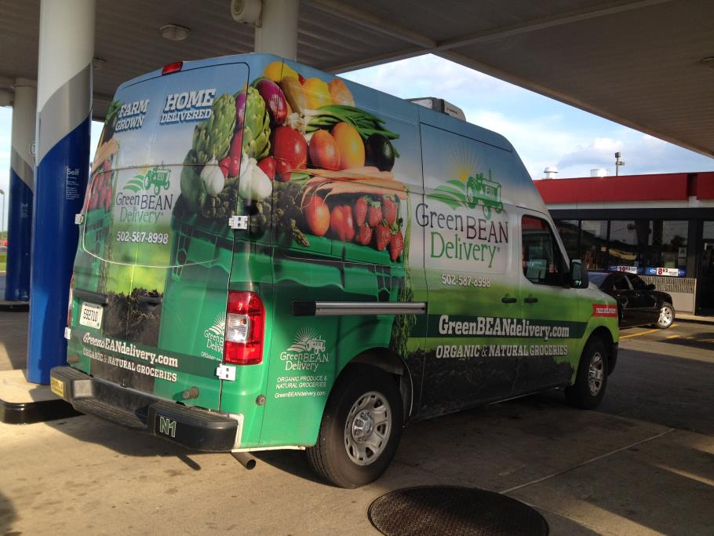
Emerging CSA Marketing and Business Strategies
Tim Woods
University of Kentucky
WERA-72
Santa Clara, CA
June 2014

Slide 2
USDA-AMS National CSA Emerging Business Strategies
Case-level observations
National survey of established CSAs

Slide 3
Elmwood Stock Farm Central Kentucky
Evolution of traditional single farm CSA
Complement to farm market and local branding
Value added products – farm estate branding
Sustainable food customer base
Difficult to compete with local suppliers to restaurants and schools
Competition from local food aggregators also emerging – also from local university

Slide 4
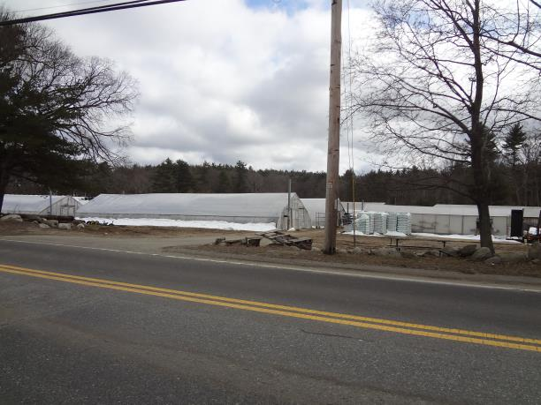
Elmwood Stock Farm Central Kentucky
Risks of shared CSA markets
Shareholder relations
Product quality
Mission creep
Farm branding limits
Demand for season extension
18 to 22 weeks, fall shares
High tunnels, meats

Slide 5
Farmer Dave’s/Many Hands Organic Farm
Partnering with urban community development agencies to reach lower income and inner-city shareholders
Harvard Medical School
Boston Housing Authority
Madison Park Development Corporation
East Boston Neighborhood Health Center
NOFA
Seafood CSA: Community Supported Fishery – extending the distribution model to a host of products

Slide 6
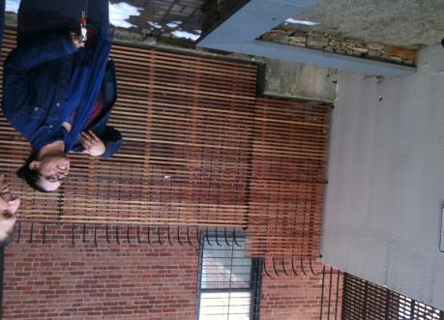
Farmer Dave’s/Many Hands Organic Farm
Shareholder recruitment
SNAP and other subsidy facilitation
Peer shareholder leadership
Cooking classes, expanded community health programs
Food consumption behavioral studies
Shared missional fit with community food systems
Elizabeth Gonzalez Suarez
Trinity Property Management

Slide 7
Connecting to Low Income Urban Shareholders
$6-8 weekly subsidy per share through food income assistance programs

Slide 8
Taking the CSA Beyond the Traditional Shareholder Base
Ginger Turner
CSA Manager for Farmer Daves
(Dave Demaresq)

Slide 9
Fair Prices for Farmers
Many Hands Organic Farm
Medium Vegetable Share: $16.25/week, $325/season
Farmer Dave
Fruit Share, $19.25/week, $250/season (13 weeks)
Small Vegetable: $21.50/week, $430/season
Regular Vegetable: $29.25/week, $585/season
Source: Drew Love, Northeast Organic Farmers Assoc.

Slide 10
CSA SNAPSHOT: PENNS CORNER FARM ALLIANCE (Pittsburgh, PA)
Timeline:
1999 Formed marketing co-op to restaurants, $16,000 in sales
2003 Started CSA; 10 grower members
2007 Hires Neil Stauffer as GM
2008-11 +20% sales growth annually
2012 Add flower, winter CSA program; start processing tomatoes
Four full-time staff
Acquired 3800 sq. ft. Pittsburgh warehouse, office, cooler space
Size: traditional cooperative of 36 farms, including a 12-farm Amish/Mennonite cooperative (Clarion River Organics)
CSA Members: ~700
2012: 509 spring shares, 630 harvest shares, 237 biweekly winter shares; 15 flower shares; ~30 egg shares
Other Outlets: Direct-to-restaurant, online ordering “Farm Stand”
Sales: $1.4 million in 2012; about 20% annual sales growth 2008-11
Future Plans: Continuing CSA; expand Farm Stand online ordering; dabbling in providing locally sourced foods to universities, private schools; developing Gift Basket line; encouraging high-end cheesemaking in the region.

Slide 11
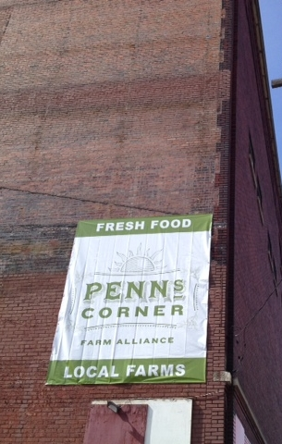
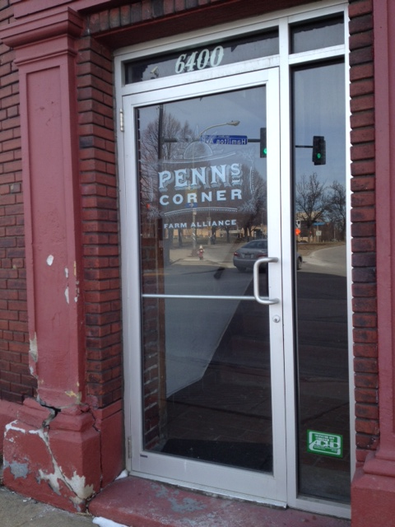
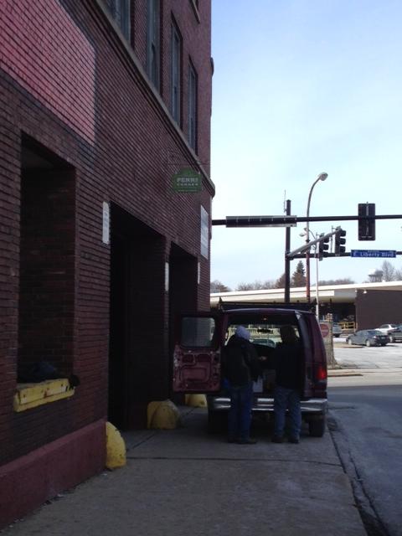
Downtown warehouse
location

Slide 12
Rapid expansion of e-commerce
Small Farm Central
CSA, farm stand, restaurant/wholesale

Slide 13
FairShare Madison, Wisconsin
Association of organic CSAs
Health Insurance Rebate program
Physician’s Plus
Cookbook sales funding substantial cooperative programming
Coalition support from Extension, medical community, strong local foods culture
Coalition able to provide
specialized CSA training for members
Shareholder recruitment
Community and fundraising benefits

Slide 14
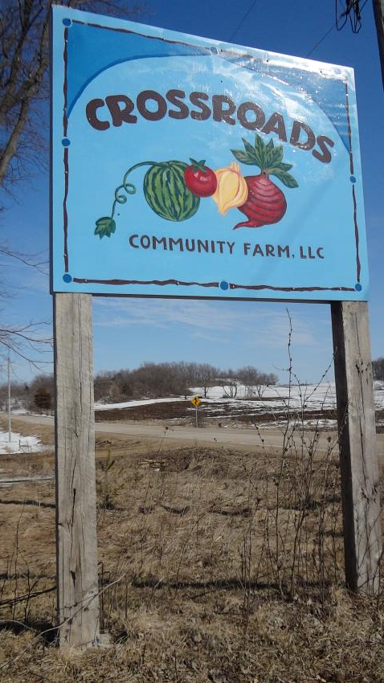
FairShare Health Rebate Program Growth
 | 2005 | 2006 | 2007 | 2008 | 2009 | 2010 | 2011 | 2012
Estimated total rebates issued | 96 | 972 | 1282 | 3550 | 6100 | 6800 | 7300 | 7200
Approximate # of shares available via FS farms | 2000 | 2800 | 3500 | 4500 | 6950 | 8650 | 8733 | 9700

Slide 15
Denver Area CSAs
CSA community post-Grant Farms (failed 10,000 share CSA)
Urban CSAs – links with Denver Housing Authority
CSA as a connection to city planning
Strong local foods and sustainable ag community in region

Slide 16
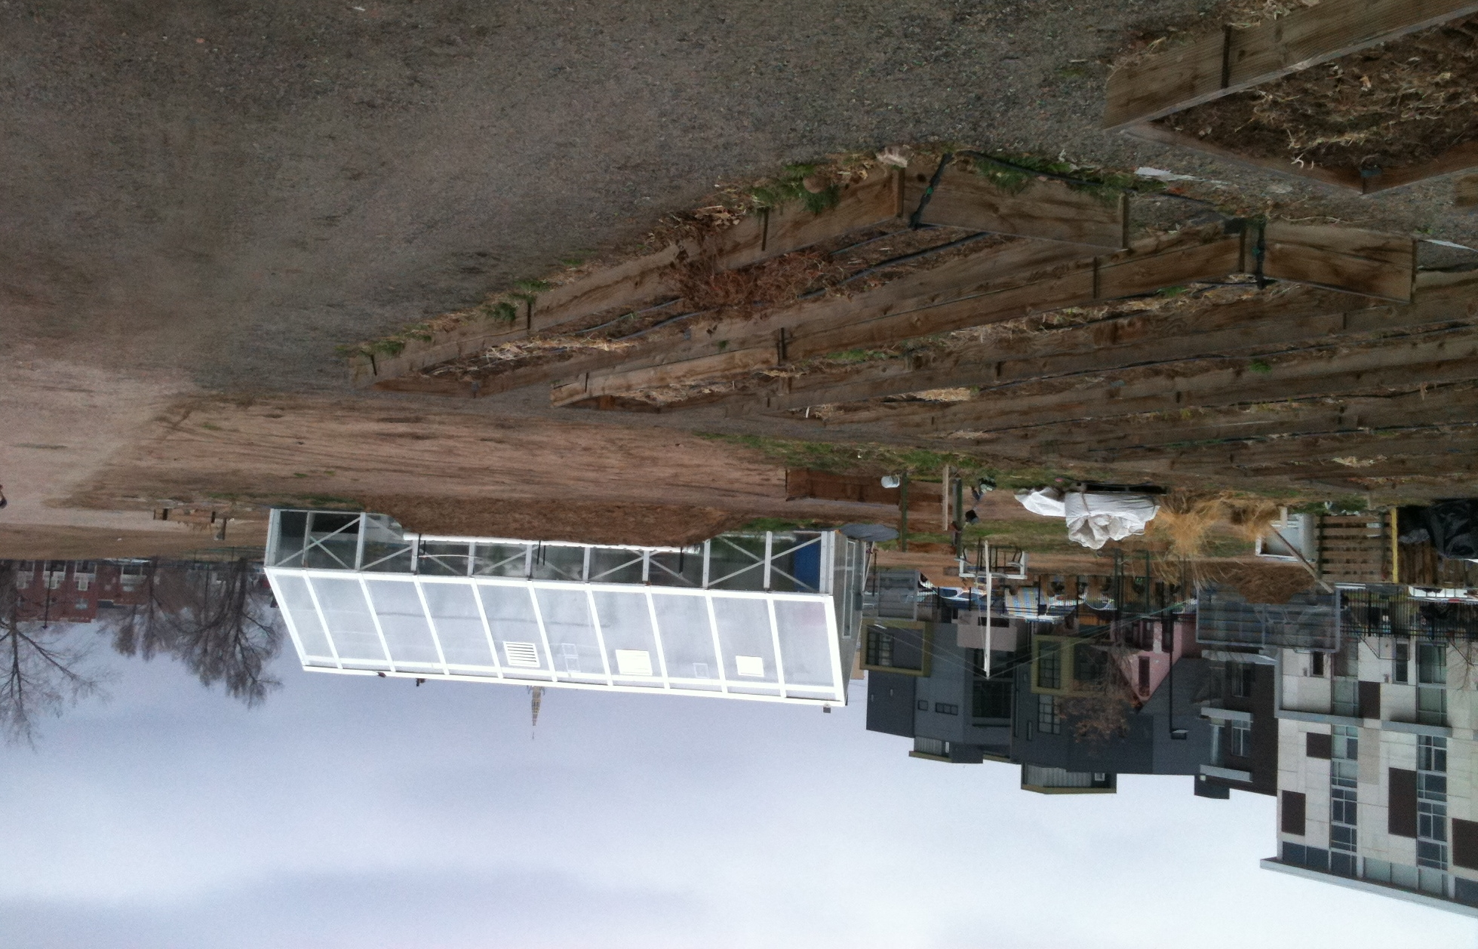
Granata Farms CSA and Urban Farmers Collective
Downtown Denver, CO

Slide 17
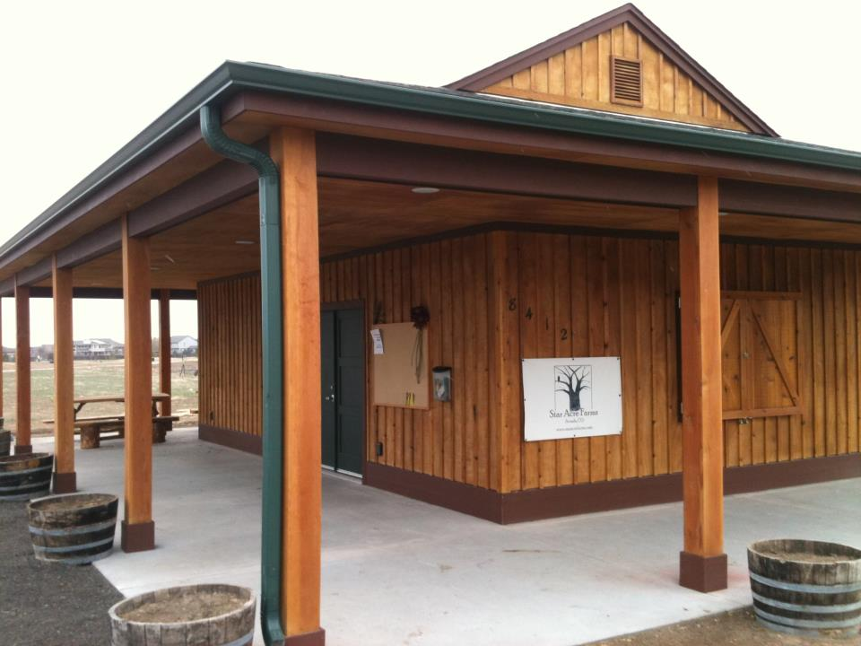
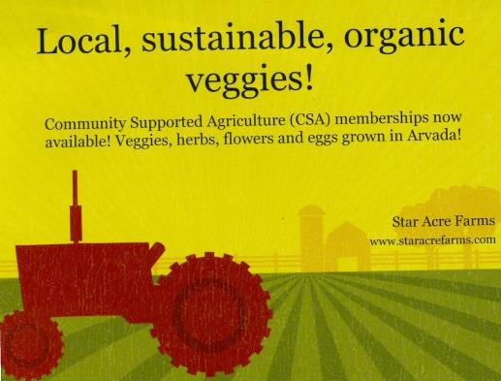
Star Acre Farms

Slide 18
Contrast Multi-Farm CSAs
Fair Shares CCSA (Combined Community Supported Agriculture)
St. Louis-based 450 share multi-farm CSA network
Around 40 farms, meat, produce, coffee, bread, pasta, cheese
Private venture
Grasshoppers Kentucky-based food hub/CSA/specialty foods distributor
40-50 KY and IN farms
Wide diversity of fresh and processed products
CSA a shrinking share of the business
Significant public investment from state

Slide 19
CSA Shareholders
Strategic reach
Grocer
Specialty wholesaler
Peapod
Value Proposition
Periphery
Mid-Level
Core
More price
sensitive
Food hubs
Local food aggregators
Multi-farm CSAs
Traditional single farm CSA
Less price
sensitive

Slide 20
Seasons CSA in Operation and Size
pct
Average shares
N=424

Slide 21
CSA Production Orientation
Production Methods | Percent
My CSA is certified organic | 25.8
I produce according to organic standards, but I’m not certified | 59.8
I incorporate some organic along with conventional methods | 12.9
I use primarily conventional growing techniques | 1.5
N=458

Slide 22
Ranking emerging competition relating to your CSA
Forced rating highest to lowest

Slide 23
CSA location distribution
Location | N | Percent
Near (within 50 miles) a large city (over 1 million) | 105 | 24.4
Near (within 50 miles) a small city (250,000-1 million) | 142 | 33.0
Small town | 114 | 26.5
Countryside | 69 | 16

Slide 24
How would you rate the demand for local food in your market area?
Change | Percent
No good basis for knowing | 1.6
Declining significantly | 1.0
Declining somewhat | 2.6
Staying about the same | 10.9
Increasing somewhat | 59.3
Increasing significantly | 24.7

Slide 25
How would you rate the demand for local food in your market area?
percent
Change | Rural | Urban
No good basis for knowing | 1.1 | 2.0
Declining significantly | 0.0 | 1.6
Declining somewhat | 3.8 | 1.6
Staying about the same | 14.8 | 8.1
Increasing somewhat | 57.9 | 60.3
Increasing significantly | 22.4 | 26.3

Slide 26
CSA shareholder recruitment for this year (2014) compared to previous few years has been….
Change | Percent
Much less difficult | 10.6
Somewhat less difficult | 15.7
About the same | 45.5
Somewhat more difficult | 19.7
Much more difficult | 5.3
Doesn’t apply | 3.2

Slide 27
Farm Sales from CSAs
Share of your total farm sales comes from your CSA
Location | Mean | SD | Min | Max | Obs.
Near large city | 55.00% | 32% | 0 | 100% | 105
Near small city | 56.00% | 31% | 0 | 100% | 142
Small town | 53.00% | 29% | 0 | 100% | 114
Countryside | 45.00% | 28% | 0 | 100% | 69
Average | 52.25% | 30% | 0 | 100% | 107.5

Slide 28
Consider the following potential changes to your CSA production since it began - please indicate where it may apply
Business function | Does not apply | Decreased a lot | Decreased some | About the same | Increased some | Increased a lot
Scale and variety of products offered | 1.4 | 1.7 | 4.8 | 20.7 | 43.3 | 28.1
Processed products offered | 51.2 | 0.5 | 1.9 | 18.0 | 22.3 | 6.1
Season extension technologies | 14.5 | 0.5 | 0.7 | 21.8 | 40.1 | 22.3
Product sourcing from other producers | 50.6 | 2.2 | 2.2 | 16.8 | 21.9 | 6.3
On-farm shareholder activities | 32.8 | 2.0 | 6.8 | 31.4 | 22.1 | 4.9
Share packing on the farm | 38.7 | 3.2 | 2.0 | 39.5 | 10.1 | 6.6

Slide 29
What we are learning
CSA agency and community partnerships that bridge entry barriers – helping with logistics, education, retention.
Scale economies still important in distribution and promotion. Tension between “authentic” farmer and community relationship objectives and subscription delivery model (Peapod and others)/ other scale efforts

Slide 30
What we are learning
E-commerce a core part of CSA business with growing applications for management
Rapid expansion in new products marketed through the CSA model
Proximity to urban markets impacts market opportunity and distance may make cooperation more compelling.

