Slide 1
Food Consumption, Attitude, and Behavioral Change Among CSA Members
Kynda Curtis, Karin Allen, and Ruby Ward
Department of Applied Economics and
Department of Nutrition, Dietetics and Food Science
Utah State University

Slide 2
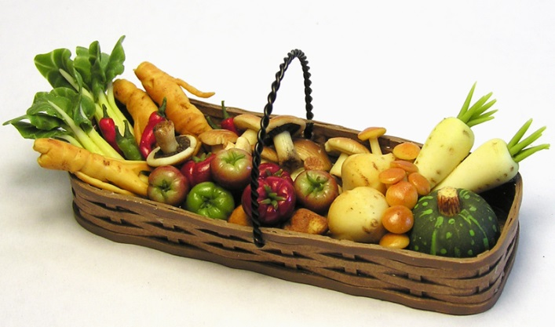
Overview
Literature on local food consumption commonly examines consumer willingness to pay (WTP) for fresh produce, motivations for local foods purchases, farmers’ market attendance, and/or CSA membership
Few studies examine the impact of purchases through direct marketing channels on consumer attitudes, dietary choice and food purchasing decisions
Majority focus on the impacts of public programs on fruit/vegetable consumption among low income individuals, such as the WIC and Senior Farmers’ Market Nutrition Programs
Notes:
Community Supported Agriculture (CSA) programs have been shown to be a viable networking and direct marketing approach, providing benefits to both farmers and consumers alike (Curtis 2011; Thilmany, Bond, and Bond 2008). CSA programs provide members weekly pre-paid baskets of fresh produce during the growing season. Farmers benefit from the pre-specified market for their products, as well as above wholesale level pricing. CSAs provide consumers with high quality and better tasting produce, commonly at lower prices than those at traditional grocery outlets (Cooley and Lass 1998; DeMuth 1993). In particular, they give consumers the opportunity to experience new foods, develop new social networks and reconnect with the land and the traditional practices of agriculture (O’Hara and Stagl 2001).
Research on consumer motivations for CSA program participation is prevalent in the literature. Common motivations include concern for the environment, a desire for fresh safe food, supporting local growers, and a sense of community connectedness (Cooley and Lass 1998; Cone and Myhre 2000; Sabine and Stagl 2001). However, member retention rates tend to fluctuate year-to-year due to the provision of too much produce, a lack of variety and choice within the baskets, and inconvenient pick-up locations and times ((Kane and Lohr 1997; Cooley and Lass 1998; Lang 2005).

Slide 3
Study Purpose
Examine the impacts of CSA program participation on consumer food purchasing habits and dietary choice
Specifically changes in behavior and attitudes toward fruit/vegetable consumption, and
Preparation of nutritionally enhanced meals
Use/preparation of unfamiliar produce items
Storage, such as canning, drying, freezing of items
Food purchases, by type and amount
Consumption of food outside the home (eating out)
If CSA program participation does indeed produce attitude and behavioral change in its participants…
Public policy encouraging CSA program membership, such as is currently done with farmers’ markets, may provide another vehicle for fostering dietary improvements
Especially in areas where farmers’ markets may not be available or accessible for targeted populations - Dollahite et al. (2005) farmers market access barrier to WIC program

Slide 4
Literature Overview – Dietary Changes
Perez et al. (2003)
CSA participants were more likely to eat more fruits and vegetables and to cook more creatively
Conrey et al. (2003)
WIC Program - Increased fruit and vegetable consumption was directly related to the nutritional information which supplemented the program
Johnson et al. (2004)
Home-bound senior program - participants increased produce intake by a full serving per day, but likely due to additional education and policy efforts
Lea et al. (2006)
The inclusion of locally-sourced salad bars in the Australian public school system increased produce consumption by both students and staff
Notes:
The majority of the research on the dietary and nutritional impacts of direct market purchases focus on the impacts of public programs on fresh produce consumption among low income individuals, such as the WIC (Women, Infant, and Children) and Senior Farmers’ Market Nutrition Programs (McCormack et al. 2010). Studies related to farmers’ markets include one by Conrey et al. (2003), which investigated the changes in nutritional health resulting from the WIC program. They found that increased fruit and vegetable consumption was directly related to the nutritional information provided by the program. Few studies assess changes in dietary choice and food preparation habits resulting from CSA membership. One study by Johnson et al. (2004), where CSA baskets were delivered directly to home-bound seniors, found that participants increased their produce intake by a full serving per day, but they attributed this success to “innovative partnerships and concurrent efforts at the individual, institutional, community, and policy levels” (p. 5).
A few studies discuss consumer attitude and behavioral changes resulting from CSA membership. For example, Perez, Allen, and Brown (2003) discovered that CSA members were likely to eat more fruits and vegetables and to cook more creatively. Ostrum (1997) found that not only were eating habits affected among CSA members, but changes in other consumption patterns resulted. Russell and Zepeda (2007) state that member dietary changes along with increased consideration of food seasonality were the direct result of the CSA’s educational components. Examples of specific changes included planning meals around available produce, exploring new foods, freezing or storing excess vegetables, and reductions in meat consumption.
This study seeks to assess the impacts of CSA program participation on consumer food consumption and preparation attitudes and behaviors. If positive impacts result, public policy encouraging CSA program membership, such as is currently done with farmers’ markets, and would provide another vehicle for fostering dietary improvements among program participants. This could be especially important in areas where farmers’ markets may not be available or accessible for targeted populations, as was the case in Dollahite et al. (2005), which found that farmers’ market access for low-income families was a barrier to the WIC program. The use of longitudinal data, including both participant survey responses and actual consumption information in the current study distinguishes it from previous studies.

Slide 5
Literature Overview – Consumer Changes
Ostrum (1997)
Participation affected consumers’ eating habits affected and other consumption patterns
CSA members tend to develop a stronger sense of community because consumers believe buying local is better for the environment, the health of the community and the health of their family members.
O’Hara and Stangl (2002)
Consumers’ environmental concerns grew stronger over the course of CSA membership
Consumers increased their desire to eat produce while it was in season
Consumers increased their desire to reduce packaging waste
Russell and Zepeda (2007)
Educational components of CSAs increased consideration of food seasonality

Slide 6
Methodology
A total of 14 participants in 4 CSA programs in Logan, Utah
A series of surveys, pre-program (early June 2012), monthly, and post program (December 2012) were administered
Participants submitted their monthly grocery store and other food purchase receipts during the six-month period
All weekly CSA basket contents were tracked by item and weight
Nutritional intake information was taken from receipts
Survey data provides stated information on changes in
Food preparation behavior
The use of new, unfamiliar food varieties
Number of of meals consumed outside the home
Attitudes regarding fruit/vegetable consumption and dietary choice

Slide 7
Sample Stats/Demographics
75% married and 81% female
28.6% have children under 18
78.6% white ethnicity
77% have a four-year degree or higher
65% employed full time
42.7% reported an annual income above $50,000
29% were CSAs members the previous year
14.3% classified themselves as vegetarians
Most learned about their CSA program from friends and family (53%), followed by a website (11%)
Notes:
From pre survey.

Slide 8
Lifestyle/Attitudes (Scale of 1-5, where 5 is Strongly Agree)
Notes:
From pre survey.

Slide 9
Primary Motive for CSA Program Participation
Notes:
From pre survey.

Slide 10
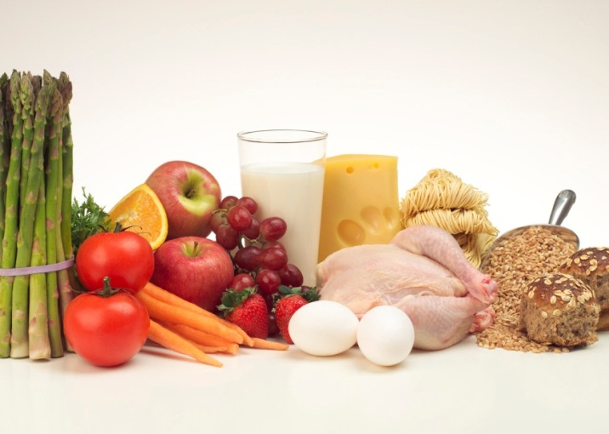
Reasons for Non-Membership in Previous Year
Unfamiliar with CSA program (40%)
Did not live in the area (27%)
Financial reasons (13%)
Needed to find others to split share (6.6%)
Couldn’t find good quality (6.7%)
CSA was full (6.7%)
Notes:
From pre survey.

Slide 11
Respondent Preferences Pre and Post
Notes:
Pre and post survey comparison.

Slide 12
Respondent Preferences Pre and Post
Notes:
Pre and post survey comparison.

Slide 13
Pre and Post Differences
Increased desire for smaller basket size
Increased interest in canning, cooking, and wine pairing classes
Decreased interest in food safety and recipe preparation classes, and farm tours
Labeling: organic and natural labeling became more important, while local (in state) labeling became less important
Quality and origin became more important, while pricing became less important
Appearance, variety, and organic production became less important when purchasing produce
Meals consumed at home weekly increased from 17.2 to 17.6
Notes:
Pre and post survey comparison.

Slide 14
Post Perceptions
100% would subscribe to a CSA program in the future
79% expressed an interest in a winter CSA program
71% felt that the recipes provided with their CSA membership and the availability of unknown produce encouraged them to preserve more food during the CSA season than normal
71% felt that their fruit and vegetable consumption was much higher (71%)
57% saw some improvement in their nutritional intake
93% felt that the recipes and the availability of previously unknown products in their baskets changed their food preparation or cooking knowledge
Participants showed a strong interest in receiving processed food item in their baskets
Notes:
Post survey only

Slide 15
Average Weekly Meals Consumed at Home by Percentage, June to November
Notes:
Having the CSA basket made a difference. Meals consumed outside the home went up after the CSA program was over in October. (Fell from 80/79 to 76% of meals at home)

Slide 16
Monthly Survey Results (June to Dec)
The percentage of CSA basket items used hovered around 90% throughout the season
The primary reason given for not using all baskets items was the inability to prepare unfamiliar items, 27%
During the first three months, participants were preparing around 72% of the unfamiliar items – this declined steeply in September (45%)
Recipe usage also decreased across the season (50% to 27%)
The storage/canning of produce peaked in August at 82% then declined throughout the fall reaching 18% in November

Slide 17
Results – Food Purchase/Consumption
Notes:
Percentages of food purchases by category. Fresh produce includes uncooked produce including bagged salads. Packaged produce includes all canned and frozen produce, including processed tomato products and canned beans. Meat includes all meats, nuts, and meat substitutes such as tofu. Dairy includes all dairy and dairy substitutes (including margarine and spreads), except frozen desserts such as ice cream. Grains includes all raw whole grains, packaged pasta/grain products, breads & bread dough, and ready-to-eat cereals. All dessert-type products (e.g. cake mix, donuts) are excluded. Packaged meals includes frozen and canned meals/soups and shelf-stable microwavable meals. “All Others” includes soda, candy, dessert items, chips, crackers, and other snack-type foods.

Slide 18
Results – Food Purchase/Consumption
Fresh produce purchases were significantly higher (p<0.05) during CSA participation, but total produce purchases did not differ
Grain product purchases were significantly lower (p<0.05) during CSA participation, but did not differ between months
Intake of Vitamin C and Folic Acid was significantly higher during CSA participation, consistent with increased vegetable consumption
Taken together, these results suggest fresh produce is replacing grain products during CSA participation, independent of any seasonal effect
Notes:
Vitamin B12 intake also increased. This is due to higher proportion of beef-based purchases in summer months (June-Sept) when CSA was active vs. more poultry-based purchases in fall months (Oct-Nov). (FYI – I verified this conclusion by looking at specific nutrient breakdowns and contributing foods in the nutrition software) No other nutrient differences were found (total calories, total/saturated/trans fats, sugars, fiber, protein, iron, sodium, calcium, etc.)

Slide 19
Conclusions
Stated results matched revealed results
Need for more research
CSA increased eating at home and produce consumption
CSA increasing some nutrition
Might have made them more adventurish eaters
September dropped off. Might be more willing in summer to try new things and use produce. As got back to school, back to old routines.

Slide 20
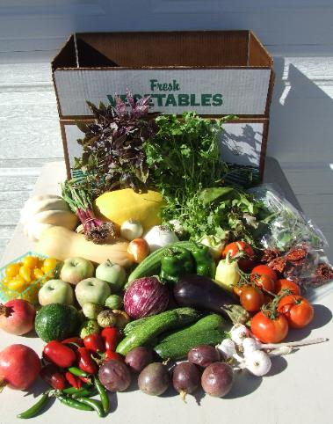
THANK YOU.. Questions?

