Slide 1
Global Vegetable Oils Market Trends: Demand Analysis and Strategic Planning Initiatives
Yasutomo Kojima
Joe Parcell
Jewelwayne Cain
Department of Agricultural and Applied Economics
University of Missouri-Columbia

Slide 2
Introduction
Vegetable oils consumption, production and trade have become one of the global topics of interest due to several factors:
(i) rising global demand for vegetable oils, especially in emerging economies
(ii) health problems related to trans fats (trans fatty acids: TFA)
(iii) increasing use of vegetable oils as biofuels feedstock along with crude oil price surge
(iv) international concerns over the environmental impacts of palm logging
In these circumstances, in order to understand global vegetable oils market trends,
it has become essentially important to analyze global demand for vegetable oils from the aspects of food use and industrial use, and to clarify the demand structure of edible and non-edible vegetable oils.

Slide 3
The Objective of This Study
The objective of this paper is
to estimate demand function of vegetable oils for food use and industrial use with cross-country panel data of 156 countries
to investigate global demand structure of edible and non-edible vegetable oils
to think about strategic planning initiatives

Slide 4
Previous Research (1)
Empirical analysis of food, biofuel and energy markets.
There are mainly three types of approaches, such as
1) Theoretical models
(Gardner 2007; de Gorter and Just 2008; de Gorter and Just 2009)
2) Cointegration analyses
(Yu et al. 2006; Hameed and Arshad 2008; Peri and Baldi 2010)
3) Partial and general equilibrium (CGE) models
(Arnt et al. 2008, Kancs and Wohlgemuch 2008)
4) Theoretical and empirical analysis
(Ciaian and Kancs 2011)
In order to empirically analyze vegetable oils market based on those theoretical models, we need to estimate demand elasticities of vegetable oils from a global perspective.
Currently, the USDA Economic Research Service (ERS) does not provide elasticity estimates of vegetable oils to the public.

Slide 5
Previous Research (2)
From a regional perspective,
Goddard and Glance (1989) analyzed demand relationships among twelve fats and oils in United States, Canada and Japan with data of per capita disappearance from 1962-86.
Their study did not include rapeseed oil in the demand equation for the U.S. in their model.
And also, they excluded sunflower oil in the model for three countries because some data was unavailable over some or all of the estimation period.

Slide 6
Demand Analysis
We focus on global markets of four vegetable oils:
soybean oil, rapeseed oil, palm oil, sunflower oil
We estimate own- and cross-price elasticities in the global market and identified income elasticities by geographic regions of Africa, America, Asia, Europe and Oceania for food use and industrial use, respectively.
Edible: Food 52.6% in 2009
Non-Edible: Feed, Seed, Waste, Processing and Other Utilities 47.4% in 2009
Demand elasticity estimates will be useful for future research, such as policy analysis related to the area of agriculture and energy.
Soybean Complex
Soybean
Soybean Meal
Soybean Oil
Rapeseed Oil
Palm
Oil
Sunflower Oil

Slide 7
Table 1. World Average of Edible Vegetable Oils Consumption per Capita
Source: FAOSTAT.

Slide 8
Table 2. Edible Vegetable Oils Consumption Share by Region
Source: Own calculations based on FAOSTAT.

Slide 9
Table 3. Change in Edible Vegetable Oils Consumption Share from 1990s to 2000s
Source: Own calculations based on FAOSTAT.
Note. These data show the difference in consumption share (%) from 1990’s to 2000’s.

Slide 10
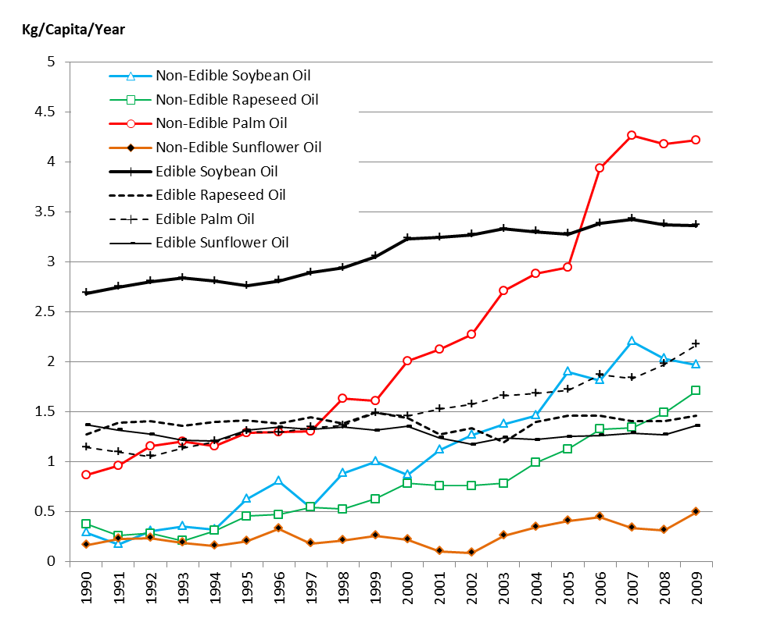
Figure 1. World Average of Edible and Non-Edible Vegetable Oils Consumption per Capita
Source: Own calculations based on FAOSTAT.

Slide 11
Table 4-1. Summary Statistics

Slide 12
Table 4-2. Summary Statistics
Edible
Non-Edible

Slide 13
Table 4-3. Summary Statistics
Edible
Non-Edible
2000-2004 Average
2005-2009 Average

Slide 14
Table 5. Rate of change in the mean of consumption and real price
Long term Change: 1990-1999 to 2000-2009 Average
Short term Change: 2000-2004 to 2005-2009 Average

Slide 15
Table 6. Real GDP Per Capita

Slide 16
Demand Model for Edible Vegetable Oils
Double-log demand model for four edible vegetable oils
$$1) \ln{{PCCON}_{F,i,t}}=C_{i}+\sum_{j=1}^{4}{γ_{ij}}lnp_{j,t}+β_{i}lnx_{t}×D_{r}+τ_{i}{×D}_{pe}+ε_{i,t} \left(i=1,…,4\right)$$
PCCON_{F,i,t} ： per capita quantity of vegetable oil i consumed for food use at time t
C_{i} : constant term of vegetable oil i’s consumption
p_{j,t} : real price of vegetable oil j (j = 1…4) at time t
x_{t} : real GDP per capita at time t,
D_{r} : region dummy variable (1 or zero) for five regions
Africa, America, Asia, Europe and Oceania where countries are located
D_{pe} : preference dummy variable (1 or zero) for each country’s preference for a certain type of edible vegetable oil i.
ε_{i,t} is a zero-mean, normally distributed constant variance disturbance
C_{i}, γ_{ij}, β_{i} and τ_{i} are parameters to be estimated

Slide 17
Demand Model for Non-Edible Vegetable Oils
Double-log demand model for four non-edible vegetable oils
$$2) \ln{{PCCON}_{I,i,t}}=C_{i}+\sum_{j=1}^{5}{γ_{ij}}lnp_{j,t}+β_{i}lnx_{t}×D_{r}+τ_{i}{×D}_{pn}+ε_{i,t} \left(i=1,…,4\right)$$
PCCON_{F,i,t} ： per capita quantity of vegetable oil i consumed for food use at time t
C_{i} : constant term of vegetable oil i’s consumption
p_{j,t} : real price of vegetable oil j (j = 1…4) and crude oil j (j=5) at time t
x_{t} : real GDP per capita at time t,
D_{r} : region dummy variable (1 or zero) for five regions
Africa, America, Asia, Europe and Oceania where countries are located
D_{pn} : preference dummy variable (1 or zero) for each country’s preference for a certain type of non-edible vegetable oil i.
ε_{i,t} is a zero-mean, normally distributed constant variance disturbance
C_{i}, γ_{ij}, β_{i} and τ_{i} are parameters to be estimated

Slide 18
Table 7. Estimation Results (156 Countries for 1990 - 2009)

Slide 19
Table 7. Estimation Results (156 Countries for 1990 - 2009)

Slide 20
Table 7. Estimation Results (156 Countries for 1990 - 2009)

Slide 21
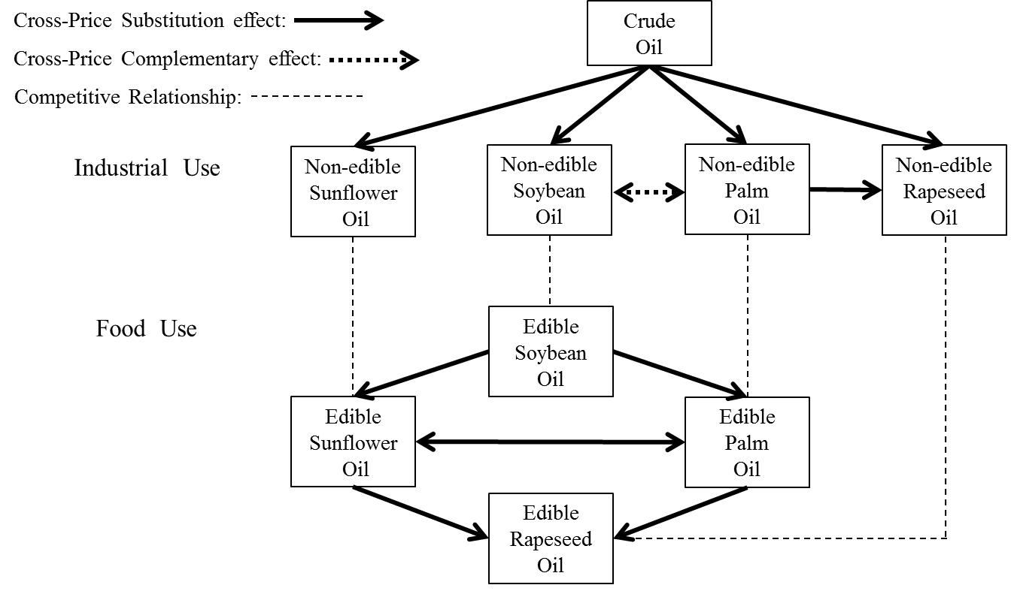
Figure 2. Cross-Price Effect on Global Demand for Edible and Non-Edible Vegetable Oils
Note. Arrow represents the direction of cross price effect on demand for the other vegetable oils at least the 10% significance level.

Slide 22
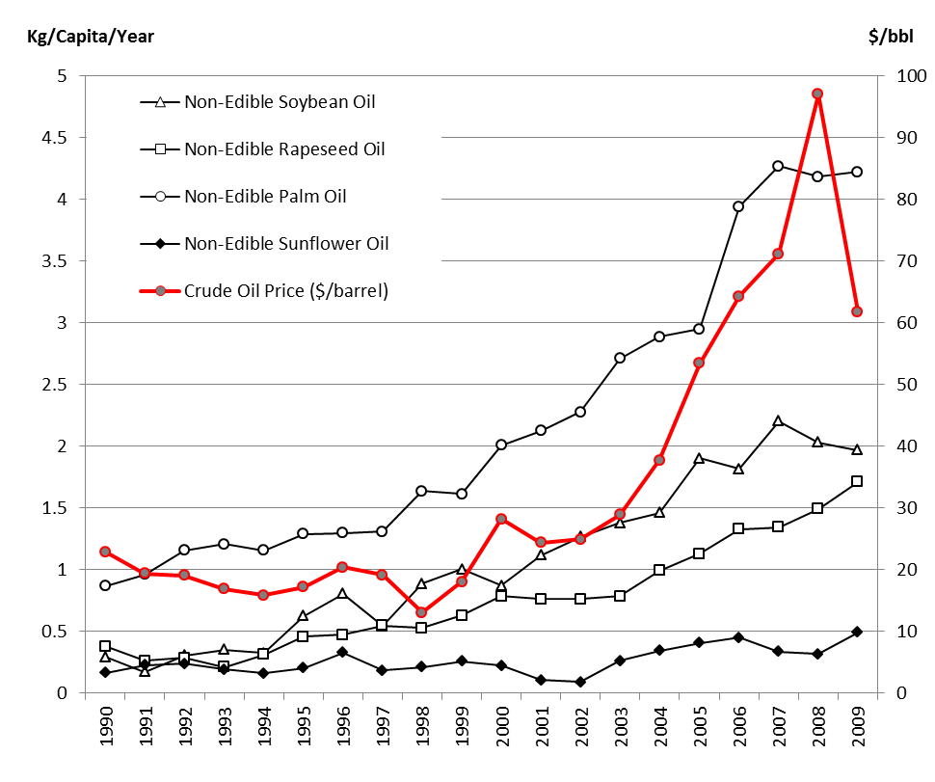
Figure 3. World Average of Non-Edible Vegetable Oils Consumption per Capita and Crude Oil Nominal Price

Slide 23
Strategic Planning Initiatives
1) Policy and regulation:
e.g. Trans Fats Issue
2) Competitive product positioning:
e.g. Emphasis on a vegetable oil’s positive characteristics
3) Technological innovation:
e.g. High-oleic soybean innovation and commercialization
Key Point: Cost Performance after Quality Innovation
Because our paper finds that soybean oil price plays a central role in demand determination of other edible vegetable oils in a global market of edible vegetable oils through its cross-price substitution effect.

Slide 24
Thank you for your attention.

