Slide 1
Mapping Hunger Vulnerability & Food Assistance Provision: An Application of a Geographical Information System (GIS)
Gregory Baker
Professor
Naumes Family Chair
Christopher Bacon
Assistant Professor

Slide 2
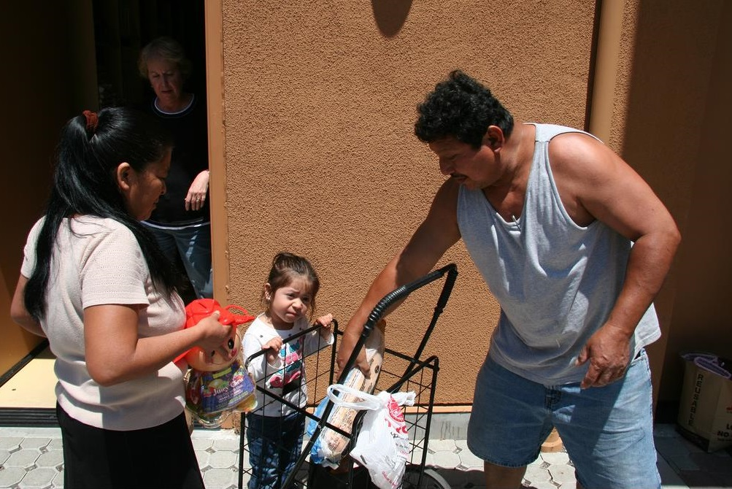
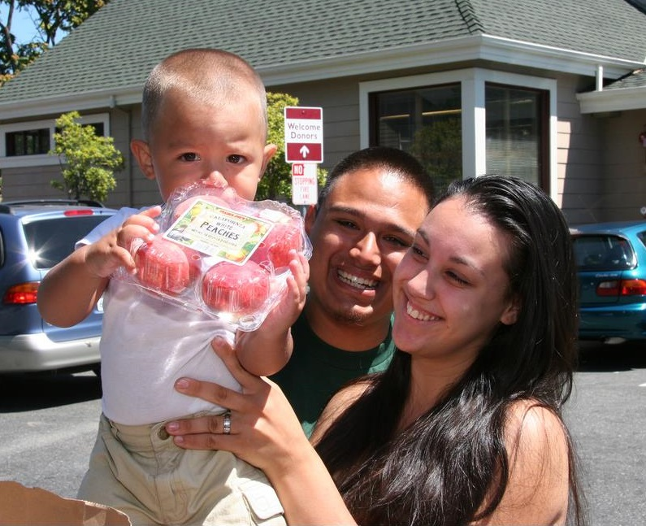
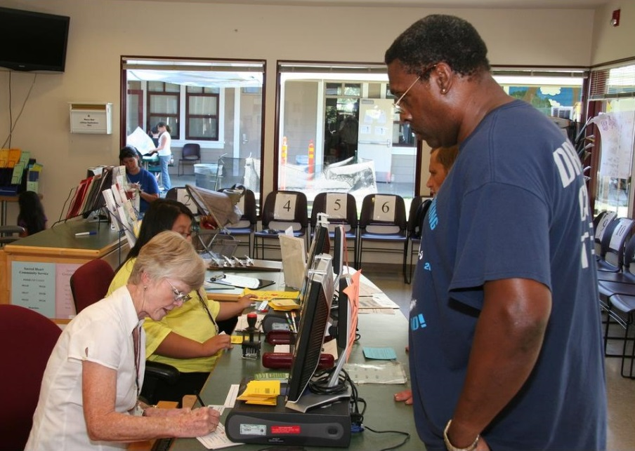
Are Hungry Populations Well-Served?

Slide 3
Research Objective
Evaluate location of food assistance distribution points relative to areas of highest poverty in Santa Clara County, CA, USA

Slide 4
Methods
Use a Geographic Information System (GIS) to plot information by census tract (Esri’s ArcGIS)
Plot % of households at or below 200% federal poverty level (US Census data)
Plot food assistance distribution sites with 1 km buffer zones

Slide 6
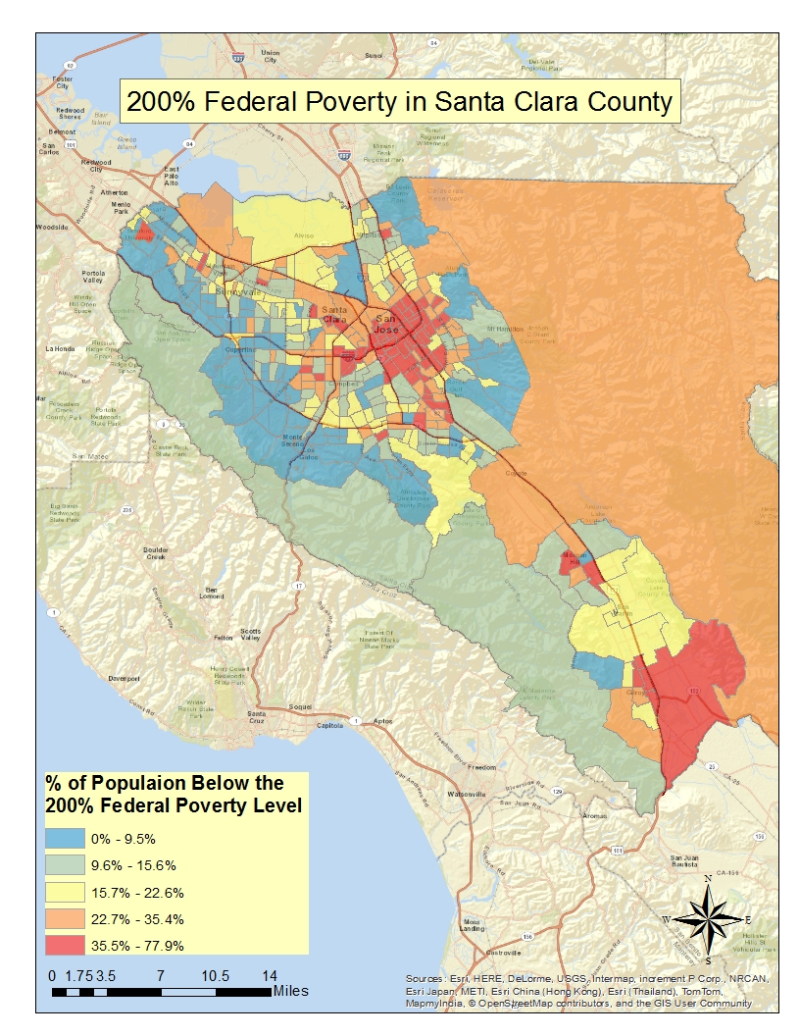

Slide 7
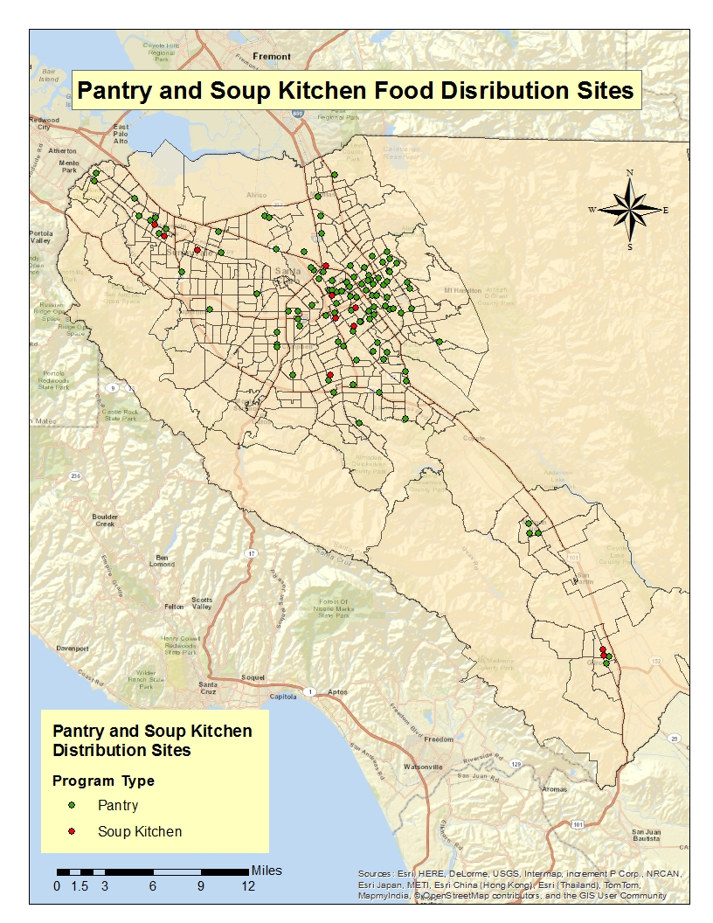

Slide 8
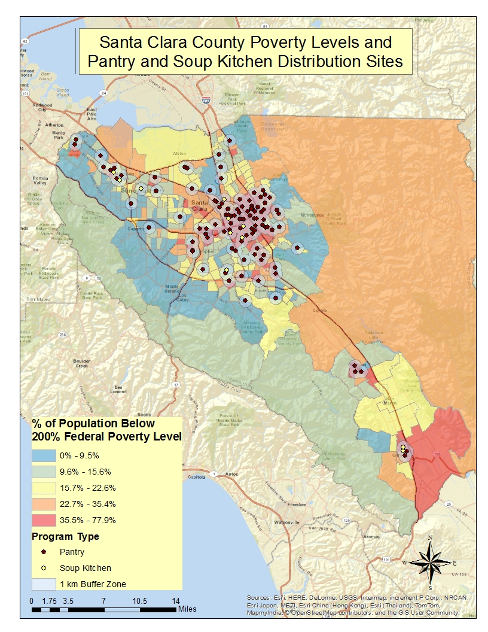

Slide 9
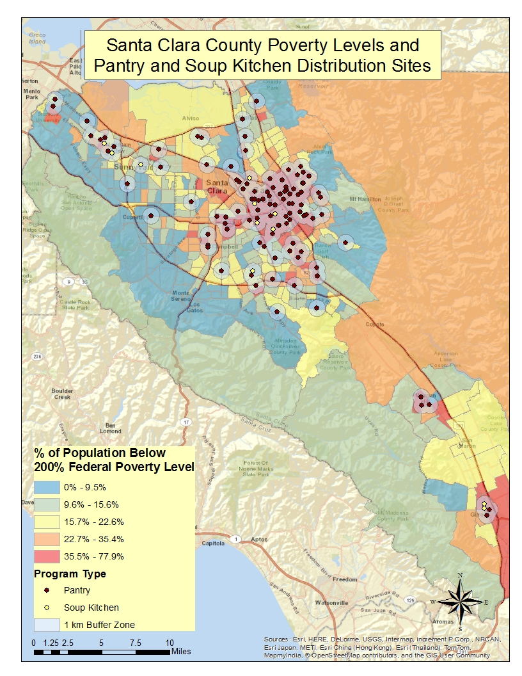
X
X
Possibly Underserved
X

Slide 10
Possibly Overserved

Slide 11
Conclusions
Apparently, good alignment between highest poverty areas & location of food assistance distribution sites
Pockets of high poverty areas with no easy access to food assistance distribution sites
Areas with highest concentration of poverty and food assistance distribution sites should be evaluated
Possible redundancies
There may be greater need for food resources elsewhere

Slide 12
Related Research
Develop Hunger Vulnerability Index
Economic
Percent of population living in poverty
Gross rent as percent of income
Social Capital
Percent living in residence less than one year
Education
Access to Affordable, Healthy Food
Nearby supermarkets or grocery stores
Nearby farmers markets, community or urban gardens
Validate by looking at relationship between hunger vulnerability and food stamp enrollment

