Slide 1
Sustainable Competitive Advantages in the Canadian Lentil Industry: A Case Study
Eric T. Micheels, Alison Sawka and Richard Gray
WERA-72 Annual Meeting
Santa Clara, California
July 1, 2014

Slide 2
Motivation
Canada major player in global lentil market
30% of global production (FAOSTAT, 2012)
57% of world exports (FAOSTAT, 2011)
95% of Canadian production occurs in Saskatchewan
Lentil exports are generally whole lentils
Issue: Plant genetics can be appropriated

Slide 4
Overview of Sask Lentil Value Chain
Saskatchewan Pulse Growers
University of Saskatchewan
Crop Development Centre
Domestic Buyers
Select Seed Growers
Growers
Processors
International Buyers

Slide 5
Investment and Yields in Lentils
SPG collects a 1% non-refundable levy on all lentils marketed in Canada
2012 production – 1.5 M tonnes
Prices of lentils ~ $480/tonne
Invested in R&D
New CRL varieties show yield increases ~3% per year
Through agreement with CDC, producers have royalty free access to new varieties

Slide 6
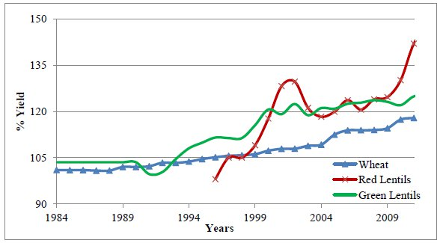
Lentil and Wheat index yields (1984-2011)

Slide 7
Issue?
What if other countries where growing conditions are similar are able to acquire and plant the new varieties?
Russia and Kazakhstan
What is the economic impact?
Are contracts a solution?

Slide 8
Hypothetical States
Developed four scenarios of increased production in Russia and Kazakhstan
Acreage relative to spring wheat
5%; 2.5%; 1.25%; no change
Result: There was not that much incentive to develop a closed-loop value chain to split lentils (mechanical protection)

Slide 9
Findings from IP Study
From 2014-2034, an additional 92 million $CAD in producer surplus is gained through protection of IP.
Break-even processing margin is $3.41/tonne

Slide 10
Resource Based View
Firms (and organizations) are bundles of resources – Penrose (1959)
Resources can create SCA when:
Valuable
Rare
Imperfectly imitable
Non-substitutable

Slide 11
SCA in Canadian Lentil Industry?
Leakage of genetics a problem, just not one that is not that economical to fix
Value is in process to create genetics, not the genetics themselves
Social complexity
Causal ambiguity
Time compression diseconomies

Slide 12
Sustainable vs. Temporary advantages
How much is the industry willing to spend to protect a temporary advantage?
Lagged effect
Multi-stakeholder engagement?

Slide 13
Solutions?
Contracts
Growers must deliver to certain processors who will split lentils
Plant Breeder’s Rights
Genetics protected from appropriation in certain jurisdictions
Something else?

Slide 14
Results and Discussion
Cost of leakage of genetics is real
Cure may be worse than the disease
Sustainable versus temporary advantages
Relationships between SPG, U of S, CDC create and sustain value

Slide 15
Questions/Comments
Acknowledgement: Project was funded by the Saskatchewan Pulse Growers
Contact Info:
Eric T. Micheels Richard Gray
eric.micheels@usask.ca richard.gray@usask.ca

