Slide 1
Teaching What Really Matters in a Way That Makes Sense
Michael McCullough 
Erik Slayter 

Slide 2
Critical Thinking Analysis Communication
Microsoft Excel
Problem Solving

Slide 3
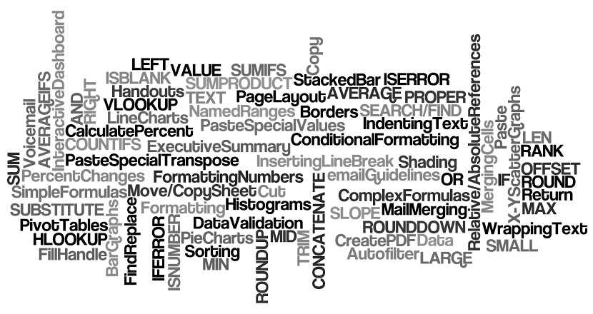

Slide 4
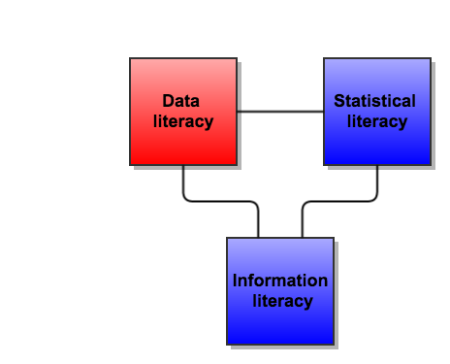

Slide 5
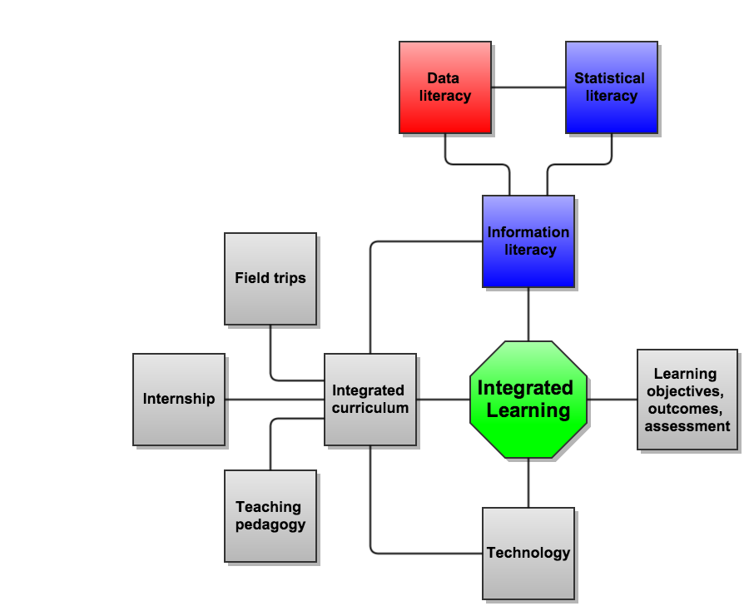

Slide 6
Course Layout
Administration of course 
Expectations 

Slide 7
Issues/Complications
Concentrated pushback from unmotivated students 
Investment to develop framework 
Obtaining good data (contextual/usable) 
Academic integrity 
Physical resources (computer labs) 

Slide 8
Considerations/Recommendations
70% rule vs minimum requirements for subsequent courses 
Build course incrementally 
Expect growing pains 
Hold a bootcamp 

Slide 9
Teaching What Really Matters in a Way That Makes Sense
Questions/Discussion 

