Slide 1
Value Creation across the Food and Agriculture Value Chain
Maria Cucagna and Peter Goldsmith
Department of Agricultural and Consumer Economics
University of Illinois

Slide 2
Farm Share Evolution

Slide 3
Motivation and Research Questions
Increasing spread between farm share and the marketing share
Lack of understanding of the term value creation
Lack of empirical studies measuring value creation within a value chain context.
Research Questions:
What drives value creation in agribusiness?
Which chain members are creating the most value?
How can this be measured?

Slide 4
Agri-Food Value Chain
Stage 3
Processors
-Soft drinks
-Brewers
-Wineries
-Packaged food
Stage 4
Delivery to consumer
-Food distribution
-Groceries
-Restaurants
Stage 2
Agricultural Production
- Farm products
Stage 1
Inputs
-Chemicals
-Agricultural inputs
-Farm equipment

Slide 5
To change a product current place, time, and form to characteristics more preferred in the marketplace.
Coltrain (2000); USDA (2002)
To add value to a raw product by taking it to at least the next stage of production.
Anderson and Hanselka (2009)
To perform an activity performed at another stage or to perform an activity never performed
Amanor-Boadu (2003); Born and Bachmann (2006); Evans (2006,2009)
The Concept of Value Creation in Food and Agribusiness

Slide 6
Weaknesses of the Term Value Creation
The definitions of value creation provide a weak description of what value creation really means
Focus solely on the process and product levels
Fails to provide a measurement of value creation
There is no study measuring value creation in food and agribusiness
Inconsistent with the financial economics literature
Do not take into account the cost of capital

Slide 7
The Concept of Value Creation in Financial Economics
Traditional accounting measures for assessing firm performance
Stock Prices
Return on Equity (ROE)
Earning per Share (EPS)
Net Operating Profits After Taxes (NOPAT)
Inferior measures of the true value of a firm
Fail to measure the real value or performance of the firm because they do not account for the cost of capital

Slide 8
Economic Value Added (EVA) as a financial tool to measure value creation.
Adding value means to use the capital efficiently
Producing a return on capital above the cost of capital
Not necessarily related with profitability.
Research determining the superiority of EVA over traditional accounting measures of value creation
There is no research measuring value creation in a value chain perspective.
Nor applied to the food and agribusiness

Slide 9
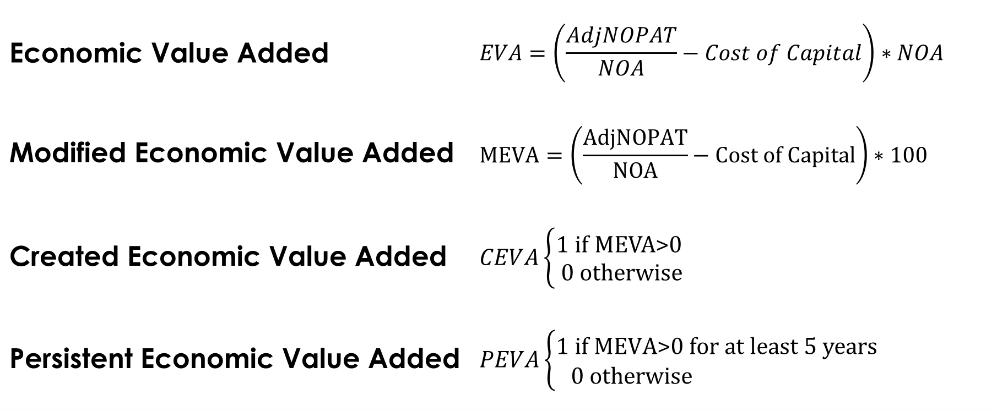
Value Creation Metrics
Economic Value Added | $$EVA=\left(\frac{AdjNOPAT}{NOA}−Cost of Capital\right)∗NOA$$
Modified Economic Value Added | $$MEVA=\left(\frac{AdjNOPAT}{NOA}−Cost of Capital\right)∗100$$
Created Economic Value Added | $$CEVA\left\{\begin{matrix}\text{1 }\text{if} \text{MEVA}\text{>0} \\ \text{ 0 }\text{otherwise}\end{matrix}\right.$$
Persistent Economic Value Added | $$PEVA\left\{\begin{matrix}\text{1 }\text{if} \text{M}\text{EVA}\text{>0 }\text{for} \text{at} \text{least}\text{ 5 }\text{years} \\ \text{ 0 }\text{otherwise} \end{matrix}\right.$$

Slide 10
Data
This study uses a ten years panel data of 454 agri-food listed companies for the period 2003-2012 .
The main source of the data is Morningstar
This data provides financial information of worldwide companies.
Balance sheets
Income Statements
The cost of capital of each company is estimated by using WACC and CAPM models.

Slide 11
Empirical Model
$$Y_{it}=α+ρ{Stage1}_{i}+β{Stage3}_{i}+γ{Stage4}_{i}+δ{logSize}_{it}+{θleverage}_{it}$$
$$+θ{GWI}_{it}+{τR\&D}_{it}+{πCOGS}_{it}+CountryFE+YearFE+u_{it}$$
$Y_{it}$is the variable of interest (EVA, MEVA, CEVA, PEVA); ${GWI}_{it}$ is intangible capital; ${R\&D}_{it}$ is research and development expenditures; $u_{it}$ is a random, idiosyncratic error term.

Slide 12
Results

Slide 13
Results
Stage I: Agricultural Inputs
Low value creator: No differences with Stage 2 in terms of EVA and MEVA
The efficient use of capital is low but persistent value creator
Stage 2: Agricultural Production
The chain actor that least efficiently uses capital.
The lowest outcome in the EVA, MEVA, PEVA and CEVA
The probability of create value persistently is negative.
The most commoditized sector

Slide 14
Results
Stage 3: Food Manufacturing
High value creator- Efficient use of capital
No differences with Stage 4 in terms of EVA and PEVA.
Stage 4: Deliver to Consumer
The chain node that most efficiently uses the operating capital
The highest MEVA of the entire value chain.
The highest probability to create value (in terms of CEVA)

Slide 15
Results
Drivers of Value Creation
Firm size has a positive effect on the four metrics of value creation.
Increasing firm leverage by one unit increases the level of value creation by 3.6 million dollars
Investing in Goodwill and Intangible has a positive effect on EVA, MEVA and CEVA
Increasing expenditures in R&D increases a firm’s EVA outcome
Decreasing COGS positively impacts firm level of value creation

Slide 16
Conclusion and Further Research
There is statistically significant evidence of differences in value creation levels across the food and agribusiness value chain.
Down-chain firms create most value.
Key drivers of value adding
Low cost of goods sold, R&D, Goodwill, Intangibles Assets
The definition of value creation or value adding in food and agribusiness should be consistent with the finance literature.
Therefore we offer the following definition:
“Food and agribusiness firms add value when they generate returns on capital that exceed the opportunity cost of employed capital.”
Thus firms add value when they efficiently produce goods and services from the capital they employ.

Slide 17
Conclusion and Further Research
Complementarities among members in the value chain
Coordination
Horizontal and Vertical Coordination
Value chain performance improvement
Agri-food value chain as an entity
Identify if there are differences in value outcome among sectors within each stage.
Value creation analysis among sectors across the agri-food value chain

