Slide 1
Value- How Northwest Cooperatives Present It and How Northwest Producers Perceive It
WERA 72 2014
Hannah Hallock
Aaron Johnson
Scott Downey
Photo by: John Heise

Slide 2
Motivation
Number of farmer-owned coops declined from 2002 to 2011 (USDA, 2011)
Total members of agricultural coops dropped from 2.8 million in 2002 to 2.3 million in 2011 (USDA, 2011)
Coop leaders believe communicating value to members is the most important communication challenge (Kenkel & Park, 2011)

Slide 3
Goals
Identify how different types of coops perceive and present their value to members and non-members
Compare what agricultural producers want and to what agricultural coops think producers want
Determine any discrepancies between the value portrayed by agricultural coops and the value perceived by producers

Slide 4
Implications
Increase coop understanding of the value within and between types of coops
Increase agricultural coop understanding of their members’ and non-members’ value perceptions
Increase agricultural coop understanding of their member and non-member wants
And to Ultimately . . .
Increase member retention
Increase new member enrollment
Increase member share of wallet

Slide 5
Strategies and Action Plan
Interview selected coops in the Northwest
Agricultural coops
Consumer food coops
Credit coops
Survey agricultural producers in the Northwest
Survey agricultural coop employees in the Northwest

Slide 6
Interview Objectives
Determine the value the coops offer and how they present it
Compare and contrast the value coops offer and how it is offered between types of coops
Identify any value differences within the types of coops
Discover any divergence between the value portrayed to consumers and the value offered

Slide 7
Interviews of Coops
At least two of each type
Agricultural coop
Consumer food coop
Credit coop
Vary selected coops by:
Geographic location
Size
Product/service
Three personnel from each coop, e.g.
Front person
Salesperson
Manager
Confidential

Slide 8
Agricultural Producer Survey Objectives
Uncover how agricultural producers perceive the agricultural coop value
Identify any divergence of agricultural producers’ wants and what coops offer
Quantitatively compare member and non-member value perceptions and wants

Slide 9
Agricultural Producer Surveys
Frame: Agricultural producers in the Northwest
Survey Questions Devised by:
Value information from interviews
Consumer Perceived Value Scale (PERVAL)
Method: Mail
Procedure
Post card
Cover letter with survey (week later)
Cover letter with survey to non-respondents (week later)
Incentive: Drawing for one $100 Visa gift card
Confidential

Slide 10
Ag Coop Employee Survey Objectives
Determine how well agricultural coop employees understand agricultural producers’ coop perceptions and wants
Recognize any significant differences between position titles and experience levels
Identify the success of agricultural coops’ value communication efforts

Slide 11
Agricultural Coop Employee Surveys
Frame: Northwest agricultural coop employees
Survey Questions Devised by:
Value information from interviews
Supplier Perceived Value Scale (PERVAL)
Method: Mail
Procedure
Post card
Cover letter with survey (week later)
Cover letter with survey to non-respondents (week later)
Confidential

Slide 12
July | August | September |  | October | November |  | December
Interview NW Coops
 | Analyze Interviews and Construct Surveys
 |  |  | Survey NW Producers
 |  |  | Survey NW Ag Coops
 |  |  |  |  | Analyze & Present Results

Slide 13
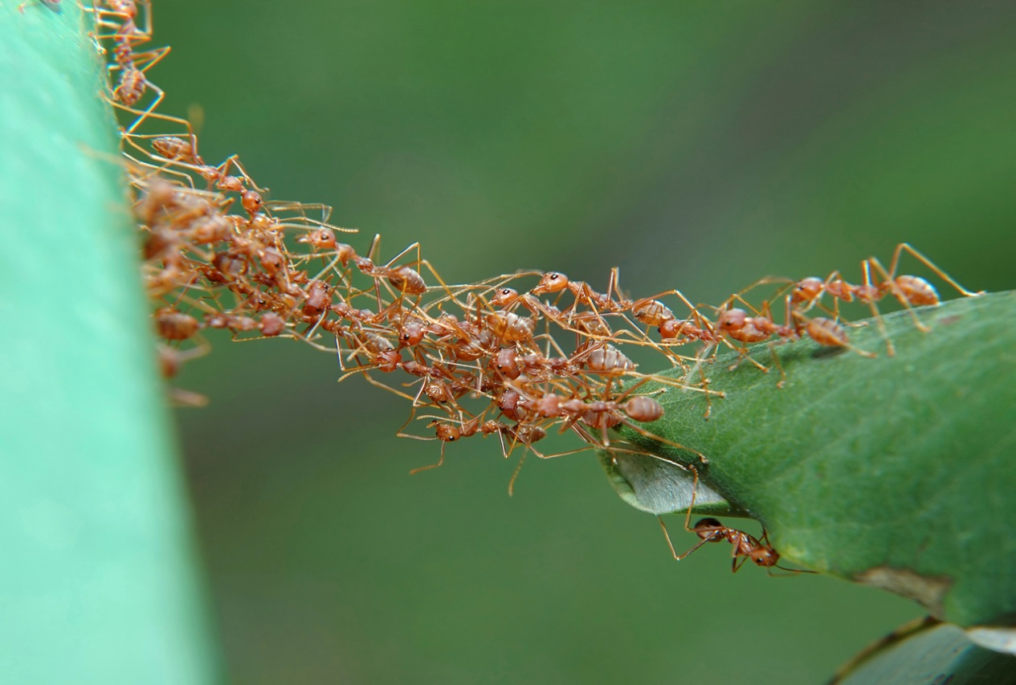
Thoughts? Comments? Suggestions?
COOPERATION
Photo by: Michelle D. Land

Slide 14
Clarification of Goals for Agricultural Coops
 | Ag Coop | Members | Non-member Producers
Coop Actual Value | X | - | -
Coop Value Portrayal | X (how and what) | - | -
Coop Value Perceptions | - | X | X
Producer Value Wants | X (think) | X | X

Slide 15
Consumer Perceived Value Scale
“Consumer’s overall assessment of the utility of a product based on perceptions of what is received and what is given” (Zeithaml, 1988)
Originally developed by Sweeney and Soultar as 19-item scale
Four Dimensional
Quality
Price
Emotional
Social value

