Slide 1
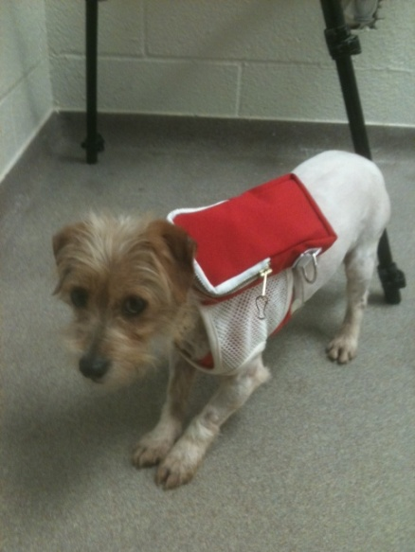
Pheromones and interomones that change heart rate and behavior of anxious dogs
W. Garrett Thompson and J. J. McGlone
Dept Animal and Food Sciences, Laboratory of Animal Behavior, Physiology and Welfare, Texas Tech University
July 18, 2012

Slide 2
Introduction
What are pheromones?
Pheromones are species-specific odors used in communication between a sender and a receiver (Karlson and Luscher 1959).
Certain pheromones (also called Kairomones) have been shown to operate across species and can either benefit or harm the sender or receiver.
The term interomone refer to a chemical that operates in a given species but will have very different effects on the receiver animal of a different species.

Slide 3
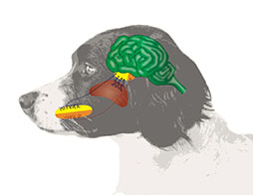
Introduction
How does a dog receive a pheromone?
Pheromones are taken into the dog by way of the vomeronasal organ and the main olfactory epithelium.
Liquids may not activate sensory neurons in the MOE and the olfactory bulb – they must be aerosols.
Notes:
The Vomeronasl organ must be accessed by trapping odors in the mucus of the vomeronasal epithelium and then being processed by the brain.
The Main olfactory epithelium can access odors by trapping them as the aerosol molecules pass on their way to the lungs. If a odor receptor is present ,the odor will settle on the receptor and a behavioral or physiological responses will occur

Slide 4
Objective
The objective of this study assess efficacy of pheromones/interomones to modulate heart rate and behavior in adult anxious dogs.

Slide 5
Materials and Methods
The dogs (8.1 ± 0.18 kg; estimated 5-12 yr intact males) were obtained from a local research facility.
Each dog was housed in a separately ventilated room with a minimum of 12 m² of floor space.
Heart rate (HR) and surface temperature were measured using telemetry system (Data Science International, St. Paul, MN).
Behavioral scan samples were used with a recording interval of 5 min over 24 h. At the end of the 24 h period for a given treatment, each dog was startled with a 110 db air horn approximately 12 cm from the dog’s head while behavior and heart rate were recorded.
Each dog received each treatment in a Latin square design with repeated measures over time. This model allowed evaluation of effects of treatment, dog, treatment by dog, time, treatment by time and dog by time.

Slide 6
Materials and Methods
Treatments Groups: administered in collar form.
Sergeant’s (SERG) pheromone collar,
2-methylbut-2-enal-Rabbit Pheromone (RP) collar
SERG+RP combined collar
Placebo/Control
Heart rate and behavior were evaluated in two phases:
A baseline or 24h period before the startle was administered.
A startle period after the initial 24h period in which the heart rate and behavior where measured for 2-3 hours.

Slide 7
Results: Heart Rate
Heart rate was changed by treatments:
Baseline 24h HR did not differ among treatments
Average = 110.1 ± 13.3 bpm)
When Startled, Rabbit Pheromone lowered (P < 0.01) HR compared to placebo
RP = 124.5 ± 7.2 bpm vs. Placebo = 157.8 ± 7.2 bpm.
The treatment by dog interaction (P < 0.01) indicated that certain dogs were more responsive than others.

Slide 8
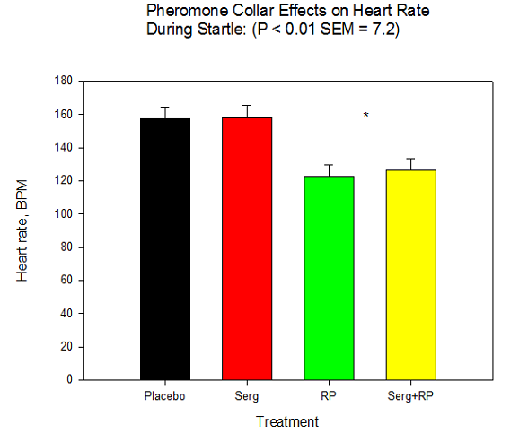
Heart rate: Main Effect of RP

Slide 9
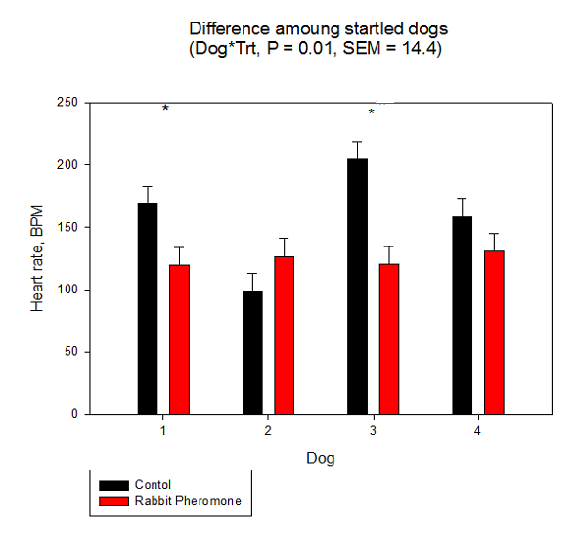
Heart rate: Dog*Treatment
Dogs 1 and 3 had lower HR with RP

Slide 10
Behavior
Dogs with Rabbit pheromone collars reduced the time spent pacing (P =0.05) and spent more time lying down (P = 0.04) compared to placebo-treated dogs (explains lower HR).
Over time RP dogs spent more time lying down over the 24h period (P = 0.004).
2/4 dogs spent less time pacing when treated with rabbit pheromone compared to placebo, while only one dog showed a significant decrease when treated with the Rp+Serg collar.
.

Slide 11
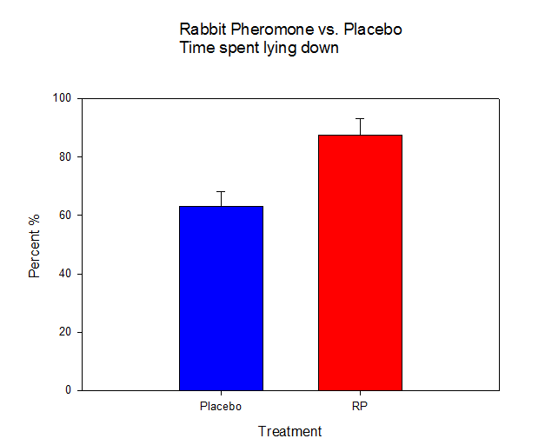
Behavior Increased lying down with RP, on average and over time (except mid day)
(P = 0.04, SEM = 8.76)
*

Slide 12
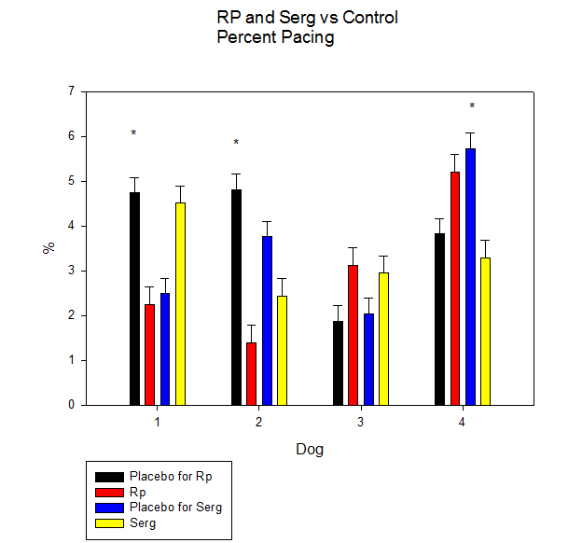
Behavior: Dog*Treatment

Slide 13
Startle Behavior
Time spent pacing, sitting, and lying were all effected during the startle period.
Rabbit Pheromone was the only pheromone that had an effect in behaviors (Pacing P = 0.04, sitting P = 0.002, and sitting over time P = 0.03)
Serg+Rp had the greatest increase in initial sitting behavior after startle.

Slide 14
Startle Behavior

Slide 15
Startle Behavior

Slide 16
Conclusions
Behavior and physiology (HR) can be used to assess dog responses to pheromones and interomones.
The RP was most effective at lowering HR and changing the behavior of anxious dogs.
The significant dog*treatment interaction indicated that anxious dogs responded differentially to the RP

