Slide 1
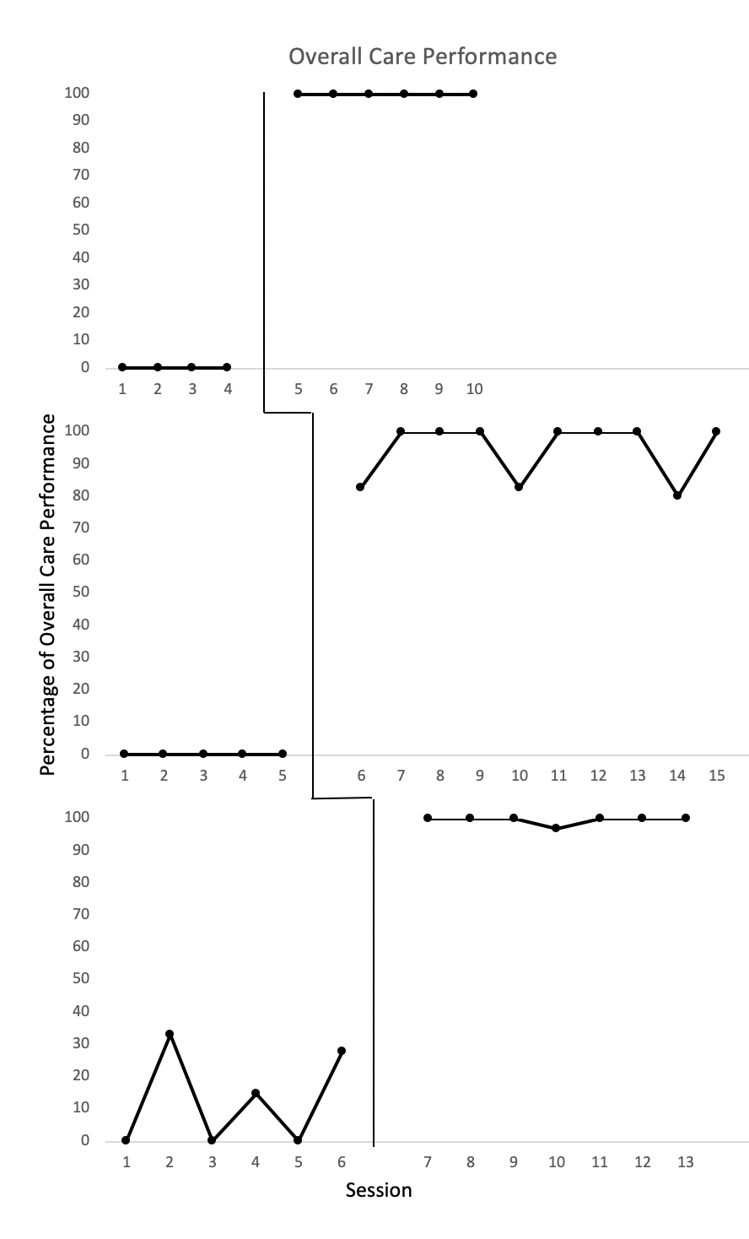
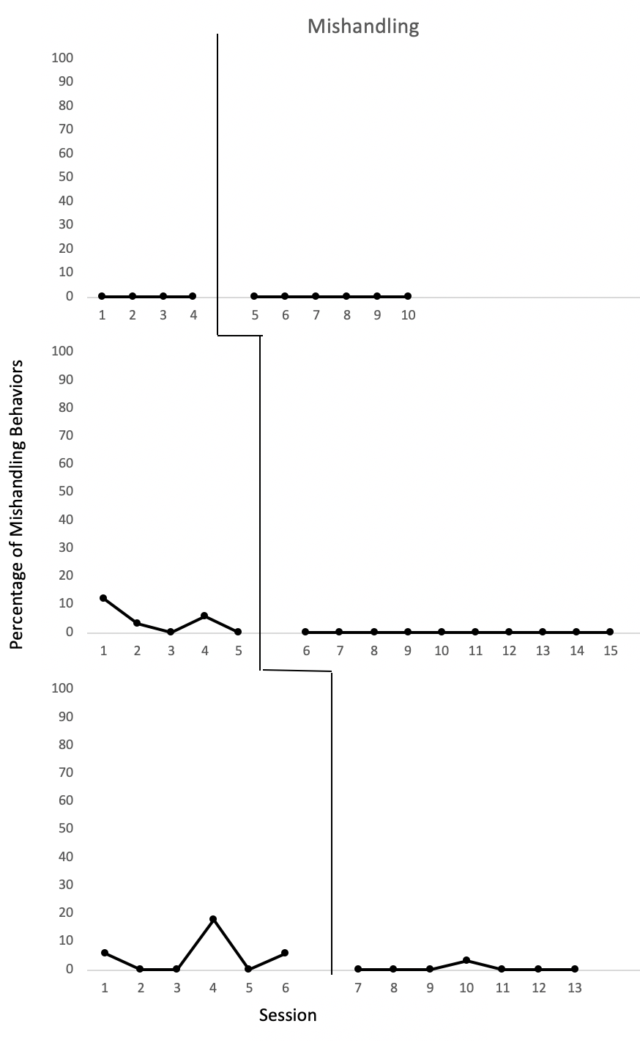
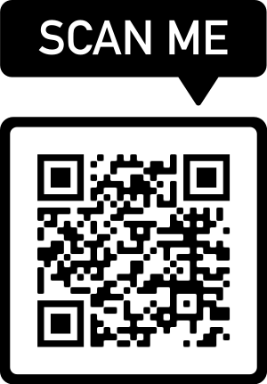
Behavior Skills Training to Increase Parenting Skills of Adults with Developmental Disabilities
Katy Wheeler, M.Ed., BCBA, Jennifer Hamrick, PhD, BCBA, Amanda DiGangi, PhD, BCBA, Nikkolina Prueitt, M.Ed., BCBA
Introduction
It is often the case that individuals with developmental disabilities do not receive adequate sexuality education during their formative years (Schaafsma et al., 2017), yet there is still an underlying desire for relationships and marriage (Healy et al., 2009). Thus, the purpose of the current study is to determine if Behavior Skills Training (BST) combined with the use of infant simulators increase parenting skills of adults with developmental disabilities.
Methods
Participants and Setting
Sukai – 20, ASD
Holly – 22, ASD, CP
Maggie – 23, ASD
Sessions took place in a mock apartment with an infant simulator
Procedures
Participants were recruited and provided informed consent
Infant simulators were programmed to simulate real-life infant needs
Baseline conducted – no training
BST conducted across four infant behaviors (rocking, burping, diapering, feeding) and data was collected post-training.
Results
Data was collected through the infant simulator software, RealCare Baby®.
Sukai:
Baseline – 0% accurate responding in Overall Care Performance (OCP); 0% mishandling behaviors (MB)
Intervention – 100% OCP; 0% MB
Holly:
Baseline – 0% OCP; 4.2% MB
Intervention – 94.6% OCP; 0% MB
Maggie:
Baseline – 12.6% OCP; 5% MB
Intervention – 99.5% OCP; 0.4% MB
Limitations/Future Research
Limitations include lack of generalization into the home setting to ensure the capability to generalize learned skills in a more familiar environment. Future research should consider extending into the participants’ daily lived experiences.
A combined approach using technology and behavioral skills training demonstrated positive impacts on parenting behaviors of young adults with developmental disabilities
Ab
Sukai
Sukai
Holly
Holly
Maggie
Maggie

