Slide 1
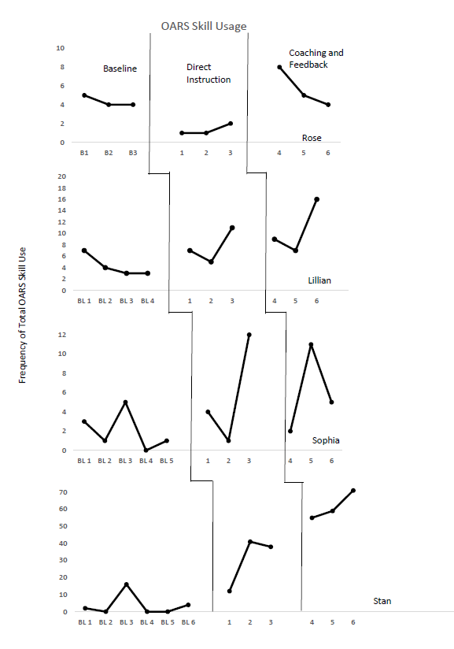
Direct Instruction/Feedback to Increase Therapy Process Skills when Providing Behavior Analytic Services
Amanda Hampton M.Ed., BCBA, Jennifer Hamrick Ph.D., BCBA, Katy Wheeler M.Ed., BCBA, Nikkolina Prueitt M.Ed, BCBA, and Alexis Favela M.Ed., BCBA
Background
Practitioners who practice in the field of Applied Behavior Analysis (ABA) are often stereotyped as being arrogant and judgmental (Freedman, 2016). Although ABA strives for effective treatment when treating individuals with autism spectrum disorder (ASD), research shows that parents will favor a therapeutic relationship with a warm and empathetic therapist over an effective treatment process and outcomes for their child (Chadwell et al., 2019).
The use of open-ended questions, affirming statements, reflective statements, and summarizing statements (OARS) (Rollnick & Miller, 2012), can help with this communication process for our practitioners. This study evaluated the use of OARS skills after direct instruction and in-vivo coaching and feedback among four graduate students who were providing services to parents of and/or individuals with ASD.
Results demonstrate all participants increased in their use of the OARS skills when working with parents of and/or individuals with ASD either after direct instruction or in-vivo coaching and feedback.
Methods
Participants:
4 participants, Age Range: 25-50 years
Masters-Level Students
Working with parents of children with ASD via telehealth or directly with adults with ASD
Procedures
Design: Multiple baseline across participants
Baseline: OARS skills were operationally defined and participants use of skills prior to direct training was observed
Intervention:
Direct instruction: Training using a Behavioral Skills Training approach followed by observation of skills in participants service delivery setting
Coaching and Feedback: Observation of skills while receiving direct coaching and feedback through bug-in-ear technology
Data Collection:
Frequency of OARS skills
Observed participant during natural service delivery opportunities
Inter Observer Agreement (IOA):
Conducted using a total count IOA method
Total Mean IOA: 91%
Research in other fields support that the therapeutic process is important. This study provided positive results for three out of four participants’ use of OARS skills when working with parents of and/or individuals with ASD after receiving direct instruction followed by in-vivo coaching and feedback.
Results
Rose: Decrease in OARS immediately following direct instruction with an average total frequency of 1.33 during direct instruction. Overall increase in average total to 5.67.
Lillian: Increase from baseline with an average frequency of 7.67 during direct instruction. Overall average total frequency of 10.67.
Sophia: Increase from baseline with an average frequency of 5.67 and slight increase during coaching to an average of 6. Continued coaching and feedback at increase intensity due to variability in responding.
Stan: Increase in OARS during direct coaching and feedback with an average total frequency of 61.67.
Limitations
The impact of participant’s setting events throughout the duration of the study on their use of OARS skills. An example is seen within Rose’s responding with the potential of a looming graduation and upcoming move.
Future Research
Gather additional information on the impact of the use of process-based OARS skills from perspective of the children, parents or clients with whom they are being used. This would provide insight on how the use of OARS skills are being received by the individuals and caregivers that are receiving treatment.
This work was supported in whole or in part by a grant from the Texas Higher Education Coordinating Board (THECB). The opinions and conclusions expressed in this document are those of the author(s) and do not necessarily represent the opinions or policy of the THECB.

