Slide 1
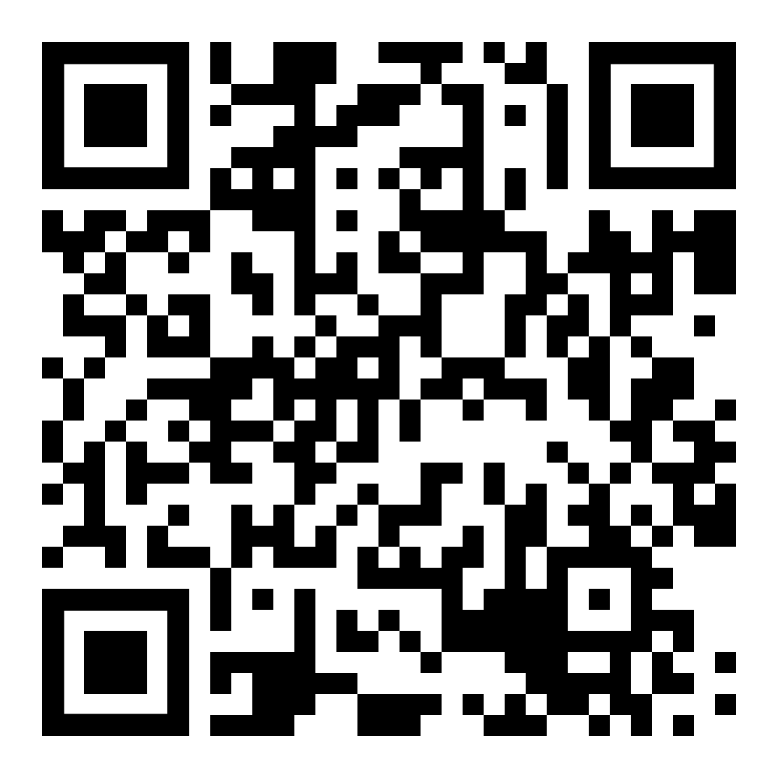
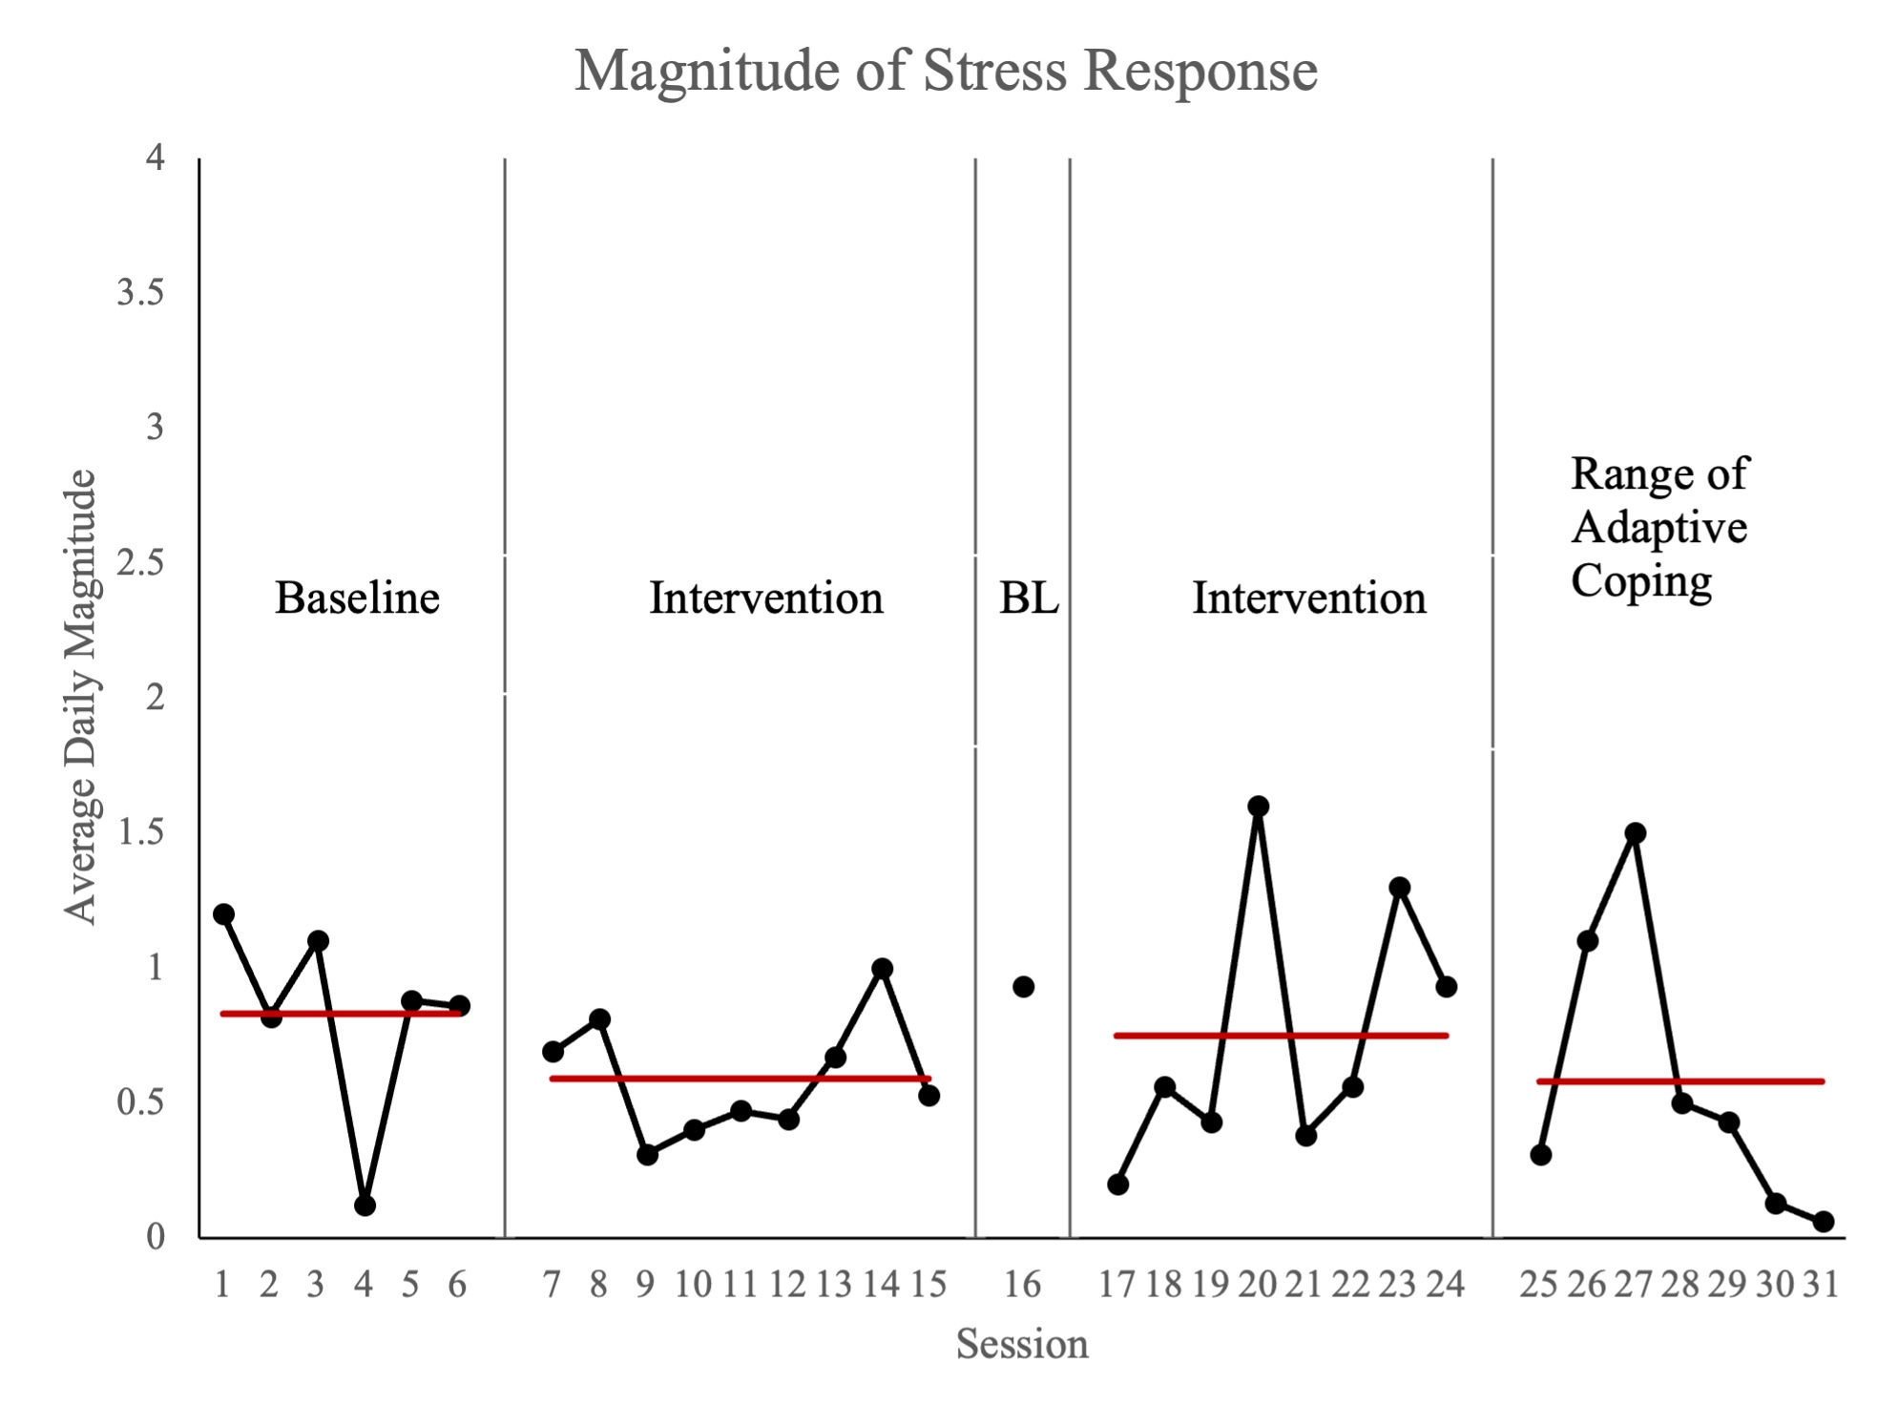
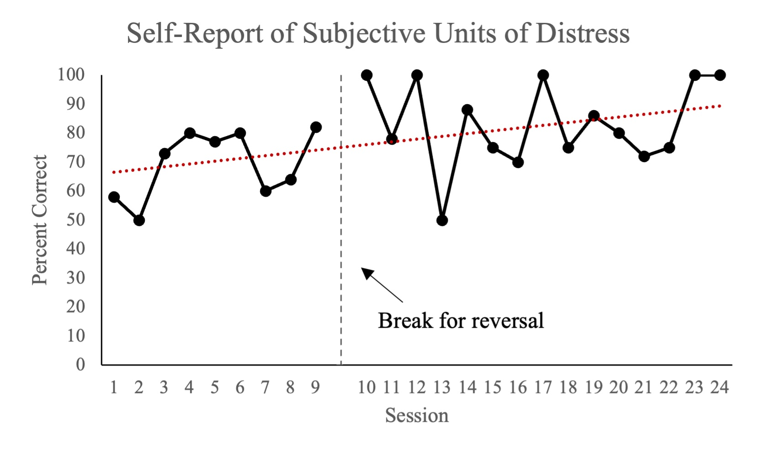
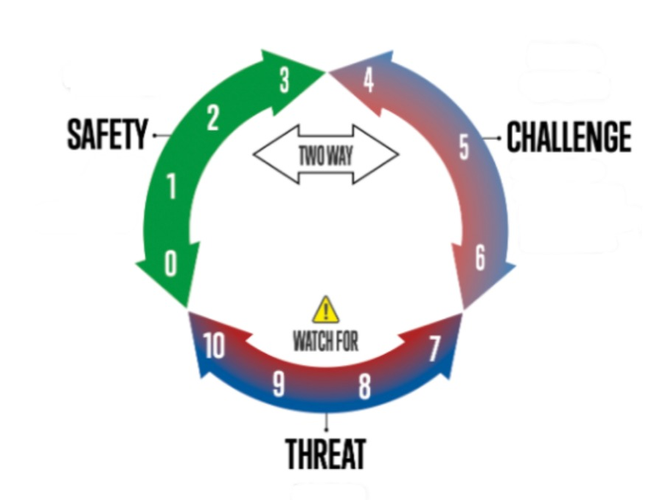
Safety- Challenge- Threat: A Pilot Package Geared Toward Building Regulation in One Adult with Autism
Katy Wheeler, M.Ed., BCBA, LBA, Mary Kathryn Dillard, M.A BCBA, LBA , Jennifer Hamrick, PhD, BCBA-D, Shayla Bozarth (Presenting Author), Emily Faz,
Jennifer Hixson, PsyD, BCBA
ABSTRACT
Regulation and modulation is often a skill area that individuals experience challenges with throughout their lifespan. Specifically, some individuals may have barriers to identifying their own complex emotions and responses that may correspond to challenging situations. Further, individuals with autism might experience negative emotionality under certain conditions due to the absence of previous intervention on teaching explicit behavioral and coping strategies when said contexts arise. This project introduced the Neurorelational Framework’s safety-challenge-threat paradigm to one young adult on the autism spectrum through the use of a treatment package that included behavioral skills training (BST), in vivo coaching, and visual aids. A reversal design was implemented to investigate the impact of the aforementioned treatment package on the participant’s stress response.
METHOD
Participant
29-year-old White female with ASD, hypothyroidism, ADHD, disruptive mood dysregulation disorder, and GAD, as determined by records review
Uses fluent, complex speech (English)
Participant assented to the process
Procedures
Research Design:
Reversal (ABAB)
Dependent Variable:
Daily average magnitude of stress response/dysregulation
Independent Variable:
A multi-step procedure:
Triad introduction (see graphic) via BST, check-ins from staff (opportunities to practice the skill) with graphic
Introduced to interoceptive cues (body signals)
Concurrent introduction to a range of adaptive coping through BST with an added social narrative.
Data Collection
Magnitude of Stress Response:
Modified partial interval system.
Self-Report of Subjective Units of Distress:
Percentage of accurate self-reported subjective units of distress.
While no significant difference in reduction of the student's average magnitude of distress was indicated during the first phase, this pilot package yielded an increase in the identification of subjective units of distress as a prerequisite for engagement and intervention on the adaptive range of coping as a next step toward building modulation.
RESULTS
No functional relation between DV and IV in Phase I.
At baseline, average stress response magnitude was .83.
At the first intervention introduction, she averaged .59.
A one-day reversal yielded .93, and
A subsequent intervention phase resulted in an average of .81.
The client was introduced to the range of adaptive coping and interoceptive skills in session 25. This phase has yielded a .58 average stress response magnitude and a decreasing trend.
Identifying Subjective Units of Distress (SUDs)
After BST -- 58% accuracy and an increasing trend with the final two data points at 100% accuracy.
Qualitative Instructor Data
"[Client] asked to go out to the playground and is taking laps on her own 🤘🏻 and she also this morning asked to go for a walk..."
"I have noticed on a couple of occasions she has asked an individual...their color number and verified with a teacher that the way she described that color number was correct."
"She is interested and asking questions about the intervention. I have also seen her recently talk about the way her body feels since ... working with her on this."
DISCUSSION
Next Steps
Interoceptive work is being introduced through DTT
Range of adaptive coping presented in sessions 25-31
Challenges/Setting Events Experienced Throughout Intervention:
Lives in a group home
Overnight visits with two separate caregiver home settings
Routinely loses items deemed important
Menstrual Cycle
Limitations
No functional relation in first phase of IV
Possible difficulty with alignment of a third party (i.e., instructor) and the client when identifying SUDs.
Future Research
Future research should investigate
The effects of this technology on different settings, such as home, school, or job sites,
The effects of this technology on behavior reduction, and
Its impacts on independent living and vocational skill acquisition.
Figure 1. Client stress response (average magnitude).
Figure 2. Client self-report data on subjective units of distress
Figure 3. Safety-Challenge-Threat triad visual from the NRF
Notes:
Data collection: Each number/color (see graphic) was trained via BST using multiple exemplars. In other words, the student provided her response, and an instructor verified the accuracy across "check-ins" throughout each day.
While no baseline data was collected, given the knowledge that the client had never been exposed to subjective units of distress and would therefore be unlikely to respond to the instruction, the client began checking in,

