Slide 1
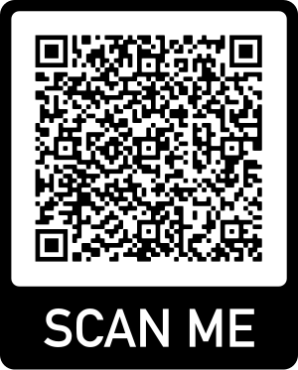
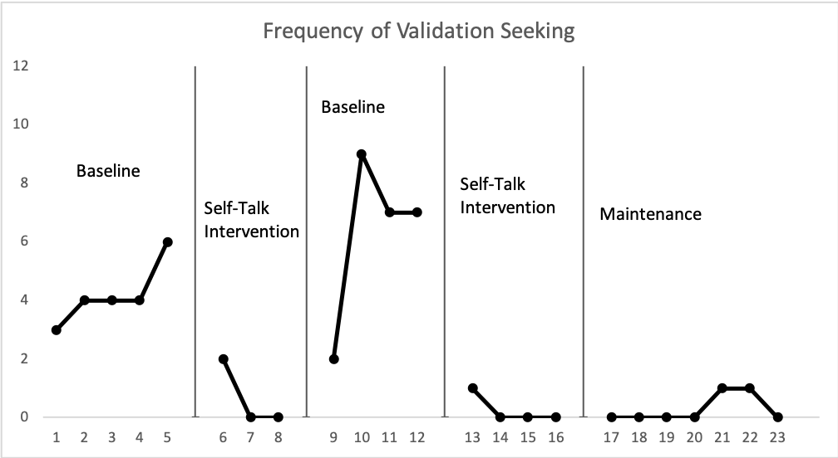
A Preliminary Look at Self-Management and Self-Talk to Decrease Validation Seeking in a Young Adult with Autism
Katy Wheeler, M.Ed., BCBA, Jennifer Hamrick, PhD, BCBA, Alexis Favela, M.Ed., BCBA
Introduction
The use of positive self-talk contributes to effective self-regulation and self-control and is helpful for impeding impulses, making purposeful decisions, and self-monitoring (Mischel et al., 1996).
Self-management has been found to be an effective tool for individuals with autism to control one’s own behavior and increase adaptive behavior (Lee et al., 2007).
The current study utilized a reversal design to determine the impact of positive self-talk, measured through collected self-management data, on validation seeking (VS) statements in one individual with autism at their job site.
Methods
Participant and Setting
One young adult with autism, aged 22.
All sessions took place at their vocational internship site.
Procedures
The goal of decreasing VS statements was generated by the participant
Appropriate self-talk statements that were a match to the participant were made.
Behavioral skills training was implemented to teach both the use of self-talk statements and the self-management form.
Results
Data was collected on the frequency of VS statements.
VS across baselines averaged 5.1 occurrences per shift. After implementing the self-management tool and self-talk intervention, VS decreased to an average of 0.43 occurrences per shift.
Maintenance was collected in which the participant continued to self-monitor without support services from the practitioner, and they maintained low rates (average of 0.29 per shift).
Mean IOA was collected in 37.5% of sessions and averaged 91.67%.
Limitations/Future Research
Limitations include lack of generalization training of the self-management skills to other potential job sites to ensure self-talk and self-management continue to be implemented by the participant in various settings.
Future research should consider extending the self-talk and self-management across different job sites.
Preliminary data demonstrates that positive self-talk taught in tandem with self-management strategies can decrease validation seeking statements in a young adult with autism during their employment.
Participant Data
Frequency of Validation Seeking Statement Use
Session
"Thank you very much. I love my intern ship and I am doing well."
-Participant on Social Validity Survey

