Slide 1
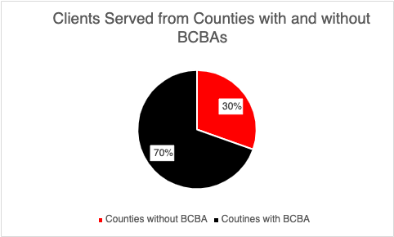
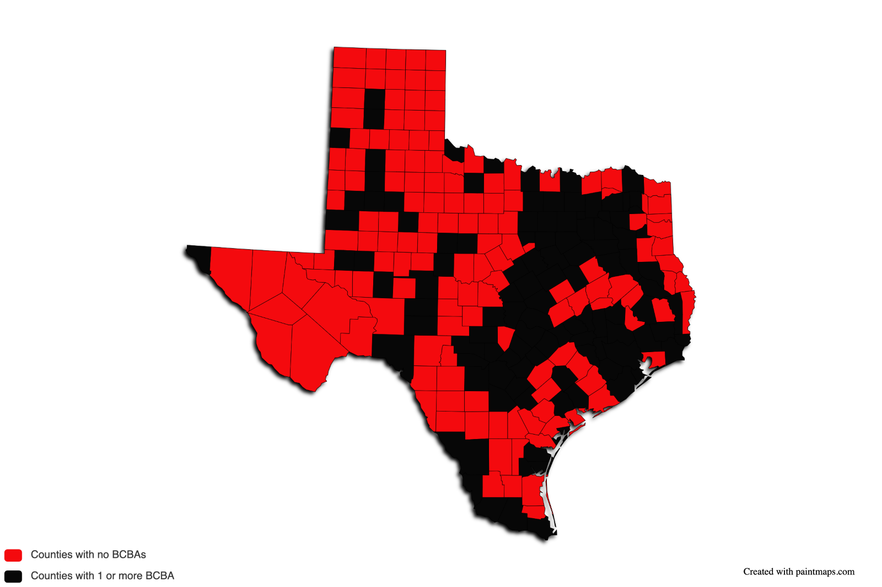
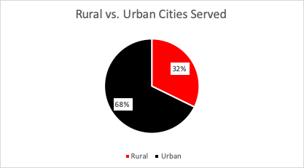
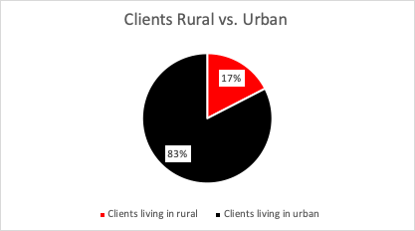
Mobile and Telehealth Outreach Clinic for Autism: Providing Supports and Services to Families Throughout Rural Texas
Lynne Hyman, M.Ed., BCBA; Madeline Fricke, RBT (Presenting Author); Jennifer Hamrick, PhD, BCBA; Alexis Favela, M.Ed., BCBA; Alyia Jeantet, BA; Devender, Banda, PhD, BCBA-D
ABSTRACT
Although the number of Board-Certified Behavior Analysts (BCBAs) working within the field of Applied Behavior Analysis is increasing at a rapid rate, aggregated data indicates many counties in the United States are lacking access to behavior analytic services provided by BCBAs (Yingling et al., 2020). Texas, following this trend, has 3,380 BCBAs; however, most are concentrated in urban areas leaving 58% of Texas lacking a BCBA within their county (BACB, 2023). The Mobile and Telehealth Outreach Center for Autism (MTOCA) is an innovative intervention model focusing on parent-implemented intervention (PII) for clients of all ages with a diagnosis of autism who live in the state of Texas. The goal of the program is to educate and support parents in developing the skills warranted to provide critical interventions to their children with autism living in rural and underserved areas of Texas. Of the families currently participating, 30% are located within counties with no access to BCBAs within their county.
KEY PROBLEM
Due to a lack of BCBAs in rural counties in Texas, families have little to no resources to support a growing need for behavior analytic approaches and interventions within their home and community.
IMPACT OF PROJECT
A behavior skills training approach is employed to educate parents to implement the intervention to fidelity within their home or community. The families will then be able to utilize behavior analytic strategies to increase necessary skills for their child's independence while decreasing problem behaviors.
PROCEDURE
Consent: BCBA will meet with parent/guardian to explain the procedures and obtain consent
Assessment: An in-person or virtually conducted Vineland-III Assessment and Functional Assessment Interview (FAI) is completed with the parents and BCBA to identify current behavior challenges.
Baseline: Parents submit videos or in-situ Zoom sessions to obtain baseline direct observation data on potential target skill.
Action plan: Upon conclusion of assessment and baseline direct observation data, the parent and BCBA will review a report to note the action plan and goals for both the parent and the client involved in the intervention.
Parent training: The parent then participates in 3-5 sessions of parent training presented in a Behavior Skills Training format until the parent is completing the intervention with 80% mastery or higher.
Parent Implemented Intervention: Implementation sessions with parent, child and BCBA for 30 minutes to an hour until the target skills have reached mastery criterion.
After intervention, parents receive a treatment report discussing progress, results & recommendations moving forward.
A month after completion of services, the BCBA will set a maintenance session with parent & child for follow up.
Data from the ongoing intervention model suggests that using parent-implemented interventions (PII) to implement behavior analytic services to support families in underserved counties of Texas provides increased access to resources and interventions necessary to help increase independence and daily living skills.
Figure 1: Demographic data indicates 30% of families enrolled in the Mobile and Telehealth grants (both currently and in the past) are from counties without a BCBA in their county.
BCBAs in Texas by County
Figure 2: Demographic data indicates out of 31 different cities in Texas served by the grants (both current and past), 32% of families are from cities considered rural based on a population of less than 5,000 people.
Figure 4: Current data, as of 4.21.23, from the BACB certificant registry indicates that of the 254 counties in Texas, only 107 of them have at least one registered BCBA. Fifty-eight percent of counties in the state of Texas do not have access to a BCBA within their county boundaries.
Figure 3: Demographic data indicates out of 86 clients enrolled in the grants (both current and past), 17% of participants are from Texas cities considered rural based on a population of less than 5,000 people.
This work was supported in whole or in part by a grant from the Texas Higher Education Coordinating Board (THECB). The opinions and conclusions expressed in this document are those of the author(s) and do not necessarily represent the opinions or policy of the THECB.

