Slide 1
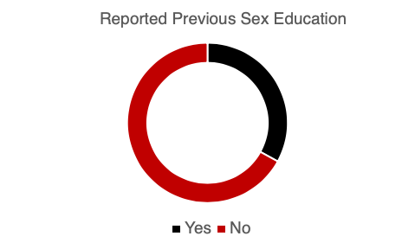
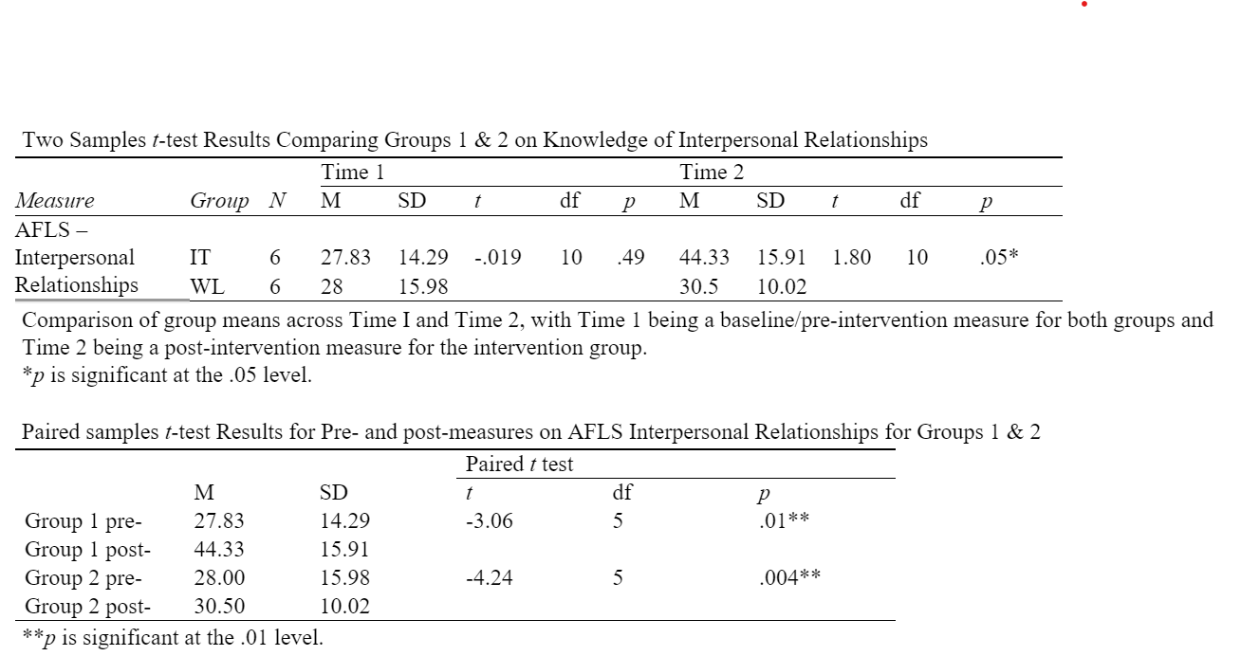
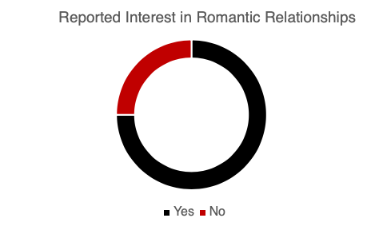
LET'S TALK ABOUT: SEXUALITY AND RELATIONSHIPS
Katy Wheeler, M.Ed., BCBA, Mary Kathryn Dillard, M.A., BCBA (presenting author), Alexis Favela, M.Ed., BCBA,
and Jennifer Hamrick, PhD, BCBA
Introduction
People often have an innate interest in both platonic and romantic relationships. In fact, feelings toward sexuality and sexuality education do not differ between various populations (Hannah and Stagg, 2016). However, there are few sexuality education curricula that exist specifically tailored for individuals with developmental disabilities and many professionals have limited knowledge about how to present sexuality education content (Wolfe et al., 2019). The current project sought to investigate the benefits of a specially tailored socio-sexuality curriculum on the interpersonal relationship knowledge as measured by the Assessment of Functional Living Skills (Partington & Mueller, 2015).
Methods
Participants:
12, 18–30-year-old individuals with ASD.
Age M = 22.08, SD = 2.07
92% reported interest in adult friendships
75% reported interest in adult romantic relationships
33% reported previous sexuality education
Measures:
Assessment of Functional Living Skills (AFLS) Independent Living Protocol
Interpersonal Relationships Domain
33 questions totaling 74 points
Intervention:
Direct instruction over OAR Sex-Ed Guide for Self-Advocates
Data Analysis:
Paired and independent t-tests
Results
Baseline =
Group 1: M = 27.83, SD = 14.29;
Group 2: M = 28.00, SD = 15.98;
t(10) = -.019, p = .49
Independent-samples t-test @ Time 2:
Group 1: M = 44.33, SD = 15.91
Group 2: M = 30.5, SD = 10.02;
t(10) = 1.803, p = .05.
Paired samples t-test (pre-post):
Group 1: t(5) = -3.06, p = .01
Group 2: t(5) = -4.24, p = .004.
Limitations/Future Research
Future research should consider replication of the direct instruction intervention to determine effects in a larger sample. Expansion of the curriculum to include opportunities for generalization of skills and knowledge should be considered. Limitations include lack of generalization of behavioral repertoires versus simply knowledge gains. Future research should consider opportunities to safely implement opportunities for skill use.
Preliminary data indicates that direct instruction using a specifically tailored sexuality education curriculum yields positive gains in interpersonal relationship knowledge for young adults, as measured by the Assessment of Functional Living Skills.

