Slide 1
Self-Assessment Questionnaire (SAQ)
Which one is right for my environment?

Slide 2
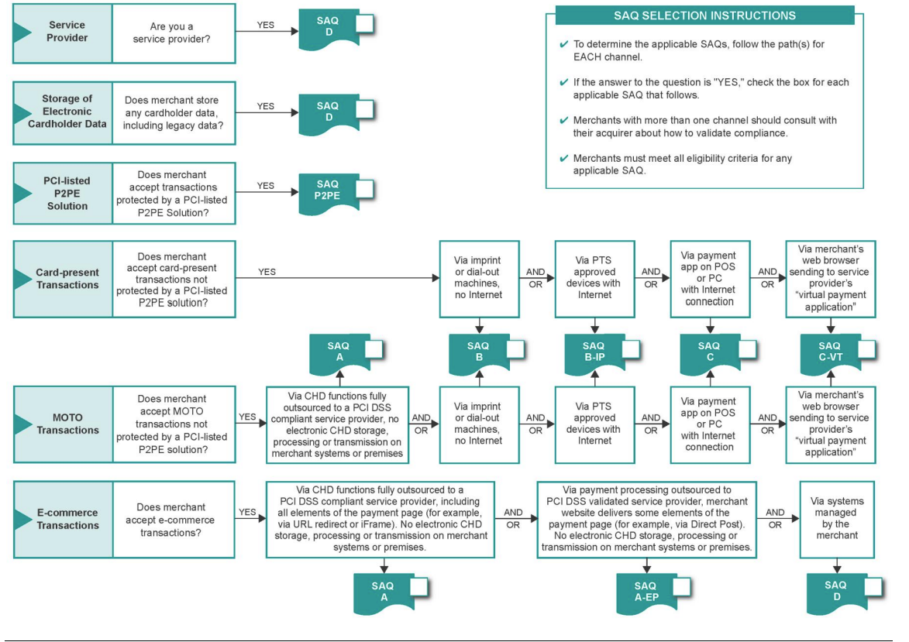
Which SAQ??

Slide 3
Point-to-Point Encrypted (P2PE)
P2PE: Merchants using only hardware payment terminals that are included in and managed via a validated, PCI SSC-listed P2PE solution, with no electronic cardholder data storage
Not applicable to e-commerce channels
Find PCI DSS validated Point-to-Point Encryption Solutions at www.pcisecuritystandards.org

Slide 4
Card Present

Slide 5
Card Present
SAQ B: Standalone dial out terminals with no electronic cardholder data storage (NO INTERNET)
Not applicable to e-commerce channels
SAQ B-IP: Merchants using only standalone, PTS-approved payment terminals with an IP connection to the payment processor, with no electronic cardholder data storage
Not applicable to e-commerce channels

Slide 6
Card Present
SAQ C: Merchants with payment application systems connected to the Internet, no electronic cardholder data storage
Not applicable to e-commerce channels
SAQ C-VT: Merchants who manually enter a single transaction at a time via a keyboard into an Internet-based virtual terminal solution that is provided and hosted by a PCI-DSS validated third-party service provider, no electronic cardholder data storage
Not applicable to e-commerce channels

Slide 7
Mail/Telephone Order (MOTO)

Slide 8
Mail/Telephone Order (MOTO)
SAQ A: Card-Not-Present merchants that have fully outsourced all cardholder data functions to PCI DSS validated third-party service providers, with no electronic storage, processing, or transmission of any cardholder data on the merchant’s systems or premises
Not applicable to face-to-face channels
SAQ B: Standalone dial out terminals with no electronic cardholder data storage (NO INTERNET)
Not applicable to e-commerce channels

Slide 9
Mail/Telephone Order (MOTO)
SAQ C: Merchants with payment application systems connected to the Internet, no electronic cardholder data storage
Not applicable to e-commerce channels
SAQ C-VT: Merchants who manually enter a single transaction at a time via a keyboard into an Internet-based virtual terminal solution that is provided and hosted by a PCI-DSS validated third-party service provider, no electronic cardholder data storage
Not applicable to e-commerce channels

Slide 10
E-commerce

Slide 11
E-commerce
SAQ A: Card-Not-Present merchants that have fully outsourced all cardholder data functions to PCI DSS validated third-party service providers, with no electronic storage, processing, or transmission of any cardholder data on the merchant’s systems or premises
Not applicable to face-to-face channels

Slide 12
E-commerce
SAQ A-EP: E-commerce merchants who outsource all payment processing to PCI DSS validated third parties, and who have a website(s) that doesn’t directly receive cardholder data but that can impact the security of the payment transaction. No electronic storage, processing, or transmission of any cardholder data on the merchant’s systems or premises
Applicable only to e-commerce channels
SAQ D: All merchants not included in descriptions for the above SAQ types

Slide 13
Questions
If you have any questions or need assistance verifying the appropriate SAQ(s) for your payment card environment, please contact Cash and Credit Management Services (CCMS).
Phone: 806-742-3271
Email: cash.credit.services@ttu.edu
Information obtained from PCI DSS Self Assessment Questionnaire Instructions and Guidelines, v3.2 SAQ-InstrGuidelines-v3_2.pdf (pcisecuritystandards.org)

