Slide 1

Graduate Orientation
-Fall 2021

Slide 2
Agenda
Welcome & Introductions Dr. Botte & Dr. Chen 8:45-9:00
Graduate Handbook Dr. Chen 9:00-9:45
Break (picture) 9:45-10:00
Departmental Expectations Dr. Botte 10:00-10:30
Library Resources Erin Burns 10:30-11:00
Safety Overview Prof. Chijuan Hu 11:00-11:30
Grad. Student Discussion Graduate Students 11:30-11:45
Q&A Graduate Students 11:45-12:00
Meet & Greet CHEGSA 12:00-1:00

Slide 3

Welcome!
We are pleased to welcome you to Texas Tech University and the Chemical Engineering family!

Slide 4
Graduate Handbook
https://www.depts.ttu.edu/che/grad/documents/GraduateHandbook_May_2021.pdf

Slide 5
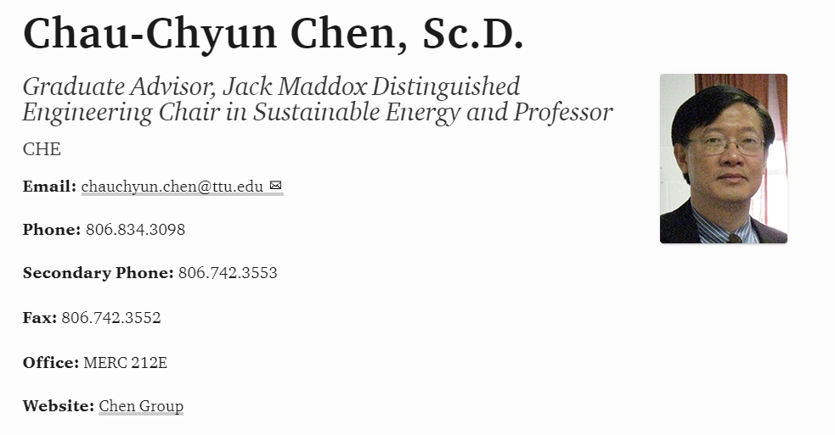
Graduate Handbook

Slide 6
Vacation policy for Ph.D. students
Ph.D. students are eligible for vacation days listed on
TTU Holiday schedule
  Additional vacation days require written permission from
  advisor (via email)
  Failure to obtain written permission → salary loss or suspension
  from graduate program
Advisor – Student Conflict
Discuss with Graduate Advisor
Students of Graduate Advisor discuss with Dept. Chair

Slide 7
Work schedule, professionalism, ethics
Work hard and smart
Communicate well (do not assume)
Be collegial to fellow students, faculty and staff
Respond to emails (even if you do not know the answer!)
Acquire, Analyze, Report and Present data truthfully (do not fudge!)
Challenge yourself and the thesis advisor!
Get to know Student Wellness Center

Slide 8
Department resources
Office staff
  Jeffrey Rammage – keys, travel reimbursement, credit-card
  purchases, reserving conference rooms
  Patricia Mccaleb – Tuition waivers, stipend, techbuy issues
  Kristina Thompson – Course work & PhD program related issues
      add/drop course, update grades, graduation
Printing – dept printer only for TA duty
Grad student kitchen – microwave, fridge etc. (IMSE_200A)
Grad Student Association (ChEGSA)

Slide 9
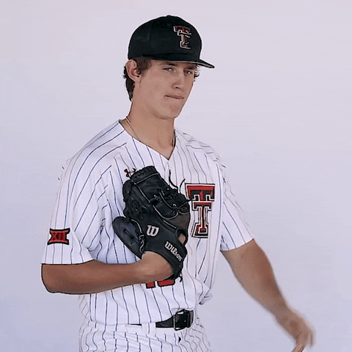

Break!
Let’s take a picture of the 2021 ChE Graduate Student Class

Slide 10
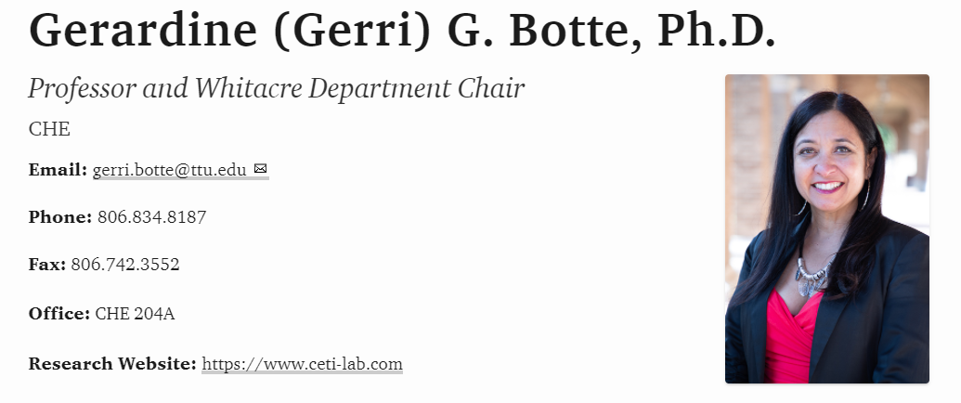
Departmental Expectations

Slide 11
Discussion
Why are you attending graduate school?
What is the difference between undergraduate and graduate education?

Slide 12

Departmental Expectations
Mission
Educate, conduct pioneering research, and disseminate ChE knowledge and innovation through internationally recognized programs for the benefit of society
Vision
Be globally renown for our excellence in engineering, discovery, and innovation

Slide 13
Departmental Expectations
Papers & Presentations
Graduate Commitment to Research
TA Commitment & Expectations
Leadership
Community of Scholars

Slide 14
F.R.A.L.S.
Family, the Red Raiders working together side by side to solve major problems in the world
Research, academics, entrepreneurship and innovation seamless integrated
Academics, creating a learning environment for sustainable education
Leadership, empowering activities to evolve as global leaders
Safety an integral part of our culture

Slide 15
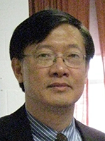
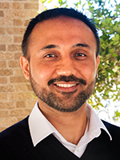
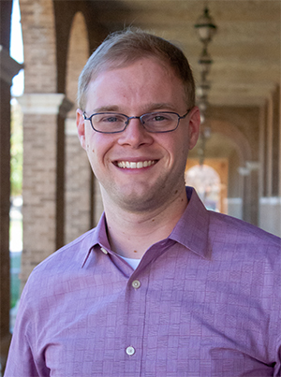
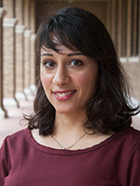
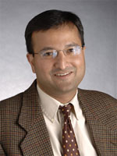
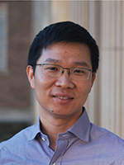
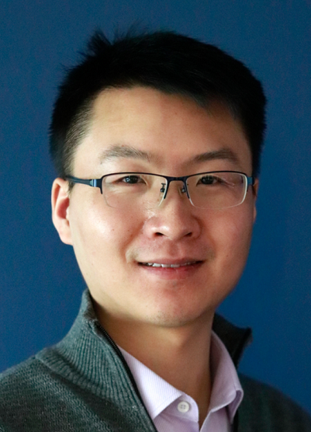
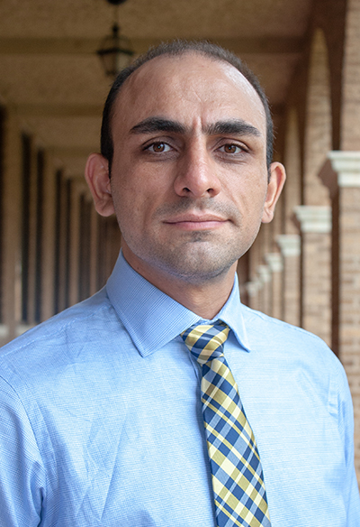
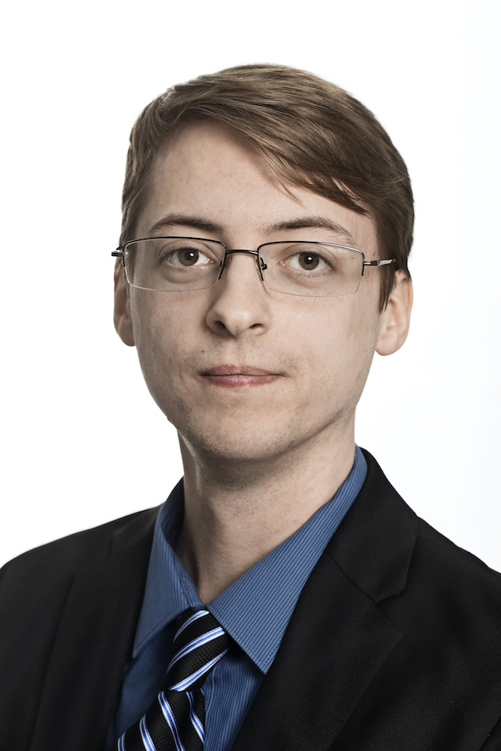
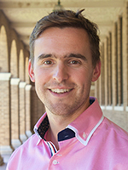
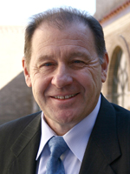
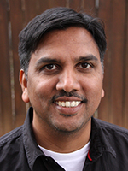
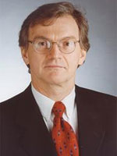
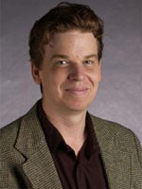
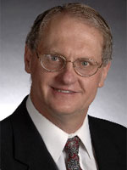
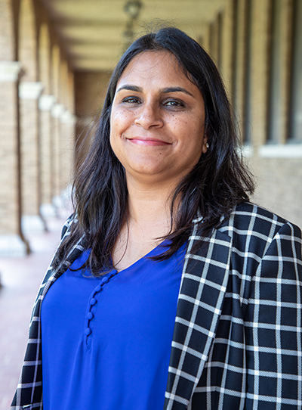
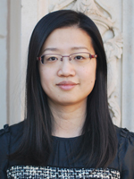


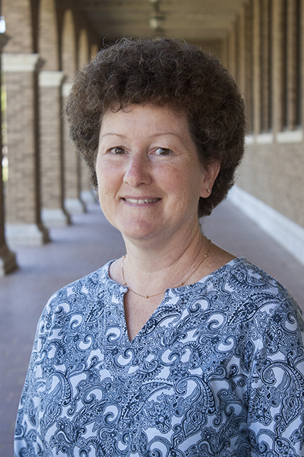
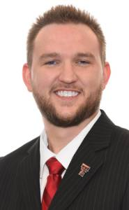
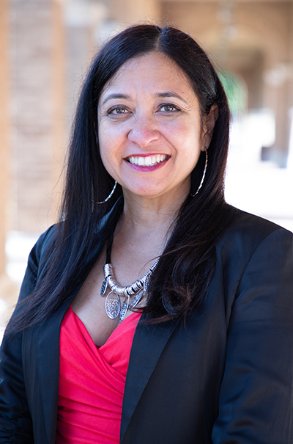

CHE Faculty & Staff

Slide 16

Library Resources
https://www.depts.ttu.edu/library/

Slide 17
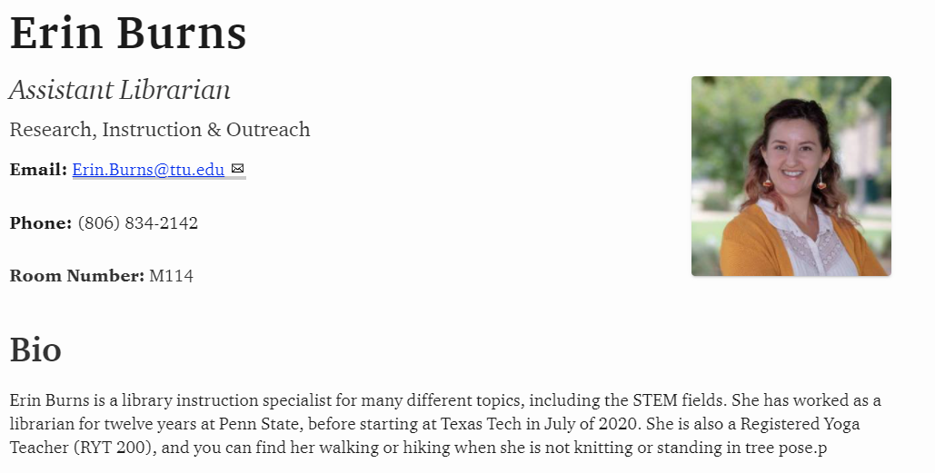
Library Resources

Slide 18
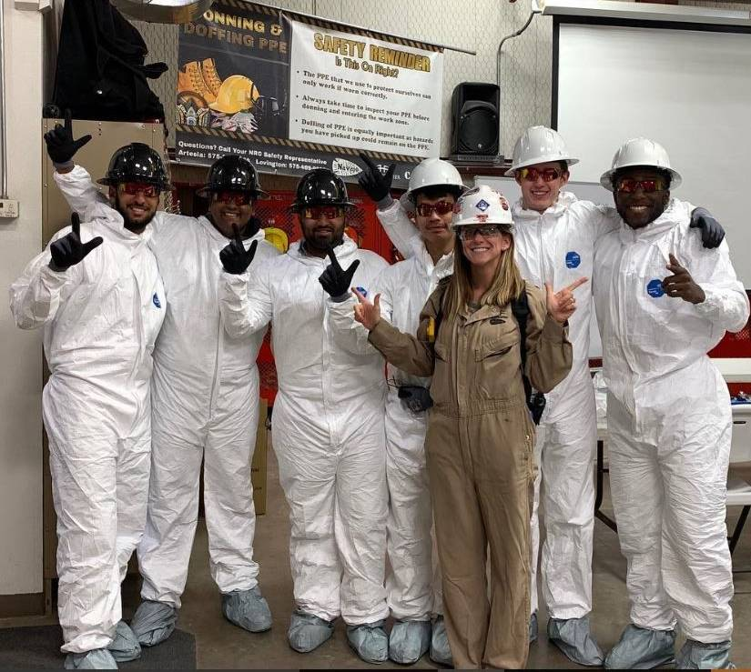
Safety Overview https://www.depts.ttu.edu/che/safetyplan.php

Slide 19
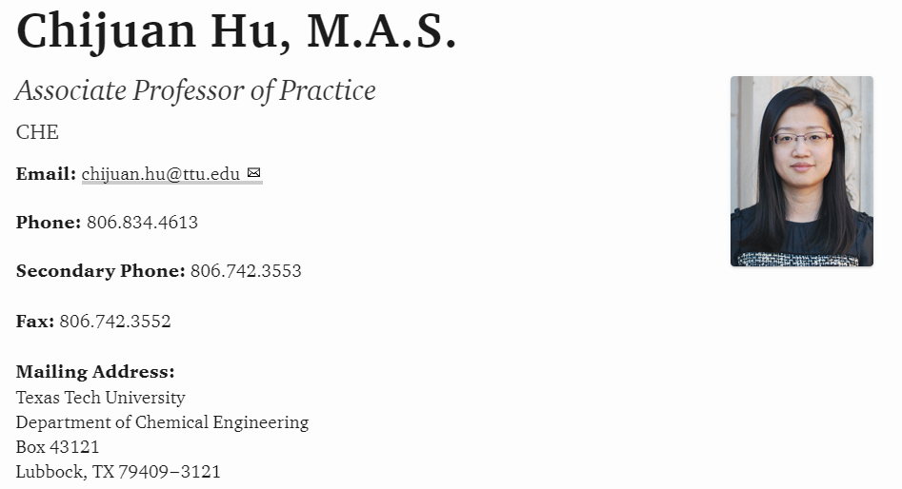
Safety Overview

Slide 20
Graduate
Student
Discussion

Slide 21

Questions?

Slide 22
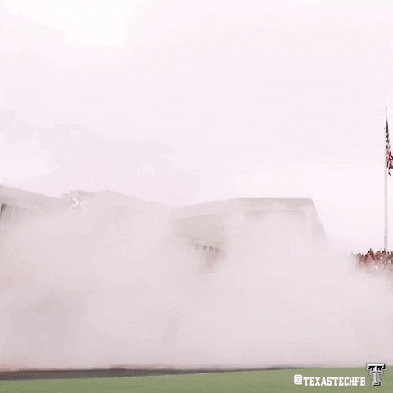
Thank you!
Let’s go eat!

