Slide 1
Creating an Inter-Organizational System for Teacher Talent
Prentice Farrar Brown & Alline Ford Brown Foundation
West Texas Rural Education Partnership Summit
Doug Hamman, Texas Tech University

Slide 2
Acknowledgements

Slide 3
Context for Partnership
Left to your own devices ...

Slide 4
Rural districts have not been well served

Slide 5
Historical & Traditional Roles of Regional Universities

Slide 6
What are some factors you’ve seen that contribute to a shortage of teachers in rural schools?
What “local flavor” would you hope to find in new teachers prepared for working in rural/regional schools?

Slide 7
It’s not a pipeline. It’s a system.
Thinking differently about cultivating teacher talent for rural schools

Slide 8
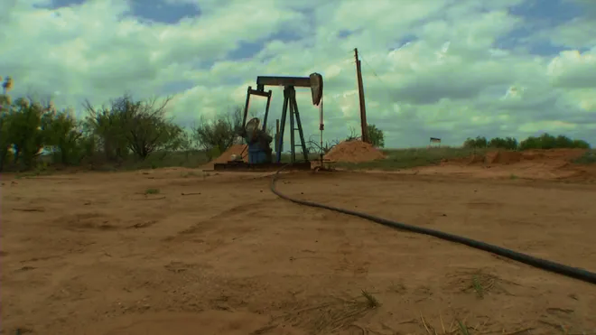

Slide 10
Elements of a System
Inputs & coding
Throughputs
Outputs
Organizations are “social systems”

Slide 11
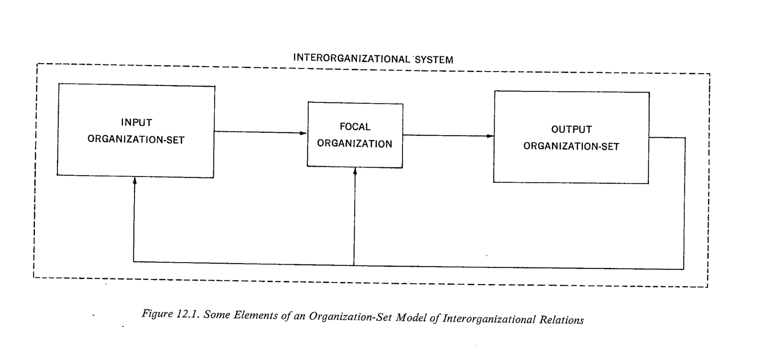
Evans (1972)
Notes:
Instead of focusing on what happen within a single organization, the focus is on what happens between the organizations.

Slide 12
Evans (1972)
Focal org
Input org
Output org
Feedback

Slide 13
Evans (1972)
Focal org
Input org
Output org
Feedback
Receives output from the input organization
Provides input to the output organization

Slide 14
Evans (1972)
Focal org
Input org
Output org
Feedback
Provides output to the focal organization.

Slide 15
Evans (1972)
Focal org
Input org
Output org
Feedback
Receives output from the focal organization

Slide 16
Evans (1972)
Focal org
Input org
Output org
Feedback
Provides feedback about ... the suitability of the focal org’s output

Slide 19
Suppliers of raw materials, trade unions, government agencies, universities, R&D

Slide 20
Transforms into products & services to export to OOS (e.g., car dealers, advertising agencies, etc.)

Slide 21
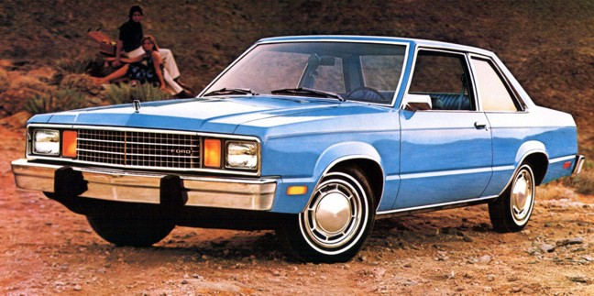
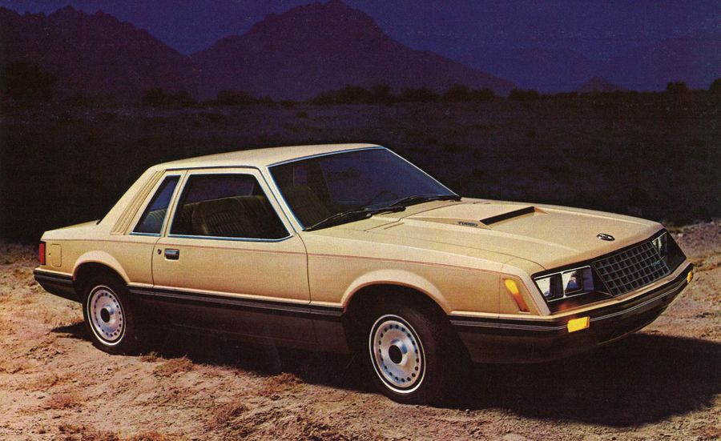
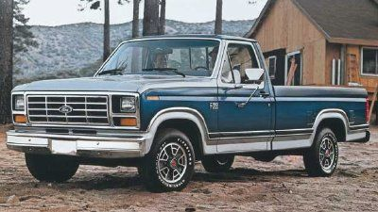
Market, sell, service products – with / without success

Slide 22
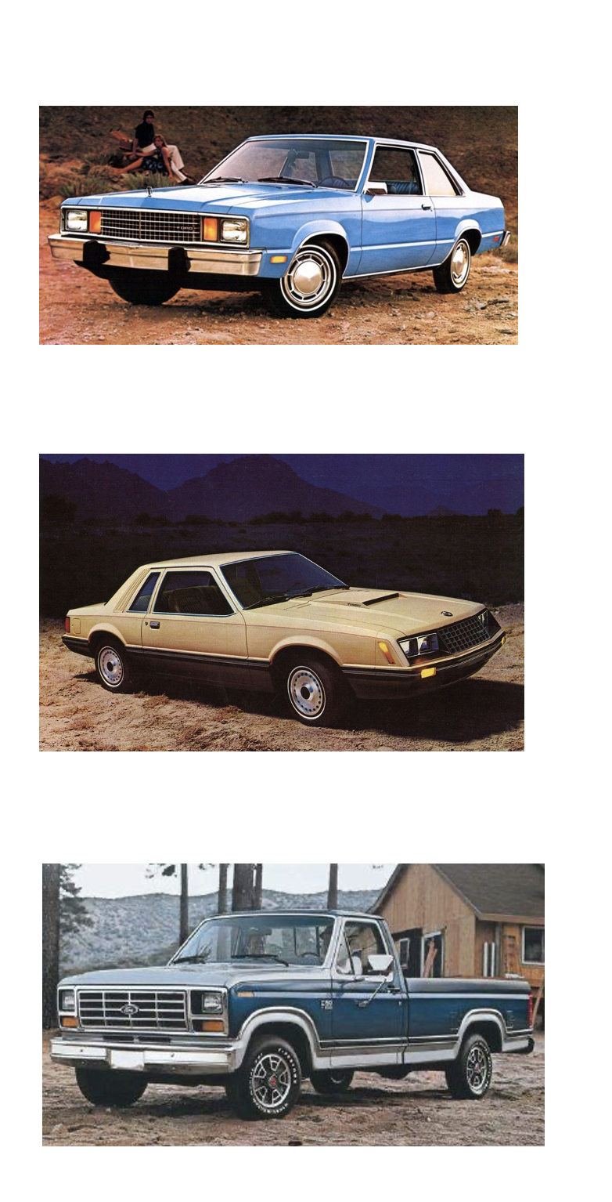
Provides feedback about ... the suitability of the focal org’s output

Slide 23
Applied to Teacher Preparation

Slide 24
Teacher preparation as an inter-organizational system ...
Educator Preparation Program
School District
Community College

Slide 25
Feedback to EPP about Teacher Candidates
Educator Preparation Program
School District
Community College
Feedback about Entering Students
Feedback about Transfers

Slide 26
Feedback to EPP about Teacher Candidates
a
b
c
Educator Preparation Program
School District
Community College
Feedback about Entering Students
Feedback about Transfers
Breaking points in the inter-organizational system for teacher preparation

Slide 27
Feedback to EPP about Teacher Candidates
a
b
c
Educator Preparation Program
School District
Community College
Feedback about Entering Students
Feedback about Transfers

Slide 28
Feedback to EPP about Teacher Candidates
a
b
c
Educator Preparation Program
School District
Community College
Feedback about Entering Students
Feedback about Transfers

Slide 29
Feedback to EPP about Teacher Candidates
a
b
c
Educator Preparation Program
School District
Community College
Feedback about Entering Students
Feedback about Transfers
Why is there a shortage of teacher talent for rural schools?

Slide 30
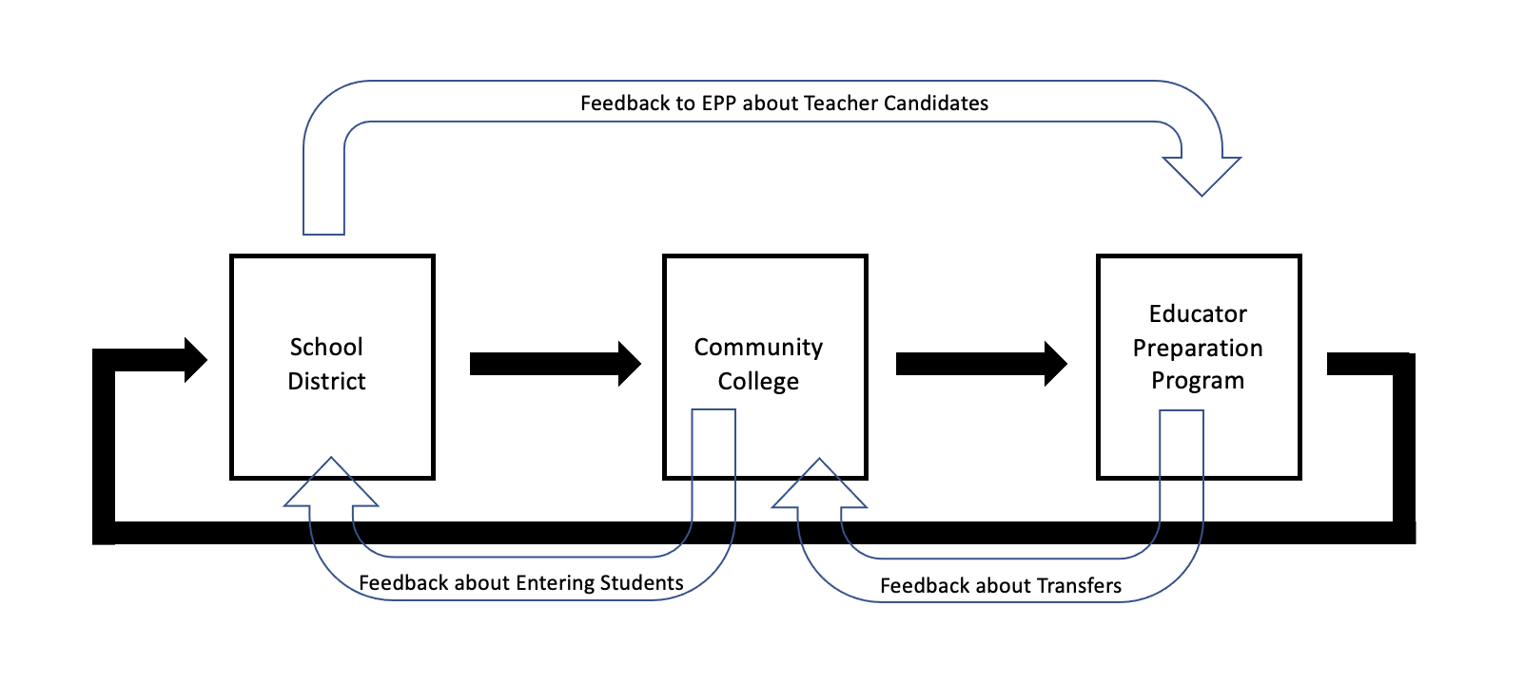

Slide 31
What does the idea of a “system” make you think about in terms of your own organizations?
From your institution’s perspective, what are the biggest challenges faced by setting up a system with other institutions? Start a list.

Slide 32
Brasher, D. (2020) The system
No coding for the next step
No meaningful communication across organizations – friends, no benefits
Limited district investment in cultivating teacher talent
Universities struggle with distance delivery

Slide 35
Setting Expectations (high) for the Year
Look who is in the room!!!

Slide 36
What’s ahead
Models of post-secondary partnership
Impact on graduates and communities
Delivering educator preparation at a distance

Slide 37
What’s expected of you ...
Post-secondary institutions (CC and 4-years)
Finalize an articulation agreement and degree pathway that supports AAT / AS completion and preparation for certification exams
December 2021

Slide 38
What’s expected of you ...
Community Colleges
Develop online delivery of AAT or AS
Offer what isn’t currently available
Prepare to offer EDUC for dual credit in partner districts
Recruit HS and paras in (partner) rural districts
Attend governance meetings with university and district(s)
May 2022

Slide 39
What’s expected of you ...
Universities
Develop online delivery of education courses during practicum
Recruit existing teacher candidates for SY2022
Develop training for rural university supervisors (SC)
Develop systems to support fidelity and effectiveness
Recruit HS and paras in (partner) rural districts
Recruit in (partner) community colleges
Attend governance meetings with CC and district(s)
August 2022 (ready for SY2022)

Slide 40
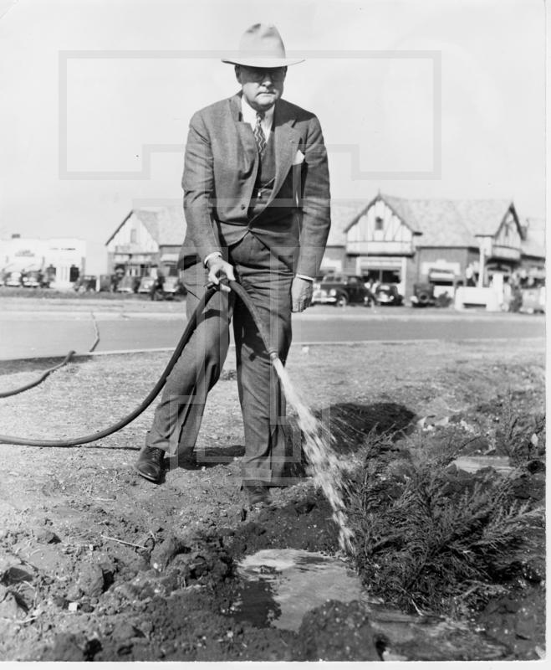
President Clifford B. Jones
Watering shrubs on Arbor Day
Texas Technological College
Circa 1940

Slide 41
Let’s take a break!

