Slide 1
Growth and development of the infant and toddler
including physical, emotional, social, and intellectual needs
Arlene Spearman
Associate Director

Slide 2
Talaris
There are few times that rival the growth and development of a child from birth to five. Research has shown that parenting during the early years is the dominant influence in all of a child's relationships and on lifelong learning. Yet many parents are unaware of the importance of their role.

Slide 4
Developmental Timeline: Physical
http://www.parentingcounts.org/information/timeline/

Slide 5
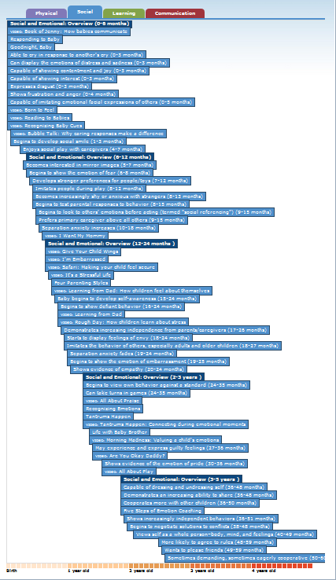
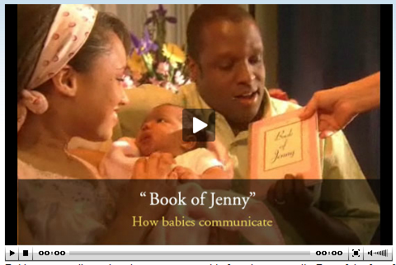
Developmental Timeline: Social

Slide 6
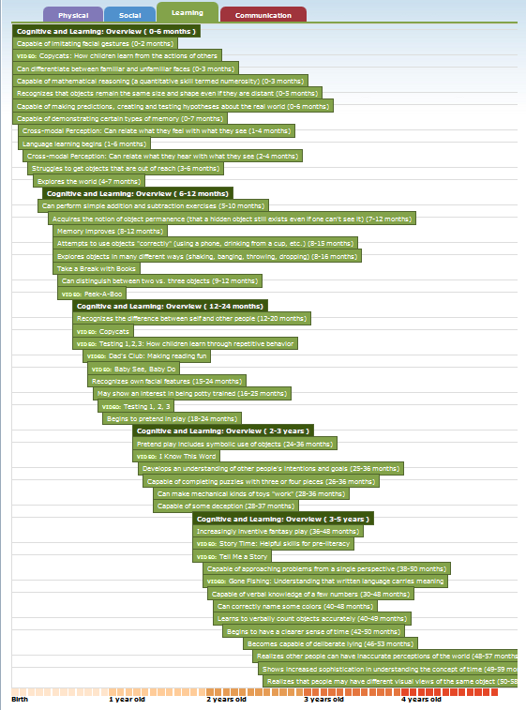
Developmental Timeline: Learning

Slide 7
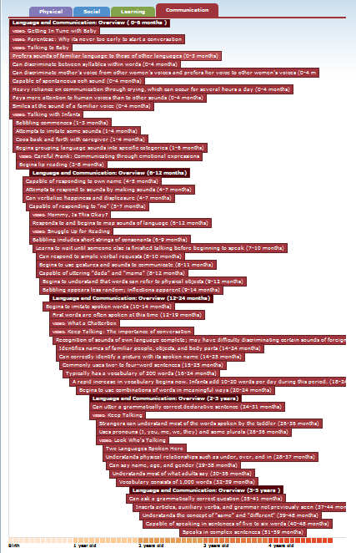
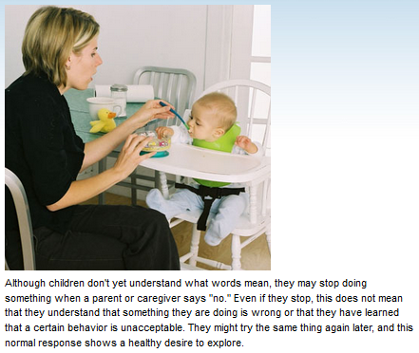
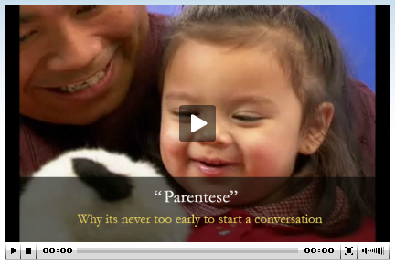
Developmental Timeline: Communication

Slide 8
Discovery Health Videos http://health.discovery.com/tv-shows/specials/videos/deliver-me-baby-development.htm
Baby Development
Infant Games and Activities
Infant Bonding
Introducing Food
Car Seat Safety
Baby Proofing
Baby Massage
Immunization

Slide 9
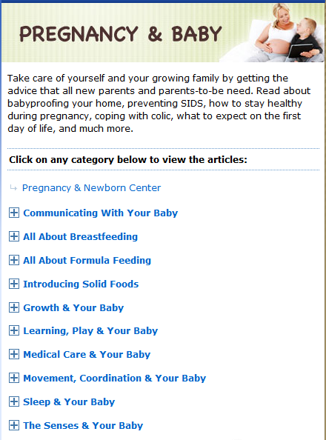
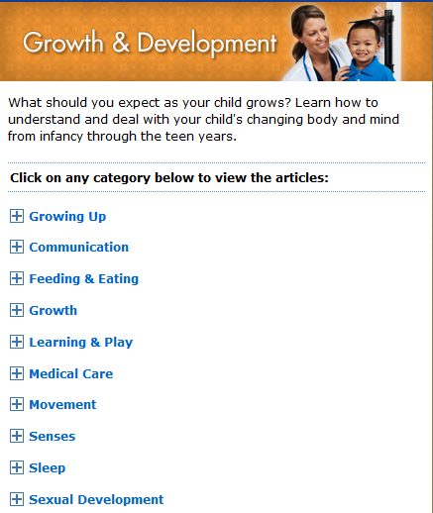
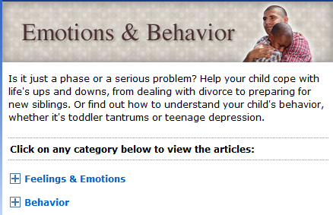
Kids Health
http://kidshealth.org/parent/

Slide 10
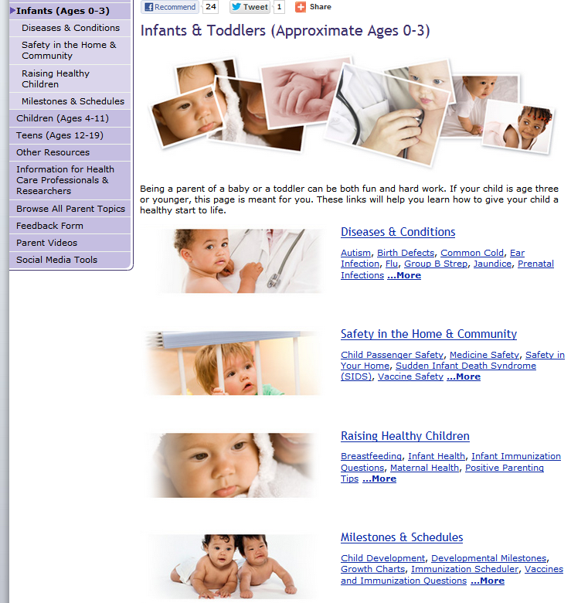
http://www.cdc.gov/parents/infants/

Slide 11
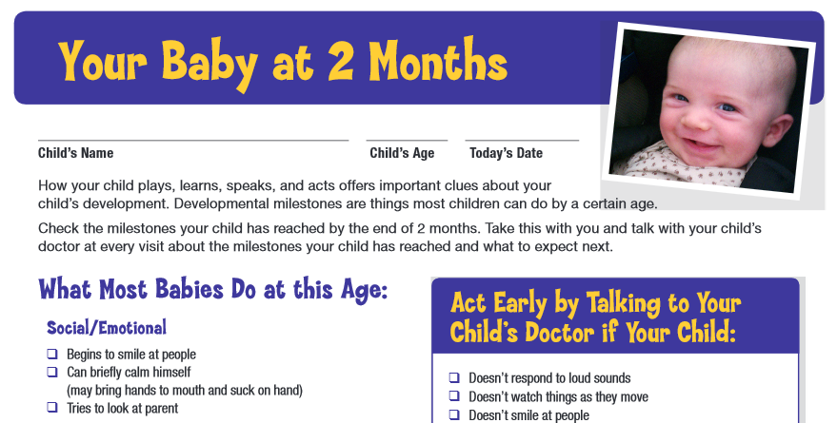
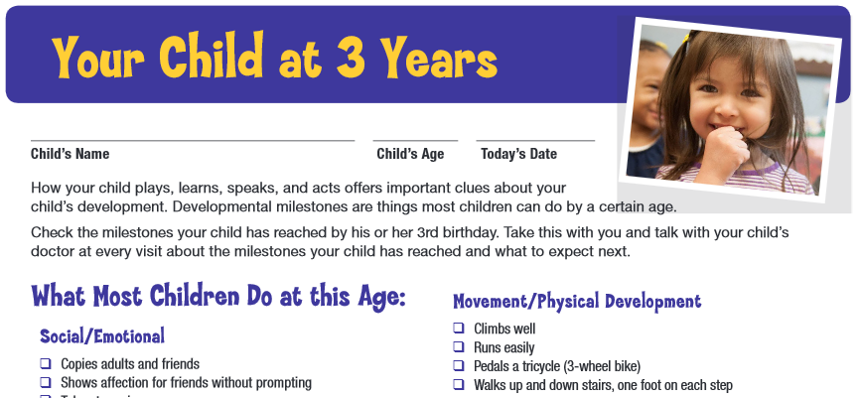
http://www.cdc.gov/ncbddd/actearly/pdf/checklists/all_checklists.pdf

Slide 12
http://www.cdc.gov/cdctv/babysteps/

Slide 13
http://www.zerotothree.org/

Slide 14
Zero to Three Podcasts http://www.zerotothree.org/about-us/funded-projects/parenting-resources/podcast/
Shh, Shh, It’s Okay: Coping With Crying in Babies and Toddlers
Night-Night…or Not: Talking About Babies, Toddlers, and Sleep
Early Experiences Count: How Emotional Development Unfolds Starting at Birth
“I Like Me!”: Developing Self-Esteem in the Early Years
Beyond “Use Your Words!”: How Babies Begin to Develop Self-Control in the First Three Years
Creating Healthy Connections: Nurturing Brain Development from Birth to Three
Our Families, Ourselves: How Our History Influences How We Raise Our Children
Daddy, Papi, Papa or Baba: The Influence of Father’s on Young Children’s Development

Slide 15
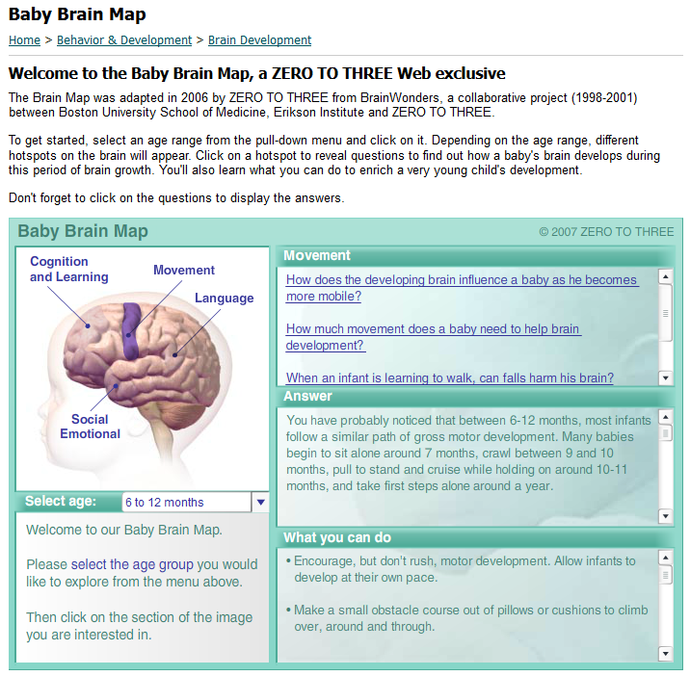
http://www.zerotothree.org/child-development/brain-development/baby-brain-map.html

