Slide 1
Electrify Your Career Courses with E-Portfolios and Social Media
2012 FCSTAT Summer Professional Development Conference
July 29 – August 3, 2012
Dallas, Texas
Presenters:
Heather Blount, Curriculum Specialist, CCFCS
Arlene Spearman, Associate Director, CCFCS

Slide 2
We will discuss:
Social Media
Social Media and the Job Search
E-Portfolios

Slide 3

What Is Social Media?
Social media includes Web-based and mobile based technologies which are used to turn communication into interactive dialogue among organizations, communities, and individuals.
Source: http://en.wikipedia.org/wiki/Social_media

Slide 4
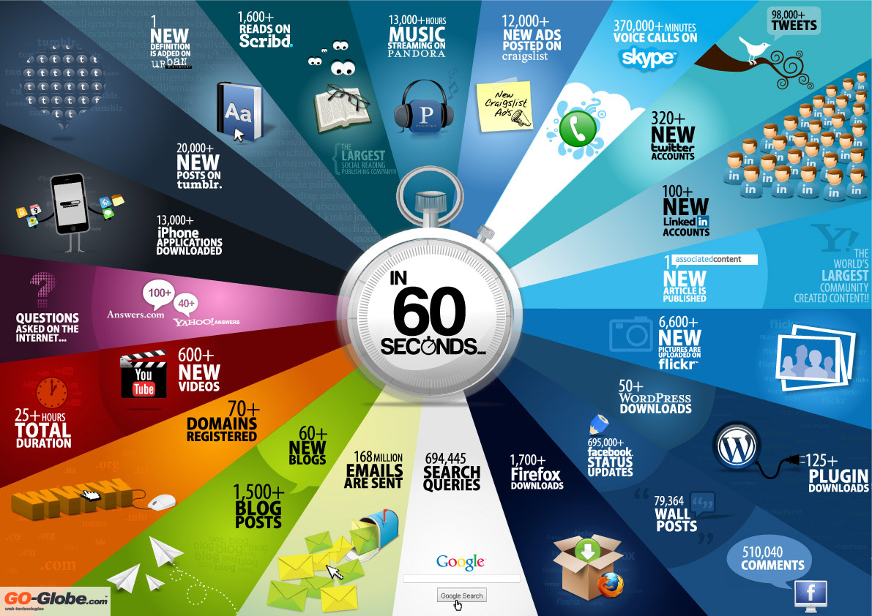

Slide 5

Social Media Who’s Who
Facebook
55% of users women; 45% men
800 million active users
Like company pages; network with others
Twitter
55% of users women; 45% men
250 million tweets per day
Follow company twitter feeds or professionals in the industry
Source: A Who’s Who of Social Marketing; imbue Marketing http://imbuemarketing.com/2012/a-whos-who-of-social-media-infographic/

Slide 6


Social Media
YouTube
50% of users women; 50% men
158 million hits per month
Upload a video resumé
Google Plus
37% of users women; 63% men
90 million active users
Network with others

Slide 7


Social Media
Instagram
15 million users
150 million photos shared
Post work related photos
Pinterest
55-70% of users women; <45% men
10 million active users
Create a job search board; post your resumé, portfolio pages, accomplishments, etc.

Slide 8
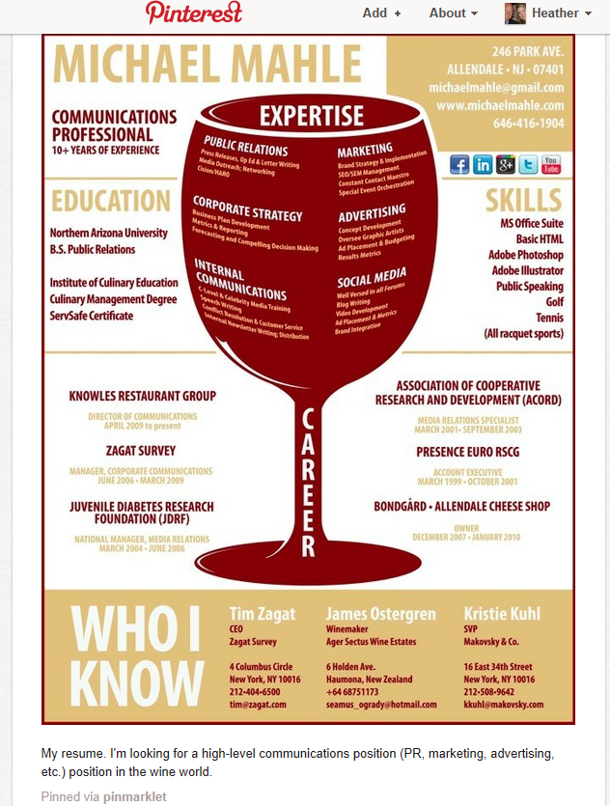
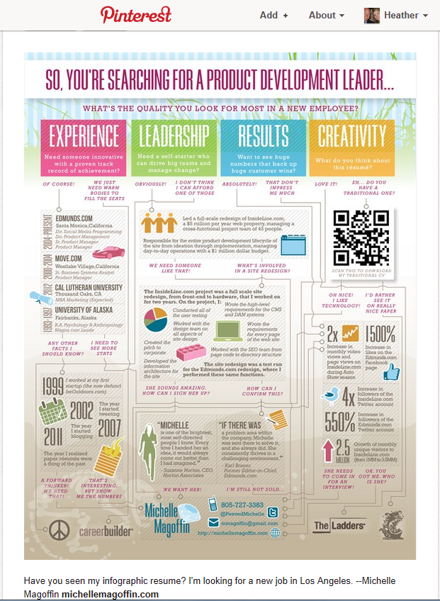
Pinterest Resumé Examples
QR codes are popping up in newspapers, on consumer products and elsewhere, that can be scanned by smartphones. Some people are adding these to their résumés to direct employers to online portfolios, contact information and other application materials. Source: Ruth Mantell, “How to Make a Resumé That Works”

Slide 9
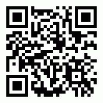
QR Codes
Top 10 Free Online QR Code Generators
http://freenuts.com/top-10-free-online-qr-code-generators/
A variety of QR code reader apps are available for smartphones.

Slide 10

Social Media
Linkedin
59% of users women; 41% men
100 million users
As of March 31, 2012, LinkedIn operates the world’s largest professional network on the Internet with 161 million members in over 200 countries and territories.
Create a profile and network with other professionals

Slide 11
Social Media Is Changing Recruitment
Notes:
http://www.youtube.com/watch?v=w6rGe-XBi9w

Slide 12
Social Media and the Job Search
Employers are…
Posting job openings
Looking for potential job candidates
Screening potential job candidates

Slide 13
Social Media and the Job Search
Do…
create an online presence/profile that is relevant
check your profile on a regular basis
be consistent
Google yourself
be careful what you tweet
Sources: Brad Schepp, 7 Tips for Landing A Job Using Social Media www.forbes.com/pictures/efkk45hifm/7-tips-for-landing-a-job-using-social-media/
Alison Doyle, Top 10 Social Media Do’s and Don’ts, http://jobsearch.about.com/od/onlinecareernetworking/tp/socialmediajobsearch.htm

Slide 14
Social Media and the Job Search
Do…
give to get – be a resource for others
build a network (in advance)
follow company Facebook pages and Twitter feeds
visit job search sites – SimplyHired, CareerBuilder, Monster, Indeed, etc.
Sources: Brad Schepp, 7 Tips for Landing A Job Using Social Media www.forbes.com/pictures/efkk45hifm/7-tips-for-landing-a-job-using-social-media/
Alison Doyle, Top 10 Social Media Do’s and Don’ts, http://jobsearch.about.com/od/onlinecareernetworking/tp/socialmediajobsearch.htm

Slide 15
Social Media and the Job Search
Don’t…
get fired
forget privacy settings
post anything you wouldn’t want a prospective employer to see
connect with everyone
spend time online while at work looking for a job
Sources: Brad Schepp, 7 Tips for Landing A Job Using Social Media www.forbes.com/pictures/efkk45hifm/7-tips-for-landing-a-job-using-social-media/
Alison Doyle, Top 10 Social Media Do’s and Don’ts, http://jobsearch.about.com/od/onlinecareernetworking/tp/socialmediajobsearch.htm

Slide 16
Resumé

Slide 17
Dan Schawbel of Forbes
“My prediction is that in the next ten years, resumés will be less common, and your online presence will become what your resumé is today, at all types and sizes of companies.”
http://blogs.forbes.com/danschawbel/2011/02/21/5-reasons-why-your-online-presence-will-replace-your-resumé-in-10-years/

Slide 18
5 reasons why your online presence will replace your resumé

Slide 19
Social networking use is skyrocketing while e-mail is plummeting.
  Employers are reviewing your profiles to see what kind of person you are outside of work, who you’re connected to, and how you present yourself.

Slide 20
You can’t find jobs traditionally anymore.
  A survey by webjob.com of recently employed job seekers found that 23% of those surveyed found their job through ads.

Slide 21
People are managing their careers as entrepreneurs.
  In the career field, the term “Careerpreneur” describes a professional who manages their career like an entrepreneur, always searching for the next big opportunity.
  You need to build your online presence before you need it and constantly look for the new opportunity that will further your personal brand.

Slide 22
The traditional resumé is now virtual and easy to build.
  Have you ever created your resumé using Microsoft Word? I’m sure you have, but those days are quickly coming to an end. Professionals are going to start using LinkedIn’s “Resumé Builder” tool to turn their LinkedIn profile into a resumé that they can use to submit to jobs.

Slide 23
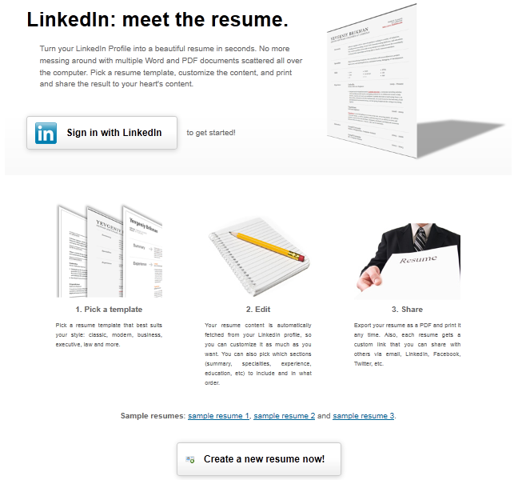

Slide 24
Job seeker passion has become the deciding factor in employment.
  Your online presence communicates, or should communicate, what you’re truly and genuinely passionate about.

Slide 25
Resumé
Treat your resumé as a marketing document.
  This is the toughest challenge of resumé-writing: figuring out what's special about yourself. What's your personal brand?
Tailor your resumé for the position you're targeting.
  You should have an all-purpose resumé for yourself, but do rework that 40- to 50-word summary to address each particular job you're after.
Write a 40- to 50-word summary that includes three reasons someone should hire you.
  The summary should vividly describe your personal brand, including three compelling reasons an employer would want you.

Slide 26
Top Skills You Need On Your Resumé
Ability to Work in a Team Structure
  More often than not, jobs will require you to work with others in order to get tasks and projects completed.
Ability to Verbally Communicate with Persons Inside and Outside the Organization
  This can come in handy when you need to get something expedited for a customer, or if you need to understand how a function or process works.
Forbes.com 3/5/2012

Slide 27
Ability to Make Decisions and Solve Problems
  Problems will eventually arise in every organization, but how you respond to these problems will determine how much damage they will cause.
  Ability to Obtain and Process Information
  Employees are often assigned multiple tasks and projects. An effective and efficient employee should be able to categorize these assignments by due dates and level of priority, which is usually based on guidelines established by the company.

Slide 28

The Bottom Line
You should never forget that your resumé is what will get you the interview; therefore, it is up to you to sell yourself well enough so that when potential employers see it, they know right away that you are a good candidate for them.

Slide 29

Electronic Portfolio

Slide 31

Electronic Portfolios

Slide 32
An E-Portfolio Is
An opportunity to effectively represent yourself and your education.
A place to collect and save coursework.
A chance to showcase accomplishments and school work to family and friends.
A tool for creating digital resumés to send to employers.
A Web portal for accessing your work, track your academic growth, and plan your career.
A chance to reflect on your education, to make connections between where you are and where you want to be.
A record of your skills, achievements, and learning.

Slide 33
Portfolio as showcase, process, and accountability
Portfolio as showcase and process
Portfolio as showcase
Years in School

Slide 34
Teacher’s E-Portfolio Management
In order to be effective and support the process of student learning, e-portfolios –
  Need to be embedded into your teaching and learning.
  Require a high level of access to technology.
  You need to set time aside for students to first learn how and then to actively reflect and give feedback on learning.

Slide 35
Is and Is Not
It is a collection of items that provides tangible evidence of the range of knowledge and skills that you have.
The items are self-selected, which shows the student’s individuality.
A portfolio is not a file of course projects and assignments.
It is not a scrapbook of memorabilia.

Slide 36
Two Kinds of Portfolios
Working portfolio
  Contains unabridged versions of the documents that have been selected.
Presentation portfolio
  This is selective and streamlined because other people do not have time to review all the material in your working portfolio.
  Large projects may be summarized in sample pages.
  All documents in a presentation portfolio should be preceded by an explanation of the importance or relevance of each item so the reviewer will understand the context of the work.

Slide 37
Balancing the Two Faces of E-Portfolios
Working Portfolio
  Digital archive of documents
  Collaboration space
  Blog
  Reflective journal
  Workspace
Presentation portfolio
  The “story” of you
  Multiple views (public/private)
  Varied audiences and purposes
  Showcase

Slide 38

Advantages
  Demonstrate technology knowledge and skills – can show everything that would be in a paper portfolio but can also show the student’s knowledge and skill with technology
  Facilitate distribution – can leave a copy with future employers
  Store many documents – the reviewer can look at what is of interest and ignore artifacts that do not apply
  Increase accessibility – can be looked at where and when have access to a computer
Disadvantages
  Time, effort, and specialized skills – can change the focus from content to form
  Accessibility – by making the portfolio more accessible, such as via the Web, there are potential security problems

Slide 39

Prove It!
Show me the money!
An artifact is tangible evidence of knowledge gained, skills mastered, values or attitudes that are characteristic of the student.
  Document
  Video
  Podcast
  Blog

Slide 40
Development Steps
Collect artifacts
Select and edit artifacts
  should reflect the student’s best work
Reflect on artifacts
  reflection gives meaning and value to artifacts
Present artifacts and reflections

Slide 41
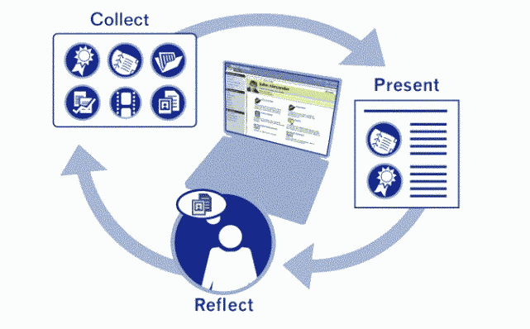
Collect
Select
Reflect
Present

Slide 42

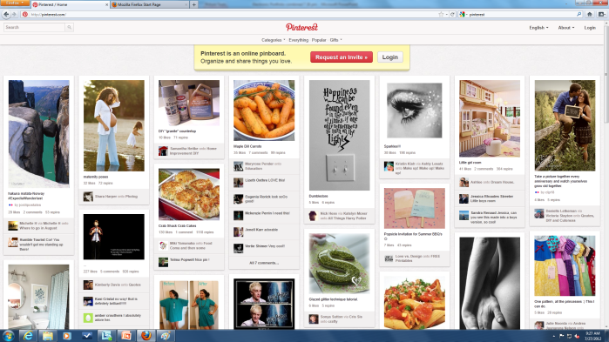
The E-Portfolio as a Container
An e-portfolio uses electronic technologies as the container, allowing students to collect and organize portfolio artifacts in many media types.
However, the selection step keeps an e-portfolio from becoming Pinterest.

Slide 43
E-Portfolio Tools

Slide 44
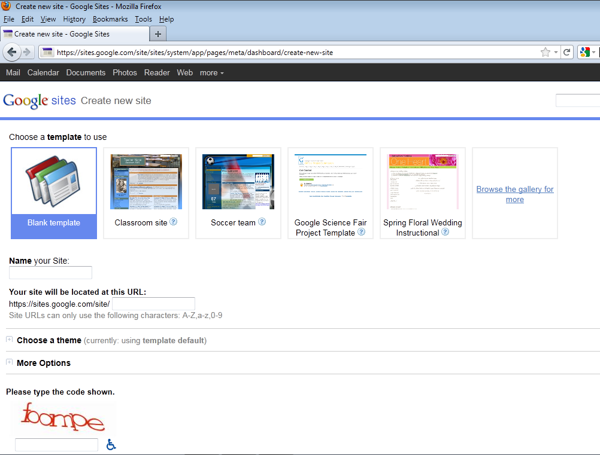

Slide 45
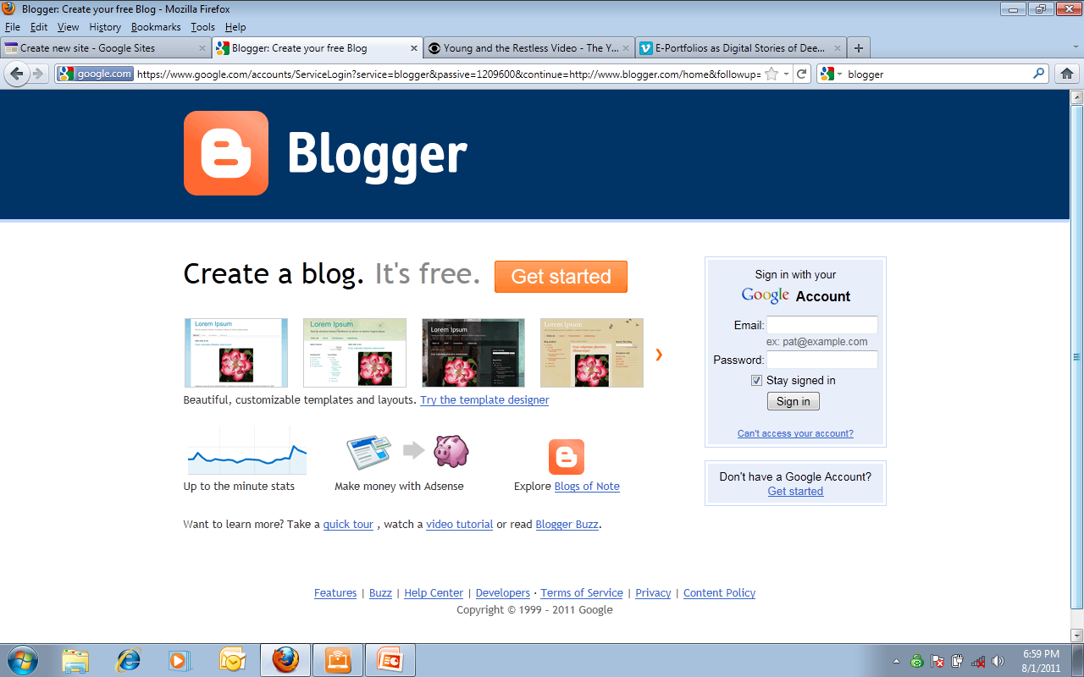

Slide 46
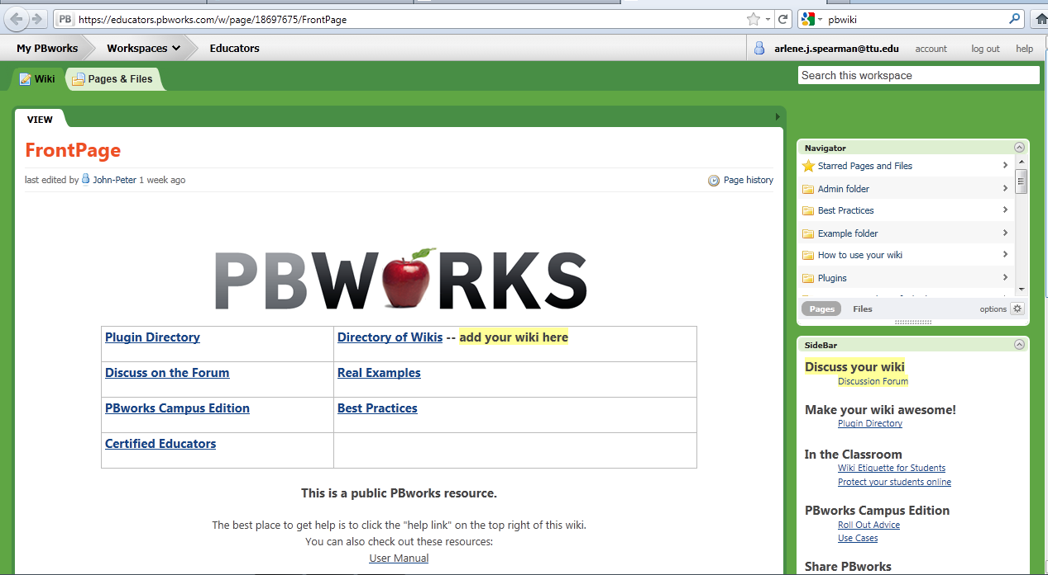

Slide 47
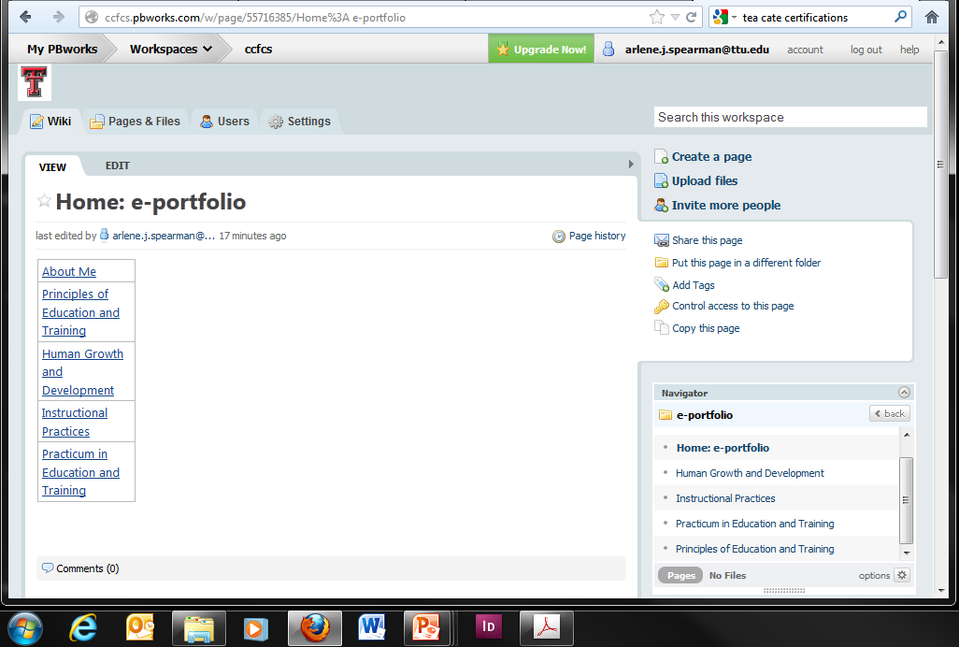

Slide 48
The student is the heart and soul of an e-portfolio----
NOT the technology

Slide 49
Sources
Putting It All Together: Education and Training
University of Wisconsin – Stout

