Slide 1
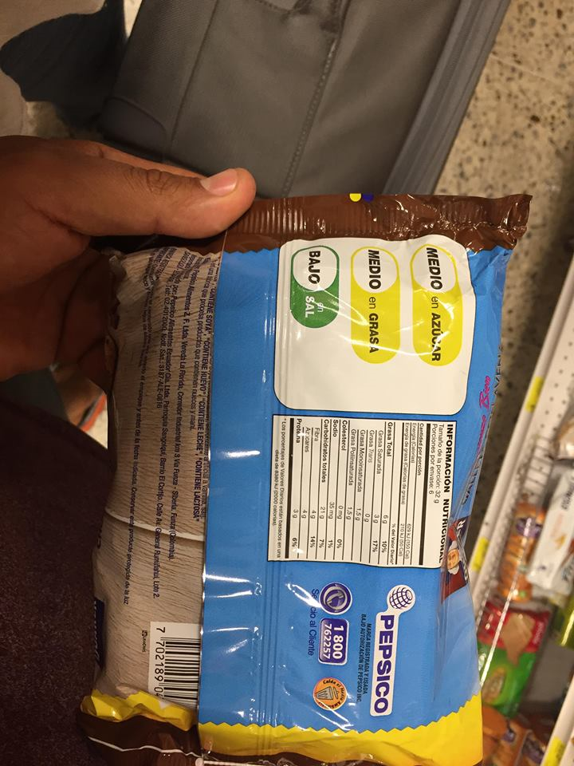
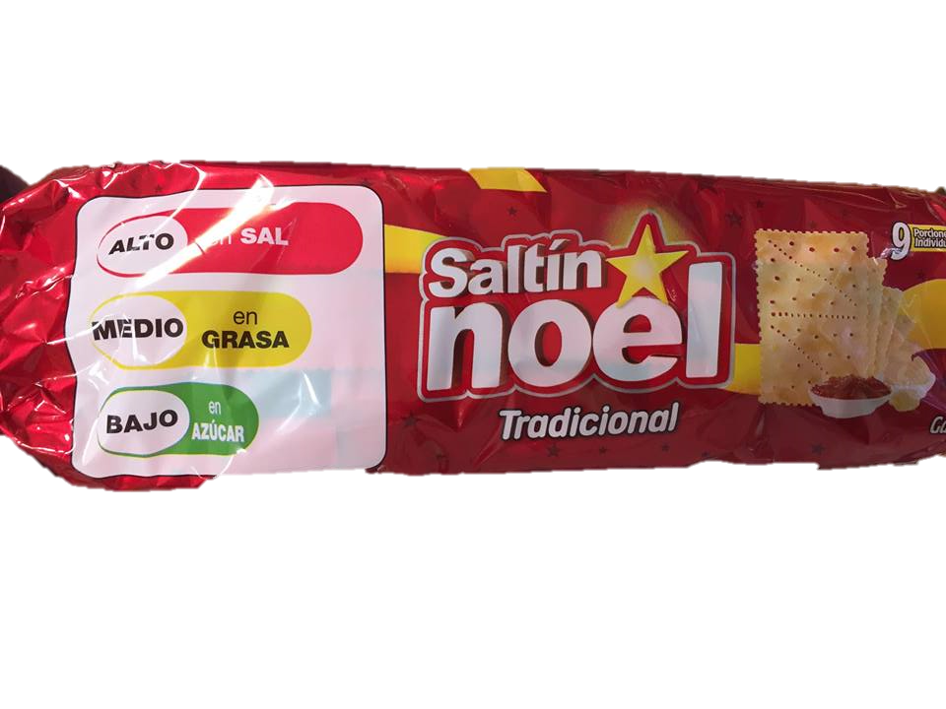
Effect of traffic light nutritional labeling on the consumption and nutritional content of cookies in Ecuador
Paoleth M. Iza Andrade.^{1,2,3}, Carlos E. Carpio², Luis A. Sandoval³, Marcos X. Sanchez⁴ 1. SOWER Scholar ICFIE, 2. Department of Agricultural and Applied Economics, Texas Tech University, 3. Zamorano University, Honduras 4. Department of Animal and Food Science, Texas Tech University
DISCUSSION
Ecuador has experienced in recent years an increase in mortality rates caused by chronic non-communicable diseases which in turn are associated with excessive consumption of salt, sugar and fat. To help reverse this trend, the Ecuadorian government introduced in 2014 the mandatory use of a traffic-light supplementary nutritional label (TLNL) in processed food products (Diaz et al., 2017; MPS, 2018).
The TLNL is additional to the regular nutritional content label and uses the red, yellow and green colors to indicate if a food products has a high, medium or low content of sugar, fat and sodium. The objective of the TLNL is to facilitate the consumers’ interpretation of the nutritional information contained in food products.
Ecuador is a pioneer in Latin America in the use of supplemental nutrition labeling polices. More recently, Chile and Bolivia have implemented similar regulations.
RESULTS
Regarding the nutritional content of cookie products, after the introduction of the TLNL, the fat content increased, on average, by 2.55% and the sodium content decreased by 10.09%. These changes are not statistically significant (α= 0.10). The content of sugar decreased by 14.49%. This change is statistically significant (α= 0.10).
On average, monthly per-capita consumption of cookies increased by 0.44g after the introduction of the TLNL. This difference is statistically significant (α= 0.10).
Regression results indicate that after controlling for other factors affecting consumer demand for cookies, the introduction of the TLNL was associated with a 11% decline in consumer purchases (significant at α= 0.05).
INTRODUCTION
Table 1: Change in the nutritional content of cookie products (before and after TLNL)
Product name | Change (g/100g of product)
 | Sugar | Fat | Sodium
Saltin Noel | 1.09 | -1.44 | 0.02
Salticas | 0.00 | 0.00 | 0.10
Club social integral | 0.00 | 0.00 | -0.08
Club social original | -0.96 | -4.79 | -0.21
Ducales | 3.08 | -3.08 | 0.00
Ritz | -8.24 | 2.20 | 0.24
Siluet canela y manzana | -10.72 | 1.78 | -0.02
Quacker avena y manzana | -15.96 | 4.53 | -0.24
Oreo | 0.00 | 2.78 | -0.22
Average change in nutritional content (g/100g) | -3.52 | 0.22 | -0.05
Average change in nutritional content (%) | -14.49 | 2.55 | -10.09
To determine the effect of the traffic light nutritional labeling on the nutritional content of cookie products in Ecuador.
To determine the effect of the traffic light nutritional labeling on consumers’ purchases of cookie products in Ecuador.
We find evidence that the introduction of the TLNL caused a reduction in the purchases of cookie products in Ecuador and also led to a large reduction of the sugar content.
Our results contrast with previous studies which did not find evidence that the TLNL had affected the consumption and/or nutritional content of other food products (Peñaherrera, 2017). The TLNL appears to have different effects on different products.
OBJECTIVES
Traffic light
label
CONCLUSIONS
One Ritz cracker weights: 3.3 g
Data for the analyses comes from two sources. Monthly aggregated data on cookies purchases (20 months before and 16 after the implementation of TLNL) was obtained from the market research company Kantar. Nutritional content formulation data from an Ecuadorian government agency (records on nutritional composition of cookies before and after the introduction of the TLNL).
This study uses a before and after research design. T-student tests were used to analyze changes in both consumer purchases and the nutritional content of cookie products before and after the implementation of the TLNL. In addition, regression analysis was used to evaluate the effect of TLNL on consumers’ purchases after controlling for other factors affecting consumer demand including long term trends, seasonality, price and the income status of the consumers.
A total of 22 cookie products were included in the analyses of consumer purchases; however, due to the lack of data, only 9 cookie products were included for nutritional content analysis.
METHODOLOGY
Díaz AA, Veliz PM, Rivas-Mariño G, Vance Mafla C, Martínez Altamirano LM, Vaca Jones C. Etiquetado de alimentos en Ecuador: implementación, resultados y acciones pendientes. Rev Panam Salud Publica. 2017;41:e54
Ministry of Public Health (MPS)(2018). Food labeling. Labeling system for processed foods. Government of the Republic of Ecuador. Quito Available online at http://www.salud.gob.ec/campana-etiquetado/.
Peñaherrera, V. (2017, November). Zamorano. Retrieved from Effect of traffic light nutritional labeling on the consumption and nutritional content of sodas in Ecuador: https://bdigital.zamorano.edu/bitstream/11036/6156/1/AGN-2017-021.pdf
For more information contact:
carlos.carpio@ttu.edu
paoleth.iza@ttu.edu
REFERENCES
Figure 2: Average monthly per-capita consumption of cookie products before and after the introduction of TLNL
REGRESION RESULTS
logTotQ= -0.413 - 0.361logFPI -0.112TLNL +0.0105T +0.00032T² -0.0867S1 -0.0105S2
(0.0274) (0.2208) (0.0331) (0.0017) (0.000086) (0.0253) (0.0233)
+0.0832S3 +0.379AB +0.161C
(0.0234) (0.0194) (0.0193)
R²: 0.8351; n: 108
logTotQ: total quantity of cookies expressed in natural logarithms
logFPI: Fisher price index expressed in natural logarithms
TLNL: dummy variable indicating the presence or absence of TLNL
T: time trend for months
S1,S2,S3: dummy variables representing quarters of the year (seasonality)
AB,C: dummy variables indicate the socio-economic level of households. AB for the high socio-economic level and C for the middle socio-economic level

