Slide 1
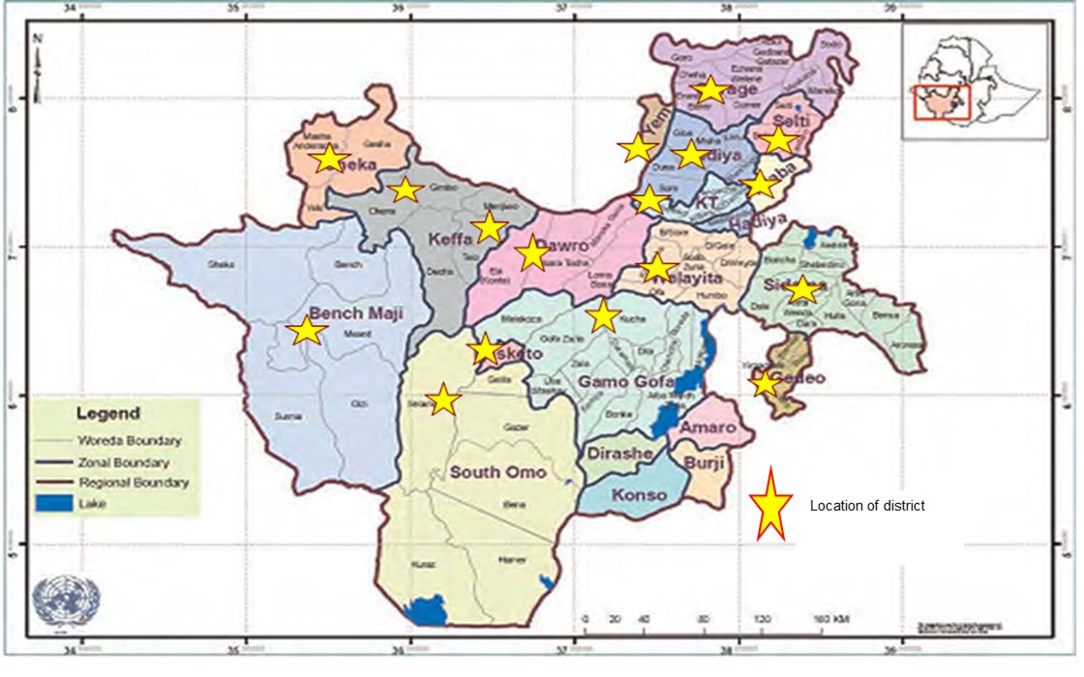
ADOPTION OF MODERN TECHNOLOGIES IN SOUTHERN NATIONS, NATIONALITIES, AND PEOPLE’S REGION (SNNPR) OF ETHIOPIA Díaz, Fátima¹; Millares, Carla²; Boren-Alpízar, Amy, PhD²; Dejene, Melisew³; Lyford, Conrad, PhD² ¹ SOWER Scholar, ² Texas Tech University, ³ Hawassa University
Introduction
Ethiopia is one of the poorest countries in the world (World Bank, 2017).
Many countries have focused their development efforts on helping Ethiopia improve its economy through several initiatives, including the adoption of modern agricultural technologies (Birdsall, Rodrik, & Subramanian, 2005).
The adoption of modern technologies can have a positive impact on many development indicators, such as improving farmers' productivity, which has a direct impact on their income and health (Meara et al., 2015).
Methodological Procedures
Conclusions
There is statistical difference between the people willing to adopt modern technologies and people who decided not to adopt based on the level of education. Overall, women from the Ethiopian region are willing to adopt modern technologies.
According to Rogers (2003), the decision to adopt modern technologies is based on the previous knowledge and persuasion. Women with a higher level of education, are more willing to adopt new technologies than the rest of the groups.
Overall, the biggest barrier to adopting modern technology is the contradiction these modern technologies have with the subjects’ religion.
Health improvement, increased productivity, and an overall life improvement are the three most frequent changes for this population when adopting modern technologies.
Descriptive statistics: Central tendency and variability
Chi-square: To determine the willingness to adopt based on education level
Baseline was conducted in 2014 to determine “Woman autonomy and decision making in SNNPR: A situational analysis”
Household survey data by Hawassa University
-Birth control methods
-Fuel saver -Plug -Biogas
-Sun lanterns
-Beehives -Farming vehicle
-Rainwater harvesting -Crop variety
-Chicken breeder -Sowing technologies
Figure 2. Map of Southern Nations Nationalities and Peoples Regional State (SNNPRS) (ONU, 2011)
Figure 3. Modern technologies.
Results of the Study
Education:
Illiterate
42.6%
Age:
29-39
38.4%
Ownership land:
No ownership land
41%
Religion:
Protestant
43.8%
Table1.Use modern technologies (n = 9662)
Groups | Yes | No | Total
Illiterate | 2748 (72.1%) | 1064 (27.9%) | 3812
Elementary school | 1067 (69.8%) | 461 (30.2%) | 1528
Middle school | 1440 (76.6%) | 440 (23.4%) | 1880
High school | 979 (77.3%) | 287 (22.7) | 1266
College | 932 (79.3%) | 244 (20.7%) | 1176
Total | 7080 (73.3%) | 2582 (26.7%) | 9662
$^{2}$(n=9662)=51.86, p<0.001
Purpose and Objectives
The purpose of this study is to measure and describe the perception female Ethiopians in the SNNPR have toward the adoption of modern technologies.
Describe the demographic characteristics of the population.
Describe the willingness to adopt modern technologies based on education level.
Determine the changes modern adoption produced in Ethiopian women’s lives.
Determine the problems that Ethiopian women face when adopting modern technologies.
Recommendations
This study can be used as a baseline in order to understand the willingness of women to adopt modern technologies, the main problems, and the impacts modern technologies produce in women’s lives. This information can be used for future interventions and projects in the region focused on the adoption of modern technologies.
This study can be replicated with people from different regions of Ethiopia to see if the perception is generalized or just focused in this group.
Further studies can be developed to determine if age has an impact in the adoption of modern technologies.
Demographic Characteristic
Figure 3. Demographic characteristic
Theoretical Framework
Knowledge
Persuasion
Decision
Implementation
Confirmation
Adoption
Rejection
References
Birdsall, N., Rodrik, D., & Subramanian, A. (2005). How to help poor countries. Foreign Affairs, 84(4), 136 – 152.
Hoffmann, V., Probst, K., & Christinck, A. (2007). Farmers and researchers: How can collaborative advantages be created in participatory research and technology development? Agriculture & Human Values, 24(3), 355 – 368. doi: https://doi.org/10.1007/s10460-007-9072-2.
Meara, J., Leather, A., Hagander, L., Alkire, B., Alonso, N., Ameh, E.,…Yip,W. (2015). Global Surgery 2030: Evidence and solutions for achieving health, welfare, and economic development. Lancet, 386(9993), 569 – 624. doi: http://dx.doi.org/10.1016/S0140-6736(15)60160-X
World Bank. (2017). Annual Report 2017. Retrieved from http://pubdocs.worldbank.org/en/908481507403754670/Annual-Report-2017-WBG.pdf
Figure 1. Model of five stages in the Innovation decision process (Rogers, 2003).
Figure 5.Problems that people face based on their level of education

