Slide 1
Feed the Future Innovation Lab for Peanut (Peanut Innovation Lab) Helping Farmers Grow Better Peanuts Dave Hoisington, Director University of Georgia

Slide 2
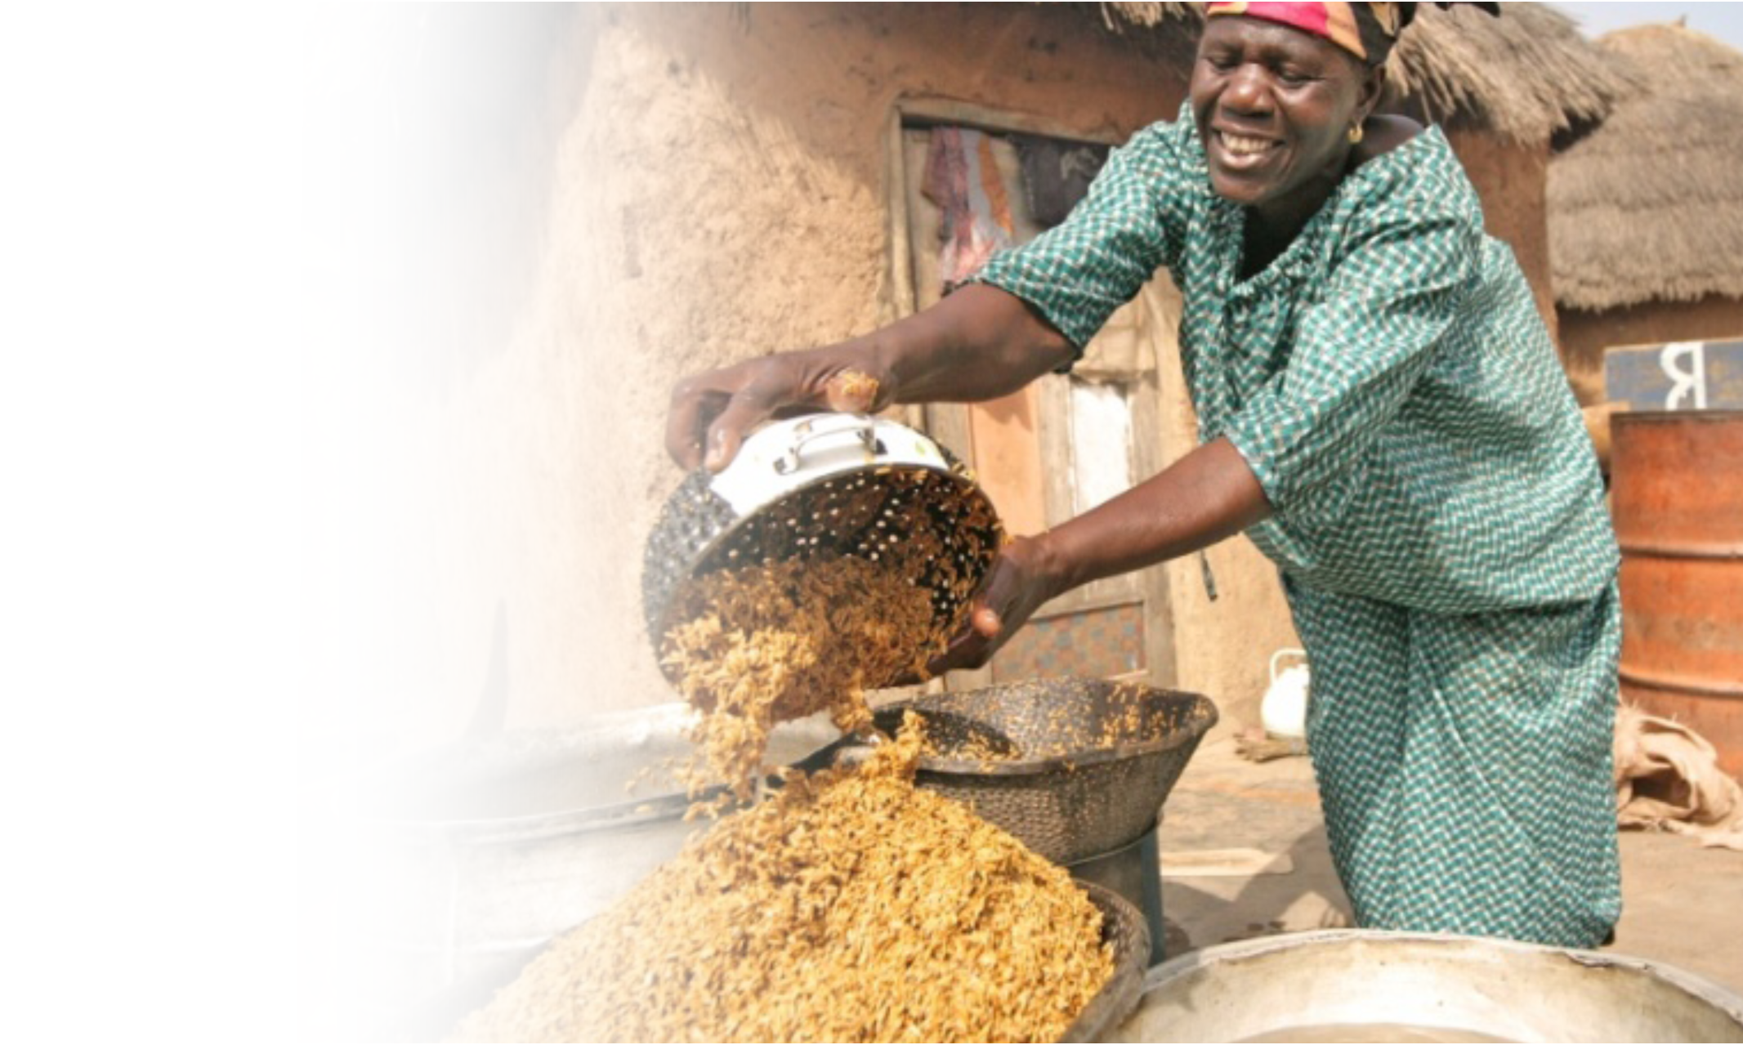
The Global Challenge: Achieving Sustainable Food Security
925 million people suffer from chronic hunger.
Demand for food is projected to increase by 50 percent over the next 20 years. Increased demand will come primarily from population and income growth in middle-income countries.
Diversified diets increasingly in demand – especially animal source foods.
Notes:
WHY ARE WE FUNDING PEANUT RESEARCH

Slide 3
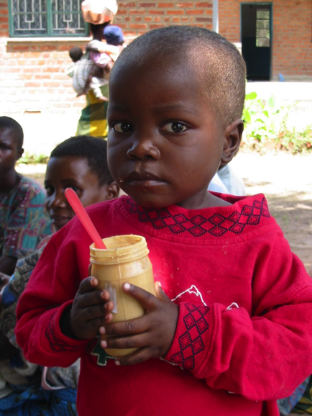
Innovation Lab Characteristics
Contribute to US Global Food Security Strategy
Support multi-disciplinary agriculture research using modern science
Long-term commitment of achieving objectives
Partnering with and investing in national research institutes
Committed to institutional capacity building, including graduate degrees

Slide 4
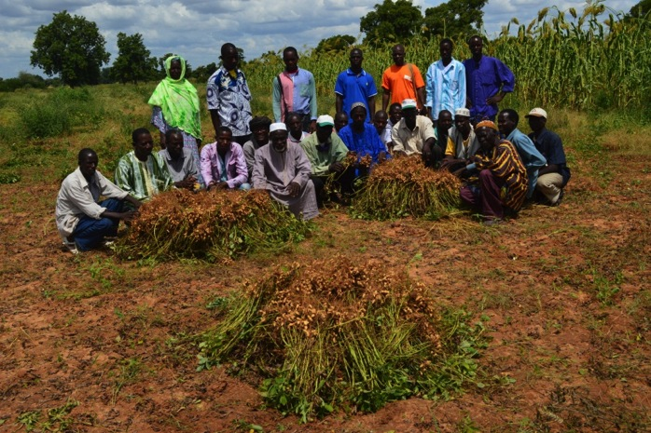
Why peanuts?
Global importance (39 million tons, 95% in developing countries)
Highly nutritious (protein, fiber, unsaturated fats, RUTF/RUSF)
Valuable as a legume in cereal systems (fixes nitrogen)
Often a women’s (and cash) crop

Slide 5
The Award
Title: Feed the Future Innovation Lab for Peanut
Short name: Peanut Innovation Lab
Awardee: University of Georgia
Length: Five years (11 Jan 2018 – 10 Jan 2023)
Amount: $14 million (up to $35 million with Associate Awards & Buy-ins)

Slide 6
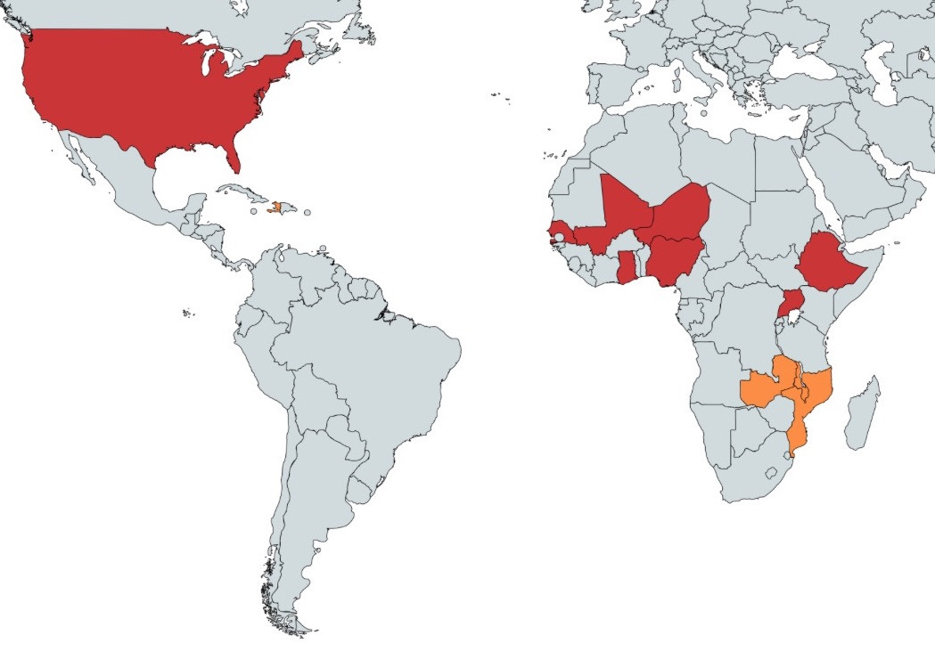
USA
Haiti
Mali
Senegal
Niger
Ethiopia
Nigeria
Ghana
Uganda
Malawi
Zambia
Primary countries
Secondary countries
Mozambique
Focus Countries

Slide 7
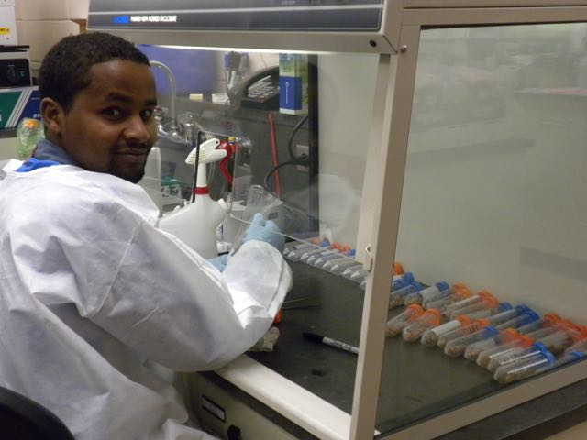
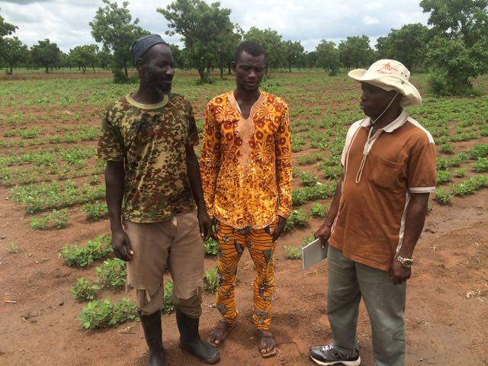
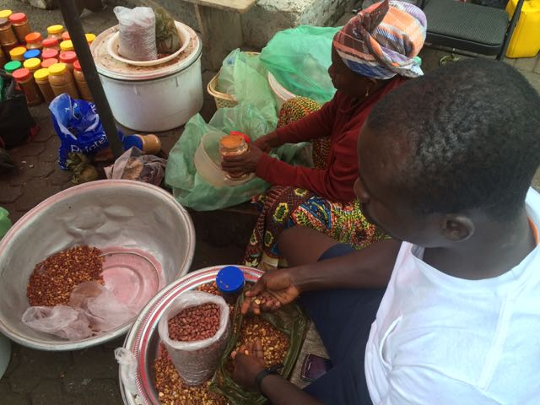
Areas of Inquiry
Improved peanut varieties
Nutrition
Gender & youth
Value-added gains

Slide 8
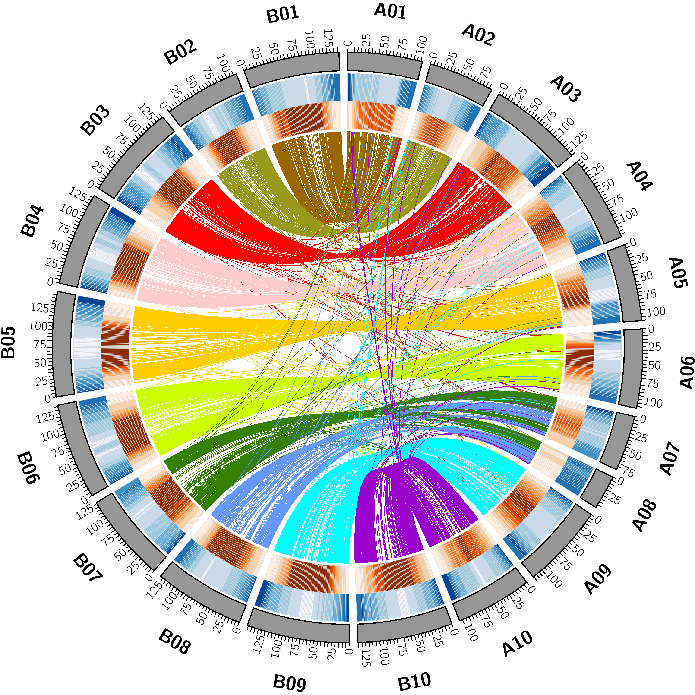
Improving peanut varieties
Increasing diversity
Genomic tools
Quality phenotyping
Marker-based breeding
Breeding informatics
Breeding networks

Slide 9
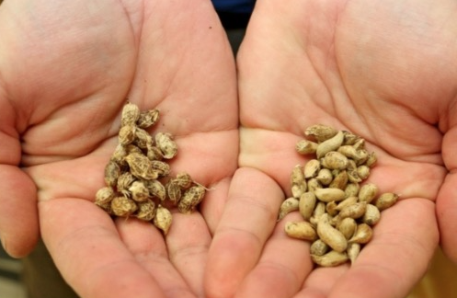
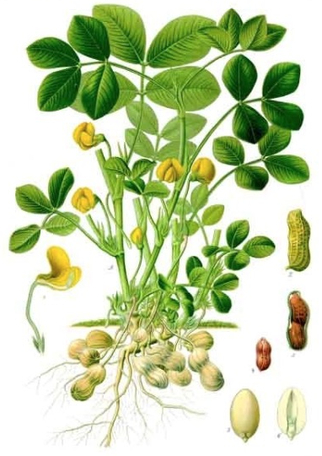
Capturing diversity
Wild Peanut Relatives
Cultivated Peanut
Arachis duranensis X Arachis ipaënsis

Slide 10
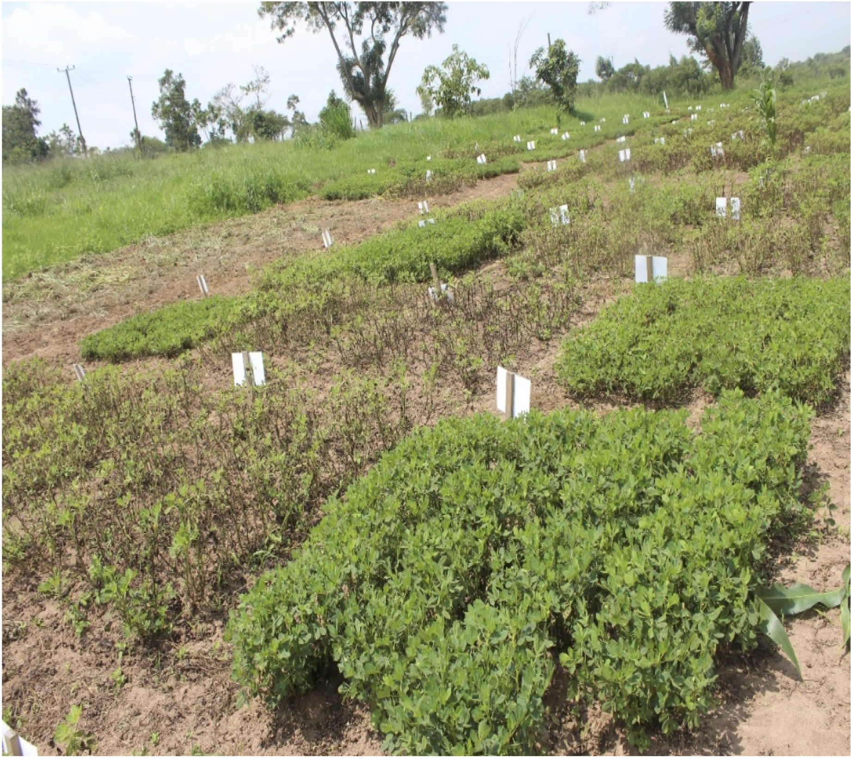
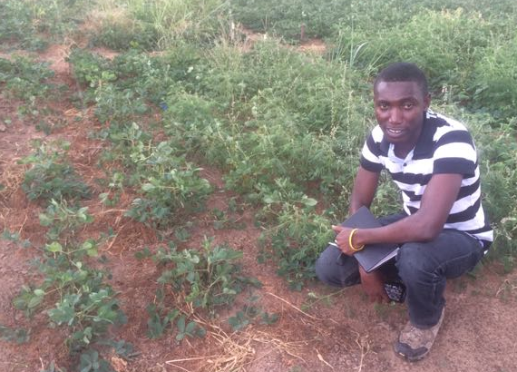
Value-added gains: Pre-harvest interventions

Slide 11
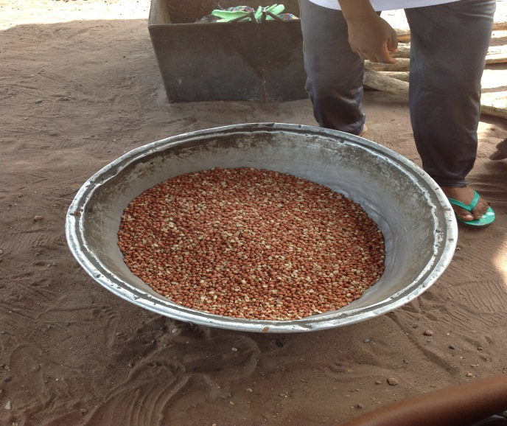
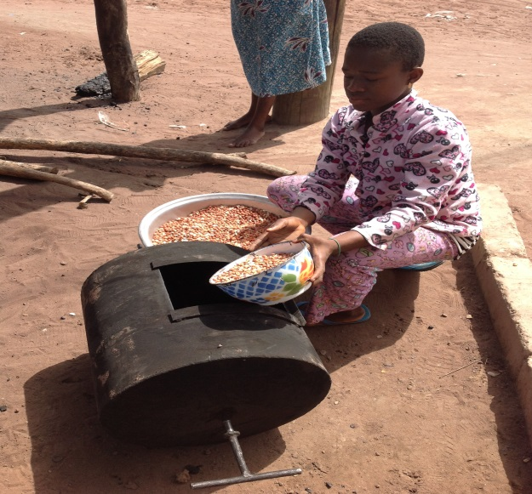
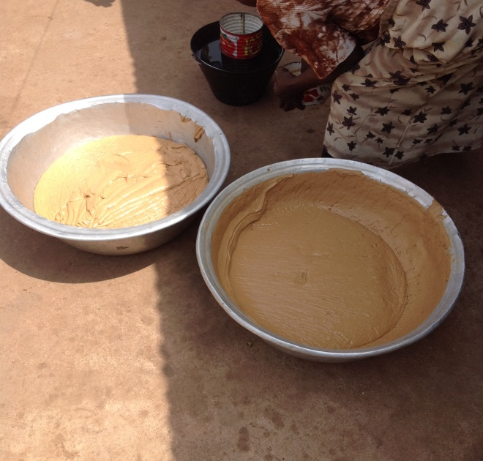
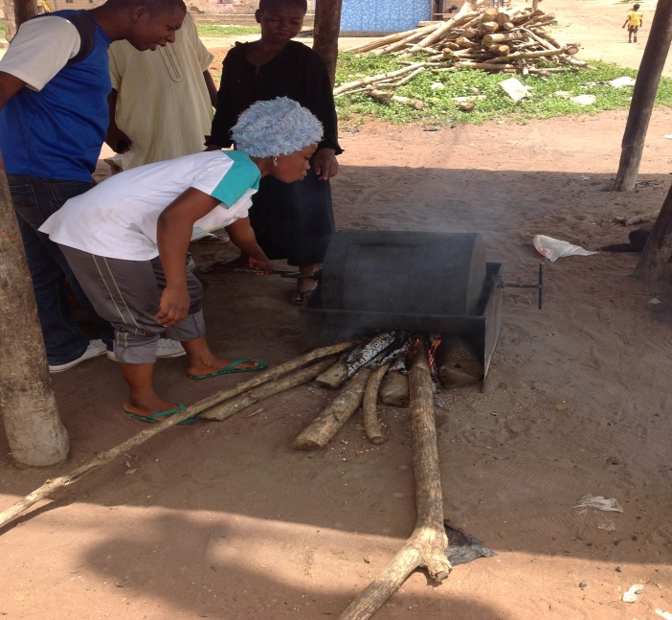
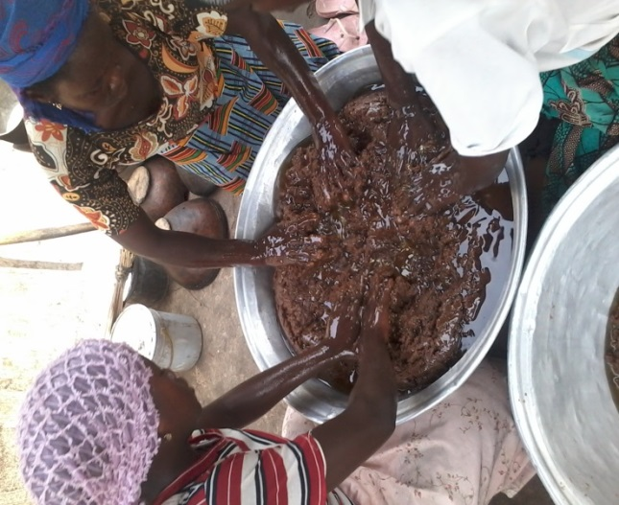
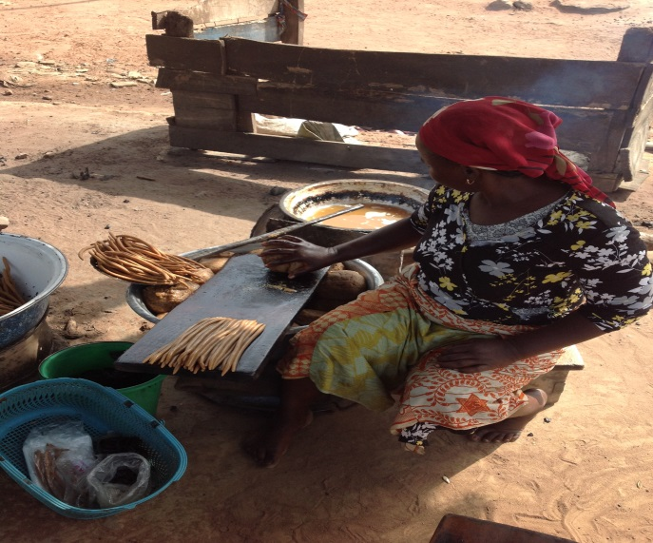
Value-added gains: Post-harvest & processing

Slide 12
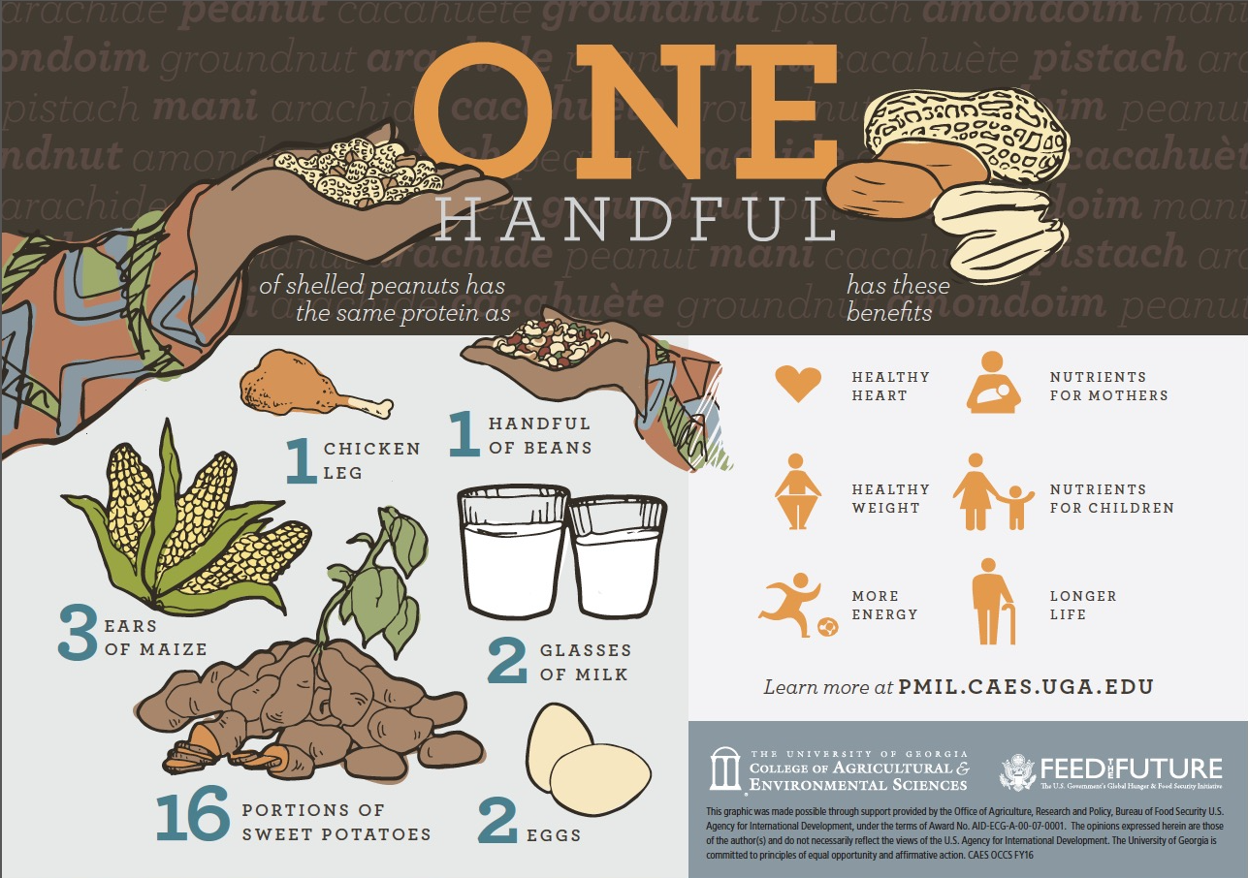
Nutrition
Better understanding of nutritional and health benefits from local consumption
Novel peanut-based foods for local markets
Nutritious varieties (high oleic, iron, zinc)
Nutritional information

Slide 13
Gender & youth
Mechanization to address constraints
Roles of information dissemination
Roles in the peanut value chain
Decision making, risks and opportunities

Slide 14
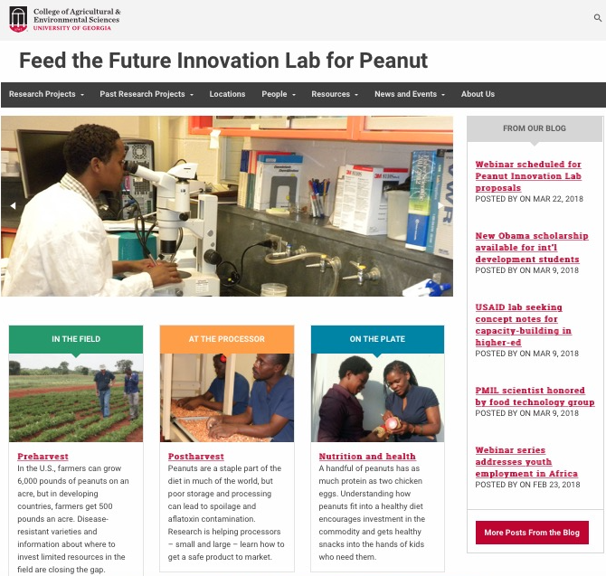
Communications
Website (www.ftfpeanutlab.caes.edu)
eNewsletters
USAID Agrilinks
Social media

Slide 15
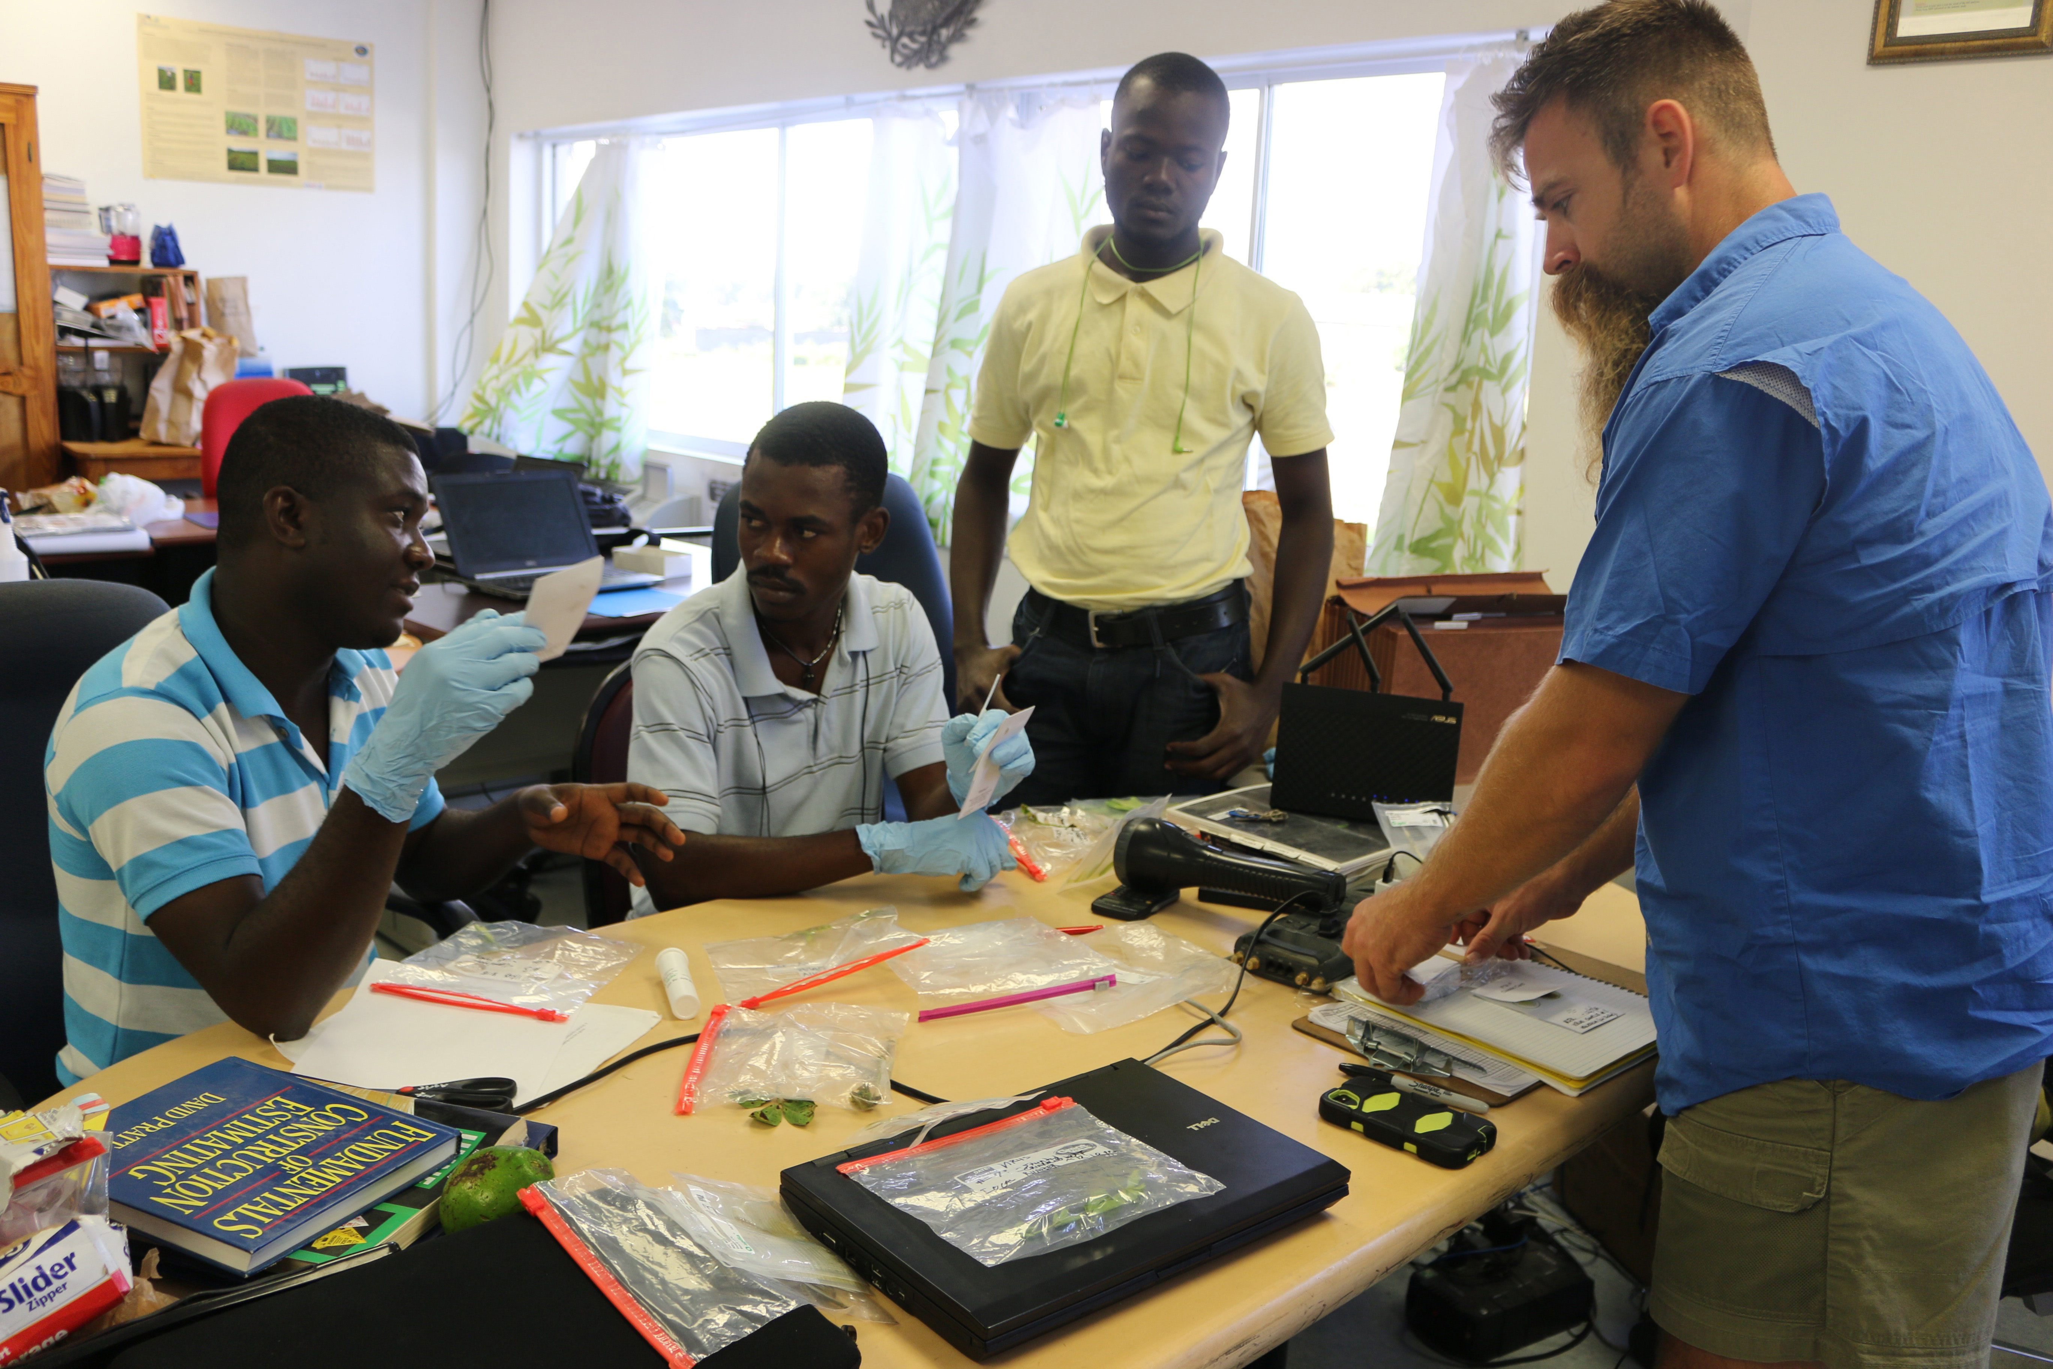
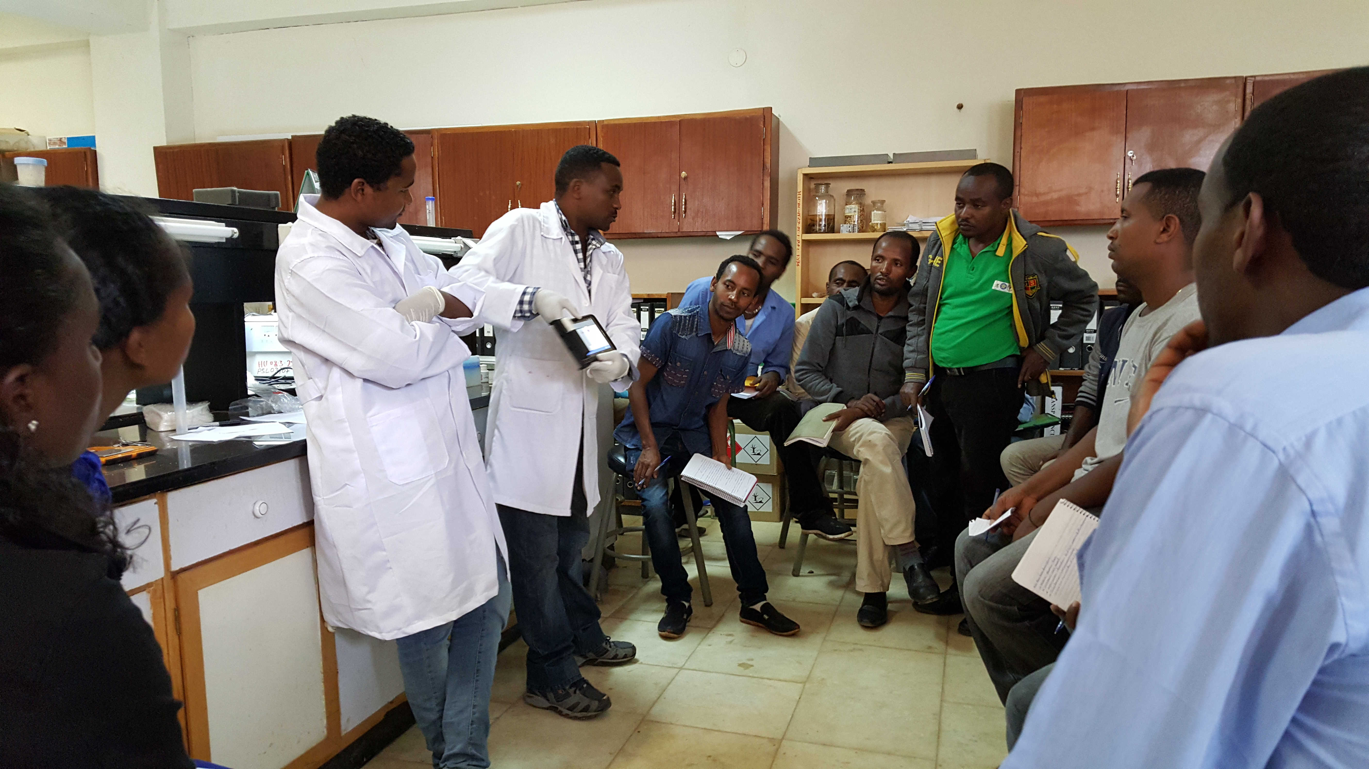
Capacity Building
MSc & PhD students
Short-term training
Training videos, manuals, guides
Infographics

Slide 16
Request for Proposals
Areas of Inquiry
Peanut Varietal Development
Value-added Gains
Other areas (nutrition, gender & youth) will be announced soon
Awards
Length: 2-4 years (~1 Aug 2018 – 30 Sep 2022)
Amount: up to $500,000 total
Target countries
First priority
Ethiopia, Ghana, Mali, Niger, Nigeria, Senegal & Uganda
Second priority (need strong justification)
Haiti, Malawi, Mozambique & Zambia

Slide 17
The Request for Proposals
Important Dates
14 March RFP Release
23 March Webinar
20 April Concept Notes due
7-9 May Review of Concept Notes (ME, AOR, EAP)
11 May Request for Full Proposals
15 June Full Proposals due
1 August Expected starting date
Submission website: www.rfx.piestar.com/peanutlab

Slide 18
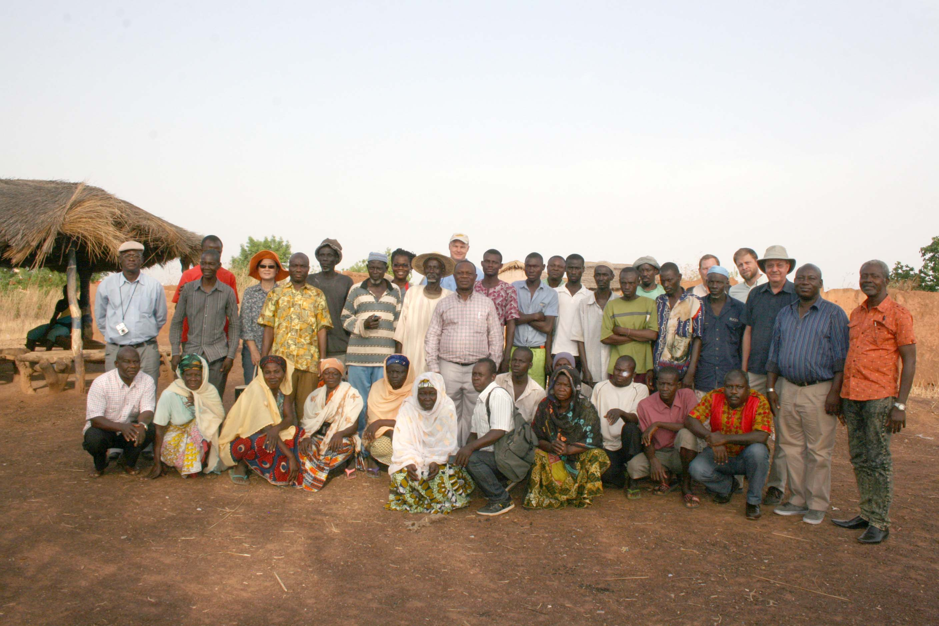
THANKS!

