Slide 1
Student Evaluation Workshop How To’s and Don’t Do’s
Kerri L Ford
Institutional Research
Unit Coordinator
Mary Elkins
Institutional Research
Unit Manager
2013 - 2014

Slide 2
OVERVIEW
Student Evaluation of Course and Instructor
Organized Courses.
Lectures, credit labs, no-credit labs, seminars and special requests
The cover sheets are new and Spice in color.
The answer sheets are red.
Blue or black ink and pencil
Other colors will not scan
Evaluation Packets (originals) must be retained in your department for at least six (6) years.

Slide 3
EVALUATION PACKETS
Evaluation Packets will be delivered to you by MailTech
Packets will include
A report listing all classes that have preprinted coversheets (checklist)
Instruction sheet for evaluation contact
Computer Center mailing label with contact information
Instructions for the Student, Proctor and Instructor
Preprinted coversheets
Blank coversheets
Evaluation forms

Slide 4
DISTRIBUTION
Getting the evaluations to the Students
A proctor should be chosen – either by you or the instructor
Encourage them to read the instructions
Place evaluation forms in an envelope
Instructor’s name, course and section.
Student Instructions
Can be read to the students by the proctor
Also available electronically
Do not send coversheets into the classroom.

Slide 5
DISTRIBUTION
Getting the evaluations back
Completed evaluations are to be brought back directly to you
The instructor is not to be in contact with the evaluation packets
If the students believe the evaluations are going straight from them to the instructor – we will get biased evaluations.
Once you receive the evaluations back add the correct coversheet to the envelope.

Slide 6
PREPRINTED COVER SHEETS
Preprinted Cover Sheets
Cover sheets are provided for all organized courses.
Some exceptions:
You can request classes be added to your preprinted list
However, when adding courses to the list all courses of that type will be included
Requests to add classes will not take effect until the following semester
Dual-instructed courses
Pre-printed sheet only for the first instructor listed

Slide 7
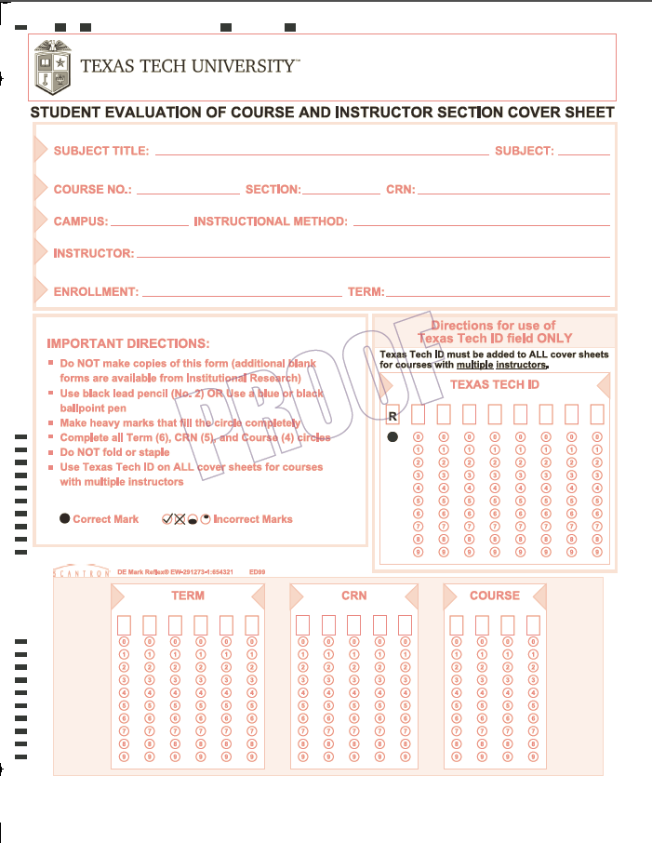
COVERSHEET

Slide 8
INSTRUCTOR INFORMATION
Where did this information come from?
Banner
SSASECT Form

Slide 9
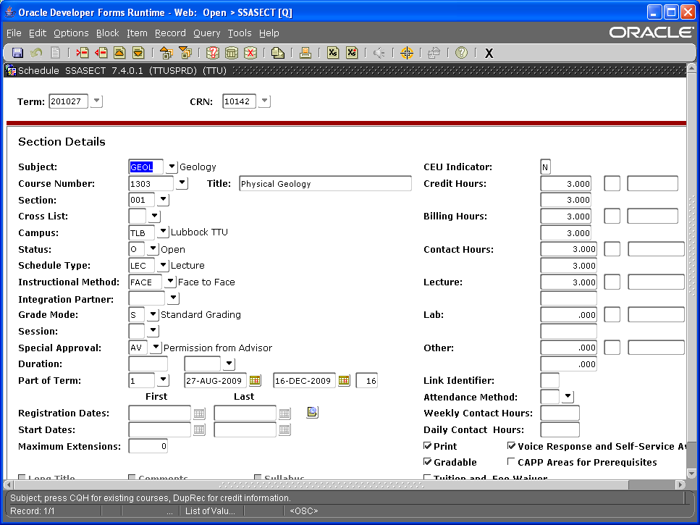
Banner, SSASECT Form

Slide 10
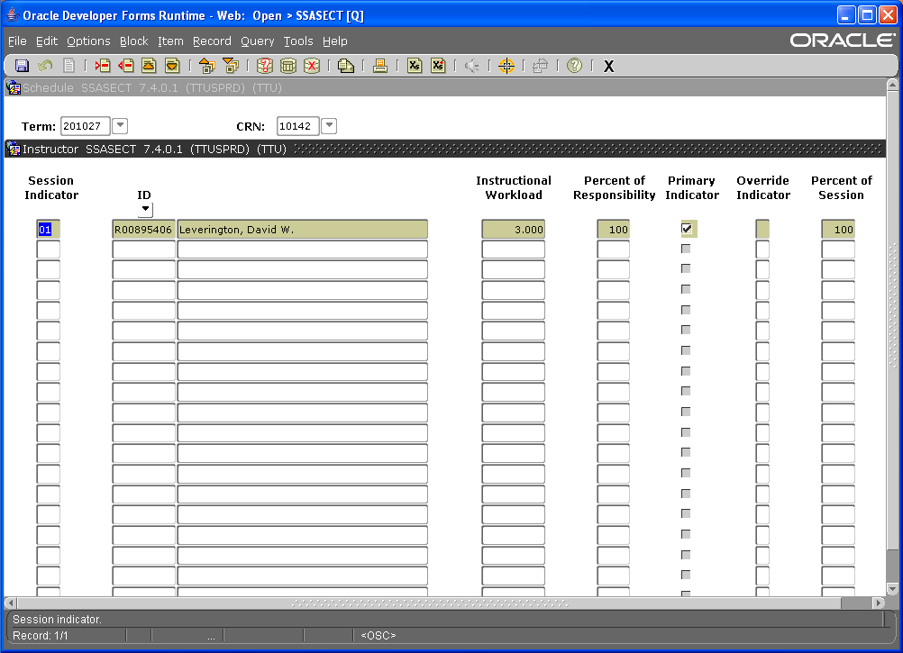
Banner, SSASECT Form, Instructor

Slide 11
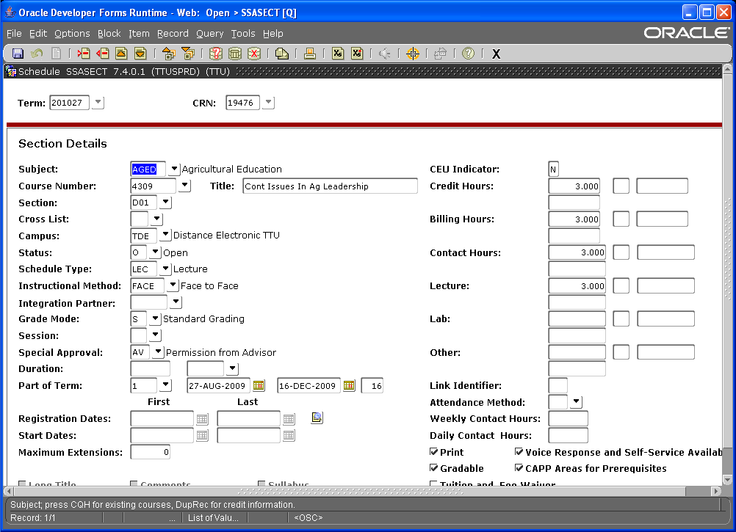
Banner, SSASECT– DISTANCE EDUCATION

Slide 12
INSTRUCTORS OF RECORD
Evaluations will only be credited to the Instructor of Record listed in Banner.
If a course is taught by someone not listed as the Instructor of Record, they will not receive credit for the course.
We are no longer able to change the Instructor of Record on a course.
This does not apply to non-credit labs.

Slide 13
DUAL INSTRUCTOR COVER SHEETS
Dual Instructed Courses
One set of evaluation sheets per instructor
Two coversheets
One preprinted coversheet
Handwritten coversheet for the other instructor
Instructor’s Texas Tech ID number
Both sheets
R number

Slide 14
HAND WRITTEN COVERSHEETS
Hand written coversheets must be filled out correctly!
Top portion completed
This includes the Subject Title, Subject, Course, Section, CRN, Campus, Instruction Mode, Instructor, Enrollment and Term
Bottom portion completed AND match the top
This includes the Term, CRN, and Course
If this is the second coversheet for a dual taught course it should also have the Texas Tech ID. As should the preprinted coversheet ☺
Bubbles have to match too!

Slide 15
PACKAGING THE EVALUATION PACKETS
Getting the Evaluation Packets ready to send to the Computer Center
Coversheets
Is there one per packet?
Is it on top of the evaluation forms?
DO NOT
Staple, paper clip, binder clip, tape or fold the evaluation forms
Add sticky notes
Seal the envelopes the evaluations are in

Slide 16
PACKAGING THE EVALUATION PACKETS
Once you have all your evaluation packets
Together
As they trickle in
Package
Box
Rubber band
Mail
Label with contact information
Problem - Computer Center will call you

Slide 17
MAILTECH
Call MailTech
MailTech’s phone number is 742-2286
Ready to go!
How many boxes?
Use this service!
No charge to you

Slide 18
COMPUTER CENTER DEADLINE
Fall 2013 - Monday, December 16, 2013
Spring 2014 - Monday, May 19, 2014
Grades are due
Computer Center due date
Can not accept after this date
Contact MailTech no later than the Wednesday prior to due date

Slide 19
RETURN OF PACKETS
Getting your packets back
Keep them handy
Scanned/non-scanned reports
Problems

Slide 20
REPORTS
Scanned and Non-scanned Reports
Generated after all scanning
Scanned Report
Everything that has scanned
Will include handwritten coversheets
Non-scanned Report
Things that didn’t scan
Based on our original list
Handwritten coversheets that did not scan will NOT be on this list

Slide 21
REPORTS
Scanned and Non-scanned Reports
Email reports in spreadsheet format
Pay attention now
Problems?
Contact me
Have the packet handy
We will go from there

Slide 22
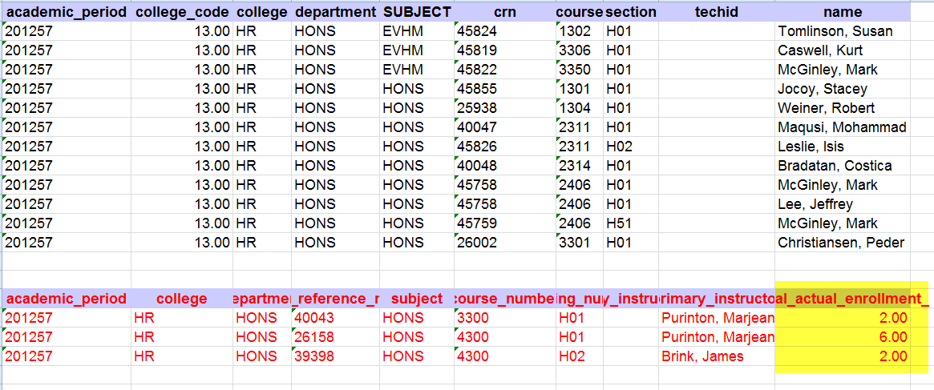
Scanned and Non-Scanned Report

Slide 23
REPORTS
Final Report
Generate online report information
Scanned/non-scanned information
Corrections
Data Warehouse
Generate custom reports or Common reports
Common reports access
Department Chair
Request sent to Mary Elkins via email
Contain your eRaider name

Slide 24
OP 32.32, Volume 1, No 3, paragraph C
Evaluation Packets must be retained by your department for at least six (6) years.
OP 32.32, No 3, paragraph C
c. Student evaluations of teaching ability will be conducted at least once each academic year by each faculty member using a standard university form (see Attachment B). Other evaluation forms may be used in addition to the standard one if the faculty member chooses to do so. These evaluations should not be available for review by the faculty member until after submission of final grades. The evaluations will be considered by the chairperson/coordinator in the annual performance evaluation of faculty members. Student evaluations should be retained in the department office for at least six years. Student evaluations should be retained or summarized for probationary faculty for use in tenure decisions.

Slide 25
LEFTOVERS
Leftovers
Send back
Coversheets
Evaluations
Send to:
Institutional Research
MS 2017

Slide 26
Institutional Research
Looking for more information
Please visit our web site: www.irim.ttu.edu
Confused or questions
Call Kerri Ford 834-2991
Mary Elkins at 834-0844
email us.

