Slide 1
Intro to Microsoft Word
ShortCourse Handout

Slide 2
Copyright © 2022 Texas Tech University. ALL RIGHTS RESERVED. Members of Texas Tech University or Texas Tech Health Sciences Center may print and use this material for their personal use only. No part of this material may be reproduced in any form without written permission from the author.

Slide 3
Introduction
Microsoft Word allows users to be able to:
- Create documents from scratch, or a template.
- Add text, images, art, and videos.
- Share your documents and work with others.
- Track and review changes.

Slide 4
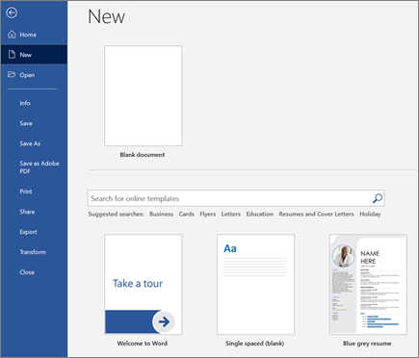
Create a document
On the File tab, click New.
In the Search for online templates box, enter the type of document you want to create, and press ENTER.

Slide 5
Adding Page Numbers
Click Insert
Click Page Numbers

Slide 6
Add Pictures, Shapes, SmartArt, Chart, and more
Select the Insert tab.
Select what you want to add:
Tables
Pictures
Shapes
Icons
3D Models
SmartArt
Chart
Ect.

Slide 7
Ribbon Extras
Watermark
Page Borders
Format Background
Ruler

Slide 8
Add text
Place the cursor where you want to add the text.
Start typing.

Slide 9
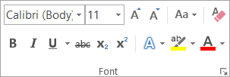
Format text
Select the text you want to format.
Select an option to change the
font,
font size, font
color,
or make the text
bold,
italics,
or underline.

Slide 10
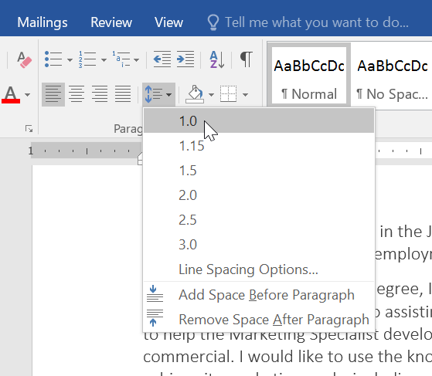
Line and Paragraph Spacing
On the Home tab, click the Line and Paragraph Spacing command, then select the desired line spacing.

Slide 11
Lists
Select the text you want to format as a list.
On the Home tab, click the drop-down arrow next to the Bullets command. A menu of bullet styles will appear.

Slide 12
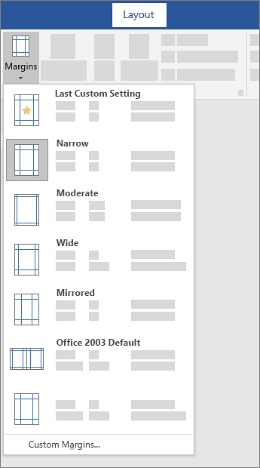
Page Layout
Select Layout > Margins. ﻿
Select the margin configuration you want or select Custom Margins to define your own margins.

Slide 13
Collaborative Editing
* When reviewing a document during collaboration, make sure that you select reviewing.

Slide 14
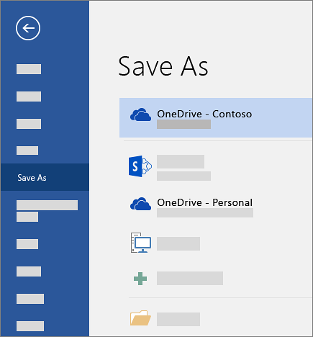
How to SAVE
Go to File > Save As (or Save a Copy).

Slide 15
Recommended FREE Online Resource
Udemy: http://cbt.ttu.edu/

Slide 16
Resources
This handout was created using information from the following sites:
https://support.microsoft.com/en-us/office/create-a-document-in-word-aafc163a-3a06-45a9-b451-cb7250dcbaa1?wt.mc_id=otc_word#
https://edu.gcfglobal.org/en/topics/word/

Slide 17
Assistance at TTU
For technical assistance, please contact IT Help Central at (806) 742-HELP or ithelpcentral@ttu.edu.
More information and training resources, including training videos, can be found at:
http://unifiedcommunications.ttu.edu. You can also contact IT Education Services at iteducation@ttu.edu or call the ATLC at (806)742-1650.

