Slide 1
Communicating with your Teachers

Slide 2
Check the class’s syllabus
Send them a message
Wait for a response
HOW TO
COMMUNICATE
WITH YOUR
TEACHER

Slide 3
When you start a class make sure to check out the syllabus. The syllabus will tell you whether you can reach your teacher through:
A message on Blackboard
Email
Another way
Every teacher is different, so look at the syllabus to know.
CHECK THE
CLASS’S
SYLLABUS

Slide 4
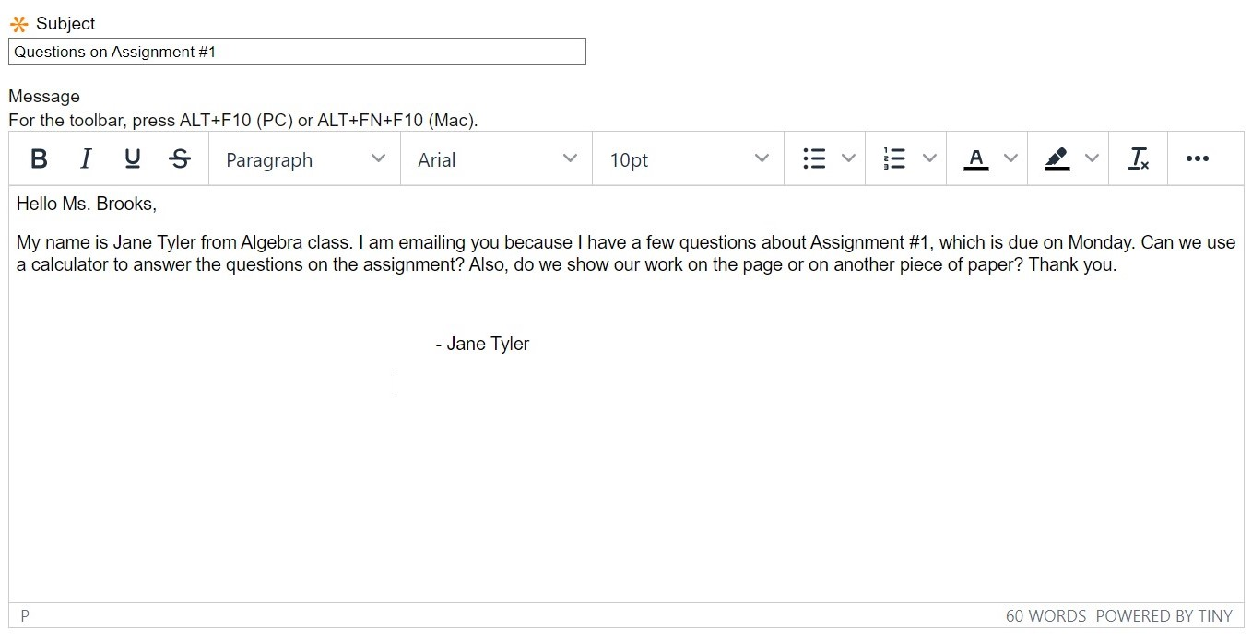
Once you know how to reach your teacher, you can now go ahead and message them! When messaging them, make sure to include:
Your name
Their name
Which class you are in
Why you are messaging them
Optional: Include photos or documents that relate to why you are messaging them
SEND THEM A
MESSAGE

Slide 5
After sending a message, wait a maximum of
3 days before sending them another message.
The teacher might not respond to your message after school hours. Make sure to not message them at the last minute.
WAIT FOR A
RESPONSE

