Slide 1
CONVERSION OF MUSCLE TO MEAT
ANSC 3404
Objectives: To learn the process of converting live muscle to meat.

Slide 2
Overview
Muscles do not suddenly eliminate all living functions
A number of physical and chemical changes occur over a period of hours or days
While homeostasis is maintained within living muscle homeostasis is lost during the conversion of muscle to meat
  Temperature, pH, oxygen…

Slide 3
Importance
Conditions immediately prior to slaughter may alter postmortem changes that affect meat quality
  Transportation, handling, and holding
Extrinsic factors immediately following slaughter may influence postmortem changes that affect meat quality
  Chill rate, electrical stimulation

Slide 4
Factors to Consider
Extensibility and degree of final contraction
pH
Water holding capacity (WHC)
Proteolytic enzymes

Slide 5
Events: Muscle to Meat
Animal is slaughtered.
Metabolism Shifts From Aerobic To Anaerobic State When O₂ Is Depleted.
Glycogen is converted to lactic acid, lowering muscle pH from ~7 to 5.6.
Creatine Phosphate (rephosphorylates ADP to ATP) and ATP decline.
W/O ATP for relaxation, myosin heads form a tight bond with actin (Actomyosin).
Muscle goes into rigor mortis (The “Stiffness Of Death”).
Proteolysis begins, tenderizing muscle

Slide 6
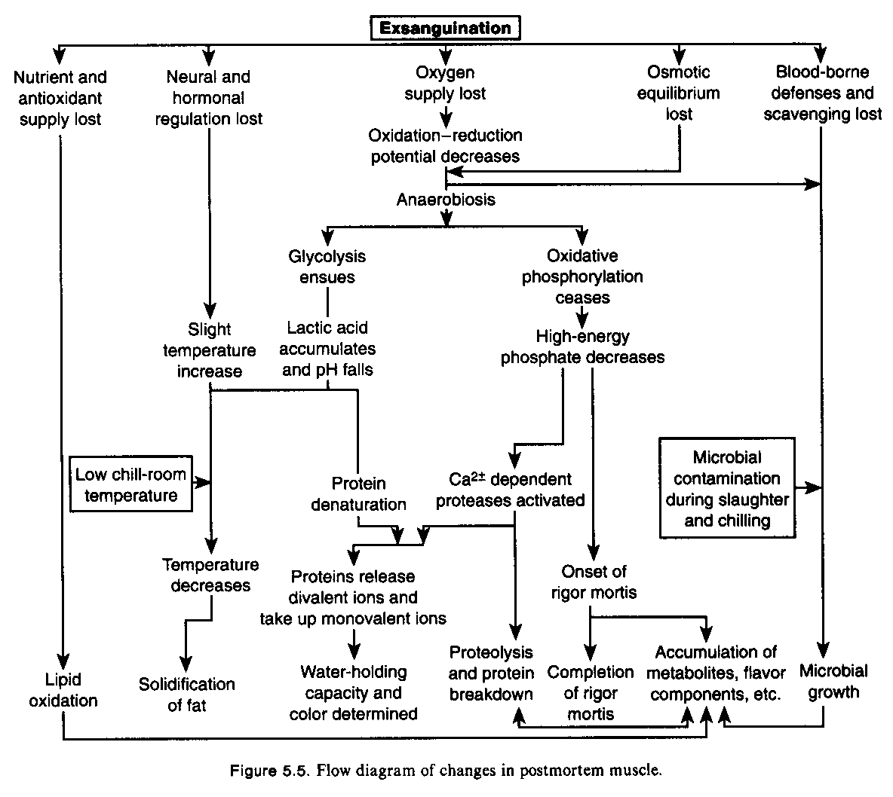

Slide 7
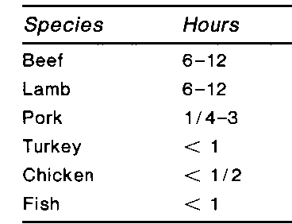
Time to the Onset of Rigor

Slide 8
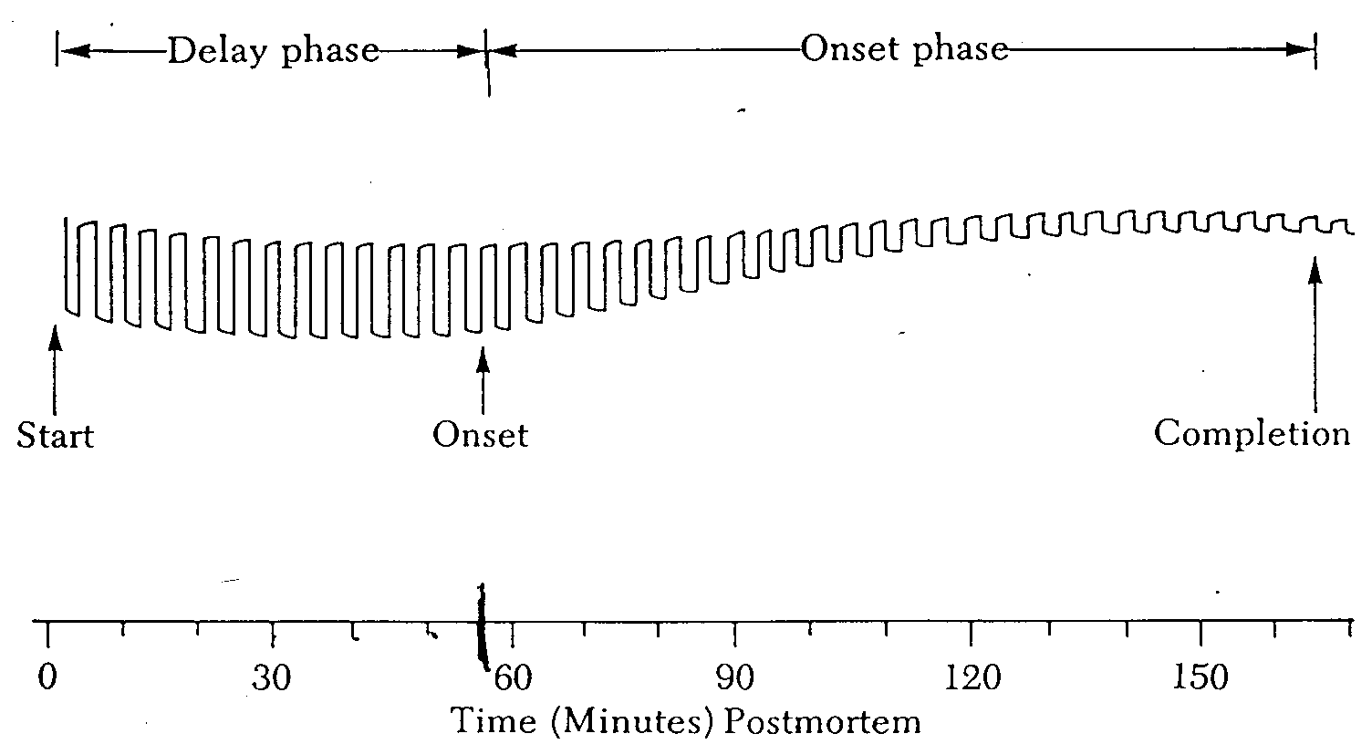
Extensibility of Muscle During Rigor Development
(Muscle is extensible and elastic)
(Muscle begins to lose extensibility)

Slide 9
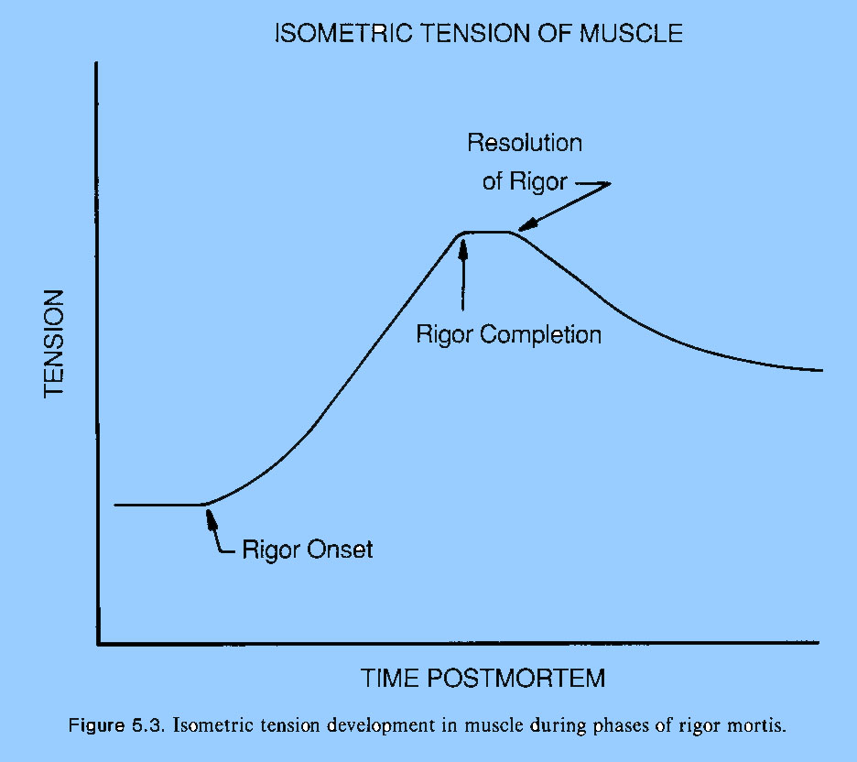

Slide 10
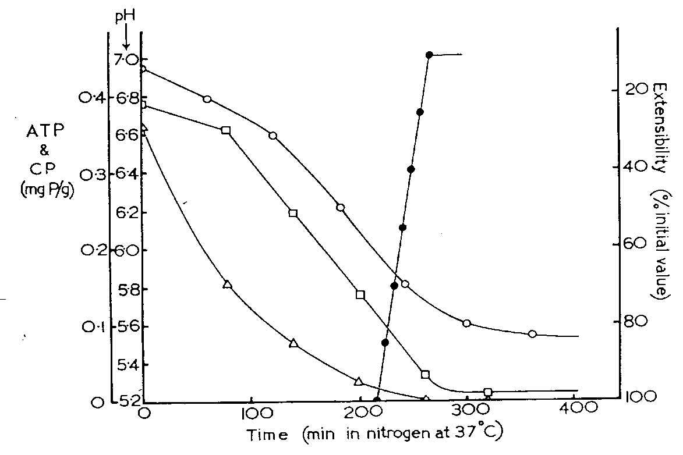
ATP, CP, pH and Extensibility Postmortem
Muscle Extensibility
Muscle pH
ATP
Creatine Phosphate

Slide 11
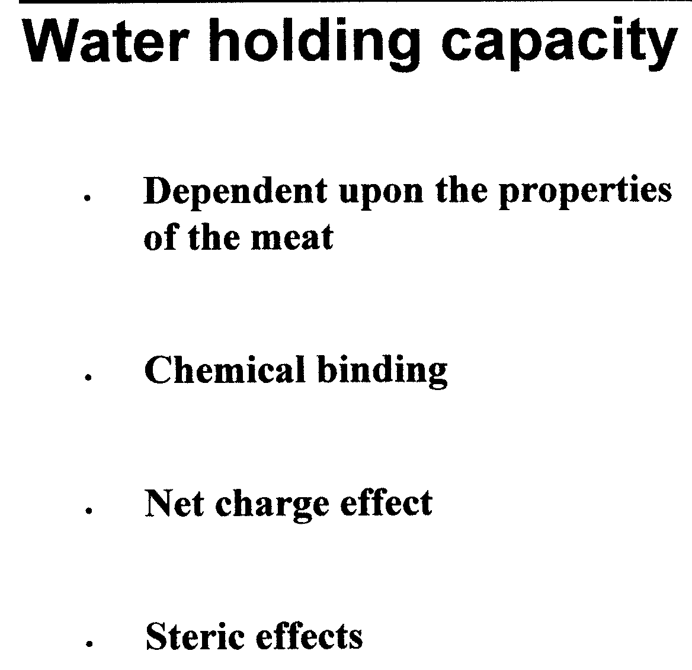
WHC – the ability of meat to retain water during application of external forces such as cutting, heating, grinding, or pressing.

Slide 12
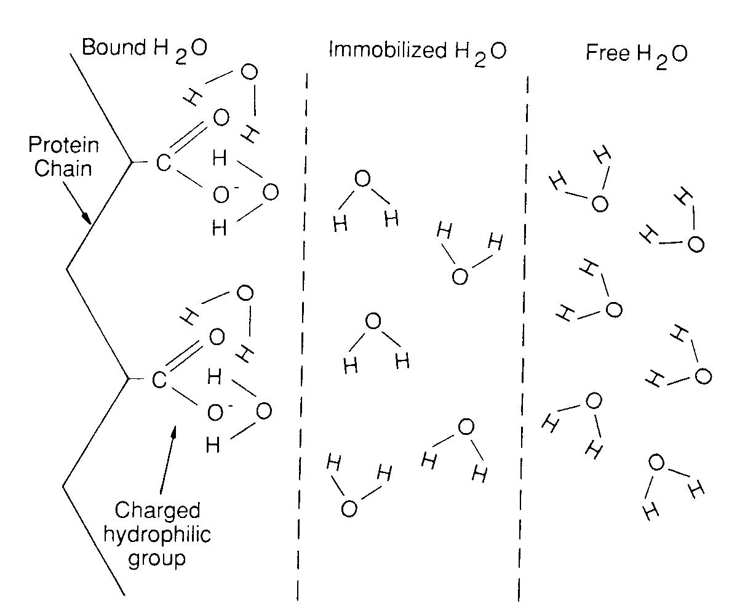
Free – held on by capillary forces, and their orientation is independent of the charged group.
Bound – hydrophilic groups on muscle proteins attract H₂0, forming a TIGHTLY bound layer.
Immobilized – has less orderly molecular orientation toward the charged group.

Slide 13
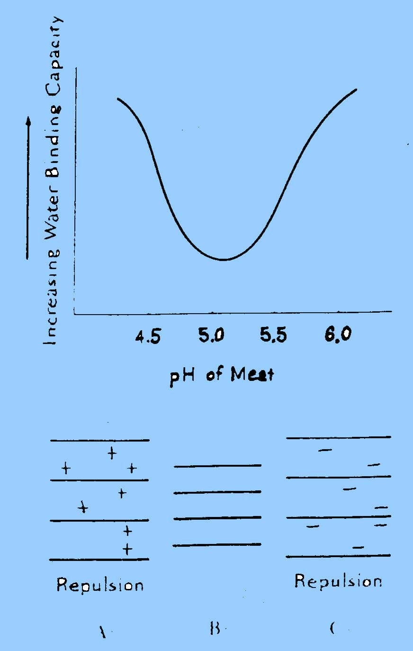
Isoelectric point of muscle vs. its pH
(All charges equal not allowing any charge available to hold the bound and immobilized water)
Greatly affects water-holding capacity (WHC)
WHC – the ability of meat to retain water during application of external forces such as cutting, heating, grinding, or pressing.
pH of normal meat
Isoelectric point
~5.1

Slide 14
Calpains and Calpastatins
Calpains (Calcium-activated Proteins) degrade proteins during cooler aging
Calpastatins inhibit the action of calpains (Brahman cattle contain higher levels)
Thus, if an animal has a higher calpastatin level, the calpains are less active, and cooler aging has less affect on muscle tenderness. Brahman cattle are naturally tougher because of higher contents of calpastatin.

Slide 15
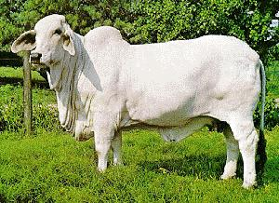
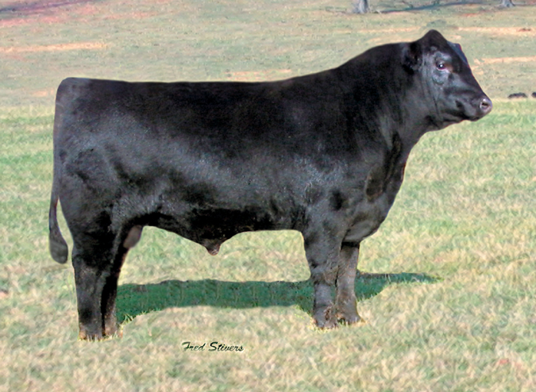
Brahman
Angus

Slide 16
Pre-Harvest Issues

Slide 17
PSE and DFD Muscle
Poultry and pigs carry one or two copies of the Malignant Hypothermia (Halothane) gene
  These animals are prone to pale, soft, and exudative (PSE) muscle.
Antemortem stress (short term stress) usually increases the severity of PSE.
Muscle pH drops very fast, body temp increases causing the meat to be pale in color, soft in texture with exudation of water.
Negative impact on consumer sales appeal and shrinkage is greatly increased.
PSE can be trigger in halothane free animals

Slide 18
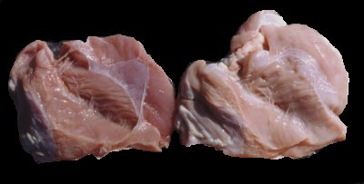
PSE in Turkey
Normal
PSE

Slide 19
DFD - “DARK CUTTERS”
Caused by a shortage of glycogen at slaughter (long term stress).
Without enough glycogen to convert to lactic acid, the muscle pH stays high, closer to 7.0 (living muscle pH)
Antemortem stressors cause DFD.
Results in muscle too dark in color, firm in texture, and dry on muscle surface (the opposite of PSE muscle); is sweeter.
Beef has the most DFD problems.
Rare in poultry

Slide 20
Dark Cutter vs Normal

Slide 21
Postmortem Issues

Slide 22
Thaw Rigor Events
Muscle is frozen before rigor mortis occurs –
  ATP hasn’t been used in rigor mortis events and is high when the muscle is frozen.
Freezing damages the SR.
When thawing occurs, calcium is released from the SR, causing a massive contraction because of the high ATP level. Toughening results.

Slide 23
Cold Shortening
Similar events occur when cold muscle shortens except it isn’t frozen (chilled below 15ºC – 16ºC b/f onset of rigor mortis occurs).
Because of too quick chilling, the SR is unable to hold the calcium.
Muscle contraction occurs while ATP still is available.
Electrical stimulation helps prevent cold shortening by using up the ATP in contractions.

Slide 24
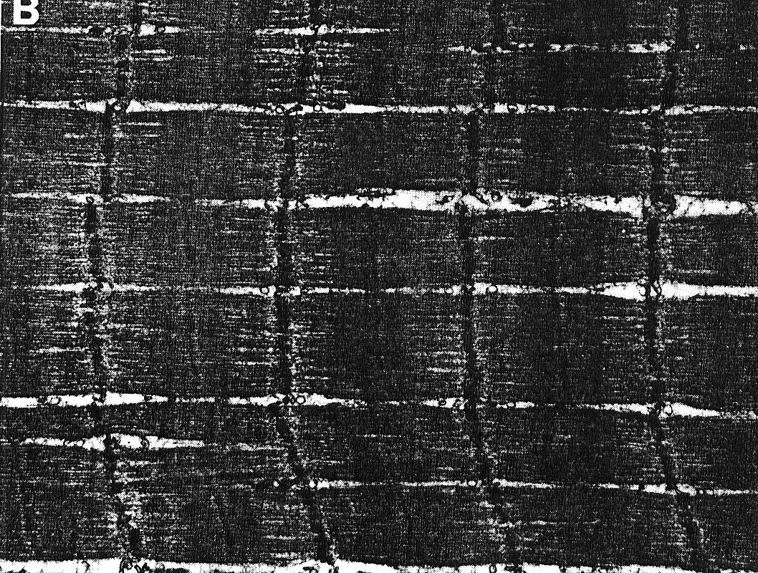
Cold Shortened Muscle

Slide 25
Heat Ring
Found in carcasses with a thin rind (lean carcass not chilled properly).
Beef carcasses need at least 0.25 in of backfat whereas lambs need at least 0.10 in of backfat.
Outer ring of muscle gets cold too quickly
  has slower glycolytic rate
  slower pH decline
  longer time until rigor develops
Result is an undesirable ring around the muscle that is darker in color, coarser in texture.

Slide 26
Blood Splash
Caused by rupture of capillaries, usually between stunning and sticking times; blood pressure skyrockets after stunning
Result is small blood spots in muscles; most problem in hogs and poultry.
An excessive stun:stick interval can cause blood splashing as can excitement before stunning.
If in fat, is called “Fiery Fat”.

Slide 27
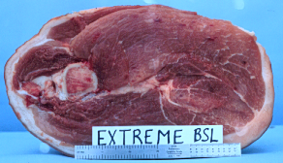
HEMORRHAGES

Slide 28
Blood Splash Lean

Slide 29
Quality Solutions

Slide 30
Electrical Stimulation
Benjamin Franklin (1749) discovered it in Turkeys…he discovered that electricity made them “uncommonly” tender.
Passing electrical current through carcasses to cause muscles to contract and use up their ATP…therefore, induce rigor mortis.
Reduces heat ring and cold shortening and may increase tenderness of low grading carcasses.
Brighter muscle color causes marbling to show better.
ES will improve overall carcass merit

Slide 31
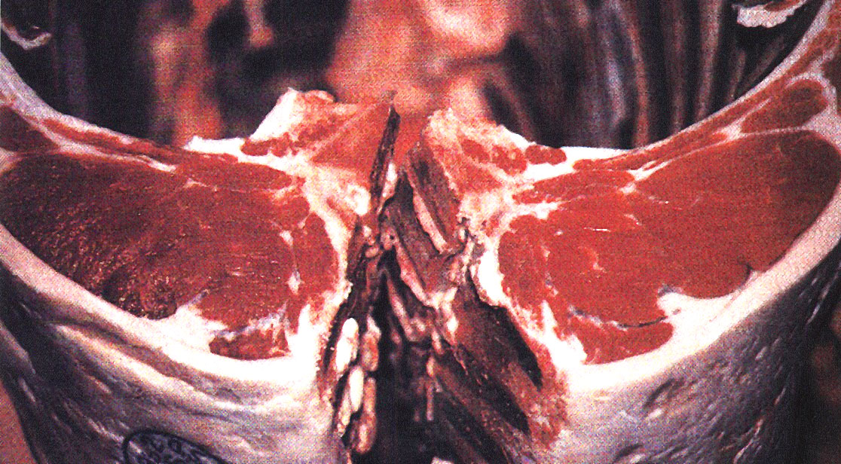
NO ES ES

Slide 32
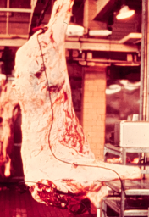
A beef side being stimulated in a laboratory setting - muscle contractions are violent.

Slide 33
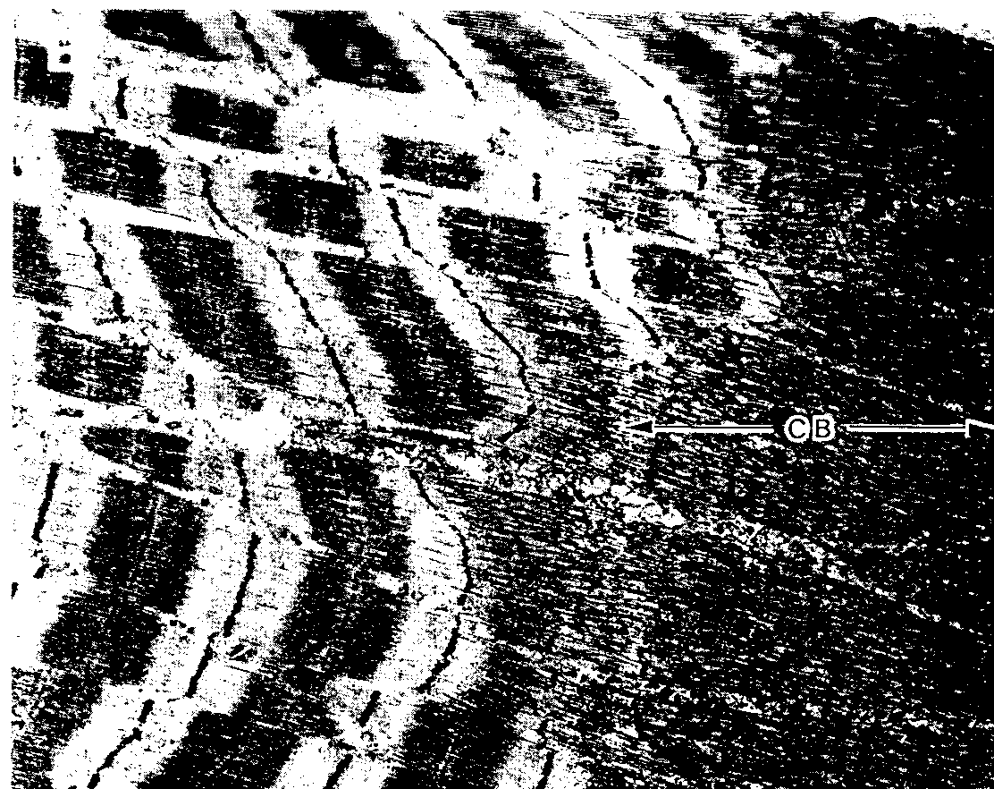
Contracture Band after Electrical Stimulation

Slide 34
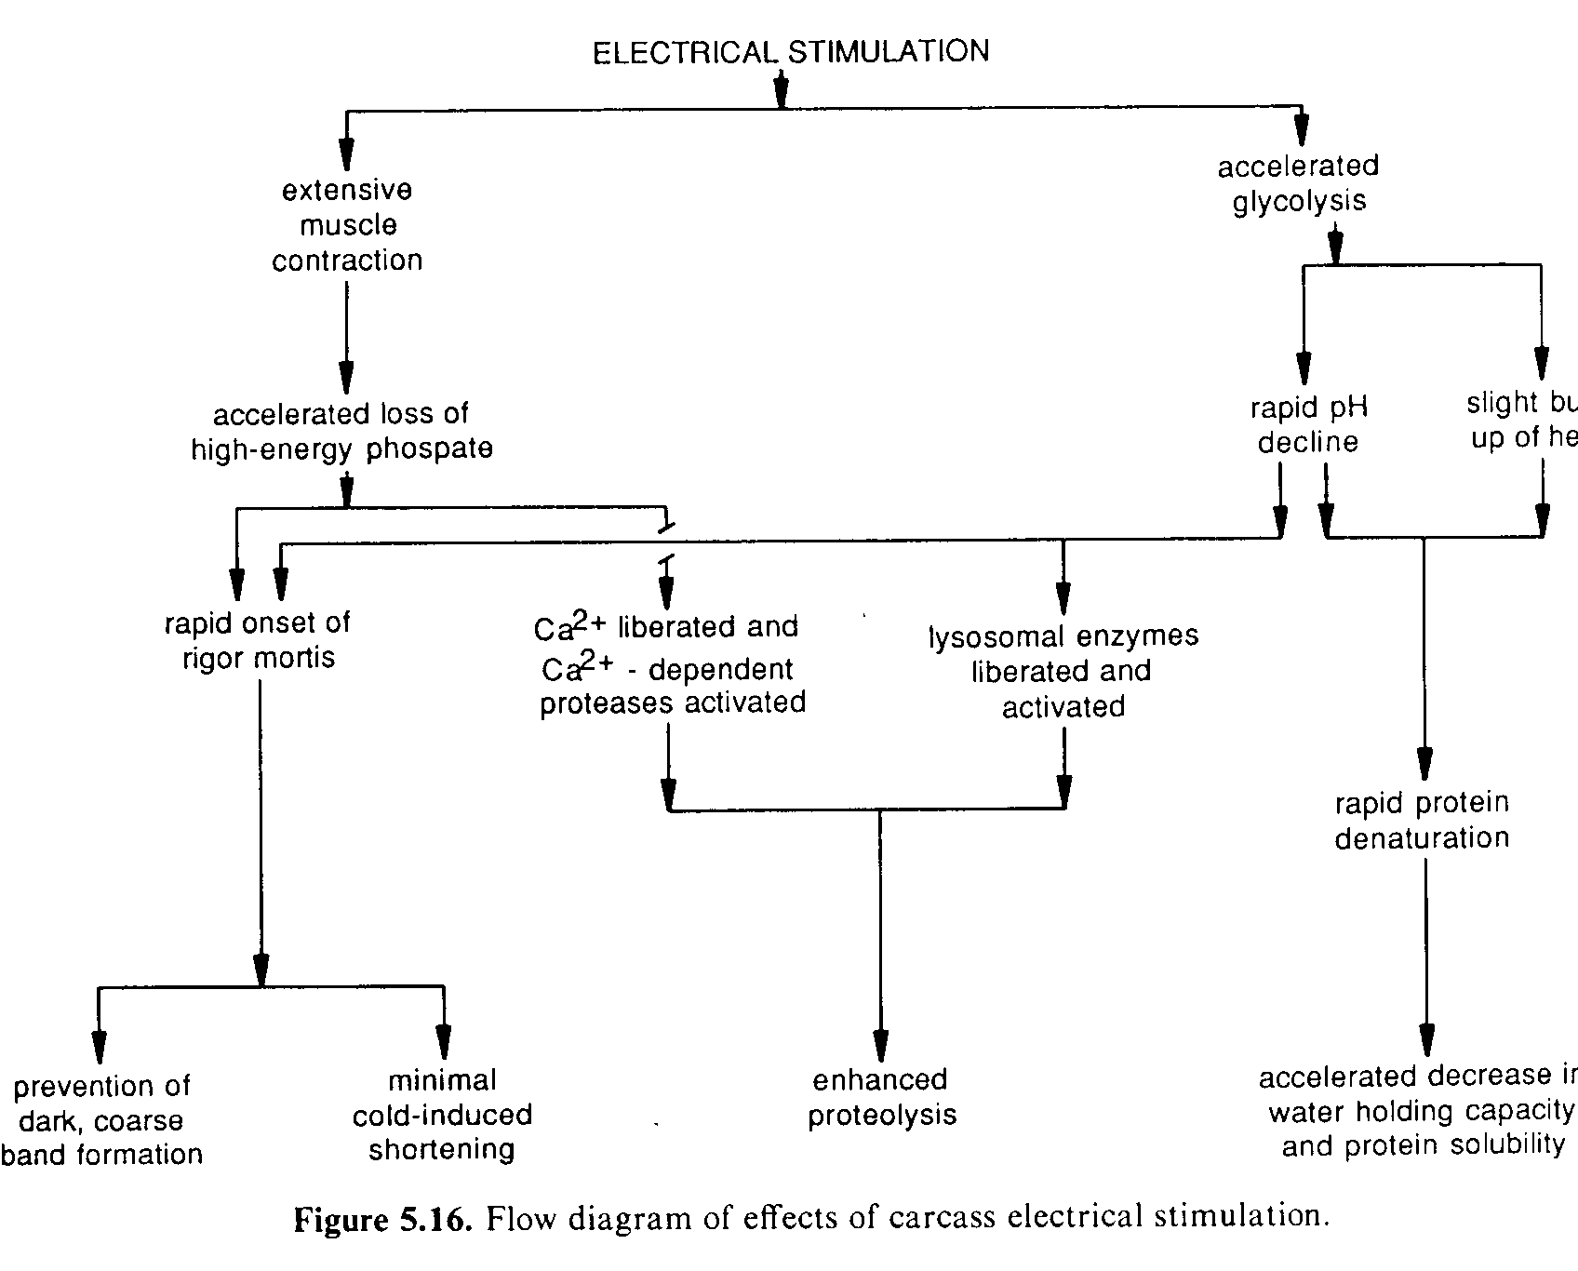

Slide 35
Hot Boning
Is desirable because hot-boned meat has a higher water holding capacity.
Prevents rapid pH drop in muscle.
Without skeletal restraint, muscles shorten and become tough if allowed to go through rigor not ground.
Injecting muscles with salt & PO₄ can lessen tenderness problems.

Slide 36
Delayed Chilling
Hold carcasses at room temperature for 2 to 4 hours after dressing.
Presents microbial problems.
Glycolytic rate is faster at the higher temperatures, ATP is depleted, and cold shortening is prevented. Aging is accelerated.
Is used on lambs in New Zealand

Slide 37
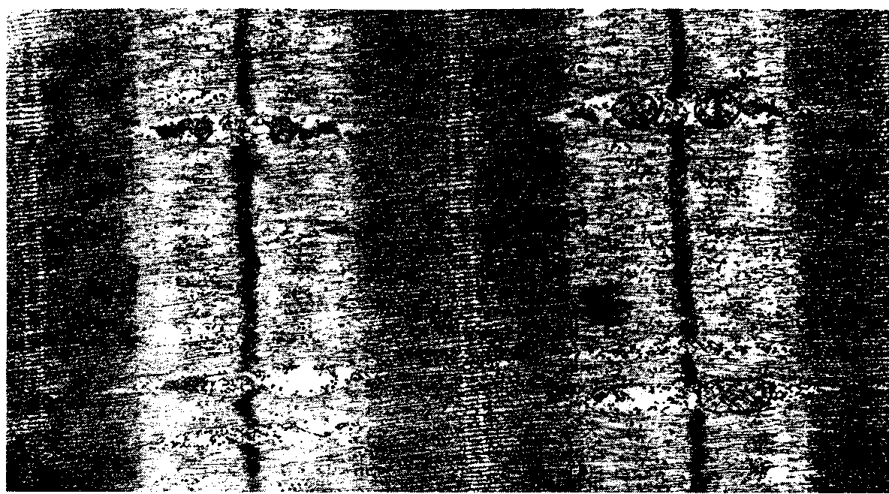
Bovine Muscle at Death (X 14,800)
Note the Integrity of the Z Disks

Slide 38
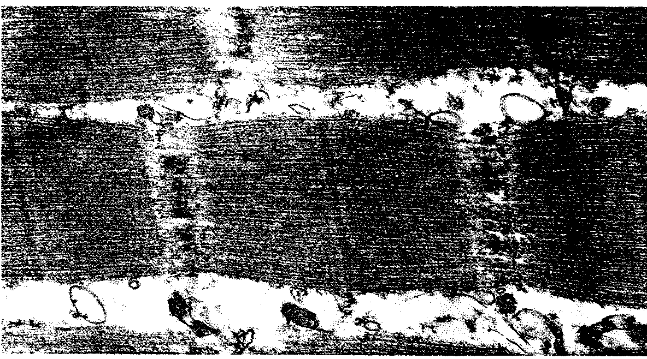
Bovine Muscle After 24h
NOTE DEGRADATION OF THE Z DISKS

Slide 39
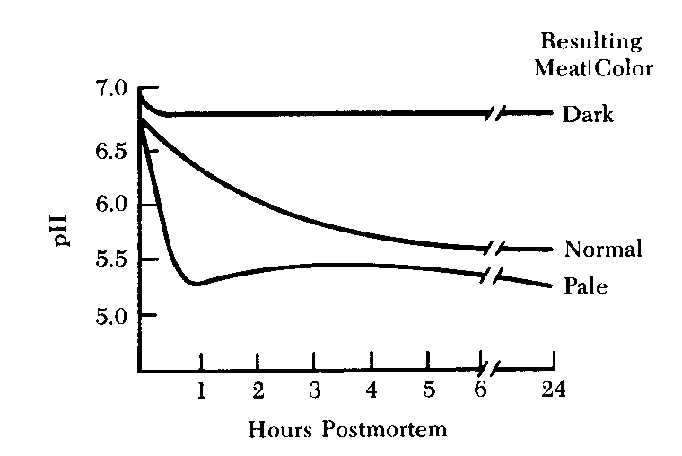
Rate of pH Decline Affects Muscle Properties

Slide 40
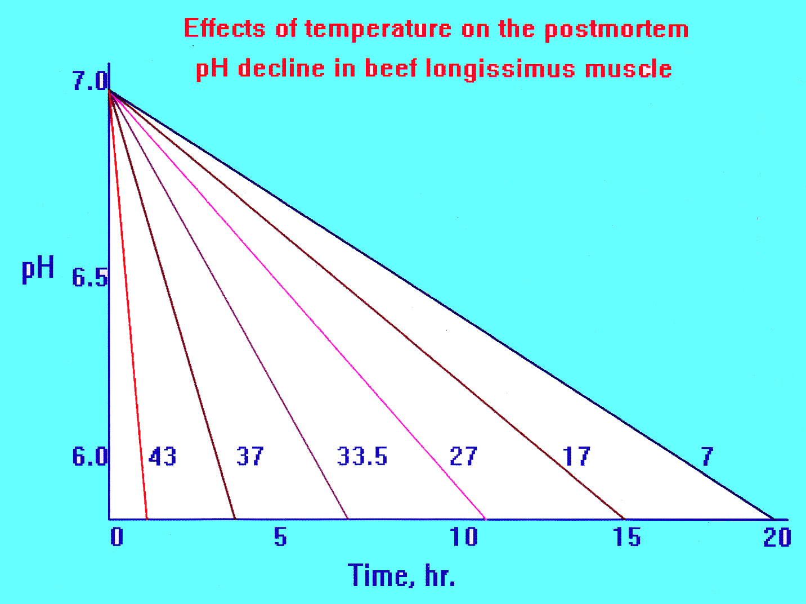
TEMPERATURE OF THE CHILL COOLER

Slide 41
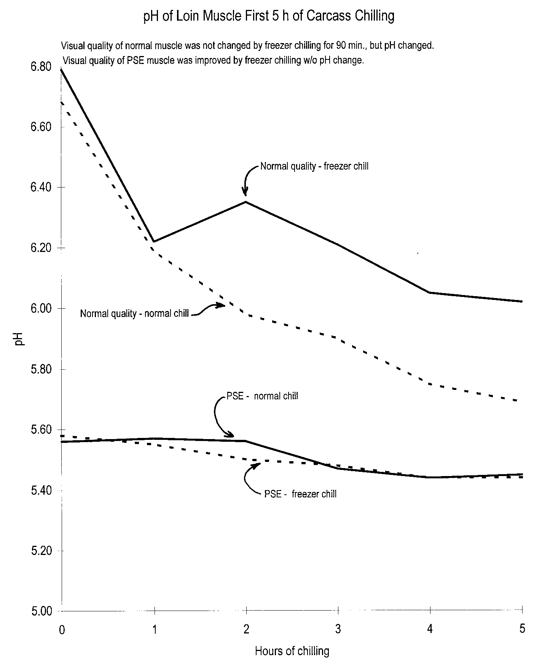

Slide 42
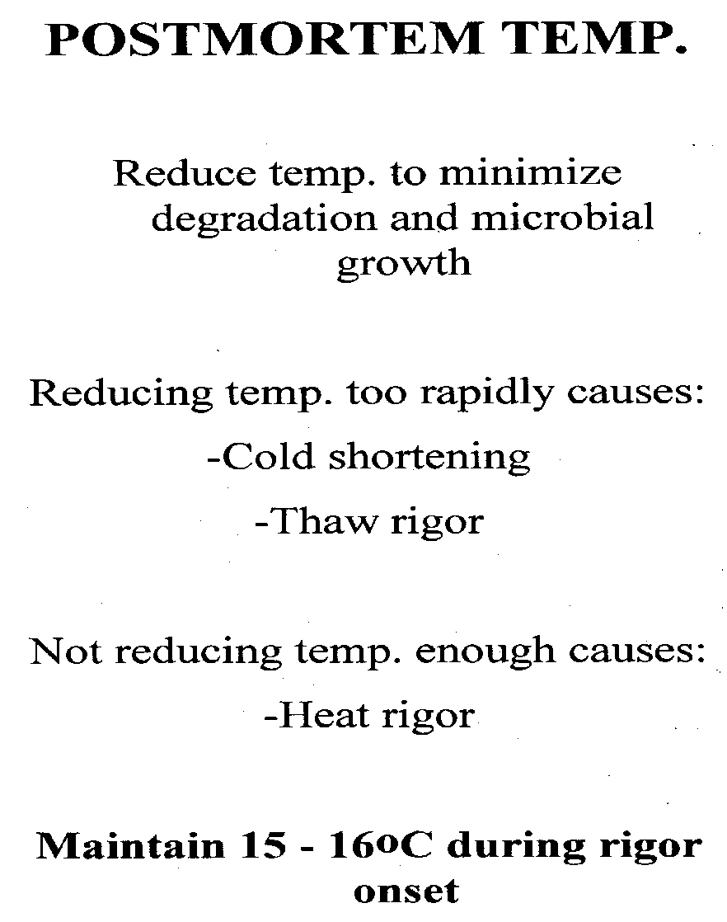
Summary of Temperate Efforts

Slide 43
End

