Slide 1
Meat Color
ANSC 3404

Slide 2
Meat Color
Meat color is very important because it affects consumer purchase decisions
Research continues to find ways to improve the length of time a product stays “bright red” in the meat case
The protein responsible for meat color is myoglobin

Slide 3
Meat Color
Dependent on
  Pigment content
  Ultimate pH and rate of pH decline postmortem
  Nature of group attached to the iron and the state of the iron
  Ingredients, processing, packaging

Slide 4
Meat Color – Pigment Content
Pigments
  Two main pigments: myoglobin and hemoglobin
  Majority of color is due to myoglobin

Slide 5
Myoglobin
Accepts oxygen from hemoglobin
Stores oxygen for use by the living muscle
Contains a globin protein attached to a porphyrin ring containing a heme iron
Nature of the group attached to the iron, and the state (covalent or ionic) of the iron determines meat color

Slide 6
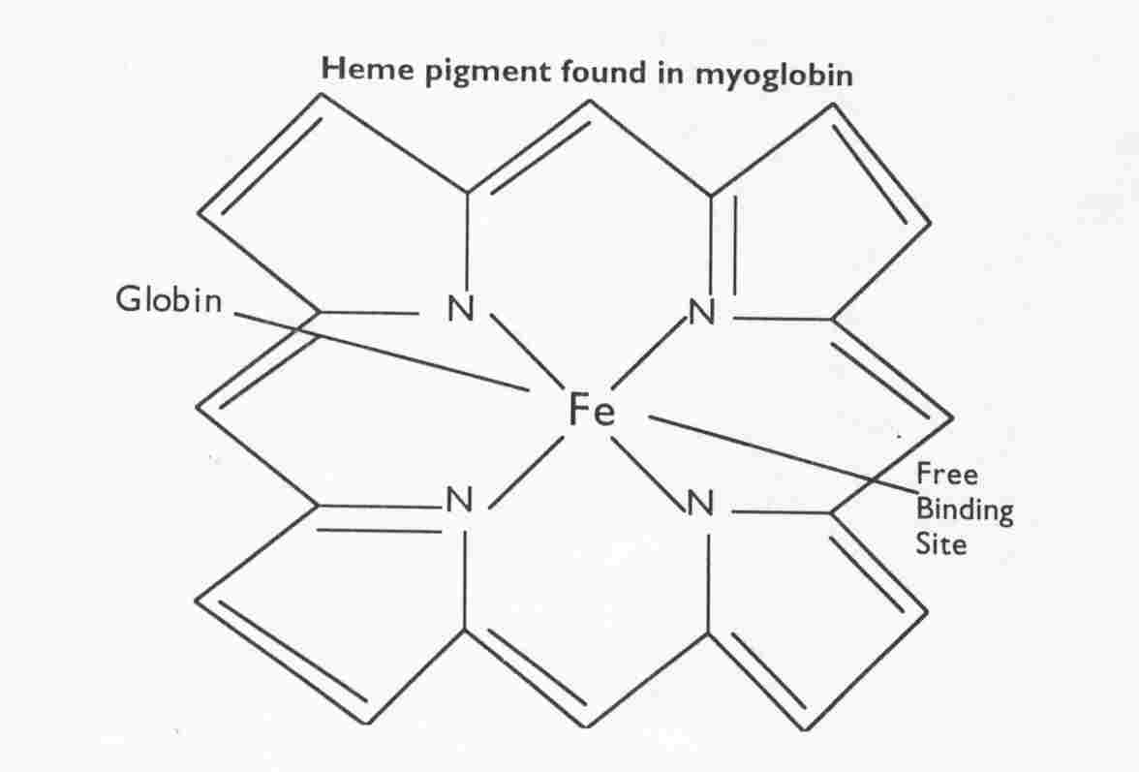

Slide 7
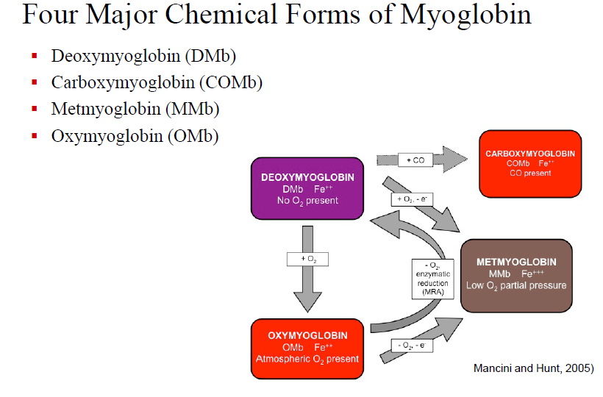
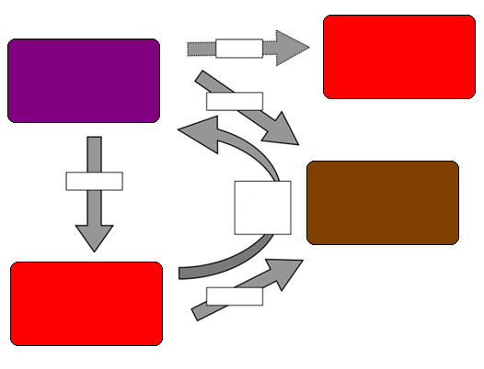
Carboxymyoglobin
COMb, Fe⁺⁺
CO present
Deoxymyoglobin
DMb, Fe⁺⁺
No O₂ present
+ CO
+ O₂ – e⁻
+ O₂
Metmyoglobin
MMb, Fe⁺⁺⁺
Low O₂ partial pressure
+ O₂ Ensymatic Reduction (MRA)
Oxymyoglobin
OMb, Fe⁺⁺
Atmospheric O₂ present
- O₂ – e⁻

Slide 8
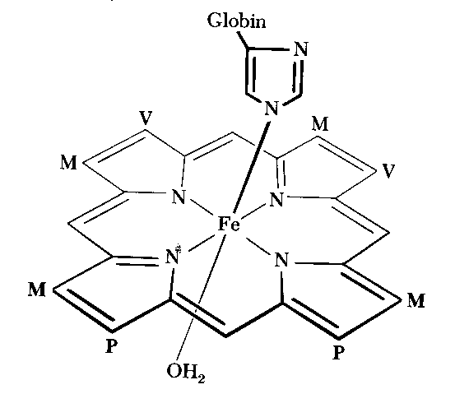
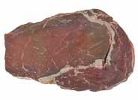
Deoxymyoglobin
Occurs when no ligand present for binding 6th site
Heme Fe is Ferrous (Fe++)
  Uncut Meat
    Only water present to bind
Very low oxygen tension required
  Typically associated with Vacuum Packaging
    Consumer acceptance of vacuum packaged products?
Purplish-red or purplish-pink color

Slide 9
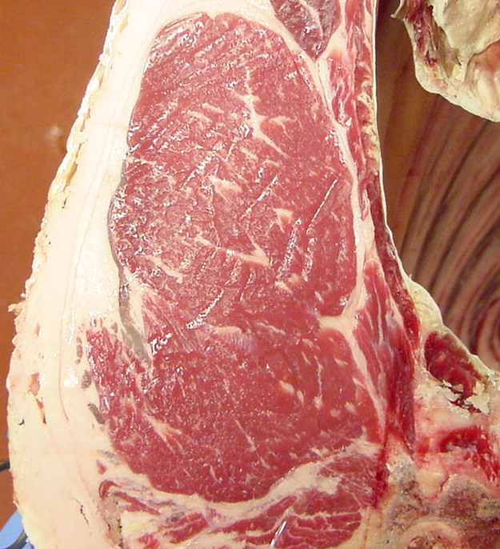
Oxymyoglobin
Heme Fe is Ferrous (Fe++)
Cut meat exposed to O2
  No change in iron’s valence
6th binding site occupied by diatomic oxygen
Distal histidine interacts with bound O2
  Requires 40 torr partial pressure of O2 (5.25%)
Alters structure and stability
Bright Cherry Red color
As exposure increases-OMb penetrates deeper
  High O2 maintains OMb, but may induce Oxidation reactions
Unstable formation
Electron availability
  Stability depends on continuing supply of O2 Oxidative Metabolism enzymes rapidly use O2

Slide 10
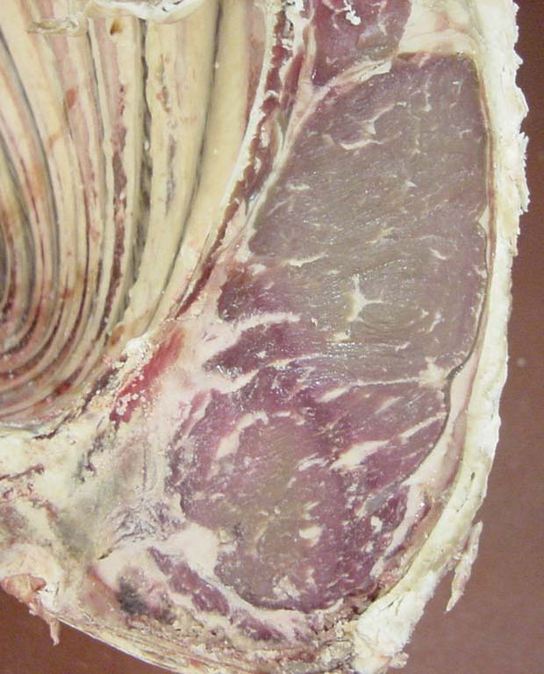
Metmyoglobin
Oxymyoglobin is very unstable
Oxidation of ferrous (Fe²⁺) Mb to ferric (Fe³⁺)
Reasons for Formation of MMb:O2 levels of 0.2-1.3%
  Complete Oxygen Consumption
    Cellular respiration
Low partial pressures of O2 (5-10mm/ 2.6-5.3%)
Low MMb reducing rates
Low Oxygen transmission rates
  Surface contamination
    Aerobic bacteria use up O2
Brown Color
Surface Discoloration MMb located between superficial OMb and interior DMb
  gradually thickens and moves to surface

Slide 11
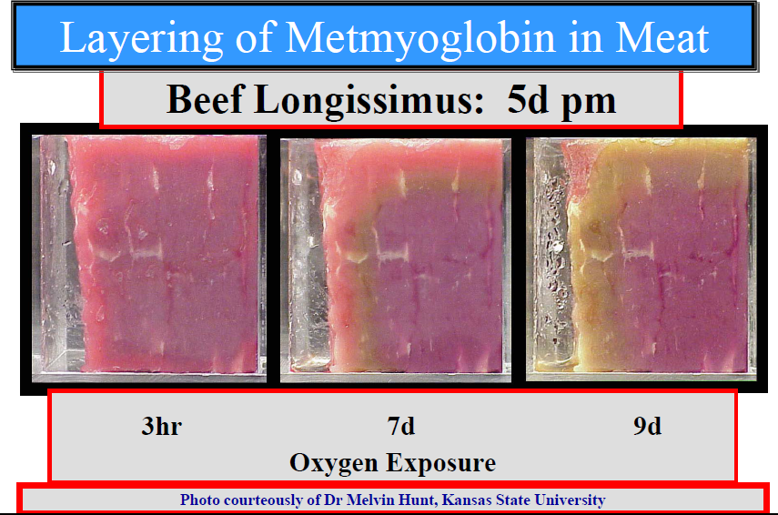

Slide 12
Factors Affecting Meat Color
Amount of myoglobin in the muscle
  Age: Veal<Calf<Young beef<Old beef
    Looses affinity for oxygen as age increases
  Species: Pork<Lamb<Beef
  Type: Support<Locomotive

Slide 13
Quantity of Myoglobin
Age class
Myoglobin content
Veal
2 mg/g
Calf
4 mg/g
Young beef
8 mg/g
Old beef
18 mg/g

Slide 14
Species Differences of Myoglobin
Species
Color
Myoglobin content
Pork
Pink
2 mg/g
Lamb
Light red
6 mg/g
Beef
Cherry red
8 mg/g

Slide 15
Fiber Type Differences
 | Muscle Fiber Type
Characteristics | RED | WHITE
Oxidative metabolism
Glycolytic metabolism
Myoglobin content
Reddness
Capillary density
Number of Mitochondria
Mitochondria size
Lipid content
Glycogen content
Fiber diameter
Contraction speed
Fatigue resistance
Contractile action
Z disk width
High Low
Low High
High Low
High Low
High Low
High Low
Large Small
High Low
Low High
Small Large
Slow Fast
High Low
Tonic Phasic
Large Small

Slide 16
Factors Affecting Meat Color
Chemical State of Myoglobin
  Ferrous (Fe++)
    H₂O→ Purple → Deoxymyoglobin
    O₂ → Red → Oxymyoglobin
    NO → Unstable pink → Nitric oxide myobglobin
    CO → Red → Carboxymyoglobin
  Ferric (Fe+++)
    H₂O (globin) → Brown → Metmyoglobin
    H₂O (denatured globin) → Brown/gray → Denatured metmyoglobin
    SH → Green → Sulfmyoglobin
    H₂O₂ → Green → Choleglobin

Slide 17
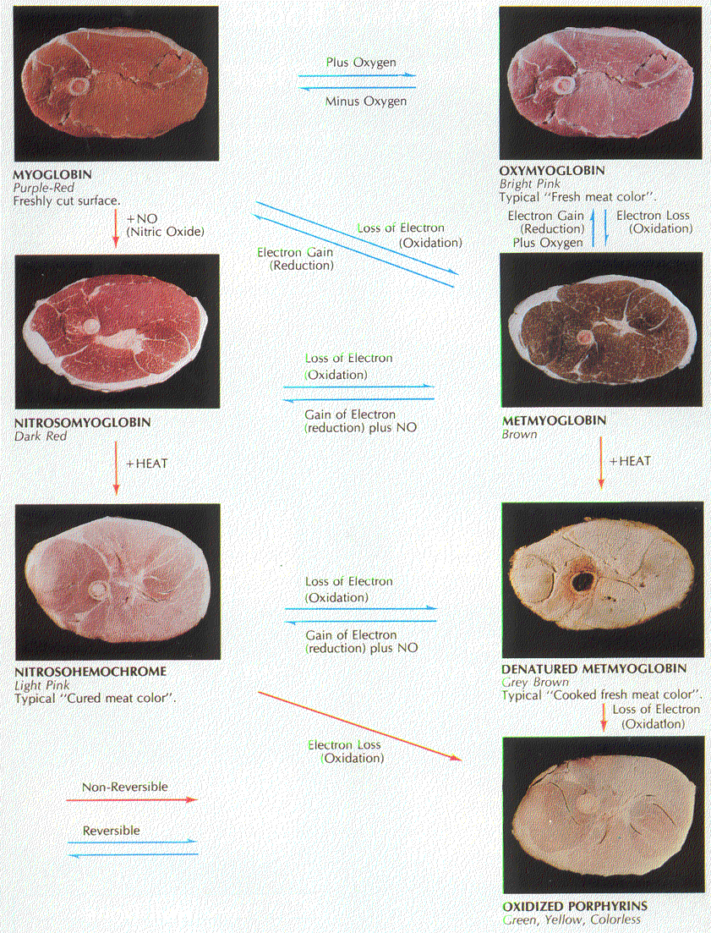
Color changes

Slide 18
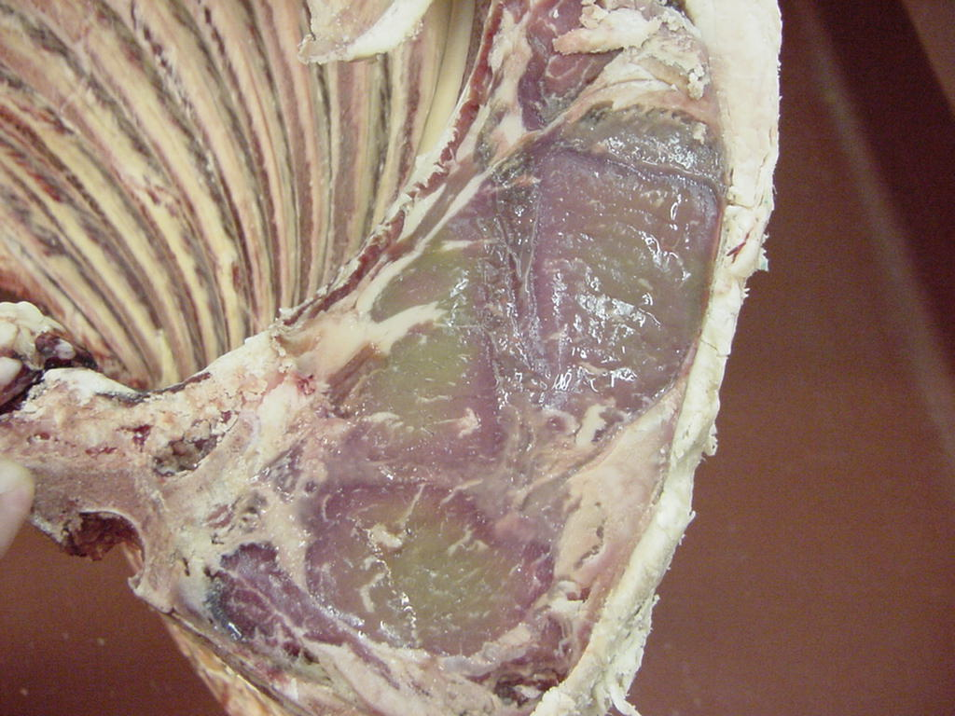
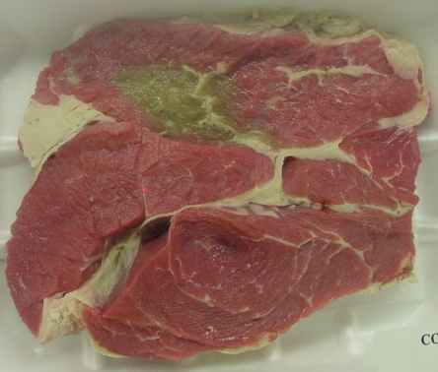
Sulfmyoglobin and Choleglobin

Slide 19
Factors Affecting Meat Color
Vitamin E feeding of cattle
  Prevents oxidation; retards conversion of myoglobin to metmyoglobin
Bacteria
  Produce metmyoglobin, choleglobin, and sulfmyoglobin pigments
Curing
  Nitrosylhemochromogen is the stable cured meat pigment

Slide 20
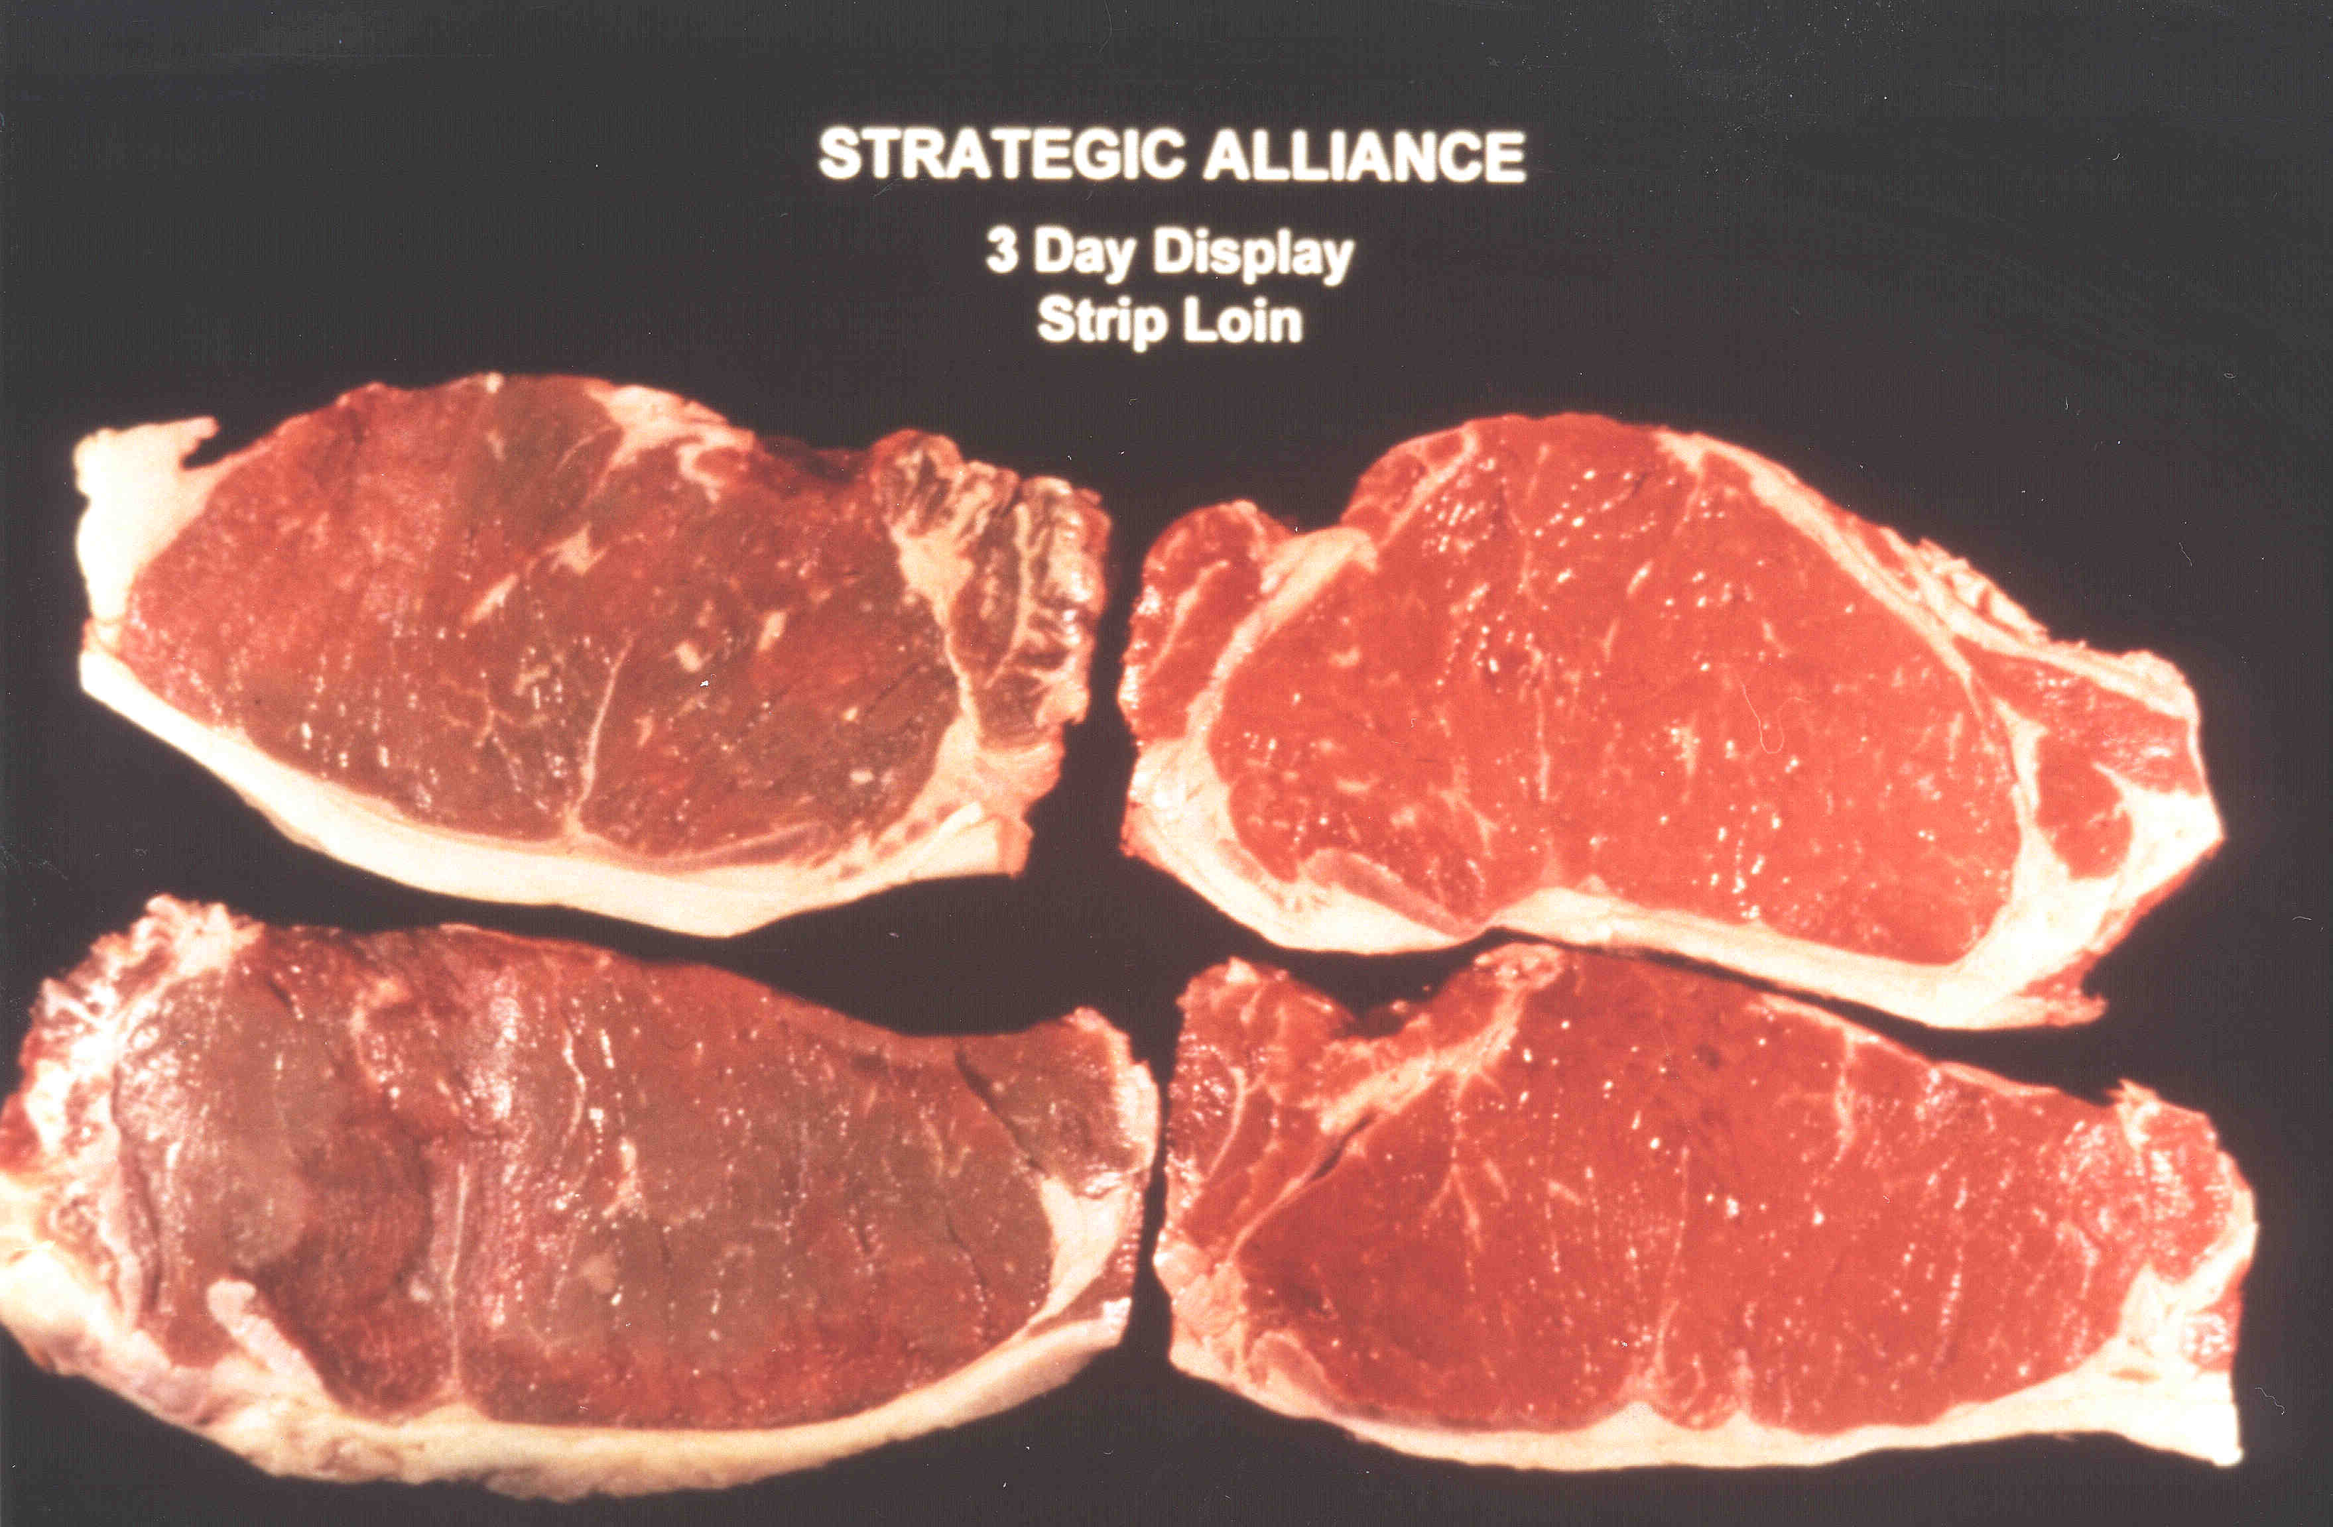
Vitamin E

Slide 21
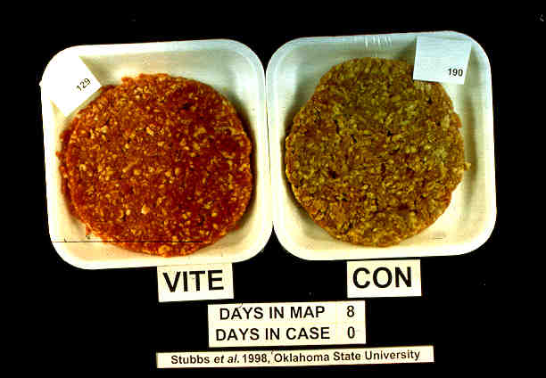

Slide 22
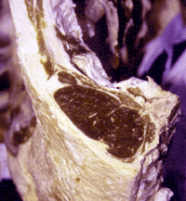
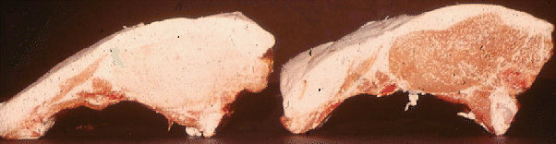
Factors Affecting Meat Color
Pre-Harvest Stress
Exposure to long-term or short term stress
Effects glycogen content of muscle and ultimate pH of muscle
Long Term Stress: DFD (dark cutter)Transport, Hunger, Fear, Aggression
Ultimate pH above 5.9 (beef), 6.5 (pork)
Short Term Stress: PSE Usually only problematic in pork
  Ultimate pH below 5.4
    Generally problem can be overcome with enhancement

Slide 24
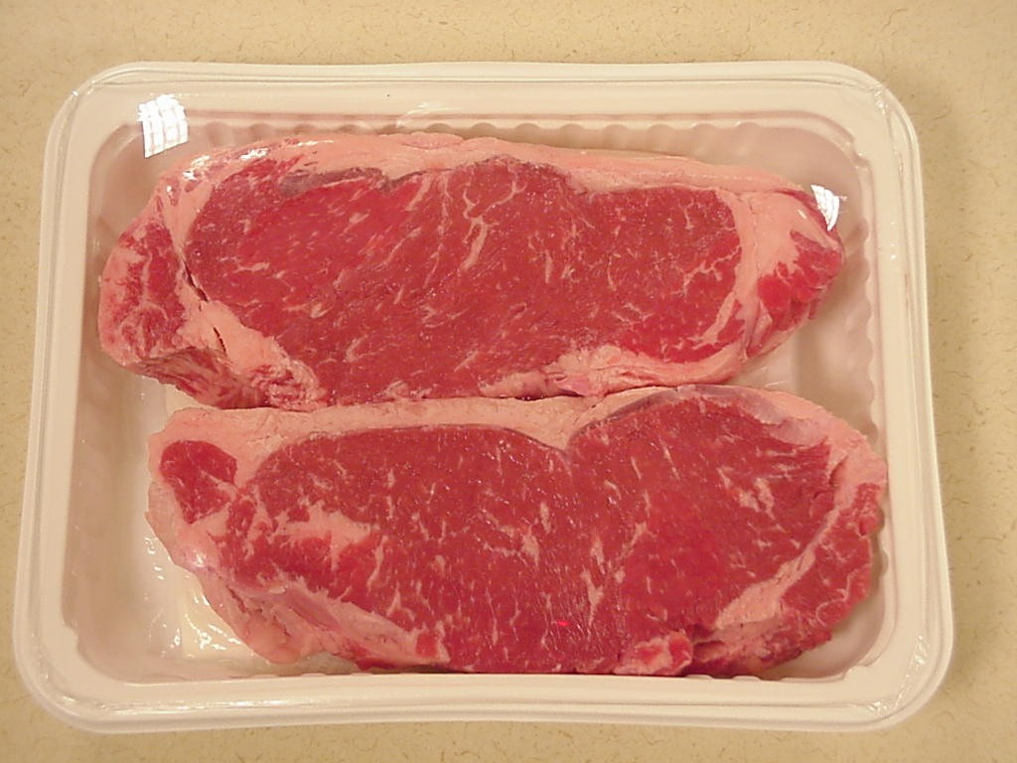
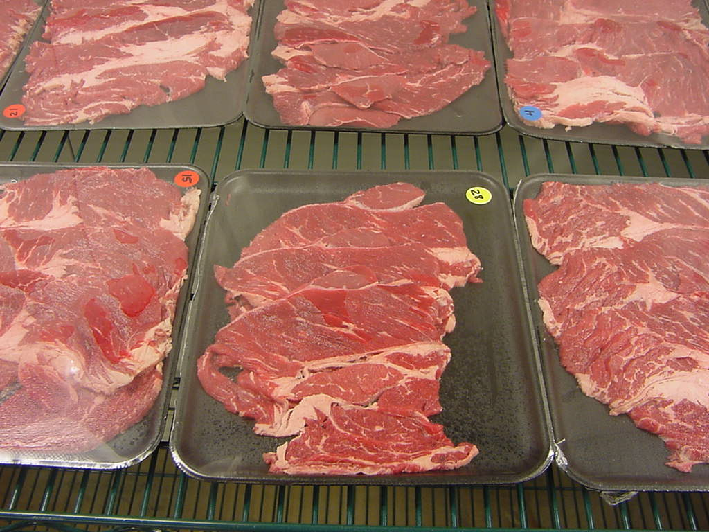
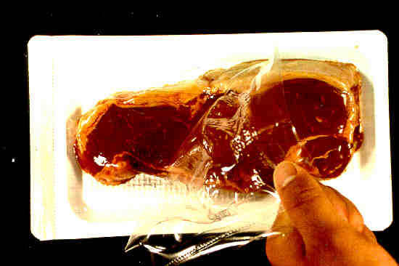
Factors Affecting Meat Color
Packaging

