Slide 1
Meat Packaging
ANSC 3404

Slide 2
Purpose of food packaging
Protect products
Contain the product
Communicate to the consumer as a marketing tool
Provide consumers with ease of use and convenience

Slide 3
Why is Packaging Important?
Appearance (color) greatest influence on consumer purchase
Food package protects against deteriorative effects
Ideally, packaging should promote or enhance shelf-life

Slide 4
Shelf-life
Factors that determine shelf-life
Water holding capacity
Color
Microbial load
Lipid stability
Utilization of correct package can extend shelf life

Slide 5
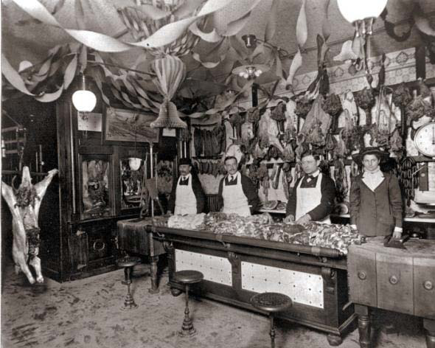
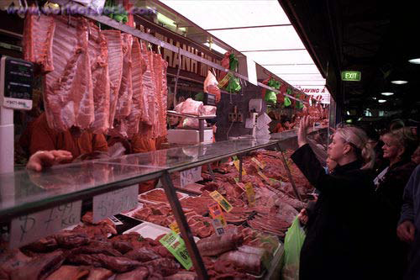
50 years ago & before: Butcher shops and full-service meat markets
Family owned and operated butcher shops
Meat wrapped in butcher paper and sold on demand basis

Slide 6
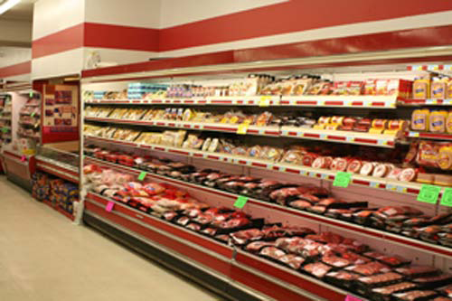
1950’s-present: Refrigerated Self-Service Display Cases
Increased consumer demand for convenience
Conversion to a 24-hour day stores
Ability to buy meat at all times
Increased requirements for food safety and wholesomeness
Competition in the market place

Slide 7
Historical Changes in Packaging
Meat cut and packaged by consumer
Animals harvested as needed
Meat cut by butcher and wrapped in wax paper
1950’s: Increased use of overwrap packaging
1950’s-1990’s: Advances in packaging technology
Increased user of barrier packaging (PVC)
Vacuum packaging
1990’s-current: Implementation of New Technology
Need for Case-Ready Products
MAP, Skin-pack, Darfresh, etc

Slide 8
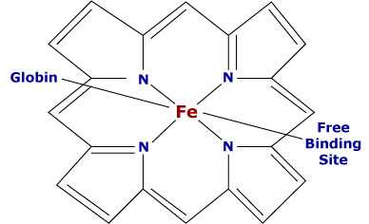
Myoglobin

Slide 9
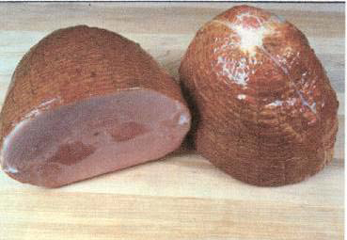
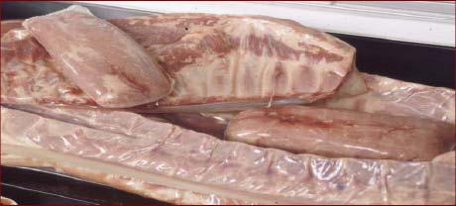
Vacuum Packaging
Utilized in Plants for Boxed Beef
Oxygen impermeable
Formation of Deoxymyoglobin
Moisture Impermeable
Extends Shelf Life
Requires strict temperature
for control of anaerobic microorganisms
Current equipment used:
Multi-chamber, heat sealing 30+pieces per minute
Disadvantages
Consumer acceptability of
Deoxymyoglobin color
Lack of Bloom

Slide 10
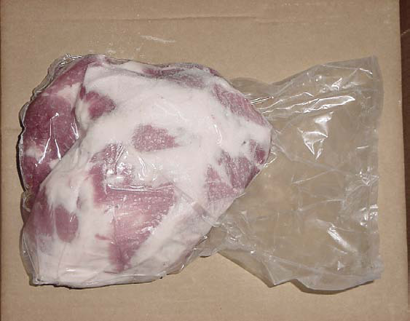
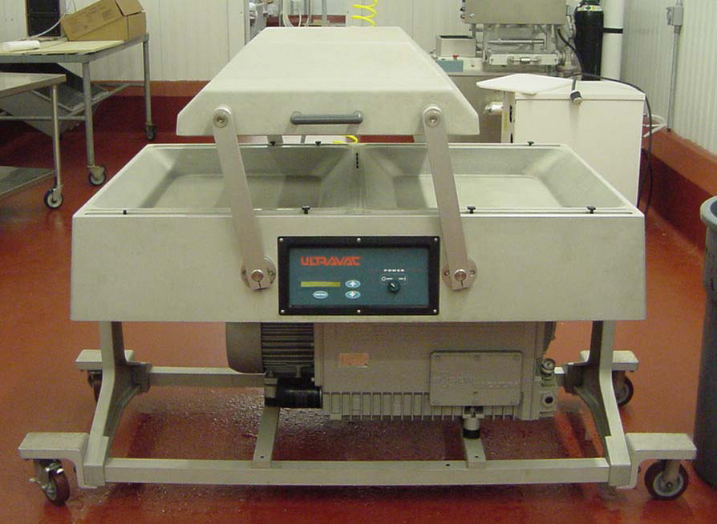

Slide 11
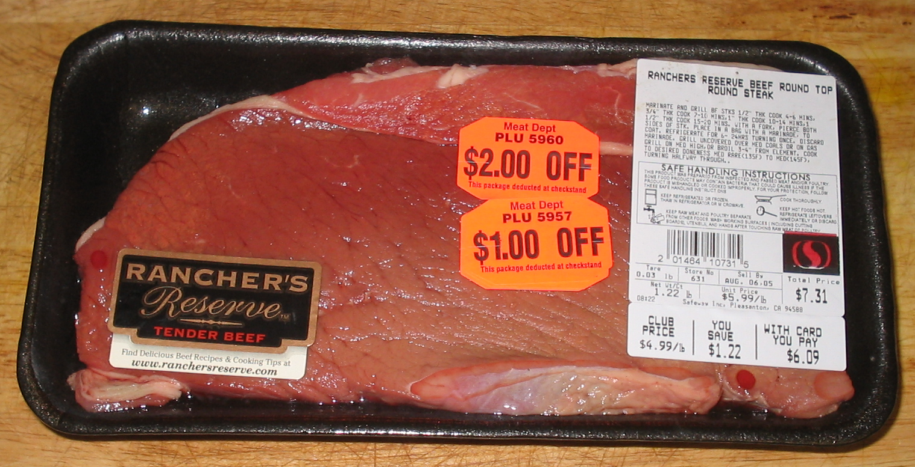
Traditional Overwrap Packaging
Uses styrofoam trays
Uses Polyvinyl Chloride (PVC) wrap
Moisture impermeable
Permeable to Oxygen:
Allows for bright red color because oxygen can be transmitted across

Slide 12
Traditional Overwrap Packaging
Advantages of Overwrap
Increased marketability
Attractive appearance
Disadvantages:Leaky, messy packages
Shorter shelf-life
Exposure to O2
aerobic bacterial growth
lipid and pigment oxidation

Slide 13
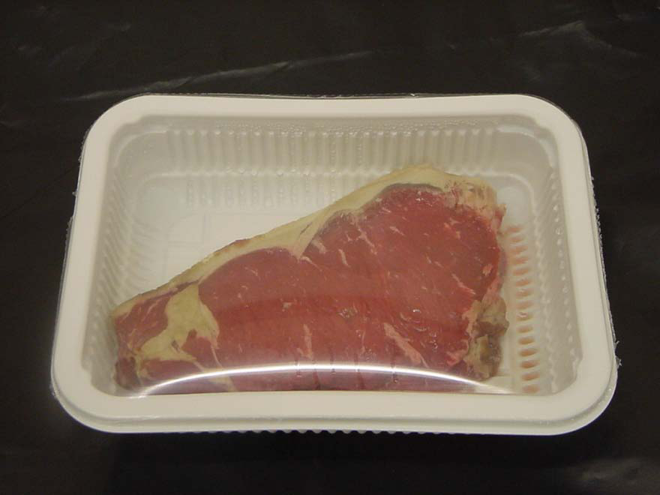
Modified Atmosphere Packaging
“MAP is the removal or replacement of the atmosphere surround the product before sealing in vapor-barrier materials”(McMillin, Huang, Ho, & Smith, 1999)
Types of MAP
Vacuum
Oxygen/CO2,Nitrogen
High Oxygen/ Low Oxygen
Carbon Monoxide
Peelable Films
Master Bag

Slide 14
Types of MAP
High-Oxygen MAP80% O2/ 20% CO2
is most common
Exposure to high oxygen atmosphere increases presence of oxymyoglobin
Decreased shelf-life
Aerobic bacterial growth
Lipid and pigment Oxidation
Increased Oxidation
Decreased flavor
Increased off-odors
Increased discoloration
Growth of spoilage microorganisms

Slide 15
Types of MAP
Low Oxygen MAP
Includes skin-packaging and vacuum
Absence of Oxygen in Low-Ox MAP
causes formation of DMb
Commonly used for “Master Packing” of Overwrap packages
Non-barrier overwrap packages enclosed in Low-Ox master pack
When removed from Master Pack and exposed to O2 bloom occurs
Decreased lipid and pigment oxidation
Promotes shelf life
Decreased microbial growth
Problems with consumer acceptability of DMb color

Slide 16
Types of MAP
Low Oxygen MAP
One type of Low-Ox MAP alleviates DMb color problem
CO-MAP
Carbon monoxide achieved GRAS status from FDA in 2002.
Approved for use at 0.4%
Benefits of CO-MAP
Increased control of oxidation
Formation of stable red color due to Carboxymyoglobin
Superior flavor by reduced lipid oxidation
Decreased discoloration by decreased MMb formation

Slide 17
Comparison of Low-Ox vs. High-Ox Packaging

Slide 18
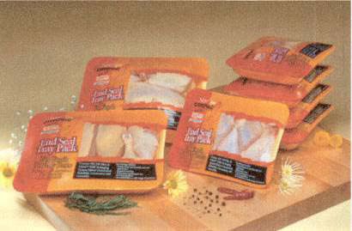
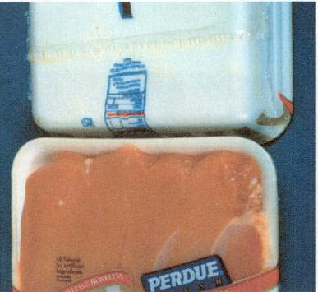
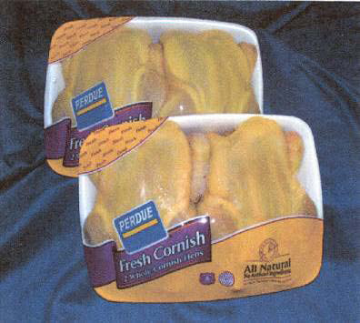
SSD/ SES
Used in the Poultry industry

Slide 19
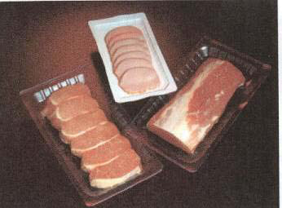
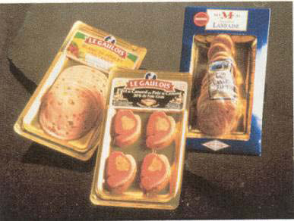
Darfresh

Slide 20
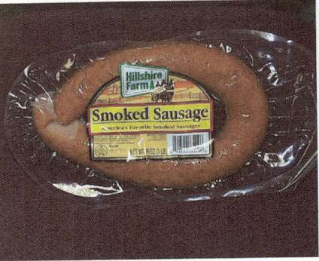
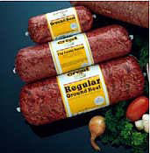
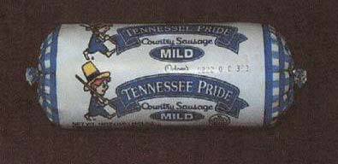
Laminate
Provides nice view of product
Chubs

Slide 21
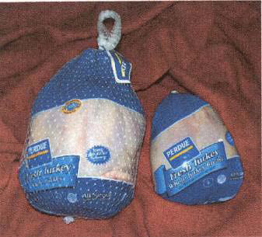
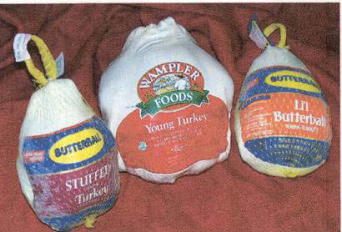
Poultry Shrink Bag

Slide 22
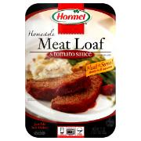
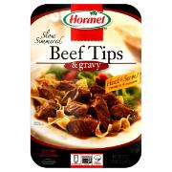
Simple Steps
Convenience
Value added

Slide 23
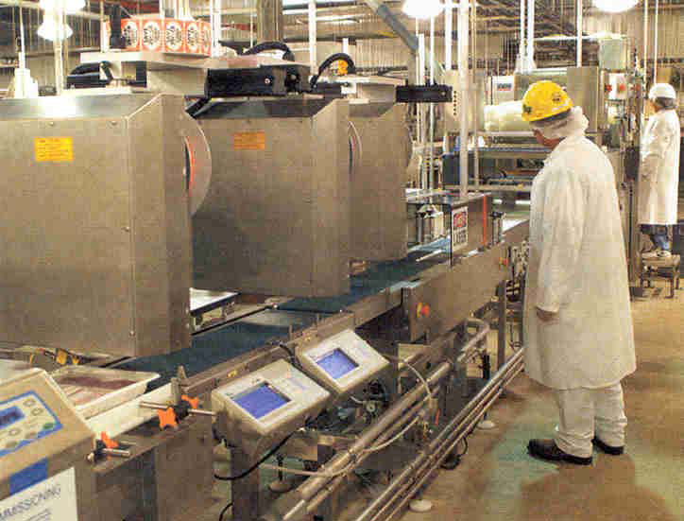
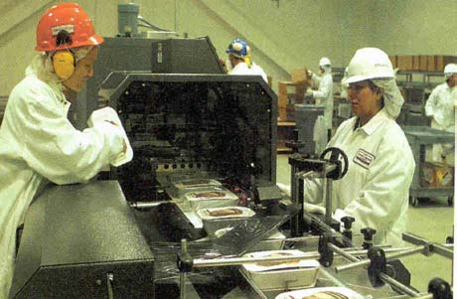
Packaging Systems

Slide 24
Major Packaging Change
Change from passive to active packaging
Food packaging originated as a means for protecting the properties of the product, but has evolved to provide and enhance many functions for the product itself.

Slide 25
Summary
Modern packaging technology and equipment provide the industry with the means to modify and enhance product quality and shelf life
Requires understanding of quality and shelf-life factors and utilization of packaging technology to correct downfalls and capitalize on advantages.

Slide 26
Future
Further extension of shelf-life
Addition of antioxidants or antimicrobials
New packaging systems and types

