Slide 1
Fresh Meat Processing
  ANSC 3404

Slide 2
Objective
To show how carcasses and wholesale meat cuts are processed to provide us with a wide variety of retail meat products

Slide 3
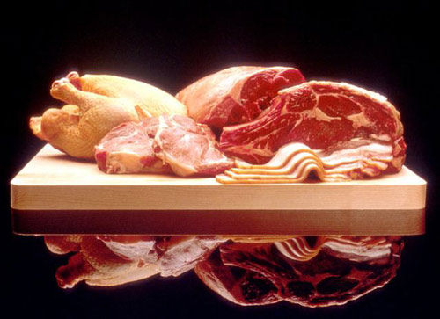
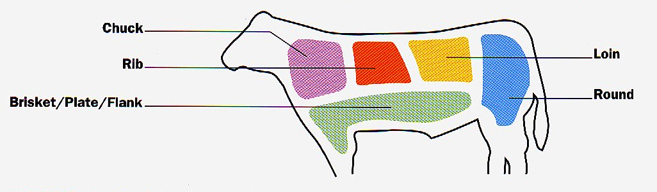
What is meat processing?
Any mechanical, chemical or enzymatic treatment of meat that alters the form in which it originally occurs

Slide 4
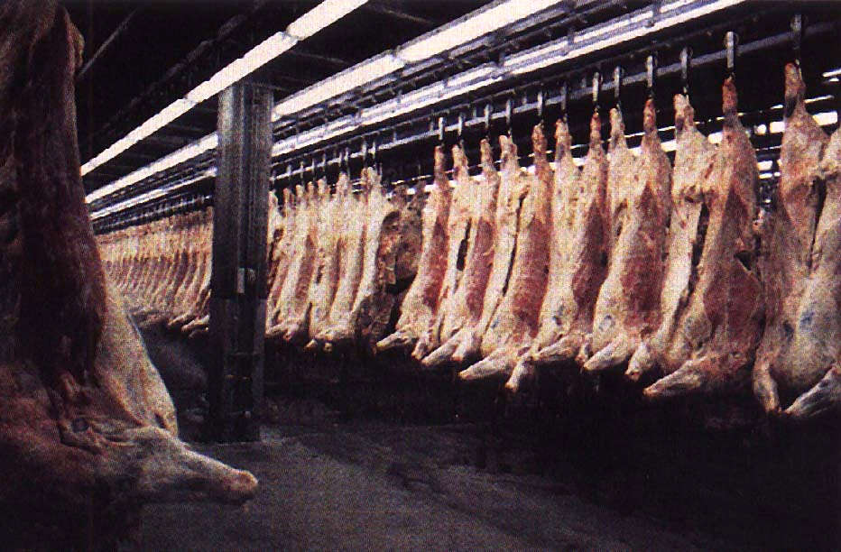
Problem: We have a cooler of beef, what do we do with it?

Slide 5
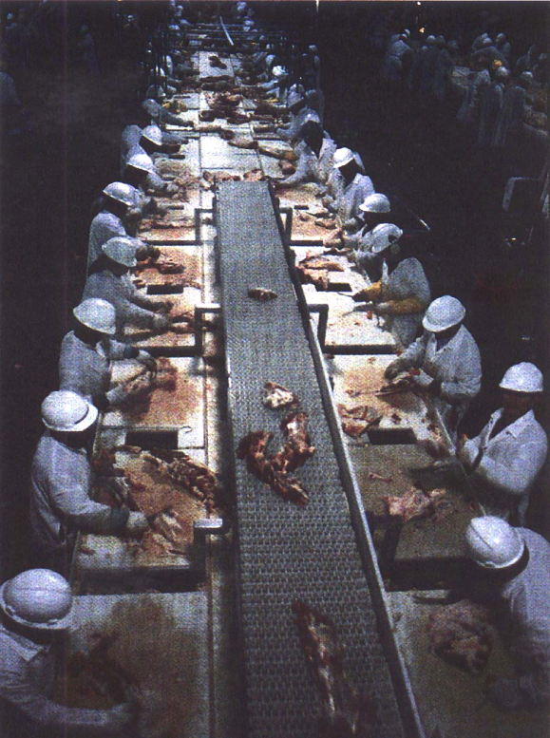
Carcass Fabrication
First step in processing

Slide 6
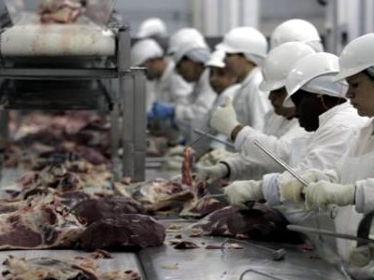
Principles of fabrication:
Separate thick from thin
Separate lean from fat
Separate valuable from less valuable
Separate tough from tender
Cut across the grain of the muscle

Slide 7
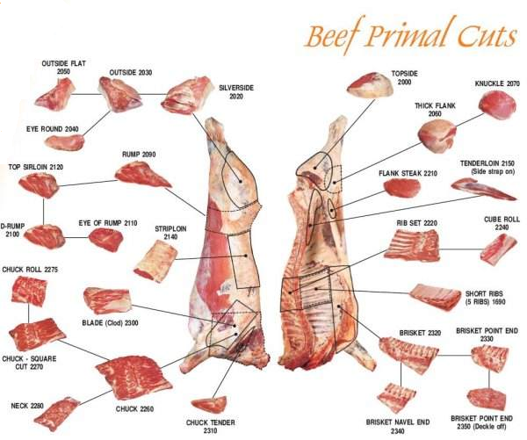

Slide 8
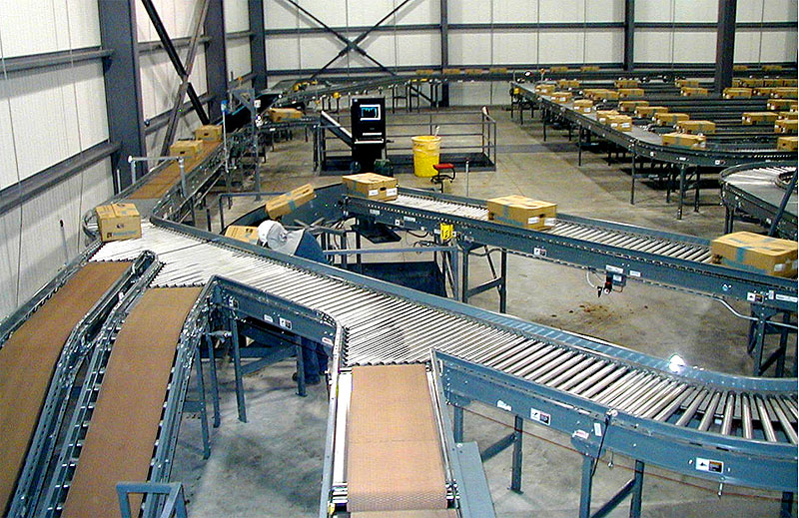
Results of Fabrication
Whole-sale cuts
  Vacuum packaged and sold as boxed beef
Lean and fat trimmings
  Used to produce ground products
Edible byproducts
  Variety meats (heart, sweetbreads, liver, kidneys)
Inedible byproducts
  Hide, tallow, bone meal

Slide 9
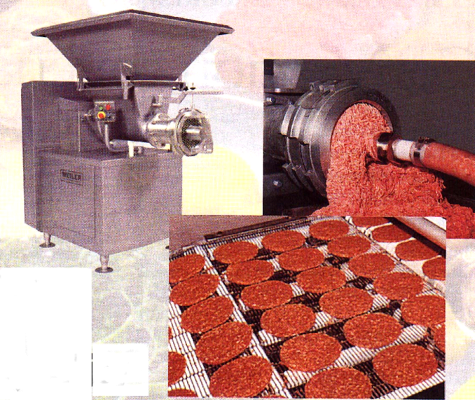
Further processing
An industry term used to describe the processes of comminuting (chop or grind) or enhancing through addition of low quality meats.
Also referred to a Value Added
Usage of fat and lean trimmings or low quality whole sale cuts

Slide 10
The function of further processing
Tenderization
  Mechanical, enzymatic or chemical tenderization
Preservation or shelf-life extension
Increasing food safety and flavor
  Usually through cooking of product prior to sales
Manipulation and control of ingredients
Portion control
Increasing convenience to customer
  Ready to eat meals

Slide 11
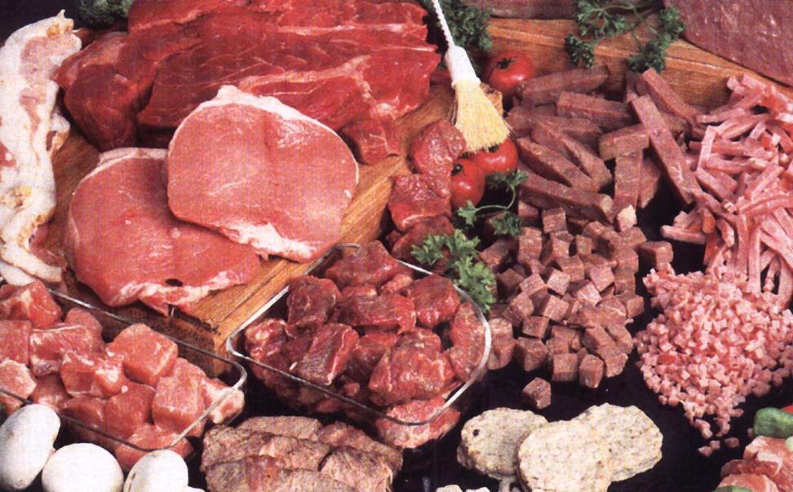
Size Reduction
Size reduction is the most common form of meat processing

Slide 12
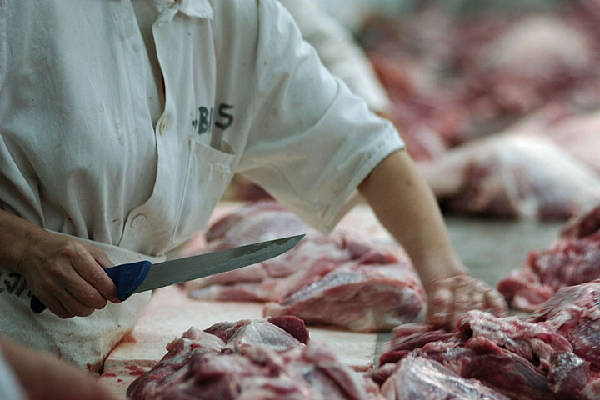
Tenderization Methods
Mechanical
  Cutting across the grain, chopping, grinding, beating with a mallet, needling, flaking

Slide 13
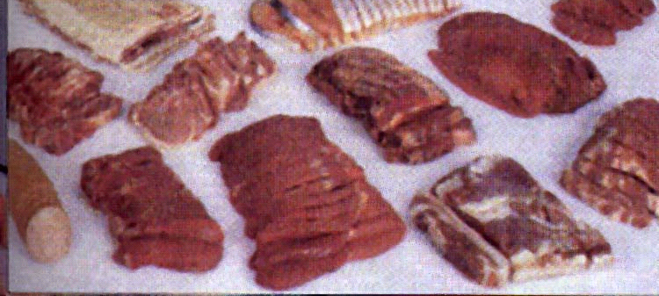
Tenderness and Thickness
Thinner a piece of meat is sliced the more tender it will be
More finely a piece of meat is ground the more tender it will be
  However, thinner more ground meat will dry out more quickly

Slide 14
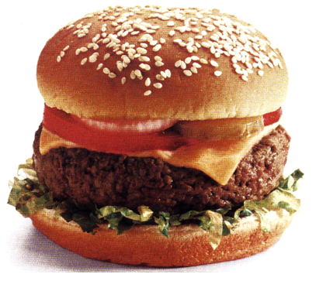
Most Common Processed Meat
Ground meat accounts for 60% of meat consumption
  Hamburger is most common
Notes:
Most processing aids are targeted for ground meats

Slide 15
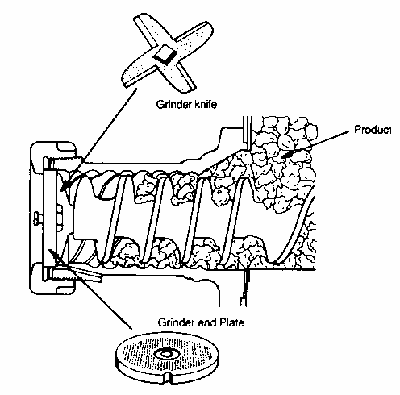
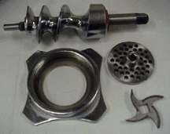
Meat Grinder
Knife and auger rotate
Grinder plate is stationary
Many contain bone plate

Slide 16

Grinder with Bone Chip Collector

Slide 17
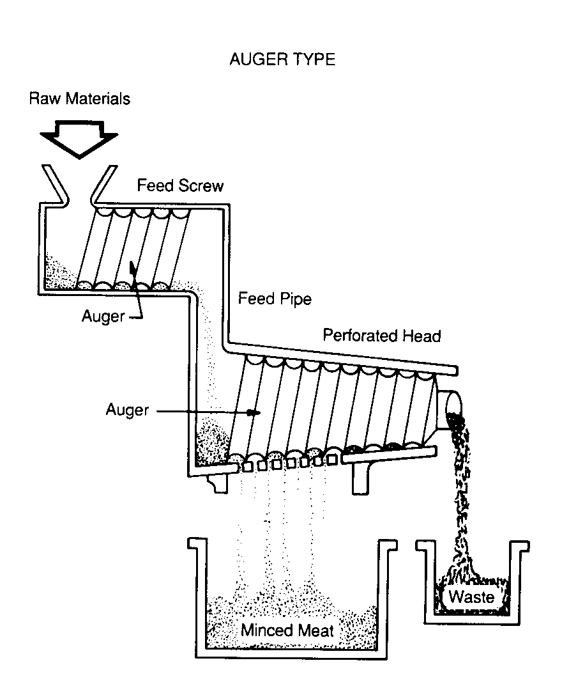
Soft tissues are pushed by the auger through holes in the head.
Hard tissues, except small pieces, do not go through.

Slide 18
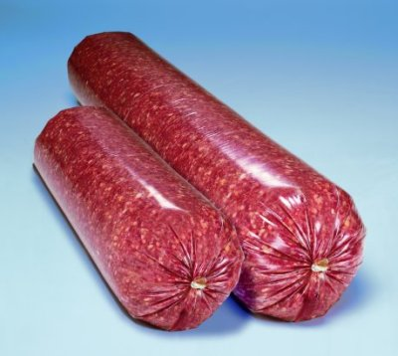
Making Commercial Patties
Usually grind the meat twice
  Course grind and determine fat content
  Add FAT to reach desired content
  Grind
  Form patties or chubs

Slide 19
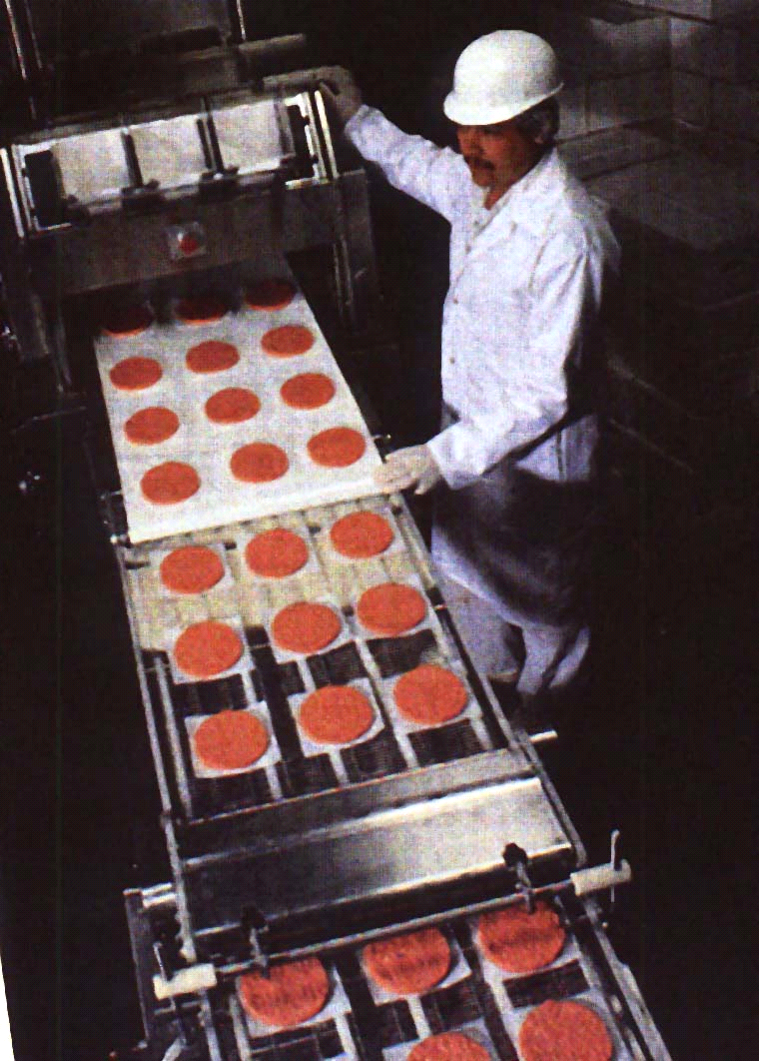
Patty Making Machine
A form of portion control
Low value product
  High cost for consumer

Slide 20
Spiral Freezer for Patties

Slide 21
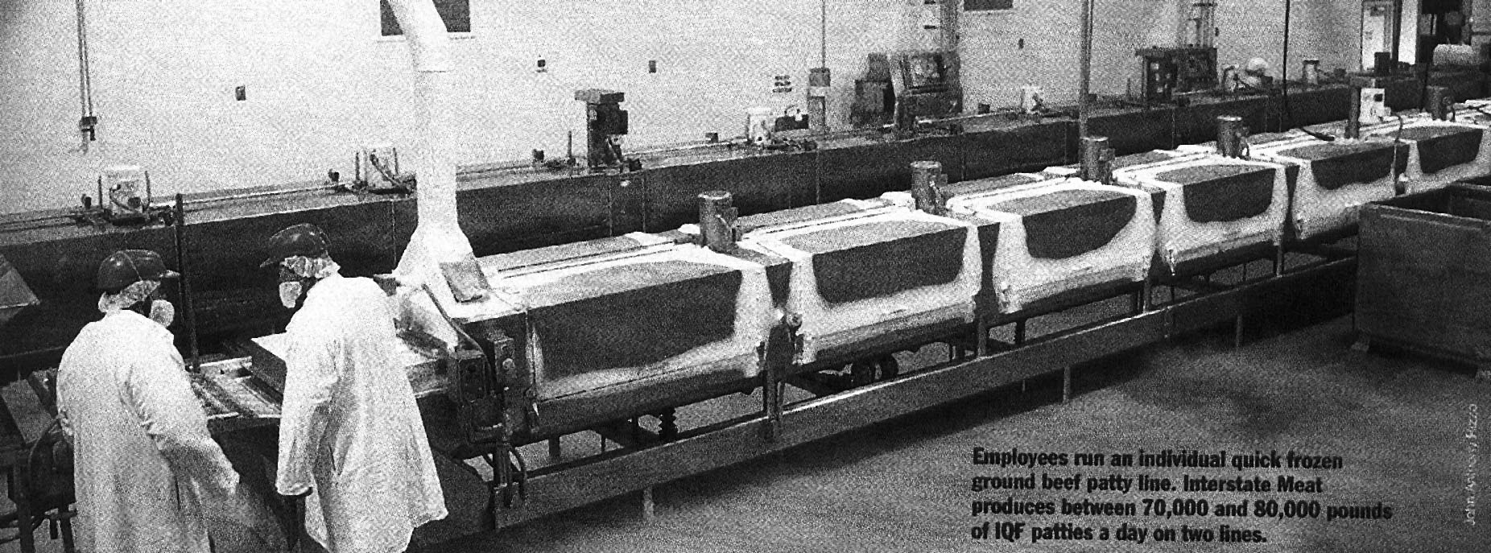
Liquid Nitrogen Tunnel

Slide 22
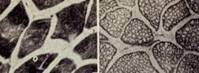
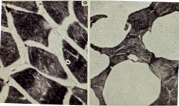
FROZEN CRYOGENICALLY
UNFROZEN CROSS SECTIONS OF MUSCLE
ICE CRYSTALS
FROZEN SLOWLY

Slide 23
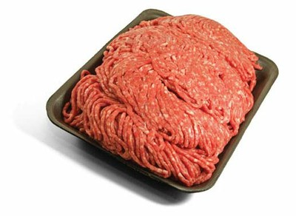
USDA-FSIS Regulations for Ground Beef
Ground Beef or Chopped Beef
  No more than 30% fat
  Can not add any more fat than what is in the trim
    Can not add stored or extra fat supplies
  No more than 25% of meat can come from the cheek

Slide 24
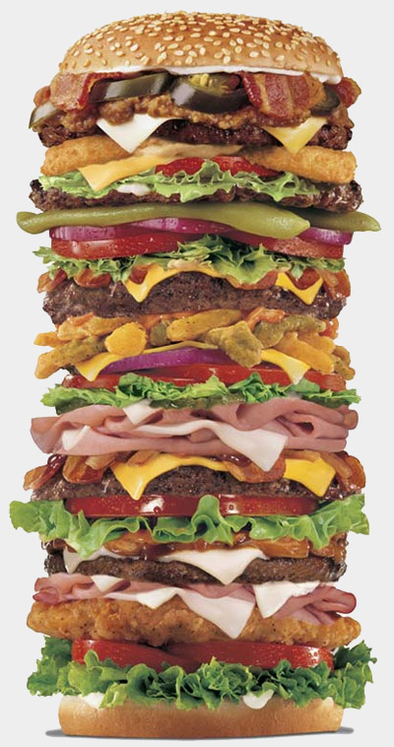
Hamburger
Can not contain more than 30% fat
Can have added fat and seasonings
Cheek meat is limited to 25%
Hamburger cannot contain added water, binders or extenders

Slide 25
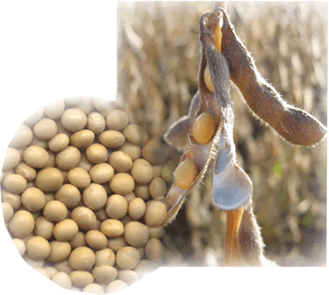
Ground Beef and Textured Vegetable Protein (Soy)
Label claim for ground beef of Hamburger that contains soy or other extender
Must contain above statement on ingredients
Cheap ingredient that is high in protein

Slide 26
Imitation Ground Beef or Beef Patties
Can contain anything
  Fat
  Seasonings
  Water
  Defatted beef
    Defatted tissue has been rendered at a temperature that wont denature the proteins (re-inspected cook products)
    Very Cheap
    Used by some fast-food chains

Slide 27

Unique Extender Added to Meat
Carrageenan
  Isolated from red seaweed
  Thickens, gels, stabilizes and suspends proteins
  Widely used in food industry

Slide 28
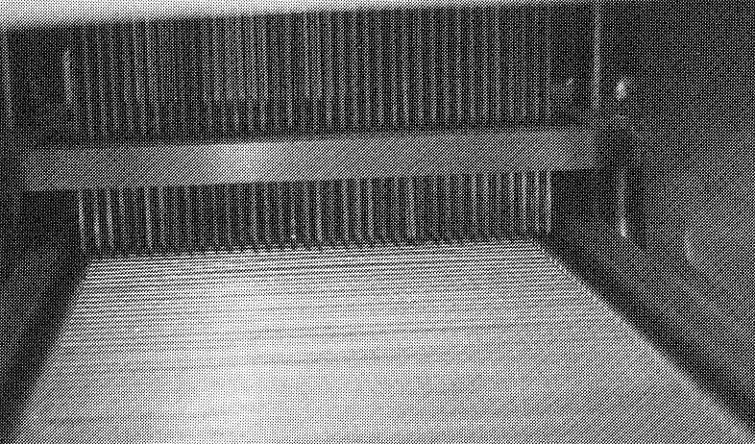
NEEDLE TENDERIZATION - FOR BONELESS CUTS
STEEL BARS PUNCTURE THE MEAT
CONVEYOR MOVES MEAT TO NEEDLES

Slide 29



Chemical or Enzymatic Tenderization Methods
  Papain
    From the papaya
    Least effective on collagen
  Bromelain
    From pineapple
      Most effective on collagen
  Ficin
    From the fig
    Affects both muscle fibers and connective tissue

Slide 30
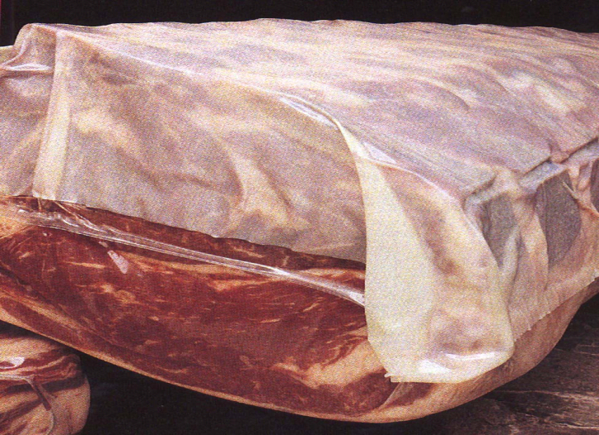
More Tenderization Methods
Aging
  Wet Aging
    Meat is aged in vacuum package
    Safe but slower than other aging mechanisms

Slide 31
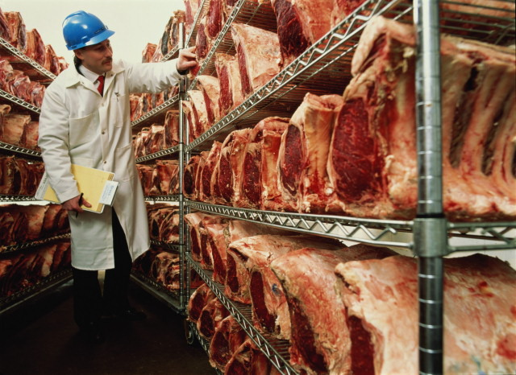
  Dry Aging
  Meat is hung in low humidity room
  Increases bacterial contamination
  Primarily used for restaurant trade

Slide 32
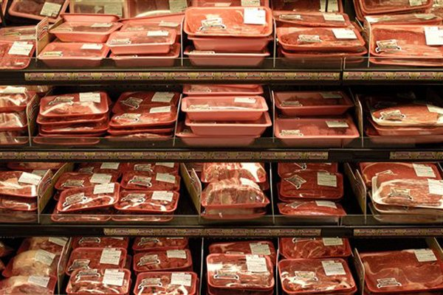
Processing and Shelf-life
What is Shelf Life?
The length of time before meat products become unpalatable, unsafe for human consumption or unattractive in the display case

Slide 33
Shelf-life
Treatment methods that extend shelf-life
  Chilling, Freezing and Freeze drying
  Heat pasteurization
  Heat sterilization
  Curing and smoking
  Dehydration
  Irradiation

Slide 34
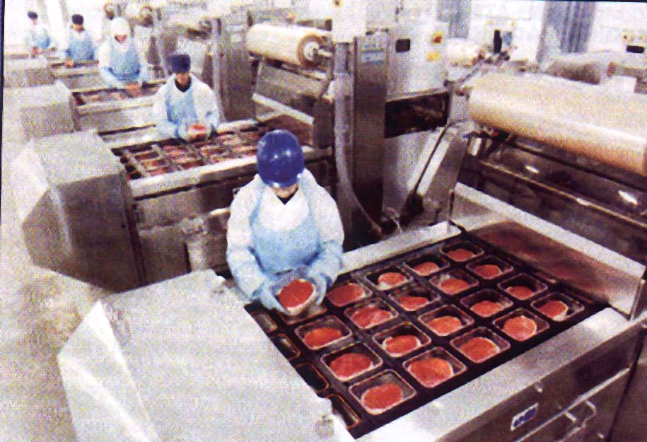
Mechanical Refrigeration
Refrigeration is main form of shelf life extension and preservation

Slide 35
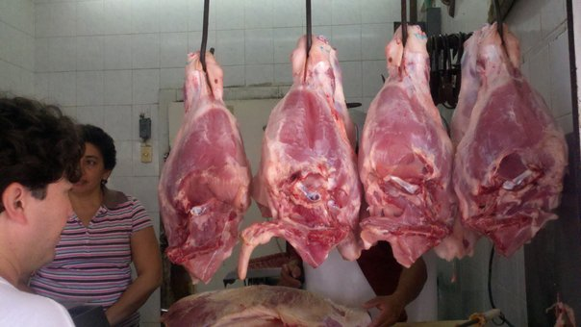
Importance of Refrigeration
Without refrigeration
  Shelf life is only a few hours
How do regions of the world where refrigeration is unavailable merchandize meat (Central Mexico)?

Slide 36
Processing to control ingredients

Slide 37
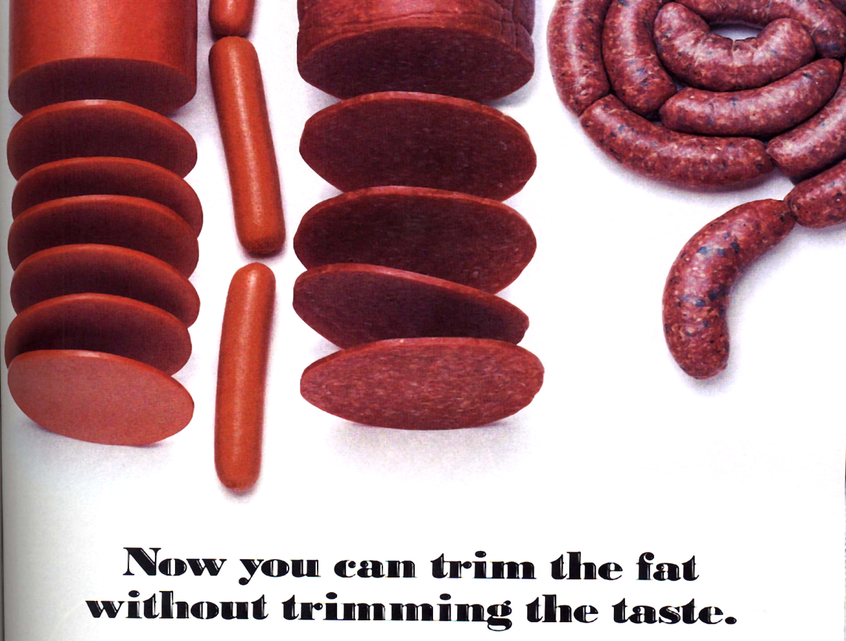

Slide 38
Why do we eat fat?
Flavor – fatted foods taste better
Texture – better mouth feel
Learned preference
  As adults we tend to repeat what we learn as children
Low fat diets can be unhealthy
Recommendation
  30% of calories from fat

Slide 39
WHAT REPLACES FAT IN LOW FAT GROUND MEAT PRODUCTS?
Water - How do we keep it in the product during cooking?
HYPS - hydrolyzed vegetable proteins; contain MSG
Soy flour, grits or texturized soy protein (p. 806 in MWE) - 50% protein, boost protein content, bind water

Slide 40
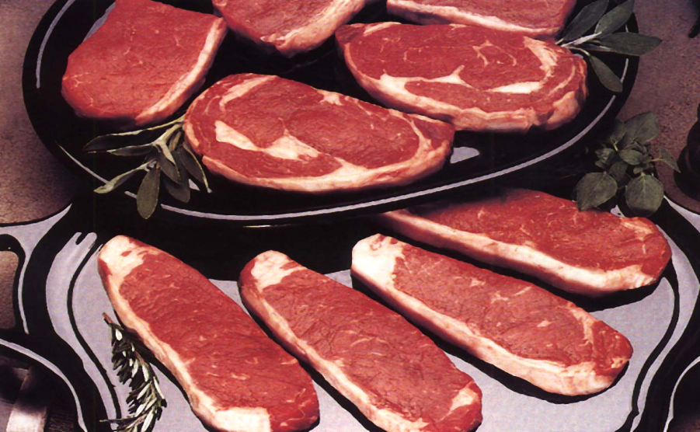
Portion Control
Example of steaks cut for hotel and tourism trade
  Very trim and similar in size
  Prevents cooking error
  Customer always receives the same product

Slide 41
Processing Continued
Restructuring Meat Products
  Method to increase value of cheap meats
  Muscles a separated and re-shaped into desired shape
  Use massage or tumbling to extract protein to stick meat pieces together
  Or use binder such as alginate

Slide 42
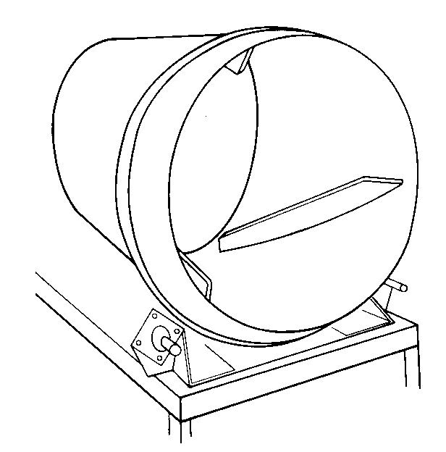
Tumbler
Impact energy
during tumbling extracts binding proteins

Slide 43
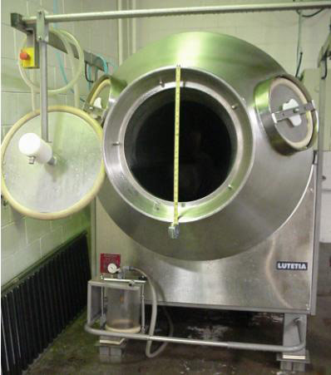
Vacuum Tumbler –
More rapidly extracts proteins

Slide 44
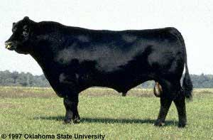
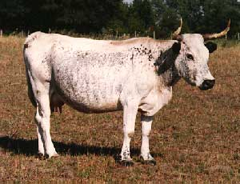
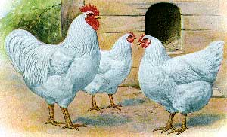
Composition Problems with Processing
Compared to poultry red meat is highly variable in composition
Why does the variation exist?
What do customers want from meat products
  Consistency

Slide 45
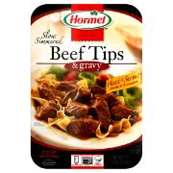

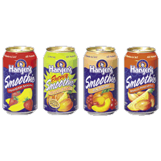
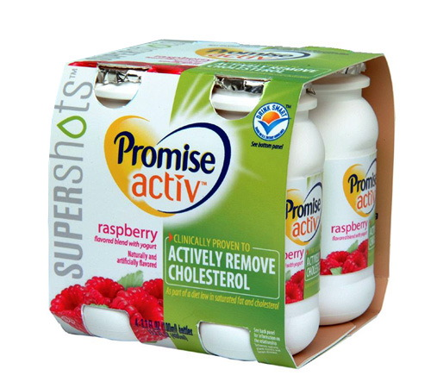
Newest Trend in Meats Processing
Home Meal Replacements
  Dinner in a box
Functional Foods
  Fruit Smoothies

Slide 46
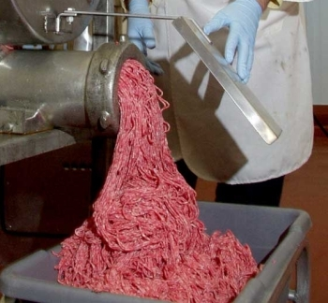
The End

