Slide 1
Meat Preservation
Sausage

Slide 2
What is a Sausage?
Word sausage is from word Salsus
Salsus means salt or preserved
Is a chopped or comminuted and seasoned meats that is formed into a symmetrical shape
Can contain non-meat ingredients

Slide 3
History of Sausage
Reason for discovery of America and trade with Asia
Used to be “Bags of Mystery”
Historically were made from by-products and left-overs
Modern sausage is made from lean trimmings or low value whole muscle cuts
Skeletal muscle, Cheek, jowl, and head meat from beef pork and poultry

Slide 4
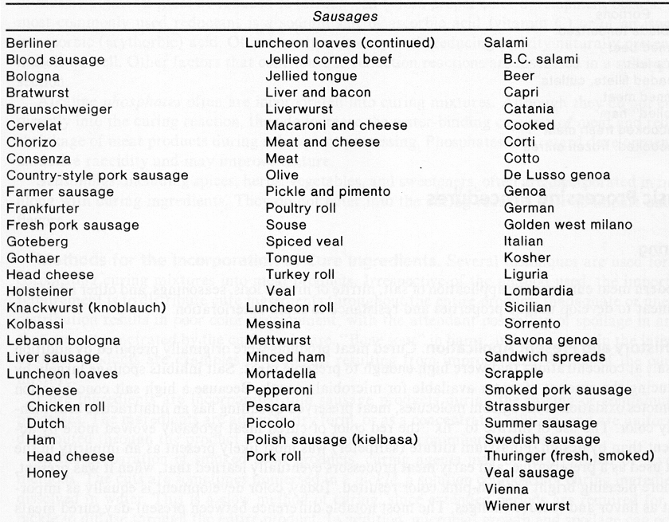
Sausage Varieties

Slide 5
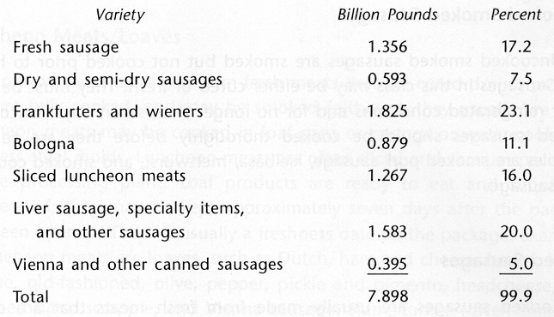
Consumption of Sausage

Slide 6
Top Dinner Sausage Consuming Cities – 2009
1. Los Angeles
2. New York
3. San Antonio/Corpus Christi
4. Houston
5. Baltimore/Washington, D.C.
6. Chicago
7. Dallas/Fort Worth
8. South Carolina
9. San Francisco/Oakland
10. Philadelphia
Source: Information Resources Inc. Based on total retail sales, excluding Wal-Mart, for the 2009 calendar year. – National Hot Dog & Sausage Council
Notes:
Texas is high in sausage consumption but not in hot dogs

Slide 7
Classifications
Degree of grinding or chopping
Coarse ground vs. emulsion or fine chop
Amount of cooking
Cooked vs. uncooked
Amount of smoke
Smoked vs. non-smoked
Amount of water added
Water added vs. no water added

Slide 8
Classifications
Amount of curing
Cured vs. not cured
Amount of fermentation
Fermented vs. non-fermented
Amount of tissue moisture
Fresh: non-smoked and uncooked
Smoked: fresh and cured
Cooked: fresh and cured smoked and non-smoked
Cured: smoked and non-smoked
Dried: semidry and dry
Meat loaves and specialty items

Slide 9
USDA Classifications
Fresh
Uncooked smoked
Cooked and smoked
Cooked
Dry and semidry
Luncheon meat, loaves and jellied

Slide 10
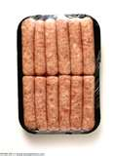
1. Fresh
Fresh, uncured meats used
≤ 3.5 % binders and extenders allowed
≤ 50 % fat
≤ 3 % water/ice
Pork, beef, and most recently chicken
Must be refrigerated and thoroughly cooked

Slide 11
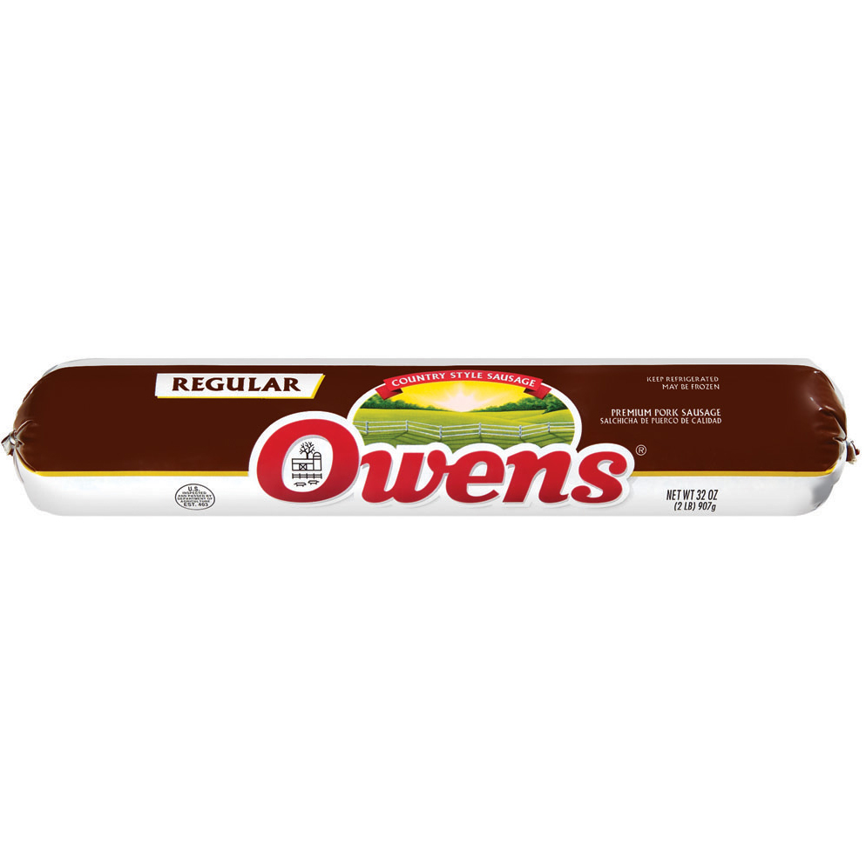
1. Fresh
Breakfast sausage
Whole hog sausage
Prepared from fresh/frozen meat from pig in such proportions as are present in a single animal

Slide 12
1. Fresh
Italian Sausage
Uncured, non-smoked sausage
85 % of formula must be meat and fat
≤ 35 % fat
≤ 3 % water/ice
Salt, pepper, fennel and anise used
If labeled as “Italian Sausage” must contain only pork
Any other species must be indicated on label “Chicken Italian Sausage”

Slide 13
2. Uncooked Smoked
Same types of products as fresh, but smoked for color and flavor
Must be cooked before consumption
Includes: fresh smoked pork sausage
Same as fresh pork but smoked
Fresh smoked kielbasa
Highly seasoned Czech sausage
Coarse ground pork with beef or mutton added
Smoked but not cooked

Slide 14
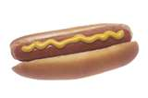
3. Cooked and Smoked
Frankfurter, bologna, knockwurst, and similar products
Comminuted, semisolid
One or more kinds of raw skeletal meat and poultry meat
≤ 35 % fat
≤ 10 % added water
Smoked or non-smoked
≤ 15 % raw or cooked poultry meat
Can contain by-product and variety meats
≤ 15 % partially defatted pork or beef fatty tissue

Slide 15
4. Cooked
Liver sausage and Braunshweiger
Fresh/frozen pork and/or beef trim
Pork liver or beef liver or veal liver or combination
Can contain: beef/pork by-products, pork skin, sheep liver, goat liver if labeled
Must be at least 30 % liver
Cooked

Slide 16
5. Dry and Semidry
Produced by fermentation
Fermentation-conversion of sugar -> lactic acid
Backslopping
Lactic acid starter culture
Lowers pH
Preserves
Inhibits growth of spoilage bacteria
Provides characteristic tangy flavor
Fermentation chamber
Dried carefully: smoked sometimes

Slide 17
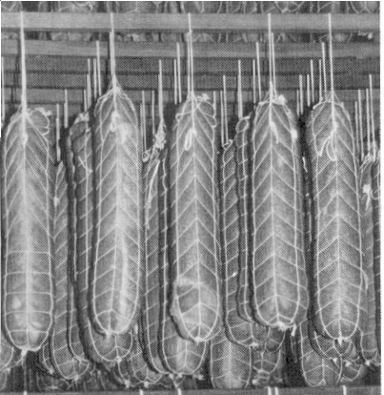
5. Dry and Semidry
Semidry (Summer sausages)
Fully cooked in smokehouse
Semi-soft due to bacterial fermentation
< 50 % moisture content
Dry (Salami)
Light smoke, if any
Drier, firmer, more expensive
< 35 % moisture content

Slide 18
6. Lunch meat, loaves, jellied
Various products
Luncheon meat
Cured and cooked
Comminuted meats
≤ 3 % water/ice
Meat loaf
Loaf shaped comminuted meat
Scrapple
Must contain at least 40 % meat and/or meat products on fresh weight basis
Cereal and/or soybean flour or meal allowed

Slide 19
6. Lunch meat, loaves, jellied
Bockwurst
Uncured
Cooked or uncooked
Meat, milk or water, and may contain eggs and vegetables
Must be at least 70 % meat
Usually pork

Slide 20
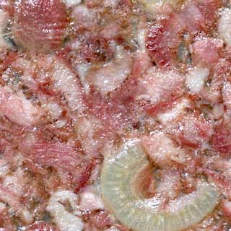
6. Luncheon meats, loaves, jellied
Head Cheese
Mixture of meats held together by a gelatin
Used in salads, sandwiches and as hors d’oeuvres
Notes:
Head cheese is not a cheese but a terrine or meat jelly made with flesh from the head of a calf or pig (sometimes a sheep or cow), and often set in aspic. While the parts used can vary, the brain, eyes and ears are often removed. The tongue, and sometimes even the feet and heart may be included. Head cheese may be flavored with onion, black pepper, allspice, bay leaf, salt, and vinegar. It is usually eaten cold or at room temperature as a luncheon meat. It can also be made from quality trimmings from pork and veal, adding gelatin to the stock as a binder.

Slide 21
Sausage Ingredients

Slide 22
Sausage Ingredients
Animal Tissues-
A. Meat – skeletal muscle (trimmings) beef, pork, poultry etc.
B. Meat by-products or variety meats (Non-skeletal, smooth muscle-tongues, lips, tripe, etc.)
Most high quality sausage are void of by-products
Water (moisture)
Usually in the form of ice
Helps cool product (avoids friction) and adds weight

Slide 23
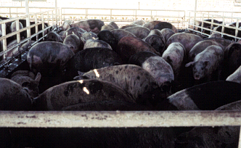
Why are sows used for Sausage?

Slide 24
Sausage Ingredients
Curing Ingredients
A. Salt
B. Spices – plant leaves, seeds, stems or roots
C. Flavorings – man made
D. Color developers – nitrites, ascorbates
Sweeteners
Non meat ingredients
Sugars, honey, etc.

Slide 25
Spices
Regional Sausages
Many sausages are regional because that is where spice is grown
Even with trade, spice regions produce the best sausage
Spice trades
Reason for discovery of Asia and America

Slide 26
Spices
Product | Spice
Breakfast Sausage | Sage
Italian Sausage | Fennel
Polish Sausage | Garlic
Bratwurst | Onions
Color Enhancement | Paprika

Slide 27
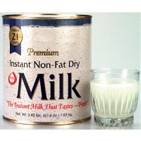
Sausage Ingredients
Binder and Fillers
A. Binder – Binds water and helps emulsify
B. Filler – Binds water, lowers costs (decreases meat contents)
C. These products are usually (soy, cereals, and milk proteins)
Binders/Extenders
Hold meat together and allow it to form
Starch
Soy
Collagen
Onions
Rice
Skin
Phosphates
Non-Fat Dried Milk

Slide 28
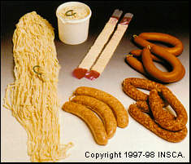
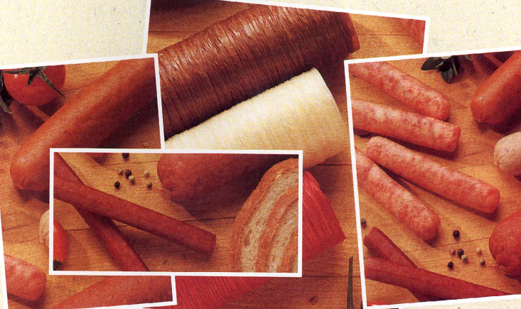
Sausage Casings
Casing determines shape of sausage
Natural Casings
Made from stomachs, intestines and bladders
Mostly from pigs and sheep
Manufactured/Artificial
Made from cotton linters, paper pulp and beef hides

Slide 29
Sausage Formulation

Slide 30
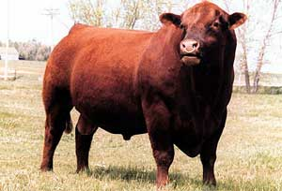
Meat Properties for Sausages
Binding Index
Relative amount of salt soluble, heat coagulable protein (SSHCP)
Bull meat has an arbitrary BI set at 100
Color Index
Measures the relative amount of myoglobin
Bull meats CI set at 100
Moisture: Protein Ratio
Moisture,% / Protein, %

Slide 31
Salt Soluble Heat-Coagulable Proteins (SSHCP)
Proteins with polar and non-polar properties
Actin and Myosin
Polar region attracted to water
Non-polar region attracted to fat
Help to emulsify fat and water
Bologna, hot dogs are true emulsions
Emulsion = mixture of two immiscible liquids (water and oil/fat)
Extracted from muscle tissue by salt, chopping , and mixing
Heat-coagulable
Harden to form a matrix during heating cycle

Slide 32
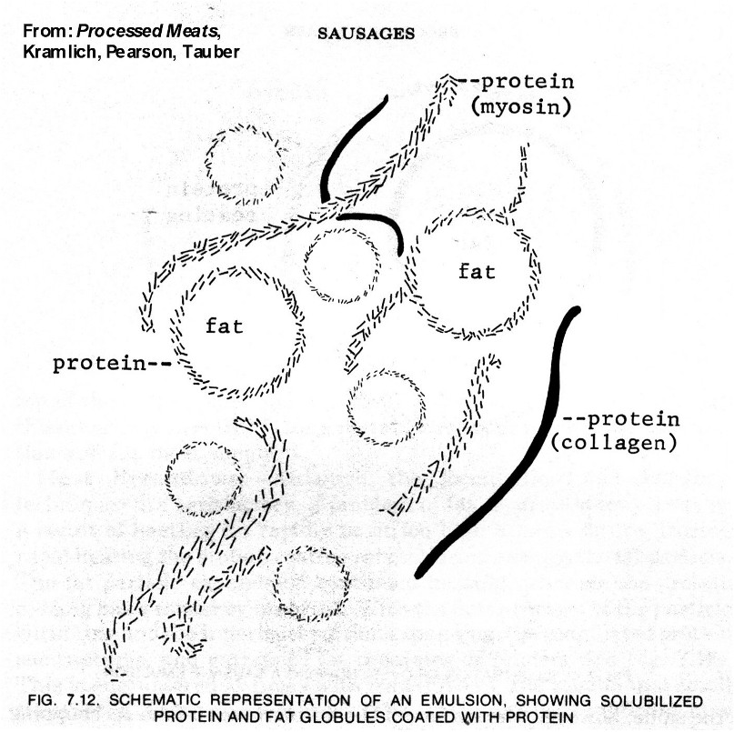
Emulsification
Fat = dispersed phase
Water = continuous phase
Solublilized proteins associate with fat and water

Slide 33
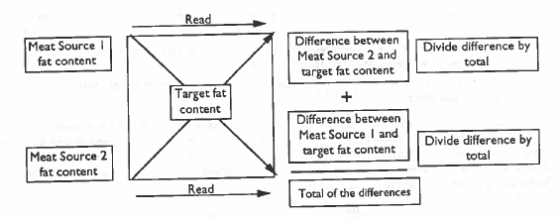
Target Fat %
Desired fat % can be achieved by mixing of two sources
Sausage Makers Square

Slide 34
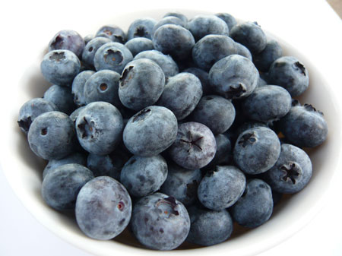

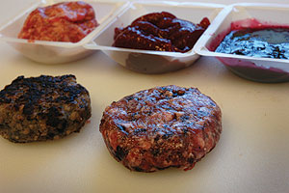
Innovation
Blueberry sausage
Fresh breakfast sausage
Includes whole ground blueberries
Adds sweetness
Reduces fat content
Adds ingredient rich in antioxidants

Slide 35
Product Development
Select type of sausage
Fresh, dry, semi-dry, cooked, cooked smoked, uncooked, lunch meat
Select ingredients
Salt, sugar, nitrites, spices….
Select 2 meat sources
70:30 Beef Trim 50:50 Pork Trim 85:15 Lamb Trim
80:20 Beef Trim 75:25 Pork Trim 90:10 Lamb Trim
90:10 Beef Trim
Exotic (Deere, Elk, etc) Trim at 93:7

Slide 36
Sausage processing

Slide 37
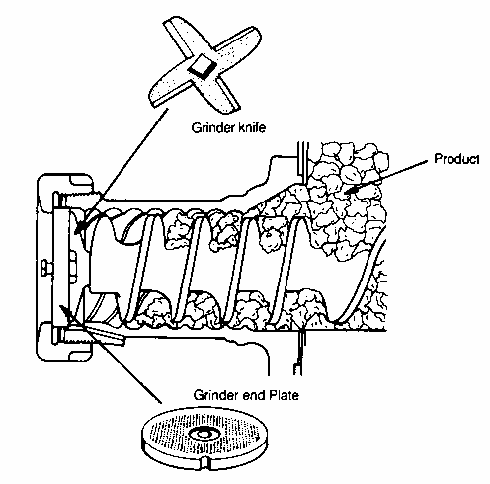
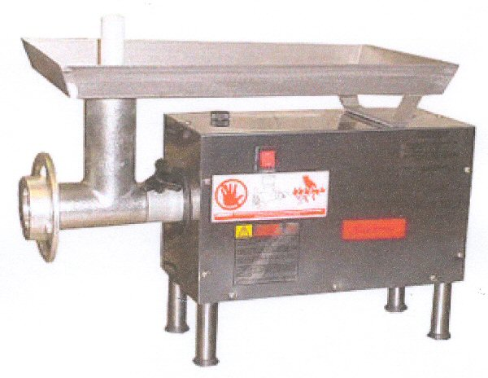
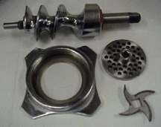
Grinding

Slide 38
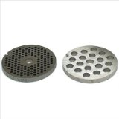
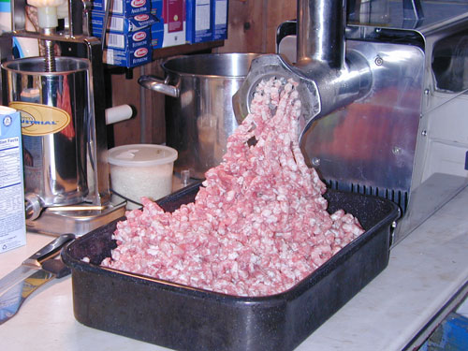
Coarse Grind
Whole muscle pieces or trim
Meat chunks of variable shape and fat content are ground to from uniform cylinders of fat and lean

Slide 39
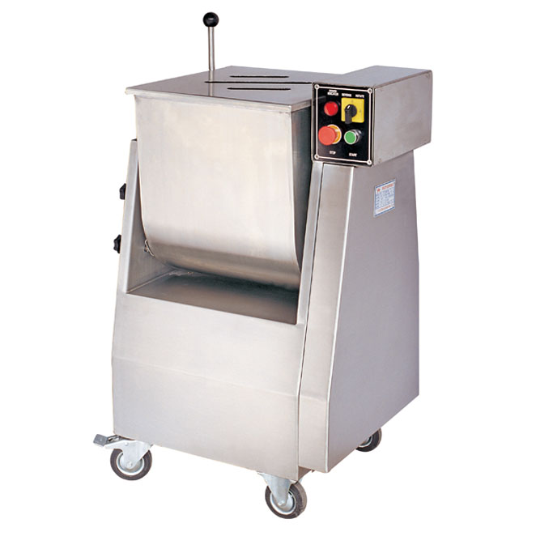
Mixing
Fat and lean cylinders are tumbled in a mixer to give uniform distribution of fat and lean particles
Mixing also aids in extraction and coating of fat particles with salt soluble proteins

Slide 40
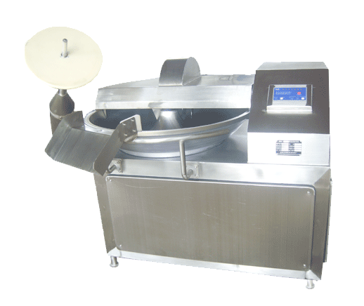
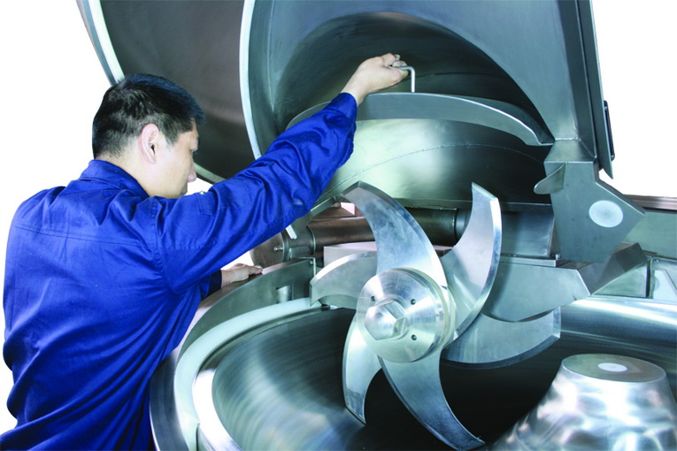
Chopping or Fine Grinding
Chopping
Used for greater particle size reduction and greater degree of emulsification

Slide 41
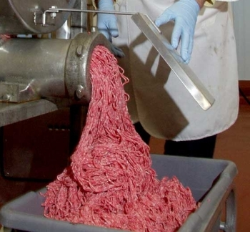
Chopping or Fine Grinding
Fine Grinding
Fine grinding plate

Slide 42
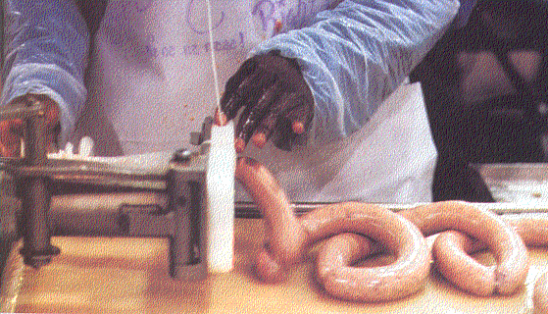
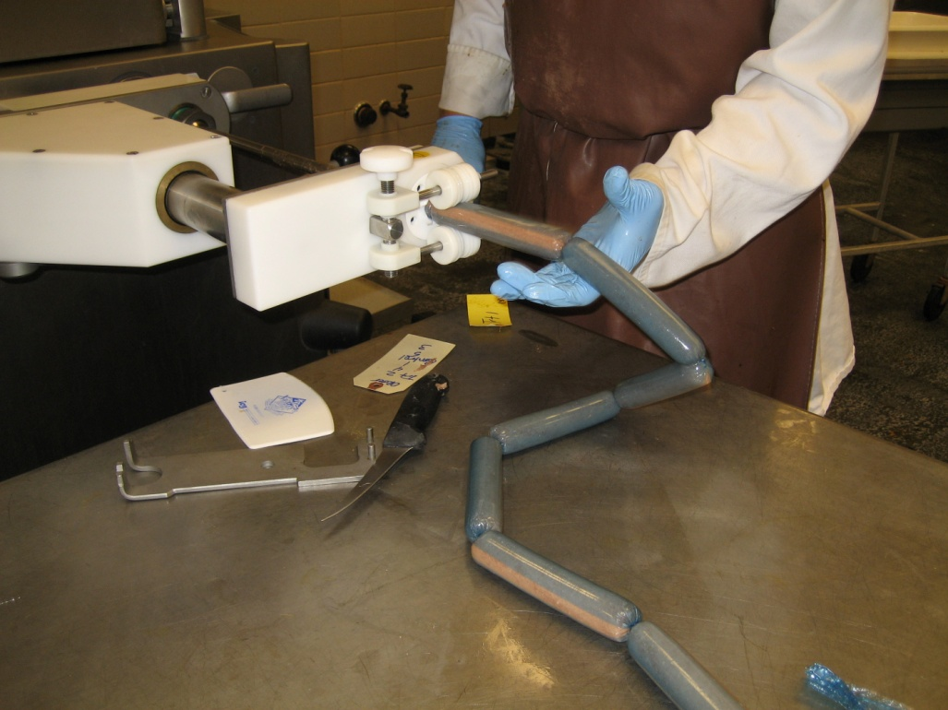
Stuffing
Stuffers extrude sausage emulsion into casings

Slide 43
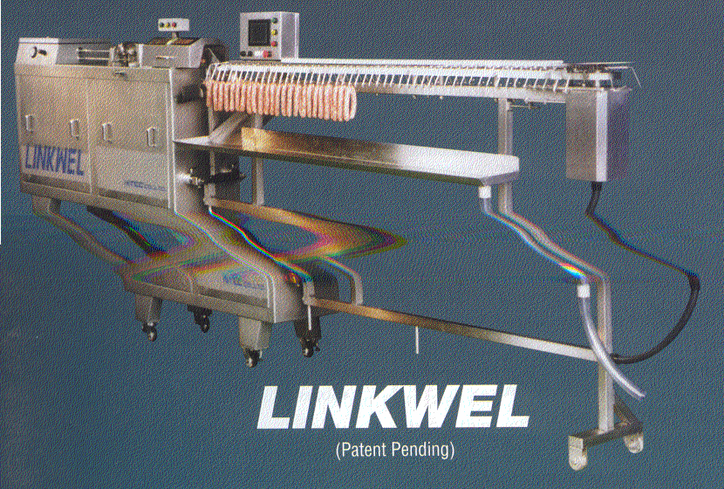
Linking and tying
Tying occurs via thread, string, or metal clips
Linking can occur mechanically or by hand twisting or drawn by string
Large items are tied or clipped with a hanging tie for suspension from smoking rod
Commercial frank machines can stuff and link 600 to 3600 lbs per hour

Slide 44
Smoking and Cooking
Smoke house performance depends on
Dimension
Time cycle
Temperature range
Thermal requirements (BTU)
Relative humidity
Air flow
Air flow pattern
Smoke Density

Slide 45
Chilling
Product can be chilled by refrigeration or cold water shower
Large volume operations using using continuous systems will rely on a brine chilling solution applied by dipping or spraying

Slide 46
Sausage Defects

Slide 47
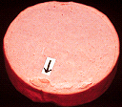

Gelatin Pocket or Fat Cap
Problem with emulsion formulation or imbalance of myosin and collagen (Too low content of lean meat in formula)
May also be result of too rapid heating or too high temp during cooking
Too much connective tissue

Slide 48

Ground To Fine

Slide 49
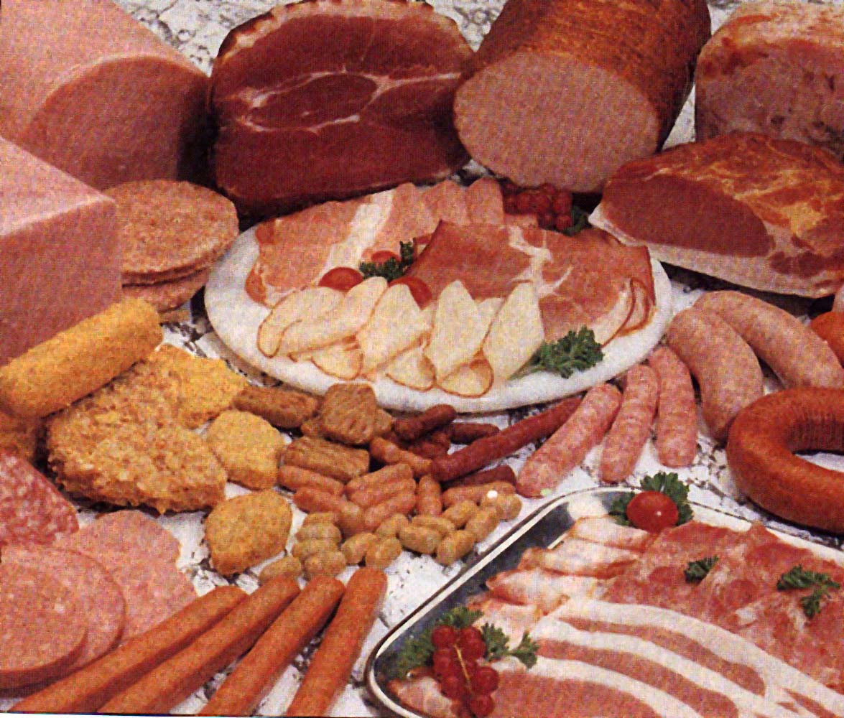
THE END

