Slide 1
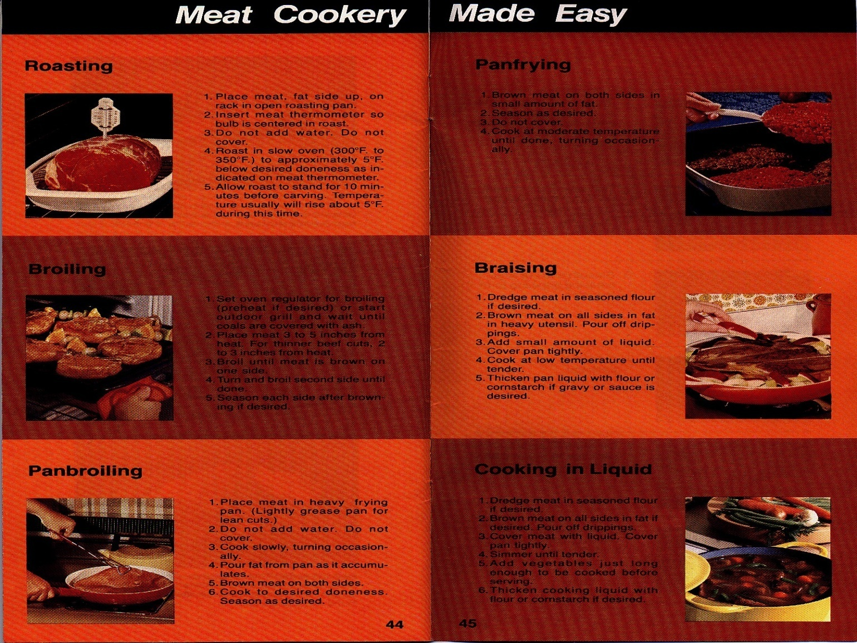
MEAT COOKERY
Prepared by:
Dr. C. Boyd Ramsey
Professor Emeritus

Slide 2
OBJECTIVES
To show the importance of cooking procedures on meat palatability
To match each meat cut with the best cooking method
To present the key procedures needed for successful indoor and outdoor meat cookery

Slide 3
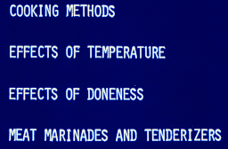
WHAT WE WILL COVER IN THIS UNIT

Slide 4
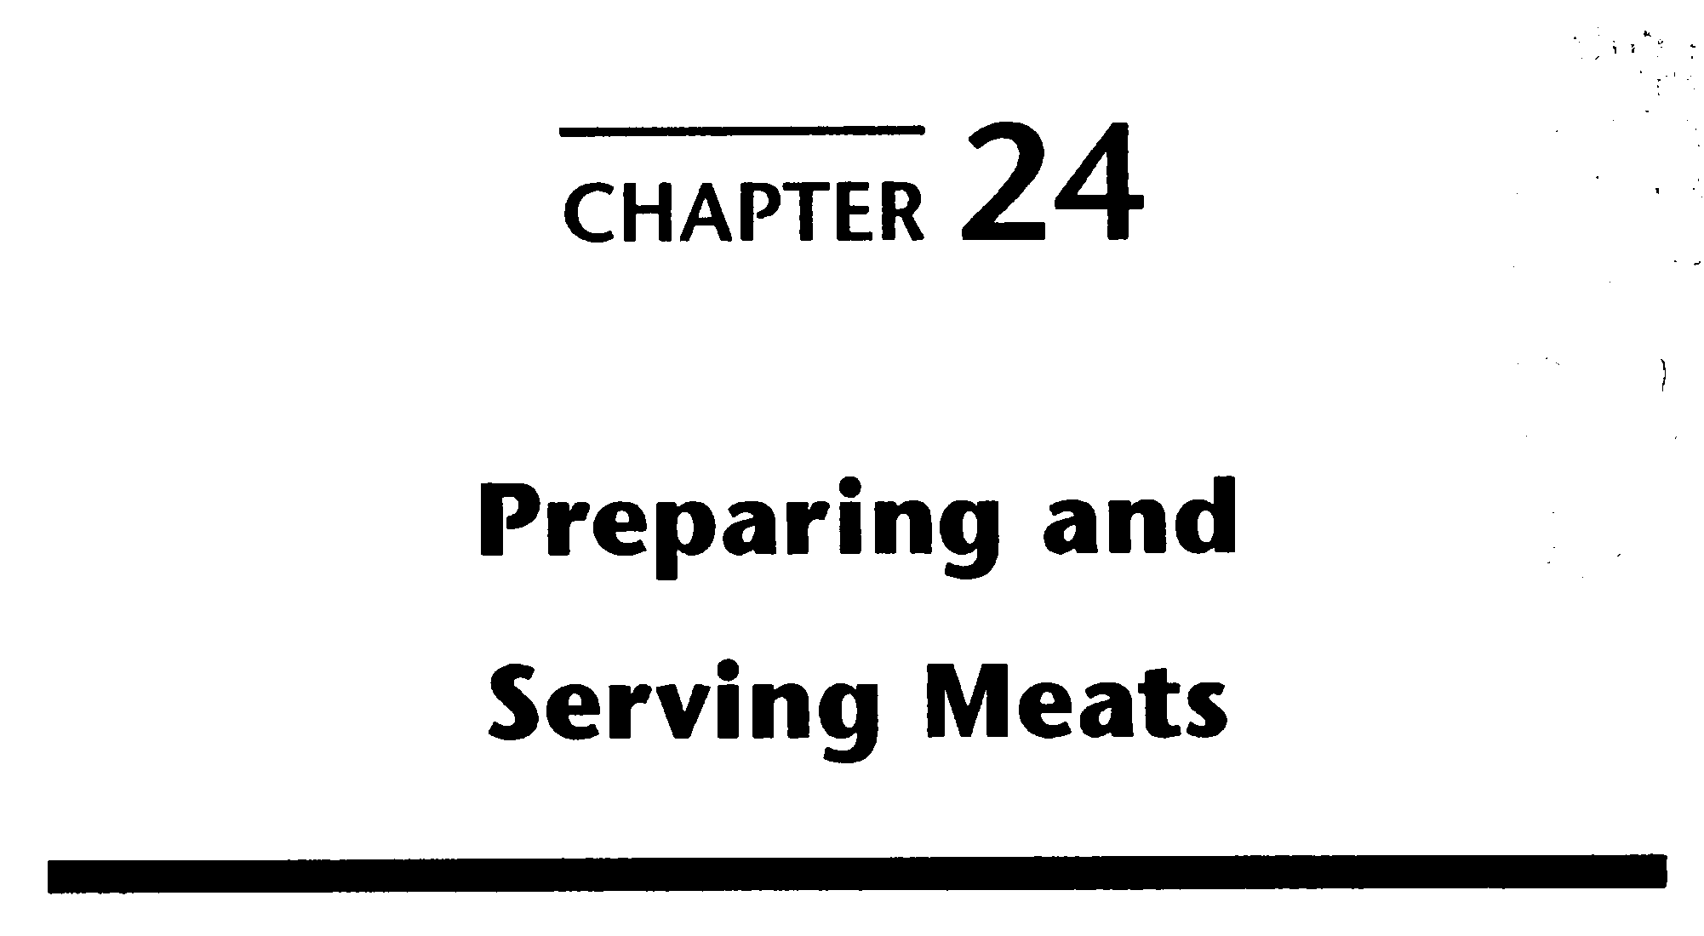
THE MEAT WE EAT

Slide 5
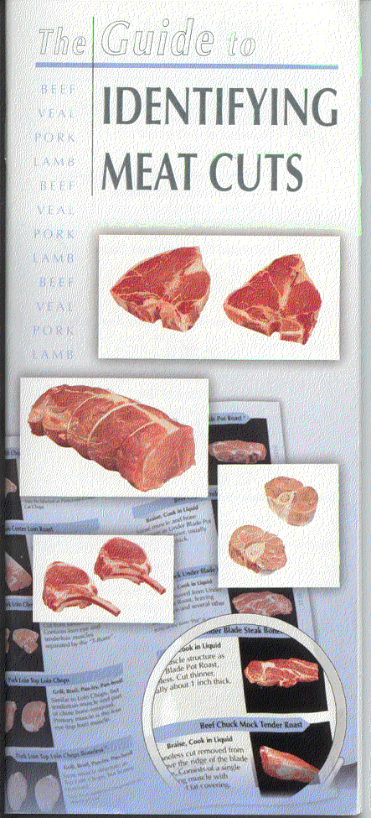
KNOW HOW TO COOK MEAT BY EACH METHOD SHOWN IN Meat Cookery - Three Easy Steps ON PAGES 52 - 54 OF “THE GUIDE TO IDENTIFYING MEAT CUTS”
Very Important!
Know which cooking method to use with all beef, pork and lamb retail cuts.

Slide 6
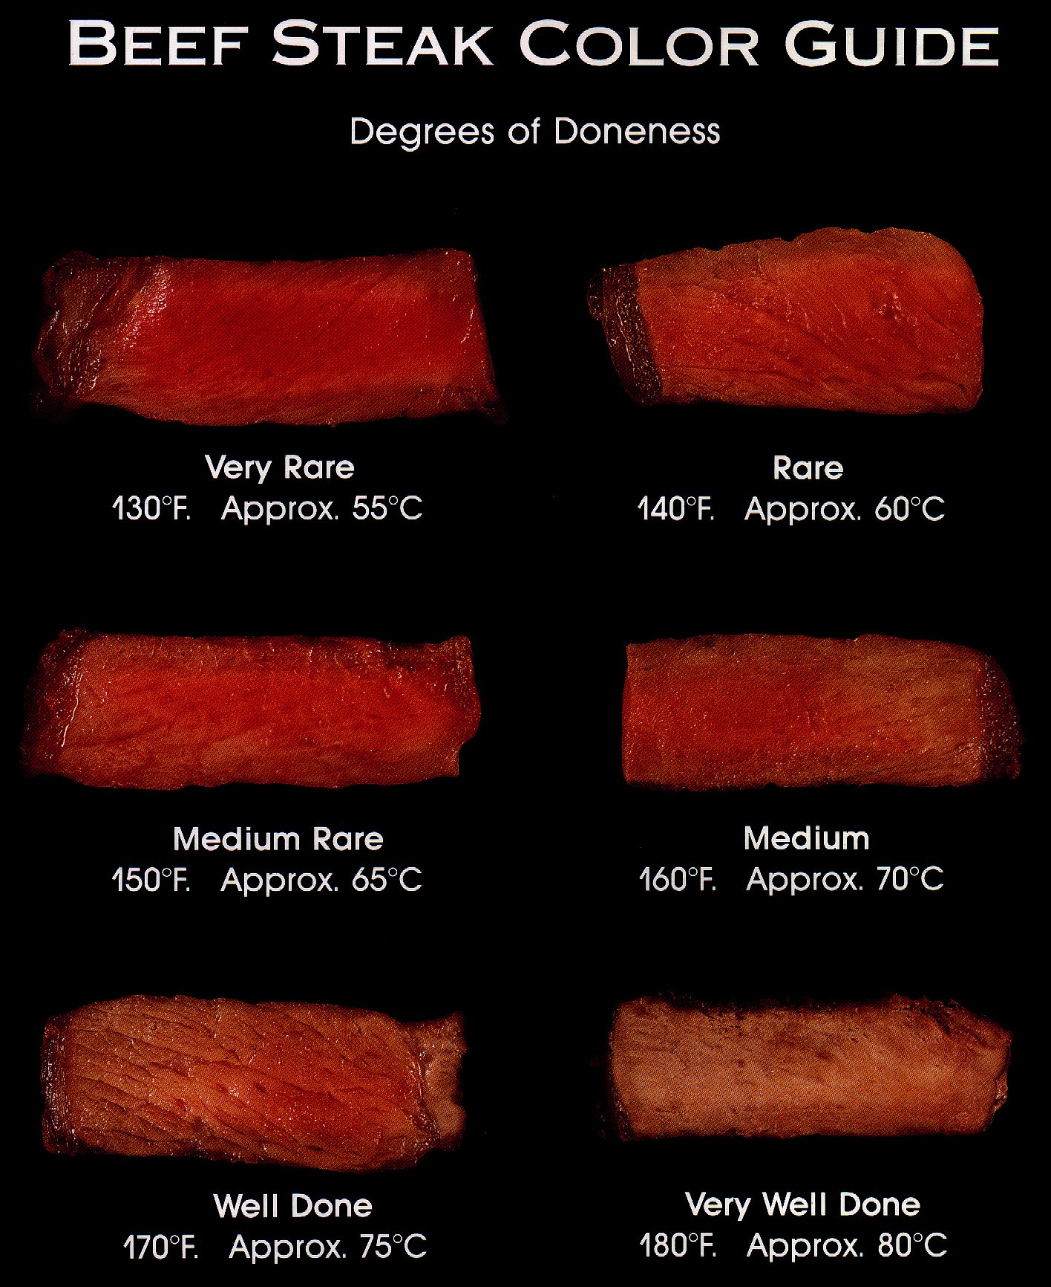
STUDY PAGES 54 - 55 OF “THE GUIDE TO IDENTIFYING MEAT CUTS”
KNOW THE INTERNAL TEMPERATURE CORRESPONDING TO EACH DONENESS

Slide 7
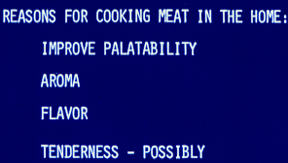
IN ADDITION TO FOOD SAFETY --

Slide 8
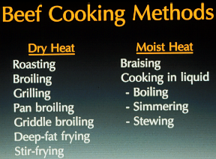
COOKING METHODS FOR MEAT
DRY HEAT
MOIST HEAT

Slide 9
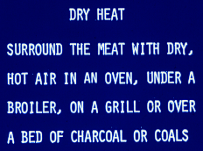

Slide 10
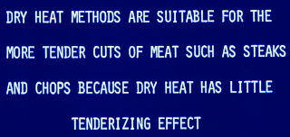

DRY HEAT DOES NOT TENDERIZE

Slide 11
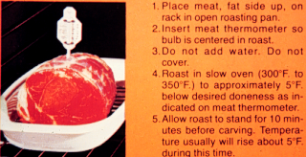
ROASTING - FOR THICK, TENDER CUTS

Slide 12
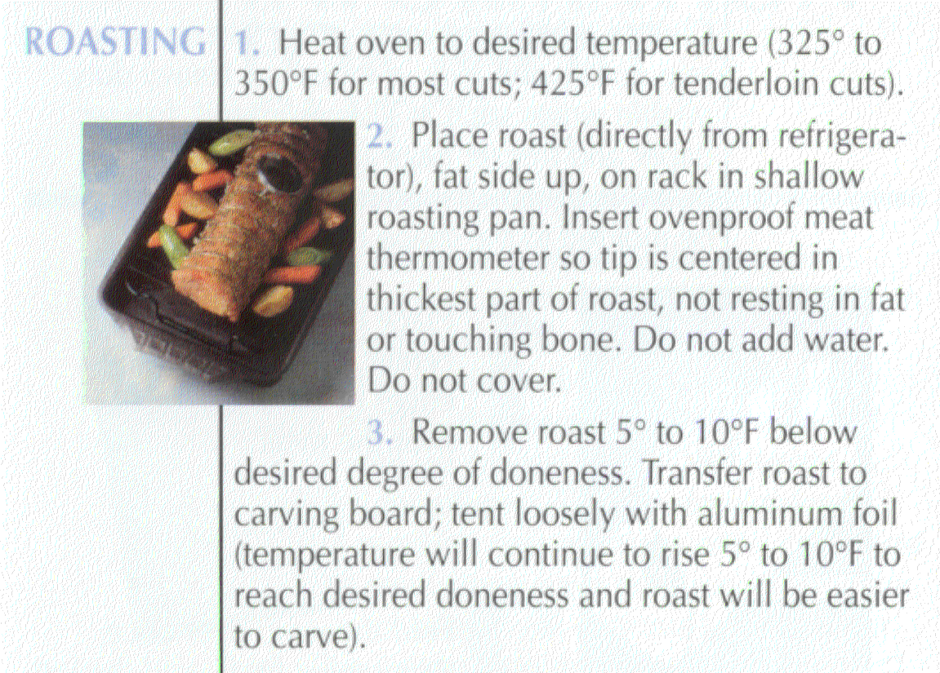
DRY HEAT COOKERY METHOD FOR THICK CUTS
STUDY PAGES 52 - 54

Slide 13
LONG TIME, LOW TEMPERATURE COOKERY OF LARGE MEAT CUTS
If a large meat cut, such as a prime rib or steamship round, is cooked for a long time at a low oven temperature (200⁰ or lower), muscle tenderization may occur.
Meat tenderizers cannot be used under such conditions because they have too much time to act.

Slide 14

BEEF ROASTS SLOWLY COOKED COMMERCIALLY IN A WATER BATH
NOTE THE UNIFORMITY OF MUSCLE COLOR

Slide 15
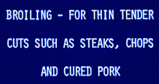
COOKING METHOD

Slide 16
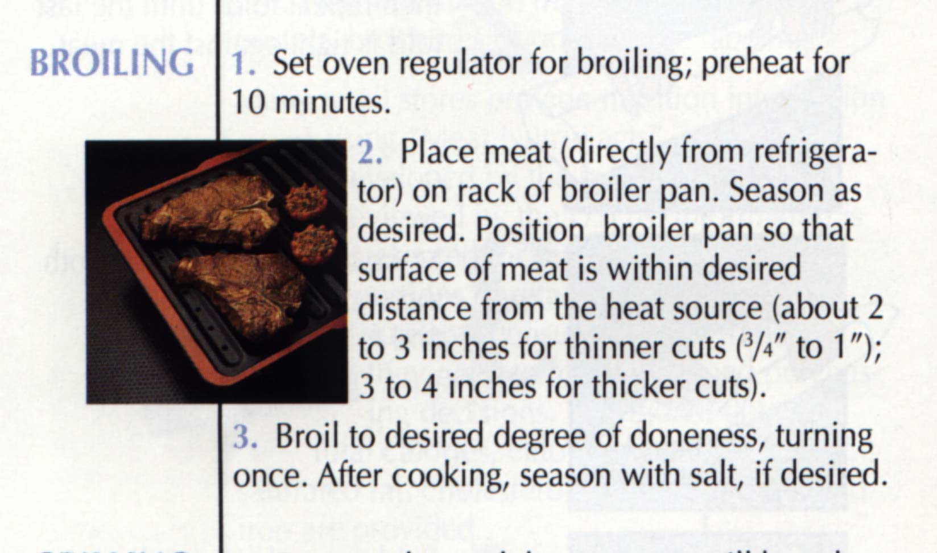
DRY HEAT COOKERY METHOD FOR THIN, TENDER CUTS

Slide 17
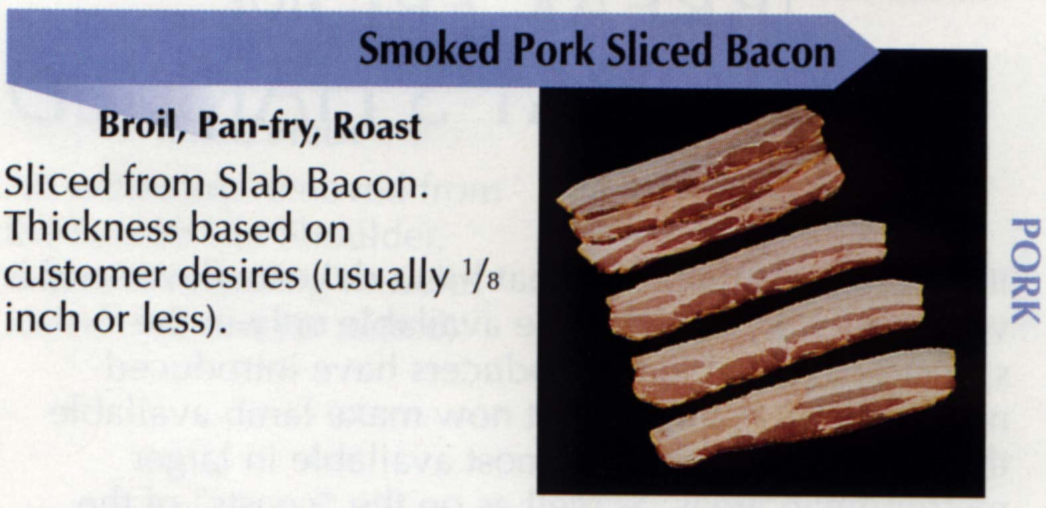
TRY BROILING BACON IF YOU HAVEN’T TRIED IT
BROILING AND ROASTING ON A RACK CONSIDERABLY REDUCE FAT CONTENT COMPARED TO FRYING

Slide 18
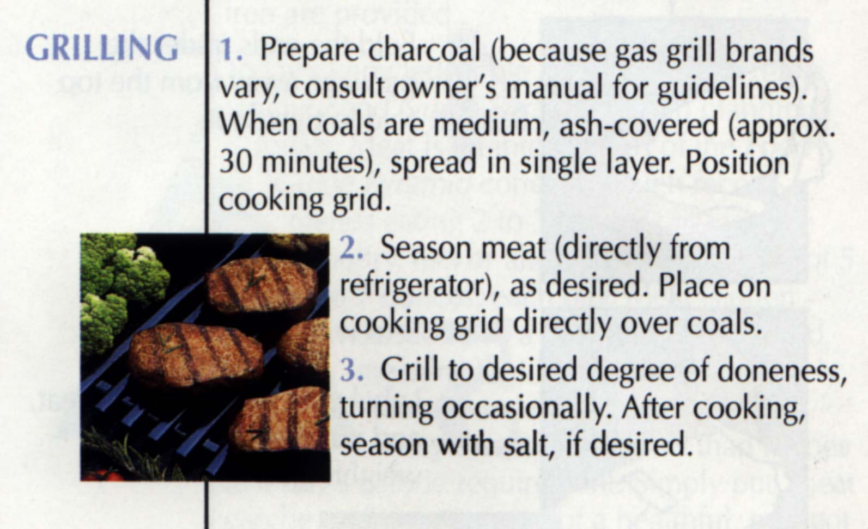
DRY HEAT COOKERY MEAT FOR THIN, TENDER CUTS

Slide 19
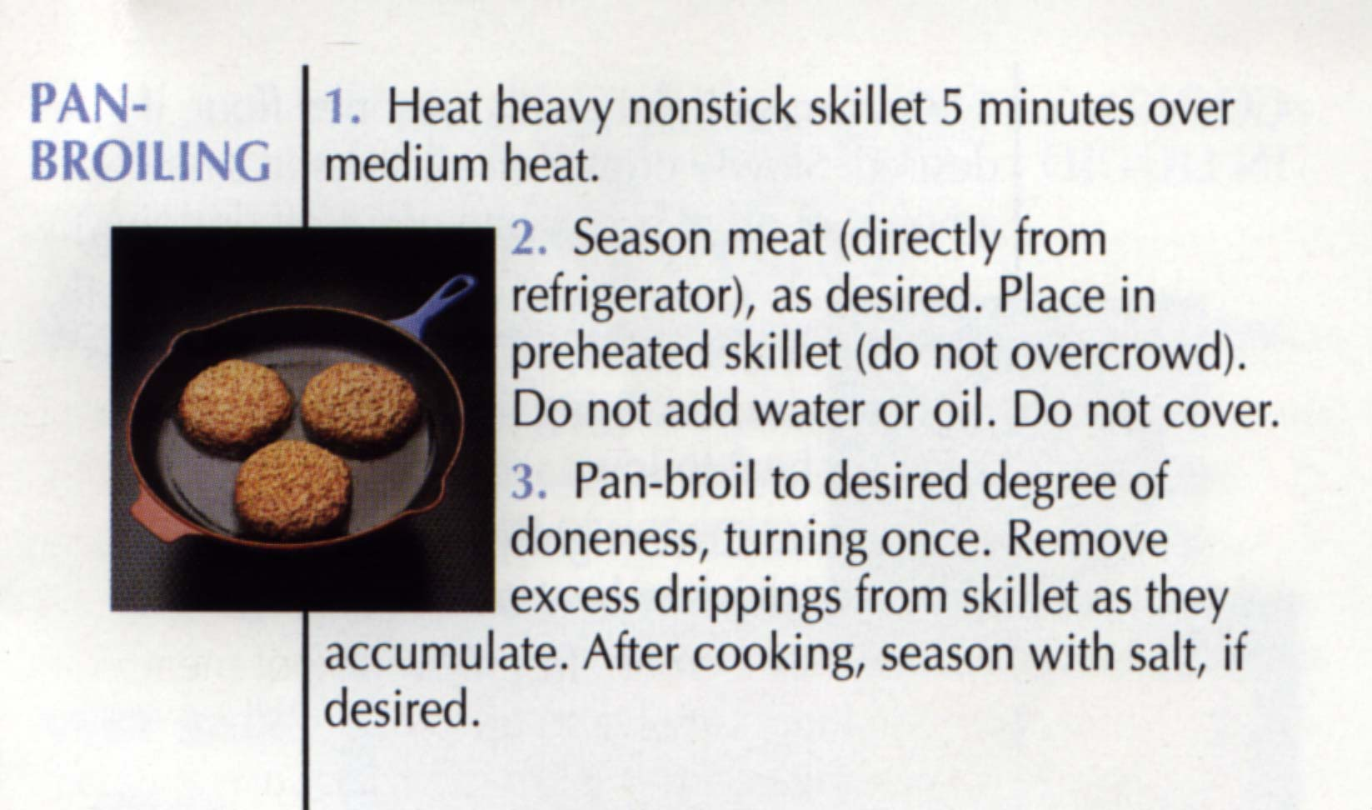
ON TOP OF THE STOVE, DRY HEAT COOKERY
METHOD FOR THIN, TENDER CUTS
ALLOWS BROILING WHEN YOU DON’T HAVE AN OVEN

Slide 20
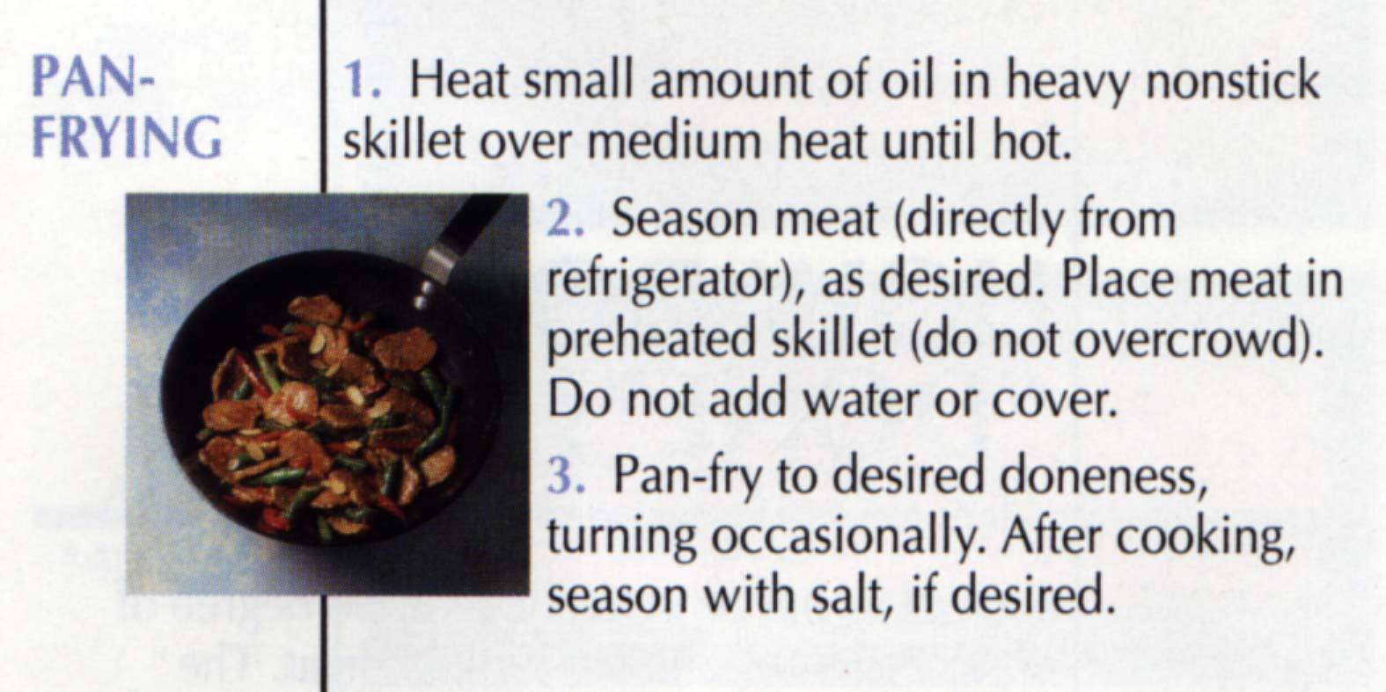
USE ONLY WHEN MEAT IS TOO DRY WITHOUT ADDED FAT
FRYING SIGNIFICANTLY INCREASES THE CALORIC VALUE OF FOODS OF ANY KIND AND INCREASES HUMAN WEIGHT PROBLEMS

Slide 21
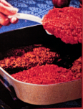
Cubed steaks should be fried to prevent dryness resulting from their open structure.

Slide 22
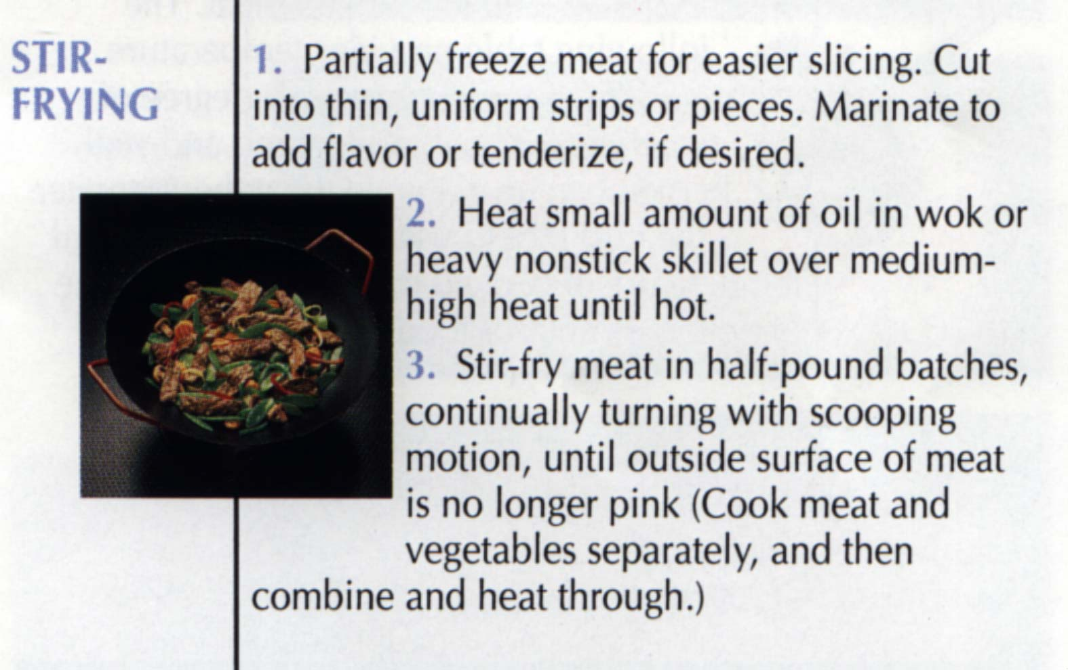
FOR SMALL, THIN PIECES OF MEAT

Slide 23
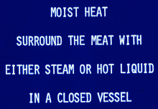
MAIN COOKING METHOD CATEGORY

Slide 24
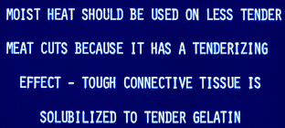
WHEN TO USE MOIST HEAT METHODS

Slide 25
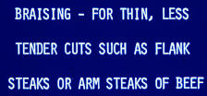
COOKING METHODS

Slide 26
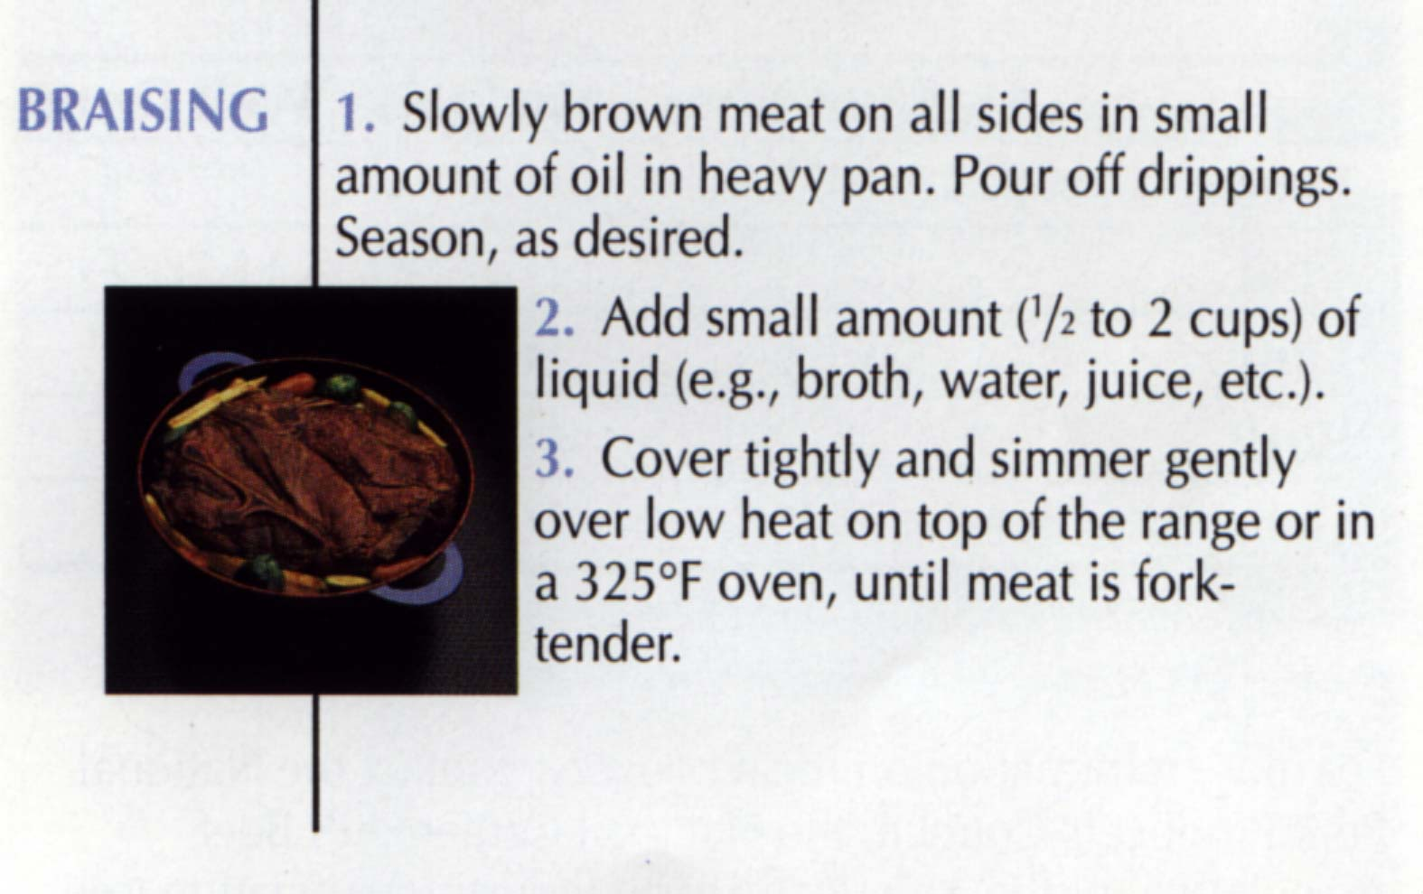
MOIST HEAT COOKERY METHOD FOR THIN CUTS
Note spelling - “brazing”
is a kind of welding.

Slide 27
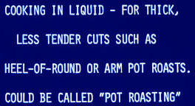
SAME AS BRAISING EXCEPT FOR THE AMOUNT OF LIQUID USED

Slide 28
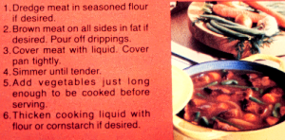
COOKING IN LIQUID (STEWING)

Slide 29
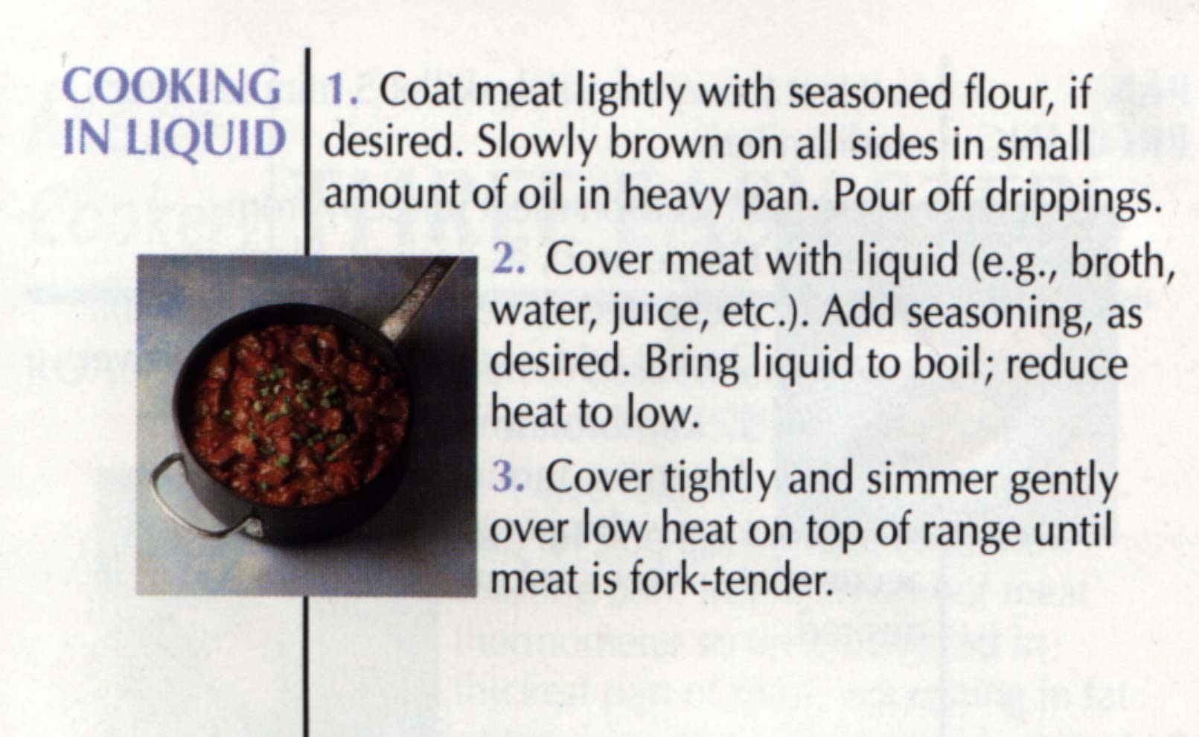
MOIST HEAT COOKERY METHOD FOR THICK CUTS
ALSO CALLED STEWING
IF MEAT PIECES ARE SMALL

Slide 30
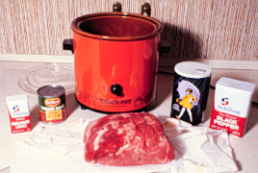
CROCK POT OR SLOW COOKER
SALT & PEPPER
TOMATO SAUCE
BEEF ROAST
MARJORAM - A SPICE

Slide 31
CROCK POT
Because moist heat cookery is used, you must add flavoring agents to the food to make it taste better.
An excellent cooking method when the cook works outside the home.
Start the cooking before you leave for work and have a delicious meal ready when you return.
For food safety purposes, the cooker should be set on “high” until the food gets hot and then turned to”low”.

Slide 32
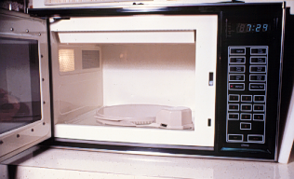
A MICROWAVE OVEN NEEDS A TURNTABLE TO PROMOTE UNIFORM COOKING

Slide 33
HOW DO MICROWAVE OVENS WORK?
A magnetron generates radar waves.
They are stirred as they enter the oven.
They bounce from wall to wall until dissipated or they enter food.
They heat by exciting water molecules and creating friction.
A dry substance will not heat.
Surfaces do not get hot enough to brown.

Slide 34
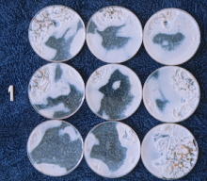
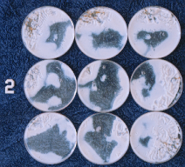
EGG WHITE PARTIALLY COOKED IN TWO MICROWAVE OVENS (1 & 2)
WHERE ARE THE HOT AND COLD SPOTS?

Slide 35
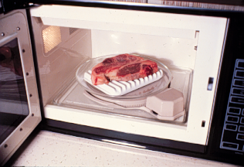
COOKING A STEAK ON A BROWNING DISH IN A MICROWAVE OVEN
Meat cooked in a microwave oven scores about 0.5 point lower than when cooked by broiling or roasting, but it’s fast.

Slide 36
WHAT CAUSES DIFFERENT MUSCLE APPEARANCE AT VARYING TEMPERATURES?
Myoglobin changes from a reddish to brownish color at 149ºF.
Thus, in cooking meat the surface regions will be hotter and change color before internal regions.
150⁰
135⁰
150⁰

Slide 37
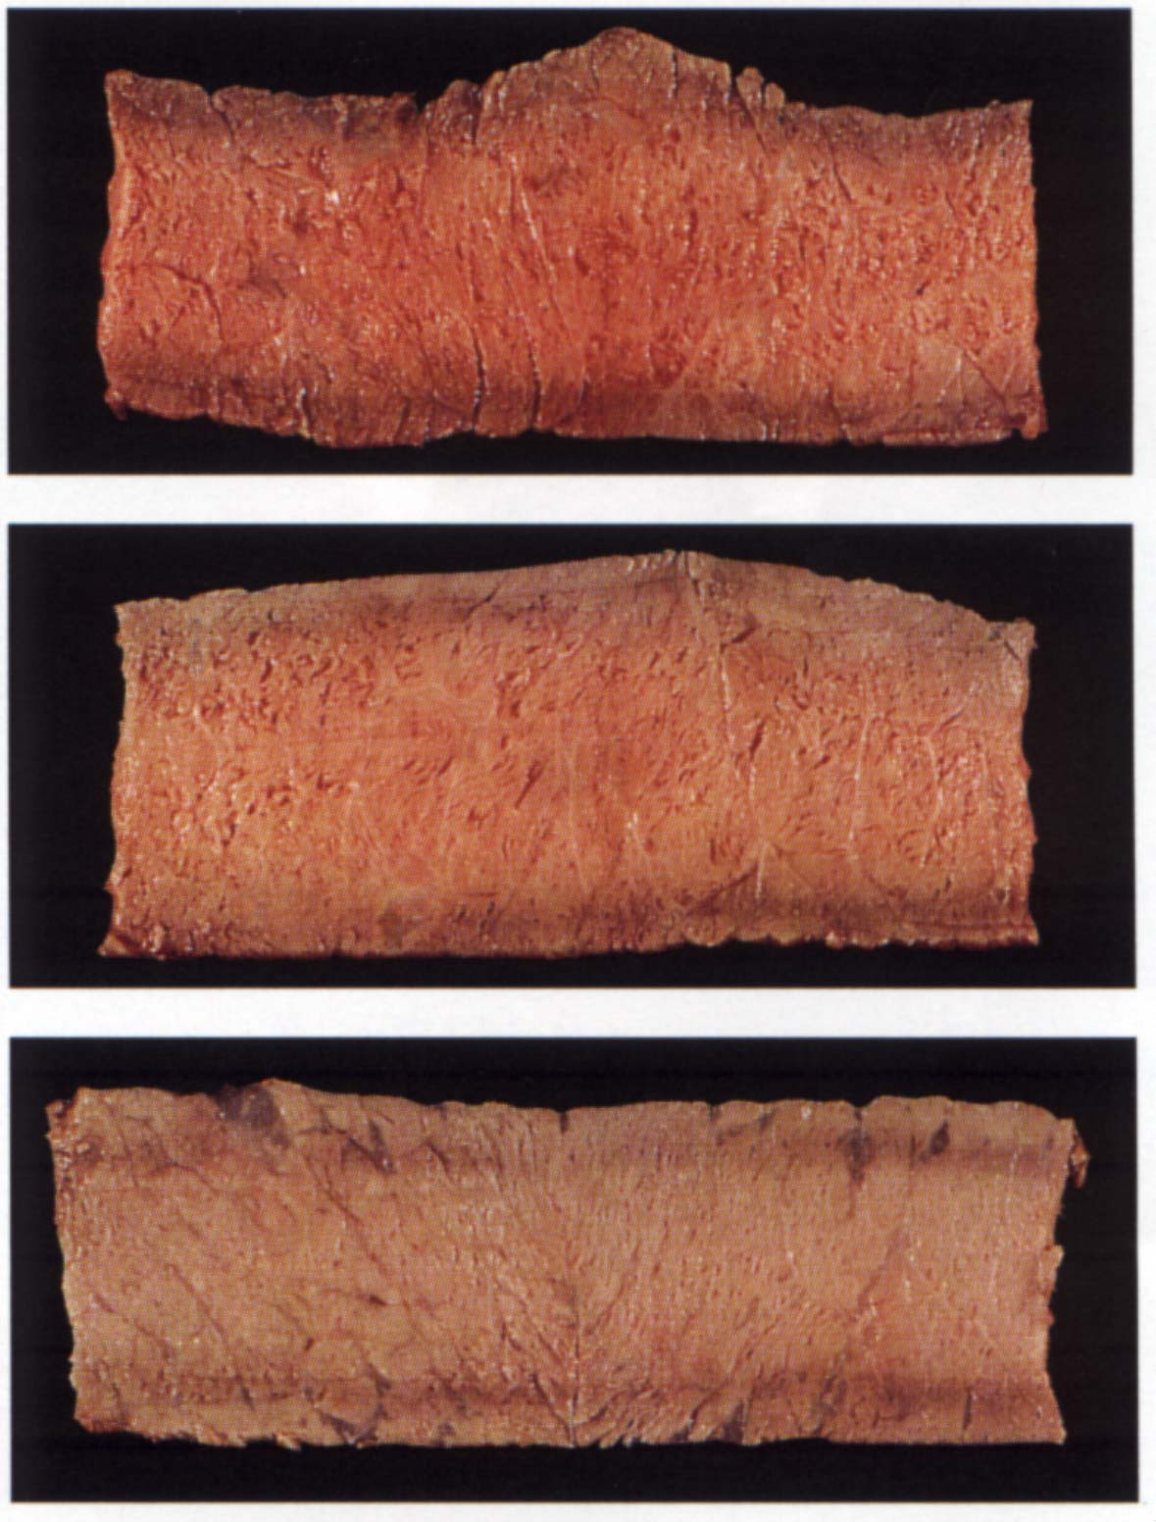
CHANGE IN COLOR FROM
MEDIUM RARE
TO
MEDIUM
TO
WELL DONE
145⁰
160⁰
170⁰
SEE PAGE 55

Slide 38
WE CAN TAKE ADVANTAGE OF THIS KNOWLEDGE
If we cook large roasts slowly, more time will be available for pigment change at or near 149⁰
Thus, we can have a well done appearance (that some people require) but have the increased juiciness and tenderness that a lesser state of doneness allows.
(i.e., we can have a well done appearance at a less than well done temperature)

Slide 39
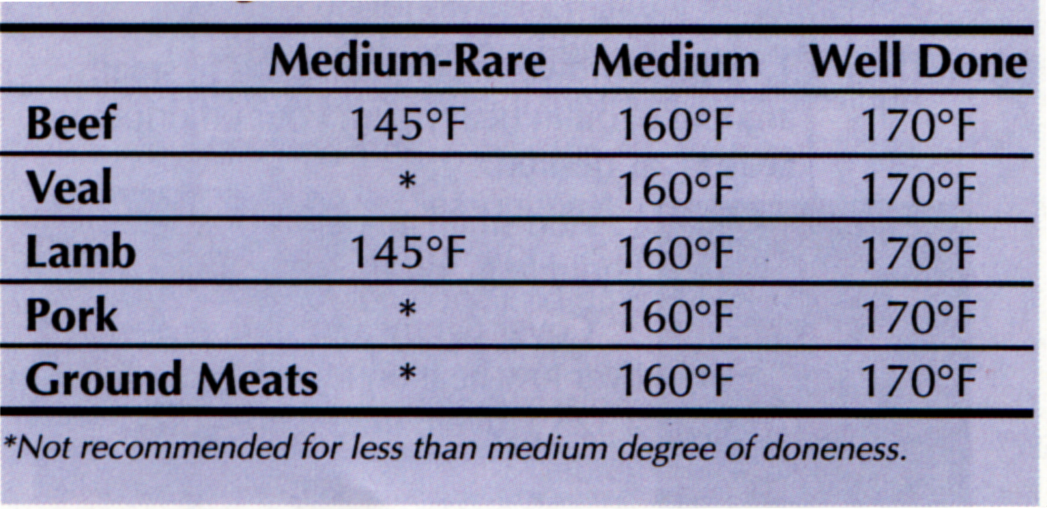
RECOMMENDED DEGREES OF DONENESS
FROM PAGE 54 OF IDENTIFYING MEAT CUTS

Slide 40
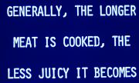
DON’T OVERCOOK MEAT

Slide 41
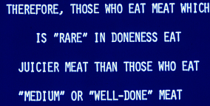
COOKING LOSSES INCREASE WITH COOKING TIME AND TEMPERATURE

Slide 42
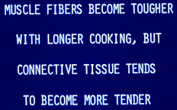
VARIABLE EFFECTS OF HEAT

Slide 43
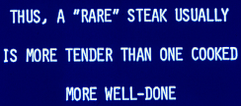
LESS DONE, MORE JUICINESS & TENDERNESS

Slide 44
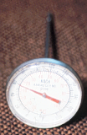
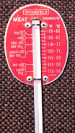
DIAL AND STEM THERMOMETERS
MORE ACCURATE, BUT FRAGILE
MORE DURABLE BUT MOST HAVE PLASTIC DIAL COVERS THAT MELT IN HEAT

Slide 45

THERMOMETER FOR MICROWAVE OVENS - THEY DON’T WORK WELL
They contain an alcohol that is non-toxic. However, this alcohol column tends to separate into segments with use.
Many microwave ovens have a built-in temperature probe.

Slide 46
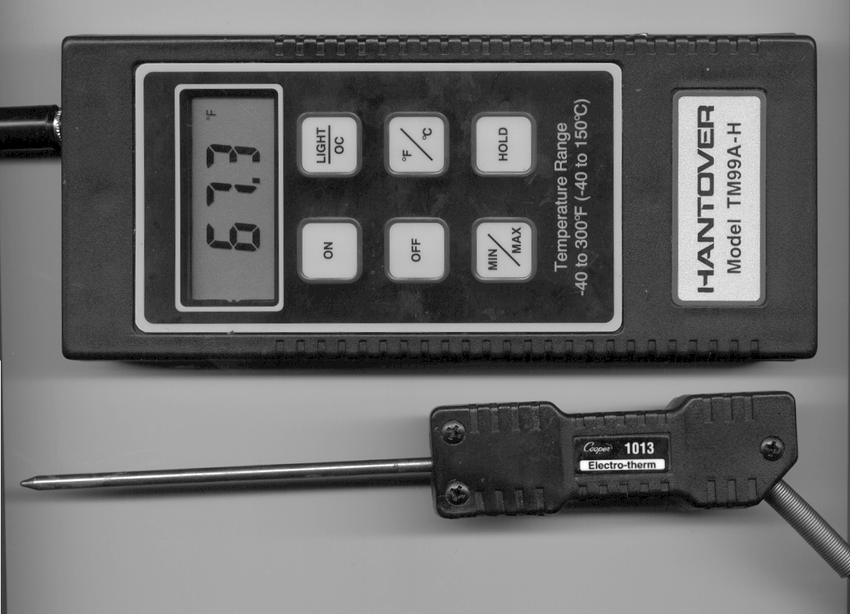
ELECTRONIC TEMPERATURE PROBE USED IN TTU MEAT SCIENCE RESEARCH
LESS EXPENSIVE MODELS ARE AVAILABLE FOR HOME USE

Slide 47
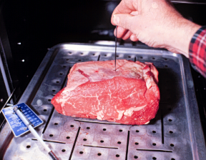
USING A METAL SKEWER TO MAKE A HOLE FOR THE MEAT THERMOMETER
Insert the thermometer’s tip in the geometric center of the roast or steak but not against bone or in fat.

Slide 48
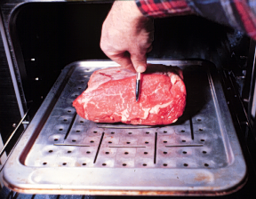
MEASURE SO THAT YOU CAN PLACE THE TIP OF THE THERMOMETER HALF WAY THROUGH THE ROAST

Slide 49
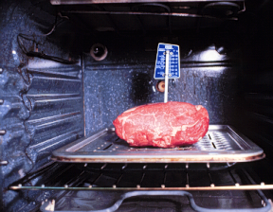
A THERMOMETER PROPERLY PLACED IN A ROAST
A METAL-CLAD STEM ON A THERMOMETER OF THIS TYPE MAKES IT MUCH MORE DURABLE

Slide 50
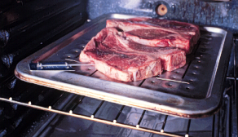
PORTERHOUSE STEAKS WITH A THERMOMETER IN PLACE READY TO BE BROILED IN AN OVEN
The internal temperature of steaks and roasts will increase 5 to 10⁰ after the meat is taken from the heat. Allow for this increased doneness.

Slide 51
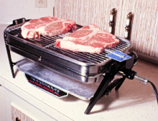
INSERT THE THERMOMETER FROM THE EDGE OF STEAKS, CHOPS OR HAMBURGERS
This farberware grill is excellent for home use - an exhaust hood above it is not necessary

Slide 52
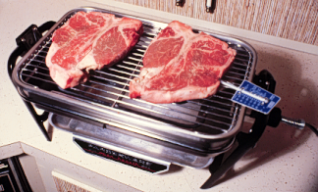
TEMPERATURE AT THE MEAT ON A FARBERWARE GRILL IS ABOUT 300⁰ - NEAR IDEAL
An opening in the bottom allows air circulation and prevents overheating

Slide 53
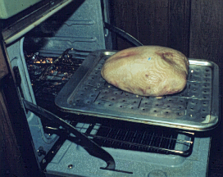
INTERNAL TEMPERATURE DEVICE IN A TURKEY BREAST TO BE ROASTED
The spring-loaded plunger pops up when the temperature is sufficient to melt the wax around the plunger.
PLUNGER
WAX
SPRING
Is not very useful - you would have to look at it frequently to see if it had emerged.

Slide 54
RESTAURANT CHEFS CLAIM THEY CAN DETERMINE DONENESS BY DEPRESSING THE COOKING MEAT WITH A SPATULA
The amount a cut of meat depresses depends on its doneness (more done, less depression), but the problem is that meat varies greatly in firmness.
If this pressure method of determining doneness always “worked,” we would receive meat with the doneness we order in restaurants.

Slide 55
FOR HEALTH’S SAKE,DON’T CHAR MEAT!!!
Some Japanese research shows that charring meat may produce carcinogens.
So, don’t overcook meat or cook with too much heat that produces charred areas.
Don’t cook with flames when charcoaling. If a fire erupts, have water handy to douse it.

Slide 56
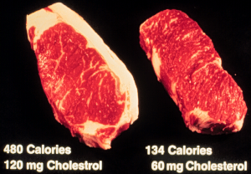
NOT EATING TRIMMABLE FAT REDUCES CALORIES BY 346 & CHOLESTEROL BY 60 mg IN JUST ONE STEAK
Trim the fat before you cook because the fat migrates to muscle during cooking.

Slide 57
THE MEAT IS DONE BUT WE’RE NOT READY TO EAT - WHAT DO I DO?!?!?!?!?!?!?!?
When cooking large cuts such as roasts, hams, turkeys, etc., if the meat gets done too soon, wrap it in foil and a towel and put it in a cooler. If you don’t have a cooler, wrap it in foil and layers of cloth. It will stay warm for hours.
Do smaller cuts the same way but for shorter times.
It is better to have roasts done early because they need to “set up” at least a few minutes before being carved.

Slide 58
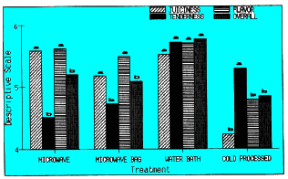
WITH PROPER PROCESSING & COOKING, HOT PROCESSED PORK IS MORE PALATABLE THAN COLD PROCESSED
JUICINESS
TENDERNESS
FLAVOR
OVERALL
THE WATER BATH WINS!
MICROWAVE MICROWAVE WATER BATH COLD
IN A BAG PROCESSED
-------------------- HOT PROCESSED ---- --------------
--

Slide 59
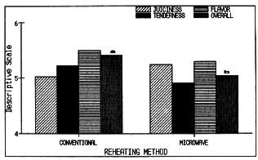
EFFECTS OF CONVENTIONAL AND MICROWAVE OVEN REHEATING OF PRECOOKED PORK PRODUCTS
JUICINESS
MICROWAVE LOSES
TENDERNESS
FLAVOR
OVERALL
CONVENTIONAL
MICROWAVE
REHEATING METHOD

Slide 60
PROCEDURE IN TTU PORK CHOP RESEARCH BY KERSH AND RAMSEY
Pork loin chops were cut 1/4, 1/2, 3/4 and 1 inch thick.
They were cooked by broiling, frying or microwaving.
Doneness was determined visually or with a meat thermometer.
A trained sensory panel evaluated tenderness, juiciness and flavor.

Slide 61

COMPARING COOKING METHODS

Slide 62

IF YOU DON’T HAVE A MEAT THERMOMETER, GET ONE!!!!

Slide 63

YOU CANNOT TELL WHEN MEAT IS DONE BY LOOKING AT ITS SURFACE

Slide 64

WHEN MEAT IS WRAPPED IN ALUMINUM FOIL, MOIST HEAT IS USED - FLAVOR


BOTH USES PREVENT CHARRING OF THE MEAT

Slide 65
COOKING DATA FOR 12-LB. HAMS
OVEN COOKING PALAT-
TEMP TIME, MIN. COOKING ABILITY
COOKING METHOD ^{O}F PER LB. LOSS, % RANKING
ROASTED IN
ALUMINUM FOIL 400 17 24 5TH
ROASTED
UNCOVERED 400 16 28.5 3RD
ROASTED COVERED 350 22 19 4TH
ROASTED
UNCOVERED 250 32 10 2ND
ROASTED
UNCOVERED FROM
FROZEN STATE 250 64 8 1ST

Slide 66
WHAT ABOUT COOKING BAGS FOR ROASTING?
Do not use cooking bags
They insulate, wasting energy and your money
They trap steam, shifting from roasting to braising with the trapped steam
Braising tenderizes but greatly harms the meat flavor
Meat should be naked during roasting

Slide 67
EFFECTS OF COOKING SPEED & DONENESS -
DATA COLLECTED IN ANSC 3201 LABS
COOKING INTERNAL COOKING WBS SENSORY PANEL SCORE
METHOD TEMP., ^{O}F LOSS, % VALUE TEND. JUIC. FLAVOR
BROILING 155 19.3 7.7 6.0 6.6 6.4
BROILING 180 30.2 9.2 5.6 5.0 5.1
CHARCOAL
GRILLING 155 13.4 5.7 7.2 6.6 7.3
Compare lines 1 and 2. The only difference is the doneness: 155 vs. 180 internally. How did the greater doneness change the meat?
Compare lines 1 and 3. Only differences are charcoal and a slower cooking w/charcoal.

Slide 68


Slide 69
MEAT TENDERIZERS
Enzymes that degrade proteins and tenderize meat.
Review information given earlier
Papain is most widely used
In home situations, any tenderizer is difficult to incorporate into the meat beyond about a 1/4-inch depth.
Commercially, enzyme solutions can be pumped into meat cuts.

Slide 70

INGREDIENTS OF A MARINADE
TOO SALTY TO DRINK

Slide 71
HOW TO USE A MARINADE
Mix the marinade and coat all surfaces of the steaks or chops.
Leave in the refrigerator for 4 to 24 hours.
Re-coating of the meat with the marinade is desirable.

Slide 72
ADVANTAGES OF MARINATING
Increases juiciness coming from the oil in the marinade
Increases flavor coming from the spices
Surface tenderness may be increased by the lemon juice or similar ingredient
Downside: calorie count will be increased because of the added fat

Slide 73
INGREDIENTS FOR A GOOD CHICKEN BBQ SAUCE - IMPARTS A GOLDEN COLOR
Ingredient For 4 halves For 100 halves Cider vinegar I cup 1/3 cup
Cooking oil 4 tsp 2 tsp
Salt 2 tsp 1/8 tsp
Tabasco sauce I gallon 3 pints
Worcestershire sauce 2 cups 4 bottles
Garlic powder (optional) 2 bottles 3 tsp
This sauce can be sprayed on cooking chicken.

Slide 74
OUTDOOR COOKERY MADE EASY
Thousands of cartoons have been drawn poking fun at backyard “cooks” in a cloud of smoke.
With a few key points, you can escape being a cartoon subject and can become an excellent backyard chef.

Slide 75
HOW IS SMOKED FLAVOR PRODUCED?
Charcoal or gas grills produce smoked flavor on meat because the meat grease cooks out and drips on something hot, creating smoke.
Grease dripping on hot metal would produce essentially the same flavor as charcoal or gas grills.

Slide 76
CHARCOAL VS. GAS AND WOOD CHIPS
In previous years of this class, we determined that students could not tell the difference in flavor of pork chops cooked over charcoal and on gas grills.
If you want a stronger smoked flavor, soak hardwood chips in water (so they will smolder and not flame) and place them on top of the charcoal or on top of the layer of rock-like material in a gas grill.

Slide 77
TEXAS GRILLS NEED “HATS”
Because of an abundance of wind in many parts of the country, particularly Texas, you should purchase a grill with a lid.
It will be cheaper in the long run if you buy a more heavily- constructed grill because they “rust out” more slowly.
You don’t need a big grill for everyday family use.

Slide 78

AN IDEAL CHARCOAL GRILL FOR EVERYDAY FAMILY USE
CAST IRON BODY WITH STAINLESS STEEL GRILL
Two dampers to control heat
Milled edges on lid and bottom - air tight
Is about 30 years old and still going strong

Slide 79

GRILL WITH CHARCOAL REMAINING FROM THE PREVIOUS COOKING
STAINLESS STEEL GRILL

Slide 80
CHARCOALING KEY POINT
USE ONLY ENOUGH CHARCOAL TO COVER THE AREA UNDER THE MEAT TO BE COOKED
THESE BRIQUETTES WOULD HEAT ONLY
THE AIR
WE DON’T NEED MORE “HOT AIR” IN TEXAS!

Slide 81

CHARCOALING KEY POINT
Each briquette then helps light the one touching it and they light more quickly.

Slide 82

CHARCOAL STACKED READY FOR LIGHTING
Partially-burned briquettes from the previous cooking are in the bottom layer.

Slide 83

APPLY LIGHTER FLUID GENEROUSLY
Do NOT use gasoline unless you also want to be “lit”.
Kerosene and diesel fuel are OK to use.

Slide 84

LEAVE THE LID OPEN WHILE THE CHARCOAL IS LIGHTING
More O₂ causes faster combustion

Slide 85

CHARCOALING KEY POINT
This time allows all fumes from the lighting fuel to burn and prevents off-flavors in the meat from the fuel.
Cooking is easier if the charcoal is hot before you begin.

Slide 86

6 MINUTES AFTER LIGHTING CHARCOAL - GRAY ASH APPEARING

Slide 87

15 MINUTES - NOT READY

Slide 88

26 MINUTES - READY TO COOK

Slide 89

THE EASIEST METHOD OF LIGHTING CHARCOAL IS BY BROILING IT
You must have an exhaust hood above the oven because charcoal smokes while lighting.
The pan’s finish will be ruined by the intense heat.
RACK IN TOP POSITION

Slide 90

CHARCOAL READY TO COOK AFTER BEING BROILED 3 MINUTES

Slide 91

CHARCOALING KEY POINT
Briquettes that touch create enough heat to cause flames from heated grease; one by itself does not

Slide 92

USING TONGS TO SPREAD THE CHARCOAL
Don’t cook with flames that will char the meat.

Slide 93

LETTING THE GRILL HEAT BEFORE MEAT IS PUT ON
The grill will be wiped after it gets hot.

Slide 94

WIPE THE GRILL AFTER IT IS HOT
Heat from the charcoal will kill all microbes on the grill.
Washed grills rust more than unwashed grills.
THIS CAST STAINLESS STEEL GRILL DOES NOT RUST

Slide 95

KEY POINT: APPLY COOKING OIL TO PREVENT THE MEAT STICKING TO THE HOT METAL
Any edible oil or fat can be used to coat the grill.

Slide 96

COOKING AND PRODUCING THE SMOKED FLAVOR
Regulate the heat by opening or closing the dampers - more open produces more heat.

Slide 97

Closing the lid and shutting the dampers deprives the charcoal of oxygen, saving the remaining charcoal for the next cooking.

Slide 98
TURNING MEAT ONLY ONCE IS MOST DESIRABLE
Best results in both palatability and cooking losses are obtained if meat is turned only one time during broiling and grilling. Cook one side, season the cooked side, and cook the second side until done.
Season the cooked side because salt draws moisture from raw meat.
To turn only once, you must have the heat at the correct level. Experiment!

Slide 99

For health purposes and ease of tending, a grill should never be made larger than this one: 1 x 2 x 3 ft.
2 FEET
1 FOOT
3 FEET
Let someone else build the “monster” that is a “killer” because of the cook having to breathe smoke and grease from the huge grill!

Slide 100

CORNERS ARE ANGLE IRON WITH A LIP ON THE OUTSIDE TO KEEP THE GRILL IN PLACE
Heavy gauge sheet metal with edge turned at the top for strength
Pipe legs slip into larger pipe sleeves welded to corners
Do not thread the legs - they will rust & not be usable

Slide 101

INSIDE GRATE FOR HOLDING CHARCOAL RESTS ON A FLAT IRON FRAME AND HAS TURNED-UP EDGES
This design protects the sheet metal from the intense heat of the charcoal and prolongs the life of the grill.

Slide 102
WHEN USING A 1 X 2 X 3 FT. GRILL, A 10-LB. BAG OF CHARCOAL IS NEEDED
Cut the bag across the top of the ends and in the top center, but do not pour the charcoal out. Apply lighter fluid and let the bag keep the charcoal stacked for lighting.
10 LB. CHARCOAL
After about a half hour, bring unburned paper to the top and then spread the charcoal before cooking.

Slide 103

GRILL TO HOLD THE MEAT IS MADE OF SMOOTH EXPANDED METAL
FRAME IS HEAVY-WALLED 1/2-INCH PIPE

Slide 104

CHECK YOUR TEXT
See MWE for information about making concrete block grills
See figure
24-12 about
turning
large
quantities
of cooking
meat

Slide 105
WHAT ABOUT GAS GRILLS?
Gas grills are handy - you don’t have to wait for charcoal to light and the heat can be regulated just by turning a dial.
Downsides:
  they are notorious for grease fires - accumulated meat grease burns & scorches the meat before you notice
  most grills have hot and cold spots, depending on the burner design

Slide 106
MORE ABOUT GAS GRILLS
You must have some material in place to protect the burner from dripping meat grease and more evenly distribute the heat from the burner.
One such product that works well is ceramic and is called “devil’s anvils”.
Do not use lava rock because the pockets in the rock hold grease and cause even more fires than other better products that have smoother surfaces.
Charcoal may give more flavor, depending on how much smoke is generated.

Slide 107
PIT BARBECUING IS FOR LARGE CUTS OF MEAT
See the information on pages 1,013 and 1,014 in MWE if you have an interest in doing pit barbecuing.
Two most common pit BBQing mistakes:
Not having the pit sealed well enough so that heat and steam escape
Not allowing enough time for the meat to get done

Slide 108
WHAT ARE THE KEYS TO MATCHING RETAIL CUTS WITH THE PREFERRED COOKING METHODS?
You must know where on the carcass the cut originated. If you learn lab materials, you will know the origins of cuts.
Then learn what parts of the carcass are tender and tough (or intermediate)
Tender ones need dry heat methods
Tough ones need moist heat methods
Lastly, learn cooking methods for thick and thin cuts and you have it!

Slide 109

BEEF PRESENTS MORE TENDERNESS PROBLEMS THAN VEAL, PORK OR LAMB
WHY?
BEEF
VEAL
PORK
LAMB
All cuts except shanks and necks of pork and lamb can be cooked with dry heat.

Slide 110

FOR BEEF, CENTER OF THE BACK IS MOST TENDER
TRANSITION AREAS
MOST TENDER
LEAST TENDER
LEAST TENDER

Slide 111

ALL LAMB AND PORK CUTS ARE TENDER EXCEPT THE SHANKS AND NECK. WHY?
DRY HEAT COOKERY METHODS

Slide 112

WHY NO DRY HEAT COOKERY CHOICE?
ROASTS ARE AT LEAST 1.5 INCHES THICK; AT LEAST 2 INCHES IS BETTER.

Slide 113

DRY HEAT COOKERY METHODS ARE OPTIONS FOR A LAMB CUT FROM THE SAME LOCATION AS THE BEEF CUT

Slide 114

DITTO FOR PORK

Slide 115

MOIST HEAT NOT NEEDED FOR THIS TENDER MIDDLE MEAT CUT OF BEEF

Slide 116

DITTO FOR LAMB

Slide 117

AND PORK

Slide 118

THE BLADE REGION OF BEEF NEEDS EITHER DRY OR MOIST HEAT COOKERY DEPENDING ON THE MEAT QUALITY

Slide 119


THIS BEEF CUT IS FROM A TRANSITION AREA (NOT TOUGH OR TENDER) ON THE CARCASS
IF CHOICE OR PRIME

Slide 120

THE SAME INFORMATION APPLIES TO RUMP ROASTS

Slide 121

WHICH BEEF CUTS ARE MOST LEAN?
TENDERLOIN TOP ROUND VERY LEAN SIRLOIN FLANK
STEAK STEAK CUBED STEAK STEAK STEAK
174 CALORIES 162 180 172 207
GROUND TOP SIRLOIN RIB EYE OF ROUND BOTTOM
BEEF STEAK ROAST ROAST ROUND ROAST
235 177 204 155 159

Slide 122
HOW SHOULD VARIETY MEATS BE COOKED?
Most variety (organ) meats are not tender. Does this fact give us a lead about proper cooking methods?

Slide 123

WHAT COLLEGE PROFESSORS HAVE TOO MUCH OF!
THEIR TOUGHNESS NECESSITATES USING MOIST HEAT COOKERY OR GRINDING FOR SAUSAGES

Slide 124

HAVE A HEART!
MOST HEARTS ARE EXPORTED OR USED IN SAUSAGES IN THE U.S.

Slide 125

HOW WOULD YOU COOK KIDNEYS?
NOTE SPECIES DIFFERENCES IN CONFIGURATION
BEEF
CALF
PORK
LAMB
ANSWER: BOIL THE PEE OUT!!!!

Slide 126

LIVERS - LAMB LIVER OFTEN IS SOLD AS CALF LIVER. WHY?
BEEF
PORK
CALF LAMB
HOW CAN YOU TELL THE DIFFERENCE BETWEEN LAMB AND CALF LIVERS?

Slide 127

WHAT COLLEGE STUDENTS NEED TO USE MORE!
SWEETBREADS - THE THYMUS GLAND OF YOUNG BOVINE. SAUTE THEM.
SOME PEOPLE LIKE BRAINS AND SCRAMBLED EGGS
ALSO CAN BE OBTAINED FROM THE PANCREAS OF SWINE

Slide 128

THE END

