Slide 1
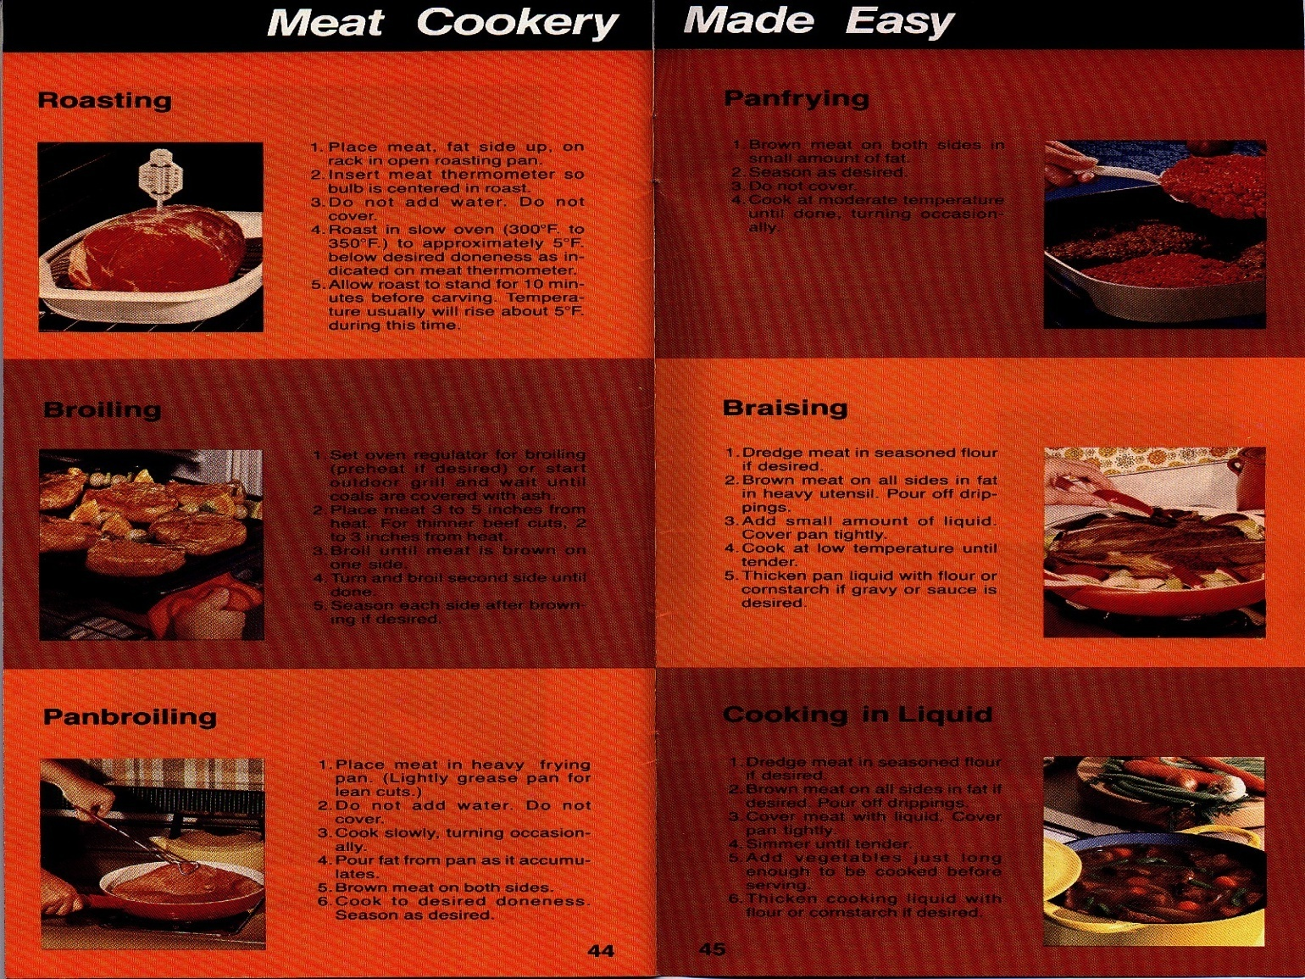
MEAT COOKERY
Prepared by:
Dr. C. Boyd Ramsey
Professor Emeritus

Slide 2
OBJECTIVES
To show the importance of cooking procedures on meat palatability
To match each meat cut with the best cooking method
To present the key procedures needed for successful indoor and outdoor meat cookery

Slide 3
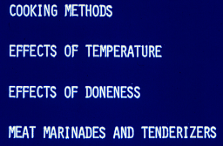
WHAT WE WILL COVER IN THIS UNIT

Slide 4
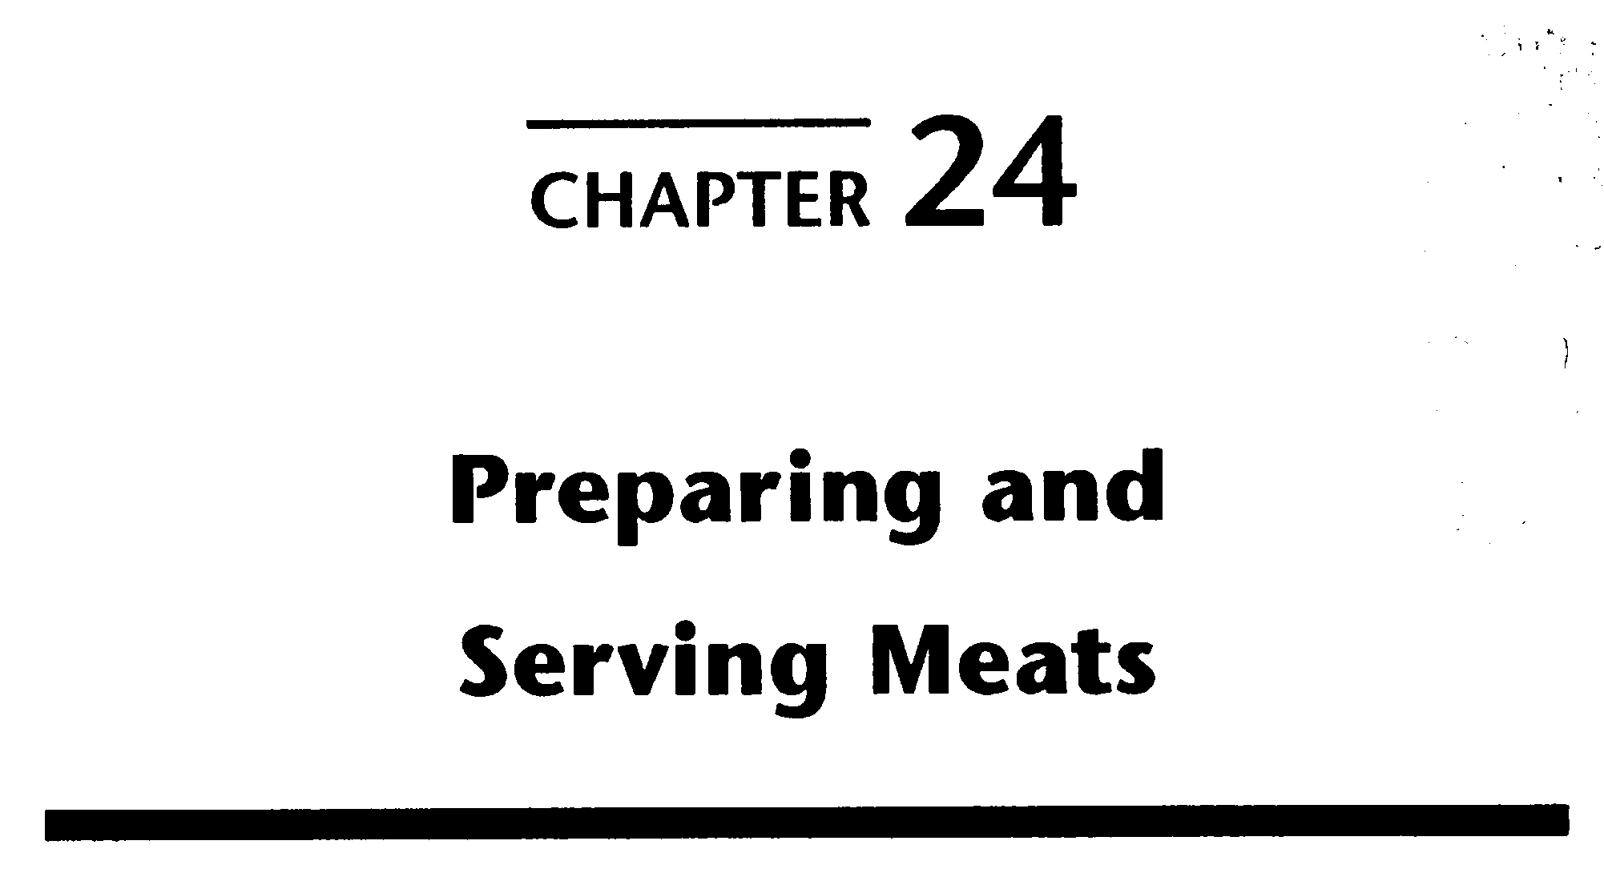
THE MEAT WE EAT

Slide 5
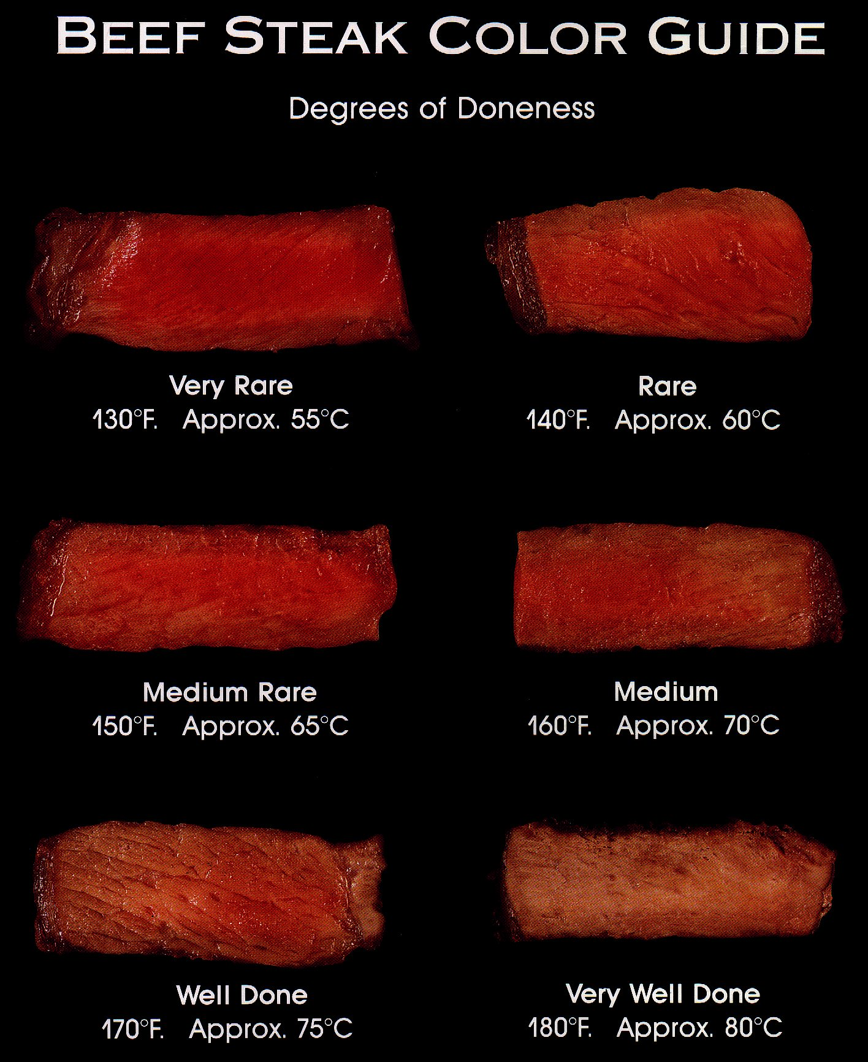
KNOW THE INTERNAL TEMPERATURE CORRESPONDING TO EACH DONENESS

Slide 6
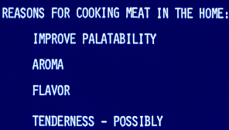
IN ADDITION TO FOOD SAFETY --

Slide 7
COOKING METHODS FOR MEAT
DRY HEAT
MOIST HEAT

Slide 8
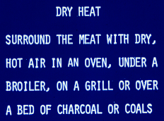

Slide 9
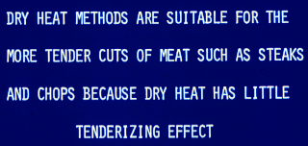
DRY HEAT DOES NOT TENDERIZE

Slide 10
ROASTING - FOR THICK, TENDER CUTS

Slide 11
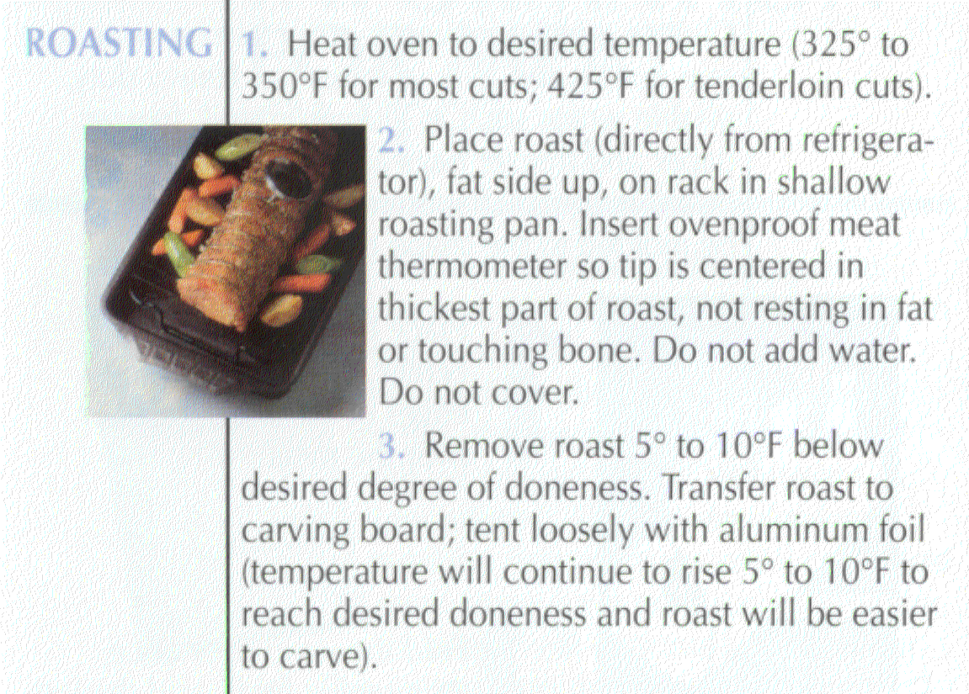
DRY HEAT COOKERY METHOD FOR THICK CUTS

Slide 12
LONG TIME, LOW TEMPERATURE COOKERY OF LARGE MEAT CUTS
If a large meat cut, such as a prime rib or steamship round, is cooked for a long time at a low oven temperature (200⁰ or lower), muscle tenderization may occur.
Meat tenderizers cannot be used under such conditions because they have too much time to act.

Slide 13
BEEF ROASTS SLOWLY COOKED COMMERCIALLY IN A WATER BATH
NOTE THE UNIFORMITY OF MUSCLE COLOR

Slide 14
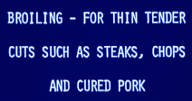
COOKING METHOD

Slide 15
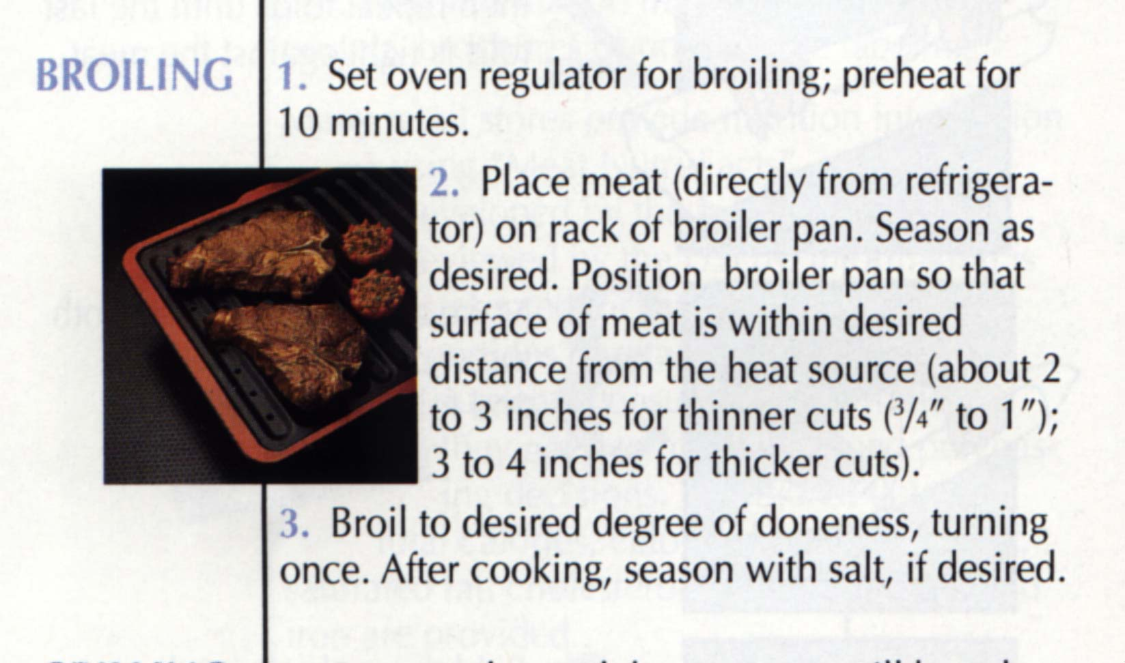
DRY HEAT COOKERY METHOD FOR THIN, TENDER CUTS

Slide 16
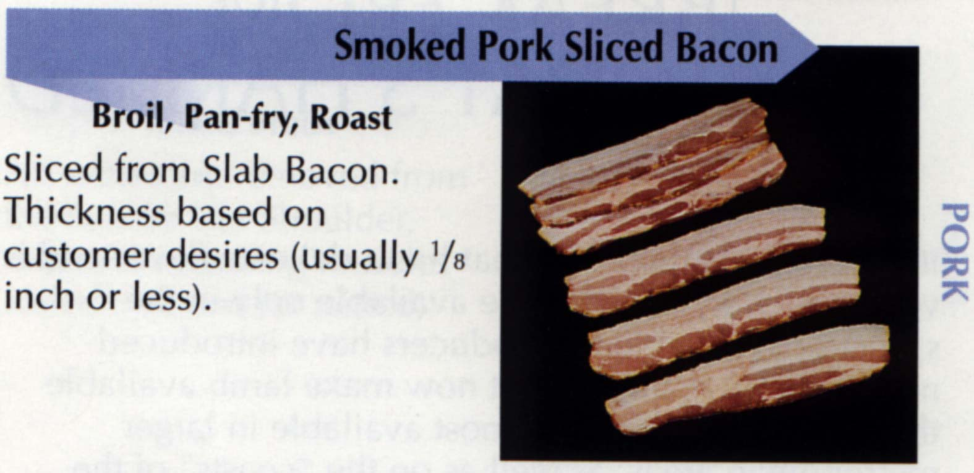
TRY BROILING BACON IF YOU HAVEN’T TRIED IT
BROILING AND ROASTING ON A RACK CONSIDERABLY REDUCE FAT CONTENT COMPARED TO FRYING

Slide 17
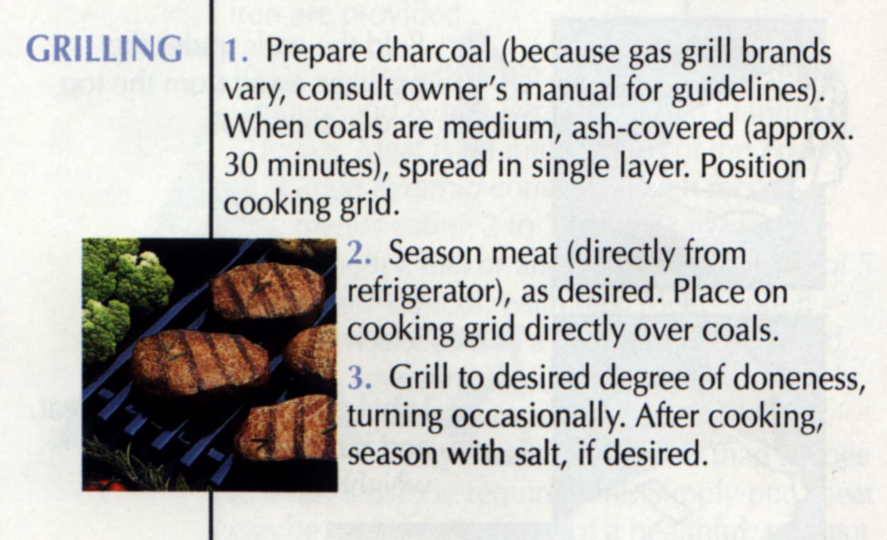
DRY HEAT COOKERY MEAT FOR THIN, TENDER CUTS

Slide 18
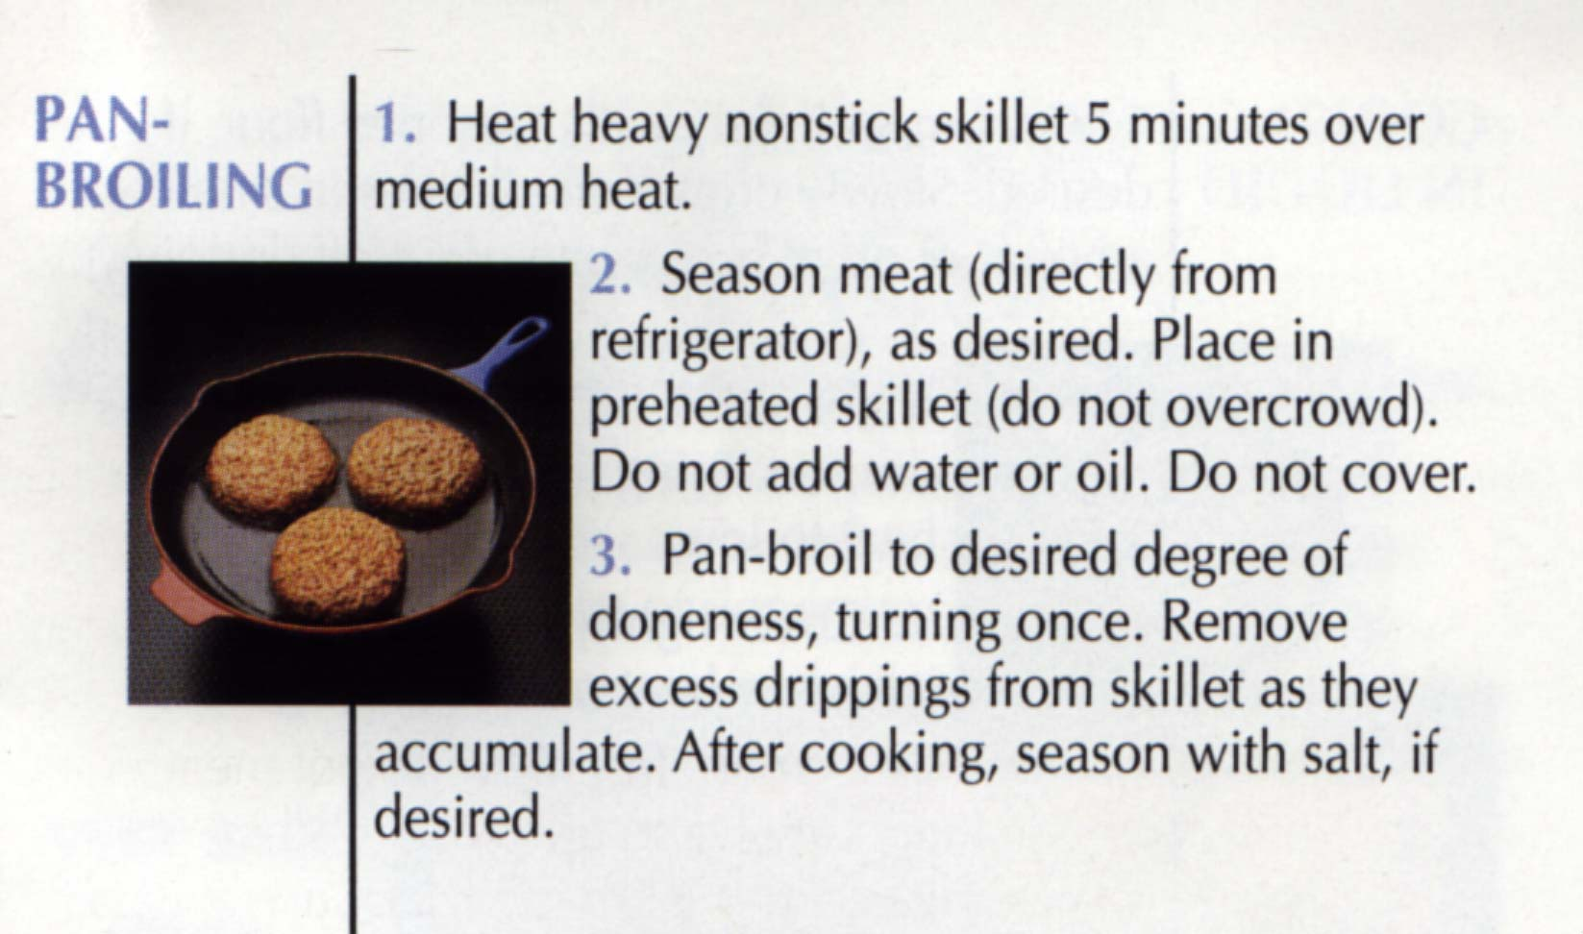
ON TOP OF THE STOVE, DRY HEAT COOKERY METHOD FOR THIN, TENDER CUTS
ALLOWS BROILING WHEN YOU DON’T HAVE AN OVEN

Slide 19
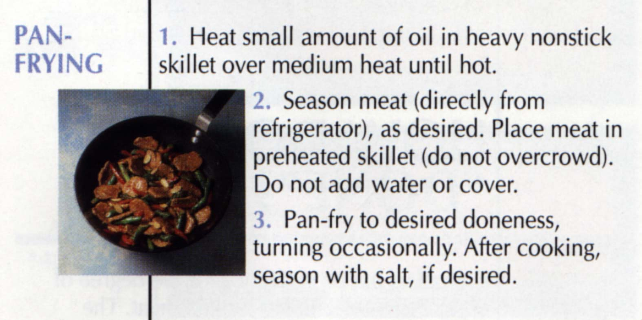
USE ONLY WHEN MEAT IS TOO DRY WITHOUT ADDED FAT
FRYING SIGNIFICANTLY INCREASES THE CALORIC VALUE OF FOODS OF ANY KIND AND INCREASES HUMAN WEIGHT PROBLEMS

Slide 20
Cubed steaks should be fried to prevent dryness resulting from their open structure.

Slide 21
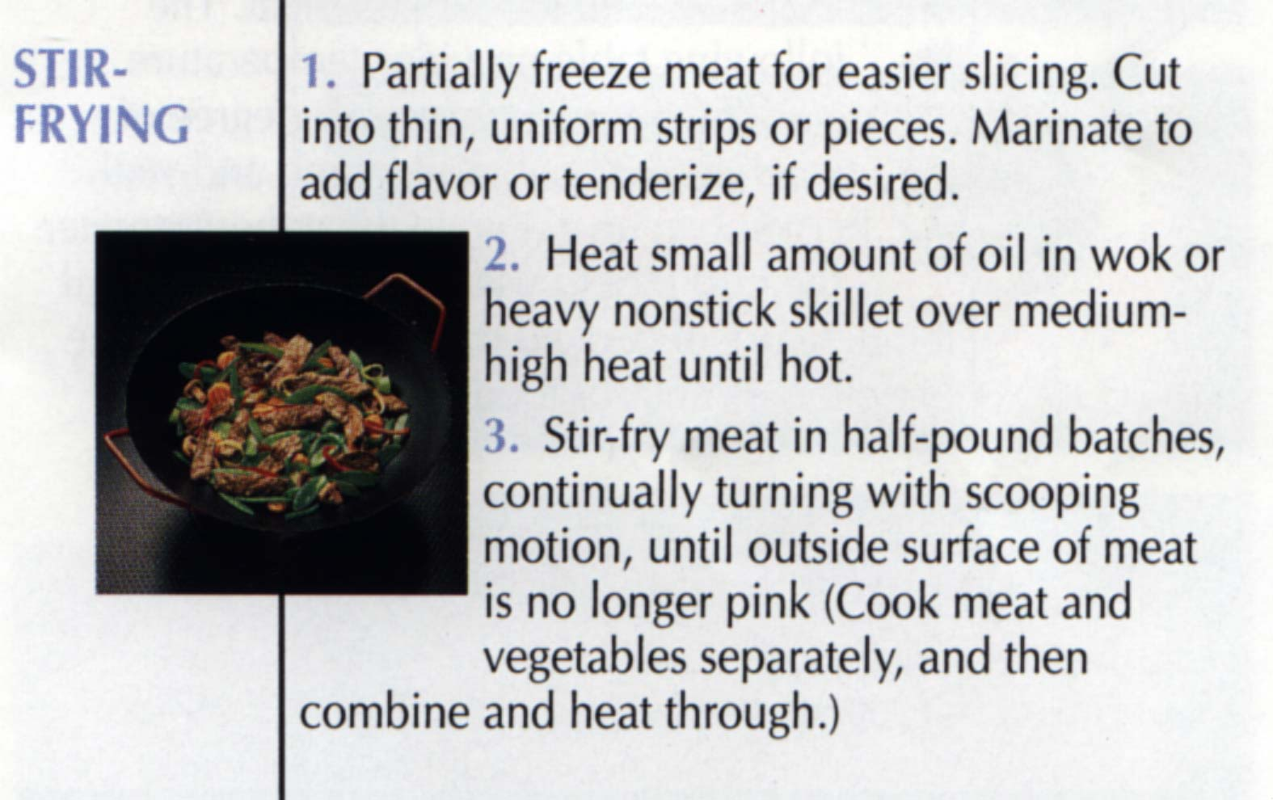
FOR SMALL, THIN PIECES OF MEAT

Slide 22
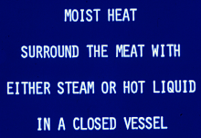
MAIN COOKING METHOD CATEGORY

Slide 23
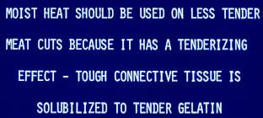
WHEN TO USE MOIST HEAT METHODS

Slide 24
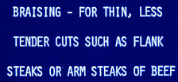
COOKING METHODS

Slide 25
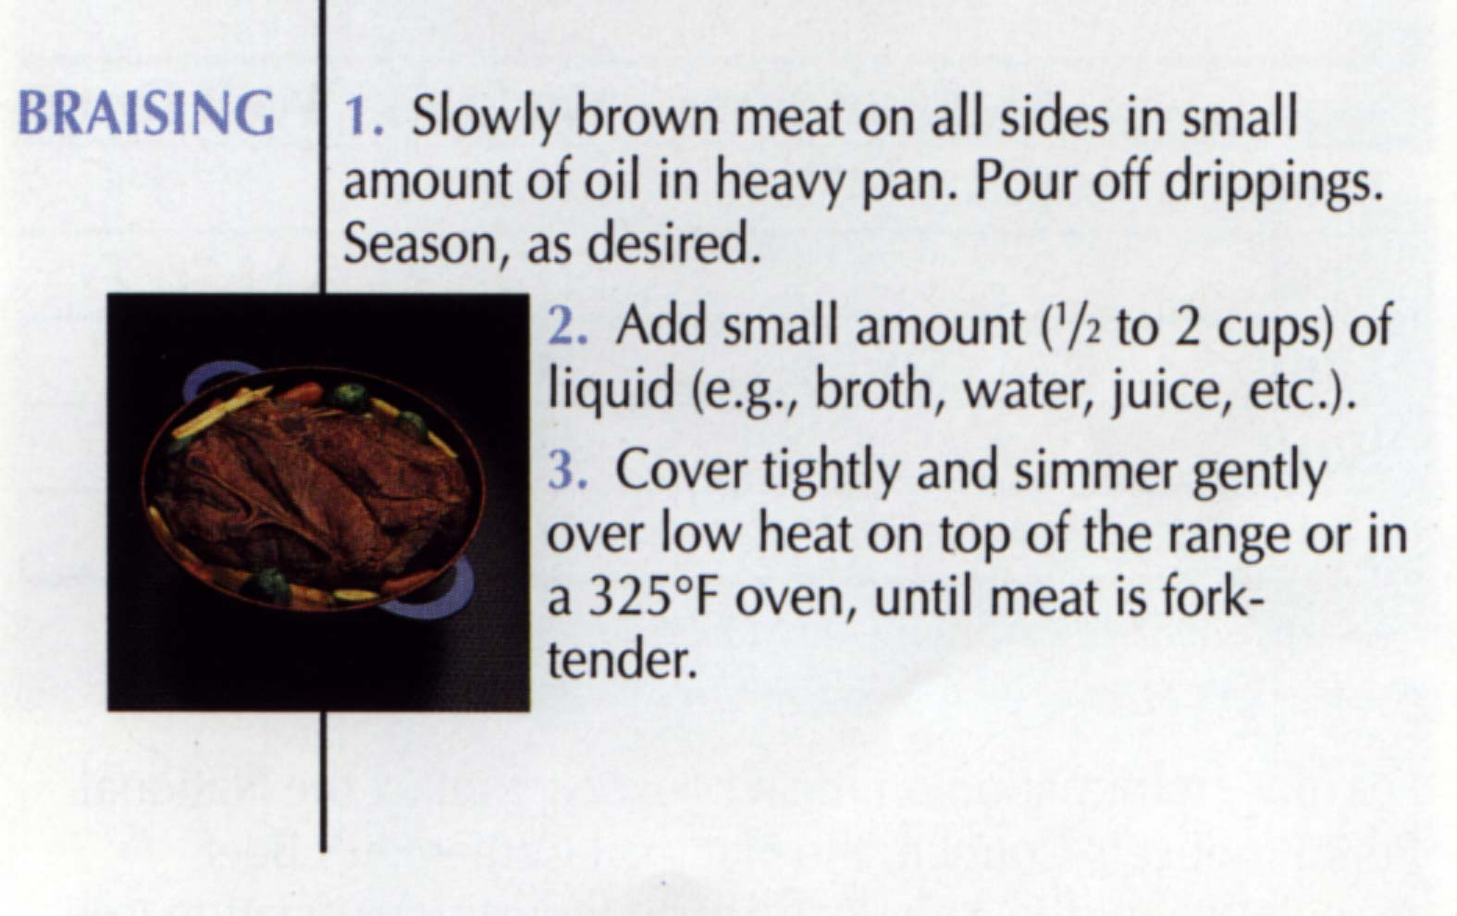
MOIST HEAT COOKERY METHOD FOR THIN CUTS
Note spelling - “brazing” is a kind of welding.

Slide 26
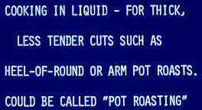
SAME AS BRAISING EXCEPT FOR THE AMOUNT OF LIQUID USED

Slide 27
COOKING IN LIQUID (STEWING)

Slide 28
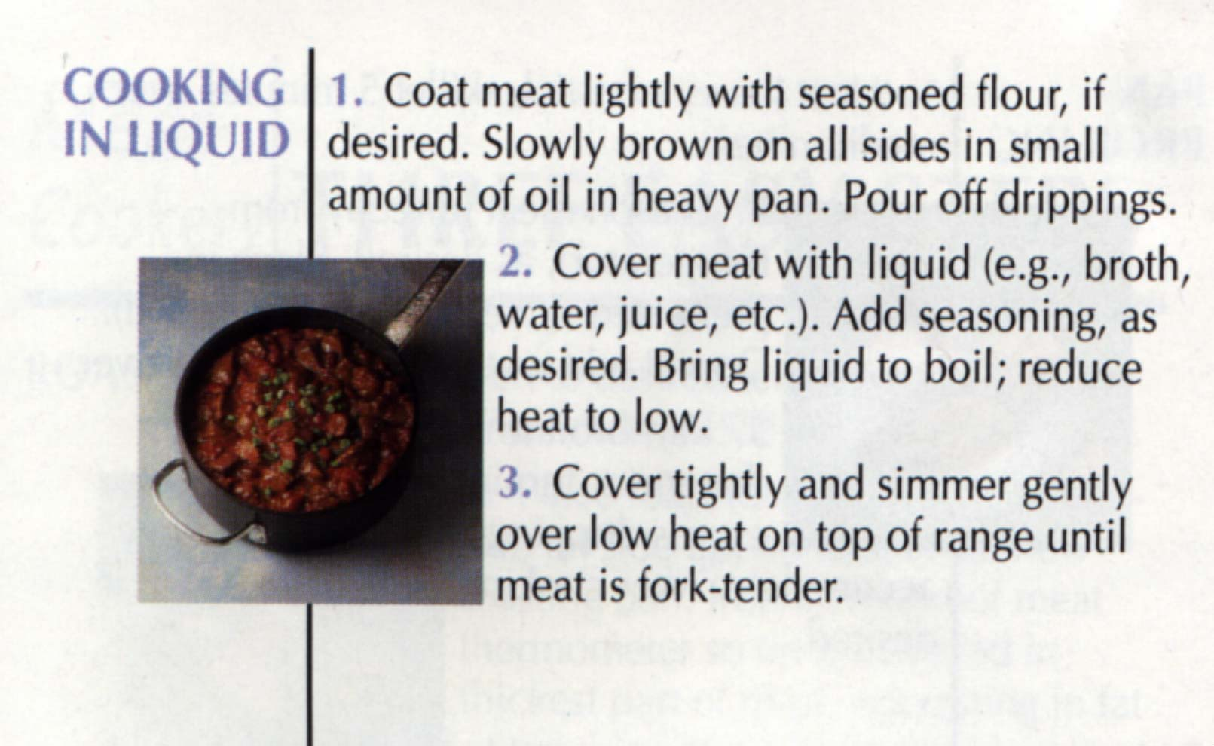
MOIST HEAT COOKERY METHOD FOR THICK CUTS
ALSO CALLED STEWING IF MEAT PIECES ARE SMALL

Slide 29
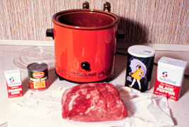
CROCK POT OR SLOW COOKER
SALT & PEPPER
TOMATO SAUCE
BEEF ROAST
MARJORAM - A SPICE

Slide 30
CROCK POT
Because moist heat cookery is used, you must add flavoring agents to the food to make it taste better.
An excellent cooking method when the cook works outside the home.
Start the cooking before you leave for work and have a delicious meal ready when you return.
For food safety purposes, the cooker should be set on “high” until the food gets hot and then turned to”low”.

Slide 31
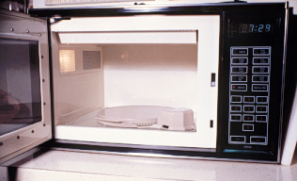
A MICROWAVE OVEN NEEDS A TURNTABLE TO PROMOTE UNIFORM COOKING

Slide 32
HOW DO MICROWAVE OVENS WORK?
A magnetron generates radar waves.
They are stirred as they enter the oven.
They bounce from wall to wall until dissipated or they enter food.
They heat by exciting water molecules and creating friction.
A dry substance will not heat.
Surfaces do not get hot enough to brown.

Slide 33
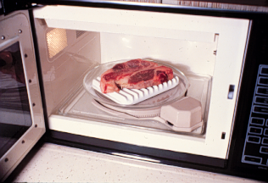
COOKING A STEAK ON A BROWNING DISH IN A MICROWAVE OVEN
Meat cooked in a microwave oven scores about 0.5 point lower than when cooked by broiling or roasting, but it’s fast.

Slide 34
WHAT CAUSES DIFFERENT MUSCLE APPEARANCE AT VARYING TEMPERATURES?
Myoglobin changes from a reddish to brownish color at 149ºF.
Thus, in cooking meat the surface regions will be hotter and change color before internal regions.
150⁰ 135⁰ 150⁰

Slide 35
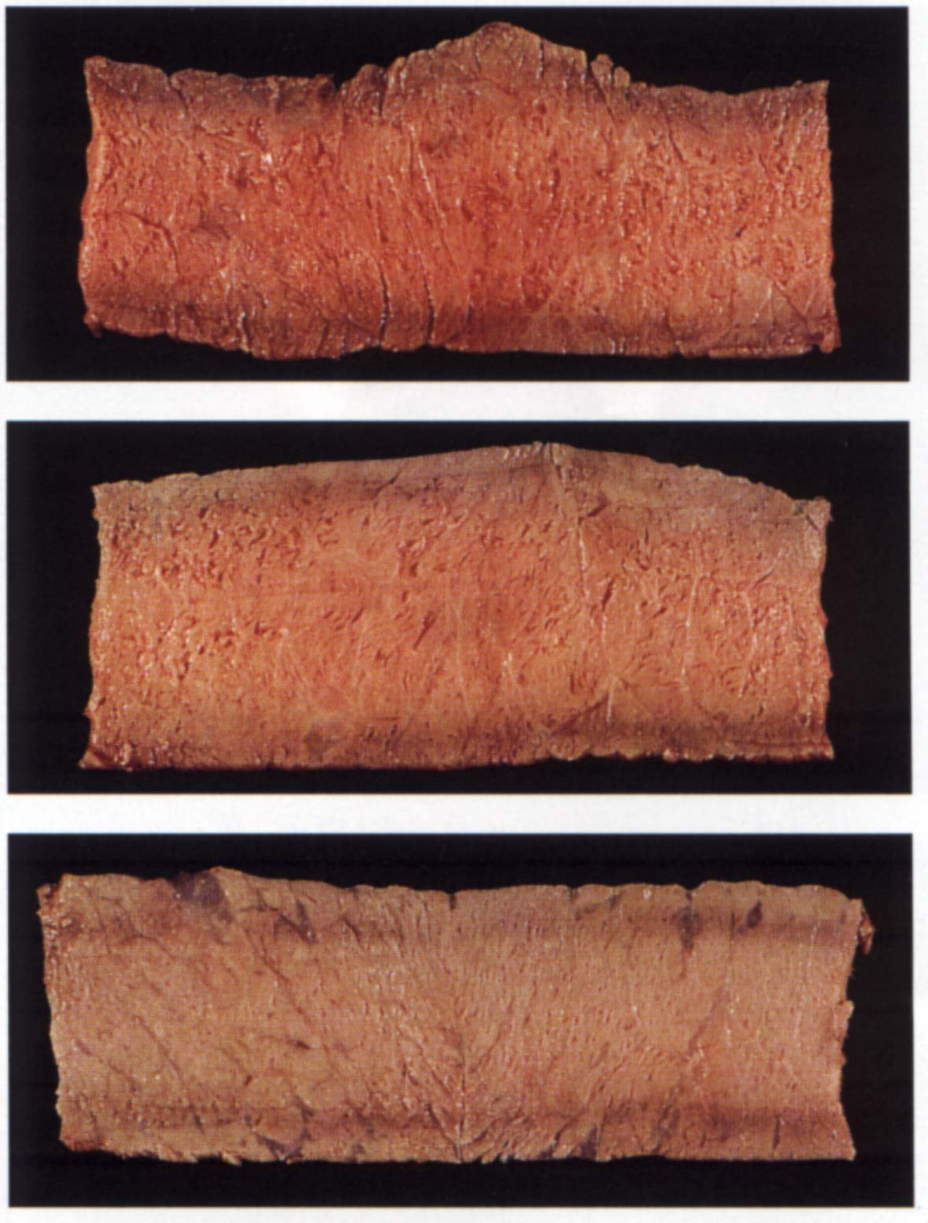
CHANGE IN COLOR FROM MEDIUM RARE TO MEDIUM TO WELL DONE
145⁰
160⁰
170⁰

Slide 36
WE CAN TAKE ADVANTAGE OF THIS KNOWLEDGE
If we cook large roasts slowly, more time will be available for pigment change at or near 149⁰
Thus, we can have a well done appearance (that some people require) but have the increased juiciness and tenderness that a lesser state of doneness allows.
(i.e., we can have a well done appearance at a less than well done temperature)

Slide 37
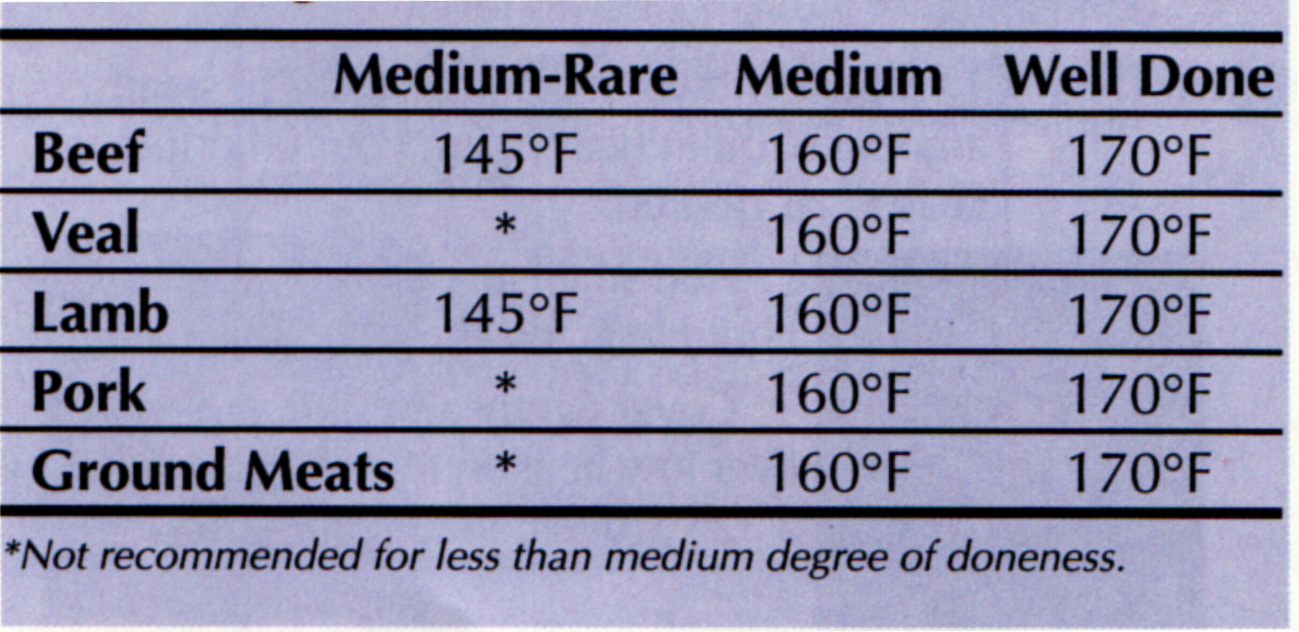
RECOMMENDED DEGREES OF DONENESS

Slide 38
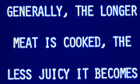
DON’T OVERCOOK MEAT

Slide 39
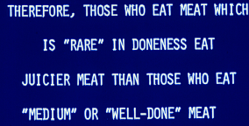
COOKING LOSSES INCREASE WITH COOKING TIME AND TEMPERATURE

Slide 40
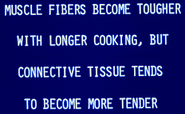
VARIABLE EFFECTS OF HEAT

Slide 41
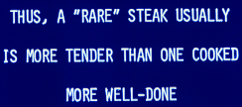
LESS DONE, MORE JUICINESS & TENDERNESS

Slide 42
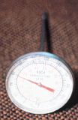
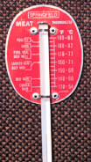
DIAL AND STEM THERMOMETERS
MORE ACCURATE, BUT FRAGILE
MORE DURABLE BUT MOST HAVE PLASTIC DIAL COVERS THAT MELT IN HEAT

Slide 43
THERMOMETER FOR MICROWAVE OVENS - THEY DON’T WORK WELL
They contain an alcohol that is non-toxic. However, this alcohol column tends to separate into segments with use. Many microwave ovens have a built-in temperature probe.

Slide 44
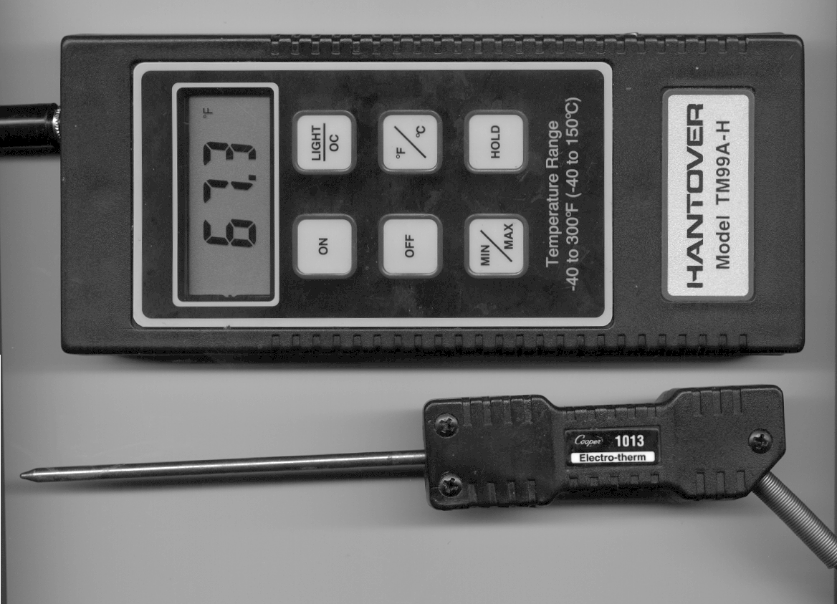
ELECTRONIC TEMPERATURE PROBE USED IN TTU MEAT SCIENCE RESEARCH
LESS EXPENSIVE MODELS ARE AVAILABLE FOR HOME USE

Slide 45
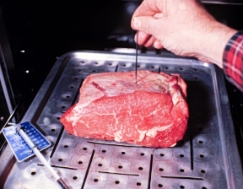
USING A METAL SKEWER TO MAKE A HOLE FOR THE MEAT THERMOMETER
Insert the thermometer’s tip in the geometric center of the roast or steak but not against bone or in fat.

Slide 46
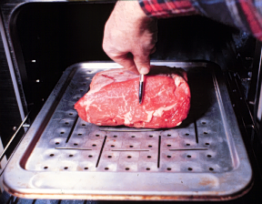
MEASURE SO THAT YOU CAN PLACE THE TIP OF THE THERMOMETER HALF WAY THROUGH THE ROAST

Slide 47
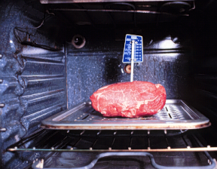
A THERMOMETER PROPERLY PLACED IN A ROAST
A METAL-CLAD STEM ON A THERMOMETER OF THIS TYPE MAKES IT MUCH MORE DURABLE

Slide 48
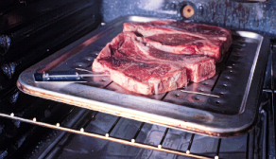
PORTERHOUSE STEAKS WITH A THERMOMETER IN PLACE READY TO BE BROILED IN AN OVEN
The internal temperature of steaks and roasts will increase 5 to 10⁰ after the meat is taken from the heat. Allow for this increased doneness.

Slide 49
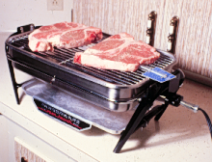
INSERT THE THERMOMETER FROM THE EDGE OF STEAKS, CHOPS OR HAMBURGERS
This farberware grill is excellent for home use - an exhaust hood above it is not necessary

Slide 50
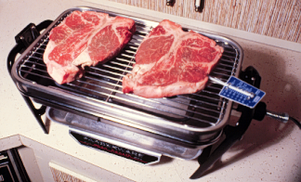
TEMPERATURE AT THE MEAT ON A FARBERWARE GRILL IS ABOUT 300⁰ - NEAR IDEAL
An opening in the bottom allows air circulation and prevents overheating

Slide 51
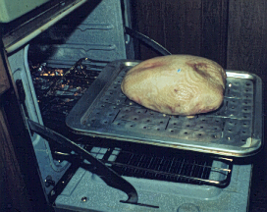
INTERNAL TEMPERATURE DEVICE IN A TURKEY BREAST TO BE ROASTED
The spring-loaded plunger pops up when the temperature is sufficient to melt the wax around the plunger.
PLUNGER WAX SPRING
Is not very useful - you would have to look at it frequently to see if it had emerged.

Slide 52
RESTAURANT CHEFS CLAIM THEY CAN DETERMINE DONENESS BY DEPRESSING THE COOKING MEAT WITH A SPATULA
The amount a cut of meat depresses depends on its doneness (more done, less depression), but the problem is that meat varies greatly in firmness.
If this pressure method of determining doneness always “worked,” we would receive meat with the doneness we order in restaurants.

Slide 53
FOR HEALTH’S SAKE,DON’T CHAR MEAT!!!
Some Japanese research shows that charring meat may produce carcinogens.
So, don’t overcook meat or cook with too much heat that produces charred areas.
Don’t cook with flames when charcoaling. If a fire erupts, have water handy to douse it.

Slide 54
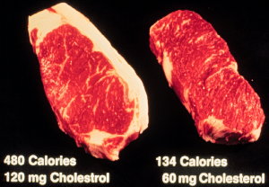
NOT EATING TRIMMABLE FAT REDUCES CALORIES BY 346 & CHOLESTEROL BY 60 mg IN JUST ONE STEAK
Trim the fat before you cook because the fat migrates to muscle during cooking.

Slide 55
THE MEAT IS DONE BUT WE’RE NOT READY TO EAT - WHAT DO I DO?!?!?!?!?!?!?!?
When cooking large cuts such as roasts, hams, turkeys, etc., if the meat gets done too soon, wrap it in foil and a towel and put it in a cooler. If you don’t have a cooler, wrap it in foil and layers of cloth. It will stay warm for hours.
Do smaller cuts the same way but for shorter times.
It is better to have roasts done early because they need to “set up” at least a few minutes before being carved.

Slide 56
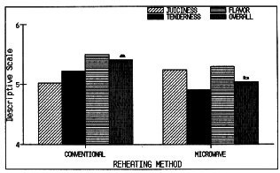
EFFECTS OF CONVENTIONAL AND MICROWAVE OVEN REHEATING OF PRECOOKED PORK PRODUCTS
JUICINESS
MICROWAVE LOSES
TENDERNESS
FLAVOR
OVERALL
CONVENTIONAL
MICROWAVE
REHEATING METHOD

