Slide 1
MEAT COOKERY PART II
ANSC 3404

Slide 2
MEAT TENDERIZERS
Enzymes that degrade proteins and tenderize meat.
Papain is most widely used
In home situations, any tenderizer is difficult to incorporate into the meat beyond about a 1/4-inch depth.
Commercially, enzyme solutions can be pumped into meat cuts.

Slide 3
INGREDIENTS OF A MARINADE
Used to marinate meat cuts, amount sufficient to marinate 4 beef steaks, 6 pork chips or 10 lamb chops:
  Cooking oil – ½ cup
  Lemon juice, cooking sherry, wine or vinegar – 2 TSP
  Black pepper – 1 TSP.
  Ginger – ¼ TSP
  Marjoram – 1 TSP

Slide 4
HOW TO USE A MARINADE
Mix the marinade and coat all surfaces of the steaks or chops.
Leave in the refrigerator for 4 to 24 hours.
Re-coating of the meat with the marinade is desirable.

Slide 5
ADVANTAGES OF MARINATING
Increases juiciness coming from the oil in the marinade
Increases flavor coming from the spices
Surface tenderness may be increased by the lemon juice or similar ingredient
Downside: calorie count will be increased because of the added fat

Slide 6
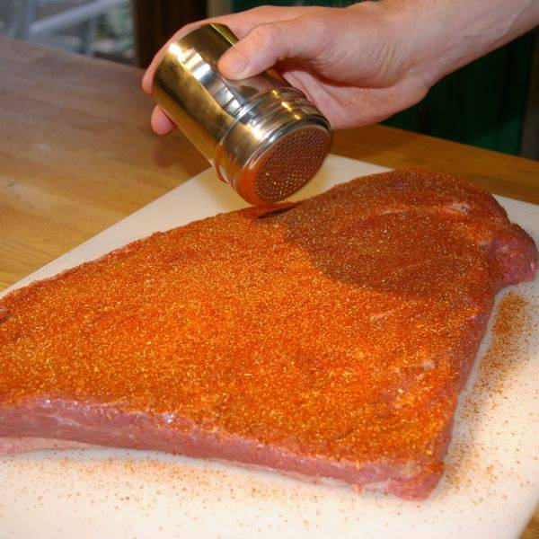
DRY RUBS
No liquid
Typically applied to brisket, pork ribs items that will be slow cooked
Rubbed on outside of meat prior to cooking

Slide 7
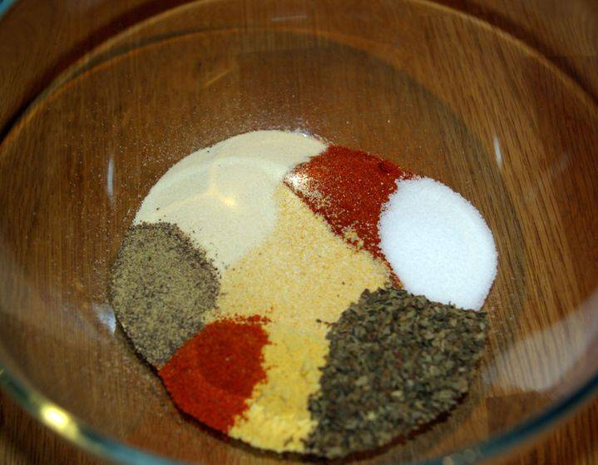
COMMON RIB RUB
Onion Powder
Red Pepper
Salt
Garlic Powder
Black Pepper
Paprika
Ground Basil
Dry Mustard

Slide 8
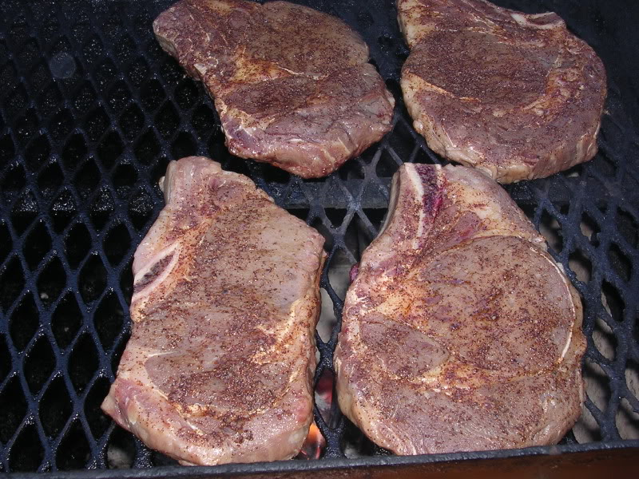
DRY RUBS
May also be applied to steaks or chops
Alternative to marinades
Less should be applied and for shorter time prior to cooking
  Can draw moisture out if applied for too long
  Can also be overpowering if too much is used

Slide 9
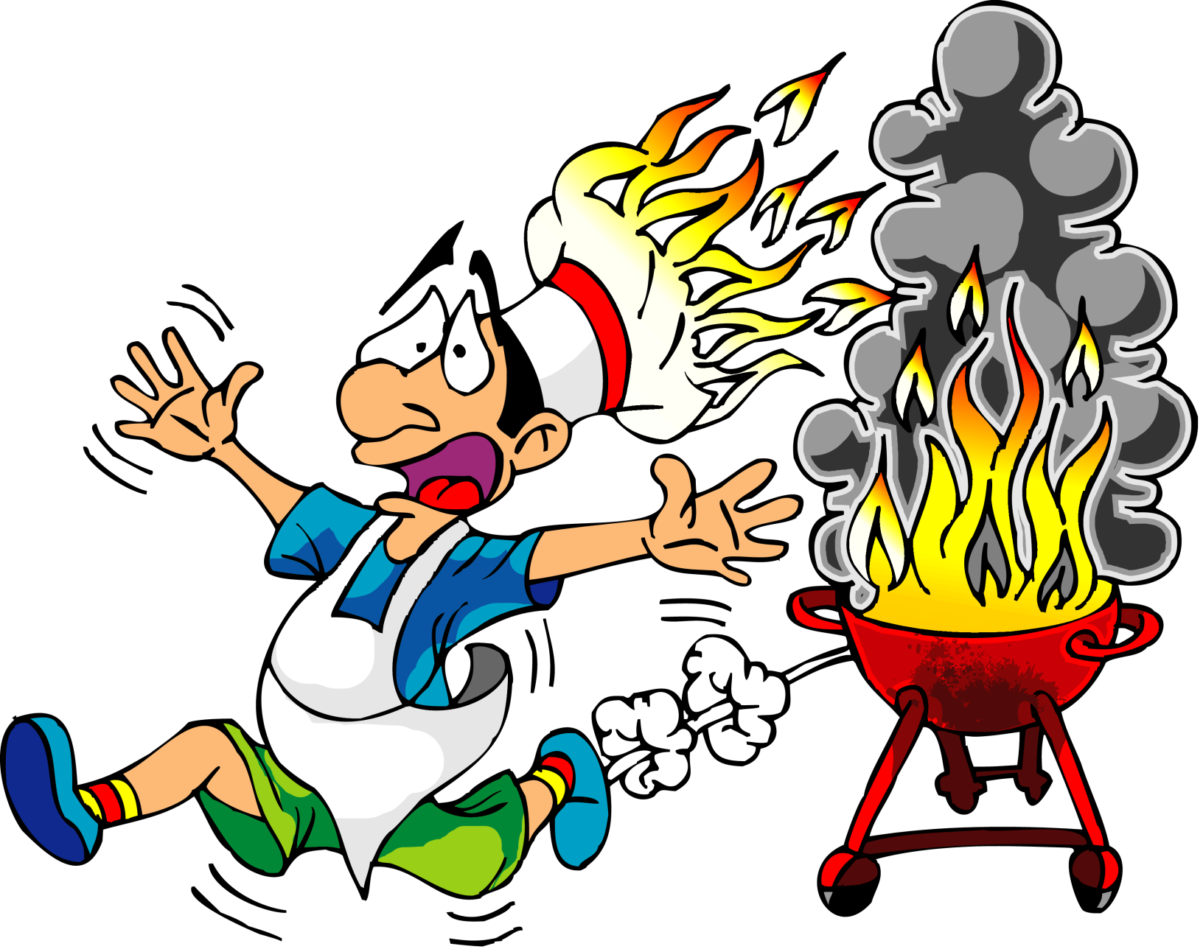
OUTDOOR COOKERY MADE EASY

Slide 10
HOW IS SMOKED FLAVOR PRODUCED?
Charcoal or gas grills produce smoked flavor on meat because the meat grease cooks out and drips on something hot, creating smoke.
Grease dripping on hot metal would produce essentially the same flavor as charcoal or gas grills.

Slide 11
CHARCOAL VS. GAS AND WOOD CHIPS
In previous years of this class, we determined that students could not tell the difference in flavor of pork chops cooked over charcoal and on gas grills.
If you want a stronger smoked flavor, soak hardwood chips in water (so they will smolder and not flame) and place them on top of the charcoal or on top of the layer of rock-like material in a gas grill.

Slide 12
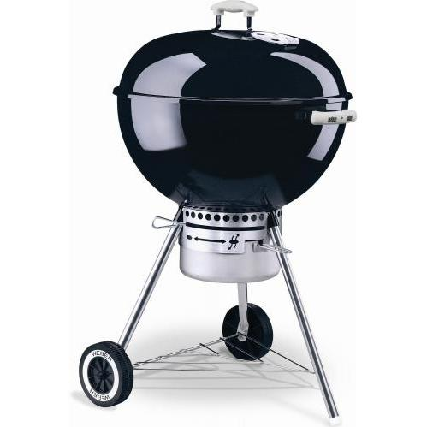
CHARCOAL GRILLING
Typically 2 dampers to control heat
More O2 causes faster combustion
Pyramid shape allows charcoal to light more quickly

Slide 13
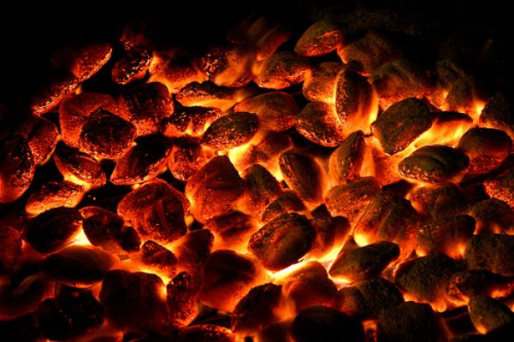
CHARCOAL GRILLING
Use lighter fluid, kerosene or diesel
DO NOT use gasoline
Allow around 20 minutes after lighting before meat is put on
This time allows all fumes from the lighting fuel to burn and prevents off-flavors in the meat from the fuel.
Cooking is easier if the charcoal is hot before you begin.

Slide 14
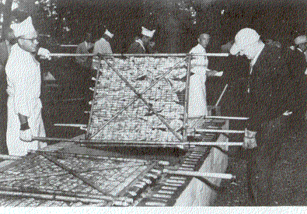
CHECK YOUR TEXT
See MWE for information about making concrete block grills
See figure
24-12 about
turning
large
quantities
of cooking
meat

Slide 15
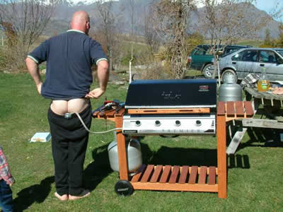
WHAT ABOUT GAS GRILLS?

Slide 16
GAS GRILLS
Gas grills are handy - you don’t have to wait for charcoal to light and the heat can be regulated just by turning a dial.
Downsides:
  they are notorious for grease fires - accumulated meat grease burns & scorches the meat before you notice
  most grills have hot and cold spots, depending on the burner design

Slide 17
MORE ABOUT GAS GRILLS
You must have some material in place to protect the burner from dripping meat grease and more evenly distribute the heat from the burner.
Charcoal may give more flavor, depending on how much smoke is generated.

Slide 18
TURNING MEAT ONLY ONCE IS MOST DESIRABLE
Best results in both palatability and cooking losses are obtained if meat is turned only one time during broiling and grilling. Cook one side, season the cooked side, and cook the second side until done.
Season the cooked side because salt draws moisture from raw meat.
To turn only once, you must have the heat at the correct level. Experiment!

Slide 19
SMOKING OR PIT BARBECUING IS FOR LARGE CUTS OF MEAT
See the information on pages 981 and 982 in MWE if you have an interest in doing pit barbecuing.
Two most common pit BBQing mistakes:
Not having the pit sealed well enough so that heat and steam escape
Not allowing enough time for the meat to get done

Slide 20
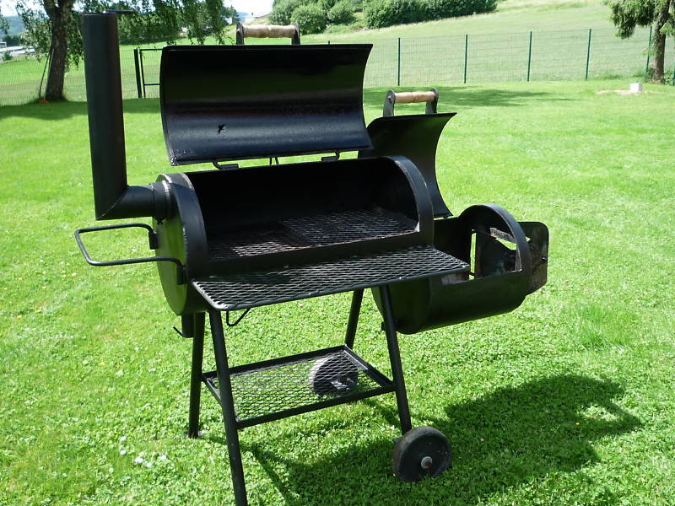
SMOKERS
Many designs
Pit
Fire Box
Multiple dampers to control heat and smoke

Slide 21
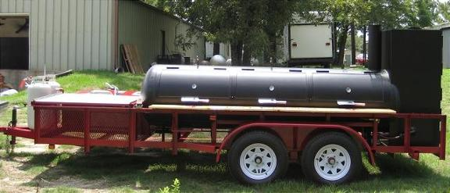
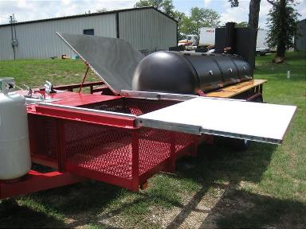
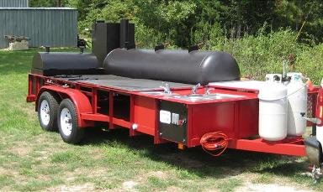
TTU Meat Science Association Smoker

Slide 22
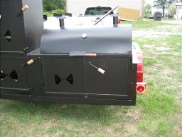
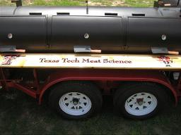
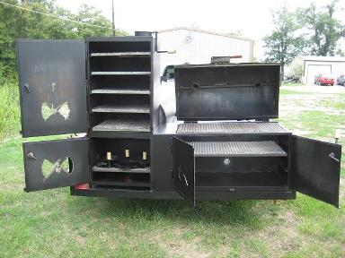
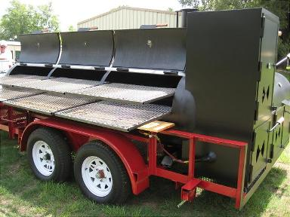

Slide 23
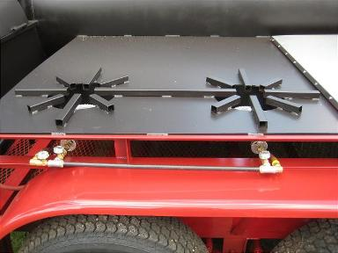
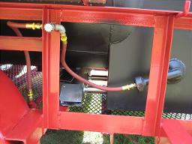
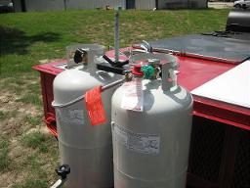
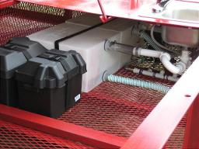
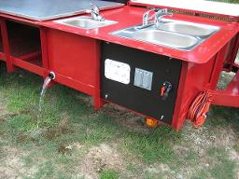

Slide 24
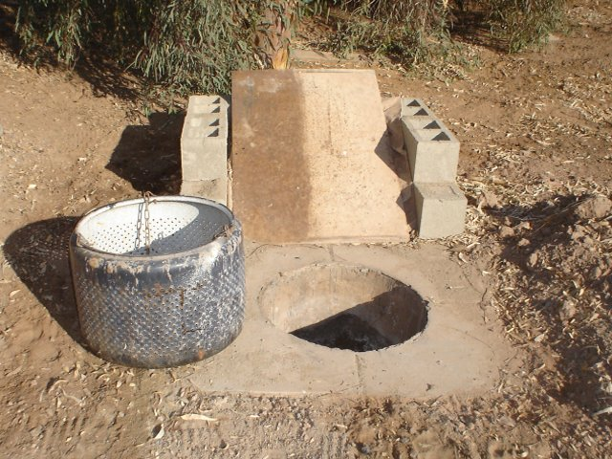
BARBECUING IN THE GROUND

Slide 25
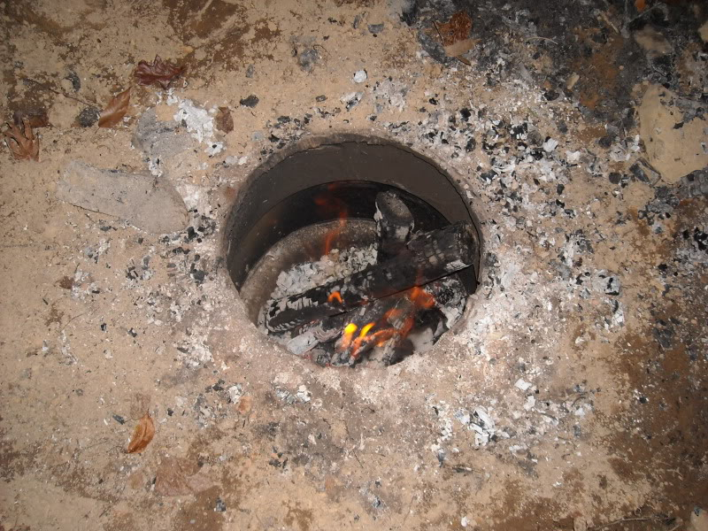
Fire built in ground
Burned until large bed of coals
Meat wrapped in burlap
Cover placed on top
Buried
24-48 hrs

Slide 26
WHAT ARE THE KEYS TO MATCHING RETAIL CUTS WITH THE PREFERRED COOKING METHODS?
You must know where on the carcass the cut originated. If you learn lab materials, you will know the origins of cuts.
Then learn what parts of the carcass are tender and tough (or intermediate)
Tender ones need dry heat methods
Tough ones need moist heat methods
Lastly, learn cooking methods for thick and thin cuts and you have it!

Slide 27
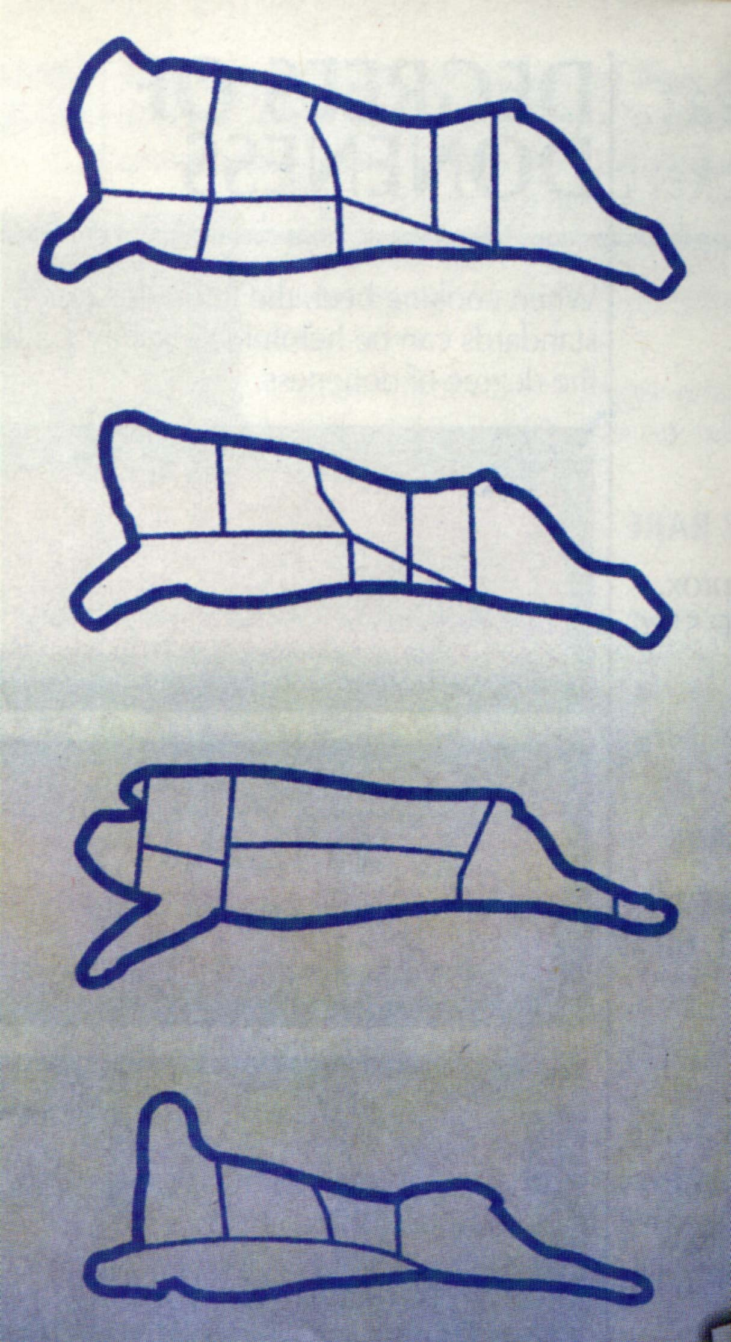
BEEF PRESENTS MORE TENDERNESS PROBLEMS THAN VEAL, PORK OR LAMB
WHY?
BEEF
VEAL
PORK
LAMB
All cuts except shanks and necks of pork and lamb can be cooked with dry heat.

Slide 28
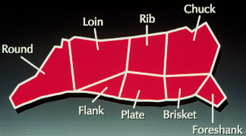
FOR BEEF, CENTER OF THE BACK IS MOST TENDER
TRANSITION AREAS
MOST TENDER
LEAST TENDER
LEAST TENDER

Slide 29
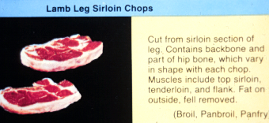
ALL LAMB AND PORK CUTS ARE TENDER EXCEPT THE SHANKS AND NECK. WHY?
DRY HEAT COOKERY METHODS

Slide 30
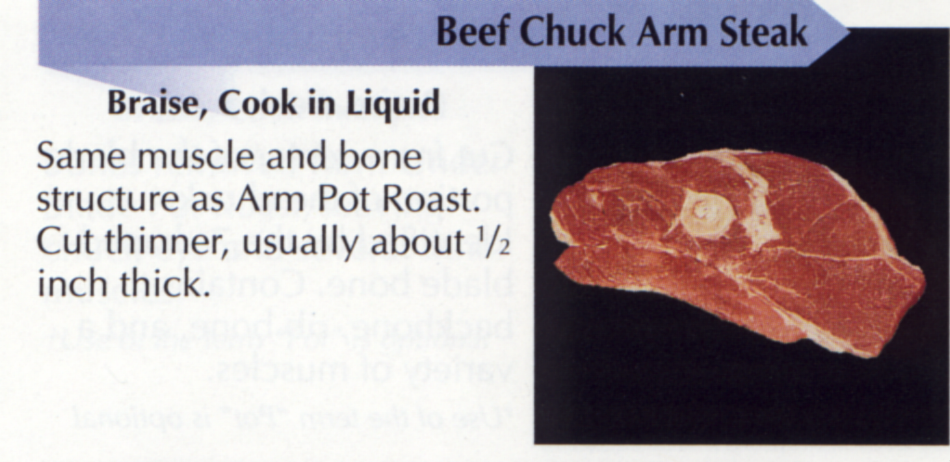
WHY NO DRY HEAT COOKERY CHOICE?
ROASTS ARE AT LEAST 1.5 INCHES THICK; AT LEAST 2 INCHES IS BETTER.

Slide 31
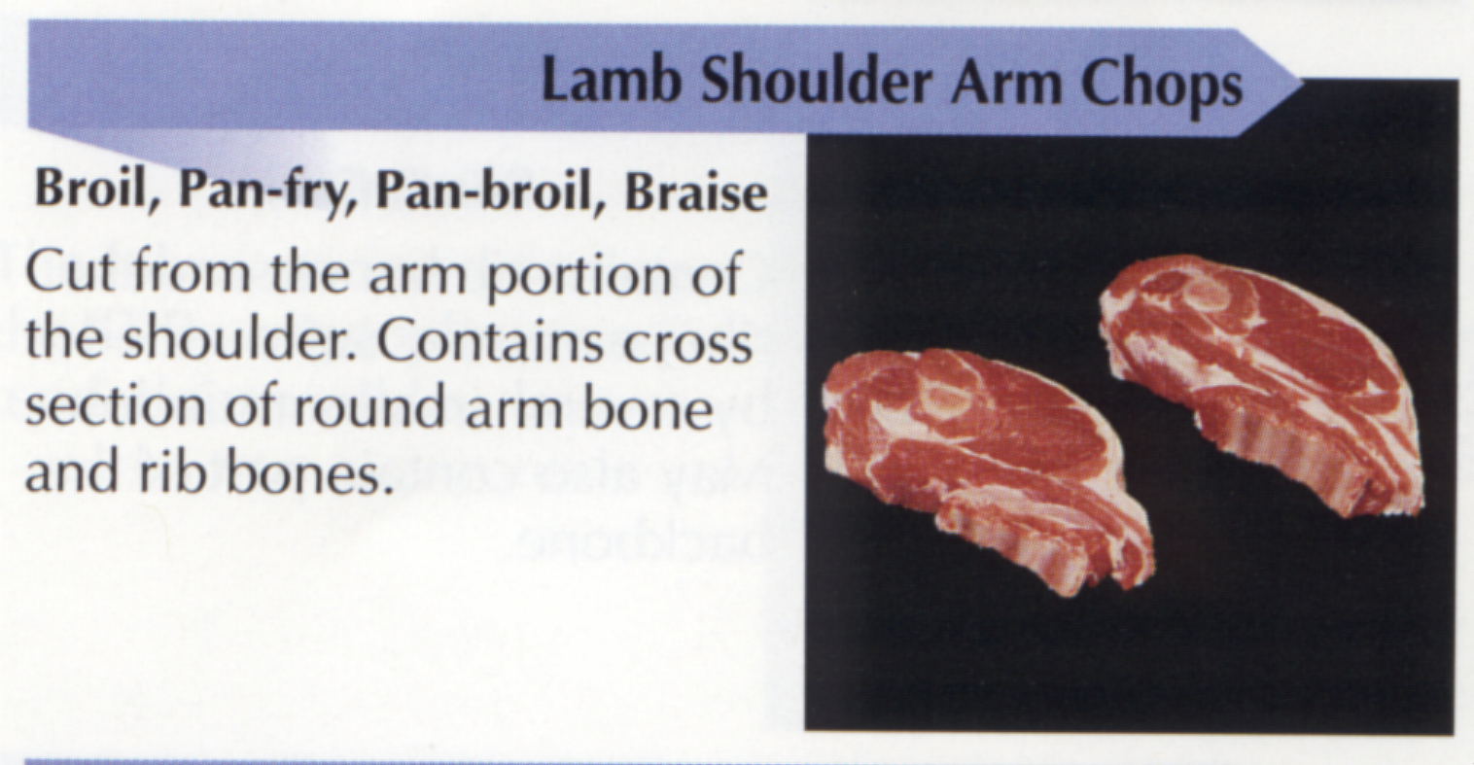
DRY HEAT COOKERY METHODS ARE OPTIONS FOR A LAMB CUT FROM THE SAME LOCATION AS THE BEEF CUT

Slide 32
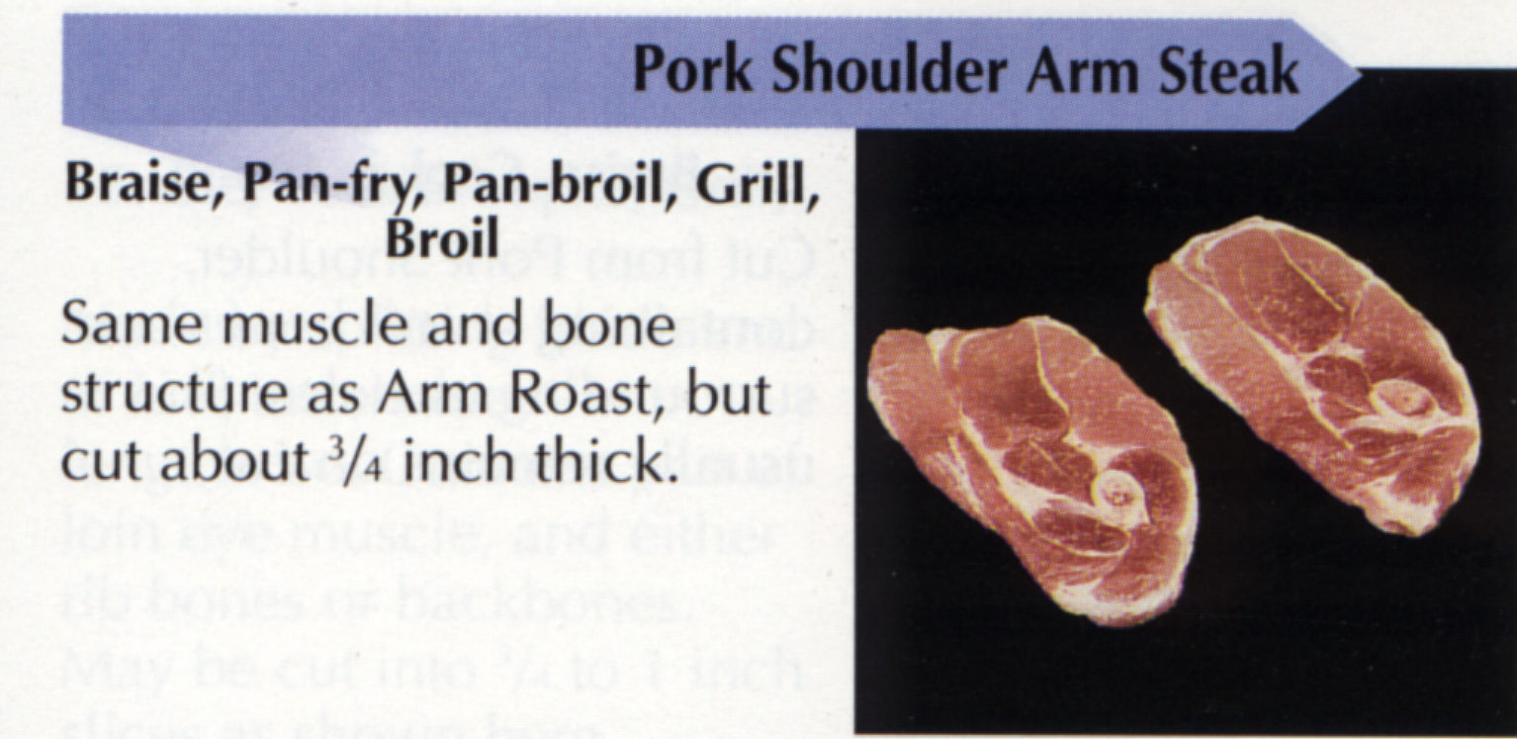
SAME FOR PORK

Slide 33
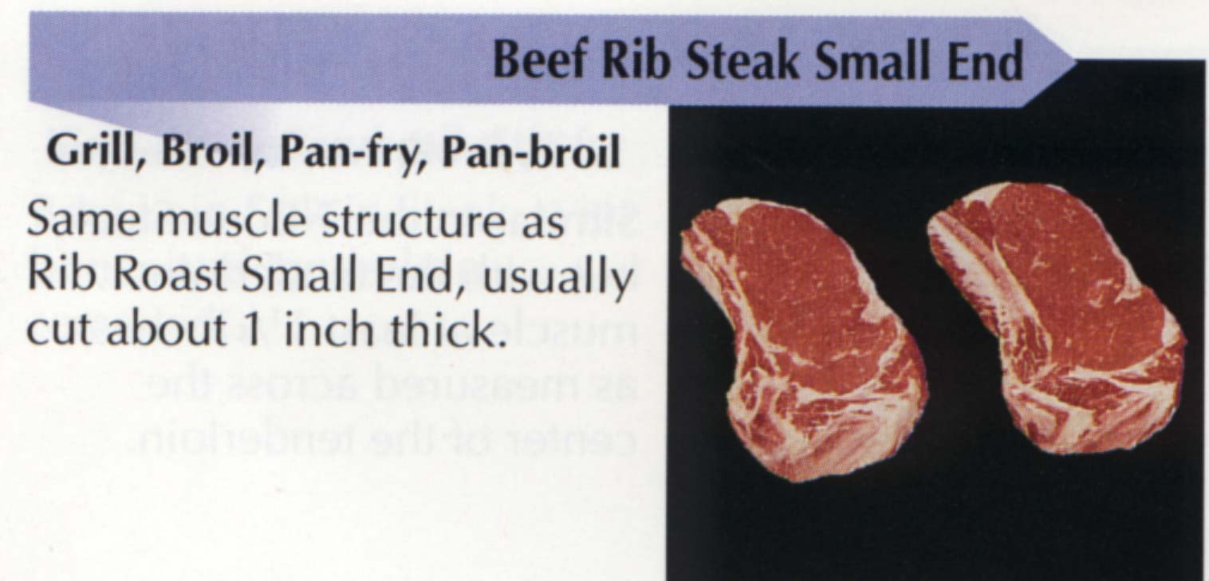
MOIST HEAT NOT NEEDED FOR THIS TENDER MIDDLE MEAT CUT OF BEEF

Slide 34
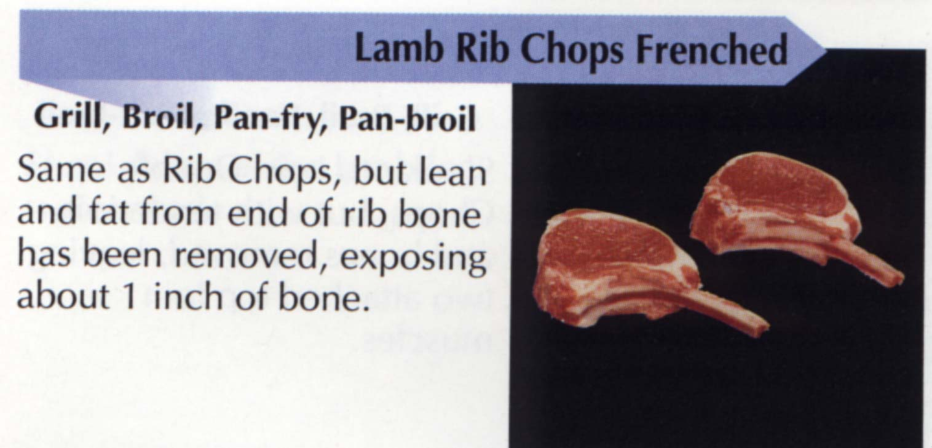
SAME FOR LAMB

Slide 35
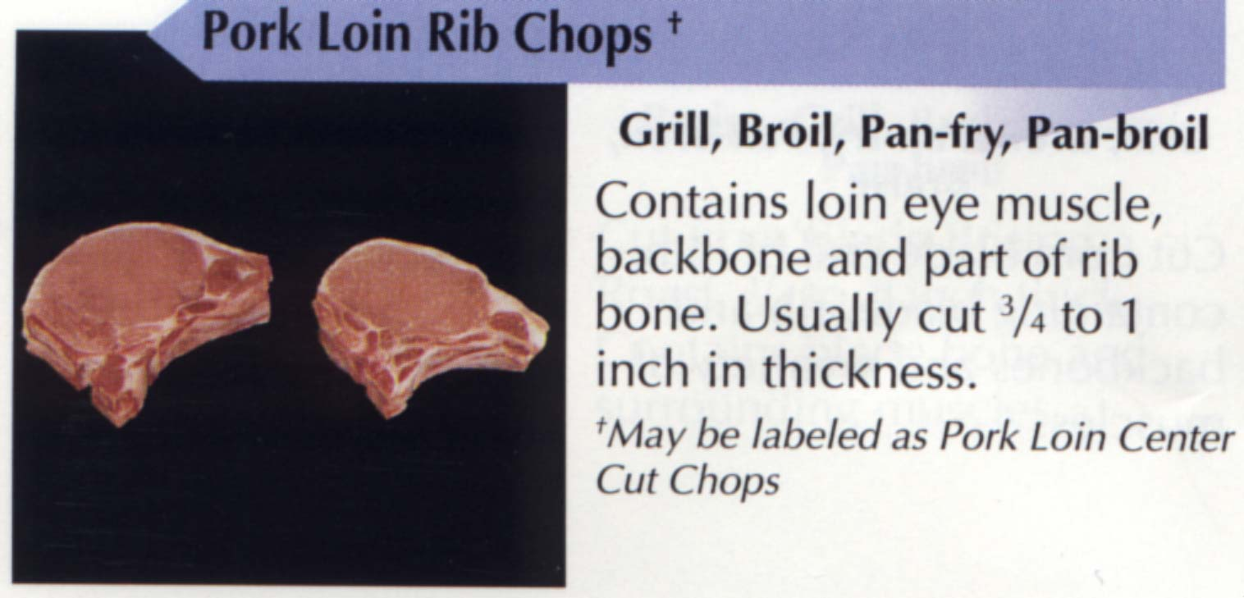
AND SAME FOR PORK

Slide 36
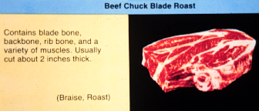
THE BLADE REGION OF BEEF NEEDS EITHER DRY OR MOIST HEAT COOKERY DEPENDING ON THE MEAT QUALITY

Slide 37
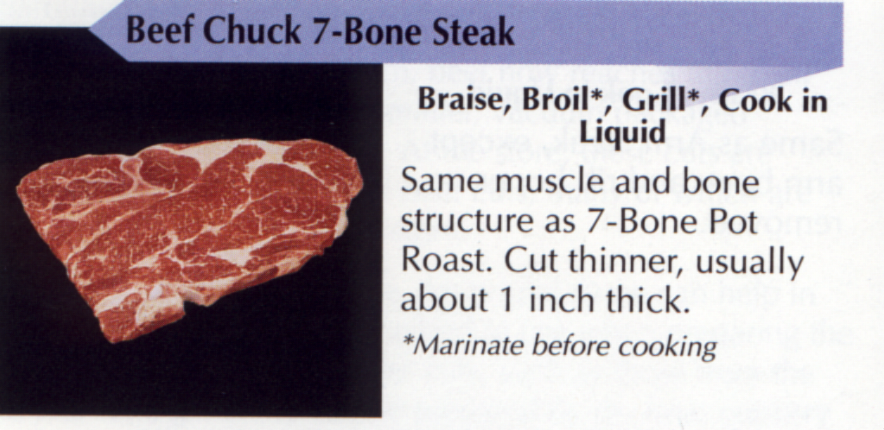
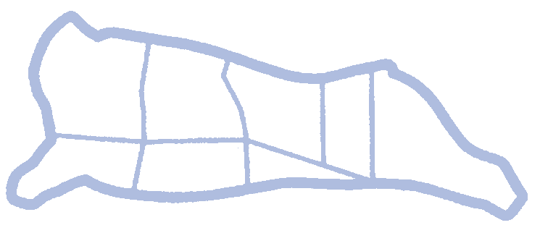
THIS BEEF CUT IS FROM A TRANSITION AREA (NOT TOUGH OR TENDER) ON THE CARCASS
IF CHOICE OR PRIME

Slide 38
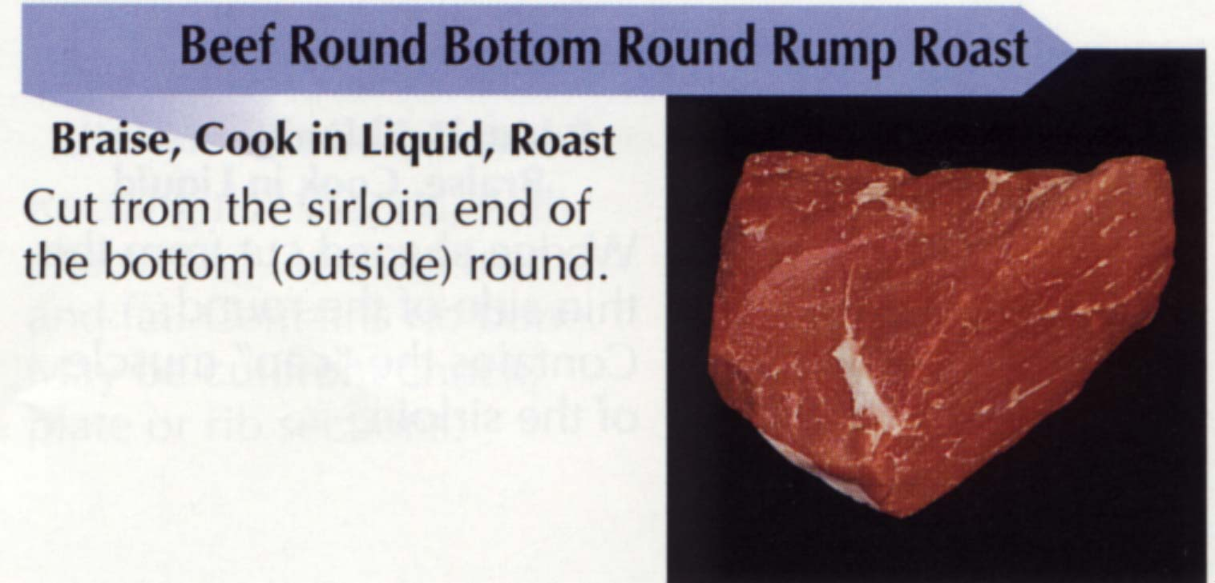
THE SAME INFORMATION APPLIES TO RUMP ROASTS

Slide 39
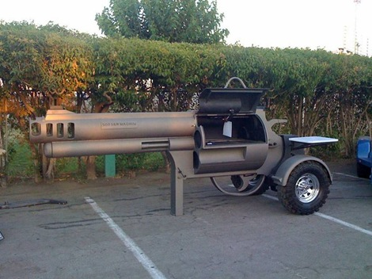
THE END

