Slide 1
2016 Area Placing Classes

Slide 2
Beef Carcasses Class 1

Slide 3
1

Slide 4
2

Slide 5
3

Slide 6
4

Slide 7
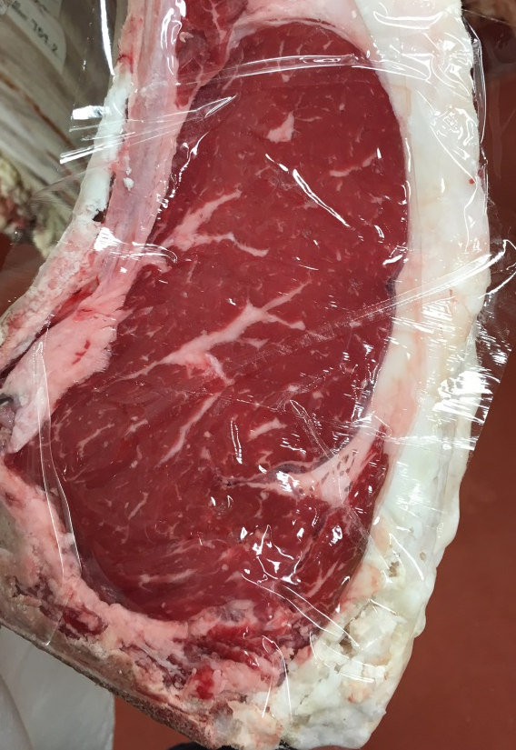
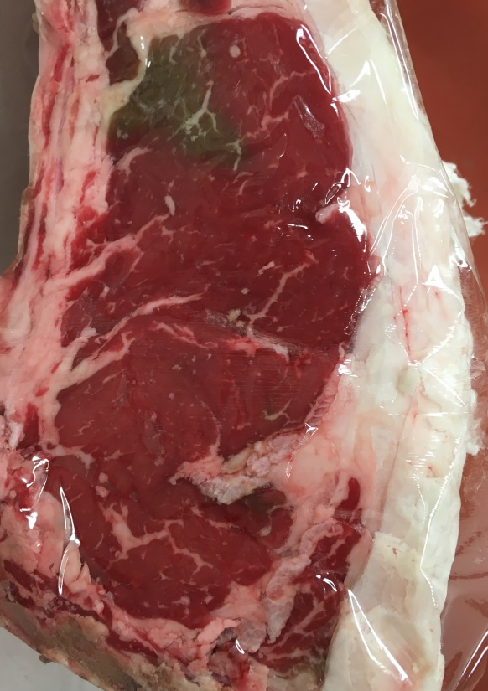
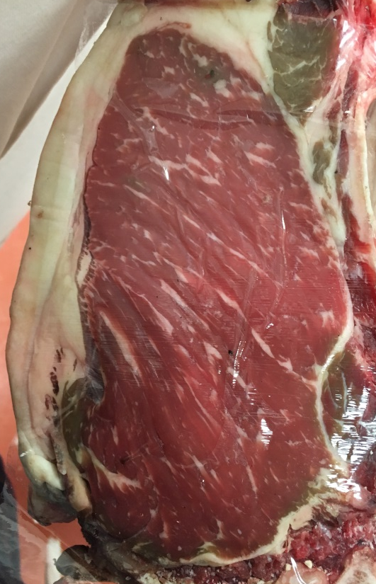
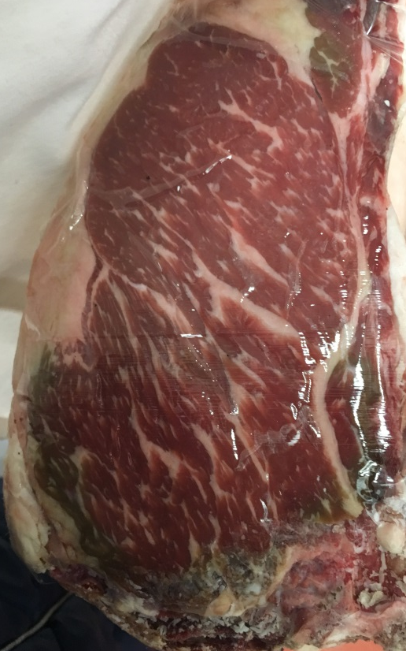
1
2
3
4

Slide 8
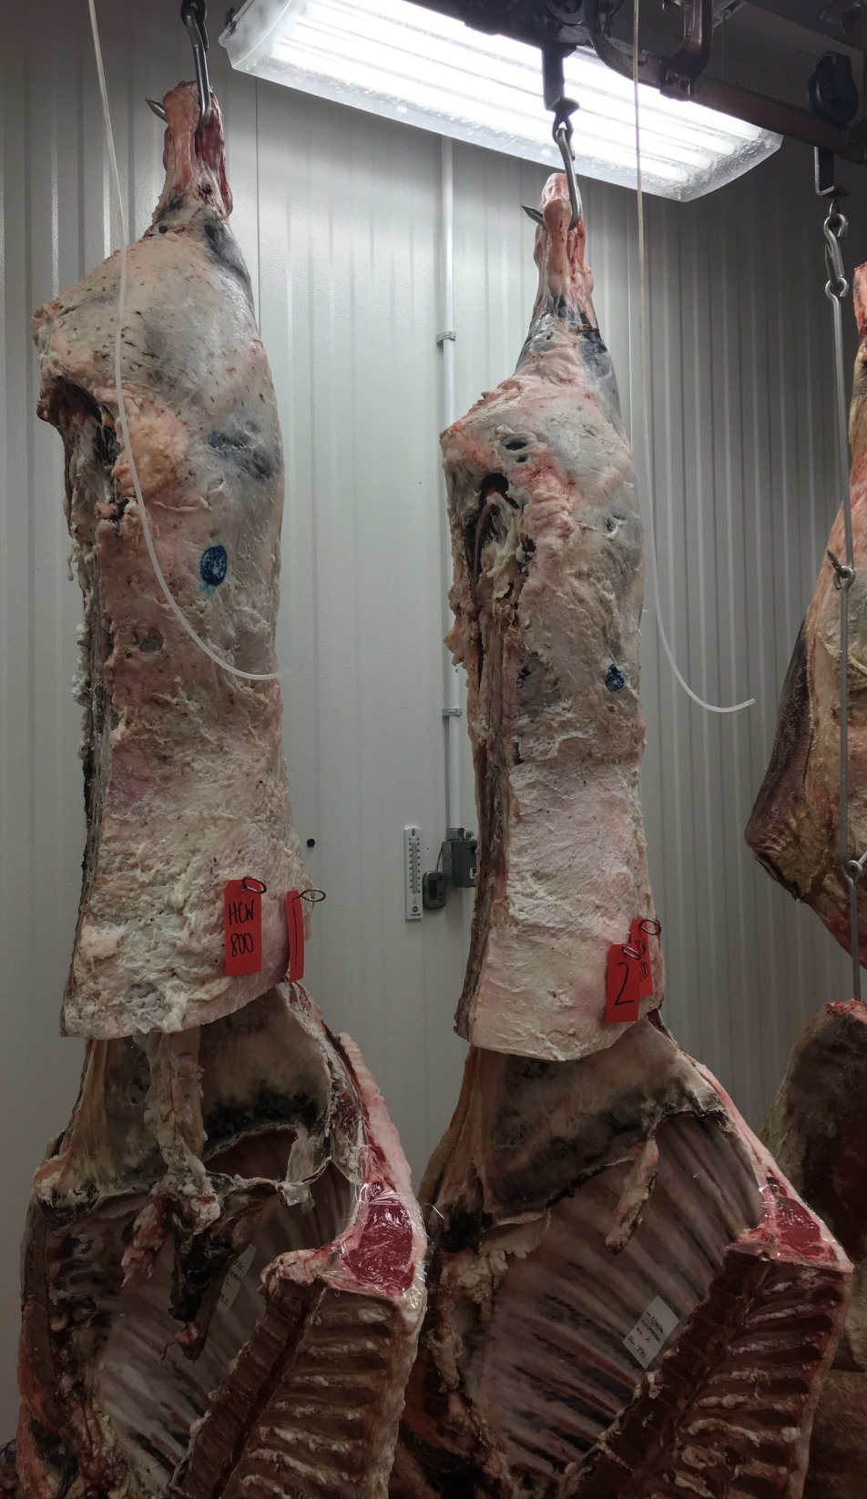
1
2

Slide 9
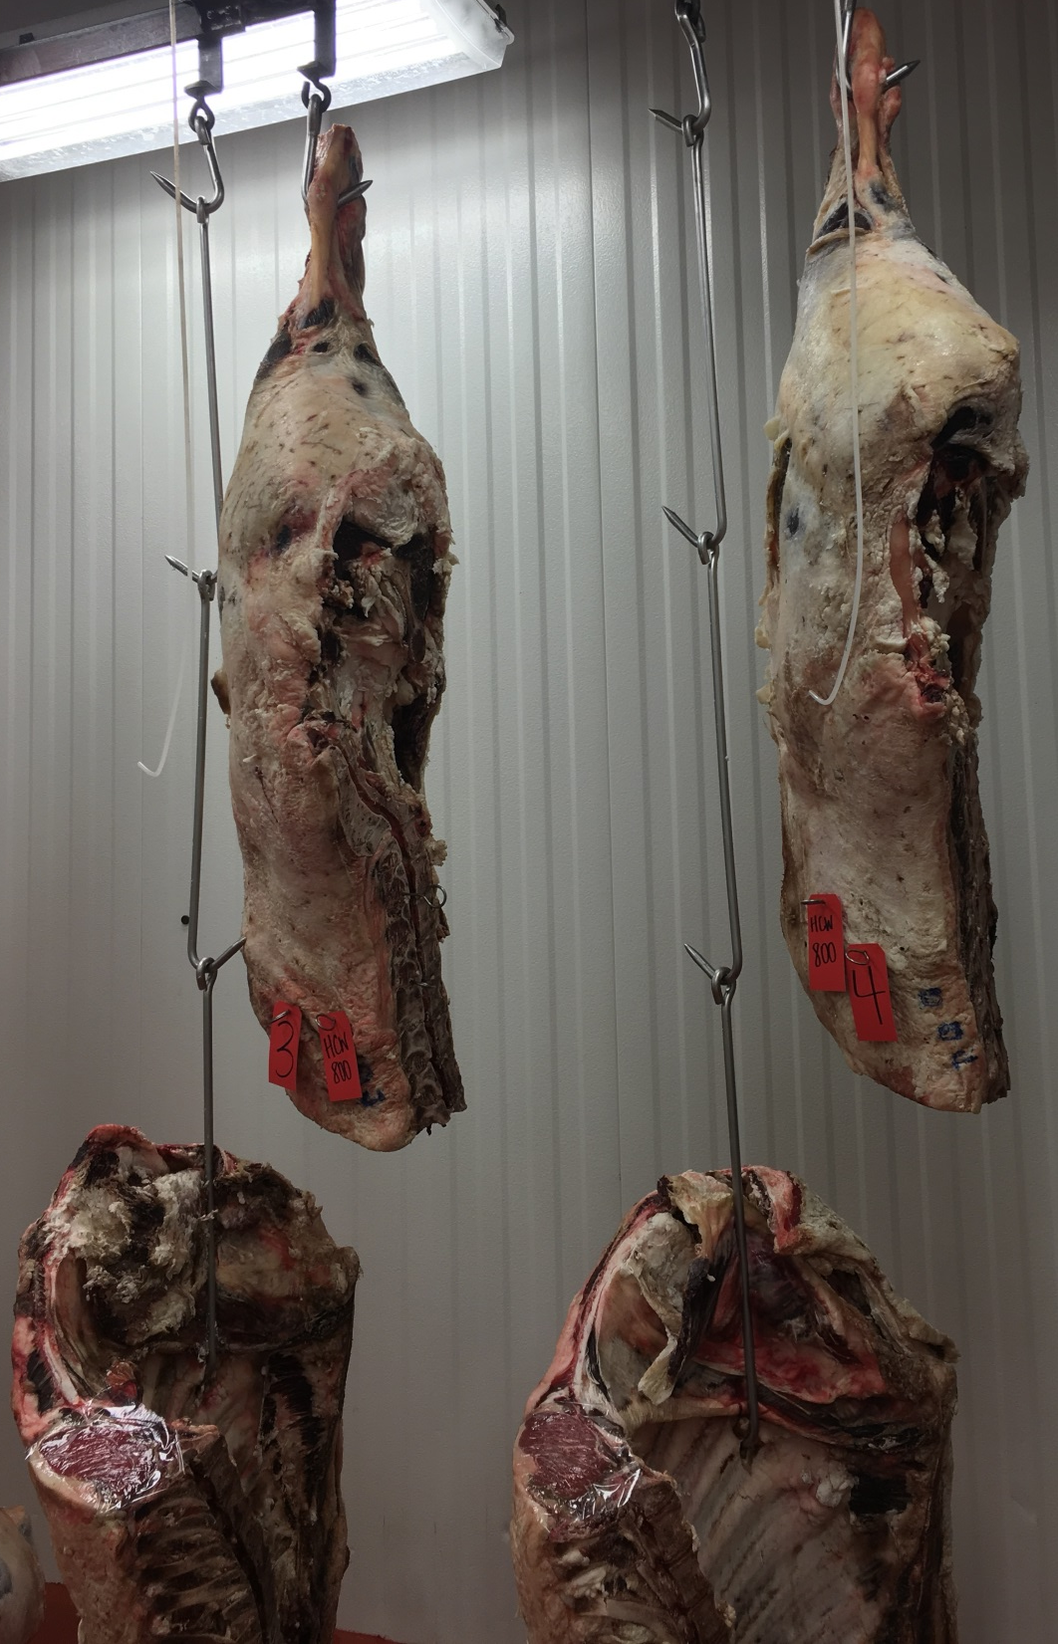
3
4

Slide 10
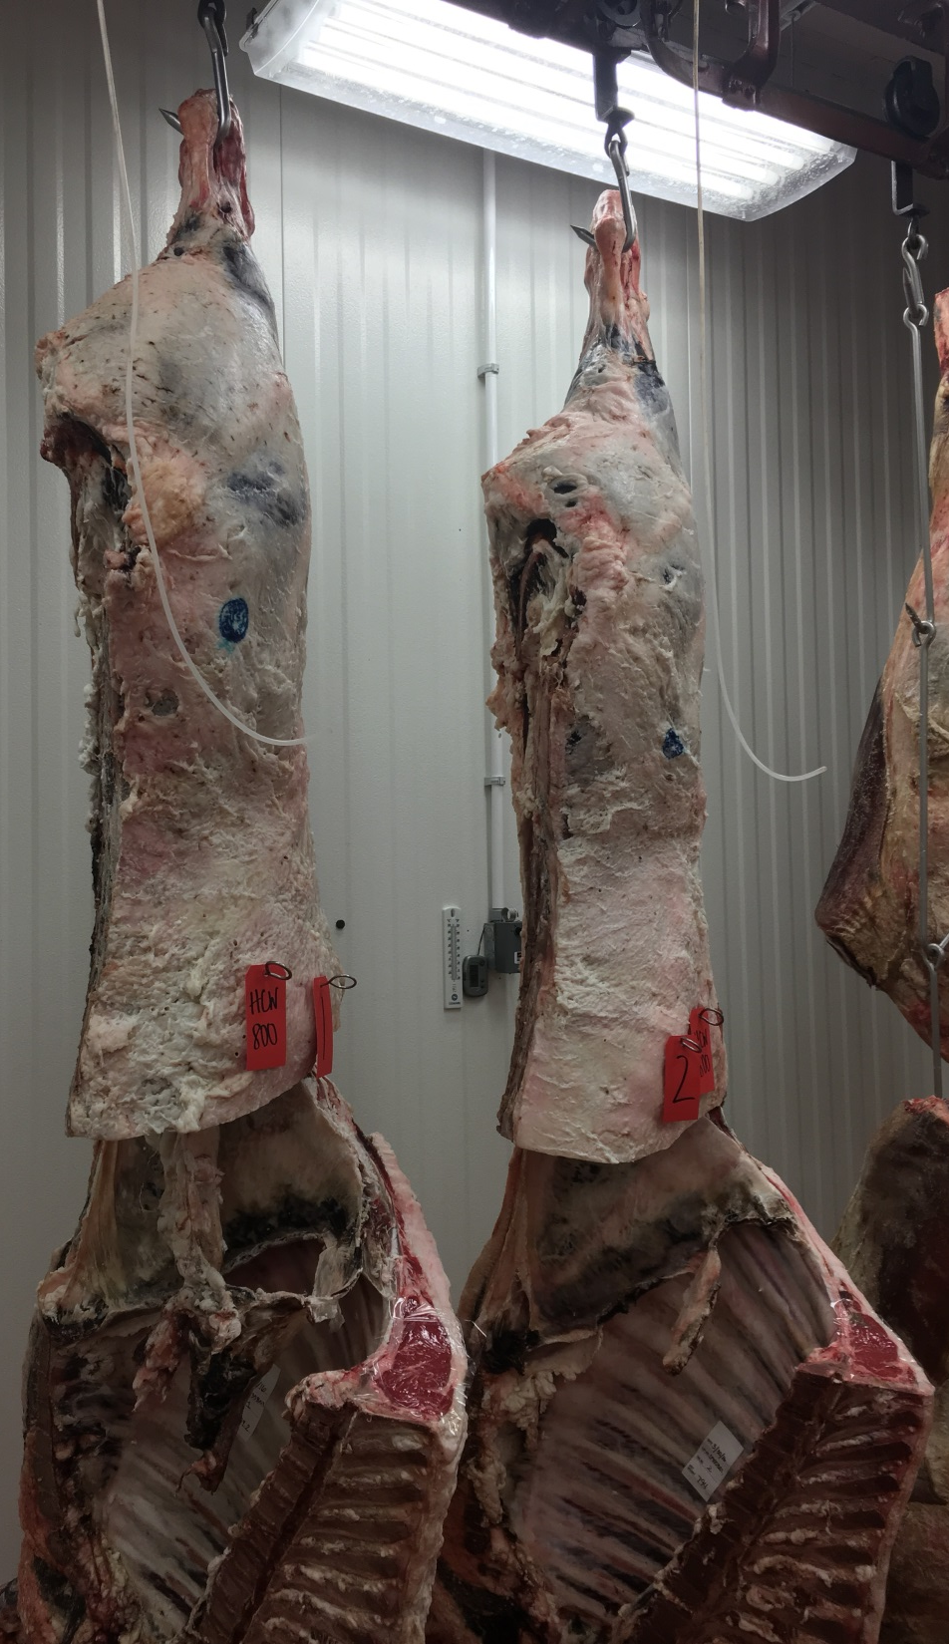
1
2
3
4

Slide 11
Questions
Which carcass possessed the highest merchandising value?
How many carcasses would qualify for a Top Choice Boxed Beef Program?
Between 1 and 2 which carcass possessed the thicker, plumper cushioned round?
Which carcass displayed the least amount of backfat?
Which carcass possessed the most uniform, cherry-red colored ribeye.

Slide 12
Officials
Placing - 4,3,1,2
Cuts: 7-5-2
Questions
1. | 4
2. | 1
3. | 1
4. | 4
5. | 1
 | PYG | REA | HCW | KPH | YG | Quality
1 | 3.9 | 13.8 | 800 | 3.5 | 3.8 | Ch- Sm 50
2 | 3.9 | 11.5 | 800 | 1.5 | 4.1 | Ch- Sm 40
3 | 3.6 | 14.7 | 800 | 1.0 | 2.7 | Ch° Mst 60
4 | 2.7 | 16.4 | 800 | 1.0 | 1.1 | Pr- Slab 55

Slide 13
Pork Carcasses Class 2

Slide 14
1

Slide 15
2

Slide 16
3

Slide 17
4

Slide 18
1
2
3
4

Slide 19
1

Slide 20
2

Slide 21
3

Slide 22
4

Slide 23
1
2
3
4

Slide 24
Questions
Which carcass had the most fat in the belly pocket?
Which carcass had the most fat over the lumbar region?
Which carcass was the lightest muscled?
Which carcass displayed the least leaf fat?
Between 2 and 3 which carcass possessed a more prominent sirloin?

Slide 25
Officials
Placing – 2,1,3,4
Cuts: 3-7-2
Questions
1. | 2
2. | 4
3. | 1
4. | 1
5. | 3

Slide 26
Lamb Carcasses Class 3

Slide 32
Questions
Which carcass possessed the lightest muscled leg?
Between 1 and 2 which carcass possessed a thicker, heavier muscled shoulder?
Between 2 and 4 which carcass was trimmer over the loin and loinedge?
Between 1 and 4 which one had more fat in the elbow pocket?
Between 2 and 3 which carcass was trimmer over the rack?

Slide 33
Officials
Placing – 4,1,2,3
Cuts: 2-6-2
Questions
1. | 3
2. | 2
3. | 4
4. | 4
5. | 3

Slide 34
Beef Ribs Class 4

Slide 35
1

Slide 36
2

Slide 37
3

Slide 38
4

Slide 39
1
2
3
4

Slide 40
1

Slide 41
2

Slide 42
3

Slide 43
4

Slide 44
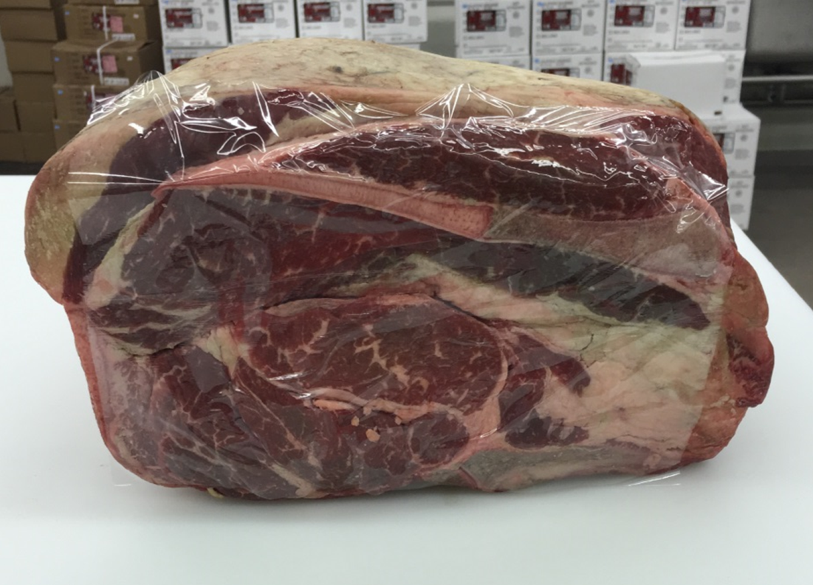
1
2
3
4

Slide 45
Questions
Which rib possessed the least area of exposed lean in the blade face with the smallest eye of blade?
Which rib was the trimmest, heaviest muscled, highest yielding?
Between 2 and 3 which rib possessed more fat opposite the ribeye and over the lower rib?
Between 2 and 4 which rib displayed a greater amount of marbling in the blade face with a much greater amount in the eye of blade?
Which rib had the lowest degree of marbling in the ribeye?

Slide 46
Officials
Placing – 4,2,3,1
Cuts: 6-2-4
Questions
1. | 2
2. | 1
3. | 3
4. | 4
5. | 1
 | Quality
1 | Ch-
2 | Ch°
3 | Ch°
4 | Ch°

Slide 47
Pork Loins Class 5

Slide 48
1

Slide 49
2

Slide 50
3

Slide 51
4

Slide 52
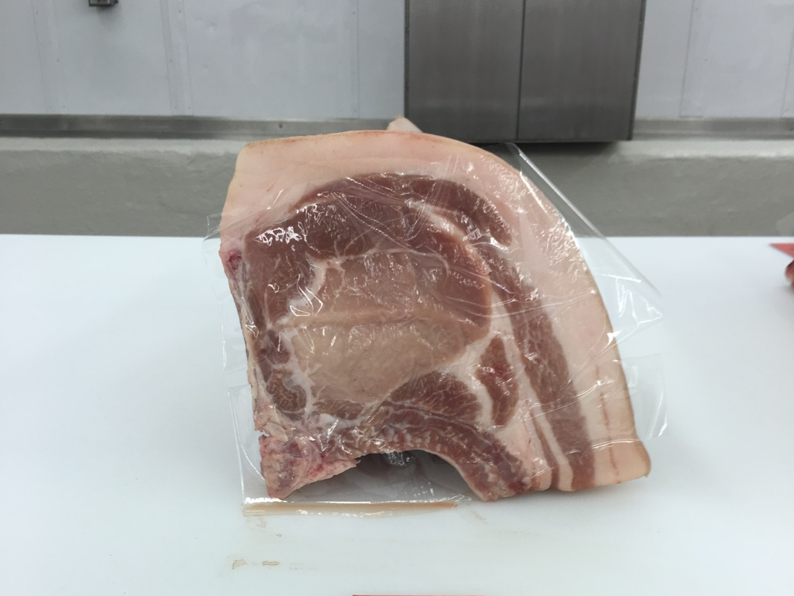
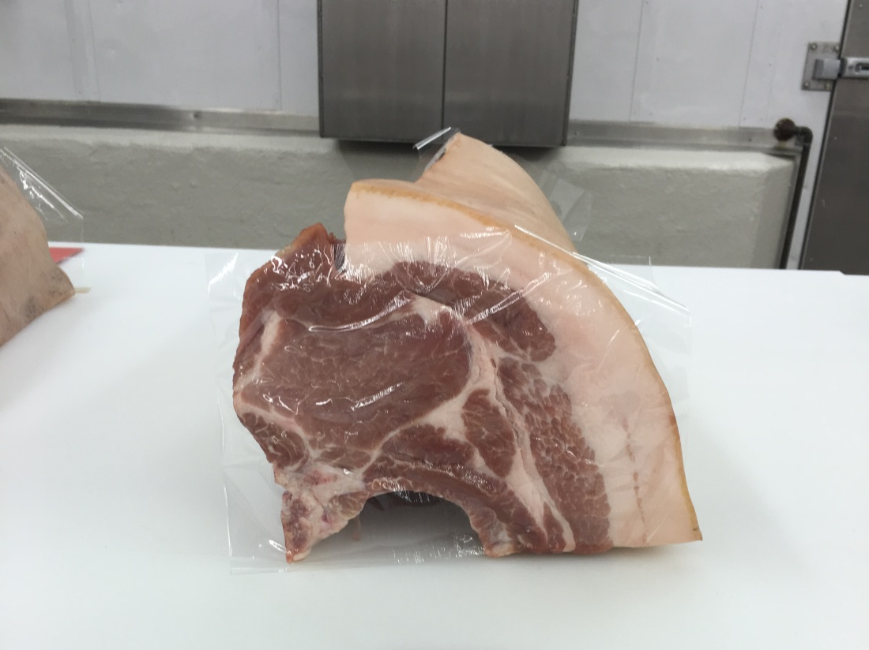
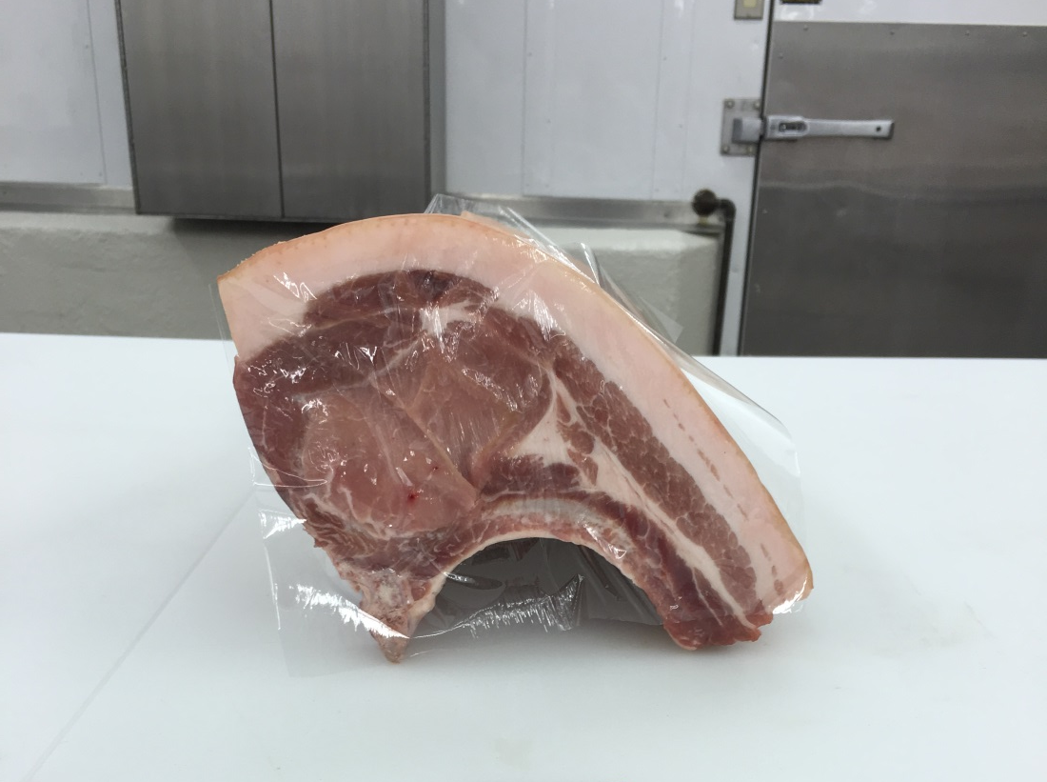
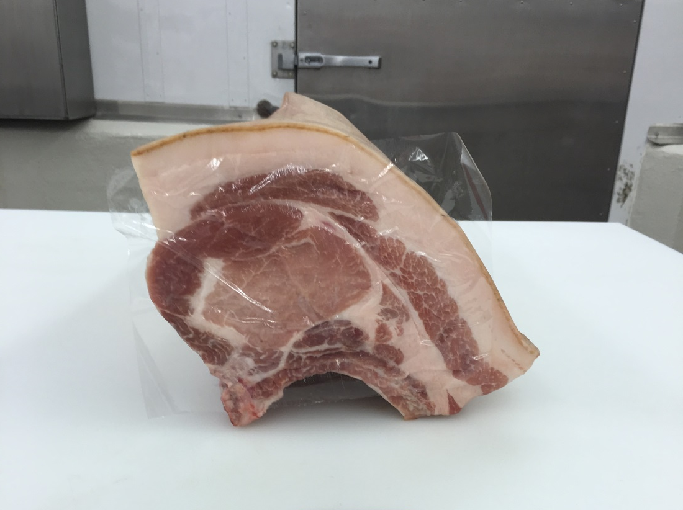
1
2
3
4

Slide 53
1

Slide 54
2

Slide 55
3

Slide 56
4

Slide 57
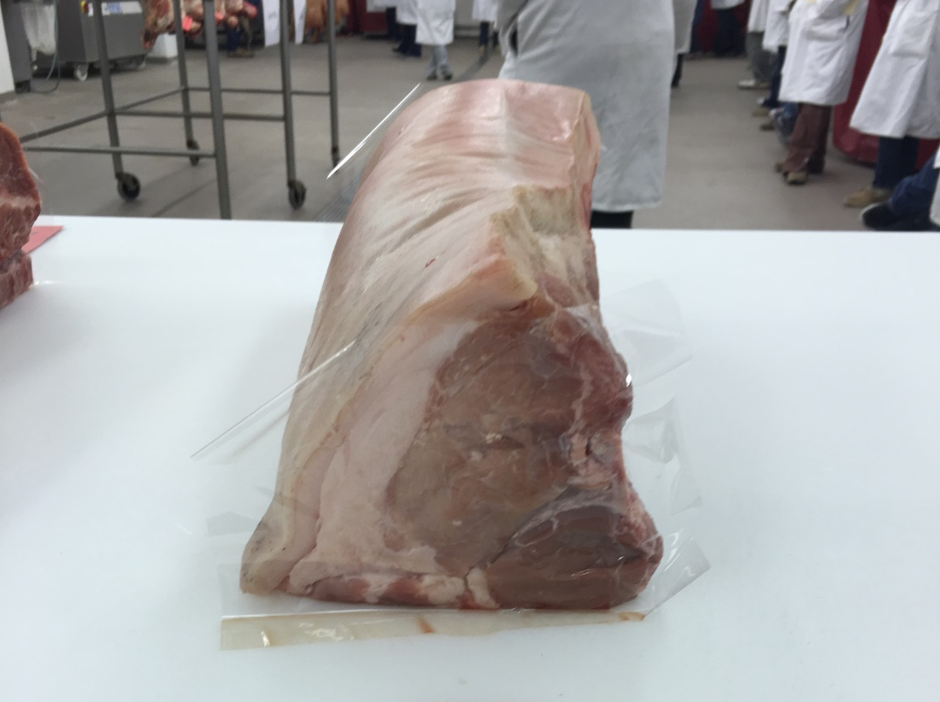
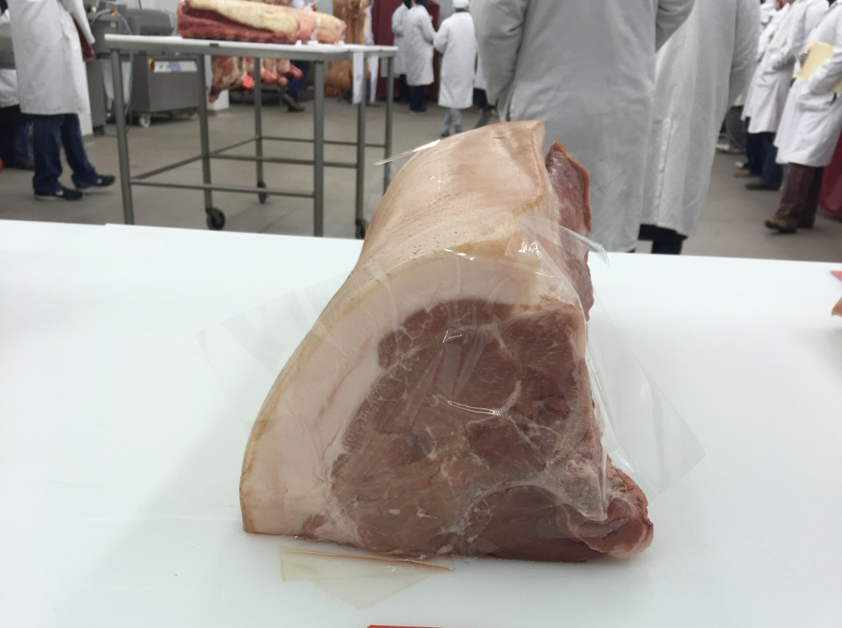
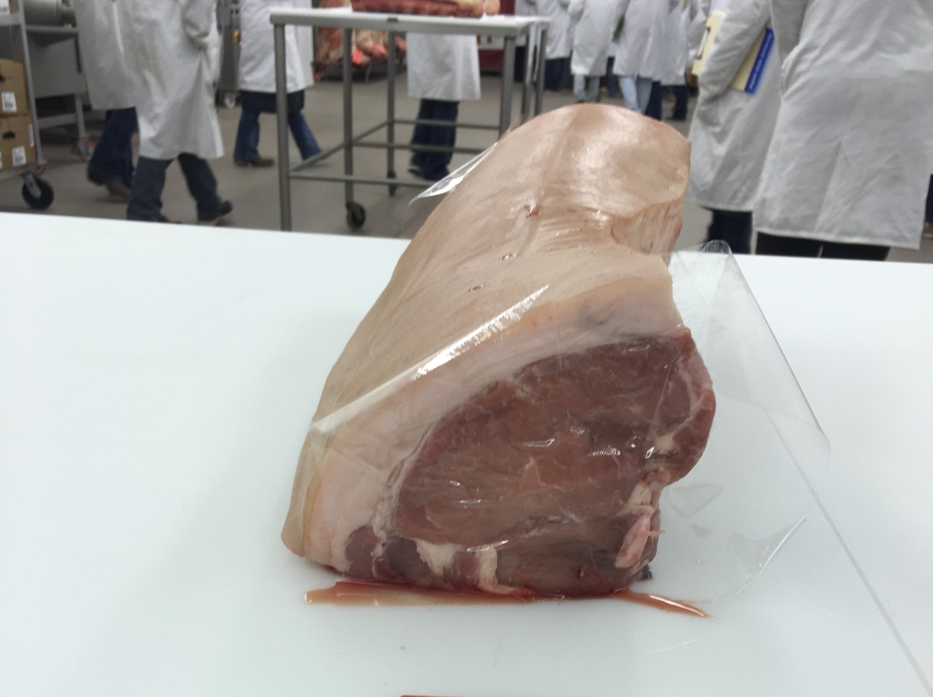
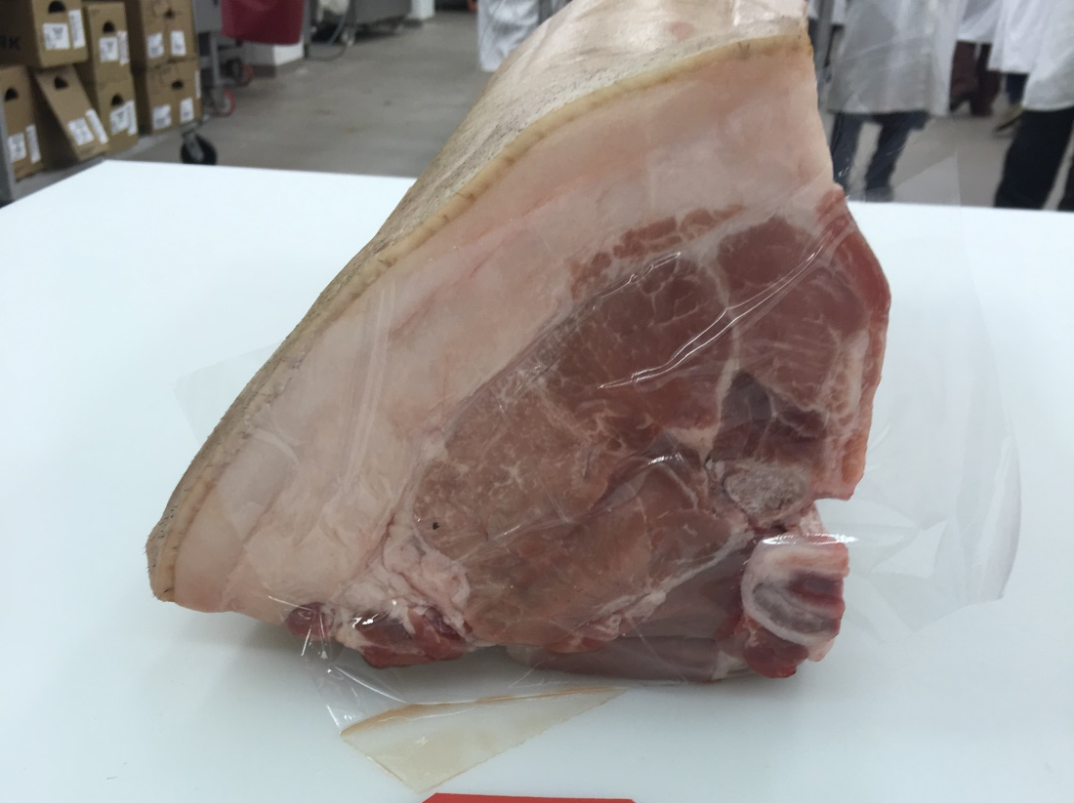
1
2
3
4

Slide 58
Questions
Which loin possessed the largest gluteus medius in the sirloin face?
Which loin had the smallest loin eye in the blade face?
Which loin displayed the darkest colored blade face?
Which loin possessed the most seam fat in the blade face?
Between 1 and 3 which loin exhibited less fat over the lower sirloin face?

Slide 59
Officials
Placing – 3,1,2,4
Cuts: 3-7-3
Questions
1. | 2
2. | 4
3. | 2
4. | 4
5. | 3

Slide 60
Lamb Blade Chops Class 6

Slide 61
1

Slide 62
2

Slide 63
3

Slide 64
4

Slide 65
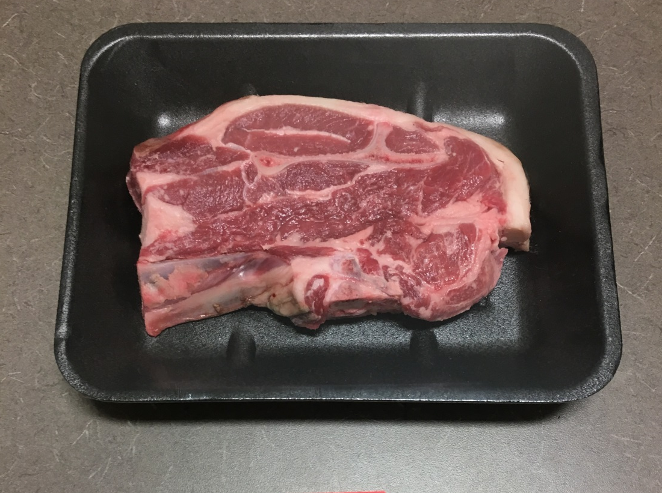
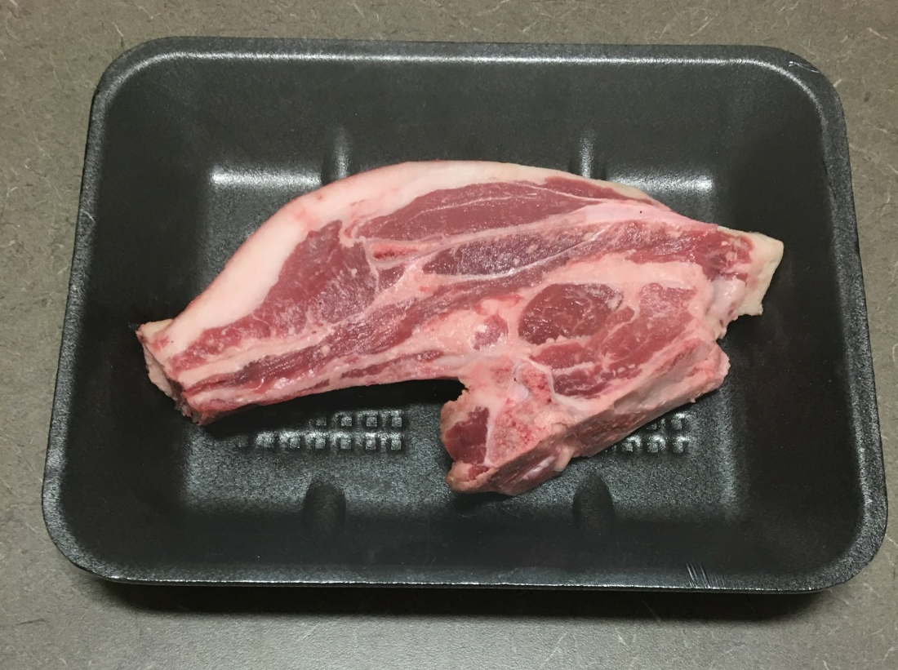
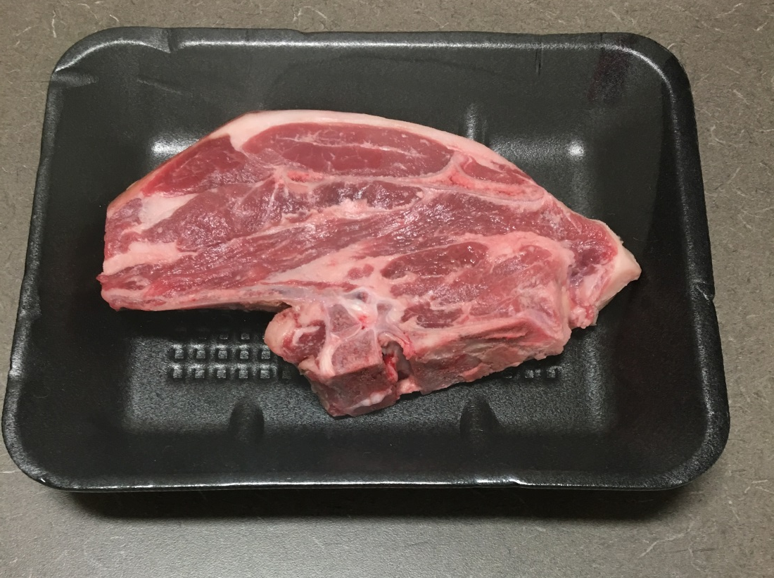
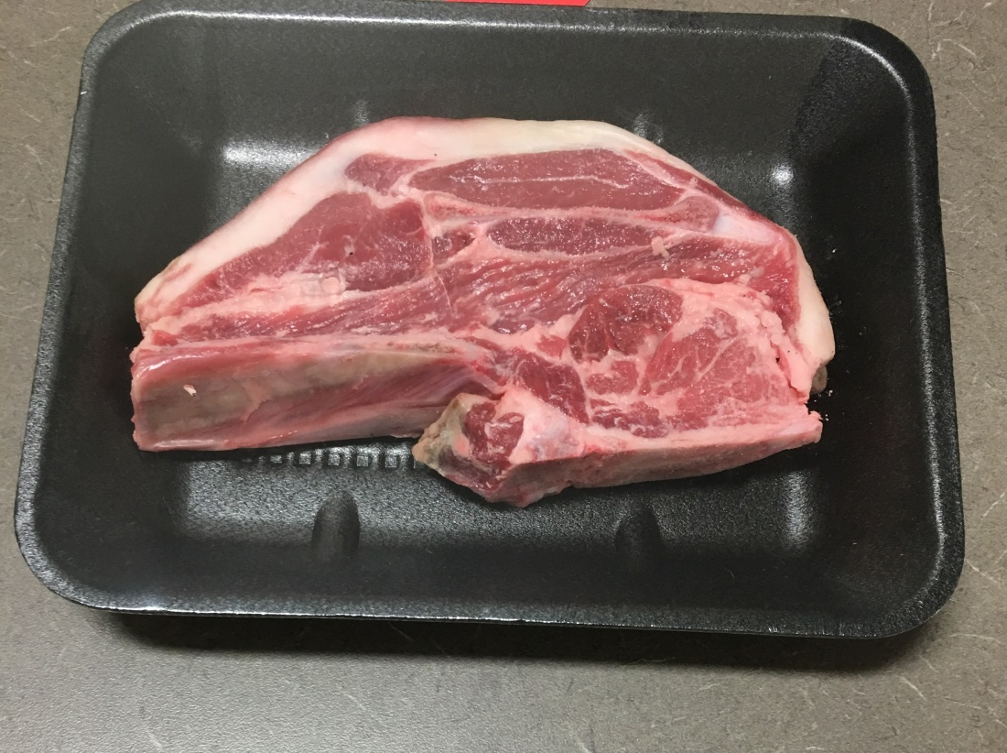
1
2
3
4

Slide 66
Questions
Which blade chop had the least external fat?
Which blade chop had the most seam fat
Between 2 and 4 which blade chop had a greater area of exposed lean?
Which blade chop possessed the largest infraspinatus.
Between 1 and 4 which one displayed a smaller blade bone?

Slide 67
Officials
Placing – 3,1,4,2
Cuts: 2-6-5
Questions
1. | 3
2. | 2
3. | 4
4. | 1
5. | 4

