Slide 1
Structure and Function of Muscle ANSC 3404 Objectives: Study the structures of muscle and the mechanism of muscle contraction.

Slide 2
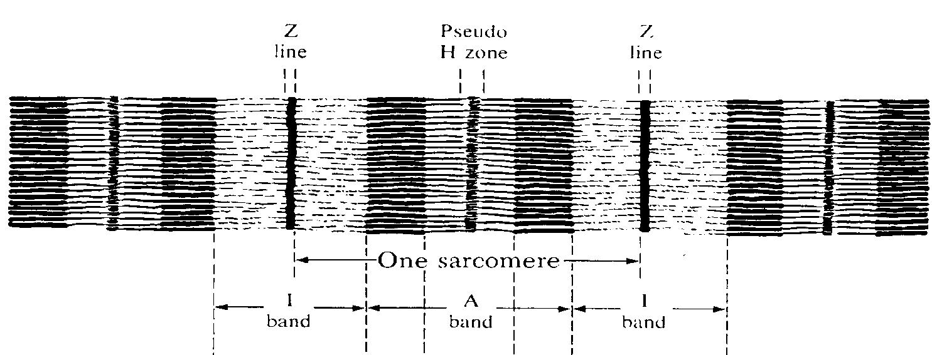
Muscle Types
SKELETAL SMOOTH CARDIAC
METHOD OF CONTROL VOLUNTARY INVOLUNTARY INVOLUNTARY
BANDING PATTERN STRIATED NON-STRIATED STRIATED
NUCLEI/CELL MULTI SINGLE SINGLE

Slide 3
Cardiac Muscle

Slide 4
Smooth Muscle

Slide 5
Skeletal Muscle

Slide 7
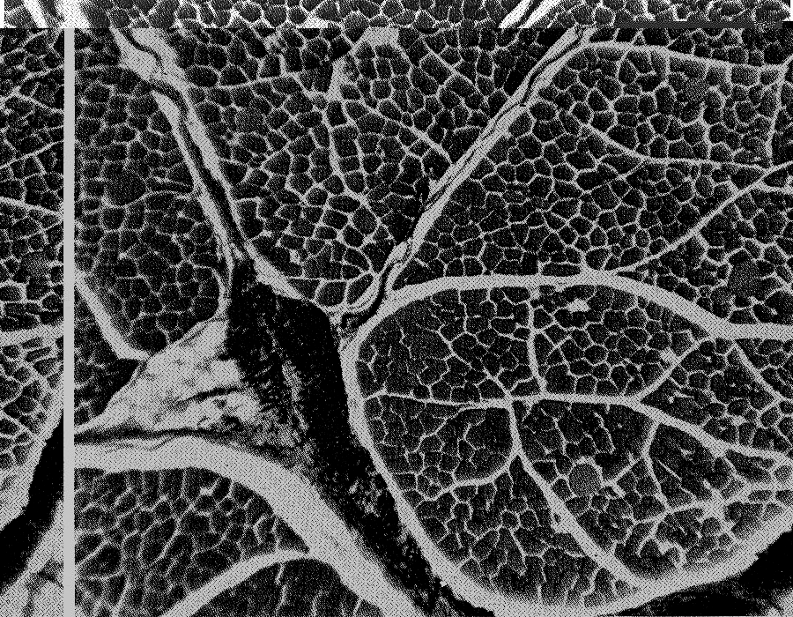
Muscle Cross Sections Showing Bundles of Myofibers
FAT CELL
BLOOD VESSEL

Slide 8
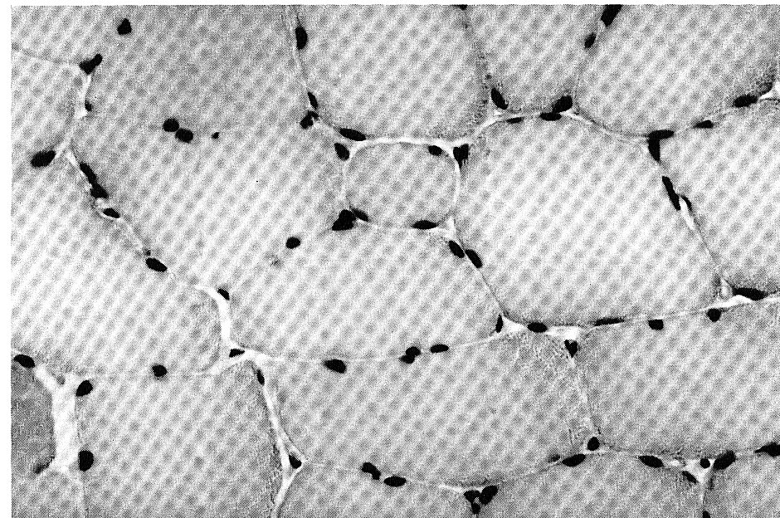
Cross Section of Muscle Fibers
NUCLEI

Slide 9
Myofiber

Slide 10
Red and White Fibers in Muscle

Slide 11
Fiber types

Slide 12
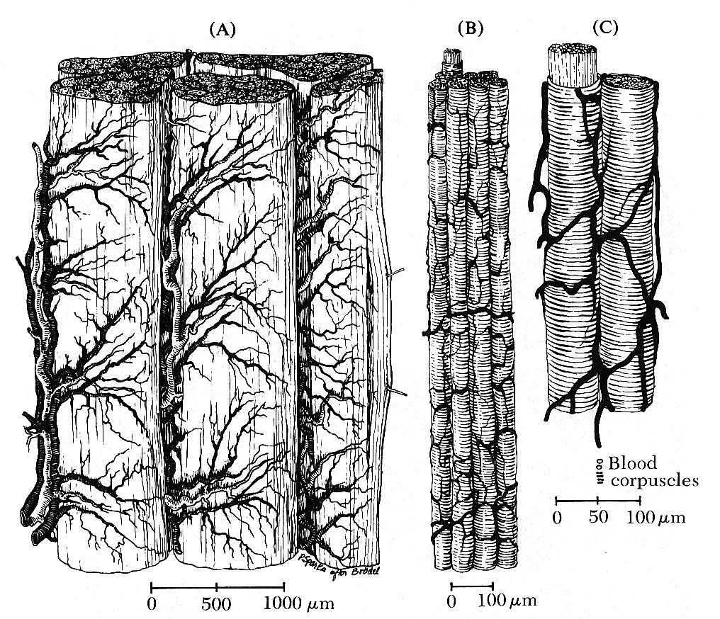
The Blood Supply for Myofibers

Slide 13
Connective Tissues

Slide 14
Position of Mysiums in Muscle
Perimysium
Epimysium
Endomysium
ENDO = within PERI = around EPI = upon

Slide 15
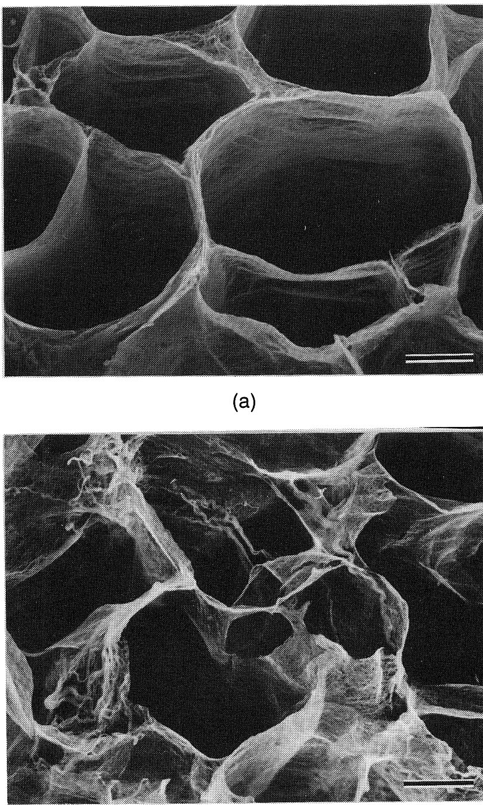
Endomysium from muscle not aged
Endomysium after cooler aging (28 D At 4ºC)

Slide 16
The Sarcoplasmic Reticulum
Sarcoplasmic reticulum
T-tubule
Calcium Storage
Required for contraction

Slide 17
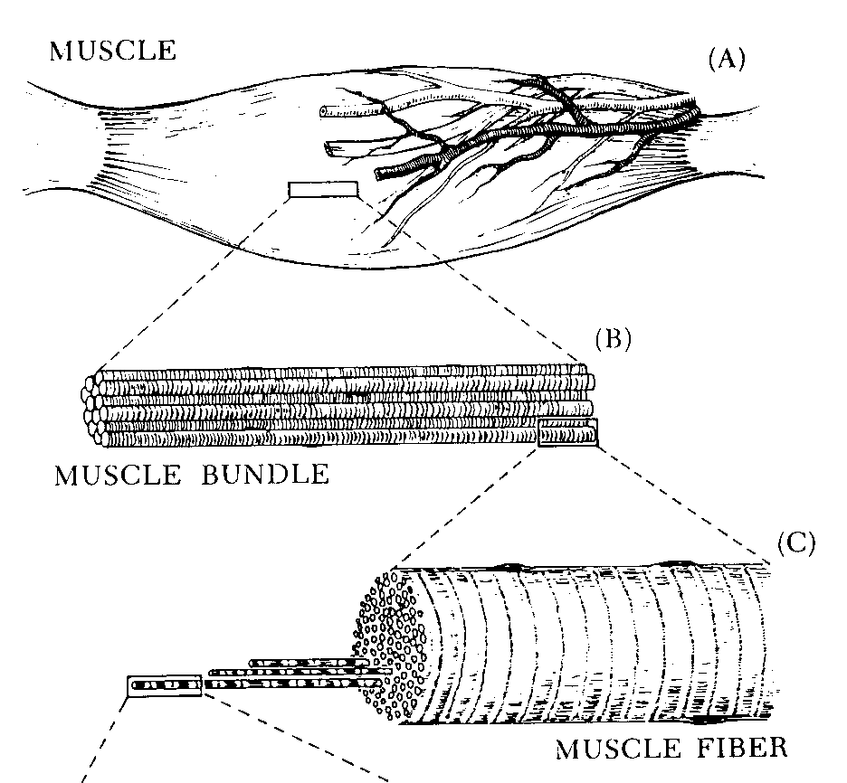
Structure of Muscle

Slide 18
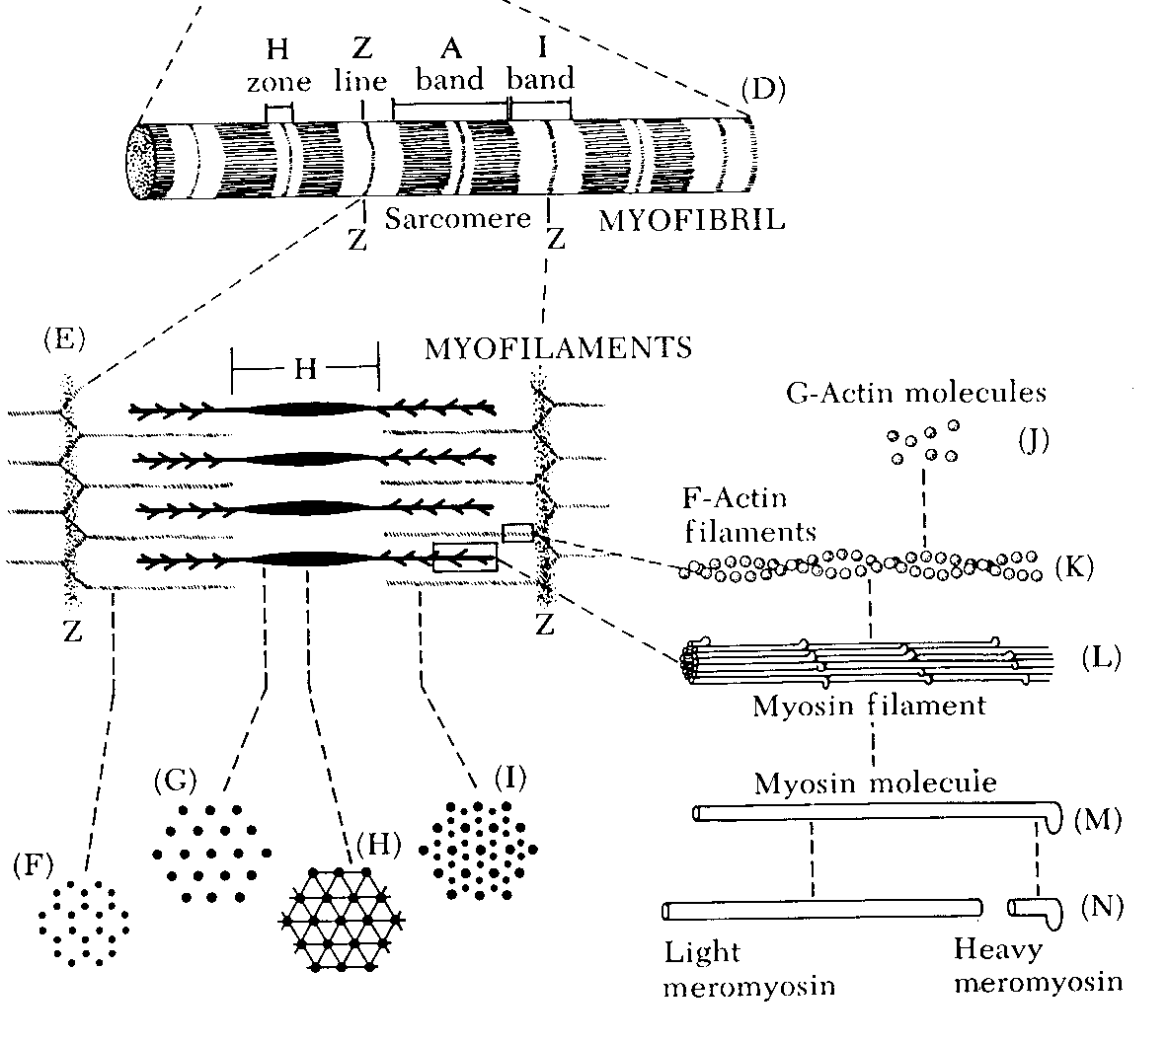
Structure of Muscle (Cont)

Slide 19
Sarcomere
Functional unit of a muscle
Runs from z-line to z-line
Actin
Myosin

Slide 20
Myosin Filament

Slide 21
Actin Filament

Slide 22
Muscle Structure

Slide 23
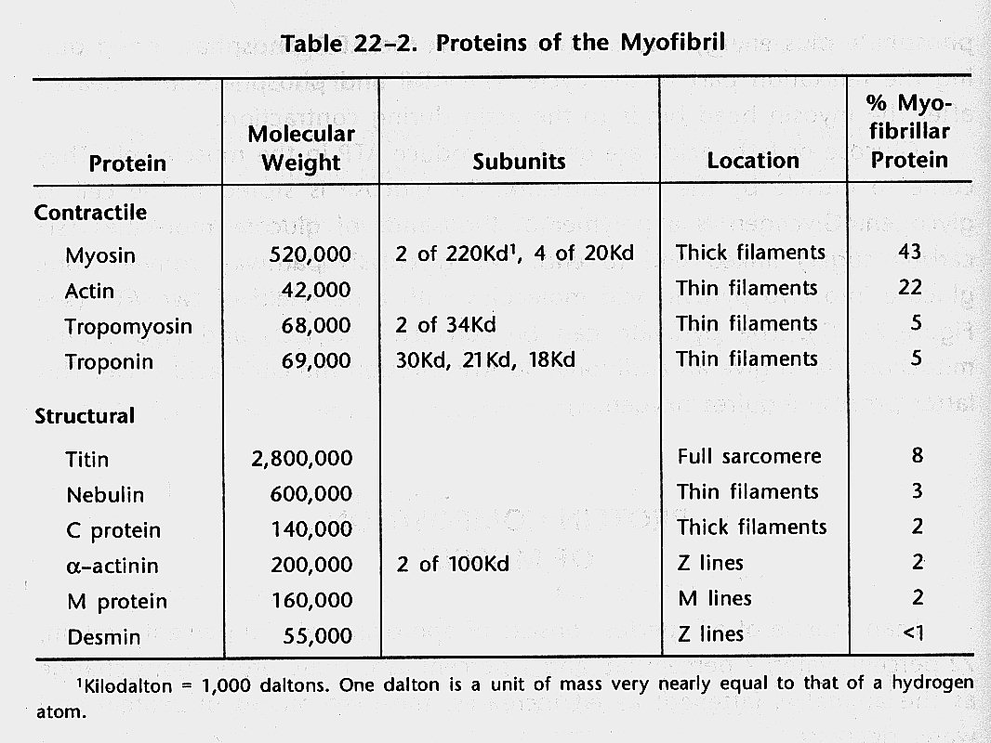
Critical Contractile Proteins

Slide 24
REVIEW

Slide 25
Fat Structures

Slide 26
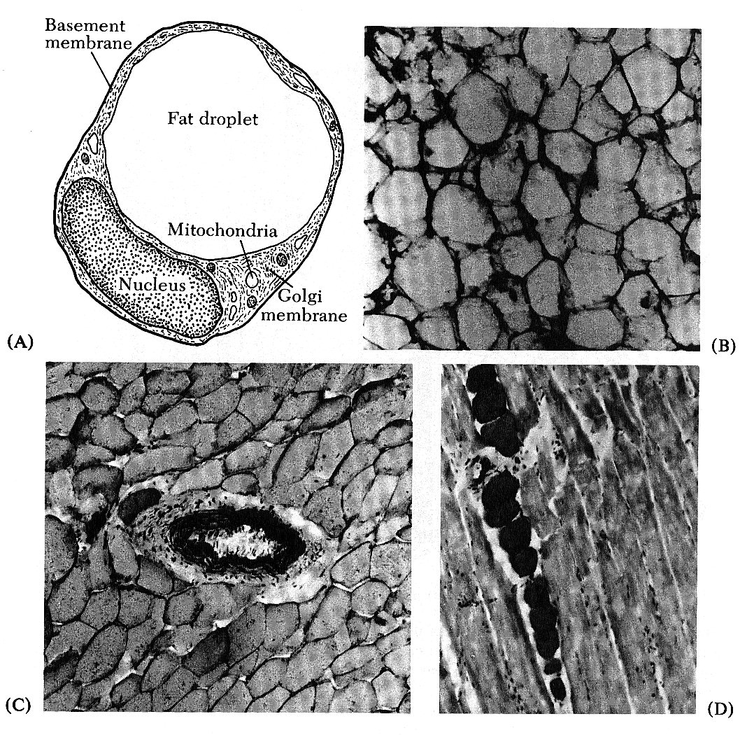
ADIPOSE TISSUE
ADIPOCYTE
BLOOD VESSEL
ADIPOCYTES

Slide 27
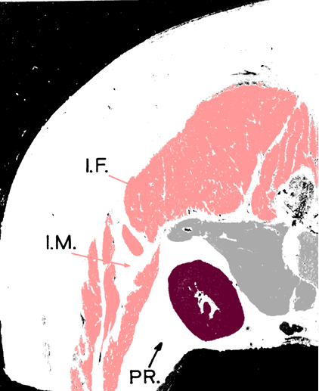
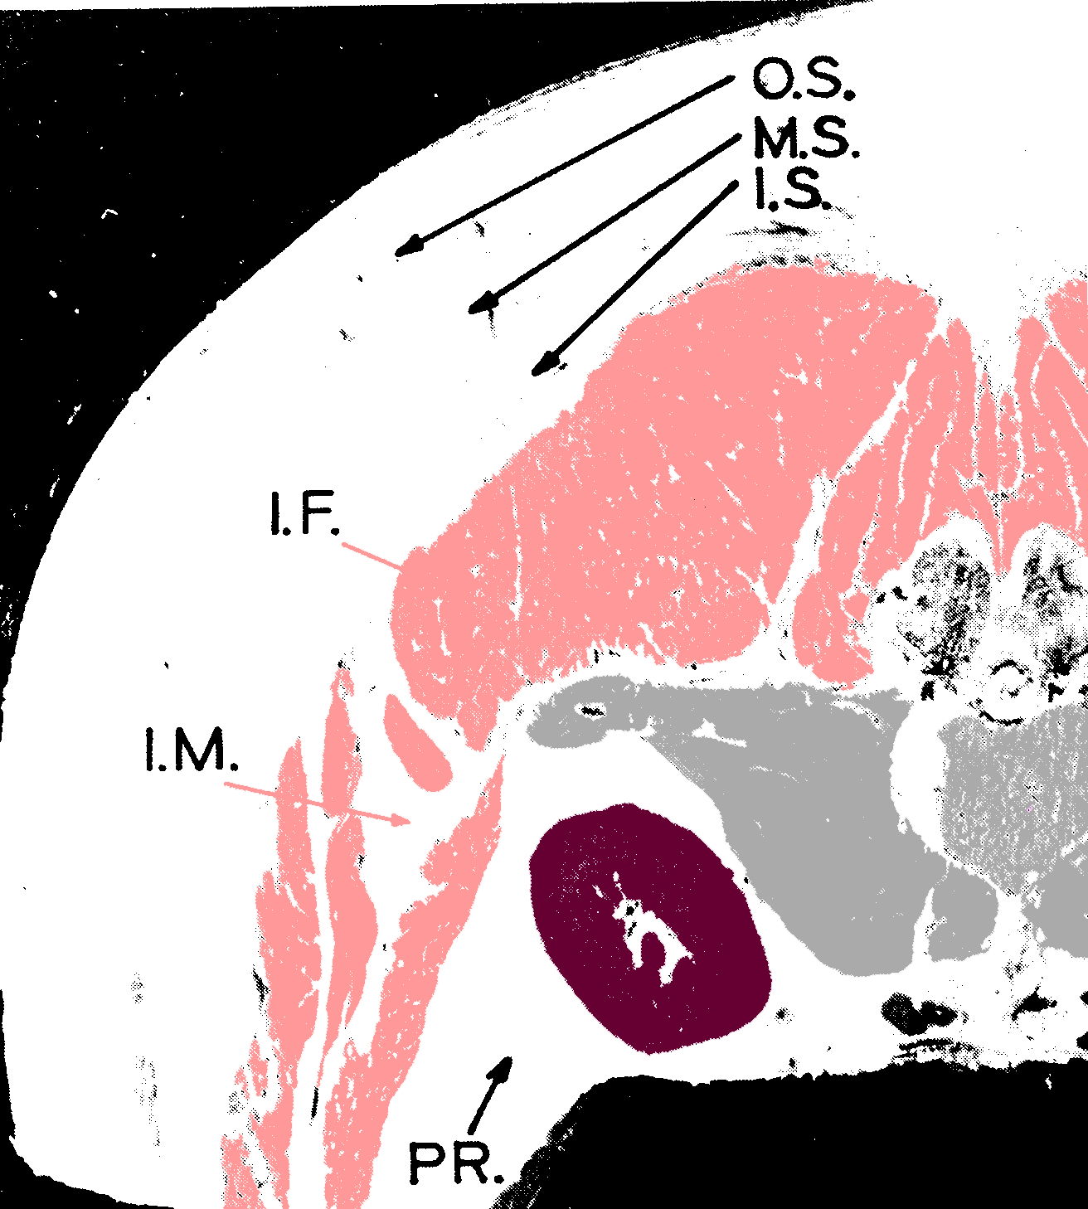
Fat Layers and Depots
I.F. = Inter-fasicular or intramucular (marbling)
I.M. = Intermuscular (seam fat)
PR. = Perinephric or Peri-renal (fat around the kidneys)

Slide 28
FAT CELLS
Adipoblasts develop at widely varying rates in different parts of the body.

Slide 29
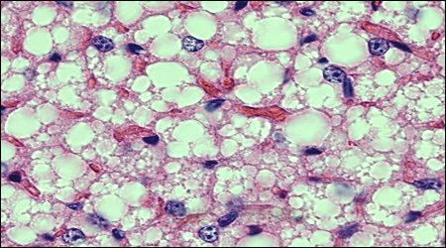
Adipogenesis
Adipoblasts
20 microns in diameter
Adipocytes
120 micron in diameter
300 micron in obese
Cellular make-up
95% of cytoplasm is lipid
Remainder primarily nucleus

Slide 30
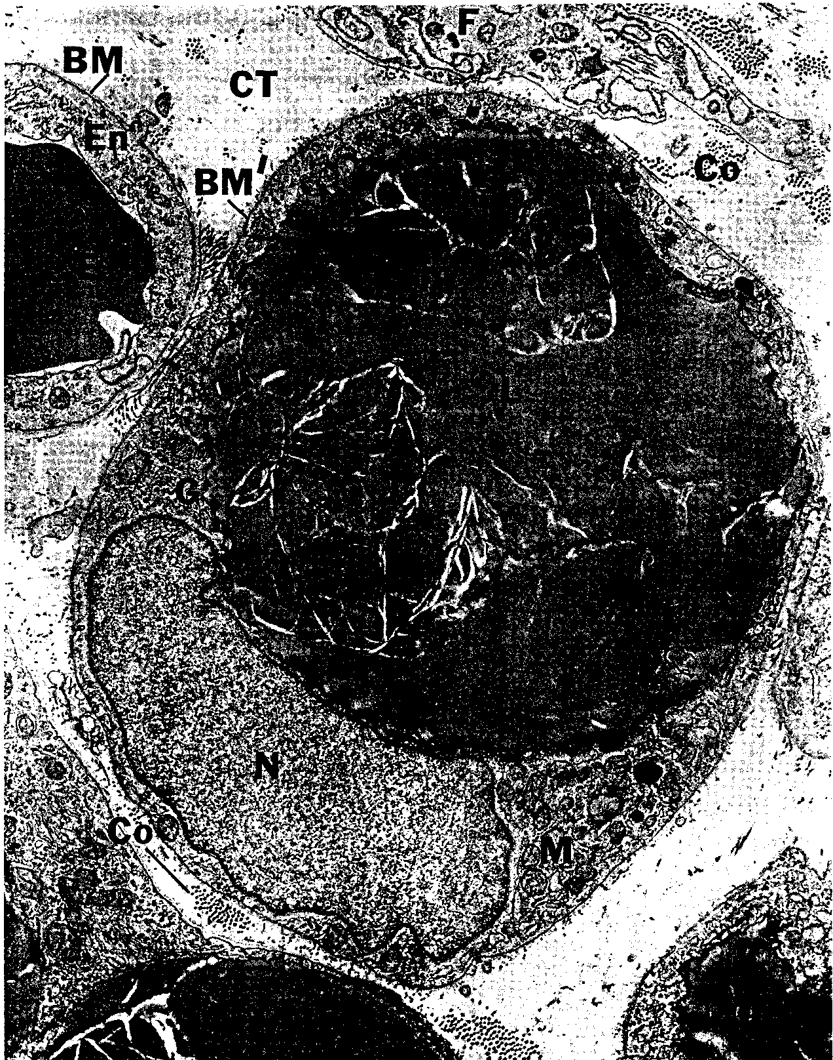
ADIPOCYTE

Slide 31
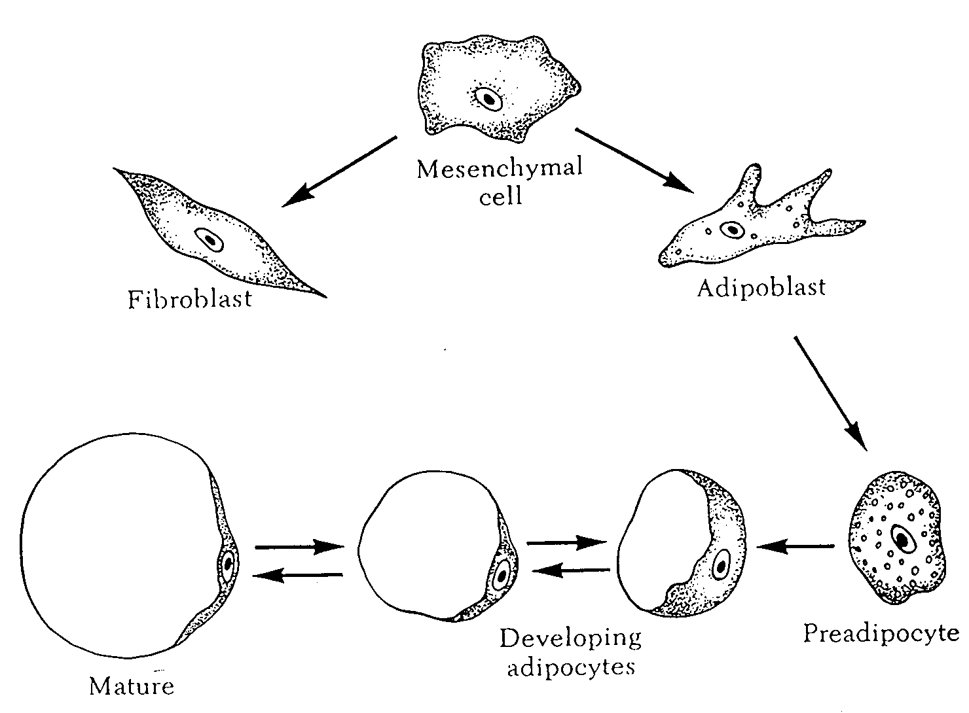
HOW ARE ADIPOCYTES FORMED?
Adipose cells begin to accumulate
ONCE RECRUITED & FILLED, AN ADIPOCYTE IS EASIER TO FILL AGAIN THAN IF NOT FILLED BEFORE
When filled with lipid, it is a mature adipocyte

Slide 32
Muscle Contraction

Slide 33
Introduction
Overall structure of muscle is designed for contraction and relaxation, which leads to movement and locomotion.
The ability to contract and relax is lost during the transformation of muscle to meat.
Events surrounding this conversion greatly impact meat palatability

Slide 34
Introduction
The biochemical processes that provide energy to the living muscle cause the accumulation of metabolites during harvest
Affects color, WHC, pH, others
An understanding of muscle contraction is necessary to understand these processes

Slide 35
Contraction
Begins with stimuli that arrive at the surface of the muscle fiber at the sarcolemma
Nerve impulse starts in the brain and is transmitted via nerves to the muscle

Slide 36
Transmembrane Potentials
Under resting conditions, an electric potential exists between the inside and outside of the cell
Fluids inside are negative
Fluids outside are positive
Results in a resting membrane potential

Slide 37
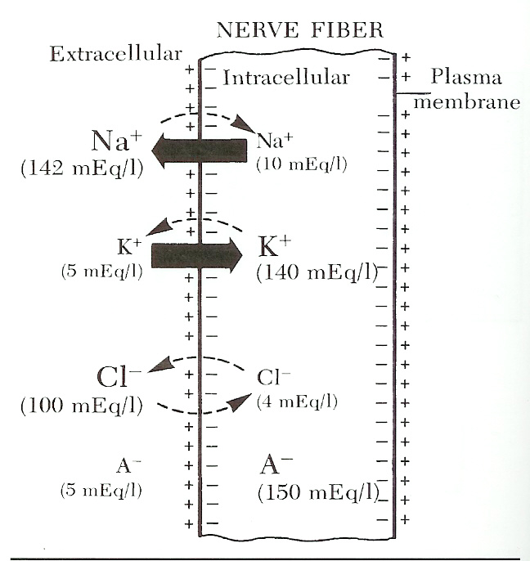

Slide 38
Transmembrane Potentials
Extracellular – Na+ and Cl-
Intracellular – K+ and A-
Na+ and K+ gradient maintained by a sodium-potassium pump.
Notes:
A- = non-difusable anions proteins and peptides

Slide 39
Action Potential
Transmits electric impulse to muscle
Travels along the membrane surface of the nerve fiber by depolarization
Initiated by a dramatic increase in the permeability of Na+
Na+ rushes into cell to establish equilibrium; however K+ stays in cell causing a change in the net charge inside the cell to positive
Lasts only a millisecond (0.5 to 1 millisecond) before the permeability to Na+ is changed to resting state

Slide 40
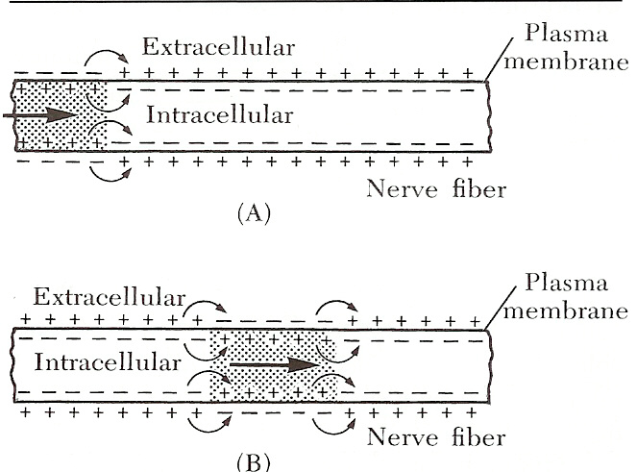

Slide 41
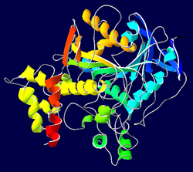
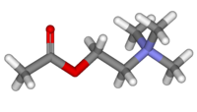
Myoneural Junction
Action potential is not strong enough to elicit a response alone
Uses a chemical transmitter called acetylcholine to be released.
Acetylcholinesterase is quickly released to neutralize the acetylcholine

Slide 42
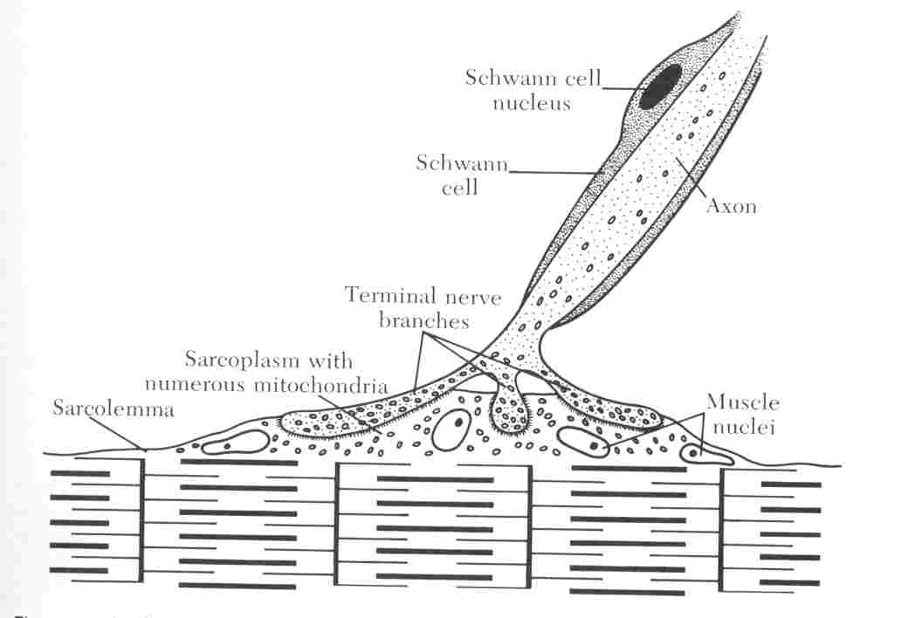

Slide 43
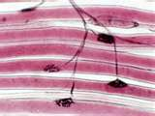

Slide 44
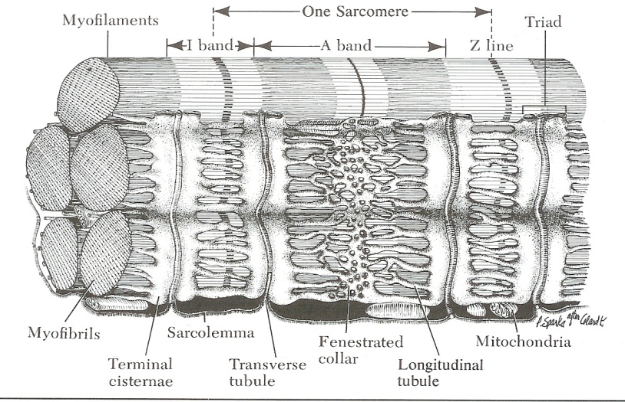
Muscle Action Potentials
Same as the action potential for nerve fibers
Communicated to the inner muscle cell via the T-tubule system
Action potential transverse a muscle fiber via the t-tubules and are ultimately responsible for the release of calcium from the SR

Slide 45
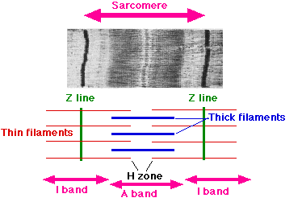
Sarcomere - Basic contractile unit of the muscle
Myosin
Actin
Tropomyosin
Troponin
Z lines

Slide 46
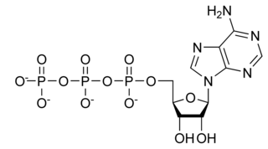
Elements required for muscle contraction and relaxation
Acetylcholine and Acetylcholinesterase
Calcium
Adenosine 5'-triphosphate (ATP)
Derived from aerobic and anaerobic metabolism

Slide 47
Sources of Energy for Muscle Contraction and Relaxation

Slide 48
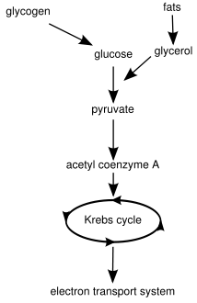
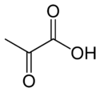
Energy
Aerobic
Glycolysis
TCA cycle
Electron transport chain
Anerobic
Excess Hydrogen is used to reduce pyruvic acid to lactic acid, which permits glycolysis to proceed at a rapid rate
Easily fatigued

Slide 49
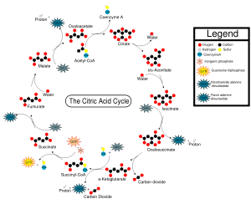
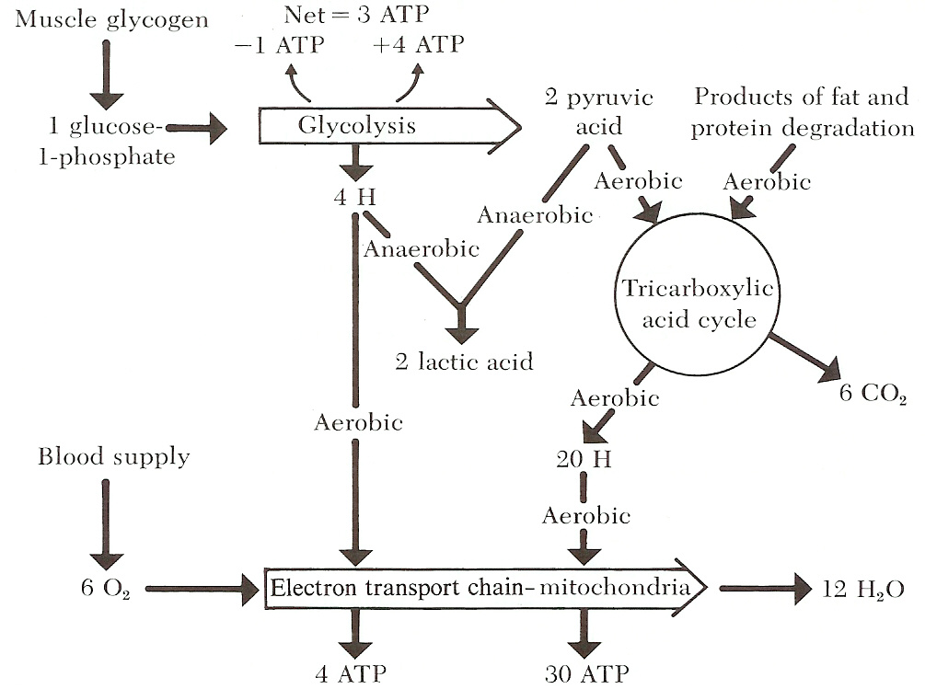

Slide 50
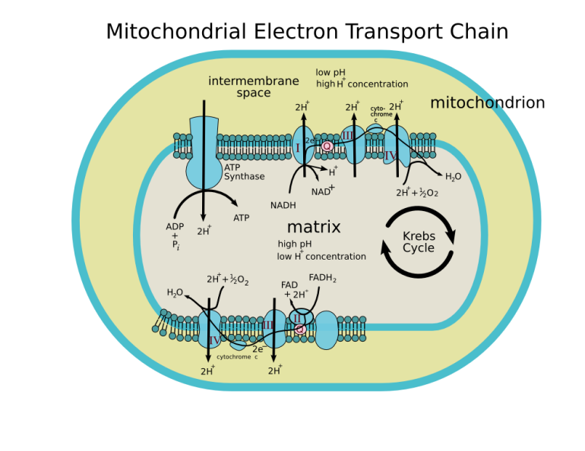

Slide 51
Contraction Phase
1. Nerve pulse/impulse transmitted through action potential
↓
2. Acetylcholine is released at neural juncture
↓
3. Action potential transmitted to muscle fiber via the T-tubles to the sarcoplasmic reticulum (SR)

Slide 53
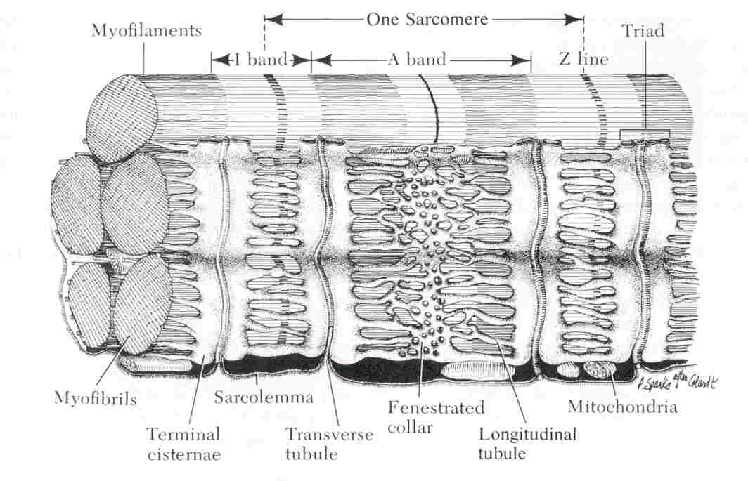

Slide 54
Contraction phase
4. Calcium is released from SR into sarcoplasm
↓
5. Calcium binds to troponin
↓
6. ATP is hydrolyzed (burned)
↓
7. Energy causes a shift in tropomyosin and actin binding site is exposed

Slide 55
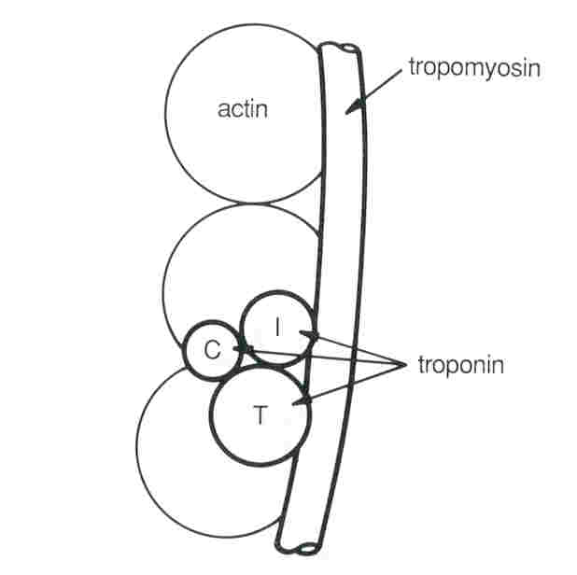

Slide 56
Contraction phase
8. Actin-myosin cross bridge forms (cross bridge is termed actomyosin)
↓
9. ATP hydrolyzed
↓
10. Myosin head rotates
↓
11. Repeated over and over; filaments slide causing shortening of sarcomere

Slide 57
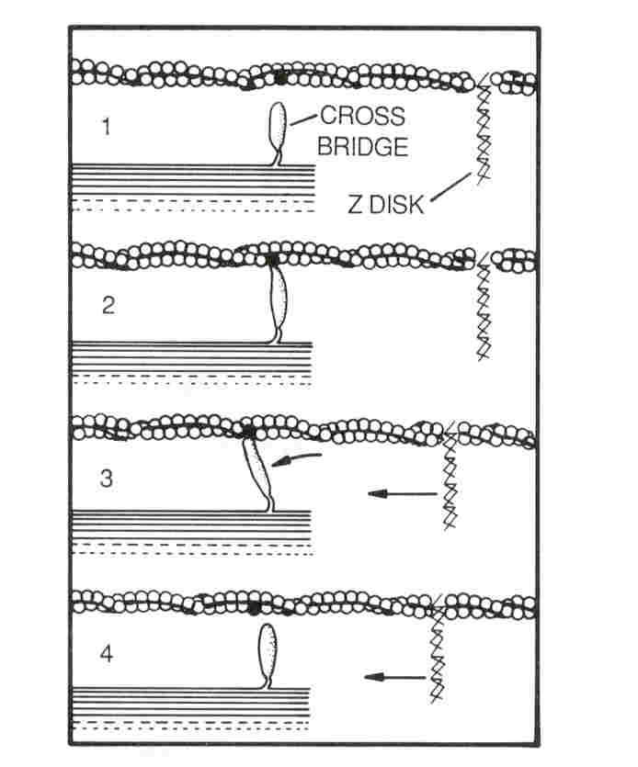

Slide 58
Contraction

Slide 59
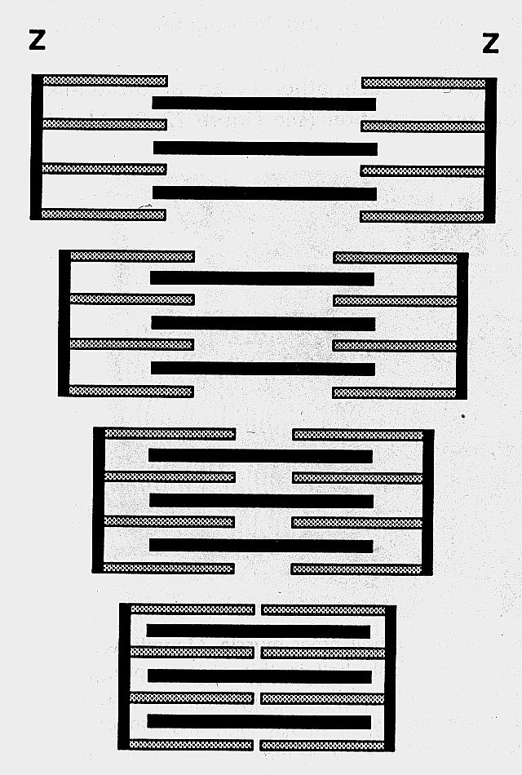
ACTIN MYOSIN
A sarcomere contracting
Notice that neither filament changes length

Slide 60
http://www.unmc.edu/Physiology/Mann/mann14.html
http://www.blackwellpublishing.com/matthews/myosin.html
http://entochem.tamu.edu/musclestruccontractswf/index.html

Slide 61
Relaxation phase
1. Acetylcholinesterase is released (neutralizes acetylcholine)
↓
2. Calcium pump activated by SR to sequester calcium
↓
3. Actin-myosin cross bridge terminated
↓
4. Tropomyosin shifts covering the binding site on actin

Slide 62
Relaxation phase
5. Passive sliding of filaments
↓
6. Sarcomere returns to resting state

Slide 63
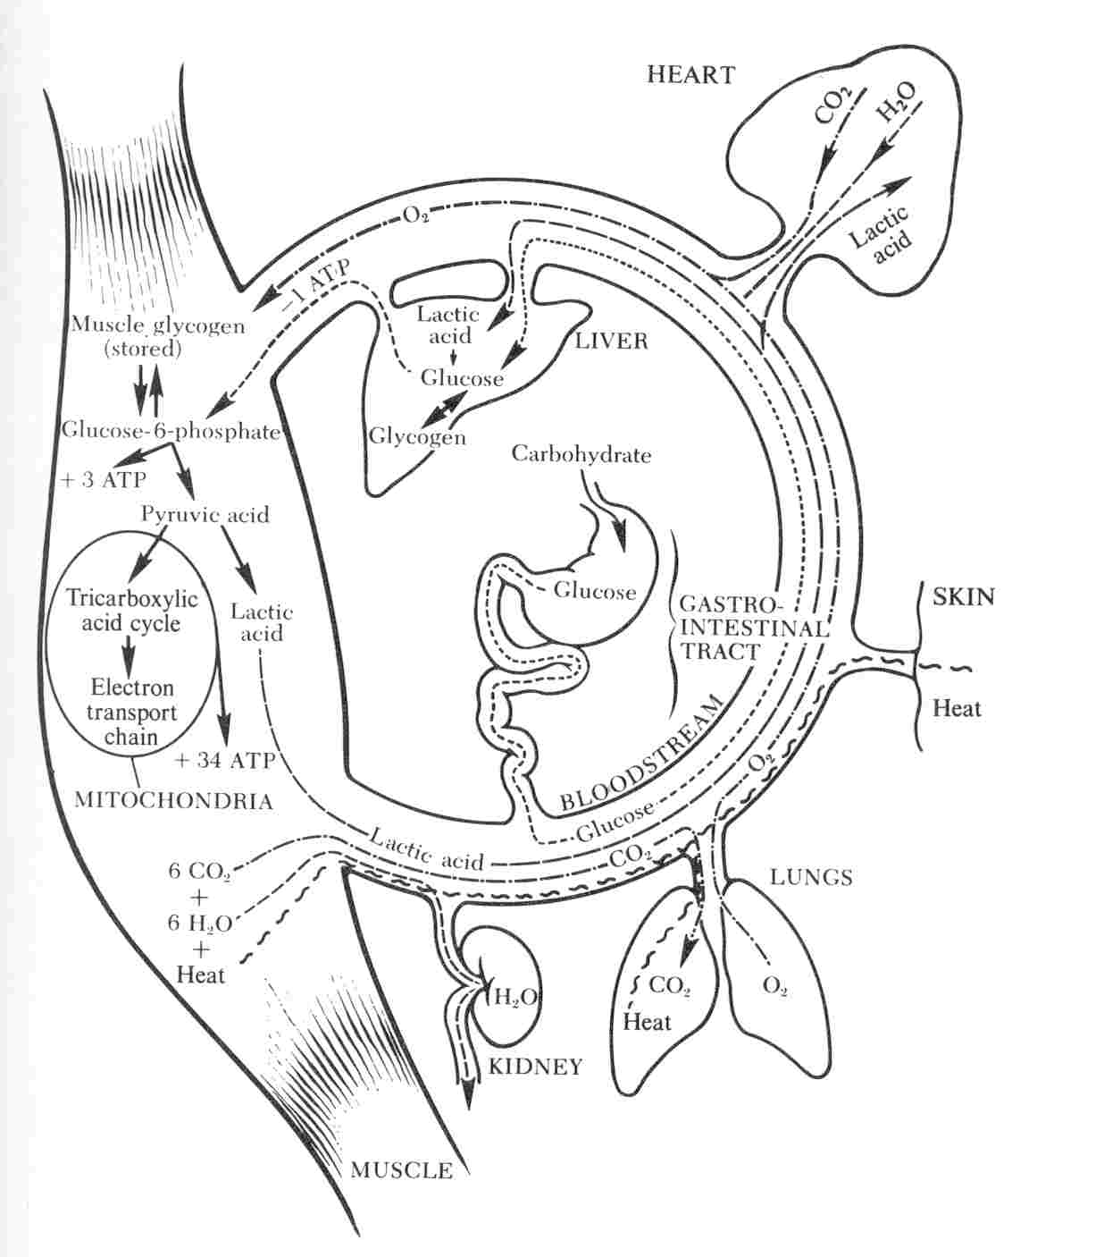

Slide 64
Be Able To:
Draw a sarcomere showing:
Myosin
Actin
Z Line
A Band
I Band
H Zone
M Line
Explain how a muscle contracts and relaxes
starting with a nerve impulse and including the SR role
Explain the role of ATP in muscle contraction and relaxation
(See p.889-900 In The Meat We Eat)

