Slide 1
Using Assurance Points and Integration Rules for Recovery in Service Composition*
Rajiv Shrestha
Masters Thesis Defense
Department of Computer Science
04/01/2010
Committee Members:
Dr. Susan Urban (Chair)
Dr. Michael Shin
Dr. Susan Mengel
*This research is partially supported by NSF Grant No. CCF-0820152.

Slide 2
Overview of Presentation
Motivation
Research Objective
Related Work
Background of Research Objective: Service Composition and Recovery Model
Extensions
Assurance Points
Integration Rules
Recovery Actions
Prototype execution environment for testing and demonstration of the algorithms
Evaluation of Assurance Points
Contributions
Future Research

Slide 3
Motivation
Service-Oriented Computing and Web Services
Platform-independent and interoperable way for organizations to make their software and data services available
Challenges of Service-Oriented Computing
Flexible ways of checking constraints and responding to execution errors
Access to execution status
to support more dynamic ways of responding to failures,
to validate correctness conditions for process execution.
to increase forward recovery activity
Notes:
A service is an implementation of a well-defined business functionality, and such services can then be consumed by clients in different applications or business processes.
SOC is interoperable (between different types of applications and technologies), loose coupling between software components so that they can be reused. SOA allows for the reuse of existing assets where new services can be created from an existing IT infrastructure of systems.
Services are self-contained (perform predetermined tasks) and loosely coupled (for independence)
Composite services can be built from aggregates of other services
Services can be dynamically discovered
Web Services → Web services are software systems designed to support interoperable machine-to-machine interaction over a network. This interoperability is gained through a set of XML-based open standards: Web Service Description language (WSDL) for binding and defining interface, Simple Object Access Protocol (SOAP) for message exchange, and Universal Description Discovery and Integration (UDDI) for discovery. These standards provide a common approach for defining, publishing, and using web services.
SOA is an architectural style that has been around for years. Web services are the preferred way to realize SOA.
SOA is more than just deploying software. Organizations need to analyze their design techniques and development methodology and partner/customer/supplier relationship.
Moving to SOA should be done incrementally and this requires a shift in how we compose service-based applications while maximizing existing IT investments.

Slide 4
Research Objective
To enhance an existing service composition model with user-defined constraints and flexible recovery actions
Assurance Points (APs) as rollback points and state capture.
Integration Rules for pre and post conditions.
Recovery Actions that integrate the use of APs and integration rules for combined use of forward and backward recovery
Prototype of the execution environment
Sub-component of the Decentralized Data Dependency Analysis Project.
Notes:
Resolve failure and recovery through different recovery actions
Recovery depends on state of the process execution

Slide 5
Assurance Points
Related Work

Slide 6
Related Work
Exception handling in service composition environment
Business Process Execution Language (BPEL) (Jordan et al., 2007)
Industry Standard for workflow language
Recovery of BPEL process is through combined use of:
Fault Handler
Repair active scopes that encountered a fault.
Compensation Handler
Undo work done in a completed scope.
Termination Handler
Terminate an active scope.
BPEL demonstrates anomalies in the recovery process
Notes:
BPEL – high level language for composing web services defines a model and a grammar for business process interaction
We use BPEL-like flow construct

Slide 7
Related Work
Aspect-Oriented Workflows (Charfi and Mezini 2007) , (Kiczales et al., 2001)
modularizes the process specification
with respect to functionality that is not a part of the main process flow
For example: logging, business rules, etc.
Checkpointing (Dialani et al., 2002), (Luo 2000), (Marzouk et al., 2009)
During failures and exceptions, the activity can be rolled back to the closest consistent checkpoint, resuming the execution from that point
How is the AP concept different?
Hierarchical Recovery Process
APs are referenceable points that store execution state
Supports user-defined correctness conditions
Integrates forward and backward recovery with constraints and APs
Potential to maximize forward recovery
Notes:
BPEL – high level language for composing web services defines a model and a grammar for business process interaction
We use BPEL-like flow construct

Slide 8
Background
Service Composition and Recovery Model

Slide 9
Service Composition and Recovery Model
Error Occurs
Abstract view of a sample process definition (Xiao, Y., & Urban, S. D. 2009)
p₁ = cg₁ = Top-level execution entity that is composed of other execution entities
copi,j = Compensation (an operation intended for backward recovery)
topi,j = Contingency (an operation used for forward recovery)
Shallow Vs. Deep Compensation

Slide 10
The Extended Approach
Extending the Model with Assurance Points and Rules

Slide 11
Assurance Point and Rule Extension
Goal → achieve flexibility and robustness in process recovery through:
Assurance Points
Integration Rules
Recovery Actions

Slide 12
Assurance Point Definition
Assurance Point (AP)
a combined logical and physical checkpoint
stores critical state data
interacts with integration rules to alter program flow
invoke different forms of recovery depending on the execution status.
AP = <apId, apParameters*, IRpre?, IRpost?, IRcond*>
apID is the unique identifier of the AP
apParameters is a list of critical data items to be stored as part of the AP,
IR_{pre} is an integration rule defining a pre-condition,
IR_{post} is an integration rule defining a post-condition,
IR_{cond} is an integration rule defining additional application rules.

Slide 13
Integration Rule Structure
CREATE RULE ruleName::{pre | post | cond}
EVENT apId(apParameters)
CONDITION (not(C)):rule condition specification
ACTION action 1
[ON RETRY action 2]
IR_{pre}, IR_{post}, and IR_{cond} are expressed as Event-Condition-Action (ECA) rules.
The action specification is executed if the condition evaluates to true.
During retry action, there is possibility to execute same integration rule for a second time → invoke action2
Notes:
Defect fault in advace and avoid failures

Slide 14
Recovery Actions
APRollback: compensate its way back to the start of the process as in the original recovery model.
APRetry: go to the previously defined AP and retry
Use AP as a backward recovery point
Backward recovery using deep or shallow compensation
By default, the process recovers to previous AP within the same scope .
The APRetry command can optionally specify a parameter indicating the AP that is the target of the backward recovery process.
Checking pre-condition and re-executing from targeted AP.
APCascadedContingency (APCC):
Hierarchical backward recovery process that searches for a possible contingent procedure.
Uses APs to check pre-condition before executing contingency procedure.

Slide 15
Service Composition with AP
Note:
Condition (c) is always expressed in a negative form (not(C)).
The expression of a pre-condition, post-condition or any additional condition is optional.
Basic Use of AP and Integration Rules
Notes:
Condition is always expressed in a negative form (not(C)).

Slide 16
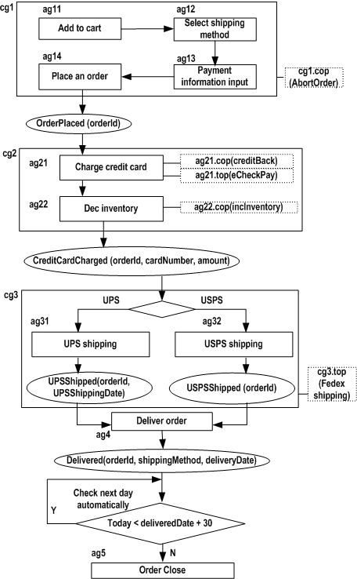
Online Shopping Example
AP Rules in the Online Shopping Process
PRE CONDITION:
create rule QuantityCheck::pre
event: OrderPlaced (orderId)
condition: exists(select L.itemId from Inventory I, LineItem L where L.orderId=orderId and L.itemId=I.itemId and L.quantity>I.quantity)
action: backOrderPurchase(orderId)
POST CONDITION:
create rule QuantityCheck::post
event: CreditCardCharged (orderId, cardNumber, amount)
condition: exists(select L.itemId from Inventory I, LineItem L where L.orderId=orderId and L.itemId=I.itemId and I.quantity<0)
action1: APRetry
action2: APRollback
CONDITIONAL RULE:
create rule Notice::cond
event: CreditCardCharged (orderId, cardNumber , amount)
condition: amount > $1000
action: highExpenseNotice(cardNumber)

Slide 17
A Prototype
A Prototype of Assurance Points, Integration Rules, and Recovery Actions

Slide 18
A Prototype
Table 2. Activities
Existing BPEL engines:
does not provide the flexibility needed to experiment with the combined approach to backward and forward recovery of this research.
will not support future directions with decentralized communication.
The process specification framework is based on BPEL using previous work with the Process Modeling Language (PML) (Ma et al., 2005)

Slide 19
Activities
Table 2. Activities
Table 2. Activities
Activity Type | Activity | Description
Atomic | assign | Changes the value of a property
 | invoke | Performs or invokes an operation involving the exchange of input and output messages
 | ag | Atomic Group containing a single invoke activity with an optional contingency plan or compensation plan
 | cg | Composite Group which containing one or more atomic or composite groups with an optional contingency plan or compensation plan
 | top | Contingency plan for executing an alternate action
 | cop | Compensation plan for executing a logical rollback
 | ap | Assurance points for invoking integration rules and recovery activity
Complex | switch | Executes activities from one of multiple sets, based on a Boolean value

Slide 20
AP and Integration Rule Syntax
Table 2. Activities
AP Specification Syntax
Process Sample
<process>
.
.
.
<ap name= “APName”> *
<apDataIn variable=“variable1” /> *
</ap>
.
.
.
<process>
<cg name= “cg0”>
.
.
<ap name= “OrderPlacedAP”>
<apDataIn variable=“orderId” />
</ap>
<ag name = “ag21”>
<invoke name=“makePayment” serviceName=“creditCard1” … />
<top name=“top21”>
<invoke name=“makePayment” serviceName=“eCheckPay”…/>
</top>
<cop name=“cop21”>
<invoke name=“makeRefund” serviceName=“creditCard1” …/>
</cop>
</ag>
.
.
<ap name= “creditCardChargedAP”>
<apDataIn variable=“orderId” />
<apDataIn variable=“cardNumber” />
<apDataIn variable=“amount” />
</ap>
.
.
<cg>

Slide 21
Process and Rule Sample
Table 2. Activities
Rule Specification Syntax
Rule Sample
<rules>
<event ap=”APName”> *
<pre> ?
<ecaRule>
<condition name=“conditionName”>
<invoke serviceName="ncname" instance="ncname"? portType="qname” operation="ncname” inputVariable="ncname"? outputVariable="ncname"?>
</invoke>
</condition>
<actions>
<action name=“actionName”> +
<invoke serviceName="ncname" instance="ncname"? portType="qname” operation="ncname"
InputVariable="ncname"? outputVariable="ncname"?>?
</invoke>
</action>
</actions>
</ecaRule>
</pre>
.
.
</event>
</rules>
<rules>
.
.
.
<event ap="orderPlacedAP">
<pre>
<ecaRule>
<condition name=“QuantityCheck”
<invoke name="checkQuantity" serviceName="ruleConditions"
portType=“rule:ruleConditionsPortType” operation="checkQuantity1"
inputVariable="quantity" outputVariable="result" />
</condition>
<actions>
<action name=“backOrderPurchase”>
<invoke name="backOrderPurchase" serviceName="shopping"
portType=“sho:ShoppingPortType” operation="BackOrderPurchase"
inputVariable="orderId" outputVariable="result" />
</action>
</actions>
</ecaRule>
</pre>
</event>
.
.
.
</rules>

Slide 22
Process Execution Architecture
Table 2. Activities
Notes:
XMLBeans creates the Java types that represent schema types → access the instances of the schema through get and set methods
The execution engine consists of three components: the XML parser, the XML processor, and the History Manager.
Unmarshalling is the reverse process, building a Java object (and dependent objects) in memory from an XML representation.

Slide 23
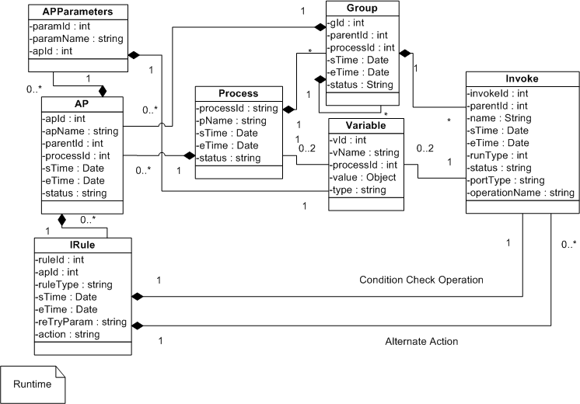
Execution History Generation
Table 2. Activities
Notes:
XMLBeans creates the Java types that represent schema types → access the instances of the schema through get and set methods
The execution engine consists of three components: the XML parser, the XML processor, and the History Manager.
Unmarshalling is the reverse process, building a Java object (and dependent objects) in memory from an XML representation.

Slide 24
Generic Process for Recovery Actions
Table 2. Activities
Notes:
Demo of algorithm

Slide 25
Sample Scenario 1: APRollback
Table 2. Activities
Assumption: IR_{post} condition fails at AP4
Action1 of IR_{post} at AP4 → APRollback
ag₀₄.cop → ag₀₃₁.cop
→ cg₀₂.cop → cg₀₁.cop
2
1
3
4

Slide 26
Sample Scenario 2: APCC
Table 2. Activities
ag₀₄.cop → ag₀₃₁.cop → cg₀₂.cop → cg₀₁.cop → cg₀.top
Assumption: IR_{post} condition fails at AP4
Action1 of IR_{post} at AP4 → APCC

Slide 27
Sample Scenario 3: APCC
Table 2. Activities
ag₀₃₁.cop →
IR_{pre} condition succeeds at AP2 → cg₀₃.top
Assumption: IR_{post} condition fails at AP3
Action1 of IR_{post} at AP3 → APCC

Slide 28
Sample Scenario 4: APRetry-Default
Table 2. Activities
ag₀₄.cop → ag₀₃₁.cop →
IR_{pre} succeeds at AP2 → cg₀₃
IR_{post} fails at AP4 → ag₀₄.cop → ag₀₃₁.cop → cg₀₂.cop → cg₀₁.cop
Assumption: IR_{post} condition fails at AP4
Action1 of IR_{post} at AP4 → APRetry
Action2 of IR_{post} at AP4 → APRollback

Slide 29
Sample Scenario 5: APRetry (AP1)
Table 2. Activities
ag₀₄.cop → ag₀₃₁.cop → cg₀₂.cop →
IR_{pre} succeeds at AP1 → cg₀₂
Assumption: IR_{post} condition fails at AP4
Action1 of IR_{post} at AP4 → APRetry(AP1)

Slide 30
Sample Scenario 6: Internal Error
Table 2. Activities
IR_{pre} condition succeeds at AP2 → cg₀₃.top → ag₀₄
Assumption: Internal Error at ag₀₃₁
By Default → APCC mode

Slide 31
Assurance Points
Evaluation of the Assurance Points

Slide 32
Evaluation of the Assurance Points
BPEL Recovery Process
1
2
Compensation Sequence:
A → B → D
OR
B → A → D
6
5
4
3
Charge Credit card
Ship Item
Compensation Sequence Demonstration
(Khalaf, Roller, and Leymann 2009)
Key:
F – Fault handler (Shaded if Activated)
C – Compensation handler (Shaded if Activated)
T – Termination handler (Shaded if Activated)
Shaded Box – Completed Scope
Black Circle – Faulted Non-scope activity
Control Link

Slide 33
Evaluation of the Assurance Points
Table 2. Activities
Comparison to BPEL
No. | Comparison Criteria | BPEL | AP
1 | Support for Control Links between Non-Peer Scopes | Yes | No
2 | Compensation for Constraint violations | No | Yes
3 | Behavior of Recovery procedures | Zigzag | Hierarchical
4 | Explicit contingency procedure | No | Yes
5 | Rules support for Constraints | No | Yes
Notes:
Control links may cross scope boundaries.
Hierarchical → semantics well defined

Slide 34
Other Comparisons
Table 2. Activities
Comparison to Aspect-Oriented Workflows
More focused on modularizing certain aspect of code
Not focused on recovery issues
Aspect-Oriented workflows can use the AP concept for recovery mechanism
Comparison to Workflows using Checkpointing Concept
Storing states, rolling back to a previous state for moving the execution to a new platform
AP enhances the traditional checkpointing concept through constraint checking using integration rules and implementing different types of recovery actions.
Notes:
Checkpointing saves process state and can create a new process and restore old state to it in the case of a process failure.

Slide 35
Concurrent Issues in AP
Table 2. Activities
NOTE:
Not necessary to recover the concurrent activities
AP
APRollback
IR_{post} condition fails at
AP2
Action→APRollback
APRetry
IR_{post} condition fails at
AP2
Action→APRetry
Compensate
APCC
IR_{post} condition fails at
AP2
Action→APCC

Slide 36
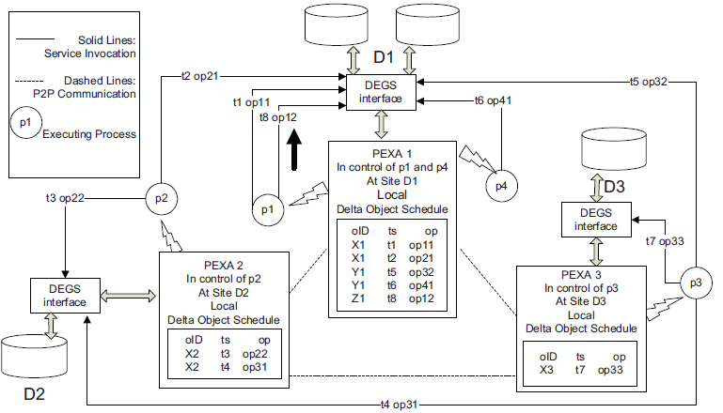
Future Application of Assurance Points
Decentralized Process Execution Agents
(Urban, Ziao, and Le 2009)
Notes:
The data dependencies are used by the recovery algorithm to identify processes that are write dependent on a
failed process. There is no explicit data about read dependencies, so potential read dependencies are identified
using runtime information about overlapping service execution as defined in [22, 23]. Dependent processes can
then query delta values, checking user-defined conditions to determine if they need to recover (e.g., execute compensating procedures) or continue running.

Slide 37
Contributions
Table 2. Activities
Defined the concept of assurance points and illustrated how assurance points can be used together with integration rules and recovery actions.
Provided a way of expressing user-defined constraints for process execution
Defined three recovery modes: APRollback, APRetry, and APCC that support combined use of Compensation and Contingency
Unlike BPEL, supports recovery actions for internal errors and violation of pre and post conditions.

Slide 38
Future Research
Table 2. Activities
Future Research Directions:
Integration of the AP concept with decentralized data dependency analysis
Extend APs with Invariants to dynamically monitor changes in constrain condition
Concurrent execution within a composite group
Integration of the AP concept into a BPEL processor with performance evaluation
Develop a design methodology
Formalization with Petri-nets and Model Checking
Notes:
An invariant is a condition that must be true during process execution between two different APs.
Methodological issues for the specification of APs, integration rules, and recovery procedures should also be addressed in the context of more extensive application scenarios.

Slide 39
Assurance Points
Questions?

Slide 40
Acknowledgements
Table 2. Activities
Committee Members:
Dr. Susan D. Urban (Chair)
Dr. Michael Shin
Dr. Susan Mengel
Research Group
The End

Slide 41
Assurance Points
Backups

Slide 42
Process Wrapper
Table 2. Activities
void executeCG(org.ap.pml.CGType cgTypeObj) {
for(int i=0; cgTypeObj.getActivityArray().length > i; i++) {
Cases if Activity is
AG: If No Mode Set → errorBool = EXECUTEActivity (AGWrapper);
CG:
If No Mode Set → EXECUTEActivity(CGWrapper);
If (APCC && (Reached Outer Layer)) {
if (! checkAPPrevious) { //No AP is found
findTOP (CG)
Succeeds → setAPCC(false); //continue forward execution
Fails → still under APCC mode
}
}
AP:
If No Mode Set → EXECUTEActivity (APWrapper, getAPRules(APName));
else If (!APRollBack && (APCC || APRetry)) {
If (APRetry && ((APDefined = APName) || (APDefined = null) ))
ExecuteActivity (AP, getAPRules(APName));
else if (APCC && Reached Outside Layer)
ExecuteActivity (AP, getAPRules(APName));
}
Assign:
If No Mode Set → EXECUTEActivity (AssignWrapper);
Switch:
ExecuteActivity (SwitchWrapper);
End Case /
Cases after Executing/Skipping Activity
errorBool: //Internal Error
findTOP (AG)
Succeeds → setAPCC(false); //continue forward execution
Fails → setAPCC(true);
i = i - 2; //go to previous activity
APCC:
If (!checkAPPrevious) {
If (Activity = AP) && (Reached Outside Layer while Recovering) {
i = i + 1; //Go to Next Activity, i.e. AG/CG
findTOP (AG/CG)
Succeeds → setAPCC(false); //continue forward execution
Fails
i = i - 2; //go to previous activity to continue APCC mode
}
else If (Activity = AG/CG) && (Not Reached Outside Layer while Recovering) {
findCOP (AG/CG); // Deep or Shallow compensation for CG
i = i - 2; //go to previous activity to continue APCC mode
}
else
i = i - 2; //go to previous activity to continue APCC mode
}
else {
i = i - 2; //go to previous activity to continue APCC mode
checkAPPrev = false; //reset the variable
}
APRollBack || APRetry:
If (Activity = AG/CG) → findCOP(AG/CG); //can be Deep or Shallow for CG
i = i - 2; //continue APRollBack || APRetry mode
Default: //running on normal mode, i.e. No Recovery mode is on or No error has occurred
End Case

Slide 43
Compensation & Contingency Wrapper
Table 2. Activities
Compensation Implementation
Contingency Implementation
void findCompensation(org.ap.pml.ActivityType activityType) {
Cases if activityType is
AG: //AG is of type org.ap.pml.AGType
If AG has cop
Execute AG.cop;
CG: //CG is of type org.ap.pml.CGType
If CG has cop
Execute CG.cop; //shallow compensation
Suceeds
Continue
Failure
For Each subGroup //in reverse order
findCompensation(AG/CG)
else
For Each subGroup //in reverse order
findCompensation(AG/CG)
}
boolean findContingency(org.ap.pml.ActivityType activityType) {
Cases if activityType is
AG: //AG is of type org.ap.pml.AGType
If AG has top
return Execute AG.top;
else
return False;
CG: //CG is of type org.ap.pml.CGType
If CG has top
return Execute CG.top;
else
return False;
}

Slide 44
AP Wrapper
Table 2. Activities
void execute(org.ap.pml.APType apObjectType, org.ap.eca.RulesType rulesType) {
If (APRetry || APCC) → revisitAP();
Else → normalAP();
}
void normalAP() {
If PostConditionRule Exists → integrationRule (PostConditionRuleType) ;
If (PostCondition does not Exists) || (PostCondition is Satisfied))
if (PreConditionRule Exists) → integrationRule (PreConditionRuleType) if(PreConditionRule does not Exists) || (PreCondition is Satisfied))
if (ConditionalRule Exists)
for (int i=0; i< eventTypeObj.getCondArray().length; i++) {
if (condRule(eventTypeObj.getCondArray(i)))
// Conditional Rule Violated
}
void revisitAP() {
if (PreConditionRule Exists) → integrationRule (PreConditionRuleType) if(PreConditionRule does not Exists) || (PreCondition is Satisfied))
if (ConditionalRule Exists)
for (int i=0; i< eventTypeObj.getCondArray().length; i++) {
if (condRule(eventTypeObj.getCondArray(i)))
// Conditional Rule Violated
}
void executeAction(String action, String targetAP) {
if (action = APRetry) {
if ((targetAP = null) || (targetAP.length() <= 0))
setAPRetry(true);
else
setAPRetry(true, targetAP);
}
else if (action = APCC)
setAPCC(true);
else if (action = APRollback)
setAPRollback(true);
}
boolean integrationRule(ecaRuleType) {
boolean executeAction = evaluateCondition(ecaRuleType. getCondition())
if (!executeAction) → return false; //condition is not violated
else {
if (countHereBefore(APName) = 1)
If (isActionTypeNormal(getActionArray(0)))
executeAction(getActionArray(0).getName(), getActionArray(0).getTargetAP());
else → invokeAction(getActionArray(0));
else if (countHereBefore(APName) = 2) {
if (second Action Exists) {
If (isActionTypeNormal(getActionArray(1)))
executeAction(getActionArray(1).getName(), getActionArray(1).getTargetAP();
else → invokeAction(getActionArray(1));
else → executeAction("APRollback", null);
}
else →executeAction("APRollback", null);
return true; //condition is violated
}
}

Slide 45
Class diagram: Process & Rule Schema
Table 2. Activities

Slide 46
Class Diagram of Activity Wrappers
Table 2. Activities

Slide 47
Process Wrapper and Code for Binding an XML document
Table 2. Activities
Wrapper class for the top-level process
Maintains defined variables and service provider information in a hash table
For Process XML document
For Rule XML Document
public static org.ap.pml.ProcessType createIpmlProcess(File file) {
org.ap.pml.ProcessDocument pDoc = null;
try {
pDoc = ProcessDocument.Factory.parse(file);
} catch (XmlException e) {
e.printStackTrace();
} catch (IOException e) {
e.printStackTrace();
}
return pDoc.getProcess();
}
public org.ap.eca.RulesType setRules(File file) {
org.ap.eca.RulesDocument rulesDoc = null;
try {
rulesDoc = org.ap.eca.RulesDocument.Factory.parse(file);
} catch (XmlException e) {
e.printStackTrace();
} catch (IOException e) {
e.printStackTrace();
}
return rulesDoc.getRules();
}

Slide 48
Execution History Generation
Table 2. Activities

