Slide 1
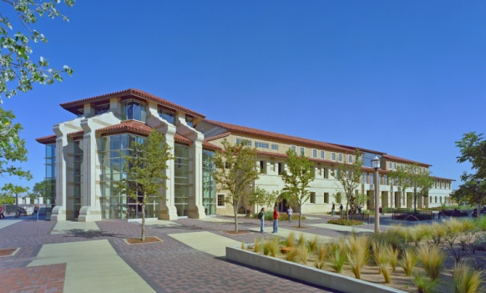
Student Union & Activities Statistical Analysis of Programs 2012-2013

Slide 2
Student Union & Activities
Assessment Data

Slide 3
Tech Activities Board (TAB) Mission and Values
Our Mission
TAB is a group of student leaders dedicated to programming social, diverse, traditional, educational, and community outreach events to enhance each student’s experience at Texas Tech University.
Our History
The Tech Activities Board (TAB) is the largest student programming organization on the Texas Tech University campus and is responsible for planning quality events for the university community. TAB was founded in the early 1950’s as the University Center Programming Board and reinvented in 2006, as TAB, to better serve and identify with the student population. Today, TAB plays a vital role in fostering and developing Red Raider spirit and traditions such as Homecoming, RaiderGate, Arbor Day, and Raiderfest and in creating community on the Texas Tech University campus.
Our Values
The image of TAB and producing quality events
The talents and gifts of our committee members
The ability to develop leaders and enhance individual skills
The diversity and ideas of all members of the campus community

Slide 4
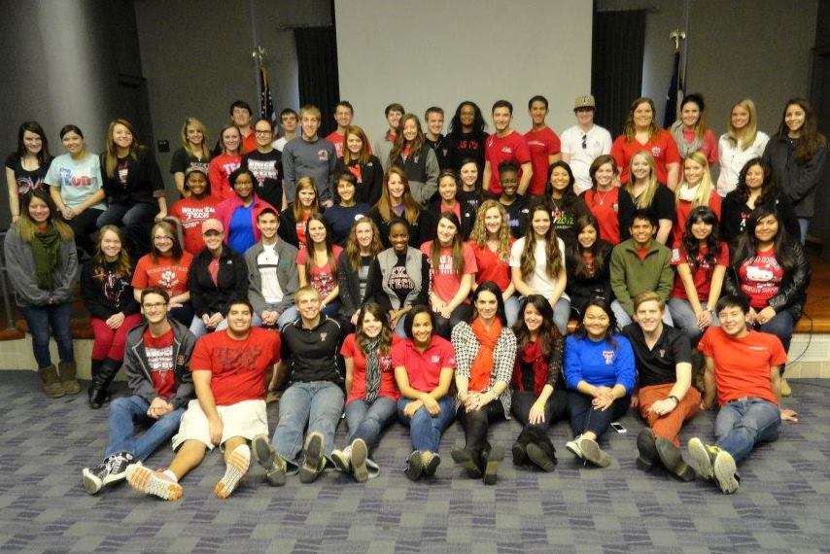
Tech Activities Board (TAB) Member Profile
Gender
Male: 33%
Female: 67%
Classification
Freshman: 30%
Sophomore: 27%
Junior: 19%
Senior: 24%
Currently Employed
Yes: 49%
No: 17%
Unknown: 24%
Other Student Organization
Involvement
Yes: 77%
No: 15%
Unknown: 8%
Major (Grouped by Respective Colleges)
Agricultural Sciences & Natural Resources: 2%
Architecture: 2%
Arts & Sciences: 26%
Business Administration: 26%
Education: 6%
Engineering: 6%
Human Sciences: 11%
Mass Communication: 20%
Visual & Performing Arts: 1%

Slide 5
Tech Activities Board (TAB) Events Assessed
Fall 2012
Laser Battle Evolution (August 23, 2012)
Hunger Games Dive-In Movie (August 24, 2012)
Photo Postcards to Home (August 29, 2012)
Alternative Fuels (August 30, 2012)
The Avengers (September 4/5, 2012)
Cosmic Bowling (September 5, 2012)
After Hours Open Mic Night (September 6, 2012)
Mr. Gatti’s (September 11, 2012)
Volunteer Fair (September 12, 2012)
Speaker Series: Reed Timmer (September 13, 2012)
Tie Dye T’s (September 19, 2012)
Big Bang Bash (September 27, 2012)
Seeking a Friend for the End of the World (October 2/4, 2012)
Lucky Bamboo (October 3, 2012)
Cookie Wars (October 3, 2013)
Cactus Creations (October 9, 2013)
Scavenger Hunt (October 9, 2012)
Leather Bracelets (October 10, 2012)
Adam Pate, Caricaturist (October 10, 2012)
TED (October 17/18, 2013)
Open Mic Night (October 18, 2012)
Corn Maize (October 25, 2012)
Speaker Series: Matt Mogk (October 29, 2012)
Halloween Film Festival (October 31, 2012)
Dark Night Rises (November 6/7, 2012)
After Hours Open Mic Night (November 8, 2012)
Photo Booth (November 14, 2012)
Karaoke Night (November 14, 2012)
The Campaign (November 27/28, 2012)
Speaker Series: Dr. Edwin Barnhart (November 29, 2012)
After Hours Open Mic Night (December 4, 2012)
Make-Your-Own Ornament (December 5, 2012)
Rest & Relaxation Night (December 5, 2012)
Notes:
The Tech Activities Board (TAB) assessed events in Fall 2012 through Spring 2013. Each committee was asked to as many events as possible. Student leaders conducted post-event evaluations, asking peers to take a few minutes to complete a paper evaluation of the TAB event they had just attended. This Fall, we were able to assess 33 events, with about 1000 students completing evaluations.

Slide 6
Tech Activities Board (TAB) Events Assessed
Spring 2013
Archery Battle (January 16, 2013)
Fire & Ice (January 17, 2013)
Comedy Night ft. Sheng Wang & Adam Ray (January 17, 2013)
Pitch Perfect (January 23/24, 2013)
Night at the Roller Rink (January 24, 2013)
Looper (January 30/31, 2013)
The Norman Magic Experience (February 6, 2013)
Make-Your-Own Silicon Bracelet (Feburary 6, 2013)
Blood Drive (February 7, 2013)
Cajun Culture Celebration (February 12, 2013)
Perks of Being a Wallflower (February 12/13, 2013)
Alternative Fuels (February 13, 2013)
Henna Art (February 20, 2013)
Battle of the Bands (February 22, 2013)
Make-Your-Own Bumper Stickers (February 26, 2013)
Wreck-It Ralph (February 27/28, 2013)
Hunger Banquet (February 28, 2013)
Red Raider Showcase Auditions (March 4, 2013)
This is 40 (March 6/7, 2013)
After Hours Open Mic Night (March 7, 2013)
Adrenaline City (March 18, 2013)
Wax Hand Sculptures (March 19, 2013)
Les Miserables (March 26/27, 2013)
Speaker Series: Mayim Bialik (March 28, 2013)
Spray Can Artists (April 4, 2013)
Singer/Songwriter Competition (April 4, 2013)
The Amazing Race (April 5, 2013)
Zero Dark Thirty (April 10/11. 2013)
Raiderfest (April 12, 2013)
Make-Your-Own Flipbook April 16, 2013)
Cosmic Bowling (April 17, 2013)
Stars & Stripes Drive-In (April 24, 2013)
Red Raider Showcase (April 25, 2013)
Rest & Relaxation Night (May 6, 2013)
Notes:
This Spring, we were able to assess 34 events, with about 1200 students completing evaluations. For the 2012-2013 year, TAB conducted post-event evaluations for 77 events and evaluated about 2,200 students.

Slide 7
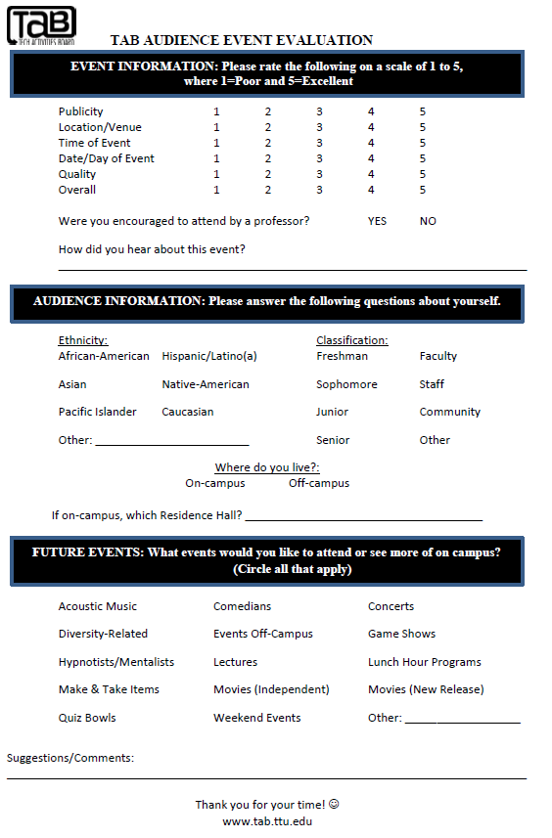
Tech Activities Board (TAB) Assessment
Tech Activities Board developed a new assessment tool that was introduced in October 2012. This updated TAB Audience Event Evaluation included the following changes to previous versions:
Updates to the Audience Event Evaluation include the question: “How did you hear about this event?” This open-ended question allows participants to provide feedback about which publicity and marketing is most effective.
Updates to the Audience Event Evaluation include the section “Where do you live?” with two questions that allow participants to provide feedback about their housing.
The first determines how much of the audience lives in both on- and off-campus housing.
If the participant lives on campus, the second open-ended question allows them to identify a specific Residence Hall where they live.

Slide 8
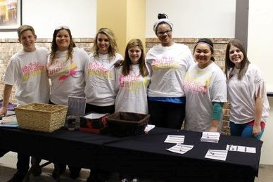
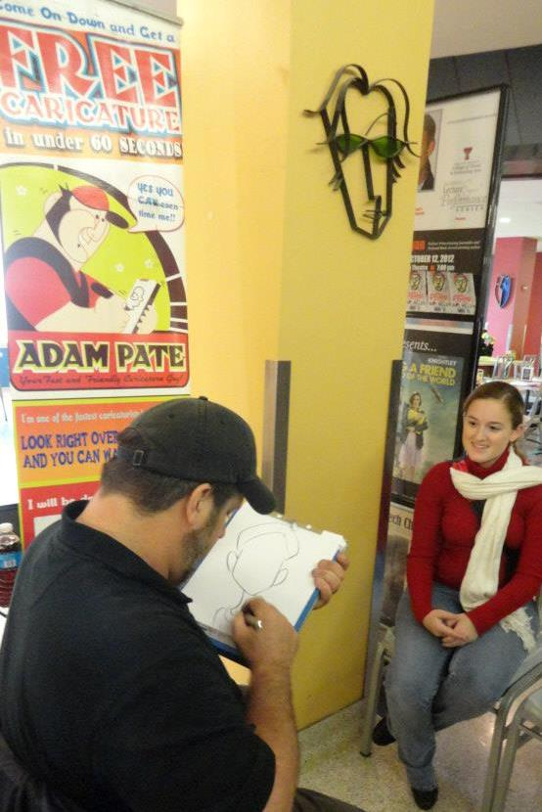
Tech Activities Board (TAB) Publicity
Of the individuals surveyed, 46% indicated that the marketing for TAB events was excellent. About 10% of those surveyed indicated that they thought the marketing was below average, which is down 10% from 2011-2012.

Slide 9
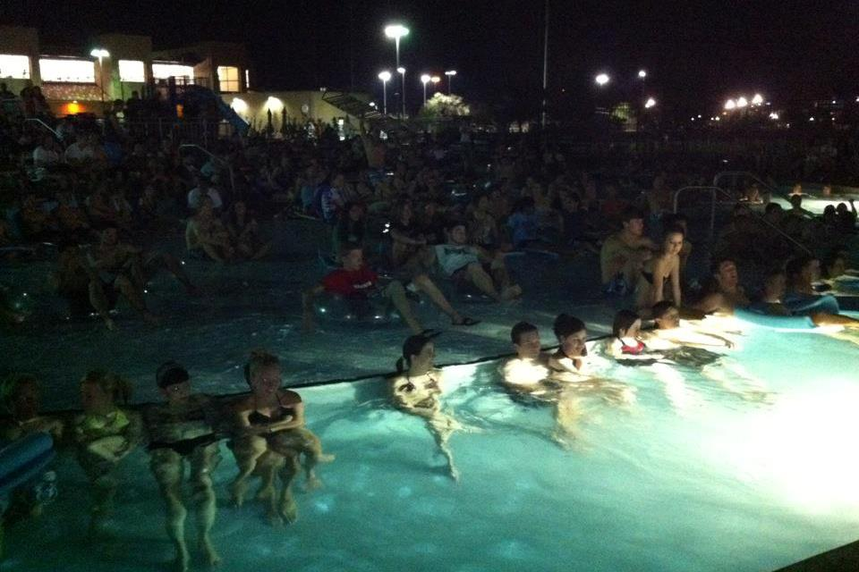
Tech Activities Board (TAB) Venue
With 98% of individuals surveyed satisfied with TAB event venues, students seem pleased with the varied venues used by TAB. Common event venues included the Allen Theatre, SUB Courtyard, SUB North Plaza, and SUB West Basement. While most of our events take place in the Student Union, TAB considers itself the programming board for the entire campus and utilizes other venues throughout campus, as well as some locations off campus.

Slide 10
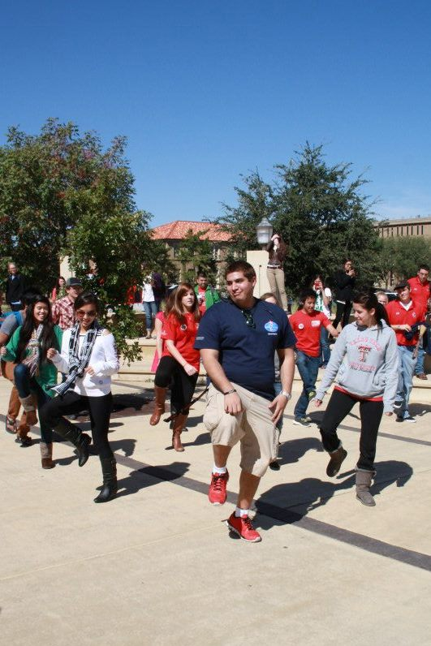
Tech Activities Board (TAB) Time
The times for TAB events vary greatly. Some events are offered in the daytime and during the lunch hour, while others are offered in the evenings or after hours. Both afternoon and evening show times are offered for the movies screened by TAB. By varying the times of events, TAB can appeal to as many students as possible.

Slide 11
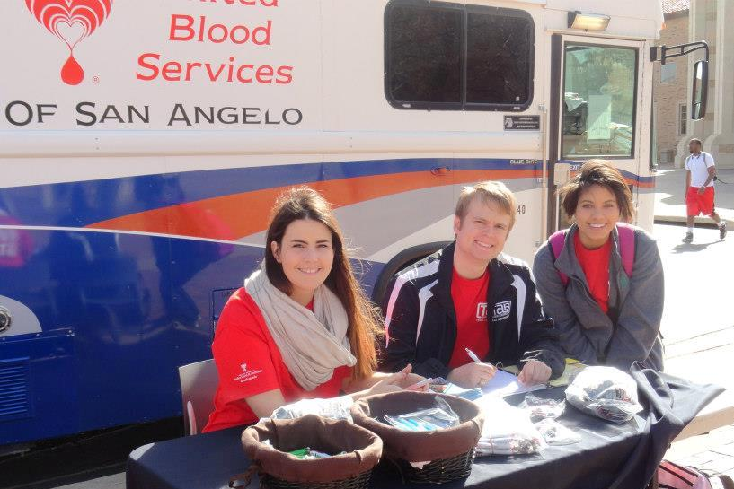
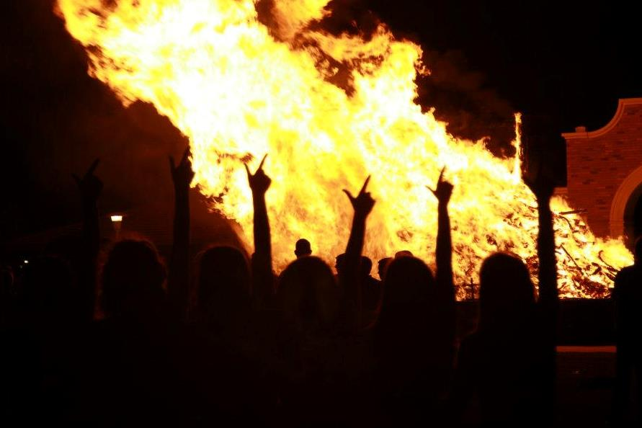
Tech Activities Board (TAB) Date
In efforts to boost student attendance, TAB takes academic, athletic, and other university events into consideration to offer events at times when more students will be able to attend. Of individuals surveyed, 90% indicated that they considered TAB event times to be better than average.

Slide 12
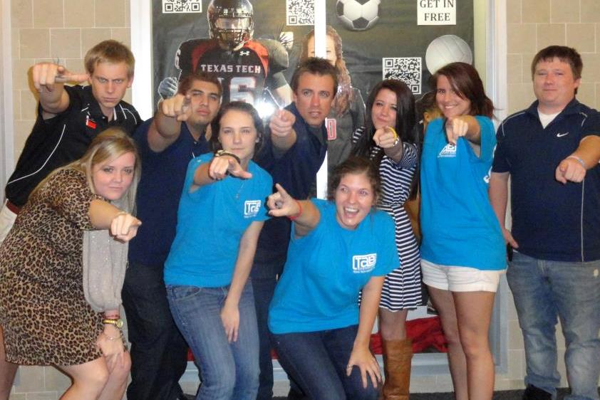
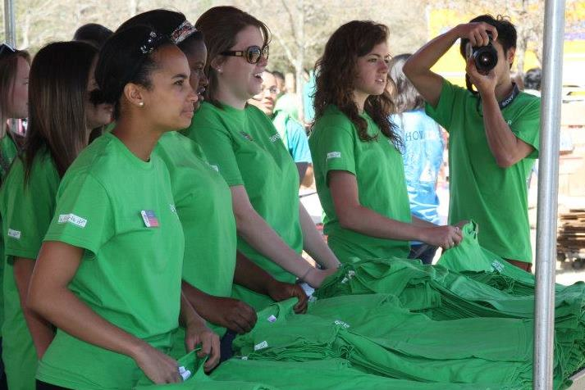
Tech Activities Board (TAB) Quality
TAB strives to maintain a high quality of events for students. Consistent with data from the past two years, 68% of individuals surveyed indicated that the quality of TAB events was excellent. This year, 92% of those surveyed considered the quality of events to be better than average.

Slide 13
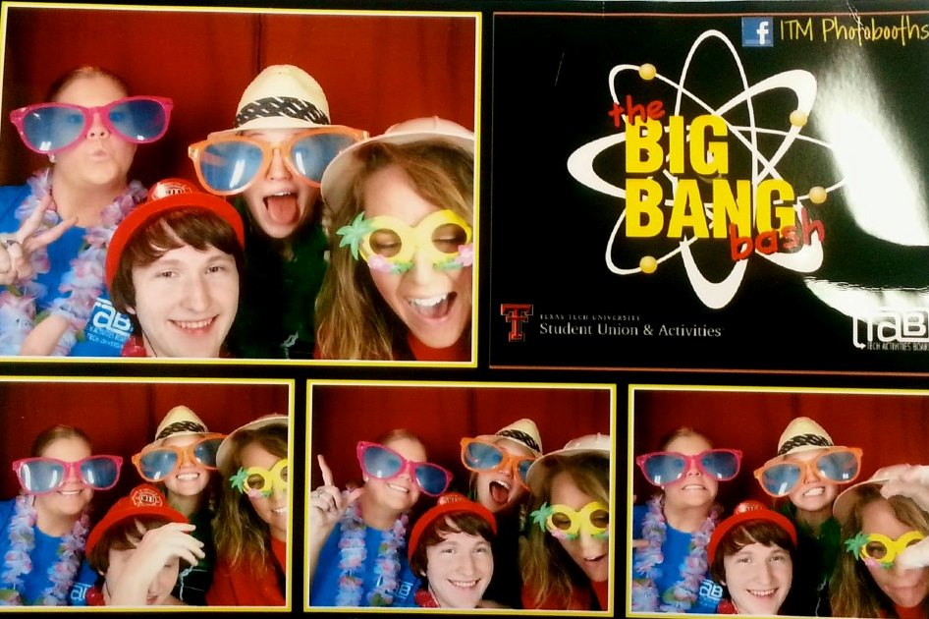
Tech Activities Board (TAB) Overall Satisfaction
This is potentially the most important statistic of the entire evaluation. Many things may make a student disgruntled: venue, date of event, subject matter; however it is the student’s overall feeling after the event that is most important. Consistent with 2011-2012 data, 66% of individuals surveyed rated overall satisfaction with the TAB event as excellent.

Slide 14
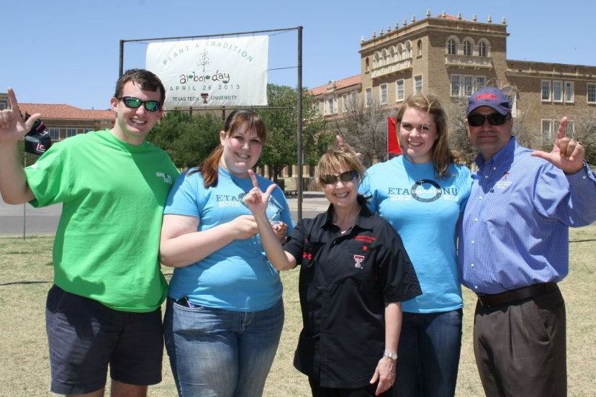
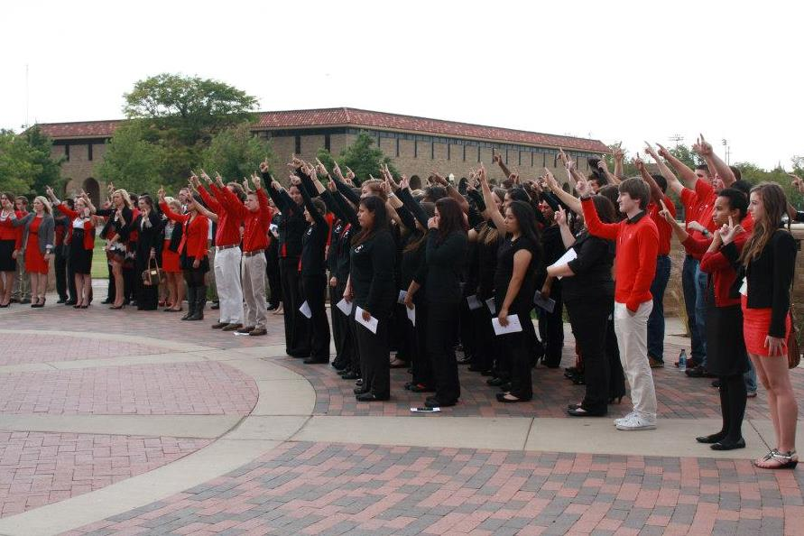
Tech Activities Board (TAB) Professor
Tech Activities Board evaluated students who were asked to attend a TAB event by a professor. TAB encouraged faculty involvement by working with faculty members or partnering with a department or college associated with the event.

Slide 15
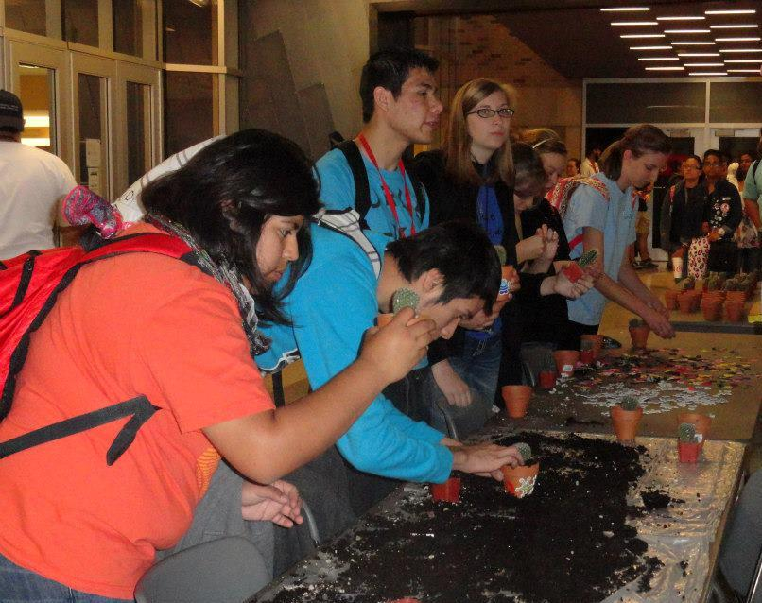
Tech Activities Board (TAB)
How did you hear about this event?
When asked “how did you hear about this event,” the most common answer was from a friend, this was followed by TAB posters and Tech Announce. This information will help TAB to determine the most effective marketing strategies to boost attendance and involvement.

Slide 16
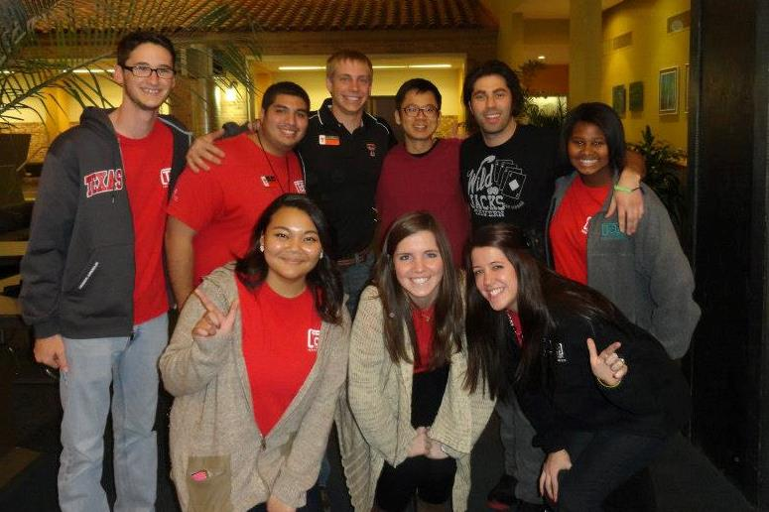
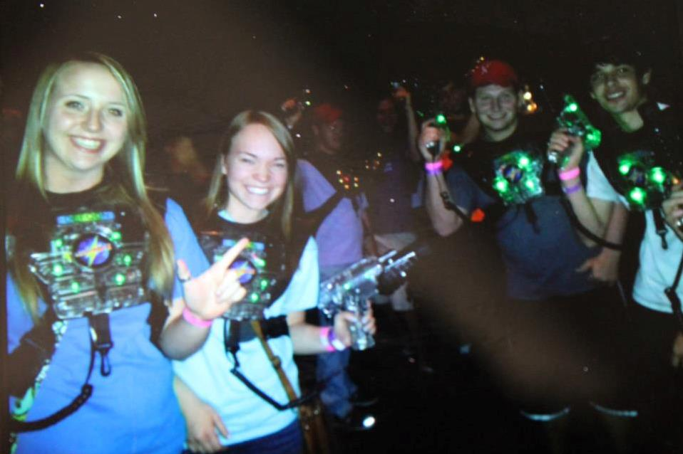
Tech Activities Board (TAB) Gender
Of those individuals surveyed, 53% identified as female and 44% identified as male. Approximately 3% of the students surveyed responded as ‘Other’ or did not respond to the question at all. While consistent with data from 2011-2012, this data only represents the first quarter of 2012-2013. This question was not used on the new assessment introduced in October 2012.

Slide 17
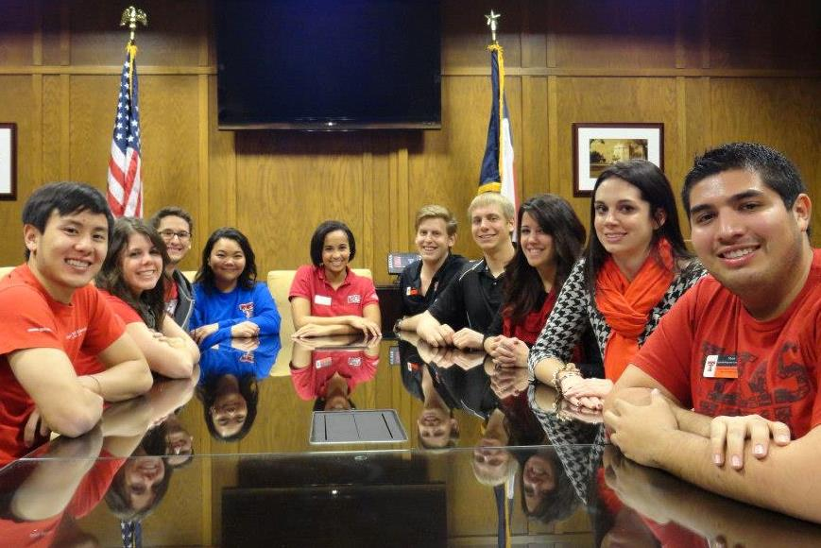
Tech Activities Board (TAB) Ethnicity
The TAB evaluation asks participants to identity ethnicity to determine if TAB events are appealing to our underrepresented populations. Approximately 22% of the students that attended our events were Hispanic/Latino, 9% were Asian-American and 9% of the surveyed attendees identified as African-American. Of the individuals surveyed, 50% identified with one or more underrepresented population.

Slide 18
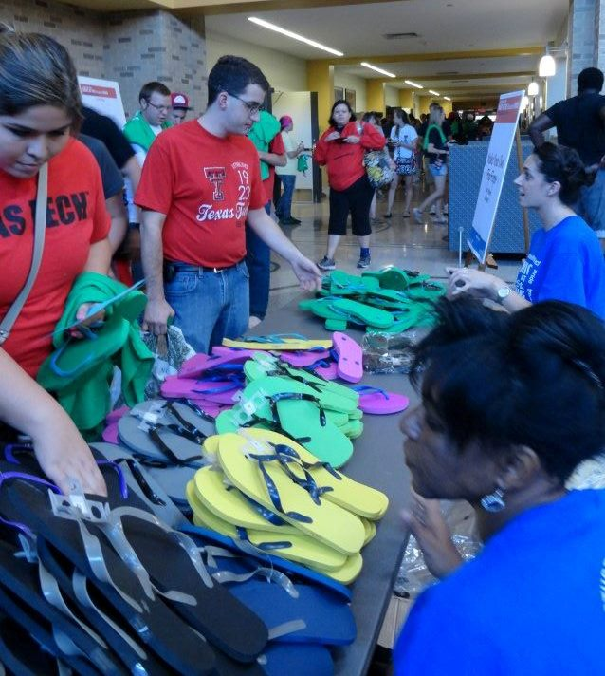
Tech Activities Board (TAB) Classification
The TAB evaluation asks participants to identity classification to determine how TAB is serving various student populations. Almost half of participants identified as being classified as freshmen.

Slide 19
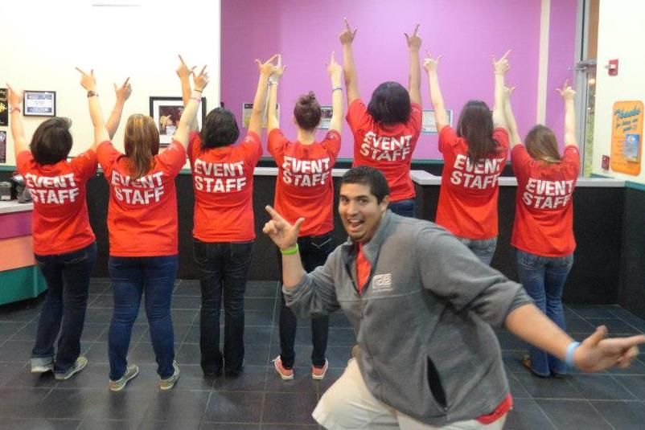
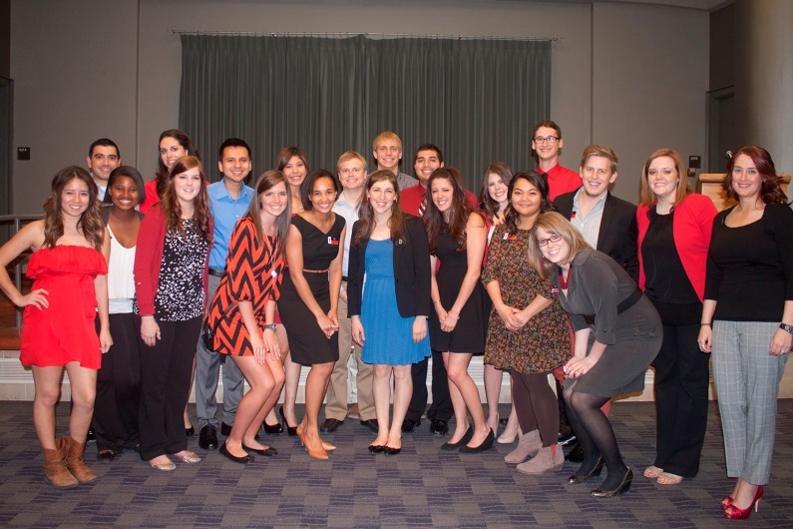
Tech Activities Board (TAB) Residency
With the new assessment, Tech Activities Board was able to collect new information about the population attending TAB events that included whether those individuals surveyed lived on-campus or off-campus. This year, 53% indicated that they live on-campus, while 39% indicated they live off-campus.

Slide 20
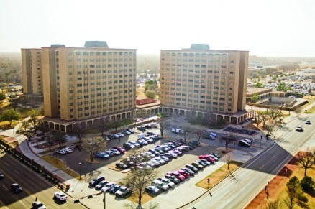
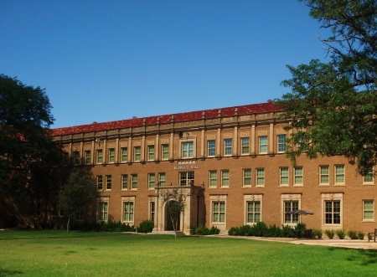
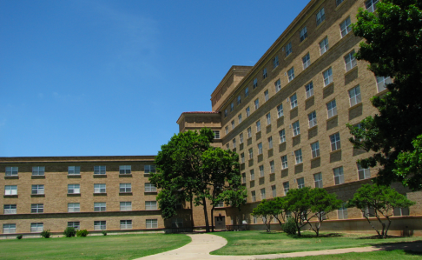
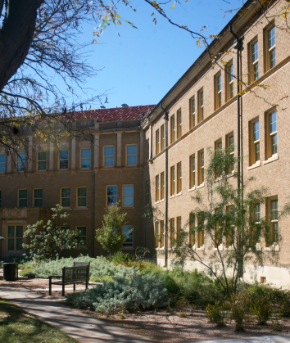
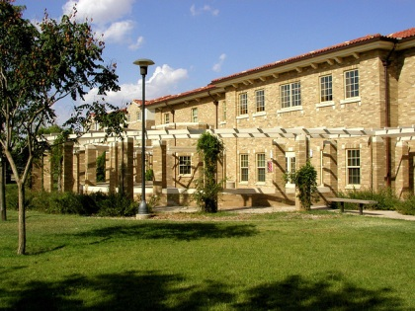
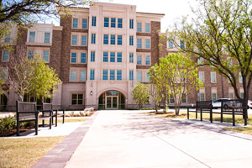
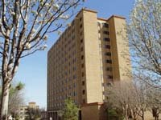
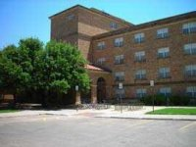
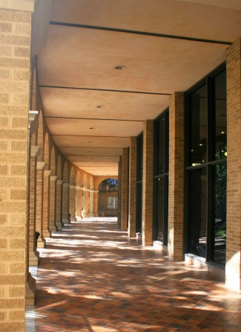
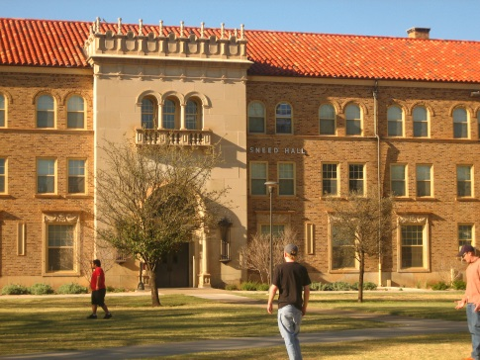
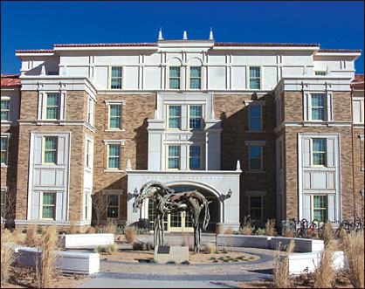
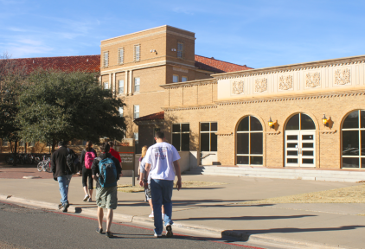
Tech Activities Board (TAB) Residency On-Campus
11%
3%
7%
18%
Chitwood/Weymouth Complex
Bledsoe Hall
Stangel/Murdough Complex
Horn/Knapp Complex
2%
5%
8%
11%
Carpenter/Wells Complex
Talkington Hall
Coleman Hall
Hulen/Clement Complex
18%
4%
5%
8%
Murray Hall
Gordon Hall
Wall/Gates Complex
Sneed Hall
Notes:
This slide is a breakdown of our students who identified as living on campus to show what Residence Halls these students are living in.

Slide 21
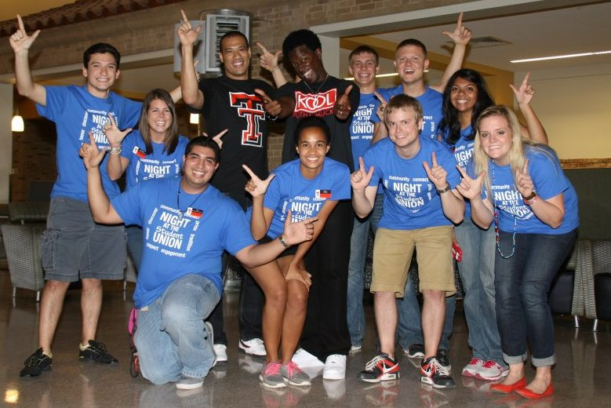
Tech Activities Board (TAB) Future Programming
What events would you like to see in the future?
Like last year, the most requested events for this year were Movies (New Releases), Comedians, and Concerts. Performing Arts and Acoustic Music were the next two highest scoring categories.

Slide 22
Tech Activities Board (TAB) Attendance Per Month
Attendance Per Month
 | 2011-2012 | 2012-2013 | Percent Change
August | 2,648 | 1,968 | -25%
September | 2,944 | 2,306 | -21%
October | 22,913 | 12590 | -45%
November | 2,203 | 1,328 | -40%
December | 261 | 631 | 141%
January | 1,446 | 1,290 | -10%
February | 1,901 | 2,985 | 57%
March | 945 | 1,945 | 105%
April | 3,509 | 2,396 | -31%
May | 214 | 268 | 25%
TOTAL | 38,984 | 30,614 | -21%
Notes:
While presenting: Just explain the changes from 2011-2012 to 2012-2013. State the months to improve attendance.

Slide 23
Tech Activities Board (TAB) Honorarium Expenses Per Month
Honorarium Expenses Per Month
 | 2011-2012 | 2012-2013 | Percent Change
August | $5,250.00 | $13,253 | 140%
September | $22,520.00 | $14,183.75 | -37%
October | $28,574.00 | $20,670.88 | -28%
November | $21,400.00 | $15,915.42 | -26%
December | $920.00 | $1,571.49 | 71%
January | $8,517.00 | $4,154.00 | -51%
February | $19,489.00 | $14,102.96 | -28%
March | $11,495.00 | $15,244.00 | 33%
April | $23,890.00 | $14,343.00 | -40%
May | $935.00 | $1,650.00 | 76%
TOTAL | $142,990.00 | $115,088.50 | -20%
Notes:
For Honorarium:
-Only count money agreed to on a contract, Food for Open Mic Nights, Money paid for scripts/questions. Do not include items purchased on P-cards (such as MYO ornament materials, unconventional, handouts, freebies, etc.)
To determine the percent change:
(Current year – previous year) / (previous year)
While presenting: State the percent changes and if the expenses were good or bad overall.

Slide 24
Tech Activities Board (TAB) Attendance Numbers
 | 2010-2011 | 2011-2012 | 2012-2013
Total Attendance | 42,835 | 38,984 | 30,614
Honorarium Expenses | $184,448.91 | $142,990.00 | $115,088.50
Price Per Student | $4.24 | $3.67 | $3.75
Fall Events | 61 | 52 | 59
Spring Events | 42 | 53 | 40
Total Number of Events | 103 | 105 | 99
Notes:
To determine price per student:
(Honorarium expenses from last slide)/Total attendance
For Fall and Spring events: count the entire number, not just those that we paid for or counted attendance at
While presenting: emphasize on the price per student for the entire year and relate it to the attendance, expenses, and the number of events.

Slide 25
Tech Activities Board (TAB) Student Leader Learning Outcomes
LEADERSHIP
 | Learning Outcome | Year Score
1 | I have the ability to persuade or influence effectively. | +5
2 | I take initiative. | +4
3 | I delegate tasks. | +6
4 | I manage meetings effectively. | +6
5 | I am able to teach various skills. | +5
6 | I motivate others in an organization. | +6
7 | I evaluate skills and knowledge of other individuals. | +7
8 | I confront problems. | +3
9 | I exercise authority when needed. | +9
10 | I work independently. | +7
11 | I foresee problems and take appropriate action. | +5
12 | I am aware of my strengths as a leader. | +7
13 | I am aware of my weaknesses as a leader. | +5
14 | I can effectively recruit, retain and recognize team members. | +7
Notes:
To determine:
On each individual sheet, develop an excel sheet and record the information for each question pre and post where 5= strongly agree, 4=agree, 3=neutral, 2=disagree, and 1=disagree. For the pre and post for each student, determine the change from pre to post (this can be positive or negative depending on their change). After you have all of the change numbers for each student, add up all of the learning outcome #1, number #2, etc. This number is the year score

Slide 26
Tech Activities Board (TAB) Student Leader Learning Outcomes
DECISION-MAKING AND PROBLEM-SOLVING
 | Learning Outcome | Year Score
15 | I identify issues and their cause/effect. | +3
16 | I mediate in times of dissension. | +6
17 | I reach logical decisions. | +7
18 | I implement decisions. | +3
19 | I deal objectively with situations and people. | +6
20 | I take responsibility for my actions. | +3
21 | I do not procrastinate. | +4
22 | I have an understanding of effecting conflict management. | +6
23 | I believe that my actions reflect sound and ethical decisions. | +6

Slide 27
Tech Activities Board (TAB) Student Leader Learning Outcomes
PLANNING AND ORGANIZATION
 | Learning Outcome | Year Score
24 | I set goals and specific objectives to meet those goals. | +7
25 | I develop a plan of action to obtain goals and objectives. | +4
26 | I evaluate progress towards the goal upon its completion. | +5
27 | I organize projects into manageable parts and processes. | +3
28 | I set and meet deadlines. | +1
29 | I am knowledgeable of trends in the campus culture | +4
30 | I am aware of the steps involved in event planning. | +3
31 | I know how to organize a major event on campus. | +4
32 | I am knowledgeable of different methods to promote an event. | +6

Slide 28
Tech Activities Board (TAB) Student Leader Learning Outcomes
ASSESSMENT AND EVALUATION
 | Learning Outcome | Year Score
33 | I know how to use and collect quantitative data for an event. | +9
34 | I know how to use and collect qualitative date for an event. | +10
35 | I know how to evaluate and reflect on an event. | +9
36 | I know how to benchmark with other programming boards and universities. | +12

Slide 29
Tech Activities Board (TAB) Student Leader Learning Outcomes
COMMUNICATION
 | Learning Outcome | Year Score
37 | I give clear instructions | +3
38 | I listen empathetically. | +6
39 | I have a command of written English. | 0
40 | I have a command of verbal English. | +1
41 | I have a command of e-mail and text messaging. | +3
42 | I can give constructive feedback. | +9
43 | I can accept constructive and non-constructive feedback in an appropriate manner. | +4
44 | I feel confident speaking in front of large groups. | +6
45 | I am comfortable interviewing for campus leader positions. | +7
46 | I seek out my advisor for advice about my programming position. | +3
47 | I seek out my advisor for advice about academics and/or my personal life. | +9

Slide 30
Tech Activities Board (TAB) Student Leader Learning Outcomes
TIME AND STRESS MANAGMENT
 | Learning Outcome | Year Score
48 | I work effectively under pressure. | +2
49 | I exhibit effective means of coping with stress. | +5
50 | I effectively manage my time. | +6
51 | I make immediate logical decisions. | +2
52 | I create a balance between academic, employment, and co-curricular activities. | +2
FINANCIAL MANAGEMENT
 | Learning Outcome | Year Score
53 | I can read and analyze a budget. | +4
54 | I accept financial responsibility and work within a budget. | +6

Slide 31
Student Union & Activities
Other Notes of Interest

Slide 32
Student Union & Activities Special Activities
Other Notes of Interest
Student Development
Graduate Assistants (Farha Habeeb and Kelsey Holt)
Spring Awards Banquet
Student attendance at I-LEAD (Alyssa Singleton)
Scholarship
2012 I-LEAD Scholarship recipient, Alyssa Singleton
Professional Development
2012 ACUI Region 12 Conference Educational Session Presenter, Alyssa Singleton
Tech Activities Board (TAB) Yearly Awards
Jerry V. Fox, Jr. Award for Outstanding Coordinator: Kandace Austin
Award for Outstanding New General Member: McKenzie Hopson
James G. Allen Award for Outstanding General Member: Eric Lee
W.B. Rushing Award for Outstanding Contribution to Campus Programs: Alyssa Singleton
Advisor’s Choice Excellence Award: Regine Cliatt
TABtime Achievement Award: Scott Layher, Texas Tech University Rec.
Notes:
While presenting: State the TAB student who received the I-LEAD opportunity. Let them know that typically a student from Tech has received the scholarship, but it is based on applicants from the entire region.
Also, briefly mention the TAB yearly awards.

Slide 33
Student Union & Activities Special Events
Other Notes of Interest
Special Events
Jason Aldean ticket pre-sale
George Strait ticket pre-sale
Rascal Flatts ticket pre-sale
Bon Jovi ticket pre-sale
Presidential Arts and Lecture Series Performances
Peter Buffett
Nachito Herrera
Judy Collins
Santa Fe Opera
Marc Cohn
Timothy Egan
Back to School Fiesta 2012
Texas Tech Band and Orchestra Camp
UIL Academic and One Act Play Competitions
Board of Regents Meetings
Foundation Board Meetings
SPICE CUP (World Wide Competition)
Career Fairs
Study Nights at the Union
Camp LEAD
4-H Conference
FACES Conference
Visitor’s Center
Football Friday
Connect Tech
Transfer Days
Texas Association of High School Councils
Hispanic Crime Fiction Conference
FFA Convention
RaiderWelcome
Conferences (25+ a year)
Red Raider Orientation
Visual & Performing Art Operas
Student Organization Academy
Notes:
Email Belinda for this information

Slide 34
Student Union & Activities Professional Affiliations
Professional Affiliations
New Century Leadership
New Century Leadership is a leadership development and community orientation program for local high school juniors. New Century Leadership is designed to teach Lubbock area youth about the importance of personal and community responsibility.
Emerging Leaders
Emerging Leaders is a year-long annual program offered by the Volunteer Center of Lubbock that helps equip and engage young professionals who are in their 20s or 30s. Through this program participants will learn how to connect with their best volunteer fit, develop skills to enhance high performance teams, serve on a nonprofit board, lead volunteer projects, and find volunteer opportunities.
Notes:
Make sure to touch base with Jon Mark to get the information from their committees and involvements

Slide 35
Student Union & Activities
Goals 2012-2013

Slide 36
Tech Activities Board (TAB) Goals 2012-2013
Tech Activities Board (TAB)
Marketing
Participation
Increase electronic presence through Facebook and Twitter
Collaboration
Student Organizations
On-Campus Departments
Committee Work
Assessment
Coordinator/Committee Assessment
Spatial Use Data
Committee Structure
Incorporate new committee, Outreach Programs, into the organization
Actively involve the organization with programs like Dance Marathon and Relay for Life

Slide 37
Contributors
Jon Mark Bernal, Associate Director
Kim Simon-Akins, Assistant Director
Sonia Moore, Unit Coordinator
Claire Maginness, Unit Coordinator
Autumn Arthur, Graphic Designer
Christine Petteys, Senior Office Assistant
Rhonda Bratcher, Specialist III
Farha Habeeb, Graduate Assistant
Kelsey Holt, Graduate Assistant

Slide 38
Data compiled by Farha Habeeb & Kelsey Holt
Graduate Assistants for Student Union & Activities

