Slide 1
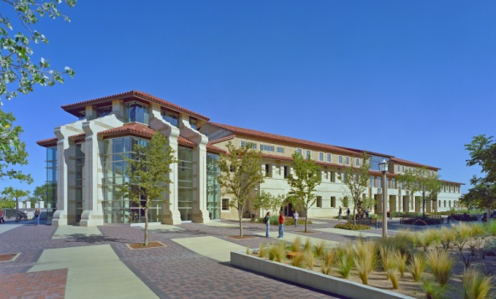
Student Union & Activities Statistical Analysis of Programs 2011-2012

Slide 2
Student Union & Activities
Assessment Data

Slide 3
Tech Activities Board (TAB) Evaluation
Events Assessed Fall 2011
After Hours (September 13, 2011)
After Hours : Open Mic Night (October 18, 2011)
Bad Teacher (October 6, 2011)
Change-Up (November 2, 2011)
Dan Ahdoot (August 25, 2011)
Ethan Zohn (November 9, 2011)
Inflatables (September 1, 2011)
Harry Potter (October 26, 2011)
Hangover 2 (September 7, 2011)
Heads vs. Feds (November 29, 2011)
Heather McDonald (October 4, 2011)
Henna Art (September 28, 2011)
Horrible Bosses (September 21, 2011)
Laser Battle Evolution (September 29, 2011)
Make Your Own Ornaments (December 6, 2011)
Make Your Own Street Signs (March 7, 2011)
Mike Bliss (September 23, 2011)
Mr. Gatti’s (September 14, 2011)
Murder Mystery Dinner (November 16, 2011)
NAQT 2011 College Quiz Bowl (October 5, 2011)
Preston Pugmire (October 12, 2011)
Rachel Brown (September 12, 2011)
Rest & Relaxation Night (December 7, 2011)
Spencer West (November 1, 2011)
The Help (November 30, 2011)
To Write Love on Her Arms (September 22, 2011)
Val’s Custom Leather Bracelets (October 25, 2011)
Notes:
The Tech Activities Board (TAB) began to assess events in Fall 2011 through Spring 2012. Each committee was asked to identify at least one or two events per month. Student leaders stood out after their events and asked peers to take a few minutes to complete a paper evaluation of the program they just attended. This year, we were able to identify thirty nine (57) events and collected over 1757 responses from students attending these programs.

Slide 4
Tech Activities Board (TAB) Evaluation
Events Assessed Spring 2012
After Hours (February 9, 2012)
After Hours (April 5, 2012)
Alternative Fuels (January 19, 2012)
Alternative Fuels (February 15, 2012)
Alternative Fuels (May 3, 2012)
Animal Haven (May 5, 2012)
Big Bang Bash (March 1, 2012)
Billiards/Ping Pong Tournament (April 30, 2012)
Bobble Heads (April 11, 2012)
Bongo Ball (February 7, 2012)
Cookies By Design (March 28, 2012)
Cosmic Bowling (January 19, 2012)
Fire & Ice (January 19, 2012)
Flip Books (February 22, 2012)
Roderick Russell (January 17, 2012)
Krochet Kids (April 25, 2012)
Make Your Own Street Signs (January 30, 2012)
Make Your Own Teddy Bear (February 8, 2012)
Media Bias Debate (March 29, 2012)
Mid-Day Music
Mr. Gatti’s (February 20, 2012)
Nevil Shed (February 27, 2012)
Raider Fest (April 13, 2012)
Rest & Relaxation Night (May 2, 2012)
Seeds for Needs (April 27, 2012)
Shane Windmeyer (April 24, 2012)
Singer/Songwriter (March 8, 2012)
Tech Amazing Race/Big Brother (March 22-23, 2012)
Tech Cash Bus (March 6, 2012)
Tech Lubbock Community Day (March 31, 2012)
The Muppets (March 7-8, 2012)
Twilight (February 1-2, 2012)

Slide 5
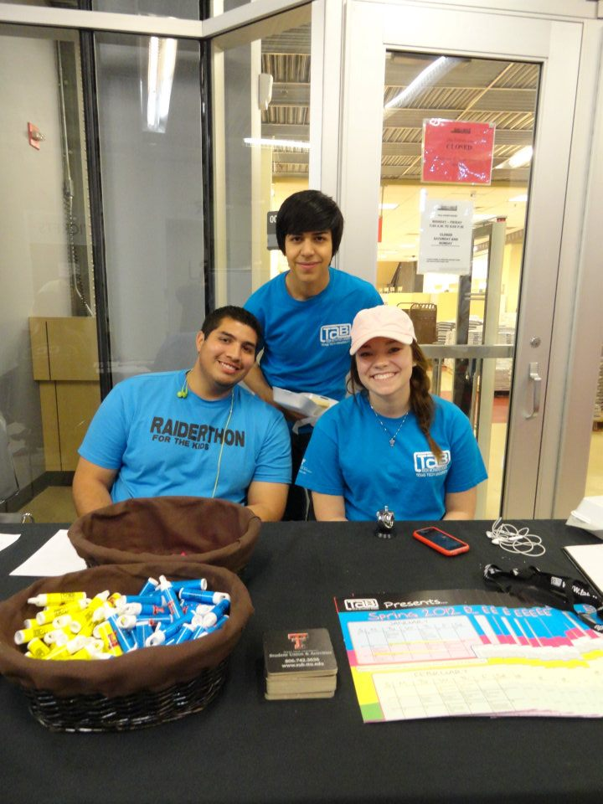
Tech Activities Board (TAB) Gender
What is your gender?
In the 2011-2012 school year, 1757 participants were surveyed at the completion of the TAB event they attended. Of those surveyed, 55% of the attendants were female. Approximately 2% of the students surveyed responded as ‘Other’ or did not respond to the question at all.

Slide 6
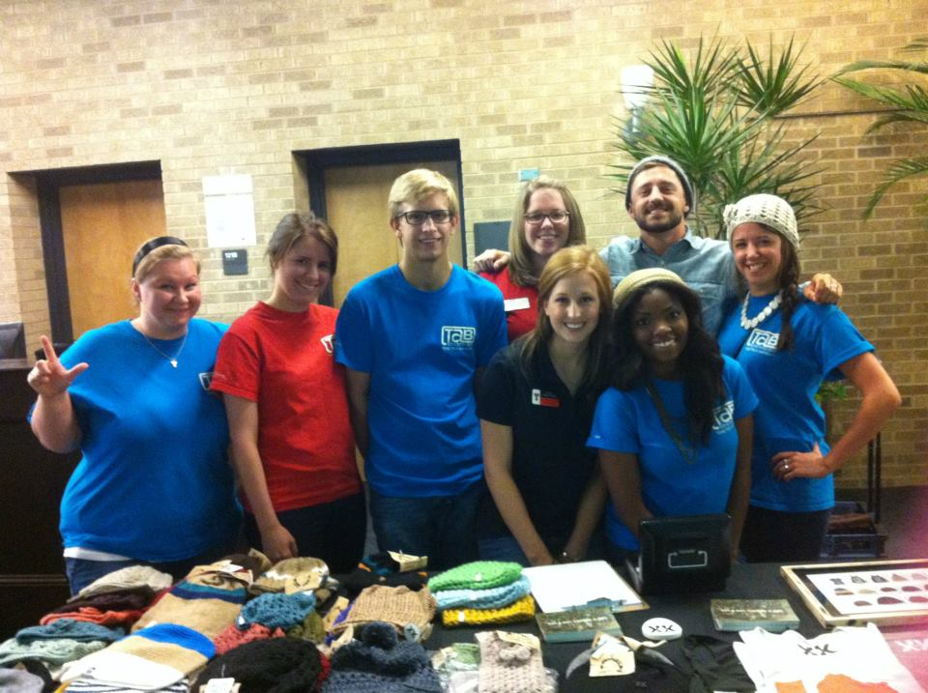
Tech Activities Board (TAB) Classification
What is your classification?
Undergraduates only
The Tech Activities Board was pleased to see a wide array of individuals attend their events this year. Overall, the freshmen and sophomores that were evaluated represented 65% of our evaluated attendance.

Slide 7
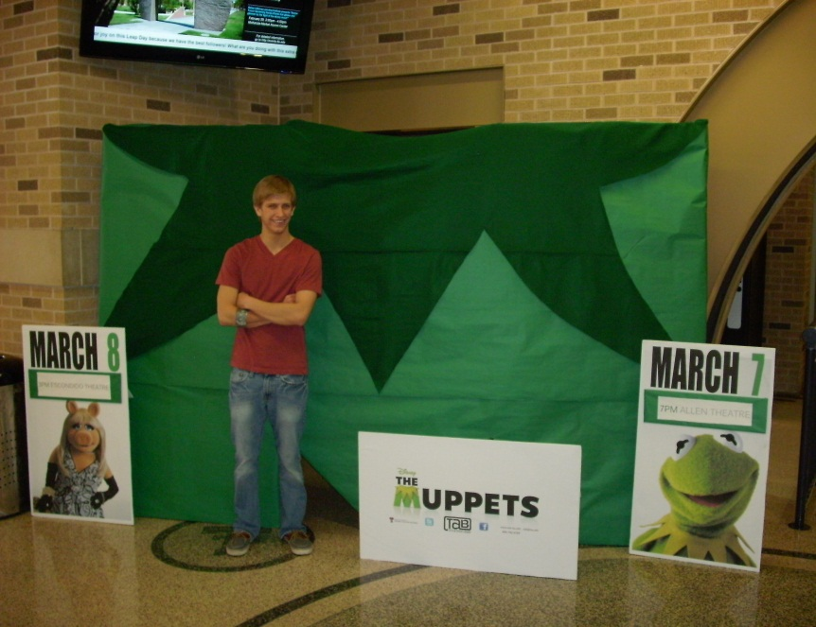
Tech Activities Board (TAB) Publicity
Last year, 43% of the individuals surveyed indicated that the marketing for TAB events was excellent. This year that number went up 8%. Another interesting note is that less than 20% of those surveyed indicated that they thought the marketing was below average.

Slide 8
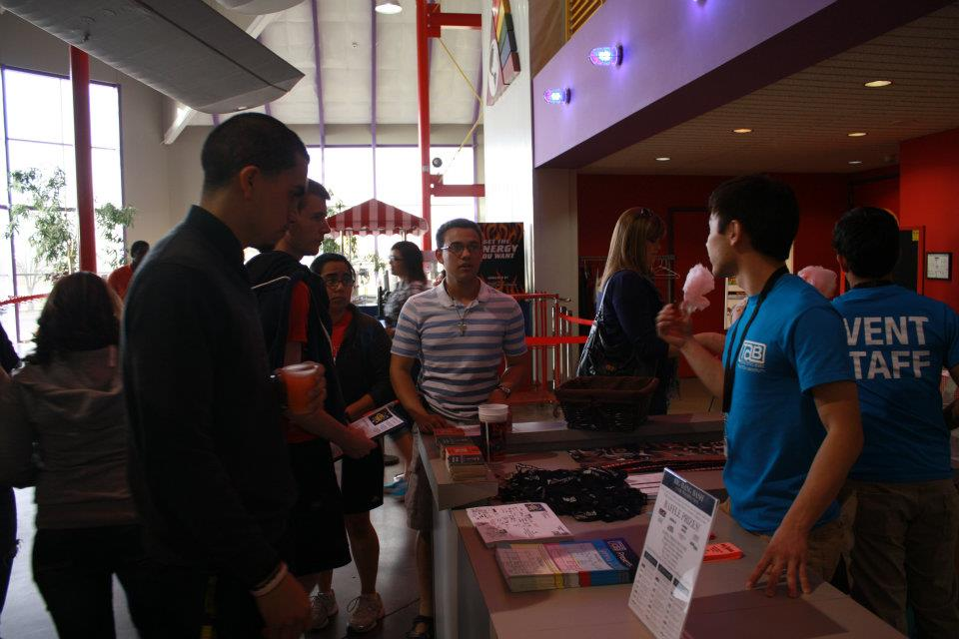
Tech Activities Board (TAB) Venue
The venues, although varied, seemed to greatly please the majority of students. Places that were generally utilized to hold events, included the Allen Theatre and SUB West Basement. While most of our events take place in the Student Union, TAB considers itself the programming board for the entire campus and will look to utilize other venues throughout campus as well as a few locations off campus. Last year, 55% of the sample indicated that the venue was excellent and this year the percentage is at 70%.

Slide 9
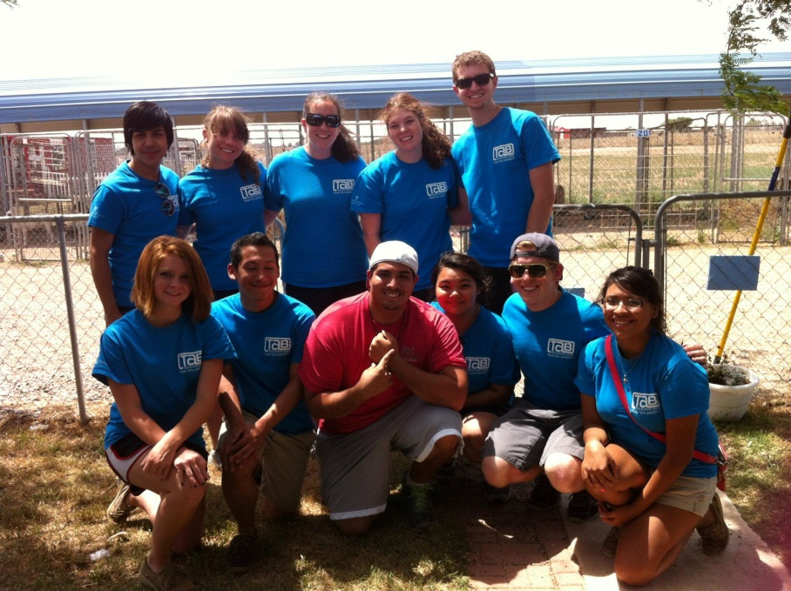
Tech Activities Board (TAB) Time
Time
The times for TAB events vary greatly; we offer several smaller events during the daytime, many of our larger events after 6:00 P.M., and our movies are shown twice, once in the evening and once in the afternoon, to appeal to as many students as possible.

Slide 10
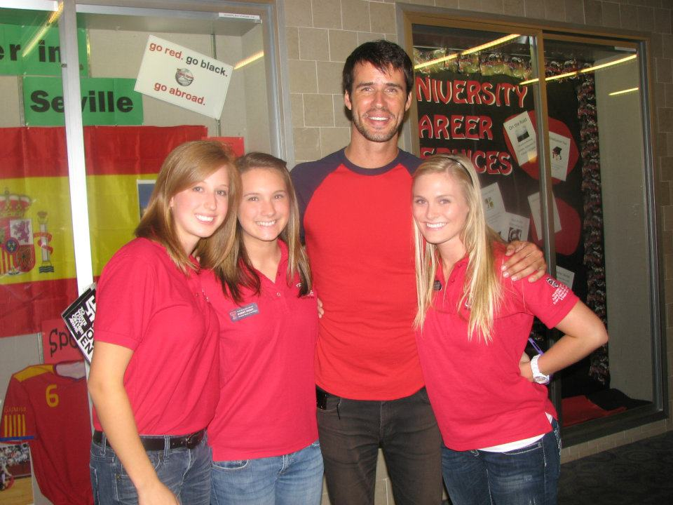
Tech Activities Board (TAB) Date
When planning events, TAB takes midterms, finals, and home athletic games into consideration and tries to offer our events at times when students have no other commitments. Last year, 56% of the sample indicated that the date selected for the event was excellent and this year the percentage was 70%.

Slide 11
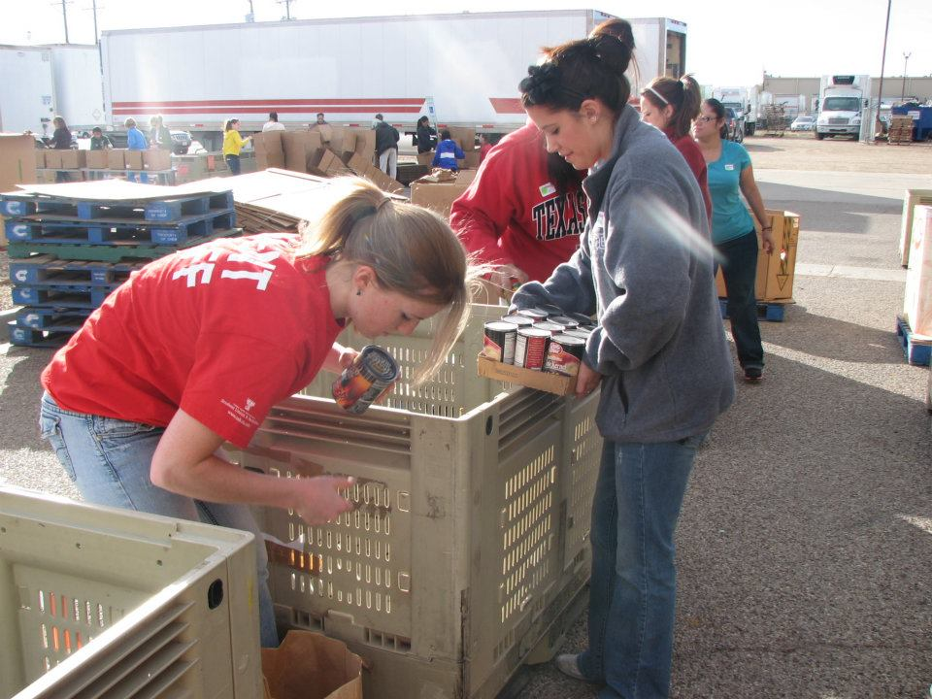
Tech Activities Board (TAB) Quality
Quality
TAB strives to maintain a high quality of events for students. Last year, 66% of the sample indicated that the time selected for the event was excellent and this year the number has grown to 69%.

Slide 12
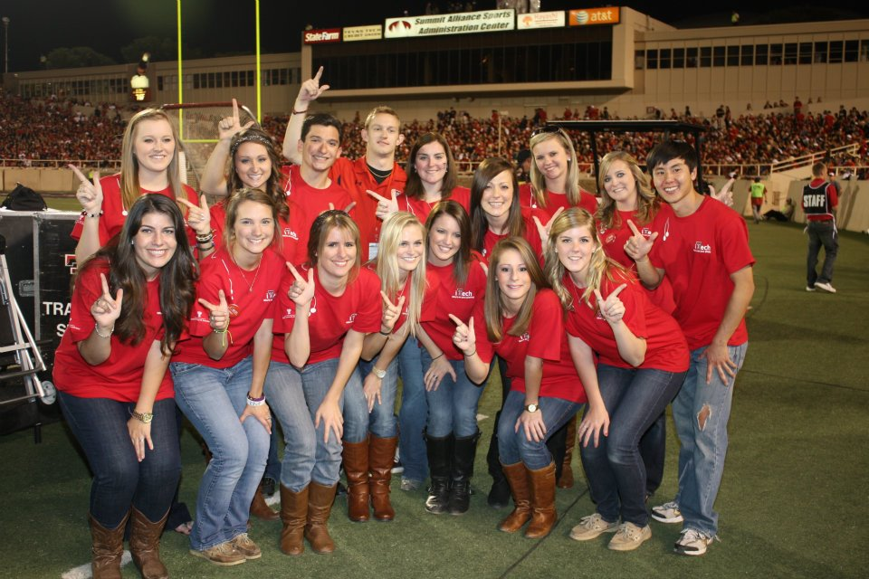
Tech Activities Board (TAB) Overall Satisfaction
Overall
This is potentially the most important statistic of the entire evaluation. Many things may make a student disgruntled: venue, date of event, subject matter; however it is the overall feeling after the event that is most important. Last year, 61% of the sample indicated that the overall event was excellent and this year the number was 68%.

Slide 13
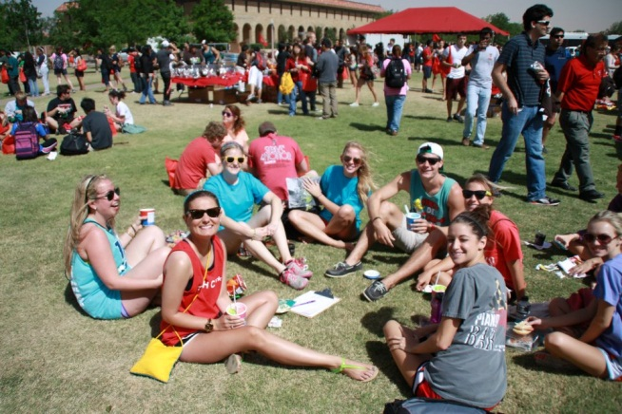
Tech Activities Board (TAB) Future Programming
What events would you like to see in the future?
The most requested events for this year were Movies (New Releases) and Concerts, following closely behind were Comedians. Performing Arts and Acoustic Music were the next two highest scoring categories. Last year, the most requested type of event was Movies (New Release) followed closely by Comedians.
Notes:
Farha

Slide 14
Tech Activities Board Attendance Numbers Per Month
Attendance Per Month
 | 2010-2011 | 2011-2012 | Percent Change
August | 2,159 | 2,648 | 23%
September | 6,555 | 2,944 | -55%
October | 2,430 | 22,913 | 843%
November | 23,078 | 2,203 | -90%
December | 162 | 261 | 61%
January | 1,517 | 1,446 | -5%
February | 1,992 | 1,901 | -5%
March | 1,562 | 945 | -40%
April | 3,325 | 3,509 | 6%
May | 55 | 214 | 290%
TOTAL | 42,835 | 38,984 | -9%
Notes:
For Honorarium:
-Only count money agreed to on a contract, Food for Open Mic Nights, Money paid for scripts/questions. Do not include items purchased on P-cards (such as MYO ornament materials, unconventional, handouts, freebies, etc.)
To determine the percent change:
(Current year – previous year) / (previous year)

Slide 15
Tech Activities Board Honorarium Expenses Per Month
Honorarium Expenses Per Month
 | 2010-2011 | 2011-2012 | Percent Change
August | $11,804.00 | $5,250.00 | -56%
September | $39,065.25 | $22,520.00 | -42%
October | $13,937.23 | $28,574.00 | 105%
November | $38,581.55 | $21,400.00 | -45%
December | $4,138.00 | $920.00 | -78%
January | $10,351.00 | $8,517.00 | -18%
February | $24,908.00 | $19,489.00 | -22%
March | $9,907.75 | $11,495.00 | 16%
April | $28,131.13 | $23,890.00 | -15%
May | $625.00 | $935.00 | 50%
TOTAL | $181,448.91 | $142,990.00 | -21%
Notes:
To determine the percent change:
(Current year – previous year) / (previous year)

Slide 16
Tech Activities Board Attendance Numbers
 | 2009-2010 | 2010-2011 | 2011-2012
Total Attendance | 62,664 | 42,835 | 38,984
Honorarium Expenses | $164,379.98 | $181,448.91 | $142,990.00
Price Per Student | $2.62 | $4.24 | $3.67
Fall Events | 59 | 61 | 52
Spring Events | 45 | 42 | 53
Total Number of Events | 104 | 103 | 105

Slide 17
Tech Activities Board (TAB) Student Leader Learning Outcomes
Leadership
 | Learning Outcome | Year Score | Semester Score*
1 | I have the ability to persuade or influence effectively. | +5 | +1
2 | I take initiative. | +2 | +2
3 | I delegate tasks. | +5 | +4
4 | I manage meetings effectively. | +2 | -
5 | I am able to teach various skills. | +7 | -
6 | I motivate others in an organization. | +1 | -
7 | I evaluate skills and knowledge of other individuals. | +4 | +1
8 | I confront problems. | +8 | +4
9 | I exercise authority when needed. | +7 | +1
10 | I work independently. | +5 | +1
11 | I foresee problems and take appropriate action. | +6 | +1
12 | I am aware of my strengths as a leader. | +4 | +1
13 | I am aware of my weaknesses as a leader. | +6 | +1
14 | I can effectively recruit, retain and recognize team members. | +4 | +1
*Semester Score indicates scores for the Student Leaders who held an Executive Position for only the Spring 2012 semester; Year Scores are calculated for Fall 2011 and Spring 2012

Slide 18
Tech Activities Board (TAB) Student Leader Learning Outcomes
Decision Making and Problem Solving
 | Learning Outcome | Year Score | Semester Score*
15 | I identify issues and their cause/effect. | +4 | -
16 | I mediate in times of dissension. | +7 | -
17 | I reach logical decisions. | +2 | -
18 | I implement decisions. | +4 | -
19 | I deal objectively with situations and people. | +5 | +1
20 | I take responsibility for my actions. | +3 | -
21 | I do not procrastinate. | +2 | -
22 | I have an understanding of effecting conflict management. | +2 | +1
23 | I believe that my actions reflect sound and ethical decisions. | +4 | +1

Slide 19
Tech Activities Board (TAB) Student Leader Learning Outcomes
Planning and Organization
 | Learning Outcome | Year Score | Semester Score*
24 | I set goals and specific objectives to meet those goals. | +1 | +1
25 | I develop a plan of action to obtain goals and objectives. | +5 | +1
26 | I evaluate progress towards the goal upon its completion. | +5 | -1
27 | I organize projects into manageable parts and processes. | +5 | -
28 | I set and meet deadlines. | +1 | -1
29 | I am knowledgeable of trends in the campus culture | +4 | +3
30 | I am aware of the steps involved in event planning. | +6 | +2
31 | I know how to organize a major event on campus. | +7 | +4
32 | I am knowledgeable of different methods to promote an event. | +6 | +3

Slide 20
Tech Activities Board (TAB) Student Leader Learning Outcomes
Assessment and Evaluation
 | Learning Outcome | Year Score | Semester Score*
33 | I know how to use and collect quantitative data for an event. | +10 | -
34 | I know how to use and collect qualitative date for an event. | +10 | -
35 | I know how to evaluate and reflect on an event. | +8 | +1
36 | I know how to benchmark with other programming boards and universities. | +7 | -1

Slide 21
Tech Activities Board (TAB) Student Leader Learning Outcomes
Communication
 | Learning Outcome | Year Score | Semester Score*
37 | I give clear instructions | - | +1
38 | I listen empathetically. | +3 | +1
39 | I have a command of written English. | +3 | +1
40 | I have a command of verbal English. | +3 | +1
41 | I have a command of e-mail and text messaging. | +1 | +1
42 | I can give constructive feedback. | +4 | +1
43 | I can accept constructive and non-constructive feedback in an appropriate manner. | +3 | -
44 | I feel confident speaking in front of large groups. | +5 | -1
45 | I am comfortable interviewing for campus leader positions. | +5 | +1
46 | I seek out my advisor for advice about my programming position. | +3 | +1
47 | I seek out my advisor for advice about academics and/or my personal life. | +1 | -

Slide 22
Tech Activities Board (TAB) Student Leader Learning Outcomes
Time and Stress Management
 | Learning Outcome | Year Score | Semester Score*
48 | I work effectively under pressure. | +5 | -1
49 | I exhibit effective means of coping with stress. | +5 | -1
50 | I effectively manage my time. | +4 | +2
51 | I make immediate logical decisions. | +7 | +1
52 | I create a balance between academic, employment, and co-curricular activities. | +5 | -
Financial Management
 | Learning Outcome | Year Score | Semester Score*
53 | I can read and analyze a budget. | +10 | +1
54 | I accept financial responsibility and work within a budget. | +4 | +1

Slide 23
Tech Activities Board (TAB) Student Leader Learning Outcomes
Adaptability
 | Learning Outcome | Year Score | Semester Score*
55 | I modify my behavior to given situations. | +2 | +1
56 | I learn new skills easily. | +3 | -
57 | I react well to change. | +1 | -
Human Relations
 | Learning Outcome | Year Score | Semester Score*
58 | I demonstrate a cooperative spirit. | +2 | +1
59 | I try to understand the varying backgrounds and lifestyles of others. | +4 | +1
60 | I respond to the needs of my peers/colleagues. | +2 | +1
61 | I actively educate myself in different cultures. | +2 | +1
62 | I cultivate relationships with others different from myself | +4 | +1

Slide 24
Contributors
Jon Mark Bernal, Associate Director
Meredith Holden, Assistant Director
Sonia Moore, Coordinator
Diana Fabing, Coordinator
Autumn Arthur, Graphic Designer
Christine Petteys, Senior Office Assistant
Rhonda Bratcher, Specialist III
Claire Maginness, Graduate Assistant
Farha Habeeb, Graduate Assistant
Drew Olesen, Student Assistant

