Slide 1
[ self ]
E XPLORE
TEXAS TECH UNIVERSITY ADVISING
Solve for (X) in terms of (why)!

Slide 2
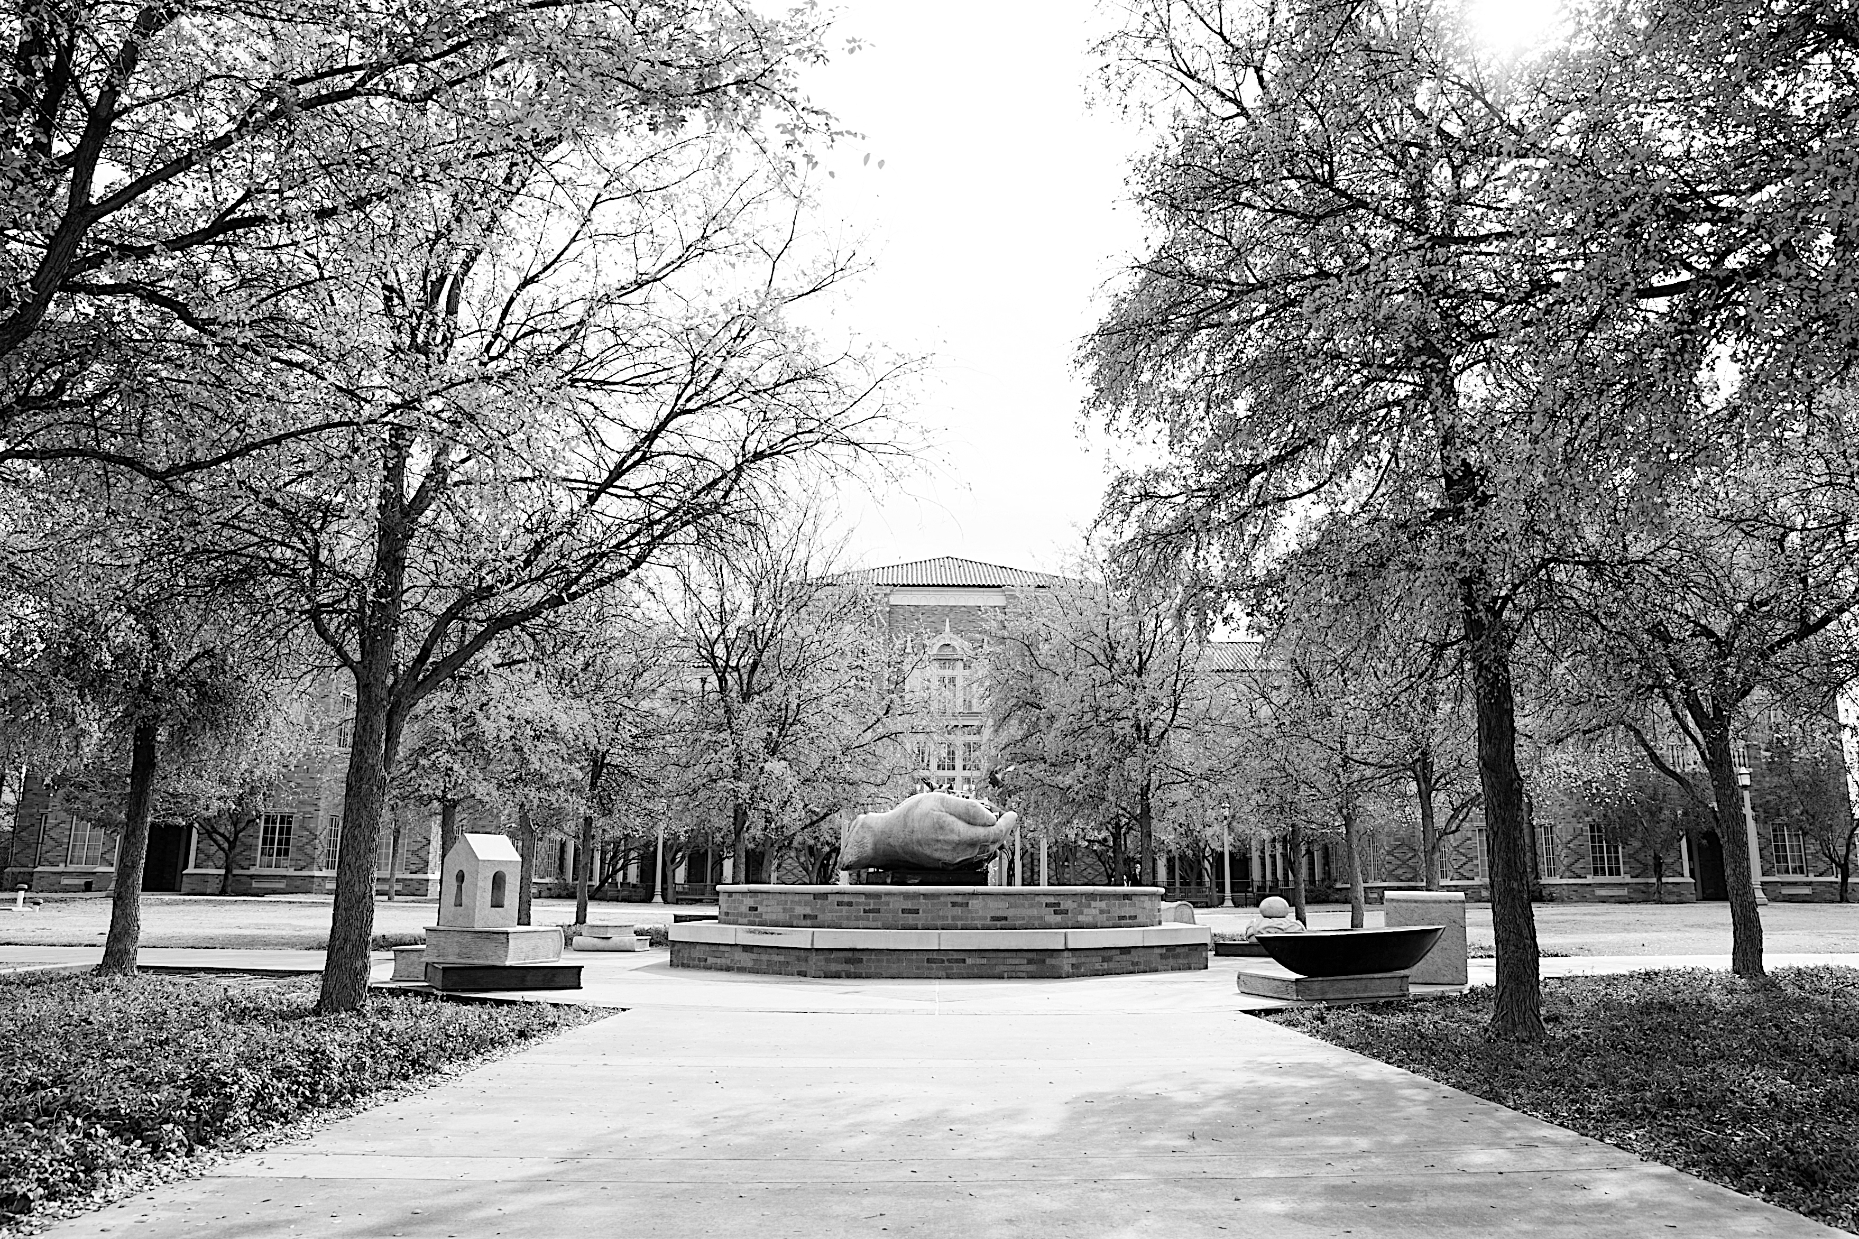
Finding out your personal connection to your future major requires that you start with exploring yourself. Such an activity can be useful to the process of deciding on a major. This can be done in two possible ways:
It can direct you to a certain major or a specific area of study.
It can confirm that a certain major fits your personal values, strengths and/or aspirations.
https://www.depts.ttu.edu/careercenter/

Slide 3
The student’s personal interest in the explored majors.

Slide 4
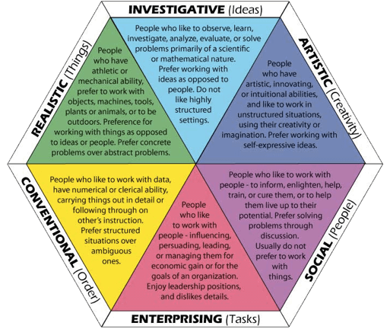
Air Traffic Controller
Archaeologist
Athletic Trainer
Cartographer
Commercial Airline Pilot
Commercial Drafter
Corrections Officer
Dental Technician
Farm Manager
Fish and Game Warden Floral Designer
Forester Geodetic Surveyor Industrial Arts Teacher Laboratory Technician Landscape Architect Mechanical Engineer Optician Petroleum Geologist
Police Officer
Practical Nurse
Property Manager
Recreation Manager
Service Manager
Software Technician
Ultrasound Technologist
Vocational Rehabilitation Consultant
Actuary Anesthesiologist Anthropologist Archaeologist
Biochemist Biologist Chemical Engineer Chemist
Computer Systems Analyst Dentist Ecologist Economist
Electrical Engineer Geologist Horticulturist
Mathematician Medical Technologist Meteorologist
Nurse Practitioner Pharmacist Physician
Psychologist Research Analyst Statistician
Surgeon Technical Writer Veterinarian
Actor (AES) Advertising Art Director
Advertising Manager
Architect
Art Teacher
Artist
Copy Writer
Dance Instructor
Drama Coach
English Teacher
Entertainer/Performer
Fashion Illustrator Interior Designer
Intelligence Research Specialist
Journalist/Reporter
Landscape Architect
Librarian
Medical Illustrator
Museum Curator
Music Teacher
Photographer
Writer
Graphic Designer
INVESTIGATIVE
“The Thinkers” a strong desire to
understand cause and effect, and
solve problems. Enjoy jobs that are
scientific in nature and jobs
that involve data analysis.
Enjoy computers,
Math, formulas
and thinking
abstractly.
“The
Doers”
Prefer to work
with objects and
things, enjoy creating
things with their hands
and using tools and
machines. Enjoy being physically
active, solving mechanical problems,
playing sports and working outdoors.
“The
Creators”
Prefer to be
expressive, innovative,
and don’t like structure
or conformity. Enjoy: poetry,
writing, photography, designing,
singing, acting, dancing, painting,
and attending exhibits and theaters.
REALISTIC
ARTISTIC
Accountant
Administrative Assistant
Budget Analyst
Business Manager
Business Programmer
Business Teacher
Catalog Librarian
Claims Adjuster
Computer Operator
Congressional-District Aide Cost Accountant
Court Reporter Credit Manager Customs Inspector
Editorial Assistant Elementary School Teacher
Financial Analyst Insurance Manager
Insurance Underwriter Internal Auditor
Kindergarten Teacher
Medical Records Technician
Museum Registrar
Paralegal
Safety Inspector
Tax Accountant
Tax Consultant
Travel Agent
“The Organizers” prefer order and
systems. They like to see things
run efficiently and smoothly.
Enjoy keeping
records, organizing,
working with
numbers
and using
computers.
“The Helpers” prefer to work with others,
and tend to be highly verbal.
Cooperative, friendly, and
understanding. Enjoy teaching,
caring for others,
volunteering,
mediating,
meeting people,
and working
in teams.
City Manager
Clinical Dietitian
College/University Faculty
Community Org. Director
Consumer Affairs Director
Counselor/Therapist
Historian
Hospital Administrator
Psychologist
Insurance Claims Examiner Librarian
Medical Assistant Minister/Priest/Rabbi
Paralegal Park Naturalist
Physical Therapist
Police Officer
Probation and Parole Officer
Real Estate Appraiser
Recreation Director
Registered Nurse
Teacher Social Worker
Speech Pathologist
Vocational-Rehab. Counselor
Volunteer Services Director
“The
Persuaders”
Prefer selling and
performing, enjoy
influencing others and
being leaders, and like
competitive activities. Enjoy
discussing politics, selling and
promoting, and having power and
Status.
CONVENTIONAL
SOCIAL
ENTERPRISING
Advertising Banker/Financial Planner
Branch Manager Business Manager
Chamber of Commerce Exec Lobbyist Credit Analyst
Customer Service Manager Education & Training Manager
Emergency Medical Technician Entrepreneur
Foreign Service Officer Funeral Director Insurance Manager
Interpreter Lawyer/Attorney Office Manager Politician
Personnel Recruiter Public Relations Rep Sales Representative
Retail Store Manager Sales Manager Social Service Director Stockbroker
For a complete list of TTU majors that match each category, you can go to:
https://www.depts.ttu.edu/careercenter/careerexploration/majors-interest/index.php

Slide 5
Activity 1.1:
Holland Codes
(RIASEC)
Holland Codes:
These are a set of personality types developed by psychologist John L. Holland in the 1970s. Dr. Holland reasoned that people work best in work environments that match their preferences. People and work environments can be matched for the best fit possible. Most people are some combination of two or three of the Holland interest areas. These two or three areas become your "Holland Code".
Take a look at the graph on the opposite page and read the description of each personality type and the matching occupations that fit each one of them. Next, try numbering three squares ranking your personality code, 1 to 3 (1 being the strongest).

Slide 6
Activity 1.1:
The following questions will provide some useful input for selecting your major.
They are quite broad in their scope, which might make them difficult to answer.
Therefore, we provided a few prompts to help you jump-start your reflective thinking.
What are my skills?
In what area do I have expert knowledge?
----------------------------------------------------------------------------------------------------------------------------------------------------------------------------------------------------------------------------------------------------------------------------
What do I enjoy doing outside of academia?
----------------------------------------------------------------------------------------------------------------------------------------------------------------------------------------------------------------------------------------------------------------------------
What are my interests and what intrigues me?
What courses did I enjoy most in high school?
----------------------------------------------------------------------------------------------------------------------------------------------------------------------------------------------------------------------------------------------------------------------------
When I dream about the future, what do I think I would enjoy doing or being?
----------------------------------------------------------------------------------------------------------------------------------------------------------------------------------------------------------------------------------------------------------------------------
What kind of activities am I not interested in, and why?
----------------------------------------------------------------------------------------------------------------------------------------------------------------------------------------------------------------------------------------------------------------------------

Slide 7
What are my abilities and capabilities?
Was poor performance in a particular area in the past due to lack of aptitude or lack of effort?
---------------------------------------------------------------------------------------------------------------------------------------------------------------------------------------------
How have others judge my performance in the past?
---------------------------------------------------------------------------------------------------------------------------------------------------------------------------------------------
What are my talents: helping others, using my hands, organizing, public speaking?
------------------------------------------------------------------------------------------------------------------------------------------------------------------------------------------------------------------------------------------------------------
What are my values?
Are my decisions and choices influenced by certain religious or philosophical beliefs?
---------------------------------------------------------------------------------------------------------------------------------------------------------------------------------------------
Do I consider service to others to be an important part of my personal philosophy?
---------------------------------------------------------------------------------------------------------------------------------------------------------------------------------------------
What practices do I consider ethical or unethical?
------------------------------------------------------------------------------------------------------------------------------------------------------------------------------------------------------------------------------------------------------------
What place does a family have in my future?
------------------------------------------------------------------------------------------------------------------------------------------------------
Will my values fit with a potential major or career field?
--------------------------------------------------------------------------------------------------------------------------------------------------------------------------------------------------------
What are my motivations?
Do my strongest motivations come from my personal interests, my abilities, my values, or from some other factors?
------------------------------------------------------------------------------------------------------------------------------------------------------
Are outside pressures (family, peers, job market …) shaping and influencing my decisions?
--------------------------------------------------------------------------------------------------------------------------------------------------------------------------------------------------------
Is my primary motivation based on the amount of money I think I can earn in a given field rather than interest in the field itself?
----------------------------------------------------------------------------------------------------

Slide 8
Who will ultimately have to live with the consequences of this decision, me or other people?
------------------------------------------------------------------------------------------------------------------------------------------------------------------------------------------------------------------------------------
What are the realities?
Will I be able to meet entrance and major requirements on time, particularly in more restrictive departments like business, engineering, architecture, nursing, etc.?
------------------------------------------------------------------------------------------------------------------------------------------------------------------------------------------------------------------------------------
What majors might fit my career goals?
(SEE THE FOLLOWING SECTION FOR HELP)
------------------------------------------------------------------------------------------------------------------------------------------------------------------------------------------------------------------------------------
Do my values, interests, abilities, skills, and motivations conflict with each other, or are they in agreement?
---------------------------------------------------------------------------------------------------------------------------------------------------------------------------------------------------------------------------------------------------------------------------------------------
Activity 1.1:

Slide 9
(x)1 =
-------------------------------------------
(why)1 =
-----------------------------------------------------------------------------------------------------------------------------------------------------------------------------------------
(x)2 =
-------------------------------------
(why)2 =
--------------------------------------------------------------------------
---------------------------------------------------------------------------------------------------------------
(x)3 =
-------------------------------------
(why)3 =
-----------------------------------------------------------------------------------------------------------------------------------------------------------------------------------------
Provide values for
(x) and (why) where:
(x) = The explored major.
(why) = How this major suits your personality, your skills,
your values, your dreams
and aspirations in life.
Keep in mind that it is recommended to come
up with at least two
sets of values for two
possible majors that
you see fit.

Slide 10
Drane Hall Room 347
Mail Stop 1038, PO Box 41038
PHONE
806.742.2189
EMAIL
advising@ttu.edu
©Texas Tech University Advising, Texas Tech University. For permission to use in part or in whole, please contact advising@ttu.edu

