Slide 1
[ courses ]
E XPLORE
TEXAS TECH UNIVERSITY ADVISING
Solve for (X) in terms of (why)!

Slide 3
1 - Core Curriculum Requirement
The core curriculum is designed to expose all Texas Tech University graduates to areas of study that are traditionally regarded as basic to the intellectual development of a broadly educated person. These areas of study include:
Written Communication [6 hours]
Oral Communication [3 hours]
Mathematics [6 hours]
Life & Physical Sciences [8 hours]
Language, Philosophy & Culture [3 hours]
Creative Arts [3 hours]
Social & Behavioral Sciences [3 hours]
American History [6 hours]
Political Science/Government [6 hours]
Multicultural Requirement [3 hours]
The Texas Tech University core curriculum complies with Texas statutes and Texas Higher Education Coordinating Board rules.
** Students should refer to college and department degree requirements and recommendations when choosing core curriculum courses. Generally, completing the core curriculum should happen during the sophomore year.
2 - Major Specific Courses
These are the specialized courses that will qualify the student to graduate with a degree in their chosen major, and they can be divided into the following:
Courses that are shared among several majors from a certain college.
More concentrated courses specifically required for that major.
Electives.
Additional core requirements.
36
The degree plan of any major consists of the following types of required courses:
https://catalog.ttu.edu/preview_program.php?catoid=21&poid=14116

Slide 4
UA advisors will aid the exploring student in finding courses that apply to all the explored majors.
The success of this strategy depends on the number of courses the exploring student is transferring in, and the majors that the exploring student is interested in.
However, this plan is only made possible if:
There are courses that are required for all majors on campus.
There are majors that require similar courses.
There are courses that are required for a certain major but will count as an elective for another.
The goal is to give the student two semesters’ worth of coursework that won’t be lost, or fall through,
no matter what option they decide on at the end of the two-semester period.
What courses
are going
to count towards the explored majors?

Slide 5
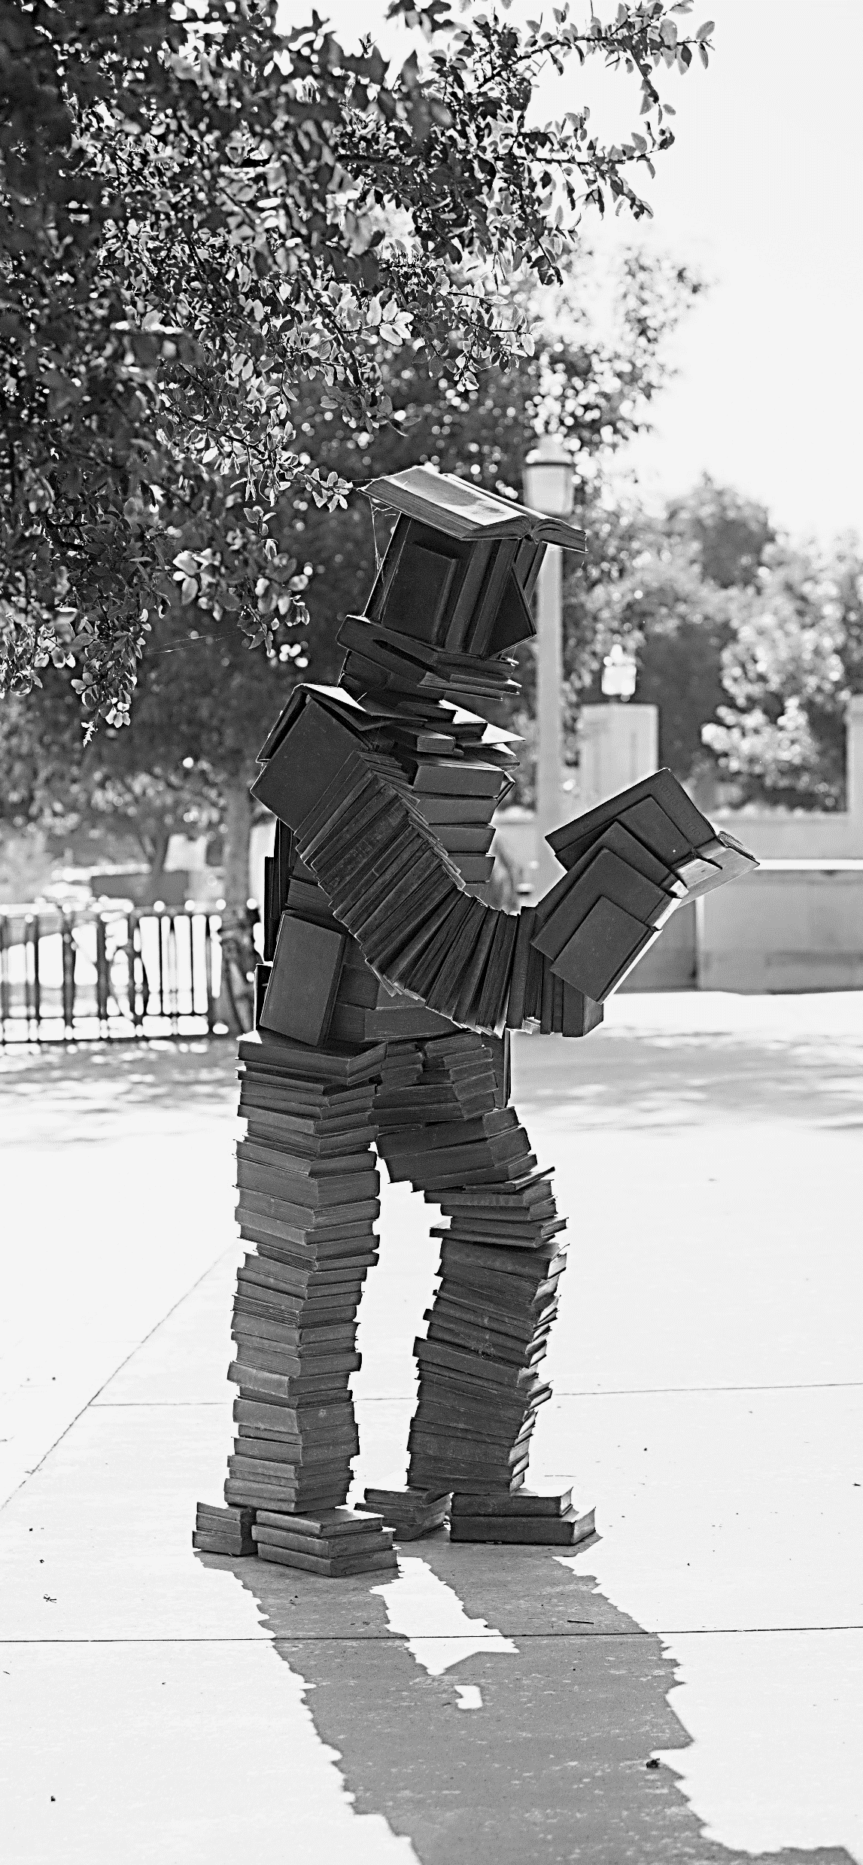
Exploring students have two valuable online tools that can aid them in the process of choosing the right courses:
Degreeworks, is a degree auditing program that allows the student, and their advisor, to see:
How previous credit fits within a certain degree plan.
What courses are still needed before graduation.
What courses might fall through the degree plan of concern.
The TTU Catalog contains:
A description of the explored major.
A description of the required coursework.
A recommended 4-year degree plan.
It is recommended that the student check with their advisor when choosing courses to make sure all pre-requisites are met and that the student has access to those courses.
https://degreeworks.texastech.edu/
https://catalog.ttu.edu/

Slide 6
(X)1_________________
(why)1
Cchosen courses for major 1:
Written Communication:
ENGL 1301
ENGL 1302
Oral Communication:
_________
Mathematics:
_________
_________
Life & Physical Sciences:
_________/_________
_________/_________
Language, Philosophy & Culture:
_________
Creative Arts:
_________
American History:
_________
_________
American Government:
POLS 1301
POLS 2306
Social & Behavioral Sciences:
_________
Multicultural Requirement:
_________
Other Courses:
__________ ___________
__________ ___________
provide values for
(x) and (why) where:
(x) = The explored major.
(why) = What courses count towards this major.
Keep in mind that it is recommended to come
up with at least two
sets of values for two
possible majors that
you see fit.

Slide 7
(X)2________________
(why)2
Chosen courses for major 2:
Written Communication:
ENGL 1301
ENGL 1302
Oral Communication:
_________
Mathematics:
_________
_________
Life & Physical Sciences:
_________/_________
_________/_________
Language, Philosophy & Culture:
_________
Creative Arts:
_________
American History:
_________
_________
American Government:
POLS 1301
POLS 2306
Social & Behavioral Sciences:
_________
Multicultural Requirement:
_________
Other Courses:
__________ ___________
__________ ___________
(X)3_________________
(why)3
Chosen courses for major 3:
Written Communication:
ENGL 1301
ENGL 1302
Oral Communication:
_________
Mathematics:
_________
_________
Life & Physical Sciences:
_________/_________
_________/_________
Language, Philosophy & Culture:
_________
Creative Arts:
_________
American History:
_________
_________
American Government:
POLS 1301
POLS 2306
Social & Behavioral Sciences:
_________
Multicultural Requirement:
_________
Other Courses:
__________ ___________
__________ ___________

Slide 8
Drane Hall Room 347
Mail Stop 1038, PO Box 41038
PHONE
806.742.2189
EMAIL
advising@ttu.edu
©Texas Tech University Advising, Texas Tech University. For permission to use in part or in whole, please contact advising@ttu.edu

