Slide 1
[ time ]
E XPLORATORY
ACTIVITY NO. 4
E XPLORE
TEXAS TECH UNIVERSITY ADVISING
Solve for (X) in terms of (why)!

Slide 2
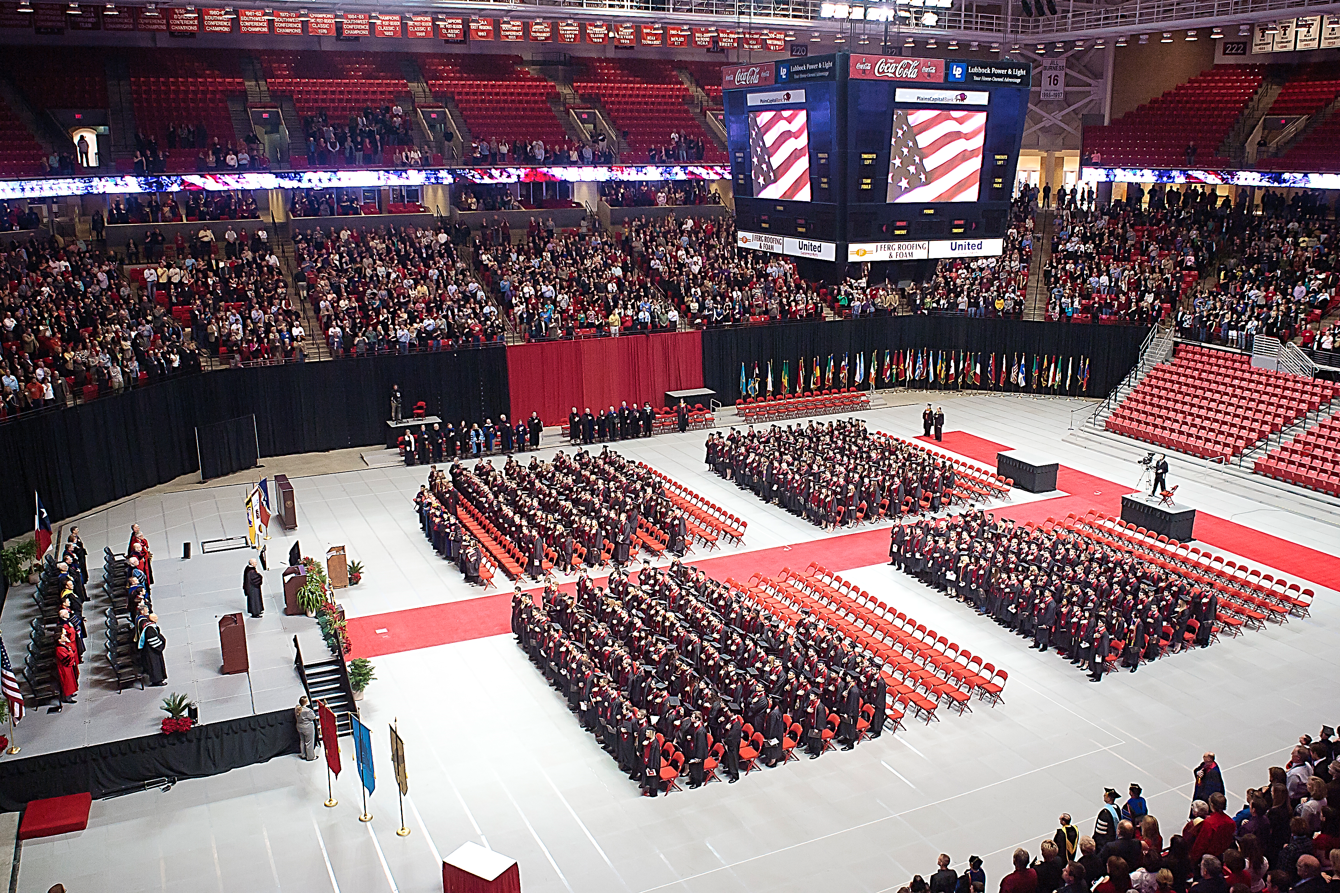
How long will it take me to graduate with this major?

Slide 3
Generally speaking, a student can run a degree audit for the explored major by using DegreeWorks. The audit should lay out the remaining hours needed to complete this degree. The remaining time until graduation can then be calculated.
However, a better estimate should come from the departmental advisor of that major.
Major advisors have more accurate information about course sequences and course availability.
”How long will it take me to graduate with this major?” would be a good question for your interview with the advisors of your explored majors.
https://degreeworks.texastech.edu/
- (X)1:
__________________
- Graduation Time:
__________________
- (X)2:
__________________
- Graduation Time:
__________________
- (X)3:
__________________
- Graduation Time:
__________________

Slide 4
Drane Hall Room 347
Mail Stop 1038, PO Box 41038
PHONE
806.742.2189
EMAIL
advising@ttu.edu
©Texas Tech University Advising, Texas Tech University. For permission to use in part or in whole, please contact advising@ttu.edu

