Slide 1
[ confirmation ]
E XPLORE
TEXAS TECH UNIVERSITY ADVISING
Solve for (X) in terms of (why)!

Slide 3
What major are you considering?
(X) =____________________________________
Why are you considering this major?
(why) = ________________________________________________________________________________________________________________________________________________________________________________________________________________________________________________
How is this major compatible with your personal values, skills, interests, and goals?
________________________________________________________________________________________________________________________________________________________________________________________________________________________________________________
- Run a "what-if" degree audit & look up the 4-year plan in the catalog.
- Review course descriptions for the required
courses.
- Do the courses look interesting?
Yes, all of them
Some of them
Only a few of them
None of them
What classes are you most excited about? ________________________________________________________________________________________________________________________
What classes are you least excited about? ________________________________________________________________________________________________________________________
Academic
major
checklist:
Is this
major
right
for me?

Slide 4
72
Look at all of the courses required for this major.
Do you have the skills and interest to complete these courses?
Yes
No
How does this major relate to your career interests?
________________________________________________________________________________________________________________________
What is a minor that would complement this major or give you an opportunity to explore a personal area of interest? ________________________________________________________________________________
Can you incorporate study abroad, student organization involvement, internships, research or other experiences? ________________________________________________________________________________________________________________________________________________________________
How confident are you that this major is a good fit for you? (5 = most confident) ________________________________________
What will you do with this major? ________________________________________________________________________________________________________________________________________________________________
academic
major
checklist:
Is this
major
right
for me?

Slide 5
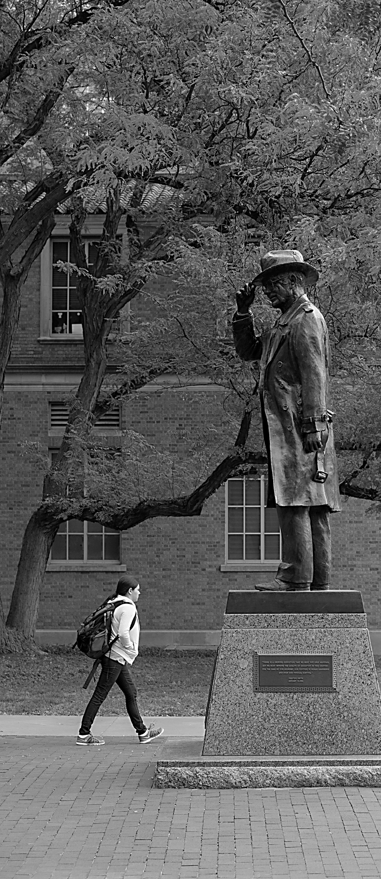
74
Moving forward!
Get declared! See the advisor for your top choice major.
Join and participate in student organizations related to academic/career path.
Make connections with faculty.
Find additional opportunities outside of campus to grow and develop.
Find a job or an internship that corresponds to academic/career path.
Utilize support services such as tutoring, office hours, undergraduate research, mentoring, etc.

Slide 6
Drane Hall Room 347
Mail Stop 1038, PO Box 41038
PHONE
806.742.2189
EMAIL
advising@ttu.edu
©Texas Tech University Advising, Texas Tech University. For permission to use in part or in whole, please contact advising@ttu.edu

