Slide 1
Society Issues for Pork Production
John J. McGlone, PhD
Texas Tech University

Slide 2
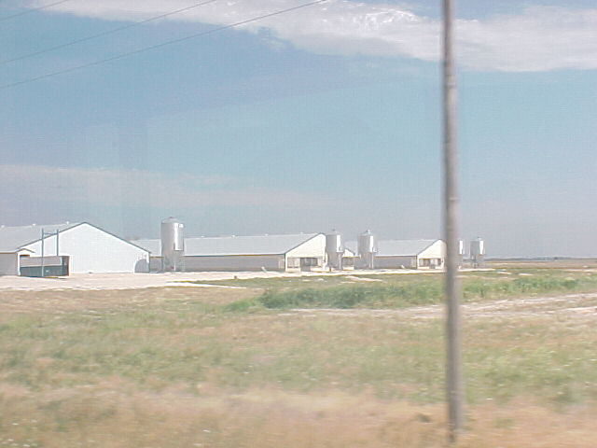
Model farms

Slide 3
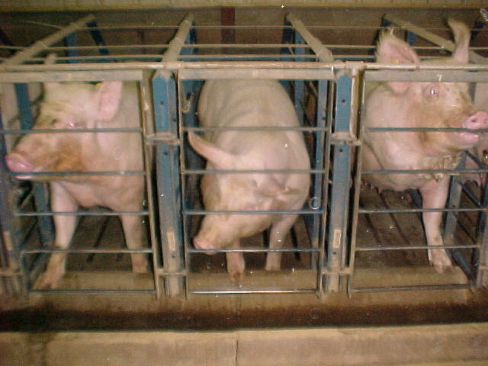
Society Issues
If the public perceives there is a problem with the industry, then there is a problem that must be dealt with.

Slide 4
Issues
Pig farms smell
Pigs suffer on farms
You can get worms from eating pork
Pork has cancer-causing chemicals
Pigs pollute the water
Pigs eat grain that people could eat
Corporate farms kill the family farm

Slide 5
Pig farms smell
Would you like to have your home next to a pig farm?
Why are pig farms not inside city limits? (note the orient)
If a pig farm actually did not smell, would you like to live near it?
“The Nebraska retirement program”

Slide 6
Pigs suffer on farms
How much space do you think sows need?
Enough to turn around?
Enough for social interactions?
Should aggressive animals be penned apart from submissive animals?

Slide 7
You can get worms from eating pork!
Should pork be required to be free from Trichinae?
Should the industry eradicate Trichinae?

Slide 8
Pork has cancer-causing chemicals
Should additives be used in meat products?
Would reducing acute deaths by 90% be worth adding 10% to the long-term cancer rate?
What advanced technologies could be used to reduce chemical-induced cancer?

Slide 9
Pigs pollute the water
Should farms of all sizes be required to spend what ever is required to prevent water pollution?
Should farms be located where water pollution risk is low?
Should farms be allowed to be near waterways?
Where should farms be located?

Slide 10
Pigs eat grain that people could eat
Feed fed to 100 million pigs in the USA could feed 54 million people
What would happen if the world grew and we could not feed everyone; would we feed grain to pigs? (and cattle)
What happens to meat consumption when poor countries improve their income?

Slide 11
Corporate farms kill the family farm
Are corporate farms killing the family farm?
The Kansas Experience
The Nebraska Experience
The Iowa experience

Slide 12
The End

