Slide 1
Neuroscience: Exploring the Brain, 4e
Chapter 9: The Eye

Slide 2
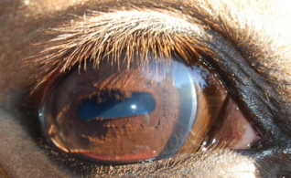
Introduction
The visual system uses light to form images of the world around us
Light is electromagnetic energy, emitted in the form of light waves
Large and small waves, short and long wavelengths
Crash into objects and are absorbed, scattered, reflected, bent…
Visual system requires a lot of neural machinery

Slide 3
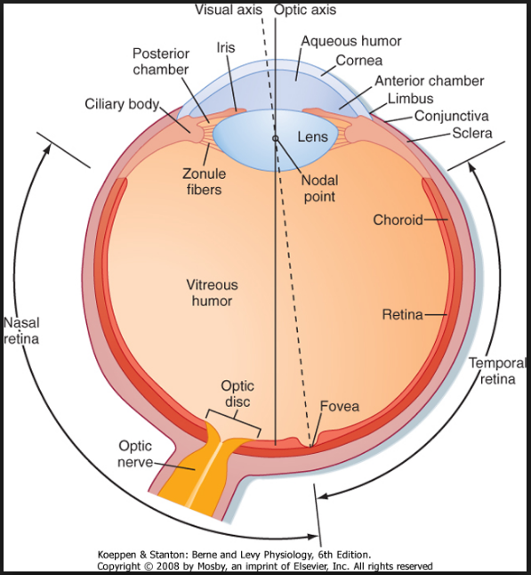
Introduction
More than 1/3 of the human cerebral cortex is involved in analyzing the visual world
Comparison of human eye is similar to a camera
Retina
Photoreceptors: convert light energy into neural activity
Automatically adjust to differences in illumination and focuses on objects
Detects differences in intensity of light
Eye movements via eye muscles
Eye transparency via tears and blinking

Slide 4
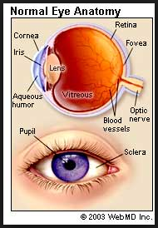
Introduction
Retina does more than register light levels, it is actually part of the brain
Each eye has 2 overlapping retinas:
One for low light levels (from dusk until dawn)
One for higher light levels that detects color (sunrise to sunset)
But regardless of time of day- specialized to detect light differences
Image processing is well under way in the retina before any information reaches the brain

Slide 5
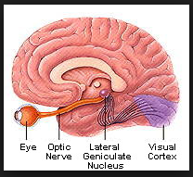
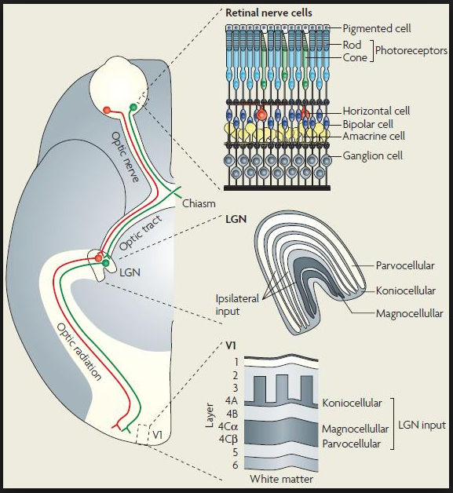
Introduction
Axons of retinal neurons are bundled into optic nerves
Will distribute information to several parts of the brain to perform different functions
Biological rythms/circadian rythms
Control of eye positions and optics
Lateral geniculate nucleus (LGN)
First synaptic relay in the primary visual pathway
Visual information ascends to cerebral cortex→ interpreted and remembered

Slide 6
Properties of Light
Light
Electromagnetic radiation (energy) is all around us and has:
Wavelength- distance bw successive peaks/troughs
Frequency- number of waves/sec
Amplitude- difference bw trough and peak

Slide 7
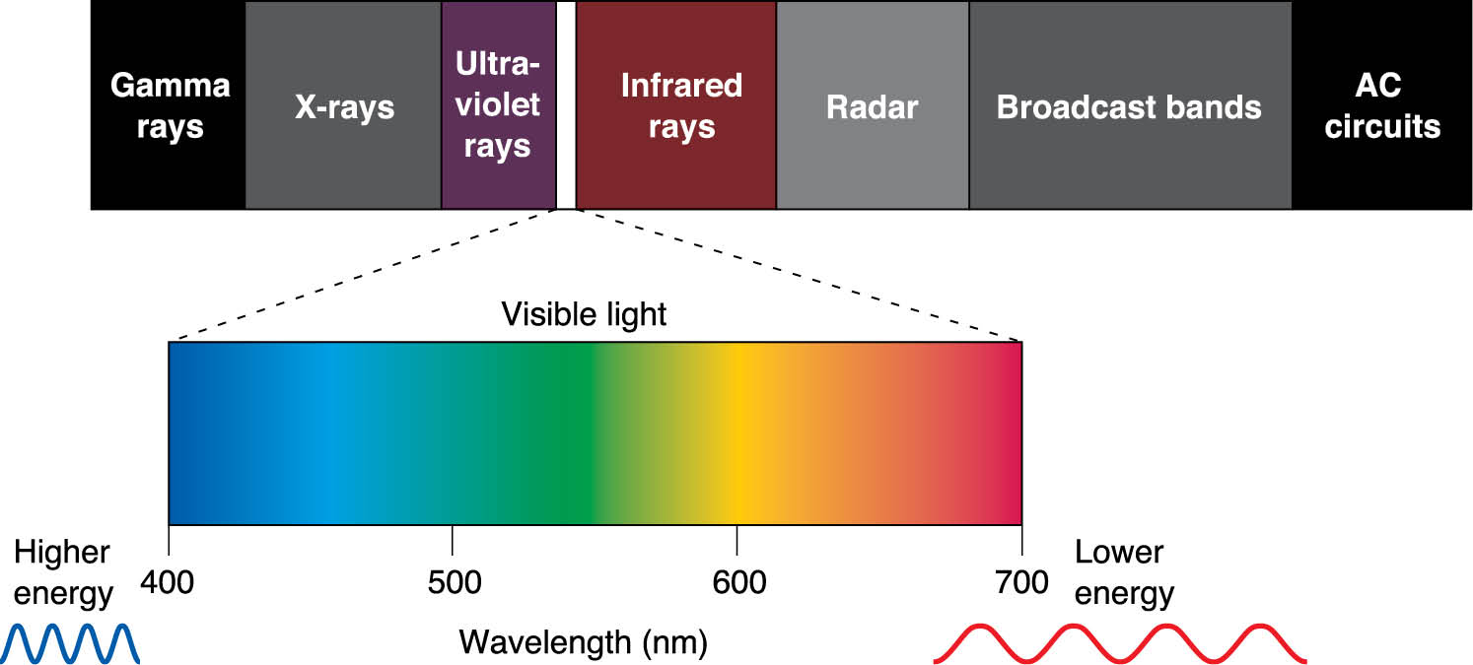
Properties of Light—(cont.)
Energy is proportional to frequency
Radiation emitted at high frequency has the highest energy content
Gamma radiation and cool colors—high energy (short wavelengths)
Radio waves and hot colors—low energy (long wave lengths)

Slide 8
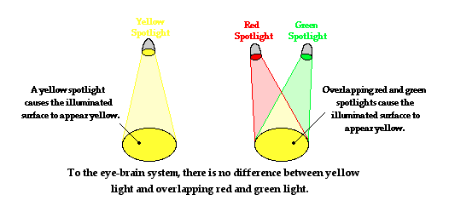
Properties of Light—(cont.)
Visible light consists of long wavelengths
Colors are themselves “colored” by the brain, based on our subjective experiences

Slide 9
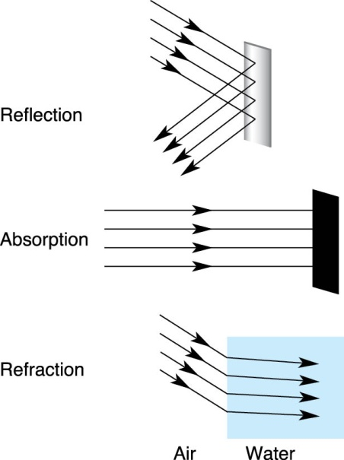
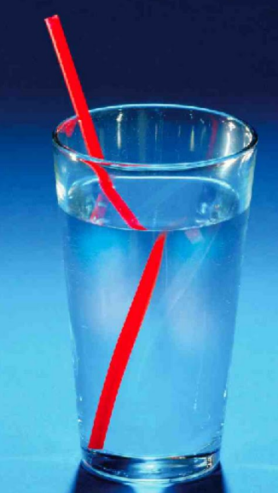
Properties of Light—(cont.)
Optics
Study of light rays and their interactions
Reflection
Bouncing of light rays off a surface
Absorption
Transfer of light energy to a particle or surface
Refraction
Bending of light rays from one medium to another
Transparent media in the eye bend light rays to form images on the retina

Slide 10
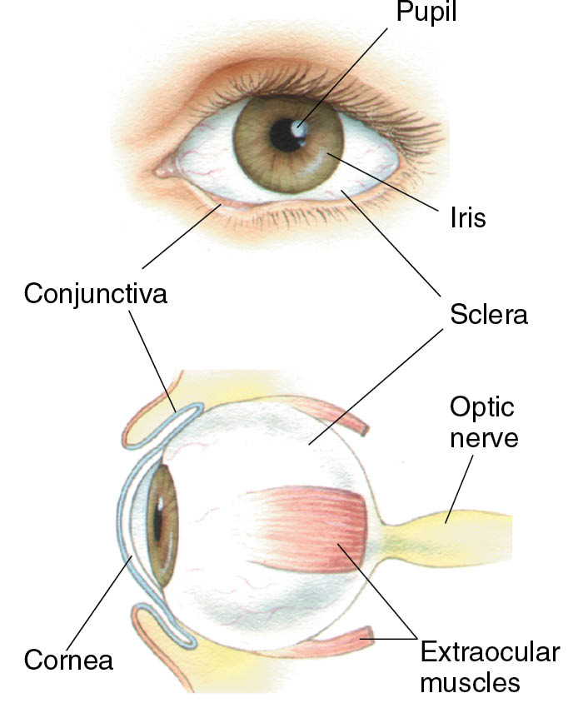
Gross Anatomy of the Eye
Pupil: opening where light enters the eye and reaches the retina
Appears dark bc of light absorbing pigments in the retina
Iris: gives color to eyes
Contains 2 muscles that constrict or dilate the pupil
Cornea: glassy transparent external surface of the eye
Continuous with the sclera
Sclera: white of the eye
Forms the tough wall of the eyeball
Optic nerve: bundle of axons from the retina

Slide 11
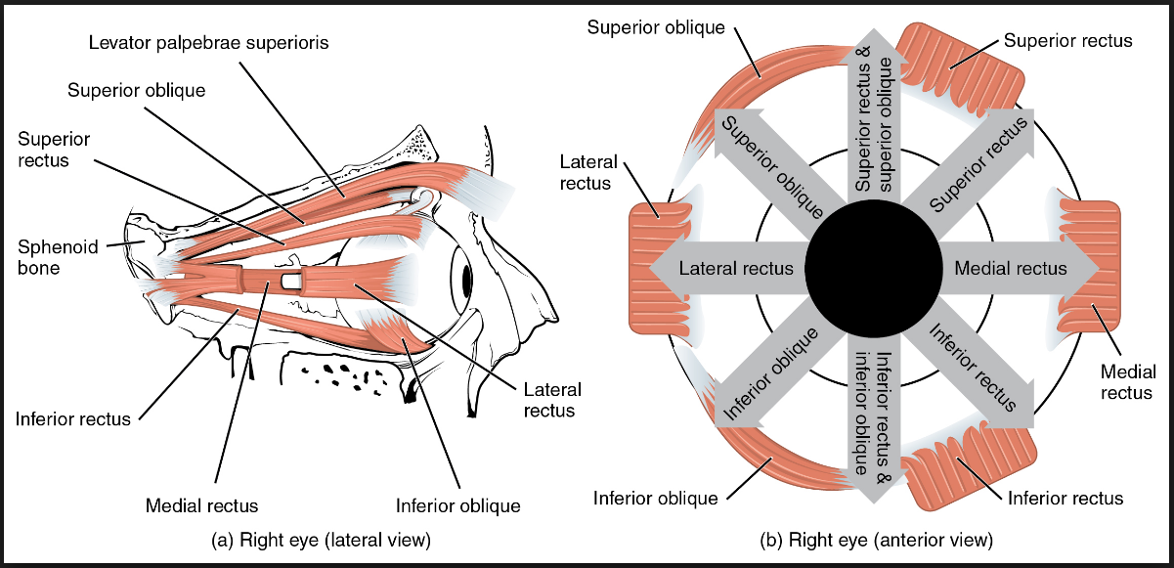
Gross Anatomy of the Eye
Extraocular muscles move the eye ball

Slide 12
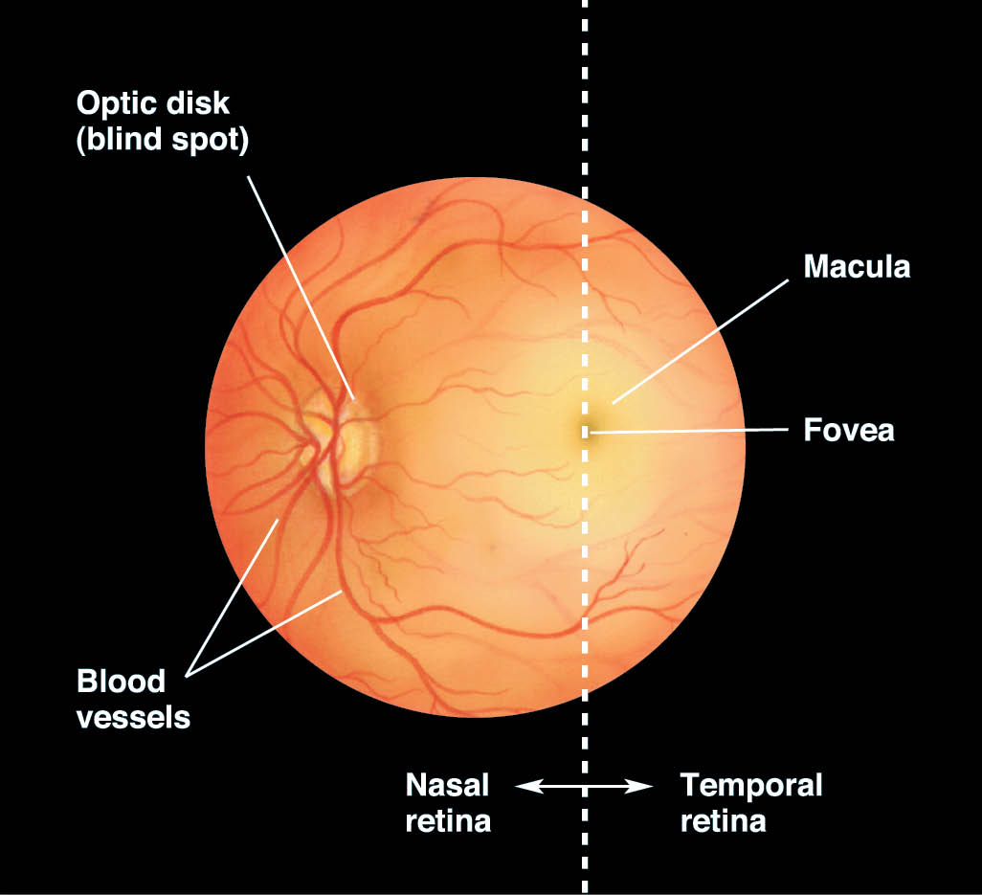
Ophthalmoscopic Appearance of Retina
Opthalmascope allows you to see into the eye through the pupil to the retina
The most obvious feature of the retina are the blood vessels on the surface
Vessels originate from the optic disc
Where optic nerve fibers exit retina
Sensation of light can’t occur at optic disc
No photoreceptors
Nor where vessels exit
Shadows on retina
Brain fills in the perception of empty space

Slide 13
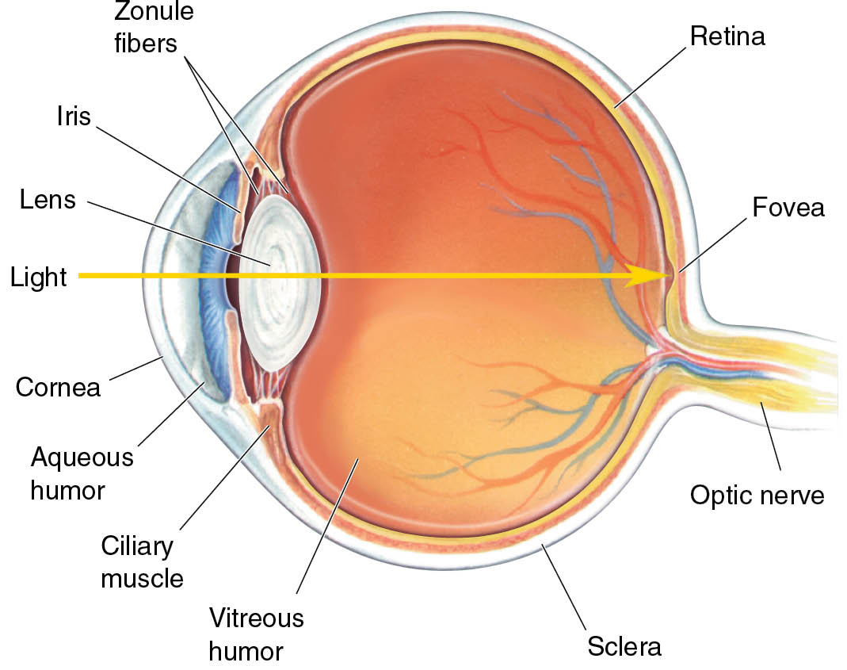
Cross-Sectional Anatomy of the Eye
There are blind retinal regions
Macula
Middle of retina is a darker colored region with a yellow hue
Absence of large blood vessels
Blood vessels arc from the optic disc to the macula
Trajectory of the optic nerve fibers (from the macula to the optic disc)
Absence of blood vessels improves quality of central vision

Slide 14
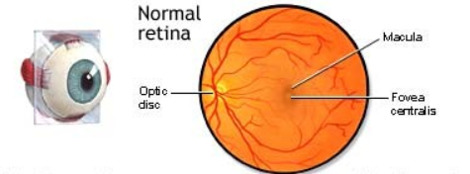
Cross-Sectional Anatomy of the Eye
Fovea Centralis
Retina is thinner in this area
Center of the retina
Reference point
Nasal
Temporal
Superior
Inferior

Slide 15
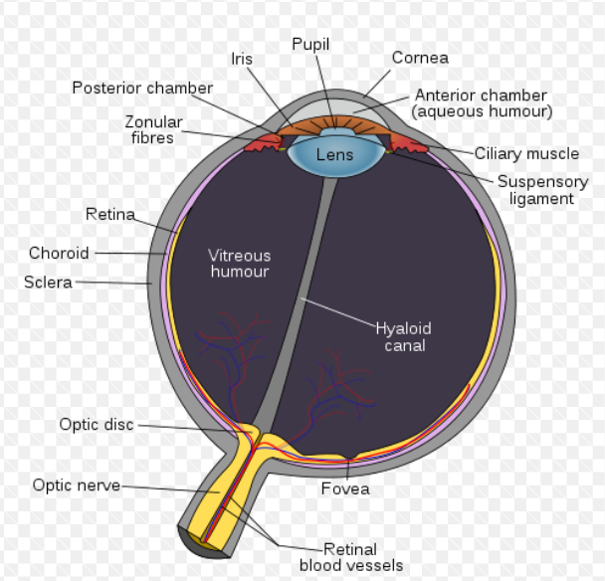
Cross-Sectional Anatomy of the Eye
Light passes through the cornea towards the retina
Cornea lacks blood vessels and is nourished by the fluid behind it → aqueous humor
The lens is transparent located behind the iris
Suspended by zonule fibers attached to the ciliary muscle which forms ring inside the eye
Changes in the shape of the lens enable adjustment of eyes to different viewing distances

Slide 16
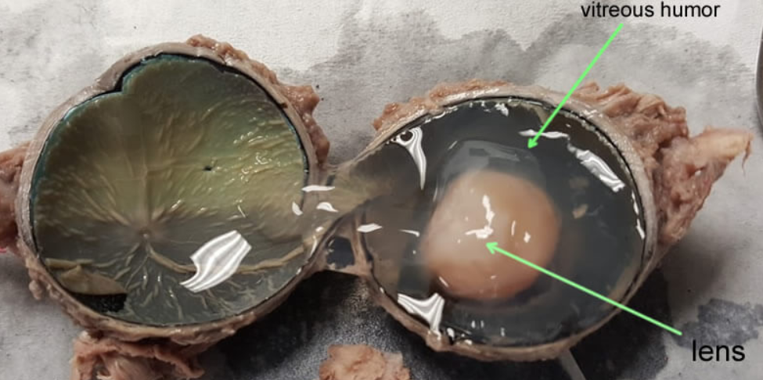
Cross-Sectional Anatomy of the Eye
Lens divides the interior of the eye into 2 compartments
Contain different fluids
Aqueous humor
Lies bw the cornea and the lens
Vitreous humor
Lies bw lens and the retina
Serves to keep the eyeball spherical
Disorder can compromise vision

Slide 17
Cross-Sectional Anatomy of the Eye
Lens divides the interior of the eye into 2 compartments
Contain different fluids
Aqueous humor
Lies bw the cornea and the lens
Vitreous humor
Lies bw lens and the retina
Serves to keep the eyeball spherical
Disorder can compromise vision

Slide 18
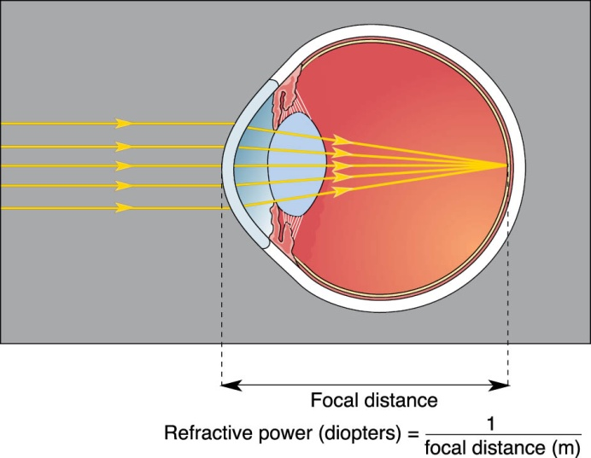
Refraction of Light by the Cornea
Eye collects light, focuses on retina, and forms image
Bringing objects into focus involves refractive powers of cornea and lens
Cornea is the sight of the most refractive power of the eyes, not the lens
Light reaches the eye from air and the cornea is mostly made of water
Refraction bc light travels slower in water than in air

Slide 19
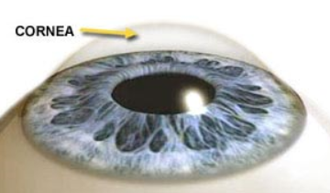
Refraction of Light by the Cornea
As light passes into a medium where its speed is slowed it will bend toward a line that is perpendicular to the border or interface bw the media

Slide 20
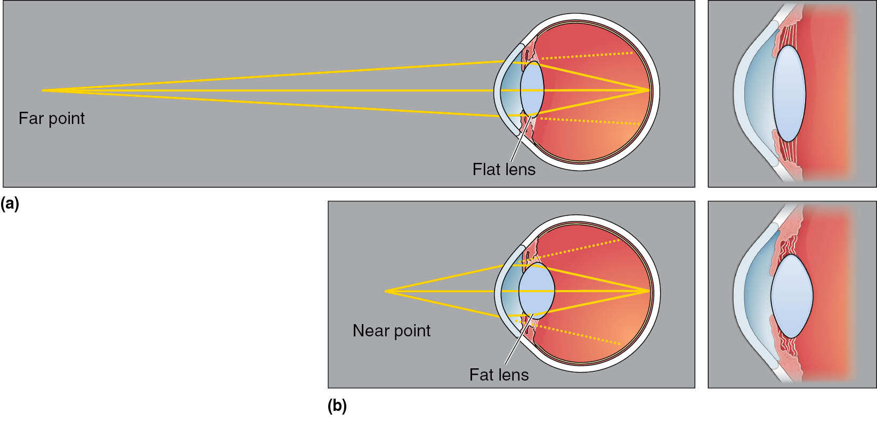
Accommodation by the Lens
Changing shape of lens provides extra focusing power
Focal distance depends on the curvature of the cornea the tighter the curve the shorter the focal distance
Eyeglasses act as a cornea

Slide 21
Accommodation by the Lens
Although the cornea performs most of the eyes refraction the lens also contributes to a sharp image of a distant point
Lens involved more in forming crisp images of objects located closer than 9 m from the eye
Changing the shape of the lens = accoodation

Slide 22
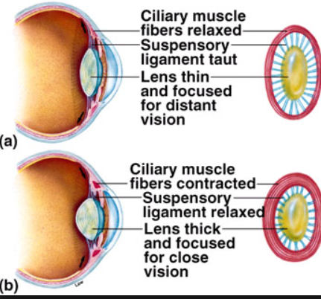
Accommodation by the Lens
Ciliary muscle forms a ring around the lens
During accommodation the ciliary muscle contracts and swells in size
Make area inside the ring smaller
Decreases the tension in the suspensory ligaments
Lens will become rounder and thicker
Rounding increases the curvature of the lens and increases the refractive power

Slide 23
Accommodation by the Lens
Relaxation of the ciliary muscle increases the tension of the suspensory ligaments and the lens is stretched into a flatter shape
Ability to accommodate changes with age

Slide 24
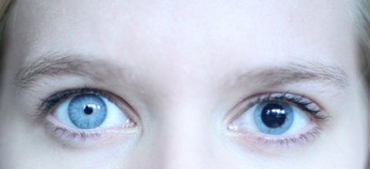
The Pupillary Light Reflex
The pupil contributes to the optical function of the eye by continuously adjust to ambient light levels
Pupilary Light reflex involves connections between retina and brain that control muscles that constrict the pupils
Shining of light into one eye causes constriction of both eyes
Neurological disorder of the brain stem if not functioning right

Slide 25
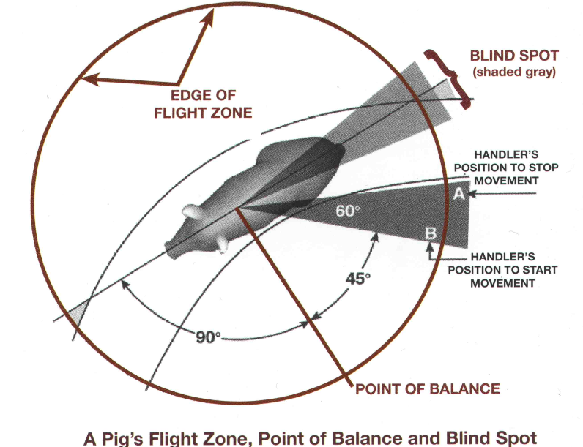
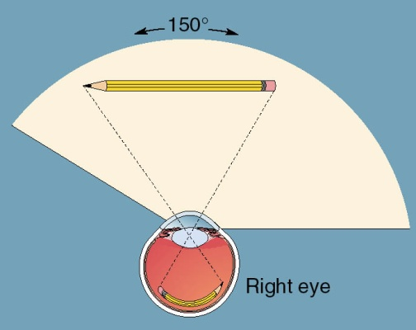
The Visual Field
Structure of the eye and position in the head limits vision at a given time
Visual fields
Amount of space viewed by retina when eye is fixated straight ahead

Slide 26
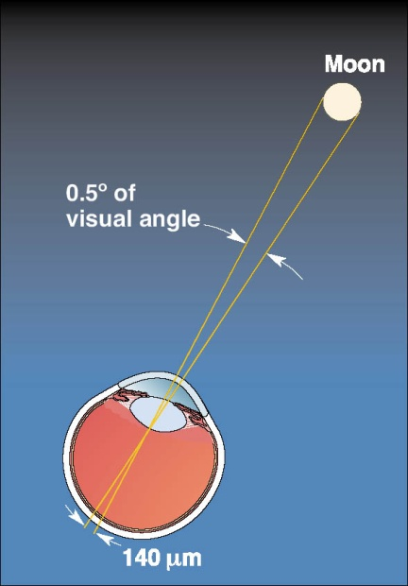
Image Formation by the Eye
Visual acuity: ability to distinguish two nearby points

Slide 27
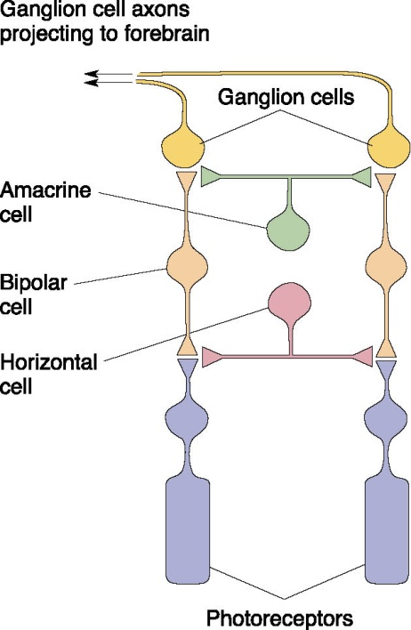
Microscopic Anatomy of the Retina
Direct (vertical) pathway
Ganglion cells
↑
Bipolar cells
↑
Photoreceptors

Slide 28
Microscopic Anatomy of the Retina—(cont.)
Retinal processing also influenced by lateral connections
Horizontal cells
Receive input from photoreceptors and project to other photoreceptors and bipolar cells
Amacrine cells
Receive input from bipolar cells and project to ganglion cells, bipolar cells, and other amacrine cells

Slide 29
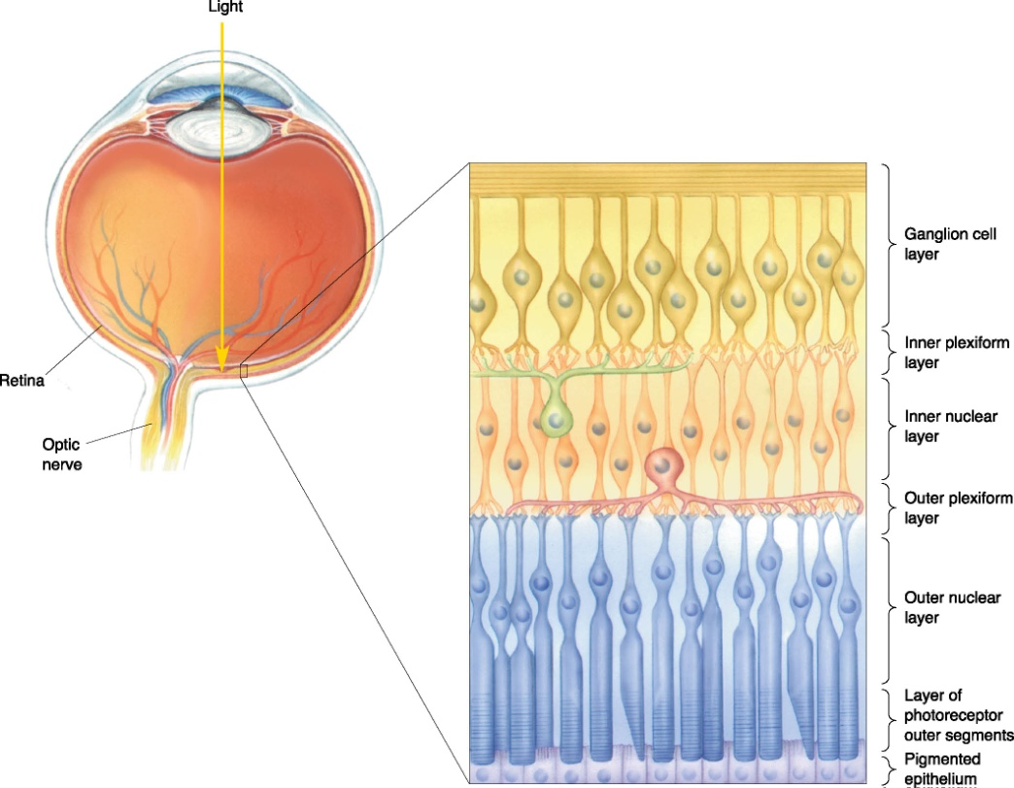
Laminar Organization of the Retina
Seemingly inside-out layers
Light passes through ganglion cells and bipolar cells before reaching photoreceptors.

Slide 30
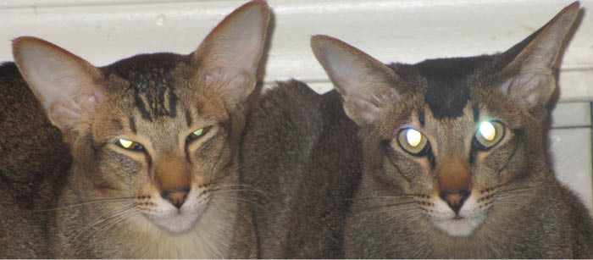
Laminar Organization of the Retina—(cont.)
Many nocturnal animals have reflective layer beneath photoreceptors.

Slide 31
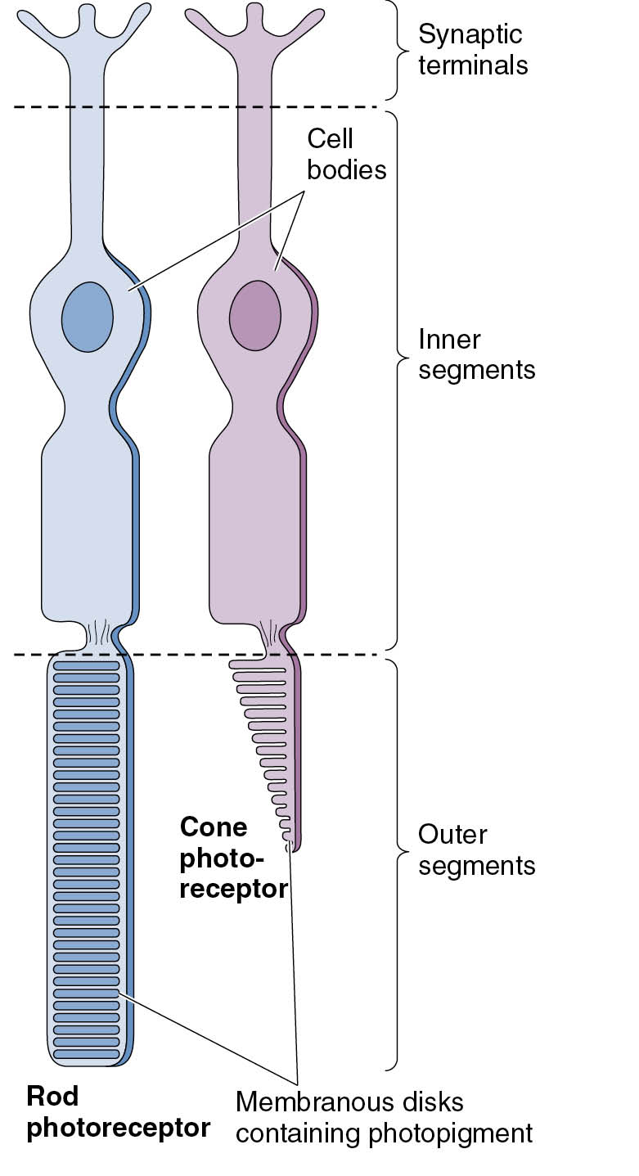
Photoreceptor Structure
Converts electromagnetic radiation to neural signals
Four main regions
Outer segment
Inner segment
Cell body
Synaptic terminal
Types of photoreceptors
Rods and cones

Slide 32
Photoreceptor Structure—(cont.)
Rods: long, cylindrical outer segment with many disks
Cones: shorter, tapering outer segment with fewer disks
Rods over 1000 times more sensitive to light than cones
Differences in rods and cones: “duplex retina”

Slide 33
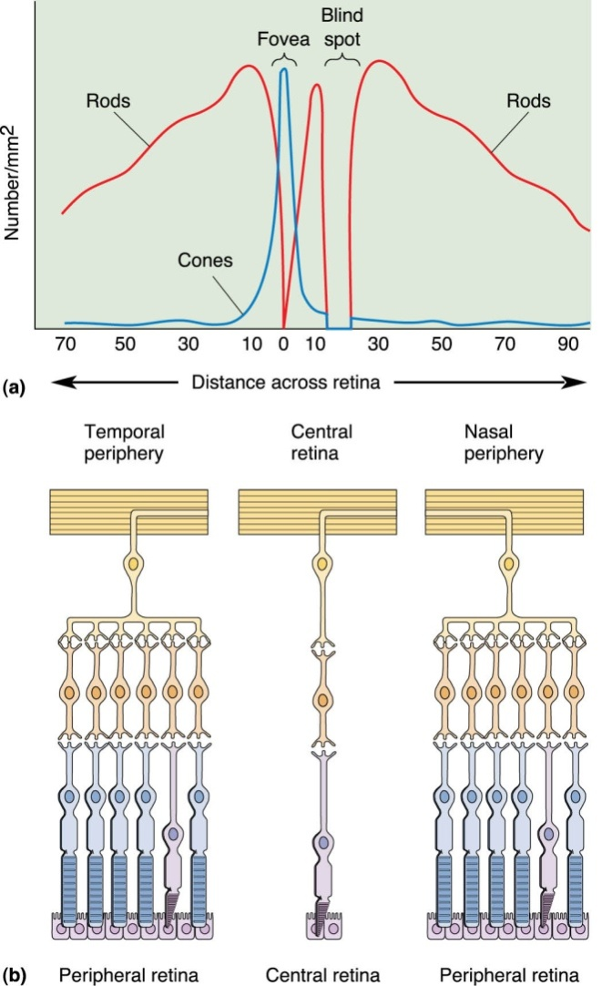
Regional Differences in Retinal Structure
Structure varies from fovea to retinal periphery.
Peripheral retina
Higher ratio of rods to cones
Higher ratio of photoreceptors to ganglion cells
More sensitive to low light

Slide 34
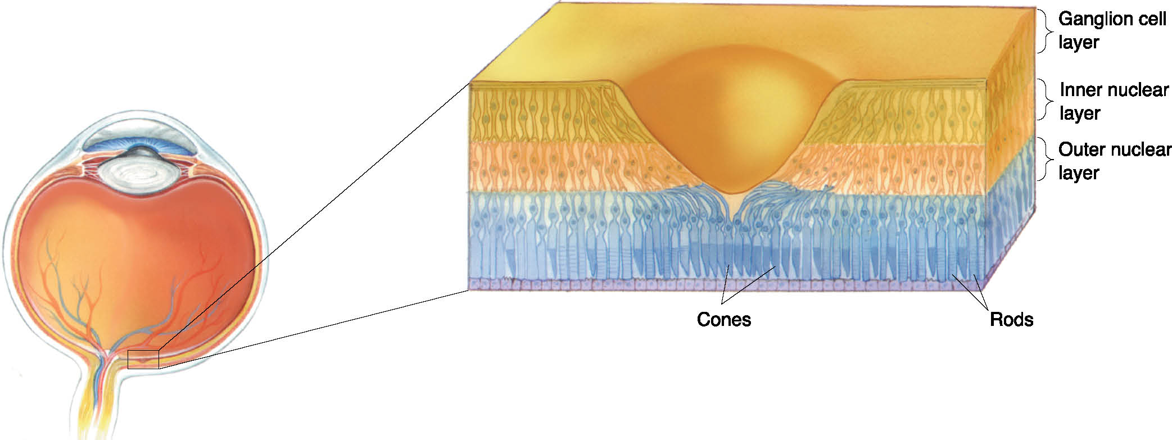
Regional Differences in Retinal Structure—(cont.)
Cross section of fovea: pit in retina where outer layers are pushed aside
Maximizes visual acuity
Central fovea: all cones (no rods)
Area of highest visual acuity

Slide 35
Phototransduction
Phototransduction in rods
Light energy interacts with photopigment.
Produces a change in membrane potential
Analogous to activity at G-protein-coupled neurotransmitter receptor
Causes a change in second messenger

Slide 36
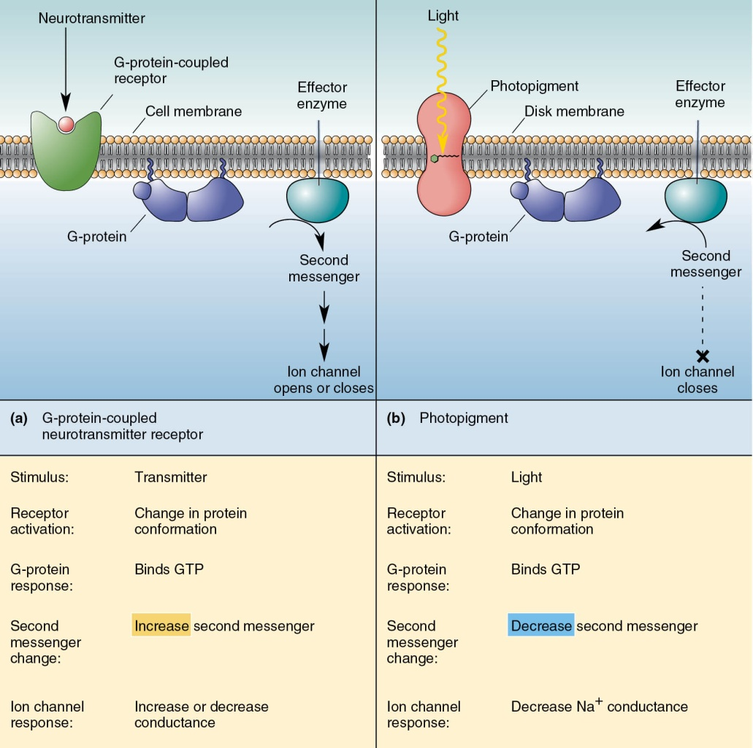
Light Transduction and G-proteins

Slide 37
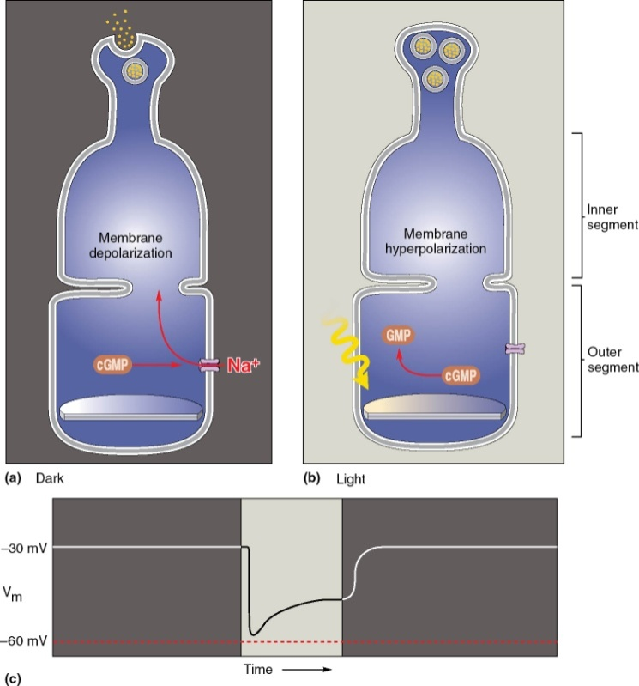
Phototransduction in Rods
Dark current: Rod outer segments are depolarized in the dark because of steady influx of Na⁺.
Photoreceptors hyperpolarize in response to light.

Slide 38
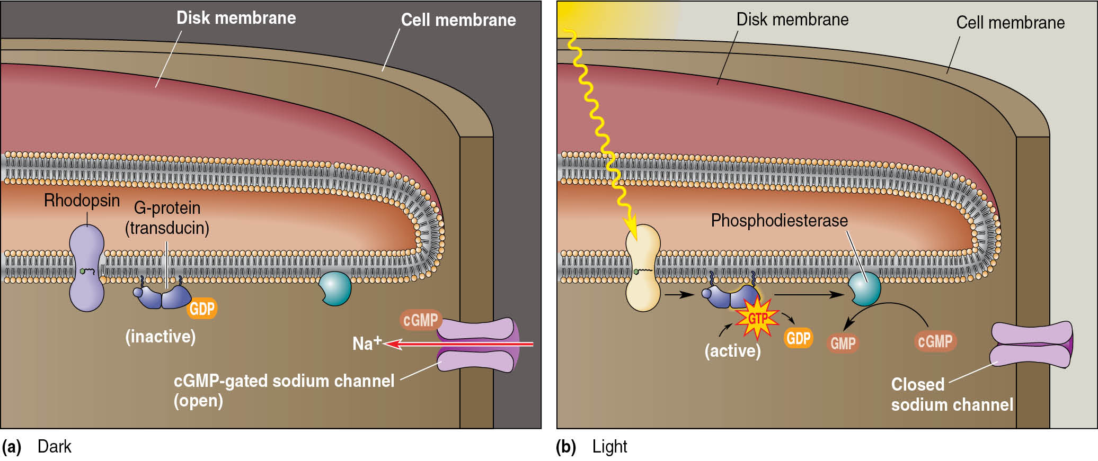
Phototransduction in Rods—(cont.)
Light-activated biochemical cascade in a photoreceptor
The consequence of this biochemical cascade is signal amplification—sensitivity to small amounts of light.

Slide 39
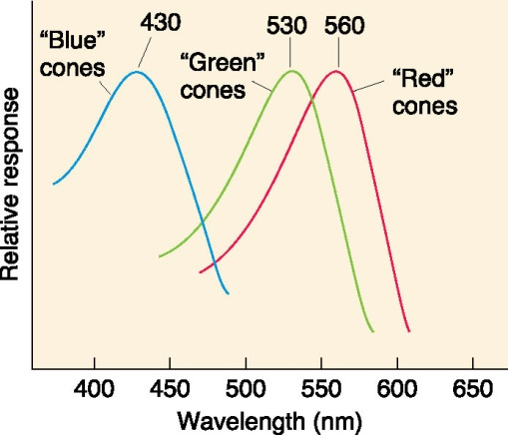
Phototransduction in Cones
Similar process to rod phototransduction
Different opsins
Red (long wavelength), green (medium wavelength), blue (short wavelength)
Color perception
Contributions of blue, green, and red cones to retinal signal
Young—Helmholtz trichromacy theory of color vision

Slide 40
Mixing Colors
Mixing of red, green, and blue light causes equal activation of the three types of cones.
The perception of “white” results

Slide 41
Dark and Light Adaptation
Factors in dark adaptation
Dilation of pupils
Regeneration of unbleached rhodopsin
Adjustment of functional circuitry
Over minutes to an hour
All-cone daytime vision
All-rod nighttime vision

Slide 42
Dark and Light Adaptation—(cont.)
Calcium’s role in light adaptation
Calcium concentration changes in photoreceptors
Indirectly regulates levels of cGMP→ channels

Slide 43
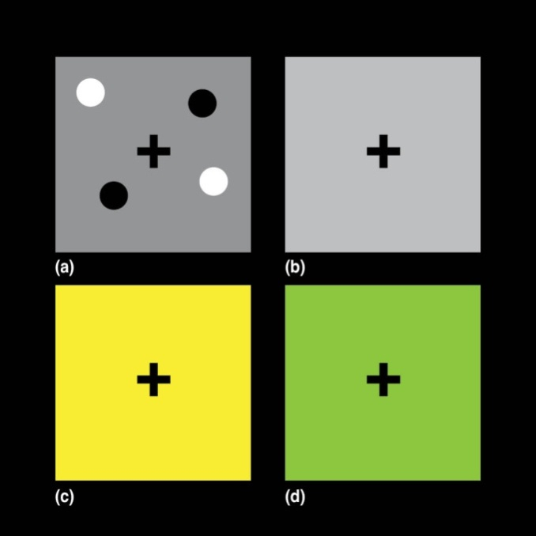
Local Adaptation of Dark, Light, and Color
Effect of pupil size the same on all photoreceptors
Photoreceptor bleaching and other adaptational mechanisms vary cone by cone.

Slide 44
Retinal Processing and Output
Research in ganglion cell output
Keffer Hartline, Stephen Kuffler, and Horace Barlow
Only ganglion cells fire action potentials.
Other retinal neurons produce graded changes in membrane potential.
Research in how ganglion cell properties are generated by synaptic interactions in the retina.
John Dowling and Frank Werblin

Slide 45
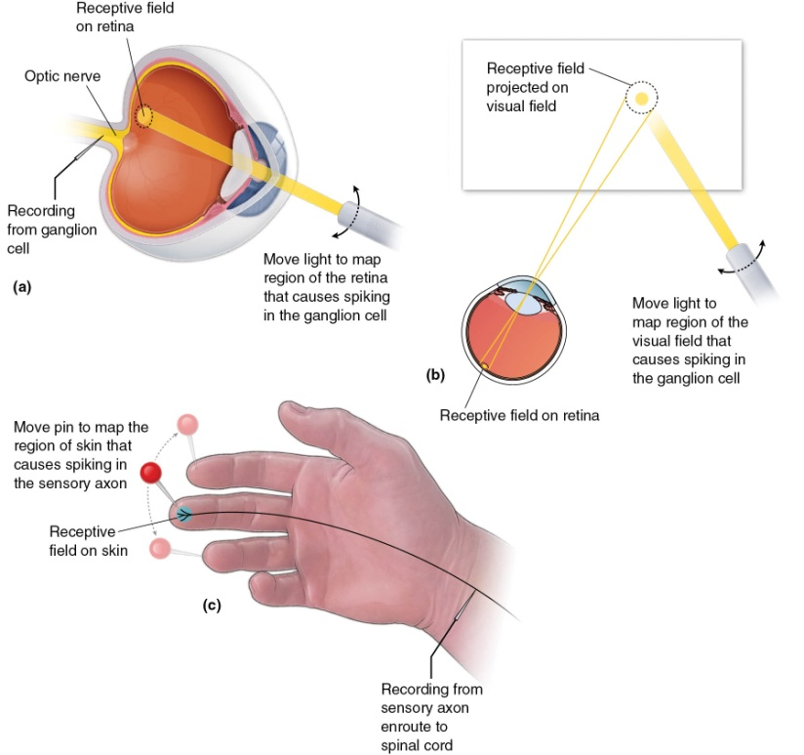
The Receptive Field
Area of retina where light changes neuron’s firing rate
Fields change in shape and stimulus specificity.

Slide 46
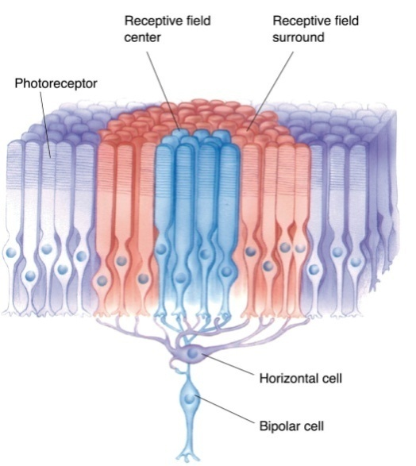
Bipolar Cell Receptive Fields
Receptive field: ON and OFF bipolar cells
Receptive field: Stimulation in a small part of the visual field changes a cell’s membrane potential.
Antagonistic center-surround receptive fields

Slide 47
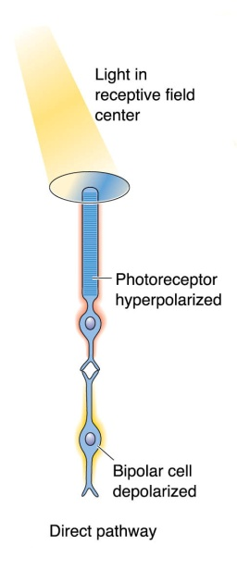
Bipolar Cell Receptive Fields—(cont.)
ON-center bipolar cell
Depolarized by light in receptive field center
Hyperpolarized by light in receptive field surround

Slide 48
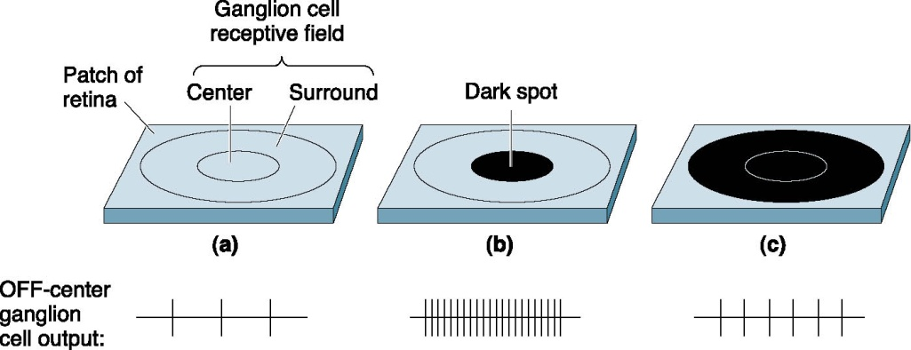
Ganglion Cell Receptive Fields
Ganglion cells different in firing action potentials
ON-center and OFF-center ganglion cells
Responsive to differences in illumination

Slide 49
Ganglion Cell Receptive Fields—(cont.)
Responses to light–dark edge crossing an OFF-center ganglion cell receptive field

Slide 50
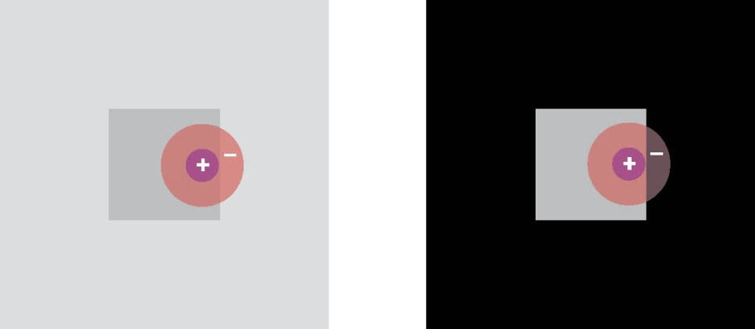
Ganglion Cell Receptive Fields—(cont.)
Influence of contrast on the perception of light and dark

Slide 51
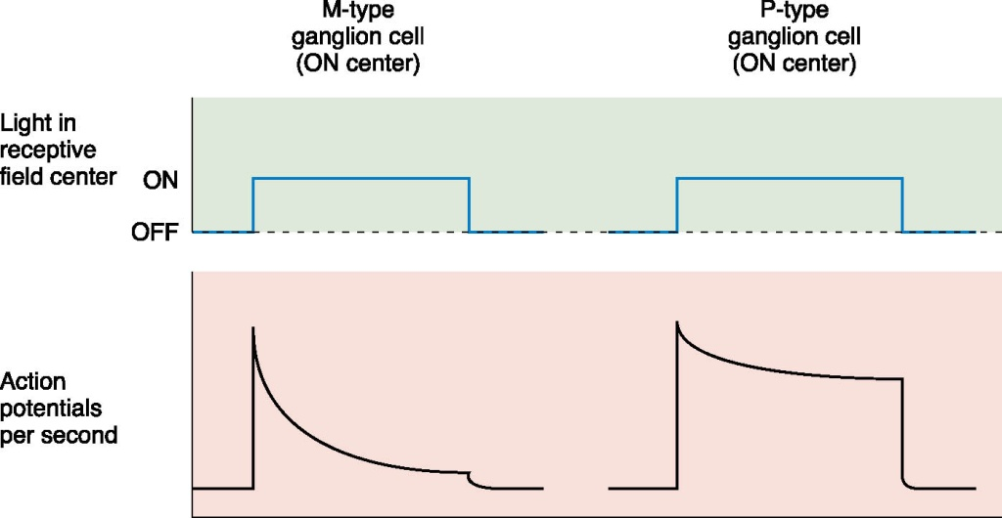
Structure-Function Relationships
Types of ganglion cells
Categorized by appearance, connectivity, and electrophysiological properties
M-type and P-type ganglion cells

Slide 52
Color Opponency in Ganglion Cells

Slide 53
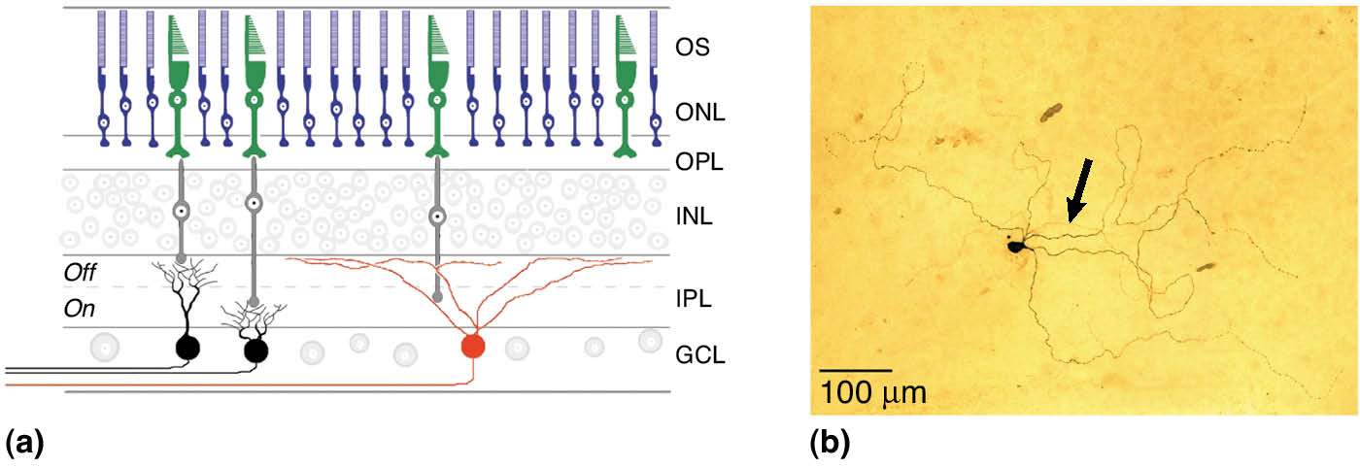
Ganglion Cell Photoreceptors
Intrinsically photosensitive retinal ganglion cells

Slide 54
Parallel Processing
Simultaneous input from two eyes
Input from eyes compared in cortex
Determines depth and distance of object
Information about light and dark: ON-center and OFF-center ganglion cells
Different receptive fields and response properties of retinal ganglion cells: M and P cells, and nonM–nonP cells

Slide 55
Concluding Remarks
Light emitted by or reflected off objects in space is imaged onto the retina.
Transduction
Light energy converted into membrane potential changes
Phototransduction parallels olfactory transduction
Electrical-to-chemical-electrical signal
Mapping of visual space onto retina cells not uniform

